Slide 1

Insights on ACT and SAT (Marketing PERSPECTIVE) Jason CHUANG

Slide 2
Problem Statement
The new format for the SAT was released in March 2016. As a data analyst supporting the SAT marketing team, the marketing colleagues would like to know what insights they can get to develop a new marketing plan. Ideally, there should be information on which states they should focus on. Your presentation and report should be geared toward non-technical executives from a marketing perspective.

Slide 3
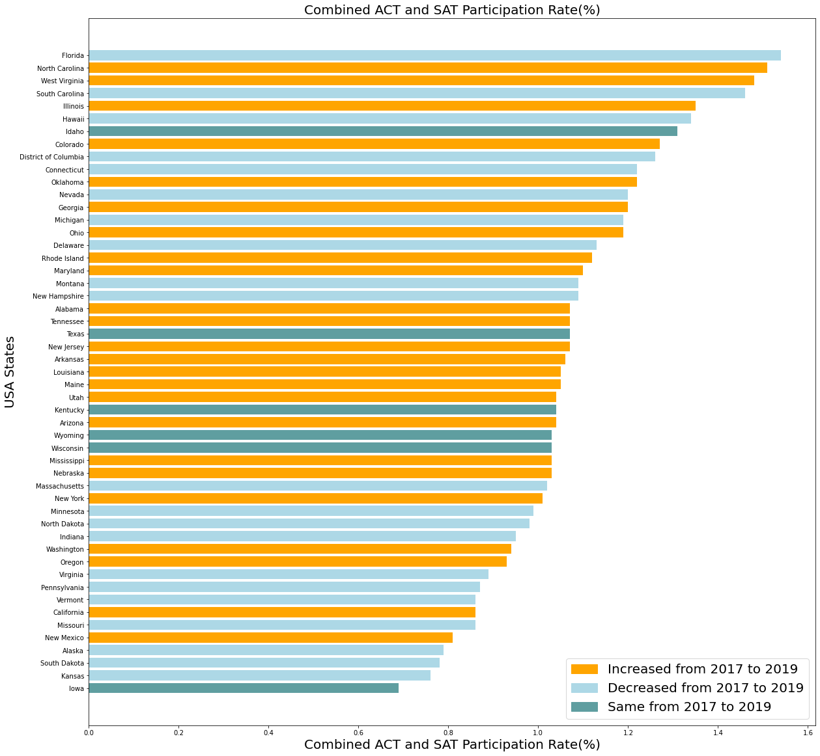
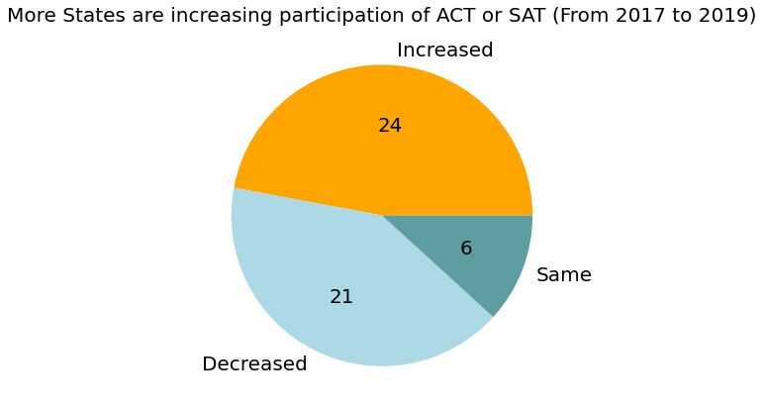
NOT a zero-sum game In States which have high ACT participation rate, we could still promote SAT as an additional test that could increase their overall chances of getting into a college of their choice
100% line
In 2019, 36 states had a combined ACT-SAT participation of more than 100%. This suggests that it is common for students to take both tests. From 2017 and 2019, 24 states had increased combined participation rate, 21 declined, and 6 remained unchanged.
Data Source:

Slide 4
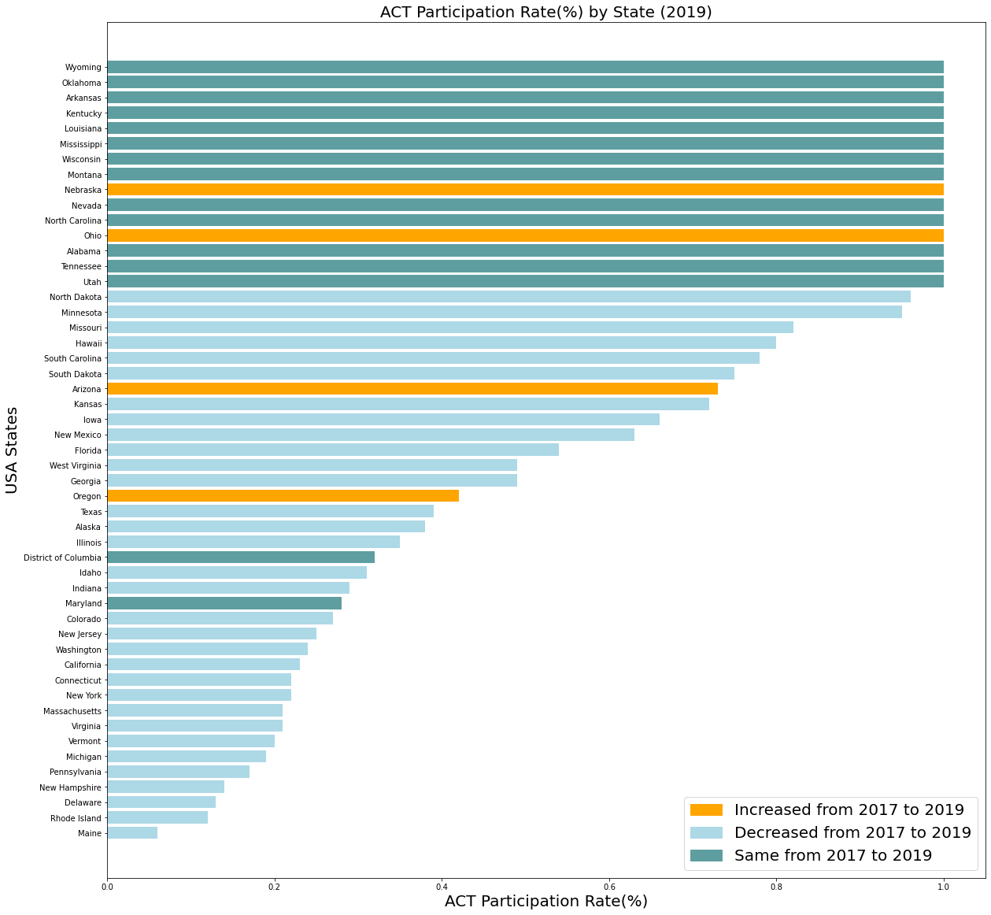
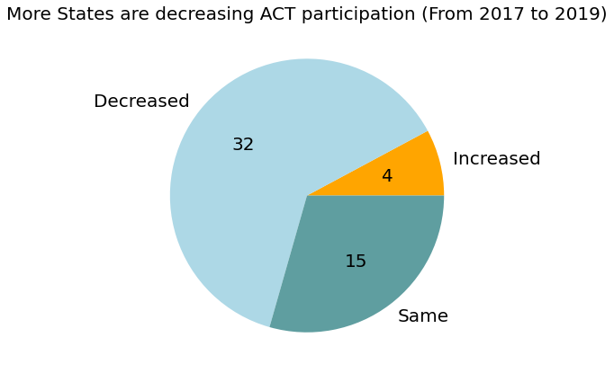
The ACT LANDSCAPE Further research can help to understand the reasons for the decline and might provide us with opportunities
15 US States had 100% ACT participation rate in 2019 but several states are showing a declining trend. From 2017 and 2019, 4 states had increased participate rate, 32 declined, and 15 remained unchanged.

Slide 5
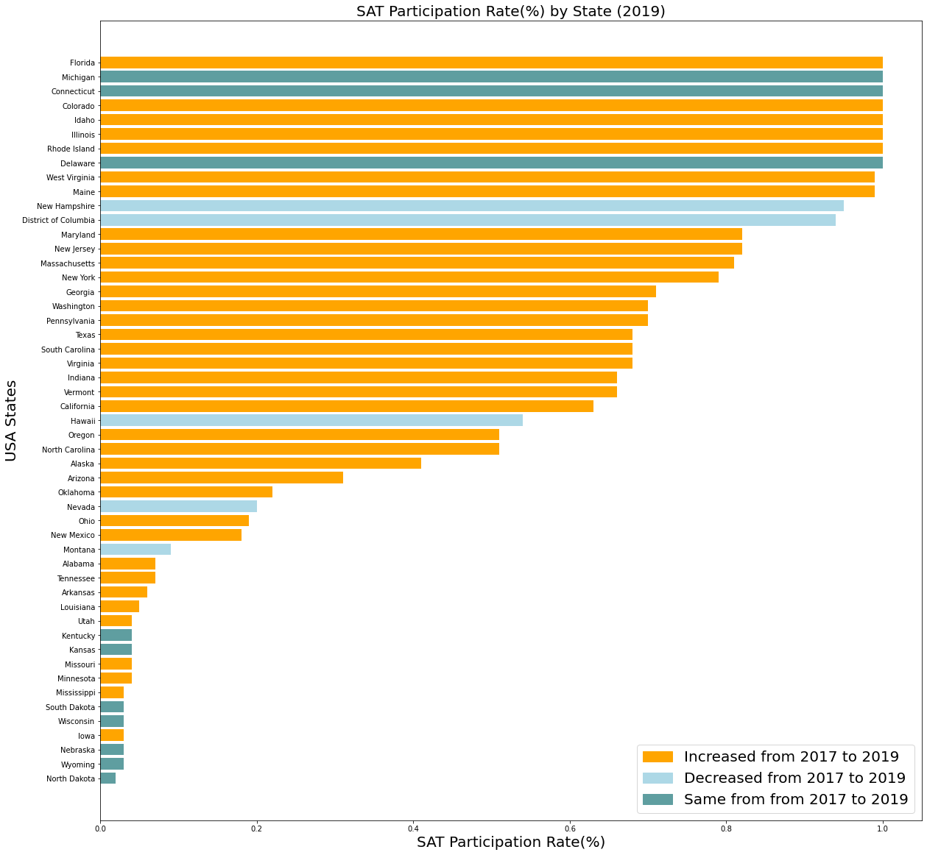
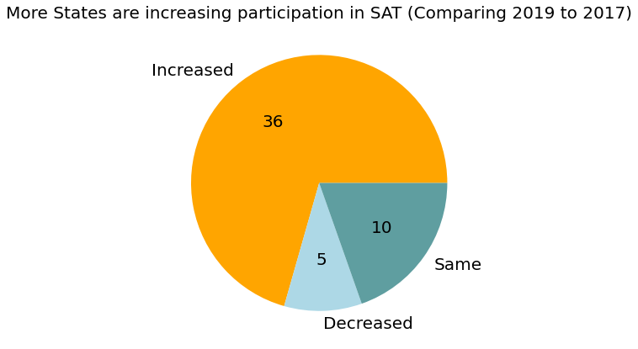
The SAT LANDSCAPE Favourite growth opportunities for states that are showing increasing SAT participation rate. A lot of these growing states have about 20-80% participate rate with room to grow.
8 US States had 100% SAT participation rate in 2019 and several states are showing an increasing trend. From 2017 and 2019, 36 states had increased SAT participate rate, 5 declined, and 10 remained unchanged.

Slide 6
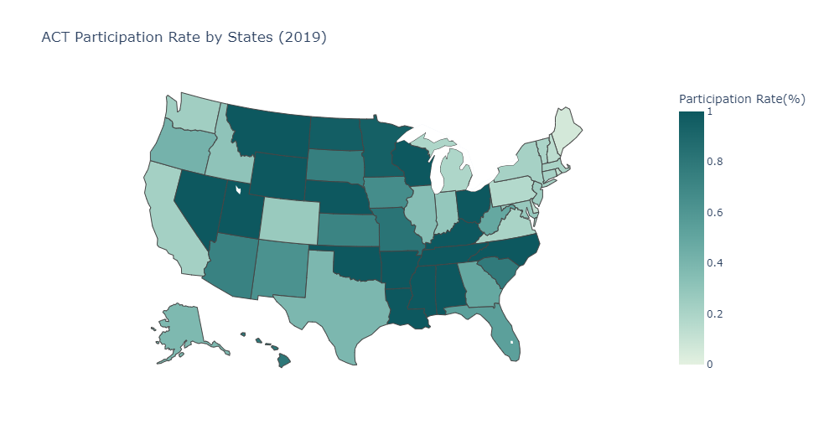
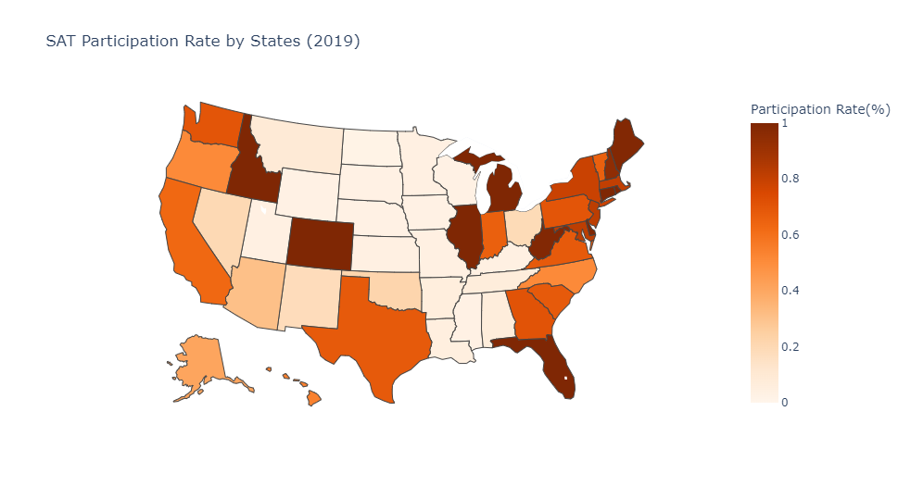
The Geographical divide
If there is a need to optimise physical resources (e.g. outreach to teachers, parents and potential students), we could use this as a guide
It seems that SAT is more popular among the coastal states while ACT is more in the inland states.

Slide 7
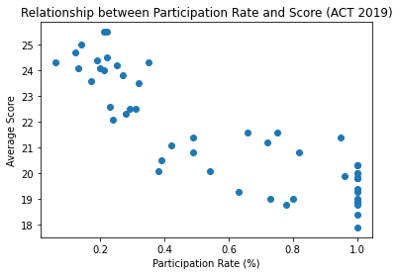
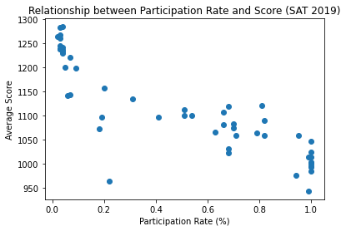
RELATIONSHIP BETWEEN PARTICIPATE AND SCORE
Not to neglect states that have low SAT participation rate as they might be providing success stories of students getting into their college of choice through SAT
For states that has low SAT participation rate, it is often the case that the students are taking both tests. They are likely to be more prepared, hence the higher average score. This is similar for ACT.
Correlation: -86.7%
Correlation: -86.7%
Low Participation but
higher average score
High Participation but lower average score

Slide 8
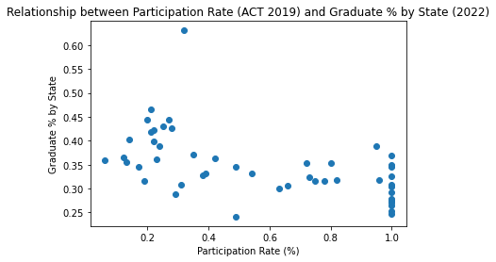
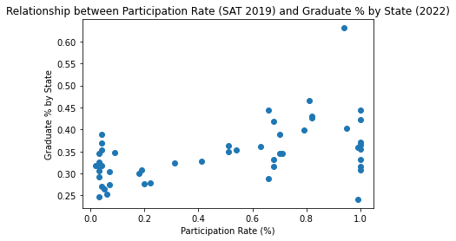
RELATIONSHIP BETWEEN PARTICIPATE AND GRADUATE % by STATE
Is SAT more preferred in states with higher percentage of graduates? Further research is needed to nail down what might be the underlying factor(s) that might result in this relationship.
States with high percentage of people having degree or higher, are more likely to have higher SAT participation and lower ACT participation.
Correlation: -54.7%
Correlation: 49.5%

Slide 9
RECOMMENDATION
Think Win-Win for States with High ACT Participation Rates
(e.g., Arkansas, Louisiana, Tennessee)
There are students who take both tests with the hope that it will increase their chance of securing a place in their desired college.
Maintaining Our Fans (SAT High Participation Rate)
(e.g., Connecticut, Delaware and Michigan)
Unsure what might be the longer-term impact on ACT and SAT that most colleges are de-emphasizing it, good to maintain the strong support from our loyal states.
Growth Opportunities for the In-betweens
(e.g., New Jersey, Maryland, Massachusetts)
These are growth opportunities for us, highly recommended to work on these states.

