Slide 1
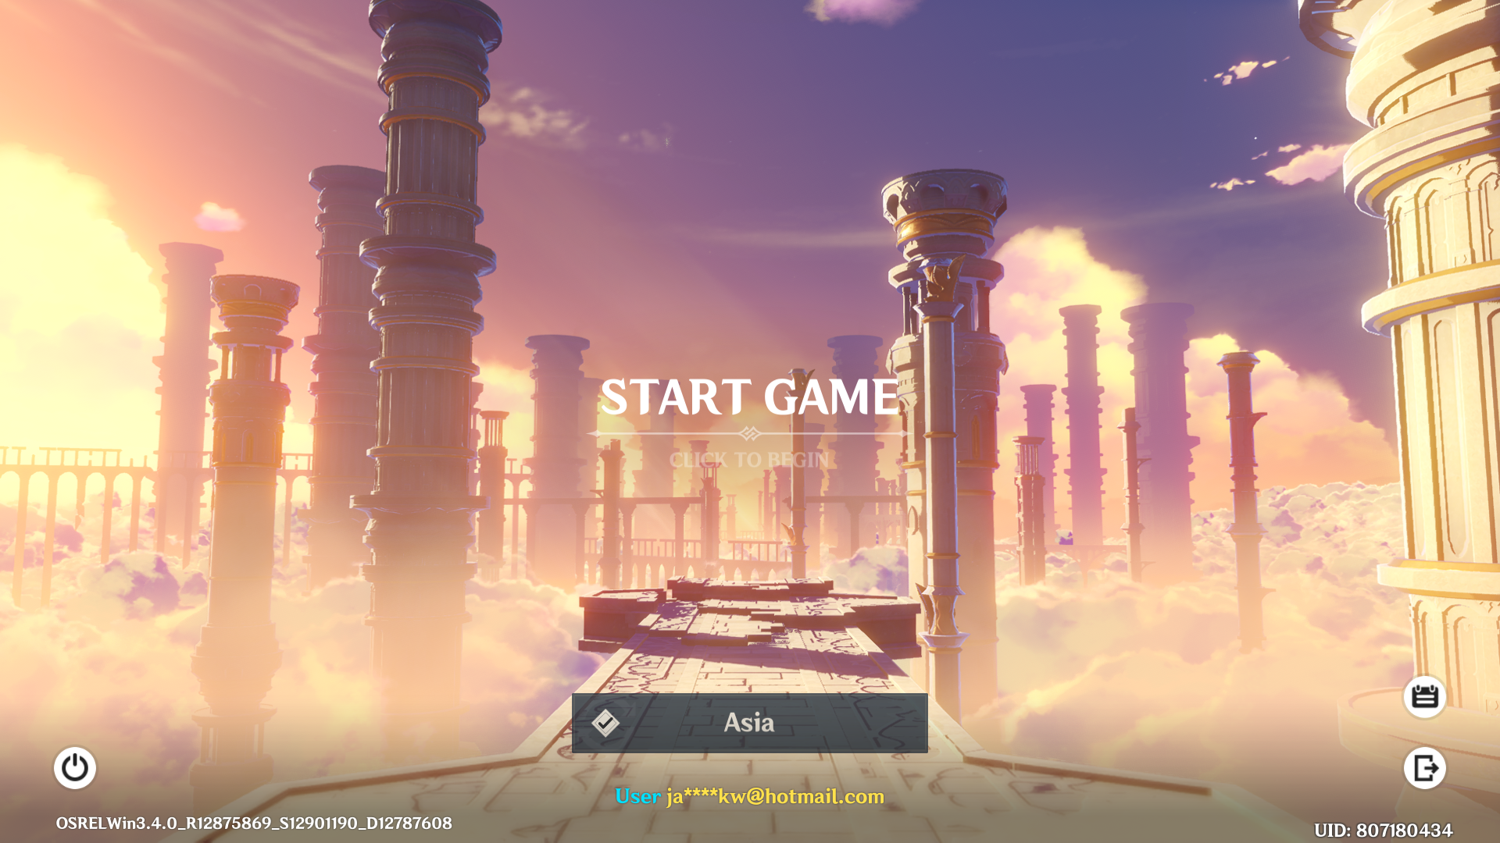
CAPSTONE PROJECT UPDATE

Slide 2
PROBLEM STATEMENT
Determine what are the different archetypes of players based on available game data that could help gamers know more about the community. Hence, could provide some suggests or tips to gamers belonging to certain archetypes.

Slide 3
SAMPLING
Drawing Samples of Gamers
who are playing in the main
three international servers
ASIA
AMERICA
EUROPE
Sample of Gamer UID
whom seek help or help
others from Discord Servers
in January 2023
2,716
2,698
2,195
Success Rate
16.6%
14.4%
16.5%
Achieved Sample
451
389
363
Total Sample Size
1,203

Slide 4
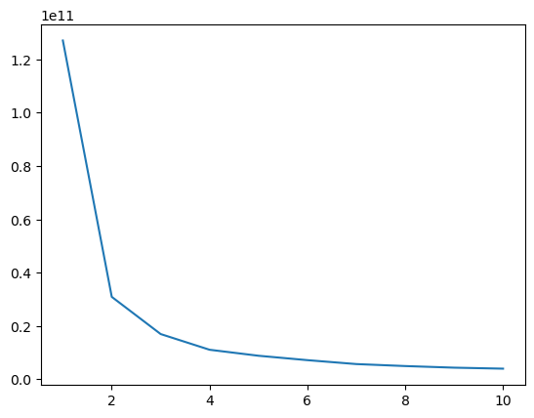
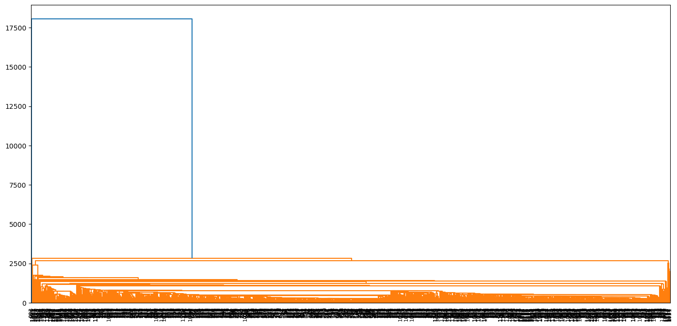
CLUSTER ANALYSIS
K MEANS
OR
HIERARCHICAL
Result in one big chuck,
not very useful
Consider a
4-Cluster solution

Slide 5
INTRODUCING THE CLUSTERS
Freshman | Sophomore | Junior | Senior
37.2% | 15.9% | 38.4% | 8.5%

Slide 6
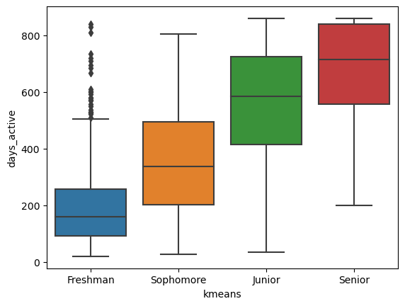
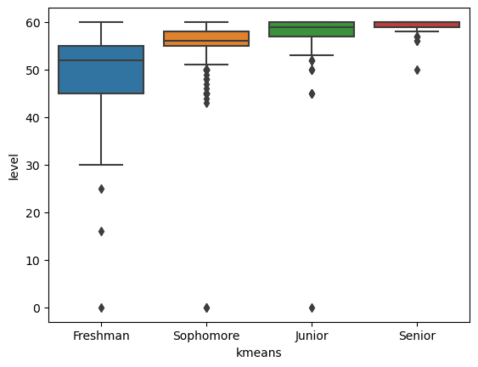
INTRODUCING THE CLUSTERS
Days Active
Adventure Rank Level
F-stats: 382.18
p-value: 0.00
significant difference between clusters
F-stats: 187.8
p-value: 0.00
significant difference between clusters

Slide 7
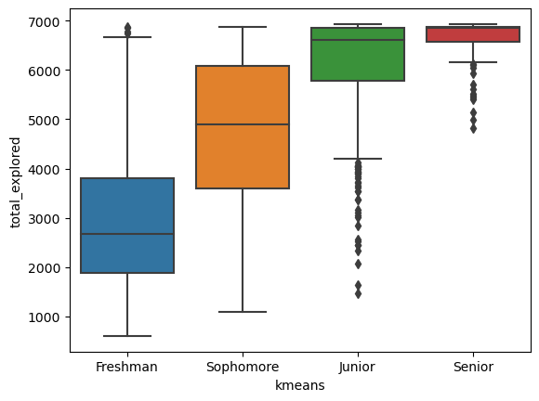
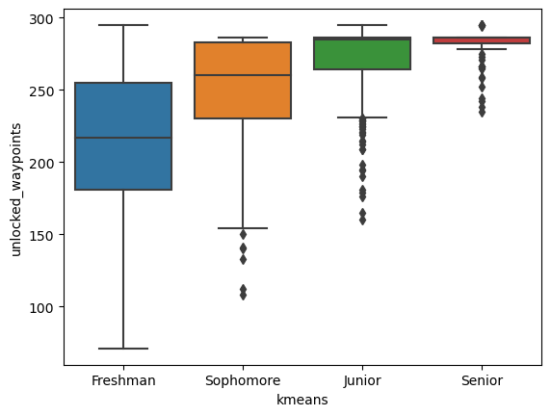
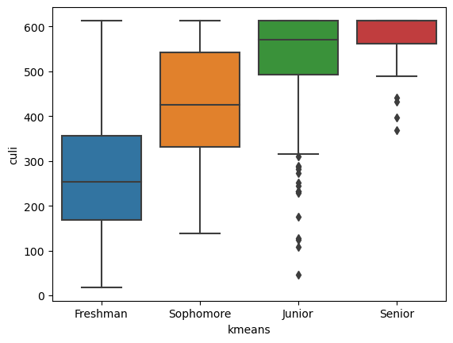
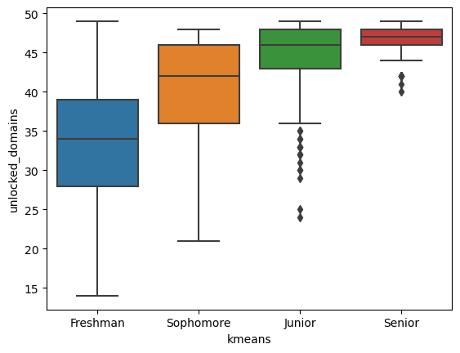
INTRODUCING THE CLUSTERS
Total Exploration
Variables with Similar Result
F-stats: 593.11
p-value: 0.00
significant difference between clusters

Slide 8
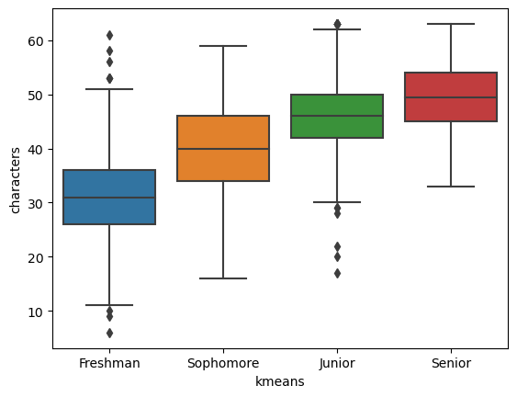
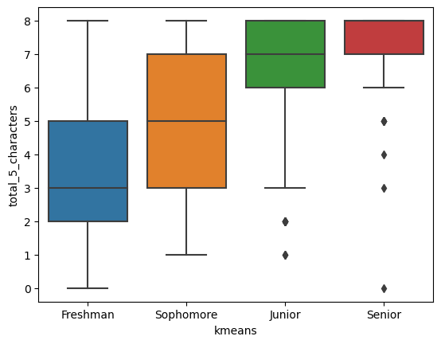
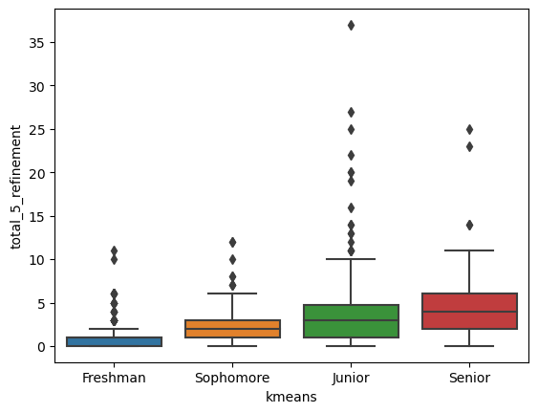
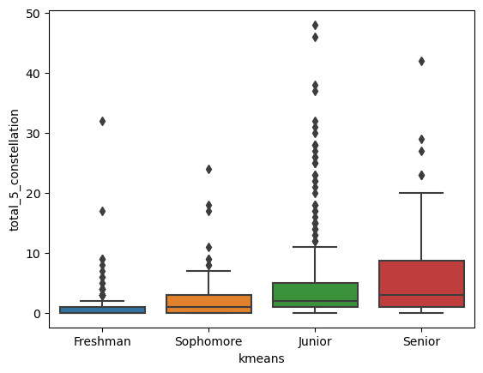
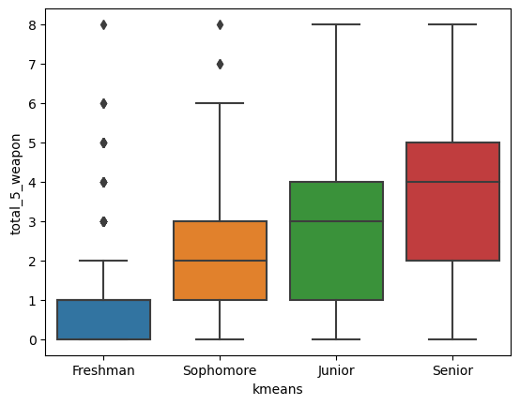
INTRODUCING THE CLUSTERS
Total no. of Characters Owned
Variables with Similar Result
F-stats: 458.96
p-value: 0.00
significant difference between clusters

Slide 9
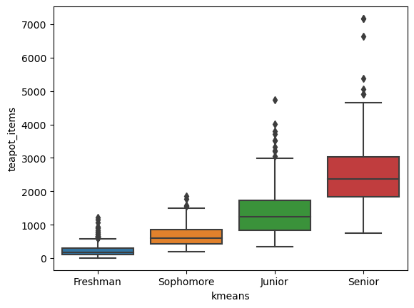
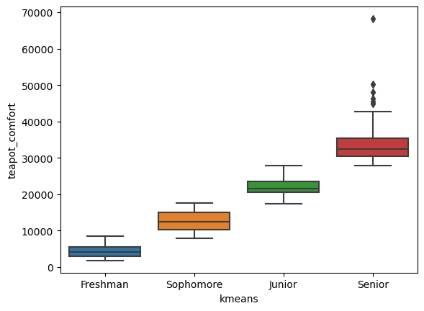
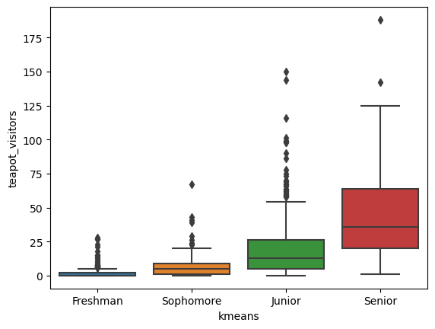
INTRODUCING THE CLUSTERS
No. of Teapot Items
Variables with Similar Result
F-stats: 630.43
p-value: 0.00
significant difference between clusters

