Slide 1
Building Competencies Around Algorithmic Awareness
[name]

Slide 2
Outline
About
Statement of Purpose
Learning Objectives
Definitions
Algorithms in Action
Teaching Concepts
Breakout Session - Programming the Library

Slide 3
About
[name]
[Description]
[name]
[Description]
[name]
[Description]
Notes:
Who we are: researchers from Montana State University Library Special Collections team
Grant: provided by the IMLS
Julian

Slide 4
Learning Objectives
Identify and define algorithms in action within common online interactions such as the sorting of a news feed, an eCommerce experience, and a search experience.​
Learn how Algorithmic Awareness as a concept fits into the ACRL Framework​
Apply session modules (released as OER) as actionable steps for teaching about algorithms in literacy instruction​

Slide 5
An Algorithm Is...
The rules that govern our software and shape our digital experiences

Slide 6
But more Complex...
“A large set of binary choices that create a ‘decision tree’ based upon many variables that are not necessarily apparent to the user”
-Matthew Reidsma

Slide 7
Algorithmic Awareness
“An understanding around the rules that govern our software and shape our digital experiences”
-Clark and Kaptanian

Slide 8
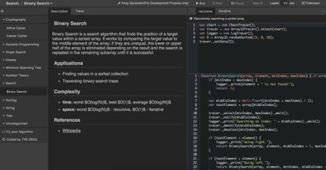
Codes, Mathematic, Complex Algorithms
http://algonimator.thegeeq.gq/ ​

Slide 9
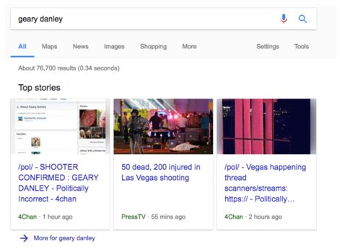
Material Consequences

Slide 10
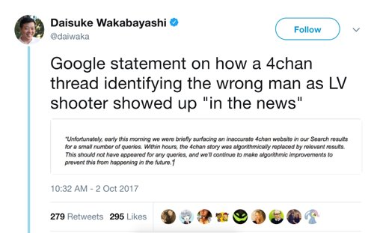

Slide 11
“The algorithm did it.”
Google, Zuckerberg, et. al.

Slide 12
“Lunch”
Ranjan Roy

Slide 13
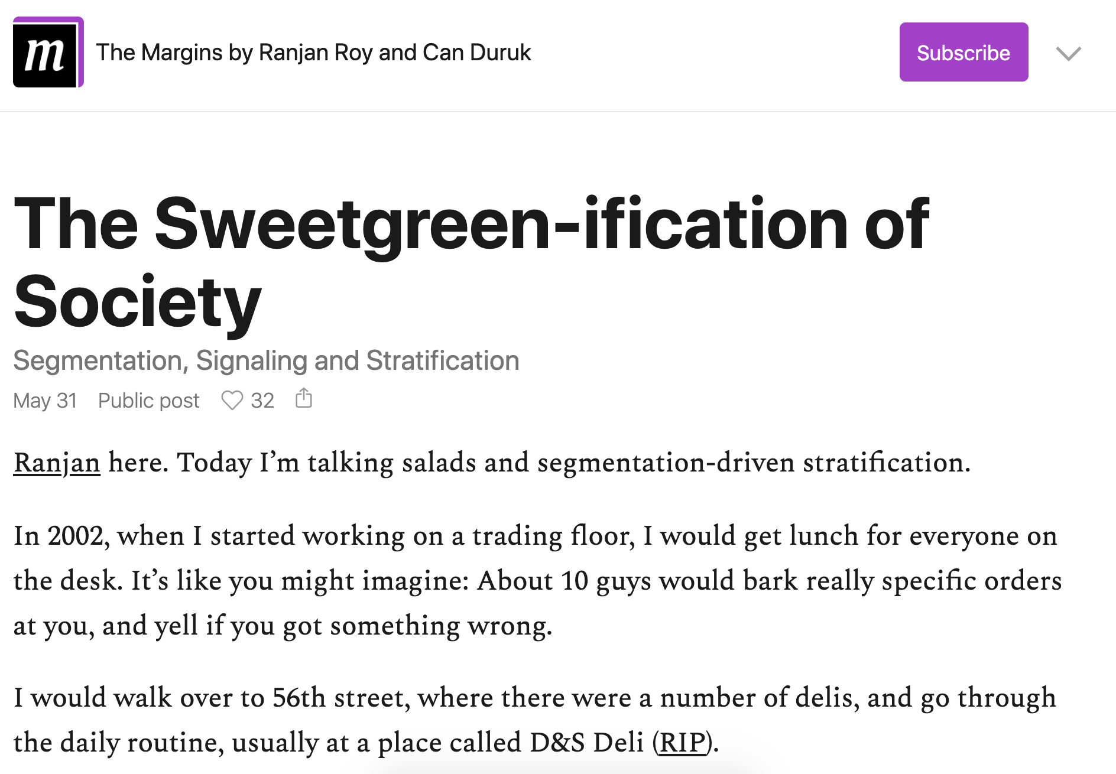
https://themargins.substack.com/p/the-sweetgreen-ification-of-society

Slide 14
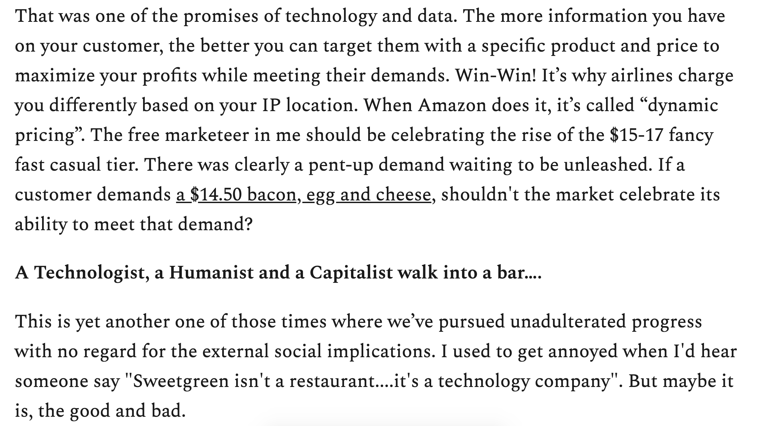
https://themargins.substack.com/p/the-sweetgreen-ification-of-society

Slide 15
Algorithm as Symptom
A ghost, something unseen

Slide 16
“We, and our patrons, routinely engage in systems that predict, recommend, and speculate about our interests based on the digital fingerprint we provide with our link clicks and “likes”, but we all struggle understanding how and why those systems work as they do”
-Jason Clark on Algorithmic Awareness

Slide 17
What if?
We could start to introduce new forms of literacy for our field
Algorithms weren’t the Ghost in the Machine
Notes:
It’s as easy to access a book page as it is a web page

Slide 18
Inspiration
Safiya Noble
Critical Algorithms Studies
Notes:
It’s as easy to access a book page as it is a web page

Slide 19
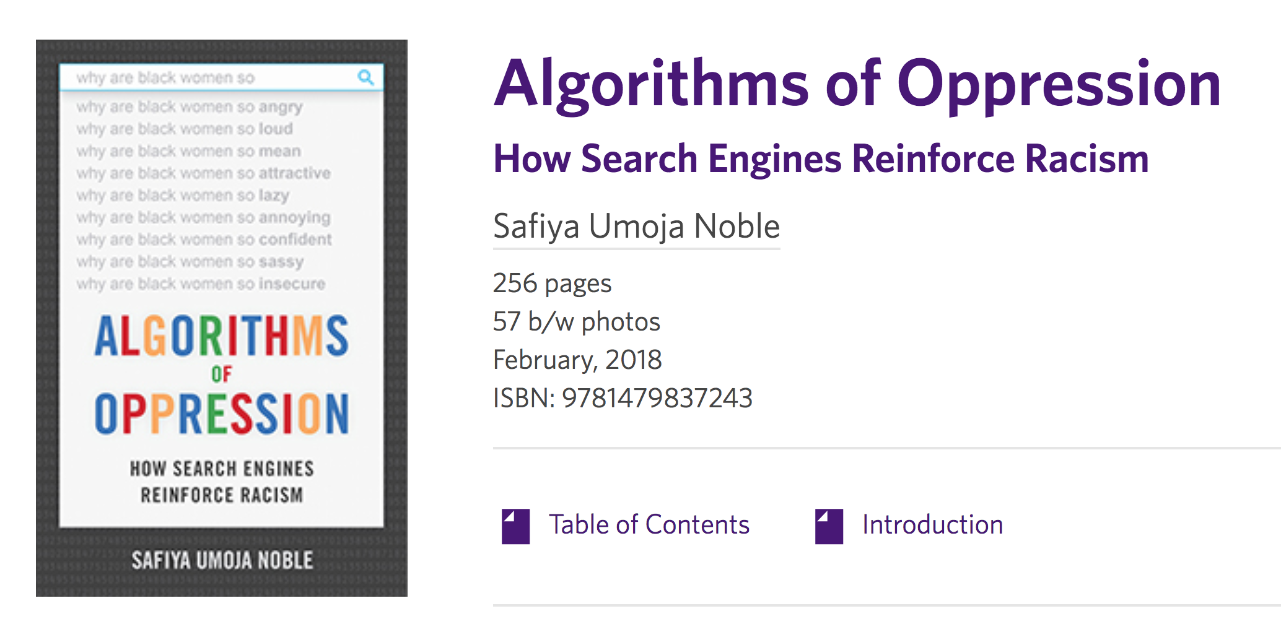
https://safiyaunoble.com/

Slide 20
Critical Algorithm Studies
https://socialmediacollective.org/reading-lists/critical-algorithm-studies/
Notes:
It’s as easy to access a book page as it is a web page

Slide 21
Librarians and Technologists as Educators
New Forms of Digital Literacy

Slide 22
Awareness Outside Our Field
Statement on Algorithmic Transparency and Accountability (ACM)
https://www.acm.org/binaries/content/assets/public-policy/2017_usacm_statement_algorithms.pdf

Slide 23
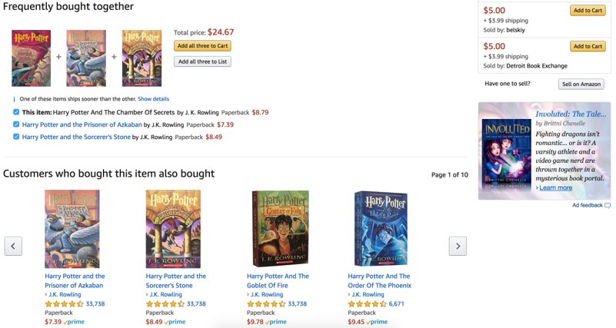
Everyday Encounters: E-commerce

Slide 24
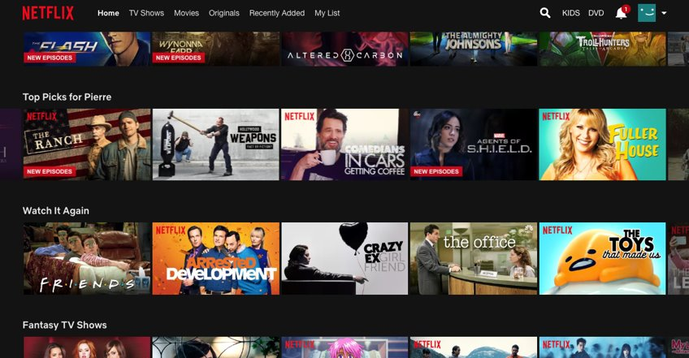
Everyday Encounters: Entertainment

Slide 25
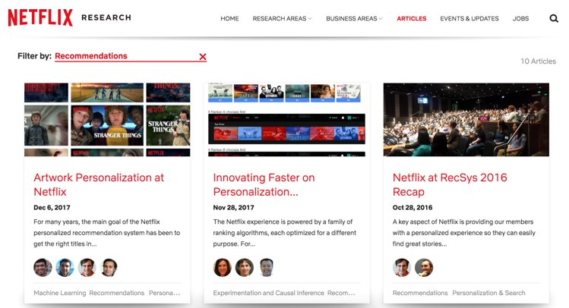

Slide 26
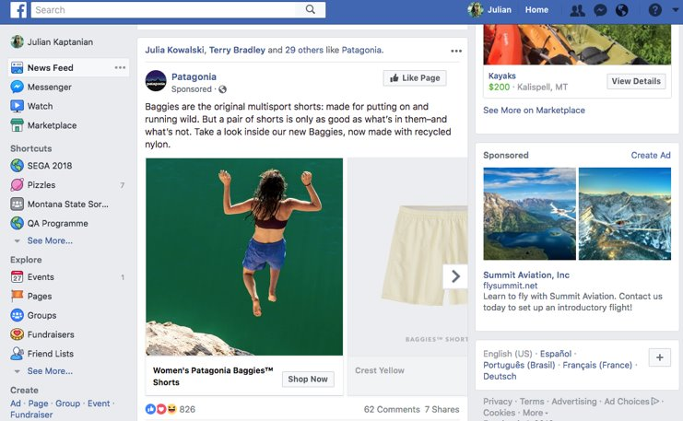
Everyday Encounters: Social Media

Slide 27
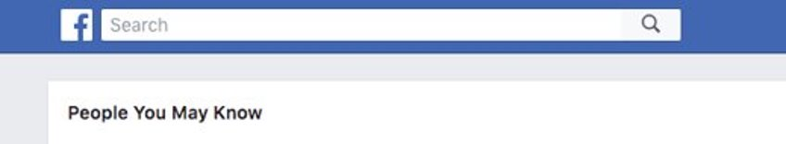
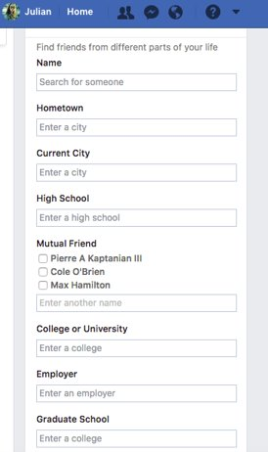

Slide 28
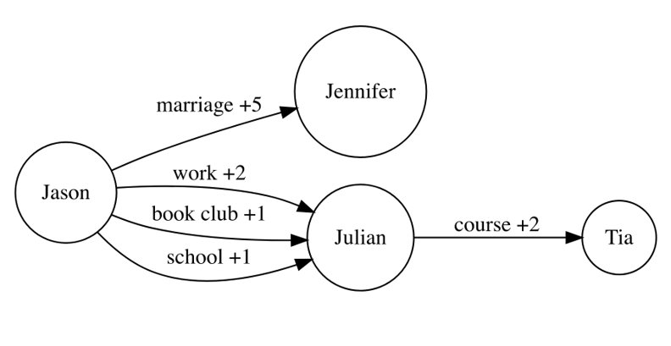
Algorithms in Action
Weighted Graph Network: Facebook Simplified
Dijkstra’s Algorithm

Slide 29
Pedagogy for the Algorithm (META)
Frame with a material consequence
Introduce “First Principle”, not math formula
Demonstrate the algorithm in action
Leave space for group to discuss

Slide 30
Teaching Tool
An “X-Ray” type search interface that demonstrates how different factors affect your search results
Location, weather, what else might be silently influencing?
E-Commerce experience: how likely are you to buy and what price do you see?
Implications?
Demo Application
Code for Demo Application

Slide 31
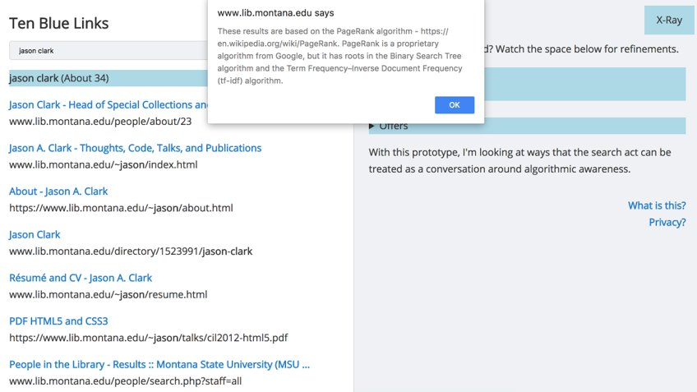
Teaching Tool Visual

Slide 32
Break-Out Session: Programming the Library
Introduction: ​
We are going to ask you to program the different goals and actions of a library. ​
We will be practicing by putting these expressions into a computer program using a pseudo code language.​
Teaching moment: This exercise will provide a theorized example of the workings of an algorithm. In addition, it will give an introduction to coding with a balance between technical and comprehensive learning. ​

Slide 33
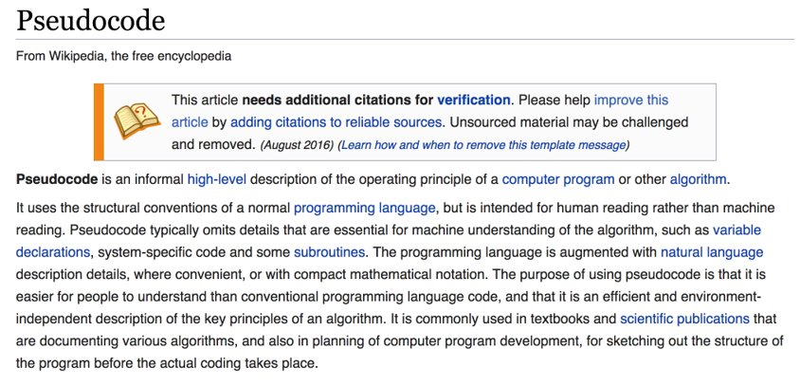
https://en.wikipedia.org/wiki/Pseudocode ​

Slide 34
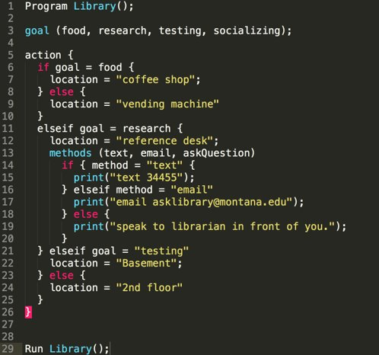

Slide 35
Breakout Session: Steps
Open​ PseudoCode template in text editor​​
Work through adding values and encoding decisions individually.​
One goal is complex​, you will need to add methods.​
Come back together to discuss.​

Slide 36
Discussion Questions
What were some of your goals?​​
How did you decide on your locations and actions?​​
How do you view the role of a programmer and what are some of the challenges they may face when creating algorithms?​​
How is the algorithm different from human direction?​​
How do you see bias in the algorithm you created?​
How could transparency affect user experience?

Slide 37
Session Modules Released as OERs
Module 1 released​
Slides​
Breakout Session (Instructions + Pseudocode)​
Teaching Tool​
Reading List​
https://github.com/jasonclark/algorithmic-awareness/tree/master/modules ​

Slide 38
Questions and Comments?

