Slide 1
Data Profiles, Transparency, Personalization, and Algorithms
[name]

Slide 2
Outline
Breakout Session: Side by Side
Data Profiling
Facebook
Google
Breakout Session: Your Google Profile
Digital Redlining

Slide 3
A Quick Exercise
What happens when you limit an algorithm?
Compare a browser connected to a profile
to a browser with privacy enabled
Notes:
http://www.kickstarter.com/projects/1371597318/the-peoples-e-book

Slide 4
Break Out Activity
Anonymous and Personal Profiles
Create understanding of how data profiles impact personalization and experiences
Goals
Discern how algorithms use your data profile to deliver a user experience.
Learn how to move into algorithmic environments without your data footprint.
Recognize the limitations of hiding and shielding your personal data from algorithmic environments.

Slide 5
Instructions
Open up 2 Web Browsers - One in which you are logged-in and one in which are not logged-in
Open up Google and Amazon.com in both Web Browsers
Run a search for “climate change”
Run a search for any query you have an interest in.
Note the personalization in the results for both environments (logged-in versus not logged-in
Feel free to compare with your neighbor

Slide 6
Discussion Questions
What are your initial observations?
What was surprising or predictable?
What do you see as the limitations to hiding your personal information from these environments?
How might these results affect your future browsing?
What are the implications of targeted advertisements and data profiles?

Slide 7
Algorithmic Awareness: reviewed definition
“an understanding around the rules that govern our software and shape our digital experiences”

Slide 8
Data Profiling
“The process of examining the data available from an existing information source (database or file) and collection statistics or informative summaries about that data”
Wikipedia Definition

Slide 9

Example: Facebook
What does Facebook know about you?
Name
Age
Type of Work
Address
Hometown
Education
Friends
Relationship Status
Likes and dislikes
Types of articles you read
Groups you’re a part of
Events you attend

Slide 10
Facebook Profile Overview and Data Download
Steps:
Login to Facebook
Go to the Down Arrow on the toolbar
Go to “Settings”
Go to “Your Facebook Information”
Click on “Download your Information”
You can choose to download this as a file or view the various information about you
For example Ad targeting, your location, and “About You”

Slide 11
Facebook - Which Companies Have Your Data?
Steps:
SEE this article https://www.buzzfeednews.com/article/katienotopoulos/facebook-advertisers-data-brokers-car-dealerships

Slide 12
Break Out Session: Your Google Profile
Open a window in Google Chrome
Go to your Google Account
Either click on three dots in upper right hand corner
Go to “Settings” then “Manage your Google Account”
Or click on your google picture
Click on “Data & Personalization”
From here you can check out your “Ad Personalization”
You can “Download your Data” from here
You may receive an email and have to wait a while for the download to occur

Slide 13
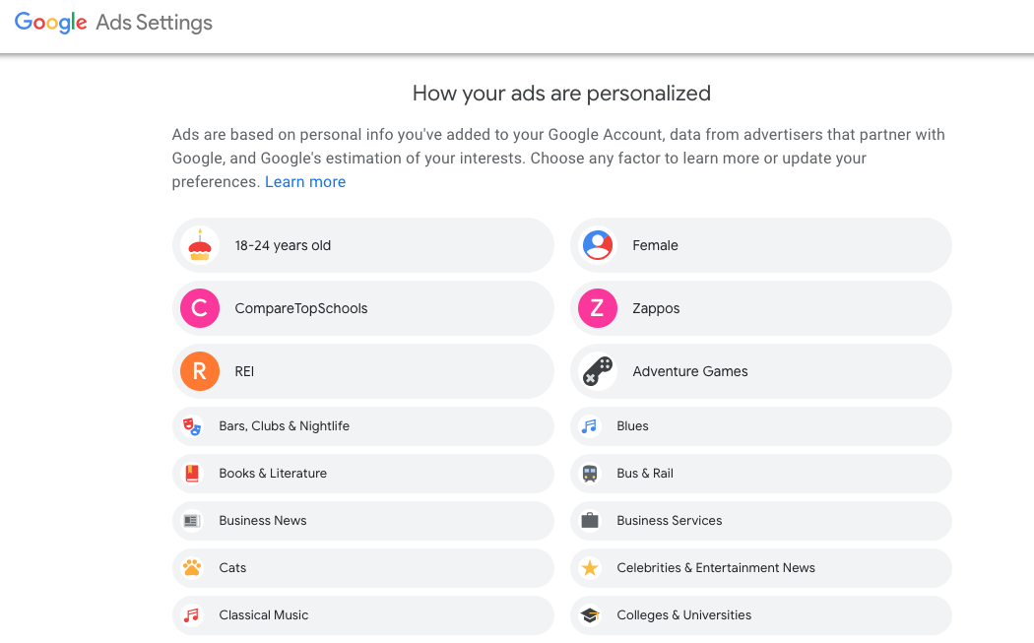
Google Personalization

Slide 14
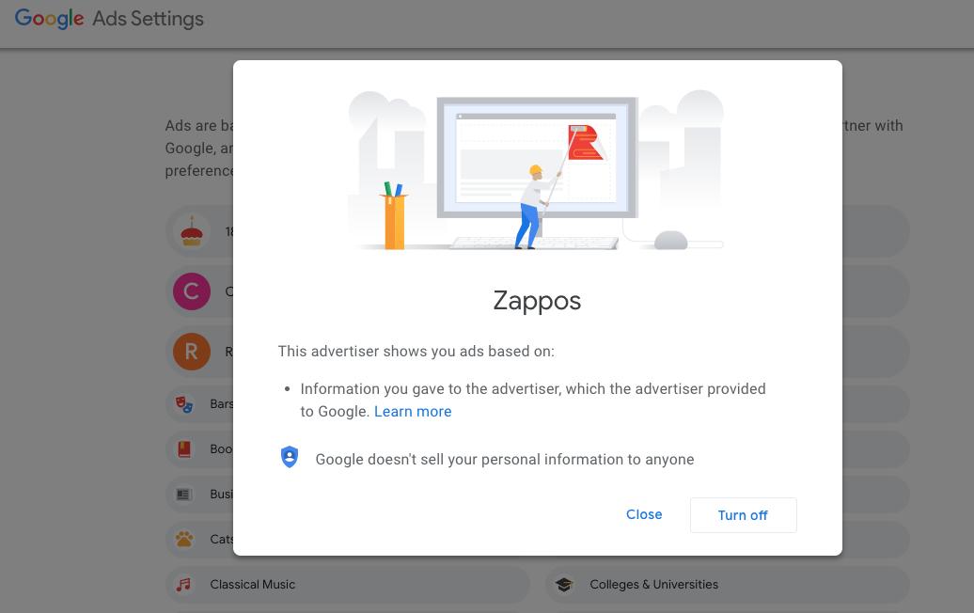
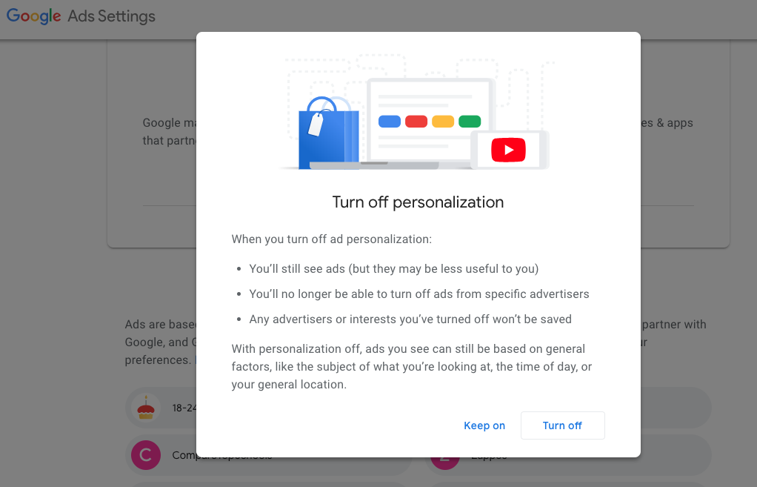

Slide 15
Many People Enjoy Personalized Ads!

Slide 16
But Who’s Getting Targeted..?

Slide 17
Ad Targeting
Cathey O’Neil- Weapons of Math Destruction
Example: Online Universities
Specifically sends ads to low income residents without higher education
Advertise a high cost, low quality option to “get out”
Also partnered with “too good to be true” loan options
Leads to high debt without gaining a step up in the working world
Those Loan Options
High interest
High amounts
Low credit score

Slide 18
Insurance Rates- Car, Home, Renters
Based on…
Gender
Age
Academics
Type of Car
Color of Car
Address

Slide 19
Digital Redlining
“ the practice of creating and perpetuating inequities between racial, cultural, and class groups specifically through the use of digital technologies, digital content, and the internet”
Wikipedia Definition

Slide 20
Questions and Comments?

