Slide 1
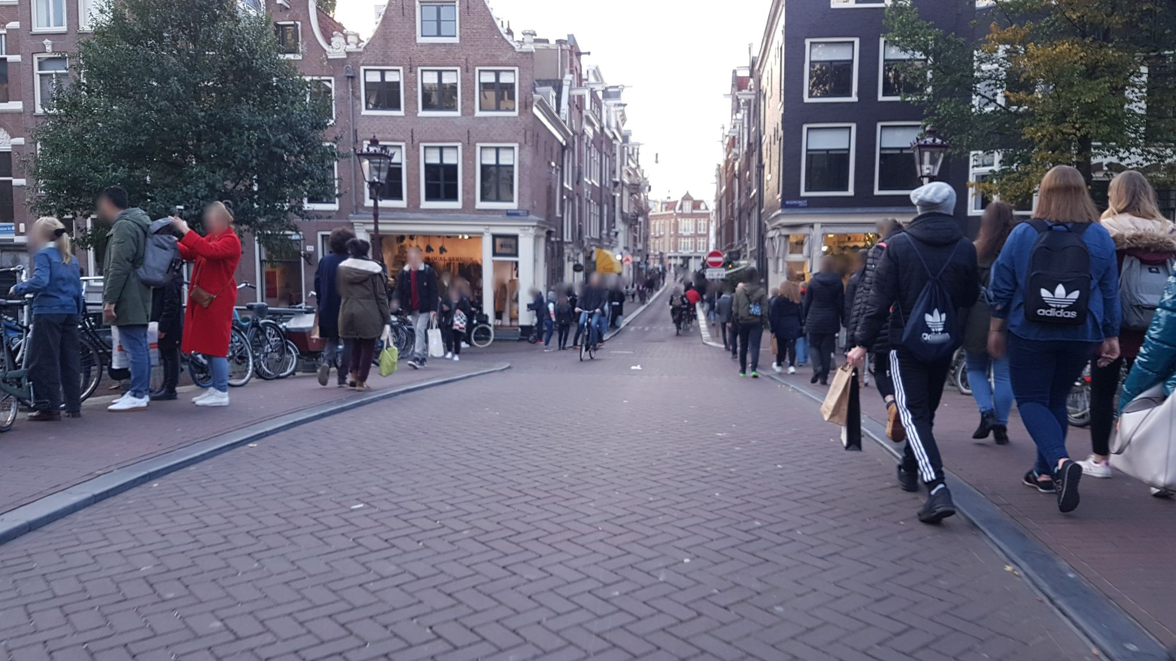
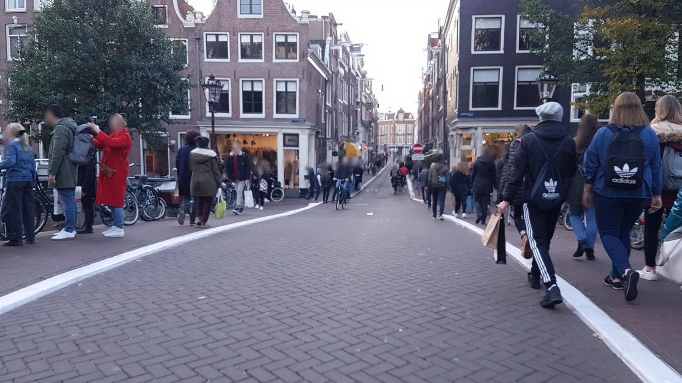
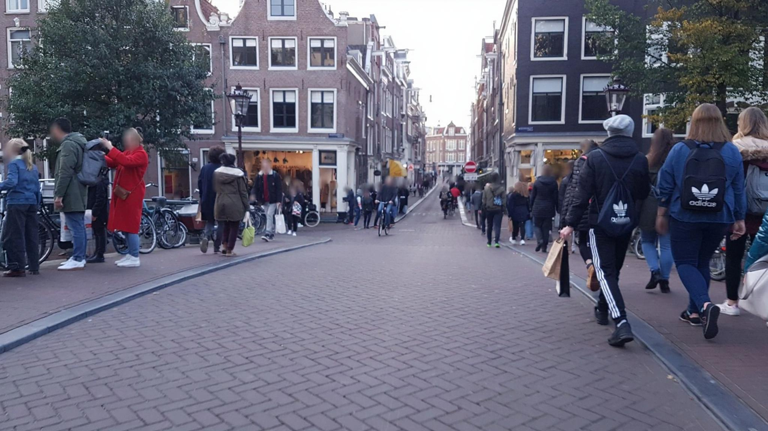
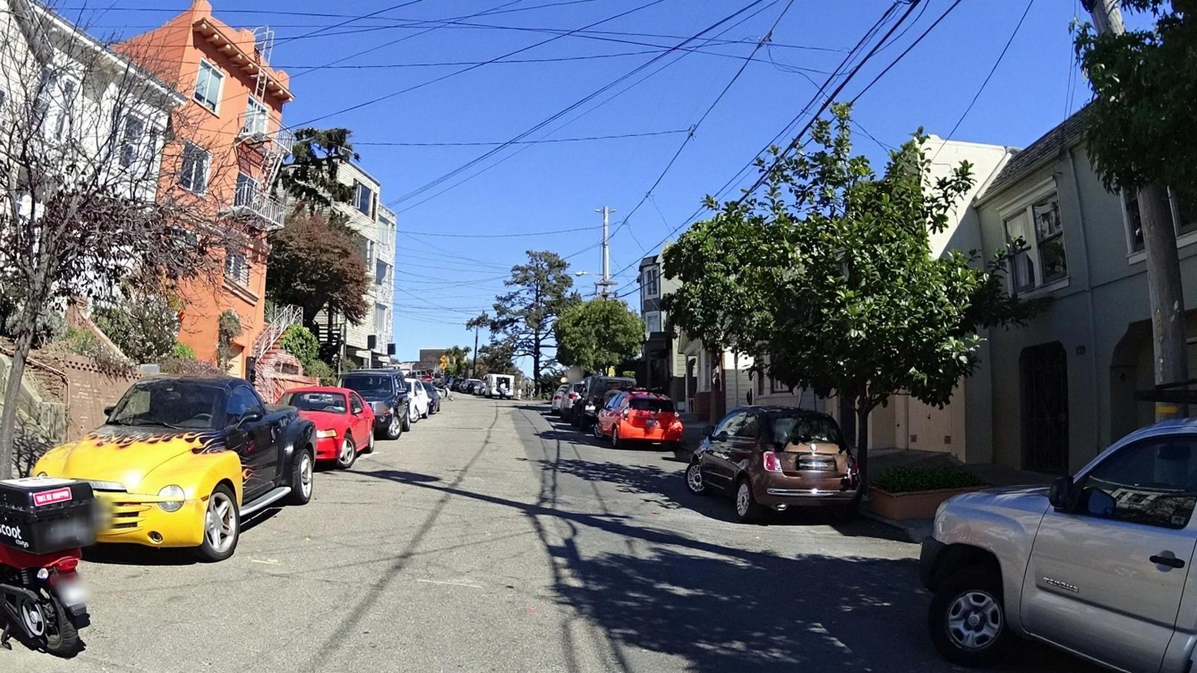
Lever-based Interventional Attribution Pipeline
L(x) Instantiated Lever Candidates
Intervention Vocabulary
+
Scene Grounding
Ontology × Visible cues → L(x)
Phase 1
instantiate
l₁ = (c, s, d, τ)
Graffiti, Wall_1, Remove, [Masked_Edit]
l₂ = (c, s, d, τ)
Lane_Marking, Road, Repaint, [Line_Edit]
Candidate Construction
l₃ = (c, s, d, τ)
Greenery, Entrance_1, Add, [Modest_Plant]
Original Image x
(Input Street-View)
l₄ = (c, s, d, τ)
Surface, Pavement, Clean, [Texture_Edit]
⋮
candidates L(x)
Stochastic Generation
Validity Audit
VLM Critic (GPT-5.4)
Valid Edits V(x)
G
Prompt-only Editor
(Qwen-Image-Edit)
Phase 2
T = 5 retries
x'ᵢ,ⱼ = G(x; lᵢ, φⱼ)
audit
✓ Same-place preservation
pass
x̃₁: lane marking
✓ Locality
repainting
Stochastic Intervention
✓ Realism
x̃₂: surface
✓ Plausibility
cleaning
valid edits V(x)
Auxiliary Scoring
Lever Summaries
fₐ
Safety Proxy
(ViT-B/16 Place Pulse)
Future Work
Human Pairwise Evaluation
(Randomised 2AFC)
V(x) & Score Shifts Δ
Phase 3
score
Δᵢ = fₐ(x̃ᵢ) − fₐ(x)
Lane marking repaint.
Δ = +3.84
Model-based Evaluation
+3.84
+3.25
Surface cleaning
Δ = +3.00
Proxy for perceptual change
Greenery addition
Δ = +3.25
Litter removal
Δ = +2.91
Lever-based interventional attribution pipeline. Each candidate is a structured lever intervention l = (c, s, d, τ) comprising a lever concept, spatial support, intervention direction, and constrained edit template. Phase 1 constructs scene-specific candidates from a curated ontology. Phase 2 performs bounded stochastic generation subject to a four-criterion validity audit. Phase 3 summarises accepted edits with auxiliary classifier scoring and, optionally, future human pairwise judgements.

