Slide 1


THE CODING DOJO
Collaboration > Competition

Slide 2
Questions?
What the hell is TDD?
What the hell is a kata?
What the hell is a dojo?
What the hell is a randori?
But I want to win at all the software?

Slide 3
TDD – Test Driven Design
Why do cars have brakes?

Slide 4
TDD – Test Driven Design
So you can drive faster.
    Stopping, when and where you want.
    From systems design: The higher the control fidelity the harder you can push the envelop.

Slide 5
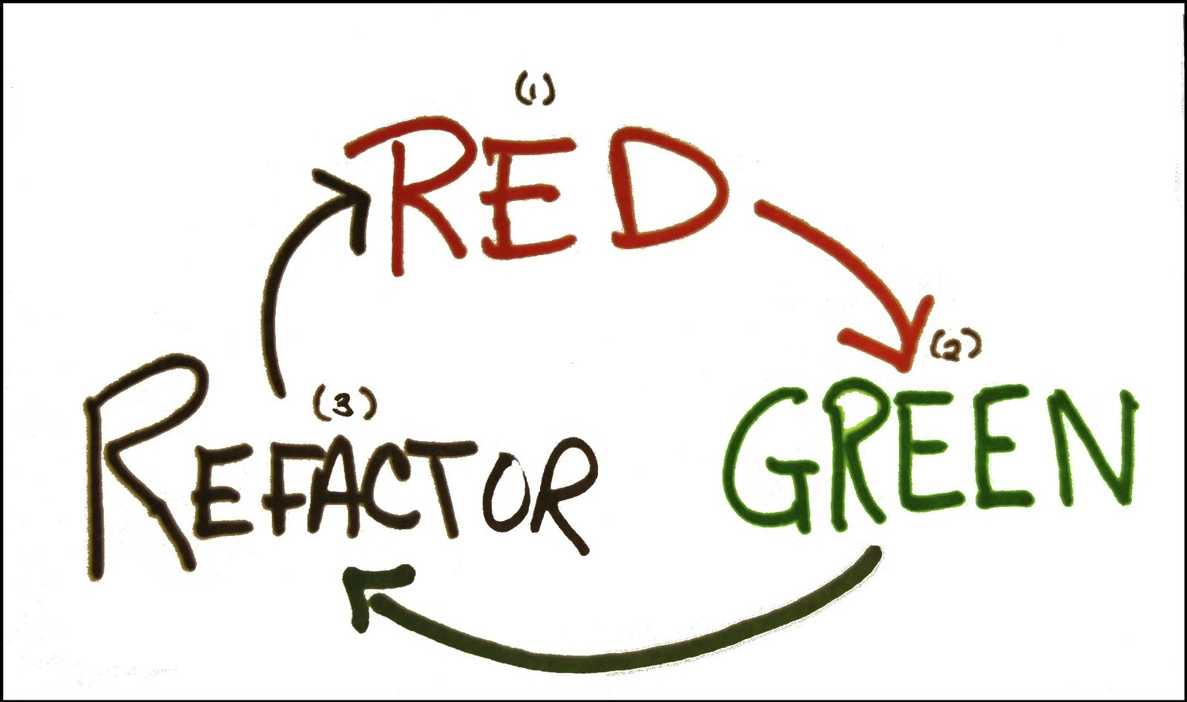

Slide 6
Dojos and Kata? [Slide TBD]
Just talk Some nonsense about learning stages. Unconscious unlearned. Conscious unlearned. Conscious learned, Unconscious learned….. Etc. Waffle.
Deliberate practice, undeliberate practice blah blah blah. Incremental difficulty. Constraints.
RETROSPECTIVE!
No ideas without code,
no code without tests

Slide 7
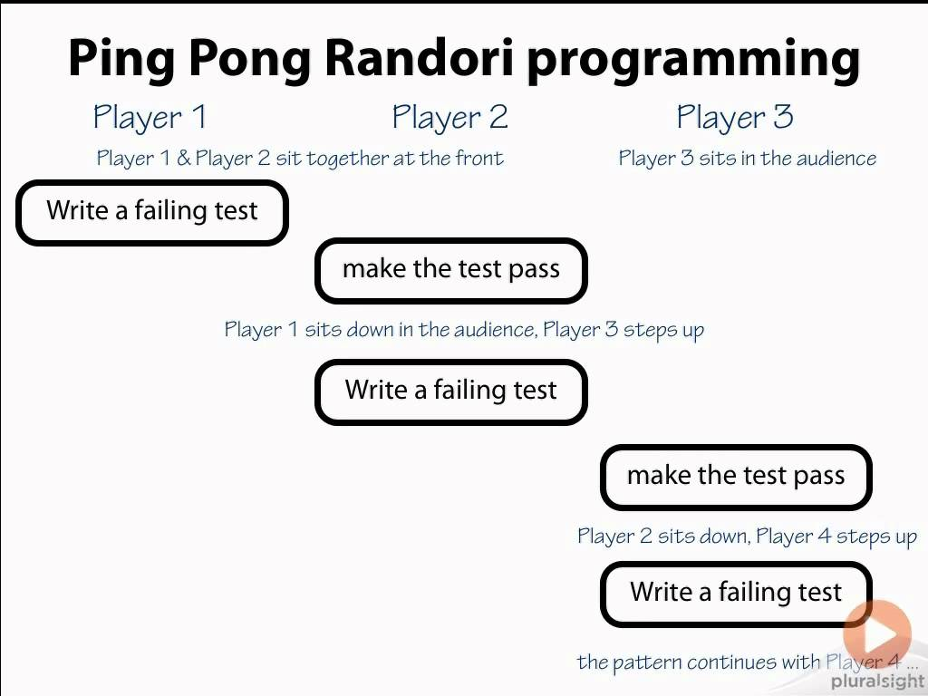
Randori
Rule: Audience participation is essential, but the final word is with the dude/dudette with the keyboard.
The Boss
The Boss
By Extension Also The Boss

Slide 8
There is no scoring and no competition. Help each other out!

Slide 9
BONUS POINTS!
Constraints;
  No mouse!
  Not C# or VB.NET! JavaScript maybe?

Slide 10
TIME TO CHOOSE

Slide 11
Kata
FizzBuzz – Divisors of 3 and 5.
Potter – Shopping basket.
Roman Numerals – Make a number a numeral
Remember: Each one is designed to be a simple task… so we all stop worrying about how we solve the problem and worry and about how we tackle solving problems.

Slide 12


Slide 13

FizzBuzz
Any number divisible by three is replaced by the word fizz and any divisible by five by the word buzz.
Numbers divisible by both become fizzbuzz.
A player who makes a mistake has to take a drink… optional.

Slide 14
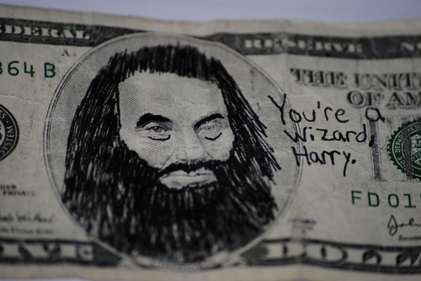
Potter
One copy of any of the five books costs 8 EUR.
If, however, you buy two different books from the series, you get a 5% discount on those two books.
If you buy 3 different books, you get a 10% discount.
With 4 different books, you get a 20% discount.
If you go the whole hog, and buy all 5, you get a huge 25% discount.
Note that if you buy, say, four books, of which 3 are different titles, you get a 10% discount on the 3 that form part of a set, but the fourth book still costs 8 EUR.
See more at: http://craftsmanship.sv.cmu.edu/katas/potter-kata#sthash.FxT6lyZJ.dpuf

Slide 15
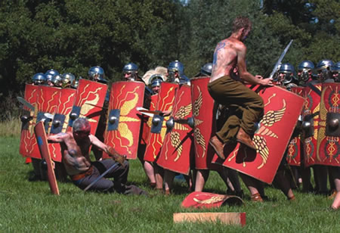
Roman Numerals
The symbols 'I', 'X', 'C', and 'M' can be repeated at most 3 times in a row. 'V', 'L', and 'D' can never be repeated.
As arabic numbers can be split into their constituent parts (1066 becomes 1 0 6 6), so too can Roman numerals, just without the zero (1066 becomes MLXVI, or M (1000) LX (60) and VI (6)).
The '1' symbols ('I', 'X', and 'C') can only be subtracted from the 2 next highest values ('IV' and 'IX', 'XL' and 'XC', 'CD' and 'CM'). The '5' symbols ('V', 'L', and 'D') can never be subtracted.
Only one subtraction can be made per numeral ('XC' is allowed, 'XXC' is not).
I | 1
V | 5
X | 10
L | 50
C | 100
D | 500
M | 1000

Slide 16

TIME IS UP

Slide 17
Retrospective – 5 mins to organise.
Answers I will not accept:
  Time – I care not for your temporal quibbles.
  Logistics – Go home, practice musical chairs with your own MiniDiscs/Zune.
  THAT IS ALL!

Slide 18
OK… now I AM the boss…
Sort of.
Something that went well.
Something that went poorly.
Your favourite bit of code.

