Slide 1
DevOps & Cloud Infrastructure SEIS 615 Software Delivery Pipelines
Jason Baker
Adjunct Instructor
Graduate Programs in Software
University of St. Thomas
St. Paul, MN

Slide 2
Agenda
Delivery Pipelines
AWS services
CodeBuild
CodeDeploy
CodePipeline

Slide 3
Deployment Pipeline
A deployment pipeline is used to manage the deployment and testing of software using a set of validation stages whenever there is a code change.
Commit
Linting
Build
Test
Deploy

Slide 4
Pipeline Benefits
Software is automatically built and tested.
Ready to go to production at any time.
Making changes to software is much easier.
Every change is tested the same way
Easier to automatically deploy changes versus using manual methods
Reinforces practice of using small batch sizes
Compliance and governance tasks are easier.
Traceability improved and tests are enforced.
Reduces need for heavy change control tasks.

Slide 5
Real World Pipeline Development
Some companies hire people to focus exclusively on pipeline development work.
CI/CD engineers
Software Delivery engineers
DevOps Engineer
Release Engineer
Build Engineer
Software engineers today have to know how to build pipelines.

Slide 6
Basic Pipeline Design
Local development stage
Developers run and test software on their local workstation
Natively, virtual machine (vagrant), container
Linting: a static code analysis process which identifies common syntax and style defects using a linter application.
Unit testing: functional tests performed at a small, modular level.

Slide 7
Basic Pipeline Design
Build stage
Usually triggered when a developer checks new code into a VCS
Linting process
Code compilation (when necessary)
Unit tests
Possible local execution tests
Package code and store in an artifact repository

Slide 8
Basic Pipeline Design
Testing stage
Code artifact is deployed to a testing environment
Automated API and/or GUI tests are run against environment
Both integration and end-to-end testing
May leverage a grid-based testing solution
Non-functional testing (service resiliency)
Performance testing
Manual testing (pipeline is stopped and manually retriggered)

Slide 9
Basic Pipeline Design
Production deployment stage/ release
Code artifact is deployed to production environment
May be first applied to a staging environment for further testing before production
Automated smoke tests are run against deployment to validate application working properly.

Slide 10
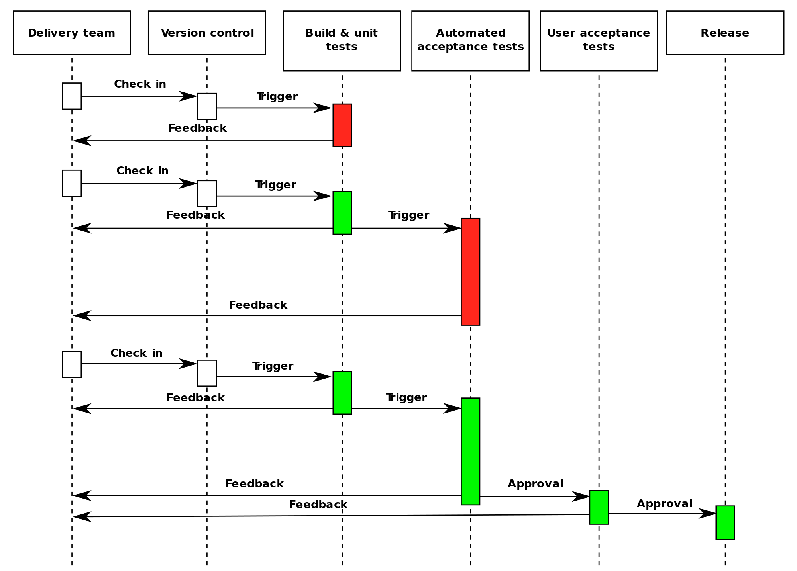

Slide 11
Deployment Pipeline Practices
Prove production-readiness for every change
All changes are potential releasable.
Only build your binaries once.
Don’t keep re-compiling or packaging app at each stage to minimize introduction of configuration inconsistencies.
Store application artifacts in a repository (example: Artifactory)
Deploy the same way to every environment.
Use the same script to deploy to a dev laptop, a test virtual machine, and a public cloud instance.
Store environment-specific configurations in separate files.
If any part of the pipeline fails, stop the line.
If a deployment to an environment fails, the whole team owns that failure and every effort should be taken to fix it.

Slide 12
Fan-in Pipeline Pattern
Multiple pipelines may feed a single assembly or deployment pipeline.

Slide 13

AWS CodeStar
A cloud development environment which allows developers to write, build, and deploy applications.
Cloud9
CodeCommit
CodeBuild
CodeDeploy
CodePipeline

Slide 14

Cloud9
A cloud-based integrated development environment (IDE).
Text editor for writing Python, PHP, Javascript, etc.
Build and test application code.
Easy command-line access to AWS API.
Team collaboration features.

Slide 15
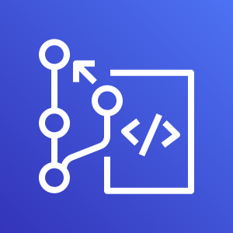
CodeCommit
A managed Git version-control service.
It's like a lighter version of GitHub.
Free tier works well for small teams (5 or less).
Why do we use GitHub instead of CodeCommit?
GitHub Classroom features
CodeCommit may work just fine for your projects.

Slide 16
CI/CD pipeline infrastructure
Building and maintaining CI/CD infrastructure is challenging:
Install and update CI server (Jenkins, Bamboo, etc)
Manage CI server settings
Install and update plugins
Create, update, and scale build node servers
May need multiple types of build nodes for various jobs
Don't forget about backups and security!
Companies oftentimes have dedicated engineers and teams to focus on supporting this infrastructure.
AWS can handle many of these challenges for us.

Slide 17
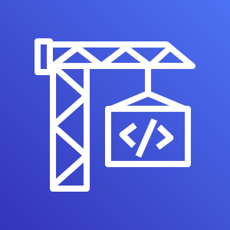
CodeBuild
Managed continuous integration service which allows you to compile code, run unit tests, and create deployment artifacts.
No need to provision or manage build servers.
Automatically scales computing resources to meet demand.
Use pre-packaged environments or bring your own.
Java, Python, Node.js, Ruby, Go, Android, .Net Core, Docker
Billed by the minute for time to complete your build and compute resources used.
Free tier: 100 build minutes of build.general1.small instance/month.

Slide 18
CodeBuild
CodeBuild uses a build project to define how to run a build.
Defines where the source code is located.
What build environment to use
Set of build commands to run
Where to store the build output artifacts
A build environment specifies:
Operating system
Programming language runtime
Tools
During a build, a build environment is created and source code is downloaded into the environment.

Slide 19
CodeBuild
A build specification (build spec) defines the commands which CodeBuild uses to run the build.
We use a YAML file called buildspec.yml located within the root directory of the source code repository to store the build spec.

Slide 20
CodeBuild buildspec.yml
version: 0.2
env:
variables:
key: "value"
phases:
install:
runtime-versions:
java: openjdk8
pre_build:
commands:
- echo Nothing to do in the pre_build phase…
build:
commands:
- echo Build started on `date`
- mvn install
finally:
- echo Run this even if the build commands fail.
artifacts:
files:
- target/myApp.jar
name: myApp.jar-$(date +%Y-%m-%d)

Slide 21
CodeBuild buildspec.yml
buildspec.yml file always starts with a version
version: 0.2
You can set environment variables during the build:
env:
variables:
key: "value"

Slide 22
CodeBuild buildspec.yml
The build process is partitioned into one or more phases:
install: used for installing run-time packages into the build environment
pre_build: run command before the build such as installing node dependencies
build: commands for the actual build process
post-build: commands run after the build such as packaging output artifacts into a WAR or zip file
Commands are shell script statements, and the build process will end if any of the commands fail.
Install runtime versions to support application build requirements: Java, Python, Ruby, etc.
The finally block of commands will always run even if any of the build commands fail.
phases:
install:
runtime-versions:
java: openjdk8
build:
commands:
- echo Build started on `date`
- mvn install
finally:
- echo Run this even if the build commands fail.

Slide 23
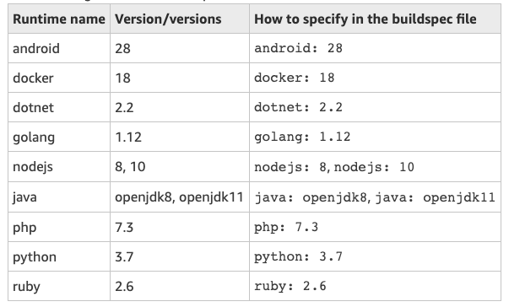
CodeBuild buildspec.yml

Slide 24
CodeBuild buildspec.yml
The artifacts section describes where the output artifacts are located and optionally what to name these artifacts after copying.
Artifacts are stored in an S3 bucket.
artifacts:
files:
- target/myApp.jar
name: myApp.jar-$(date +%Y-%m-%d)

Slide 25

CodeBuild Hands-on
Goal: build a simple Java application using CodeBuild
Setup a GitHub repo that CodeBuild can work with:
Click the following link and fork a copy of a Java GitHub project into your personal account:
https://github.com/seis615/java-project
Create a GitHub personal access token with:
Repo and admin:repo_hook scope privileges
Create a secret in AWS Secrets Manager:
Name: github-token
Key: token, value: <GitHub personal access token>
Notes:
Create build project:
Click on Create build project link
Project configuration:
Project name: java-project
Source:
Source provider: GitHub
Repository: Connect using OAuth
CodeCommit connects to GitHub
Repository URL: Repository in my GitHub account
GitHub repository: jasondbaker/java-project
Primary source webhook events:
Enable: Rebuild every time a code change is pushed to this repository
Environment:
Environment image: Managed image
Operating system: Ubuntu
Runtime(s): Standard
Image: aws/codebuild//standard:2.0
Service role: New service role
Buildspec:
Build specifications: Use a buildspec file
Artifacts:
Type: Amazon S3
Bucket name: <your codebuild bucket name>
Enable semantic versioning
Logs:
CloudWatch: Enable CloudWatch logs
Click Create Project button

Slide 26
CodeBuild Hands-on
Create a build project.
Start a build and run Apache Ant (a Java build manager).
Review buildspec.yml file.
ant: Apache Ant is a Java build manager
Run unit tests, compile Java code, copy artifact to S3
Update the source code repository and trigger an automated build.
We can automate this entire configuration using CloudFormation ☺
https://seis615.s3.amazonaws.com/app-codebuild-template.yaml

Slide 27
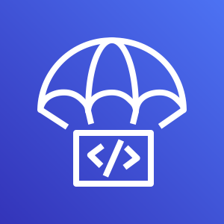
CodeDeploy
A service which automates application code deployments to:
EC2 instances
Lambda functions
Containers (ECS)
On-premise servers
Benefits:
Rapidly release new features.
Avoid downtime during application deployment.
Automate deployments and eliminate manual steps.
Scales deployments from a single instance to thousands.

Slide 28
CodeDeploy
Overall process:
Tell CodeDeploy about your application, how it should be deployed, and where it should be deployed to.
Add a special configuration file (appspec.yml) to your application bundle which describes how to install the software.
Create a deployment which initiates the deployment of the application bundle to a set of compute resources.

Slide 29
CodeDeploy
Key components:
Application: code components you want to deploy.
Compute platform: where you want to deploy application code to (EC2, Lambda, ECS…)
Deployment group: a set of individual compute instances (EC2)
Deployment type: the method used to make the latest application version available.

Slide 30
CodeDeploy
Two deployment types:
In-place deployment
OneAtATime (Rolling release)
HalfAtATime (Rolling release/Min in service)
AllAtOnce (Big Bang release)
Blue/green

Slide 31
CodeDeploy
AppSpec file:
YAML file which describes how to install the application on the compute platform.
Describes where to install application files on destination instances.
Specifies custom permissions for deployed files.
Specifies scripts to run during stages of the deployment process.

Slide 32
CodeDeploy appspec.yml
version: 0.0
os: linux
files:
- source: myApp.jar
destination: /var/app/myApp.jar
permissions:
- object: /var/app
group: wheel
mode: 440
type:
- directory
hooks:
AfterInstall:
- location: scripts/run_tests.sh
timeout: 90

Slide 33
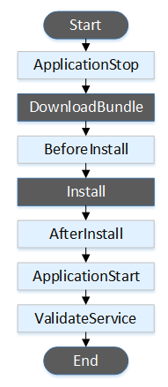
CodeDeploy appspec.yml
Hooks describe lifecycle events which occur during the deployment process.
Events differ based on compute platform and deployment type.
We can specify scripts to run at each event.
Install application dependencies
Configure application settings
Run post-installation smoke tests

Slide 34
CodeDeploy Hands-on
Goal: Deploy and application update to a simulated production environment.
Deploy production environment stack:
https://seis615.s3.amazonaws.com/app-prod-env-template.yaml
Upload website.zip file to S3 artifact bucket in stack using encryption.
https://seis615.s3.amazonaws.com/website.zip
Test access to production ALB
Create CodeDeploy resources:
Application, Deployment Group, Deployment
Watch the deployment process and lifecycle events.
Of course we can always build this configuration using code!
https://seis615.s3.amazonaws.com/app-codedeploy-template.yaml

Slide 35
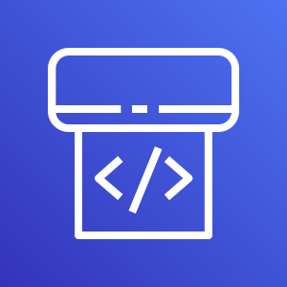
CodePipeline
A fully managed continuous delivery service.
Check in code to source control.
Build software artifacts.
Automatically deploy artifacts to compute environment.
Basically automates the integration of CodeCommit/GitHub, CodeBuild, and CodeDeploy.
Pricing: $1 month/pipeline (first month free)

Slide 36
CodePipeline
Pipeline architecture:
A pipeline consists of a set of stages executed sequentially.
Each stage consists of a set of actions.
Example stages:
Source: Retrieve source code from repository (CodeCommit, GitHub, S3).
Test: Run unit test suite.
Build: Compile and/or package source code into output artifact.
Deploy: Install artifact in compute environment.

Slide 37
CodePipeline
Stage action types:
Source, Build, Test, Deploy, Approval, Invoke
Each action type supports a specific set of providers:
Source: S3, CodeCommit, GitHub
Build: CodeBuild, CloudBees, Jenkins, TeamCity
Test: CodeBuild, Device Farm, Jenkins, Runscope…
Deploy: S3, CloudFormation, CodeDeploy…

Slide 38
CodePipeline
Technical constraints:
Pipeline must contain at least two stages.
First stage must contain source actions (i.e., must retrieve source code).
At least one of the stages must not contain a source action.
Stage names must be unique.

Slide 39
Infrastructure Pipelines
CI/CD pipelines aren’t just used to build software, we also use them to build infrastructure.
Two general use cases:
Automate testing of our infrastructure.
A change to a configuration management or infrastructure definition script triggers a pipeline.
Automate deployment of infrastructure and our software.

Slide 40
Infrastructure Pipeline
CloudFormation template pipeline example:
Lint CloudFormation template to validate syntax
Deploy CloudFormation template
Wait for AWS resources to be built
Test AWS resources to verify that required resources are installed and working properly
Terminate AWS resources
Publish new template

Slide 41
CodePipeline Hands-on
Create GitHub personal access token
Fork python-project repository:
https://github.com/seis615/python-project
Review changes to CodeBuild template code
Source and Artifacts are managed by CodePipeline
Deploy CodePipeline template
https://seis615.s3.amazonaws.com/app-codepipeline-template.yaml
Watch pipeline execute stages and test application deployment.

