Slide 1

DevOps & Cloud Infrastructure SEIS 615 AWS VPC, Databases & Security
Jason Baker
Adjunct Instructor
Graduate Programs in Software
University of St. Thomas
St. Paul, MN

Slide 2
Agenda
EC2
Elastic Load Balancing
EFS
VPC
Bastion hosts
NATing
Databases
RDS
ElastiCache
DynamoDB
Redshift
Elasticsearch
Neptune
AWS Security
Shield
WAF
Guard Duty
KMS

Slide 3

Elastic Load Balancing (ELB)
ELB is a managed load balancer for EC2 instances.
Provides a single endpoint for external users and redirects incoming requests to instances.
Monitors health of instances and routes requests to healthy instances.
Load balancing algorithms:
Round-robin for TCP requests
Least Outstanding Requests for HTTP/HTTPS

Slide 4
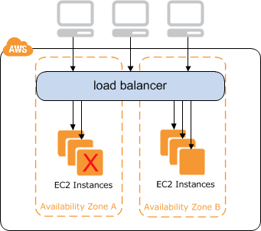
ELB
Benefits:
Scale application performance by adding more instances
Automatically handle failed instances
Protect against failure of an entire availability zone

Slide 5
ELB
Three different types:
Application load balancer (we will use this one)
Network load balancer
Classic load balancer
Components:
Listener: handles requests from clients on a specified protocol and port then forwards to a target group
Target group: a set of registered targets (like EC2 instances) that the ELB can route requests to
Healthcheck: a periodic check which determines the availability of registered targets

Slide 6
ELB

Slide 7
ELB
ELB is priced on a per second basis like EC2 instances.
Additional features:
Sticky sessions: bind a user’s session to a specific instance instead of randomly redirecting (session affinity).
SSL termination: install an SSL/TLS certificate directly on the ELB versus on individual instances.
Internal load-balancing: can also use to load balance internal traffic such as database connections.

Slide 8

ELB Hands-on
Launch two instances running webservers (using webserver-failover AMI ami-598b6124)
Create a new ELB:
Listen on HTTP
Setup health check (index.php)
Add two instances
Monitor status of ELB to verify service health.
Access webservers via ELB endpoint.
Remove one webserver instance to monitor ELB status.

Slide 9

Elastic File System (EFS)
A file system that can be shared across multiple EC2 instances.
Where EFS fits in:
Type | Purpose
S3 | Object storage Data presented as buckets
EBS | Block storage (like a SAN) Data presented as volumes
EFS | File storage (like a NAS) Data presented as file systems

Slide 10
EFS
A fully managed file system for EC2 instances.
Shareable across thousands of instances
Scalable to petabytes
Works with standard operating system APIs
Based on Network File System version 4 (NFSv4).
Files redundantly stored across multiple AZs.

Slide 11
EFS
Use cases:
Scalable content repository storing customer uploads.
Deploying website files across fleet of deployed EC2 instances.
Sharing home directories across instances.
Benefits:
Native file system interaction with OS and applications.
AWS managed infrastructure.

Slide 12

Virtual Private Cloud (VPC)
A VPC is a logically isolated virtual network within a region that is used to partition resources.
It’s like a private cloud-based data center.
Benefits:
Allow you to build secure application architectures.
Securely partition applications and organizations.
VPCs are challenging to understand at first, but are critically important to working with AWS.

Slide 13
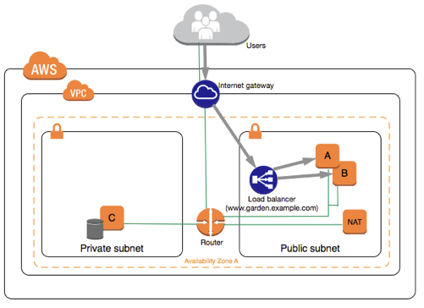
VPC
Example use case: public webservers with backend database servers

Slide 14
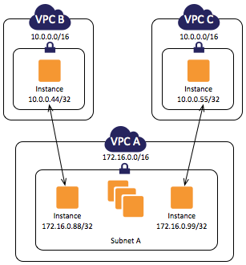
VPC
A region may contain multiple VPCs.
Each VPC has its own privately-routable network.

Slide 15
Private IPs
Helpful tool for visualizing IP network blocks: http://cidr.xyz/

Slide 16
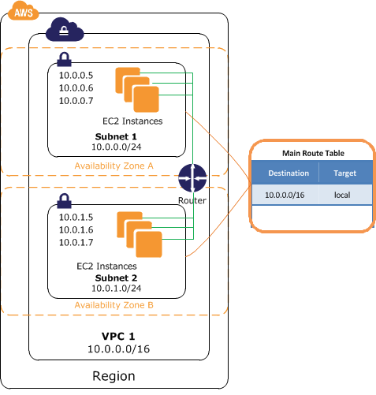
VPC
A VPC network is partitioned into one or more subnets.
Each subnet is associated with one AZ.
Each subnet is associated with one route table.

Slide 17
VPC IP addressing
Every EC2 instance has a private IP address, automatically assigned based on the subnet.
Some instances may also have a dynamically assigned public IP address based on subnet setting.
Dynamically assigned public IP addresses are pulled from a general pool and change every time an instance starts.

Slide 18
Elastic IP
An elastic IP is a permanent public IP address that is associated with an instance.
IP address doesn’t change when the instance is restarted.
AWS user can provision elastic IP addresses and assign the addresses to instances as needed.
Small monthly fee for each IP address not associated with an instance.

Slide 19
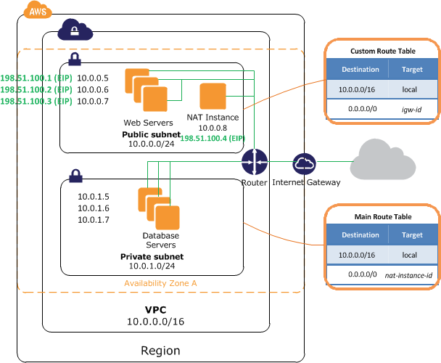
Internet Gateway
To access the Internet directly an instance must have a public IP address and be on a subnet that routes through an Internet Gateway.
Only one IG allowed per VPC.
No extra fee for using an IG.

Slide 20
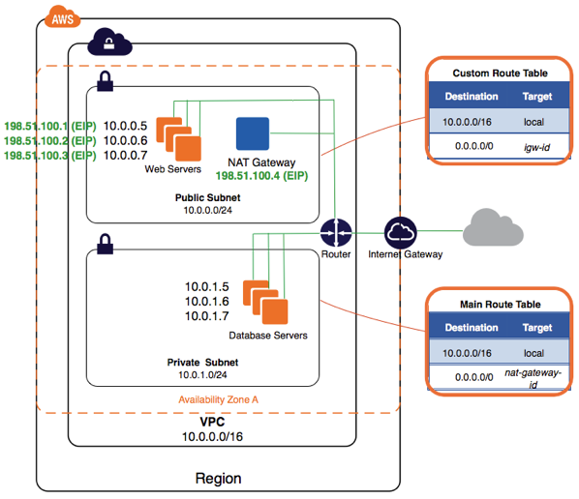
NAT Gateway
A NAT Gateway allows an instance on a private subnet to communicate with the Internet.
Hourly fee for a NAT (it’s basically a managed EC2 instance).

Slide 21
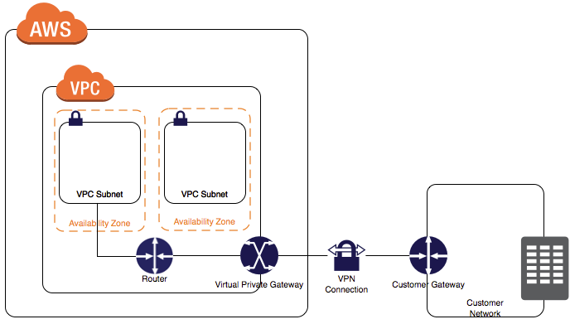
Virtual Private Gateway
VPG securely connects a VPC to a corporate network.

Slide 22
Access Control Lists
ACLs define rules to filter network traffic to and from subnets.
It’s like a firewall for subnets.
Filters traffic outside of subnet and before security groups.
Rules are stateless, meaning ingress and egress rules must be explicitly defined.
Default rule is all ingress/egress data allowed.
New rules start by denying all data.

Slide 23
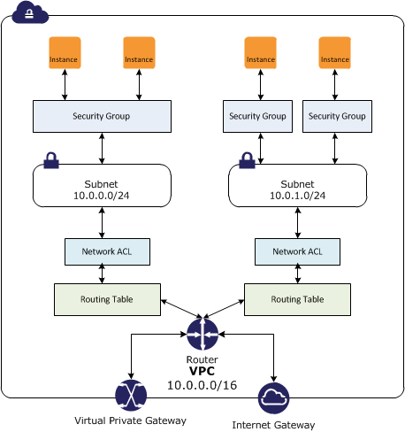
Access Control Lists

Slide 24
VPC Tenancy
VPCs can support three different tenancy options:
Default: instances run on shared hardware.
Dedicated: instances run on single-tenant hardware.
Host: an instance runs on a dedicated host.
Single tenant options help meet certain regulatory requirements, but at a much higher cost.
~ $2,000/mo region fee to deploy dedicated instances.

Slide 25
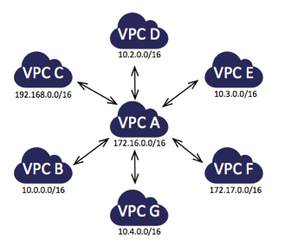
VPC Peering
It’s possible to route traffic between VPCs in different regions and accounts.
Traffic routing cannot be transitive (VPC C cannot communicate with VPC F).
A star topology is the recommended peering strategy.

Slide 26
Default VPC
Your AWS account has a default VPC setup in each AWS region.
The default VPC has an Internet Gateway and all subnets will route public traffic through it.
All subnets will dynamically assign public IPs to new instances.
Default VPC is great for learning AWS, but is likely not appropriate for production.

Slide 27
VPC Hands-on
Create a new VPC
Name: classvpc
CIDR block: 10.0.0.0/18
Create two subnets in VPC on separate AZs
Public subnet
Name: class-public
AZ: us-east-1a
CIDR block: 10.0.1.0/24
Private subnet
Name: class-private
AZ: us-east-1b
CIDR block: 10.0.2.0/24
Review main route table for VPC and current subnet association

Slide 28
VPC Hands-on
Add Internet Gateway to VPC
Name: class-IG
Attach to new VPC
Launch one instance into each subnet.
Configure routing tables for public and private subnets.
Public routing table routes through IG
Setup a NAT in the public subnet.
Create separate routing table for private subnet.
Modify private subnet route table to route through NAT.
Terminal into public and private servers to verify access.
Access private server using ssh proxy configuration:
ssh-add -K server-key.pem
ssh -A ec2-user@<server1 public IP>
From public server: ssh ec2-user@<backend1 private IP>

Slide 29
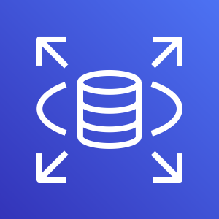
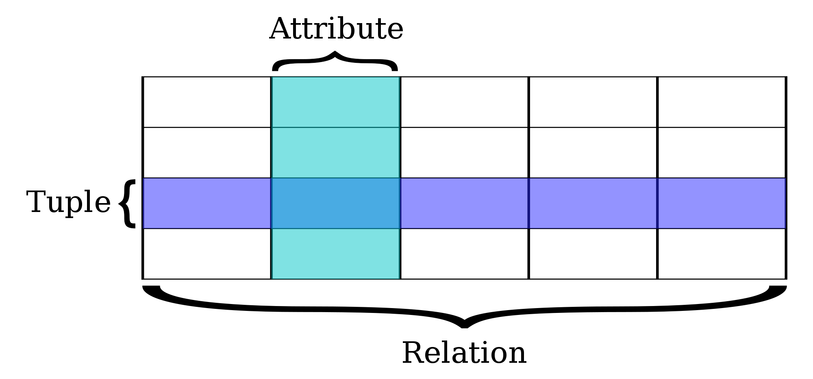
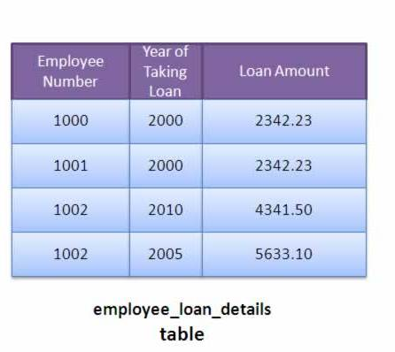
Relational Database Service (RDS)
Managed database service supporting traditional relational databases.

Slide 30
RDS
Supported databases:
MySQL
MariaDB (MySQL fork)
Microsoft SQL Server
Oracle
PostgreSQL
Aurora (designed by AWS)
MySQL & PostgreSQL compatible engines
RDS provides an endpoint for each database which is used by an application for communication.

Slide 31
RDS
RDS supports two different database backup schemes:
automated backups
snapshots.
Automated backups: RDS performs a full daily backup of the database and stores transaction logs since the backup job.
Retains backup data for 1 to 35 days.
During recovery full backup is restored and then transaction logs are replayed.
Backup data is stored on S3.
Backups occur during a specified window and the database storage I/O may be significantly reduced.

Slide 32
RDS
RDS snapshots are initiated manually by the user and exist indefinitely – even after database is removed.
It’s possible to use RDS data backups to copy databases (for testing or to move).
Multi-AZ capability provides standby database instance in a separate AZ for fail-over purposes.
Writes to main database server are synchronized to the standby database.
Main purpose is for greater service resiliency, it does not improve performance.
Although, it allows RDS to update or backup a server without degrading I/O.

Slide 33
RDS
All database types support Multi-AZ
Aurora is special because it is only offered in a multi-AZ architecture (2 DBs in 3 AZs = 6 total!).
Read Replica: a database instance in a separate AZ which asynchronously copies data from the main database.
Only used for READS
Scales database performance by allowing database clients to read data from multiple instances.
Up to 5 read replicas supported.
Owner can promote a read replica into a separate database, splitting relationship with parent.

Slide 34
RDS Hands-on
Create an RDS database.
Create database security group.
Locate database endpoint.
Review automatic backup schedule.
Perform a snapshot.

Slide 35
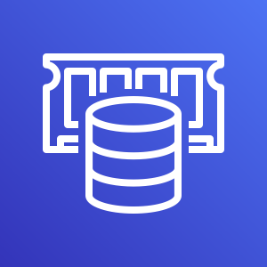
ElastiCache
ElastiCache is a distributed in-memory caching system.
Huge performance improvement when reading from memory vs. disk.
Main memory reference = 100 ns
Read 4k randomly from SSD = 150,000 ns
Benefits:
Cache frequent database queries
List of corporate store locations
Product listing
Store frequently-accessed data
Web sessions

Slide 36
ElastiCache
Supports two types of cache systems:
Memcached
Redis
Memcached
Very reliable key/value store
Simple to operate and use
Redis has more features today
Storing data in a variety of formats beyond key/value: list, array, sets, and sorted sets
More complex to operate
AWS supports master/slave replication and cross AZ redundancy

Slide 37
Redis example
redis-cli -h mycachecluster.eaogs8.0001.usw2.cache.amazonaws.com -p 6379
set a "hello" // Set key "a" with a string value and no expiration
OK
get a // Get value for key "a"
"hello"
get b // Get value for key "b" results in miss
(nil)
quit // Exit from redis-cli

Slide 38
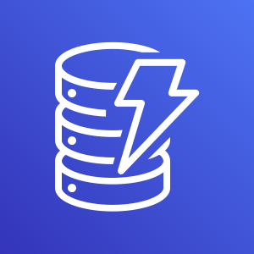
DynamoDB
AWS NoSQL database utilizing a key/value and document processing architecture.
Based on Google Big Table design.
Each table is comprised of items stored in JavaScript Object Notation (JSON).
Anti-pattern: table is a namespace, not a relational table!
Supports highly scalable number of reads and writes with unlimited data storage.
Automatically scales data storage, no need to reconfigure database like RDS (relational).
Data replicated between 3 separate datacenters (not necessarily in separate AZs).

Slide 39
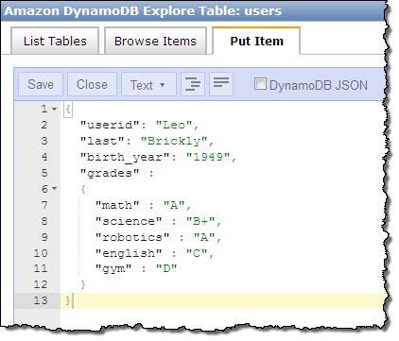
DynamoDB

Slide 40

Redshift
Managed data warehousing and analytics database (OLAP).
Online Transaction Processing (OLTP) focuses on querying and maintaining individual transactions.
Products purchased in a specific order
Online Analytical Processing (OLAP) focuses on the analysis of aggregate sets of data.
Total store sales across North America
Uses columnar storage to improve performance.
Generally computation is performed on values within a column, so store them in the same page to improve query performance (reduce I/O).

Slide 41
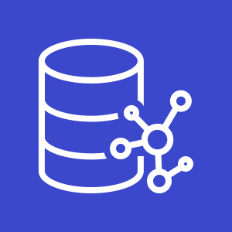
Neptune
Managed graph database service for applications with highly connected datasets.
Social media applications
Recommendation engines
Knowledge graphs

Slide 42

Elasticsearch
Managed Elasticsearch service
Fast indexing and search across massive amounts of data
Ingest data and analyze, report, and visualize in real time.
Includes Kibana web console
Integrated with AWS security and services

Slide 43
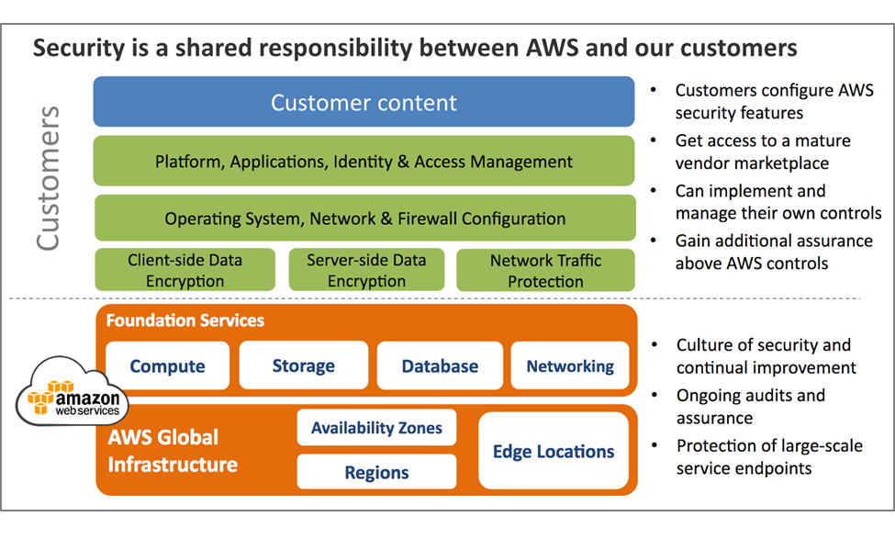
AWS Shared Security Model

Slide 44
AWS Network Security
AWS network and Amazon network use similar infrastructure, but are logically separated from one another.
AWS prevents IP spoofing: instance sending data with an IP or MAC address that’s not it’s own.
Network port scans must be approved by AWS in advance.

Slide 45

Web Application Firewall (WAF)
Managed service which protects your web applications from common attacks.
SQL injection
Cross-site scripting
Create custom security rules using web console or API
Deploy as part of CloudFront, ALB, or API Gateway

Slide 46

Shield
Managed service which protects your application from Distributed Denial of Service (DDos) attacks.
Network layer 3 and 4 attacks
Available in either standard or advanced tier depending on resources being protected.

Slide 47

GuardDuty
Threat detection service which continuously analyzes logs from CloudTrail, VPC network traffic (Flow Logs), and DNS logs.
Trigger alerts to notify staff about anomalies or automatically remediate issues.

Slide 48

Inspector
Security scanning service which assesses application vulnerabilities
Network: verify open ports
Host system packages
CVE: Common Vulnerabilities and Exposures
OS configuration
CIS: Center for Internet Security Benchmarks
General security best practices
Disable root over ssh
Configure password complexity

Slide 49

Certificate Manager
Service which allows you to generate and deploy SSL/TLS certificates for use with AWS services.
ELB
CloudFront
API Gateway
Certificates are available for free, but only work with AWS resources.

Slide 50

Key Management Service (KMS)
A service which allows you to create encryption keys for use across a variety of AWS services.
Keys for encrypting S3 buckets
Keys for encrypting AMIs
Control access to encryption keys using policies and audit access to keys.

Slide 51

Security Hub
Provides a comprehensive view of high-priority alerts and compliance issues across accounts.
Security Information and Event Management (SIEM)
Single site which integrates alerts from various AWS services
GuardDuty
Inspector
Macie
Third-party AWS partners

Slide 52
Top 5 Cloud Security Issues (or how to get your CEO fired)
Stolen access credentials
Use multi-factor authentication to mitigate
Compromised access keys
Never publish keys on Internet in source code
Rotate keys daily
S3 bucket is publicly available
Use AWS Config to monitor account for public buckets
Third-party tools like Threat Stack
Permissive security group rules
Review and test all rules to make sure only required ports are accessible
Set both ingress and egress rules
Improperly scoped role/policy associated with resource
Only give resources the minimal amount of access needed to complete work

