Slide 1
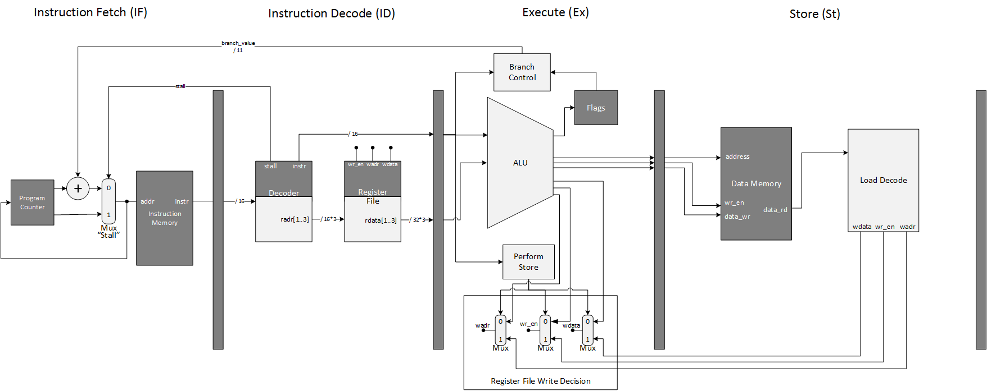
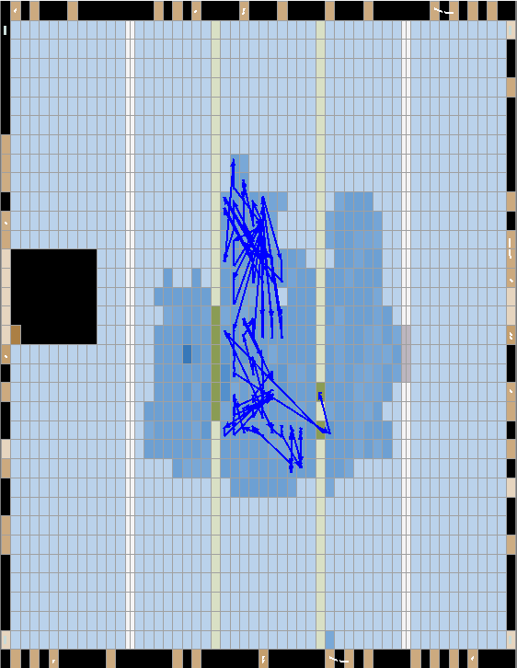
Design and Implementation of A RISC-V Microprocessor
Jason Dempsey, jason.dempsey@digipen.edu
I. Abstract
Field Programmable Gate Arrays (FPGAs) are rapidly becoming the de-facto development platform for hardware and ASIC designs. Specifically, designs in computer architecture such as microprocessors may be rapidly created, iterated upon, and verified without the need of interacting with hardware until the final stages of the development cycle. This project is an open microprocessor platform using the RISC-V Instruction Set Architecture (ISA). Utilizing the Low Level Virtual Machine (LLVM), C programs compiled in the Clang compiler may be ran on this microprocessor implementation.
Design
This CPU is a 4 stage pipelined, Harvard architecture, Reduced Instruction Set CPU. It adheres to the RISC-V ISA guidelines in that it consists of 32 registers, each being 32 bits in width (this is also referred to as the 'Word' size), and is a load/store architecture. A load/store architecture is one which supports specific instructions to read/write to/from memory respectively. It should be noted that the RISC-V ISA standards classify separate extensions to the complete set. This CPU adheres to the base set as well as the multiplication (M) extension which supports various multiplication instructions, division, and remainder operations.
Another component of this design is the LLVM layer upon which C programs may be written and compiled into RISC-V assembly and loaded directly onto the FPGA. This allows for actual and complete programs to be executed by FPGA hardware very quickly.
III. Pipeline Implementation
Fetch
The Instruction Fetch stage is responsible for ensuring the program counter is correct and also outputting the next instruction from the instruction memory.
The program counter is implemented as a 32-bit valued register which will either be continuously incremented or modified by a value determined by a branching statement.
Decode
The Instruction Decode stage determines if and which registers will be read from in the execute stage.
As instructions are read into the decoder, from the instruction memory, it must determine if that instruction requires data from the Register File to execute correctly. If so, up to 3 registers may be read from. This action takes place on this stage's clock boundary.
Another critical task that the decoder must control is stalling. The pipeline must be stalled whenever a Load operation is decoded. Because the Register File must be written to by the operation, before it is read in the next instruction. This action requires an additional clock cycle and in turn, an additional stage within the pipeline. (See Store)
Execute
The Execute stage performs the operation specified by the opcode.
Given an opcode, what must happen first, is it must be determined what operation must be performed, given the opcode. Once this happens, either the ALU or branch controller must perform the given action.
Store
The store stage is responsible for executing the Load operation which was deferred to by the execute stage.
Once the store stage is invoked, the instruction is once again decoded so as to determine the exact operation to perform. Depending on the instruction, only specific parts of data may be needed. For instance, LB only wants the first byte of the data to load.
IV. Testing & Validation
Design validation was performed in two pieces. The first performed verification of the implementation of the RISC-V instruction set and CPU implementation. A test bench was created to verify instructions which were implemented within the design. Upon the first stage of verification, the second stage consisted of compilation of a small C program to verify the disassembly could be loaded into memory and simulated.
The design was synthesized onto an Altera Cyclone IV E EP4CE22F484N. The worst case path may be seen as the dark blue line. This path slows the design down the most and is a common problem among HDL designs. Missing worst case timing requirements could require an entire refactor of your design. In this case, the design missed the ‘slack’ time by approximately 50ns, which implies that more work is to be done to meet this timing requirement.
V. Discussion & Conclusion
The project should be seen as a success even though some ideas did not get fully realized.
The design can simulate and even synthesize onto an FPGA development board, though minimal physical testing took place.
The RISC-V compilation toolchain is something that worked almost initially as well as an ‘obj2mif’ program which stripped the RISC-V disassembly from an ‘obj’ file, and generated a correct Memory Initialization File to be loaded onto the FPGA.
Unfortunately, branch prediction did not fully make it. The scope of the task was slightly underappreciated and thus a fully working implementation could not be realized.
This was a fantastic opportunity to explore architectures and instruction sets outside of the realms of ARM. RISC-V is a fantastic platform that should be further considered for future use in the realm of education.
Figure 1: Synthesis Footprint
VI. Acknowledgements
I would like to thank Dr. Jeremy Thomas for keeping me on the right track as well as Dr. Lukas van Ginneken who allowed me to explore something I truly enjoy.
VII. References
Waterman, Andrew, et al. "The RISC-V instruction set manual—volume I: user-level ISA." CS Division, EECE Department, University of California, Berkeley (2014).
Waterman, Andrew. "Design of the RISC-V Instruction Set Architecture." (2016).
Computer
Engineering

