Slide 1
MATLAB
Class 4: plotting

Slide 2
Plotting Tips
The first thing you need to consider when plotting is your message, the audience, and type of plot
Making a graphic is always helpful for a reader but not always necessary. Can you say this image in words?
Notes:
https://journals.plos.org/ploscompbiol/article?id=10.1371/journal.pcbi.1003833

Slide 3
Plotting Tips
In a general sense the type of plot you pick is very important
Bar plots and line graphs are simple and effective ways to convey a message and are readable by almost all audiences
Notes:
https://journals.plos.org/ploscompbiol/article?id=10.1371/journal.pcbi.1003833

Slide 4
Plotting Tips
It is important to remember there is a wide range of scientific literacy in the world and your audience may not be accustomed to reading plots, specifically really complex figure
Notes:
https://journals.plos.org/ploscompbiol/article?id=10.1371/journal.pcbi.1003833

Slide 5
Plotting Tips
Try plotting information with the least amount of ink as possible
Do not overcrowd graphs, give each one room to breath
Colour choice is important and can make figures misleading
Notes:
https://journals.plos.org/ploscompbiol/article?id=10.1371/journal.pcbi.1003833

Slide 6
Plotting Tips
Do not mislead readers, be careful about adjusting axes to exaggerate effects
Label everything clearly including axes and units
Always plot confidence intervals or a measure of data spread / uncertainty
Notes:
https://journals.plos.org/ploscompbiol/article?id=10.1371/journal.pcbi.1003833

Slide 7
Plotting Tips
Your plot should highlight your data in the best way possible: do not plot a histogram for a binary outcome variable or a bar plot if your data is continuous
Notes:
https://journals.plos.org/ploscompbiol/article?id=10.1371/journal.pcbi.1003833

Slide 8
Plots tell a story
Notes:
https://journals.plos.org/ploscompbiol/article?id=10.1371/journal.pcbi.1003833

Slide 9
Plotting Tips
Do not mislead readers, be careful about adjusting axes to exaggerate effects
Label everything clearly including axes and units
Always plot confidence intervals or a measure of data spread / uncertainty
Notes:
https://journals.plos.org/ploscompbiol/article?id=10.1371/journal.pcbi.1003833

Slide 10
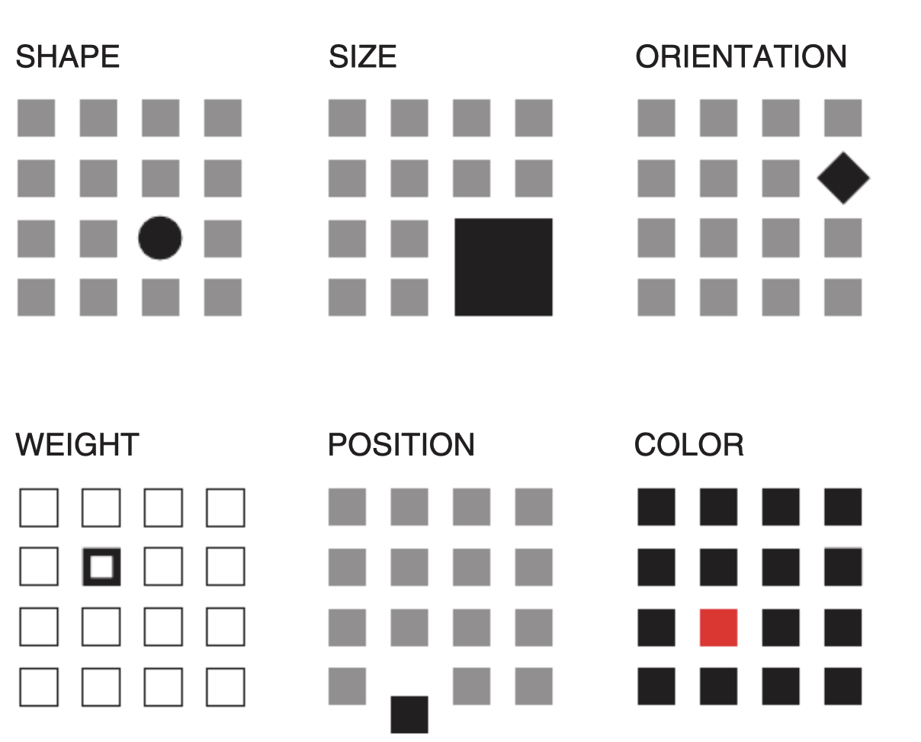
Plotting Tips
Rolandi et al., 2011
Notes:
https://journals.plos.org/ploscompbiol/article?id=10.1371/journal.pcbi.1003833

Slide 11
Plot function
The plot() function in MATLAB takes in x, y values and returns a line plot. Each element of the plot can be manipulated using different specifiers

Slide 12
Plot function
After running plot() you can manually alter aspects of the resulting figure
Xlabel(‘time’)
Ylabel(‘money’)
Title(‘Time is money’)

Slide 13
Plot function
If you have provided multiple sets of information to the plot function or a matrix, you can use the legend() function to label each element you’ve plotted

Slide 14
Plot Colours
You can change the colour of your lines by specifying one of the following colours from the table
e.g., plot(x, y, ‘r’)
y | yellow
m | magenta
c | cyan
r | red
g | green
b | blue
w | white
k | black

Slide 15
Plot Markers
'o' | Circle
'+' | Plus sign
'*' | Asterisk
'.' | Point
'x' | Cross
'_' | Horizontal line
'|' | Vertical line
's' | Square
'd' | Diamond
'^' | Upward-pointing triangle
'v' | Downward-pointing triangle
'>' | Right-pointing triangle
'<' | Left-pointing triangle
'p' | Pentagram
'h' | Hexagram
You can change the markers of your data by specifying one of these
e.g., plot(x, y, ‘x’)c

Slide 16
Plot Lines
You can change the appearance of the lines of a plot() by specifying one of these
e.g., plot(x, y, ‘-.’ ) these can be combined with markers and colours
Plot(x, y, ‘x-.r’)
- | Solid line
-- | Dashed line
: | Dotted line
-. | Dash-dot line

Slide 17
Plot other specifiers
‘MarkerSize’, size
‘LineWidth’, size
‘MarkerEdgeColor’, [ R G B alpha]
‘MarkerFaceColor’, [ R G B alpha]
‘Color’, [ R G B alpha]
Etc…
(potential to make a MATLAB plotting cookbook in future)

Slide 18
Figure and close all
I always recommend you begin a new graph by running figure this ensures that you are not overwriting any previous information you’ve plotted before
Reminder that close can be used to close currently opened figures

Slide 19
Hold on / off
The command hold on allows one to add to the existing axes of a plot you just made. It is like adding another layer.
This does not need to be the same type of plot
Hold off removes this hold on the figure and allows you to overwrite them

Slide 20
Other Line plots
If you would like to plot your data in log-log space you can use the function loglog() which works essentially the same way that plot does
Useful when data is decaying or exponentially growing

Slide 21
Error Bars
It is always important to give the reader a sense of how uncertain a measure is, whether that be std, std error, or CI
To plot error bars in MATLAB use the function errorbar()

Slide 22
Error Bars
errorbar() takes the x, y, and error
All specifiers are like plot() except for ‘CapSize’
Use ‘LineStyle’ to remove line between x values this allows you to plot the error bars separately from the underlying graph

Slide 23
Bar graphs
Creates bar plots, see examples in code
Special specifier ‘stacked’
Can use xticks and xlabels to relabel the x-axsis or change the number of ticks (same for yticks)

Slide 24
Plot but make it fashion
There are many toolboxes in addition to the basic functions of MATLAB, some are developed my MATLAB and others are external and need downloading
We will cover some additional methods to plot in MATLAB

Slide 25
Histograms
Allows you to visualize distributions of data
histogram(X, nbins)
‘BarWidth’
‘FaceColor’
‘FaceAlpha’

Slide 26
Scatter
Scatter plot of data inputs take x and y
Same colour and marker specifiers as plot
‘filled’ to colour in marker

Slide 27
Other plots
Loglog, semilogx, semilogy
Boxchart, barh, stairs
Imagesc, polarhistogram

Slide 28

Gramm
I’m not a regular graph, I’m a cool graph

Slide 29
Gramm
Toolbox developed to extend MATLAB’s graphing capacities. The code runs much like ggplot in R, whereby data is fed into the gramm function and each layer of the graph is added on top
See below for a cheat sheet summarizing gramm’s capacities
https://github.com/piermorel/gramm/raw/master/gramm%20cheat%20sheet.pdf

Slide 30
Gramm
Gramm example script:
g=gramm('x',cars.Model_Year,'y',cars.MPG,'color',cars.Cylinders,'subset',cars.Cylinders~=3 & cars.Cylinders~=5);
g.facet_grid([],cars.Origin_Region);
g.geom_point();
g.stat_glm();
g.set_names('column','Origin','x','Year of production','y','Fuel economy (MPG)','color','# Cylinders’);
g.set_title('Fuel economy of new cars between 1970 and 1982’);
Figure('Position',[100 100 800 400]);
g.draw();
See example on their website

Slide 31
References
Rolandi et al 2011. A Brief Guide to Designing Effective Figures for the Scientific Paper. Advanced Materials
Rougier et al 2014. Ten Simple Rules for Better Figures. Plos Computational Biology
Nature blog http://blogs.nature.com/methagora/2013/07/data-visualization-points-of-view.html

