Slide 1
MATLAB
Class 4: plotting and descriptive stats

Slide 2
Statistics aims to understand your data by describing it and making predictions

Slide 3
Descriptive stats aims to describe data’s distribution by central tendency (location in a plane) and dispersion (spread) around the location

Slide 4
Inferential stats aims to predict future outcomes or observations based on your data

Slide 5
Inferential stats aims to predict future outcomes or observations based on your data more on this in the next class…

Slide 6
Useful descriptive stats and associated functions

Slide 7
Data Structures
Median
Mean
Mode
Returns the middle value of array
Average value of array
Returns most common value of array

Slide 8
Data Structures
Median
Mean
Mode
Note: that for MATLAB V 2018b and newer you can use the input ‘all’ to take the mean, median, etc across ALL elements. Previously you need to script this
Returns the middle value of array
Average value of array
Returns most common value of array

Slide 9
Data Structures
Maxk
Max
Min(k)
Find the largest k elements of an array
Find largest elements of an array
Find the smallest (k) elements of an array

Slide 10
Data spread
range
STD
var
Difference between max and min
Computes standard deviation of array
Computes variance of array

Slide 11
Data spread
range
STD
var
Difference between max and min
prctile(x,p) returns the p percentile of the data vector X
Computes standard deviation of array
Computes variance of array

Slide 12
Dealing with missing data
Missing data in MATLAB generally takes the form of NaN values
You need to address these before running analysis
Ismissing()
Rmmissing

Slide 13
Dealing with outliers
You can manually check if there are any outliers in your data (e.g., check for data above 3 SD)
or you can use isoutlier()

Slide 14
Confidence Intervals
Not only do you want to DESCRIBE the general tendency of your data but also the SPREAD...

Slide 15
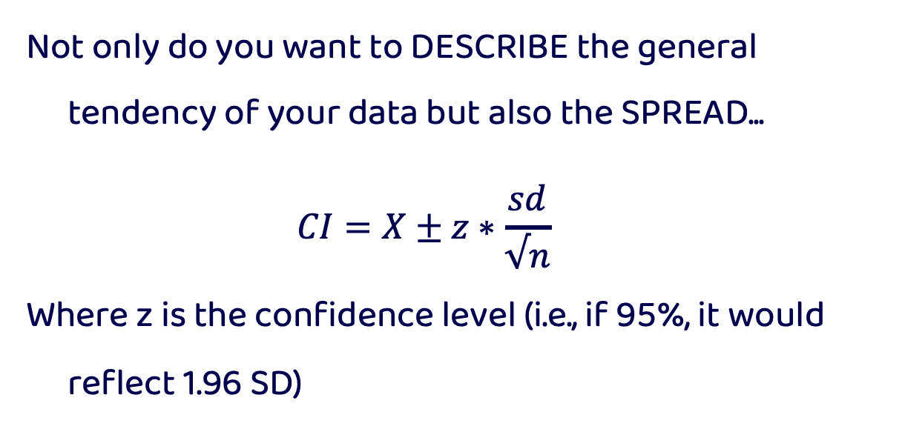
Confidence Intervals
Not only do you want to DESCRIBE the general tendency of your data but also the SPREAD...
$$CI=X±z∗\frac{sd}{√n}$$
Where z is the confidence level (i.e., if 95%, it would reflect 1.96 SD)

Slide 16
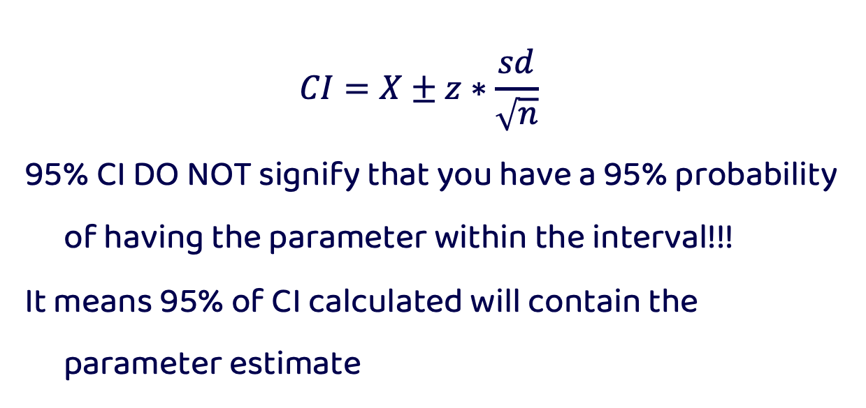
Confidence Intervals
$$CI=X±z∗\frac{sd}{\sqrt{n}}$$
95% CI DO NOT signify that you have a 95% probability of having the parameter within the interval!!!
It means 95% of CI calculated will contain the parameter estimate

Slide 17

Plotting

Slide 18
Plotting Tips
The first thing you need to consider when plotting is your message, the audience, and type of plot
Making a graphic is always helpful for a reader but not always necessary. Can you say this image in words?
Notes:
https://journals.plos.org/ploscompbiol/article?id=10.1371/journal.pcbi.1003833

Slide 19
Plotting Tips
In a general sense the type of plot you pick is very important
Bar plots and line graphs are simple and effective ways to convey a message and are readable by almost all audiences … but they are not always the best option
Notes:
https://journals.plos.org/ploscompbiol/article?id=10.1371/journal.pcbi.1003833

Slide 20
Plotting Tips
It is important to remember there is a wide range of scientific literacy in the world
Your audience may not be accustomed to reading plots, especially complex ones
Notes:
https://journals.plos.org/ploscompbiol/article?id=10.1371/journal.pcbi.1003833

Slide 21
Plotting Tips
Try plotting information with the least amount of ink as possible
Do not overcrowd graphs, give each one room to breath
Colour choice is important and can make figures misleading
Notes:
https://journals.plos.org/ploscompbiol/article?id=10.1371/journal.pcbi.1003833

Slide 22
Plotting Tips
Do not mislead readers, be careful about adjusting axes to exaggerate effects
Label everything clearly including axes and units
Always plot confidence intervals or a measure of data spread / uncertainty
Notes:
https://journals.plos.org/ploscompbiol/article?id=10.1371/journal.pcbi.1003833

Slide 23
Plotting Tips
Your plot should highlight your data in the best way possible: do not plot a histogram for a binary outcome variable or a bar plot if your data is continuous
Notes:
https://journals.plos.org/ploscompbiol/article?id=10.1371/journal.pcbi.1003833

Slide 24
Plots tell a story
Notes:
https://journals.plos.org/ploscompbiol/article?id=10.1371/journal.pcbi.1003833

Slide 25
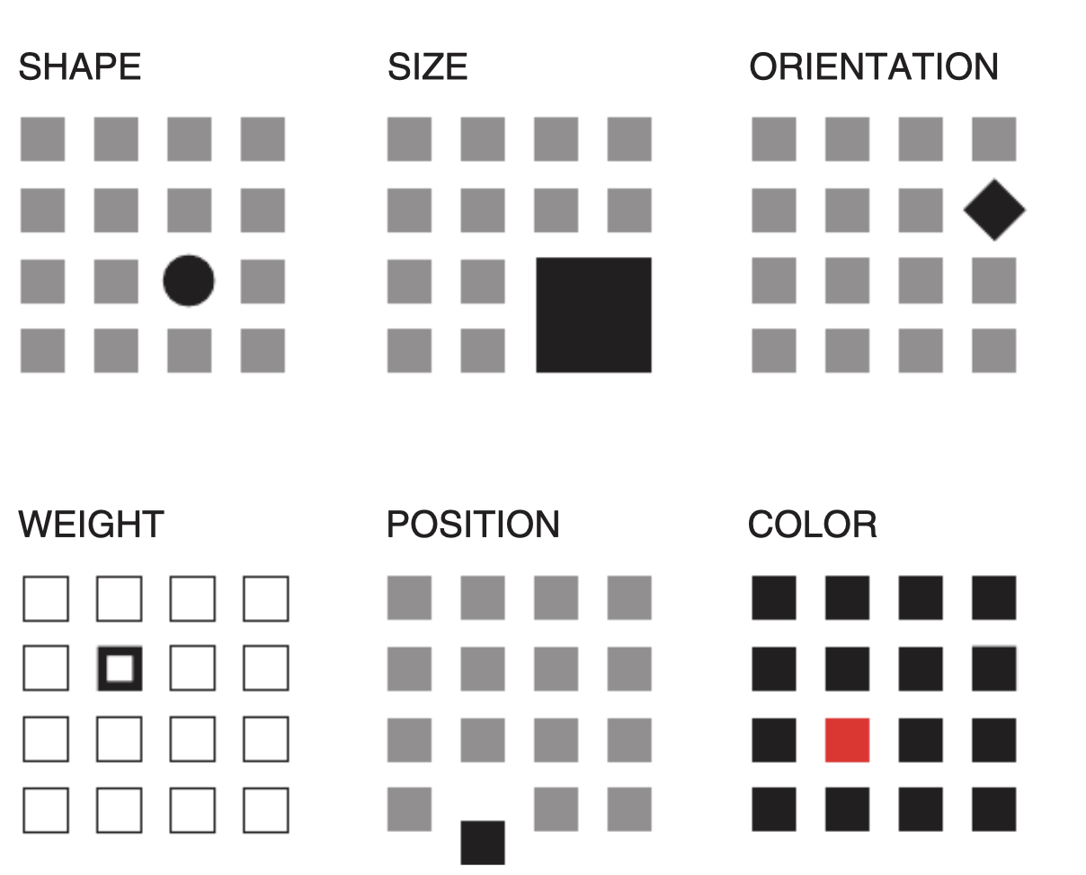
Plotting Tips
Rolandi et al., 2011
Notes:
https://journals.plos.org/ploscompbiol/article?id=10.1371/journal.pcbi.1003833

Slide 26
Plot function
The plot() function in MATLAB takes in x, y values and returns a line plot. Each element of the plot can be manipulated using different specifiers

Slide 27
Plot function
After running plot() you can manually alter aspects of the resulting figure
Xlabel(‘time’)
Ylabel(‘money’)
Title(‘Time is money’)

Slide 28
Plot function
If you have provided multiple sets of information to the plot function or a matrix, you can use the legend() function to label each element you’ve plotted
Plot() assumes the rows are observations and the columns are the different conditions for the legend

Slide 29
Plot Colours
You can change the colour of your lines by specifying one of the following colours from the table
e.g., plot(x, y, ‘r’)
you can also specify RGB values using a specifier, see below
y | yellow
m | magenta
c | cyan
r | red
g | green
b | blue
w | white
k | black

Slide 30
Plot Markers
'o' | Circle
'+' | Plus sign
'*' | Asterisk
'.' | Point
'x' | Cross
'_' | Horizontal line
'|' | Vertical line
's' | Square
'd' | Diamond
'^' | Upward-pointing triangle
'v' | Downward-pointing triangle
'>' | Right-pointing triangle
'<' | Left-pointing triangle
'p' | Pentagram
'h' | Hexagram
You can change the markers of your data by specifying one of these
e.g., plot(x, y, ‘x’)

Slide 31
Plot Lines
You can change the appearance of the lines of a plot() by specifying one of these and can be combined with markers and colours
e.g., plot(x, y, ‘-.’ )
plot(x, y, ‘x-.r’)
- | Solid line
-- | Dashed line
: | Dotted line
-. | Dash-dot line

Slide 32
Plot other specifiers
‘MarkerSize’, size
‘LineWidth’, size
‘MarkerEdgeColor’, [ R G B alpha]
‘MarkerFaceColor’, [ R G B alpha]
‘Color’, [ R G B alpha]
Etc…
(potential to make a MATLAB plotting cookbook in future)

Slide 33
Figure and close all
I always recommend you begin a new graph with the figure command; this ensures that you are not overwriting any previous information you’ve plotted before
Reminder that close() can be used to close currently opened figures

Slide 34
Hold on / off
The command hold on allows one to add to the existing axes of a plot you just made. It is like adding another layer.
This does not need to be the same type of plot
Hold off removes this hold on the figure’s axes and allows you to overwrite them

Slide 35
Other Line plots
If you would like to plot your data in log-log space you can use the function loglog() which works essentially the same way that plot does
Useful when data is decaying or exponentially growing

Slide 36
Error Bars
It is always important to give the reader a sense of how uncertain a measure is, whether that be std, std error, or CI
To plot error bars in MATLAB use the function errorbar()

Slide 37
Error Bars
errorbar() takes the x, y, and error
All specifiers are like plot() except for ‘CapSize’
Use ‘LineStyle’ to remove line between x values this allows you to plot the error bars separately from the underlying graph

Slide 38
Bar graphs
Creates bar plots, see examples in code
Special specifier ‘stacked’
Can use xticks and xlabels to relabel the x-axsis or change the number of ticks (same for yticks)

Slide 39
Plot but make it fashion
There are many toolboxes in addition to the basic functions of MATLAB, some are developed by MATLAB and others are external and need downloading

Slide 40
Histograms
Allows you to visualize distributions of data
histogram(X, nbins)
‘BarWidth’
‘FaceColor’
‘FaceAlpha’

Slide 41
Scatter
Scatter plot of data inputs take x and y
Same colour and marker specifiers as plot
‘filled’ to colour in marker

Slide 42
Other plots
Loglog, semilogx, semilogy
Boxchart, barh, stairs
Imagesc, polarhistogram

Slide 43

Gramm
I’m not a regular graph, I’m a cool graph

Slide 44
Gramm
Toolbox developed to extend MATLAB’s graphing capacities. The code runs much like ggplot in R, whereby data is fed into the gramm function and each layer of the graph is added on top
See below for a cheat sheet summarizing gramm’s capacities
https://github.com/piermorel/gramm/raw/master/gramm%20cheat%20sheet.pdf

Slide 45
Gramm
Gramm example script:
g=gramm('x',cars.Model_Year,'y',cars.MPG,'color',cars.Cylinders,'subset',cars.Cylinders~=3 & cars.Cylinders~=5);
g.facet_grid([],cars.Origin_Region);
g.geom_point();
g.stat_glm();
g.set_names('column','Origin','x','Year of production','y','Fuel economy (MPG)','color','# Cylinders’);
g.set_title('Fuel economy of new cars between 1970 and 1982’);
Figure('Position',[100 100 800 400]);
g.draw();
See example on their website

Slide 46
References
Rolandi et al 2011. A Brief Guide to Designing Effective Figures for the Scientific Paper. Advanced Materials
Rougier et al 2014. Ten Simple Rules for Better Figures. Plos Computational Biology
Nature blog http://blogs.nature.com/methagora/2013/07/data-visualization-points-of-view.html

