Slide 1
MATLAB
Class 5: statistics basics

Slide 2
Statistics aims to understand your data by describing it and making predictions

Slide 3
Descriptive stats aims to describe data’s distribution by central tendency (location in a plane) and dispersion (spread) around the location

Slide 4
Inferential stats aims to predict future outcomes or observations based on your data

Slide 5
Useful descriptive stats and associated functions

Slide 6
Correlations
Correlations is the relationship between any two variables
They can be described in different ways:
Pearson—linear relationship between continuous variables
Spearman Rho—nonparametric rank correlation, describing two variables as a monotonic function

Slide 7
Correlations in MATLAB
corr — returns a matrix of pairwise correlations between columns
corrcoef — Returns the correlation between vectorized matrices
corr2 — returns correlation coefficient for matrices (i.e., one value for its 2-d inputs)

Slide 8
Reminder: Reshape can help you
Reshape is a useful function to transform any sized matrix into a different shape
Reshape(X, [new dimensions])
Note that the new dimensions need to be consistent with the previous ones
i.e., dim1*dim2*dim3 == newdim1*newdim2 etc..

Slide 9
T-tests
Student t-test allows you to test mean differences between normal distributions
There are many different flavours of t’s
one-sample vs two samples
paired vs unpaired
one tail vs two

Slide 10
T-test
T-tests assume that your data come from a normal distribution and the observations are sampled independently from one another
These assumptions apply for both paired and unpaired test

Slide 11
T-tests
One-sample t-tests test the hypothesis that mean is different than a prespecified u0
Independent-sample t-tests test the hypothesis that the mean difference between both samples is not 0

Slide 12
T-tests
Paired t-tests are used when the observations are repeated, i.e., each person is sampled twice thus each observation comes in a pair
Unpaired t-tests are used when the observations are independent

Slide 13
T-tests
One tail tests are used when you have directional hypotheses (i.e., group A is bigger than group B)
Two tail tests are used when you have non-directional hypotheses (i.e., group A is different than group B, but you don’t care if it’s bigger or smaller)

Slide 14
T-tests
In MATLAB there are two functions for the student t-test
ttest() is used for one-sample and paired tests while ttest2() is used for independent sample (i.e., two-sample) tests

Slide 15
Ttest()
One sample and paired t-tests
Ttest(x) runs a one-sampled t-test against zero
Ttest(x, y) paired t-test
‘Alpha’
‘Tail’ can specify ‘left’, ‘right’, ‘both’

Slide 16
Ttest2()
Ttest2() runs a two independent samples t-test.
Has the same specifiers as ttest() including:
‘Dim’ to specify a dimension along which to run the test and ‘Vartype’ for ‘equal’ and ’unequal’ variances

Slide 17
T-tests
Given the same number of data which type of t-test is more stringent? Which one requires a bigger mean diff for the same value of t?

Slide 18
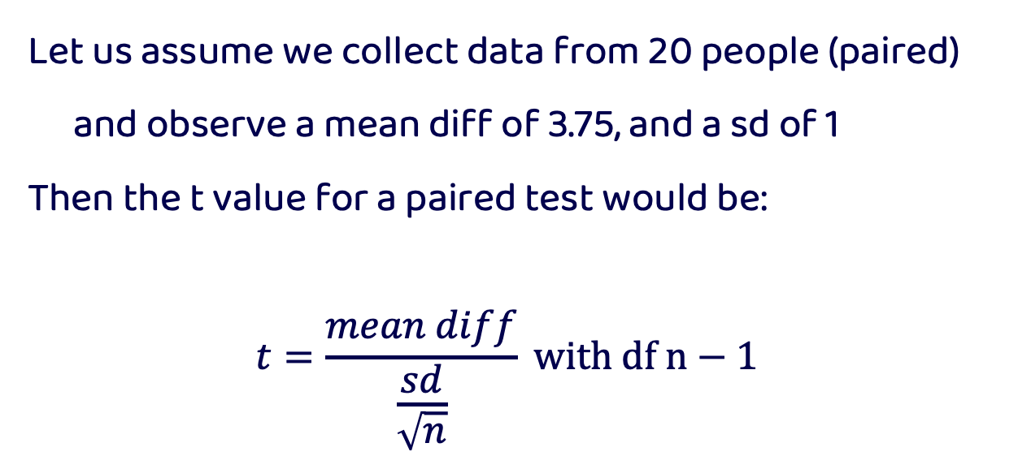
T-tests
Let us assume we collect data from 20 people (paired) and observe a mean diff of 3.75, and a sd of 1
Then the t value for a paired test would be:
$$t=\frac{mean diff}{\frac{sd}{\sqrt{n}}} with df n−1$$

Slide 19
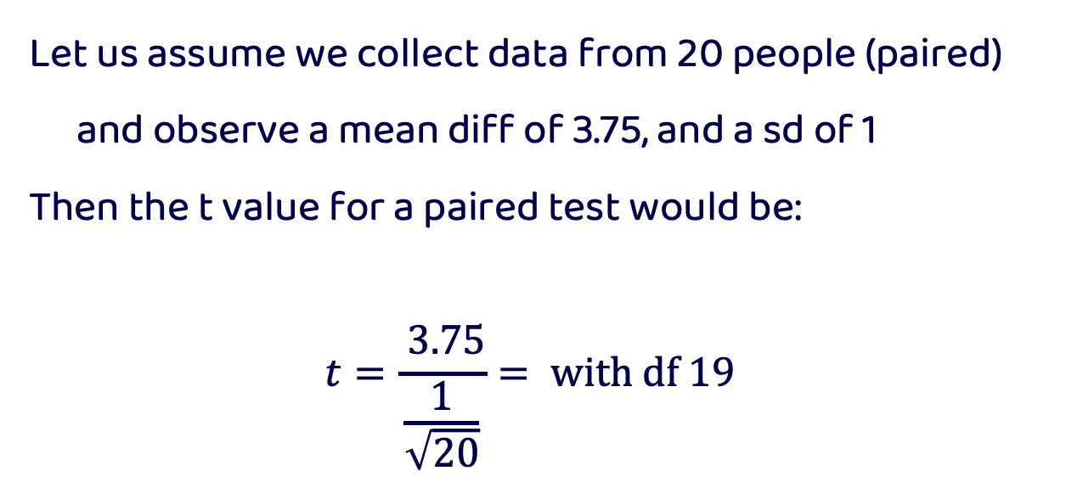
T-tests
Let us assume we collect data from 20 people (paired) and observe a mean diff of 3.75, and a sd of 1
Then the t value for a paired test would be:
$$t=\frac{ 3.75}{\frac{1}{\sqrt{20}}}= with df 19$$

Slide 20
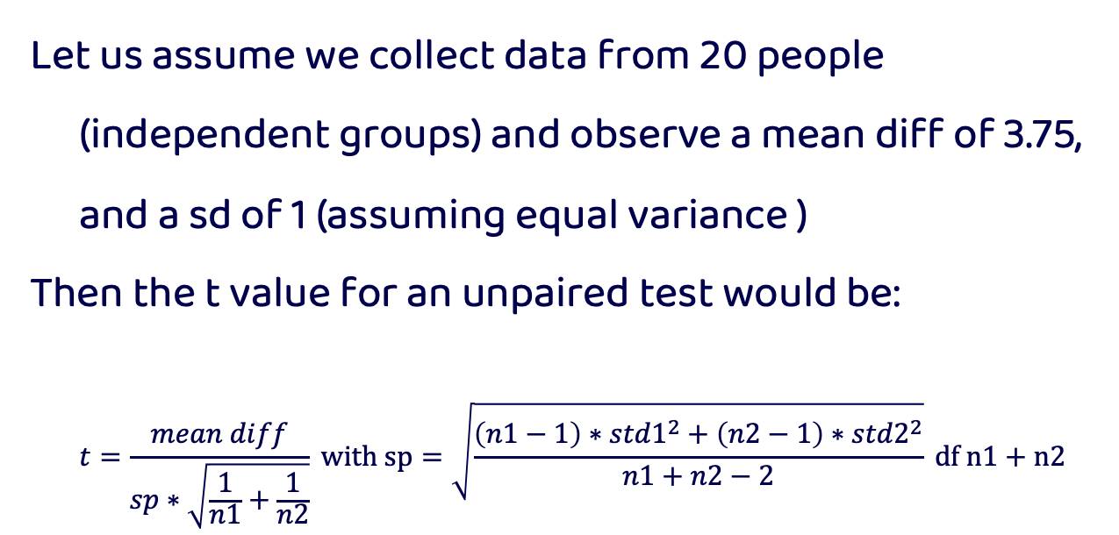
T-tests
Let us assume we collect data from 20 people (independent groups) and observe a mean diff of 3.75, and a sd of 1 (assuming equal variance )
Then the t value for an unpaired test would be:
$$t=\frac{mean diff}{sp∗\sqrt{\frac{1}{n1}+\frac{1}{n2}}} with sp=\sqrt{\frac{\left(n1−1\right)∗{std1}^{2}+\left(n2−1\right)∗{std2}^{2}}{n1+n2−2}} df n1+n2−2$$

Slide 21
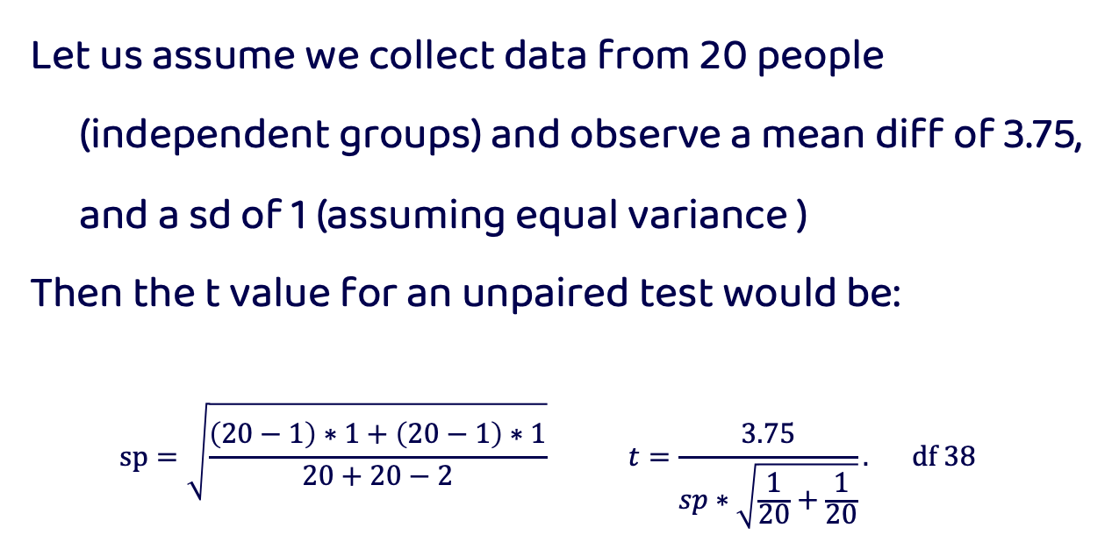
T-tests
Let us assume we collect data from 20 people (independent groups) and observe a mean diff of 3.75, and a sd of 1 (assuming equal variance )
Then the t value for an unpaired test would be:
$$sp=\sqrt{\frac{\left(20−1\right)∗1+\left(20−1\right)∗1}{20+20−2}} t=\frac{3.75}{sp∗\sqrt{\frac{1}{20}+\frac{1}{20}}}. df 38$$

Slide 22
T-tests
T value for paired is larger, in comparison to t values of unpaired or independent tests
This is because within-person designs have more power as they control for more noise by observing the same person twice

Slide 23
Non-parametric tests
In stats there are some tests that are non-parametric, by this statisticians mean that the test does not require assuming a specific model or distribution for your data
These are sometimes referred to as non-distributional tests
These tests are used when you do not want to assume a specific distribution (e.g., violation), or do not know the distribution of your data

Slide 24
Non-parametric t-tests
Regular t-tests assume your data is normally distributed
There is a non-parametric equivalent of a t-test called the permutation t-test. This test works on the premise that you can observe a null distribution from your own data by randomly permuting groups.
Reminder: a null distribution is the distribution when the null hypothesis is true

Slide 25
permutations
Group A Group B
Permutations build a null distribution of data based on your observations under the assumption that randomly shuffling your data will void the effect of interest. Thus, you can measure how surprising the effect you observe is given your data based on the computed null distribution
A
B
Permute data
A
B

Slide 26
permutations
Group A Group B
This technique is very similar to bootstrapping without replacement (i.e., no duplicate observations).
A
B
Permute data
A
B

Slide 27
permutations
Group A Group B
A
B
Permute data
A
B

Slide 28
Bootstrapping
A very similar concept in statistics is the idea of bootstrapping to get a measure of uncertainty around an estimate (e.g., CI)
Bootstrapping is like permutations in that they resample your data, however bootstrapping requires replacement
It is often used to calculate the error associated to an estimate, effect, or performance of an algorithm and allows you to know if one given data point is driving the effect you see

Slide 29
Bootstrapping
Bootstrapping is like permutations in that they resample your data, however bootstrapping requires replacement
A
B1
B2
B3
Avg _{obs}
Avg _{b1}
Avg _{b2}
Avg _{b3}

Slide 30
Bootstrapping
The computed Avg for each bootstrap will allow you to get an idea of what range of values you could expect given your data
A
B1
B2
B3
Avg _{obs}
Avg _{b1}
Avg _{b2}
Avg _{b3}

Slide 31
ANOVA
Analysis of Variance is a linear model to test if there is a difference between two or more means (i.e., groups sometimes called levels)
Let us start with a one-way ANOVA

Slide 32
ANOVA
One-way ANOVA (i.e., one FACTOR)
Test the difference between groups (levels). It answers the question:
Are the group means spread out much more than what you’d expect if you had sampled all the groups from the same distribution?

Slide 33
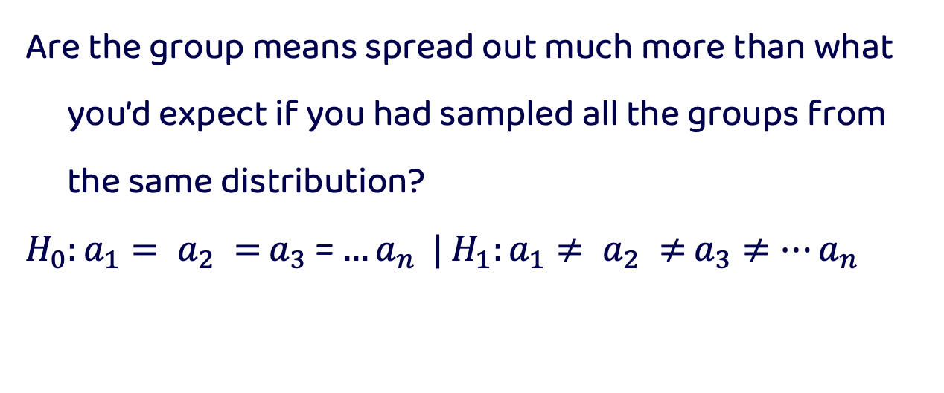
ANOVA
Are the group means spread out much more than what you’d expect if you had sampled all the groups from the same distribution?
$H_{0}:a_{1}= a_{2} =$ $a_{3}$= $…a_{n} |$ $H_{1}:a_{1}≠ a_{2} ≠$ $a_{3}≠…a_{n}$

Slide 34
ANOVA
Assumptions of a One-way ANOVA:
Normality of data
Homogeneity of variances (all variances are born equal)
Independent samples

Slide 35
ANOVA
Normality of data
Can test this by visualizing your data / residuals (see regression) or by a Shapiro-Wilk test (see link)

Slide 36
ANOVA
Homogeneity of variances
Also called homoscedasticity can be assessed visually or with a Bartlett test (see code)
This is a more ’serious’ assumption to break when running an ANOVA

Slide 37
ANOVA
Independence
We assume our observations are independent of one another. This may be broken when the observations are taken from the same subject (repeated measures) or when dependent variables are correlated (see regressions)

Slide 38
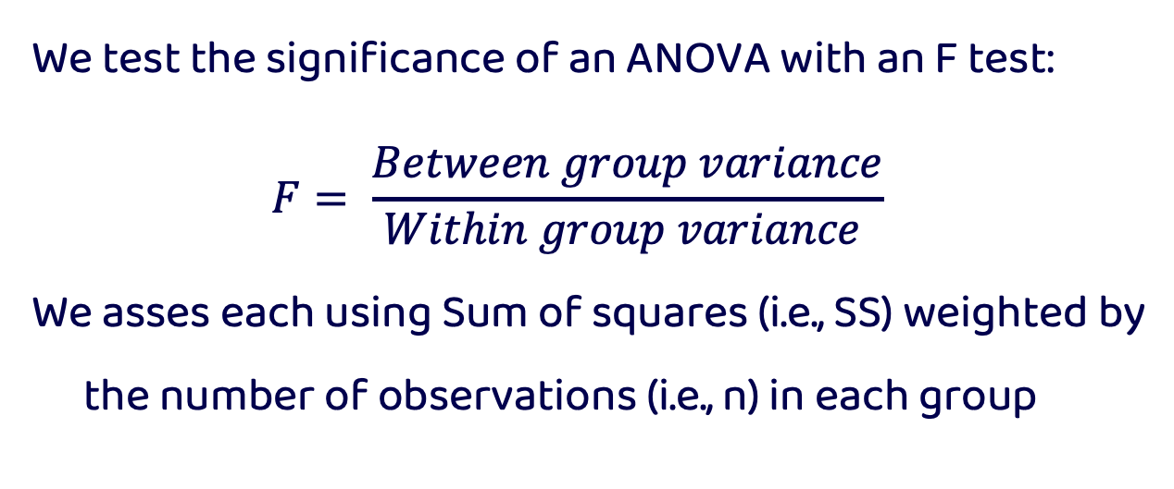
ANOVA
We test the significance of an ANOVA with an F test:
$$F= \frac{Between group variance}{Within group variance }$$
We asses each using Sum of squares (i.e., SS) weighted by the number of observations (i.e., n) in each group

Slide 39
ANOVA
Between-group SS
How spread apart are your group means
Within-group SS
How spread apart is each distribution
*** Note we always normalize these by their degrees of freedom
*** See code for visual depiction of an example with three means

Slide 40
ANOVA
How is a One-way ANOVA different from a t-test:
T-tests are used to test the difference between TWO means whereas ANOVAs test the difference between two or more means

Slide 41
ANOVA
How is a One-way ANOVA different from a t-test:
They both test slightly different questions: t-tests tells you if TWO means are different whereas an ANOVA will tell you if there are mean differences but NOT WHICH means are different

Slide 42
ANOVA
The ANOVA can be generalized to test multiple dependent variables like the Two-way ANOVA
With multiple factors / DV you can test interactions in what we call a ‘crossed’ model where every group A co-occurs with every group B

Slide 43
Crossed Two-way ANOVA
Factor / DV A
Factor / DV B
Group / Level 1A
Group / Level 2A
Group / Level 3A
Mariah
Halloween
Jlo
Halloween
Lady Gaga
Halloween
Group / Level 1B
Mariah
Christmas
Jlo
Christmas
Lady Gaga
Christmas
Group / Level 2B

Slide 44
ANOVA
Post-hoc testing:
After you are certain that the means differ, what next? Sometimes you need to do additional tests, and sometimes you don’t. This all depends on your underlying question!!!

Slide 45
ANOVA
Post-hoc testing: NOT ALWAYS NECESSARY
In some cases, we just care that the means of our groups are different and not which differ from one another. When we have two groups, we know that they are different, no additional test is needed.

Slide 46
ANCOVA
There are many iterations of an ANOVA including the analysis of covariance!
Here we test the INDEPENDENT effect of dependent variables (factors) regardless of COVARIATES of no interest (referred to as nuisance variables)
*** we will cover this idea in more detail in the regression slides!

Slide 47
Signal Detection Theory
An analytic tool used to analyze data in it’s ability to discriminate between two signals or signal and noise
Assumes there is an inherent uncertainty in the classification
We will look at the case where there are two classes to categorize

Slide 48
Signal Detection Theory
There are two parameters that describe signal detection theory
The criterion: where you draw the boundary between signal and noise
Sensitivity: one’s ability to discriminate between signal and noise

Slide 49
Signal Detection Theory

Slide 50
Signal Detection Theory
D prime or sensitivity
criterion

Slide 51
Signal Detection Theory
Present Absent | Signal Noise
 | Hits | False Alarms
 | Misses | Correct Rejection

Slide 52
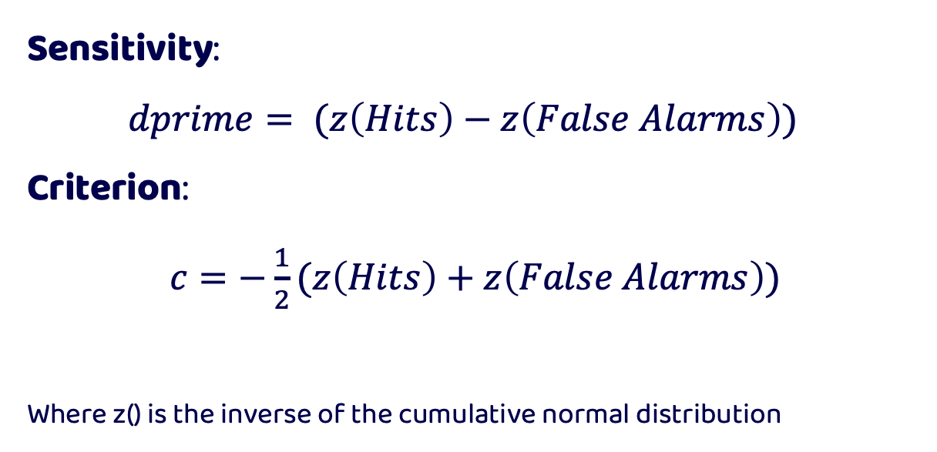
Signal Detection Theory
Sensitivity:
$dprime= (z\left(Hits\right)−z\left(False Alarms\right))$
Criterion:
$c=−\frac{1}{2}(z\left(Hits\right)+z\left(False Alarms\right))$
Where z() is the inverse of the cumulative normal distribution

Slide 53
Signal Detection Theory
What to do when you get values of 0 or 1 as probabilities?
You cannot take the inverse cumulative normal distribution of 0 or 1 as it returns infinite values.
We therefore must apply a correction to our data

Slide 54
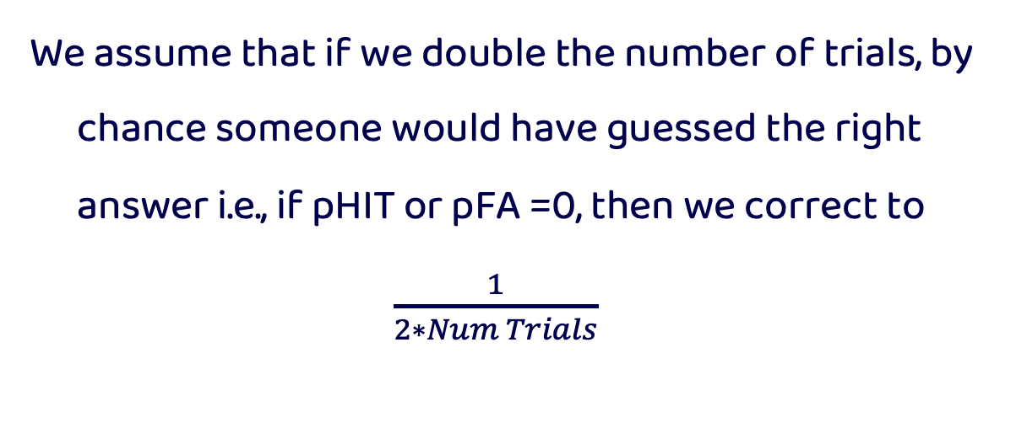
Signal Detection Theory
We assume that if we double the number of trials, by chance someone would have guessed the right answer i.e., if pHIT or pFA =0, then we correct to
$\frac{1}{2∗Num Trials}$

Slide 55
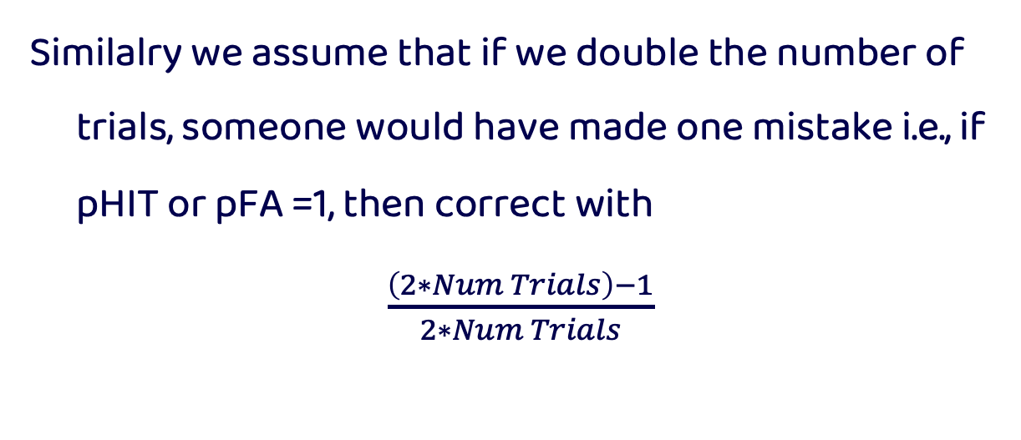
Signal Detection Theory
Similalry we assume that if we double the number of trials, someone would have made one mistake i.e., if pHIT or pFA =1, then correct with
$\frac{\left(2∗Num Trials\right)−1}{2∗Num Trials}$

Slide 56
Receiver Operating Characteristic Curves
Is a diagnostic plot that helps visualize the ability of a binary classifier to separate two classes
This is achieved by plotting the rate of True Positives against false positives

Slide 57
Receiver Operating Characteristic Curves

Slide 58
Receiver Operating Characteristic Curves

Slide 59
Receiver Operating Characteristic Curves

Slide 60
Receiver Operating Characteristic Curves

Slide 61
Receiver Operating Characteristic Curves

Slide 62
Receiver Operating Characteristic Curves

Slide 63
Area Under the Curve
Measures the area under the ROC curve and reflects one’s ability to classify classes given a variable
AUC of 1 or 0 is perfect classification while 0.5 is chance level (i.e., along the diagonal)

Slide 64
Area Under the Curve

Slide 65
ROC in MATLAB
[X,Y,T,AUC] = perfcurve( labels, scores, posclass)
labels—the two classes to be discriminated
scores—the ‘x’ values used in discrimination
posclass—which class is larger of the two

Slide 66
ROC in MATLAB
[X,Y,T,AUC] = perfcurve( labels, scores, posclass)
X— x values of ROC curve
Y— y values of ROC curve
T—array of thresholds used
AUC—returns the value of AUC

