Slide 1
MATLAB
Class 2: Basics part 2

Slide 2
Sets
All I want for Christmas is you
Always be my baby
We belong together
Joy to the world
Open arms
Obsessed
My all
Emotions
Forever
Fantasy
Make it happen
Honey
Shake it off
Vision of love
Jason
Kevin

Slide 3
Sets
All I want for Christmas is you
Always be my baby
We belong together
Joy to the world
Open arms
Obsessed
My all
Emotions
Forever
Fantasy
Make it happen
Honey
Shake it off
Vision of love
Jason
Kevin

Slide 4
Sets
All I want for Christmas is you
Always be my baby
We belong together
Joy to the world
Open arms
Obsessed
My all
Emotions
Forever
Fantasy
Make it happen
Honey
Shake it off
Vision of love
Jason
Kevin

Slide 5
Sets
All I want for Christmas is you
Always be my baby
We belong together
Joy to the world
Open arms
Obsessed
My all
Emotions
Forever
Fantasy
Make it happen
Honey
Shake it off
Vision of love
Jason
Kevin

Slide 6
Set operations
Ismember — checks is element is inside set
Setdiff — looks for the elements not unique to both sets
Intersect — returns the elements unique to both sets
Union — joins two sets

Slide 7
Data Structures
Structs
Tables
Cells
Object with fields used in object-oriented programing
Matrix that can hold DIFFERENT types
Container that can hold ANY information

Slide 8
Tables
Keeps information in a neat fashion of different types, much like an excel sheet or a dataframe in R
Useful when you have a matrix but need to store info of different types
Cannot do matrix math on these
Each column will contain info of the SAME type

Slide 9
Structs
Object that contains several fields: i.e., a student has a
Student.name
Student.age
Student.GPA
Student.FavMariahSong
Student.Thesis

Slide 10
Cells
The most flexible of data structures in MATLAB
Holds any information you’d like in a cell
Indexable with same rules of matrices c{1,2}
Can contain different types in each cell regardless of its neighbours (i.e., columns and rows)

Slide 11

Cells
Indexing into cells works a little different…
I’m not a regular index (1,2), I’m a cool index {1,2}

Slide 12
Cells
Indexing a cell array is a lot like a regular array
Yet there is a key difference between c(1,2) and c{1,2}
The latter indexes the contents of the cell, the former indexes the cell itself
Note: you can index an array after indexing a cell c{1,1}(1)

Slide 13
Cell Operators
To help visualize your cell structure and the contents it holds use cellpolt()
You can also convert between cells, structs, matrices, etc given that data conversion is possible

Slide 14
Cell FUN
Applies a function to each cell of a cell array, very useful tool when working with data of different lengths
cellfun( function, cellarray)

Slide 15
Conditionals and flow of logic
Sometimes we want something to happen only IF a criterion is true or a specific CASE is met
For example:
we only want to include subjects IF their Ids are odd
we only want to warn users in CASE of an error

Slide 16
REMINDER: Boolean Operators
How can we ask the computer a question:
Is equal to ==
Is greater than >
Is less than <
Is NOT equal to ~=
The OR operator ||
The AND operator &&

Slide 17
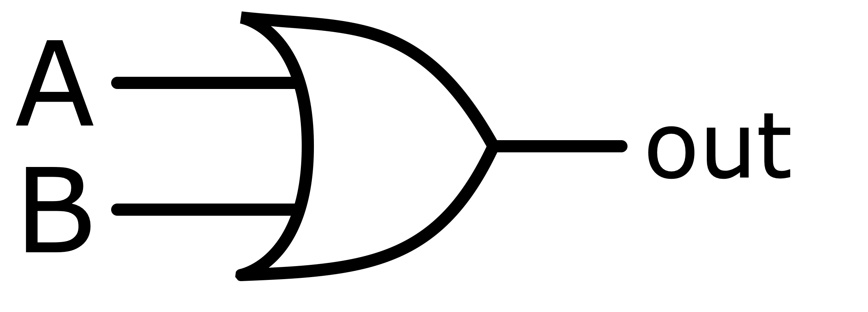
Boolean Operators
Two very special operators: AND and OR

Slide 18
Boolean Operators
Two very special operators: AND and OR
AND

Slide 19
Boolean Operators
Two very special operators: AND and OR
OR

Slide 20
IF & SWITCH statement
These are the gate keepers/ decision makers of your code
These functions allow you to branch your code depending on conditions

Slide 21
IF & SWITCH statement
True
code inside the if statement
IF
Code after the if statement
False

Slide 22
Elseif
True
code inside the if statement
IF
False
Code after the if statement
else if
False
code inside the elseif statement
True

Slide 23
SWITCH statement
Useful when there are a finite number of acceptable inputs that you want to check the value of
Works exactly like an if but with cases, if a case is not met you move on to the next

Slide 24
LOOPS
We also might want to repeat lines of code several times
Instead of copying and pasting code 100 times we can use loops

Slide 25
For LOOPS
For variable_name = values to iterate over
Do STUFF in here……
end

Slide 26
While LOOPS
while conditional statement
Do STUFF in here……
end

Slide 27
While LOOPS
while conditional statement
Do STUFF in here……
end

Slide 28
While LOOPS
while conditional statement
Do STUFF in here……
end

Slide 29
While LOOPS
while conditional statement
Do STUFF in here……
end

Slide 30
While LOOPS
while conditional statement
Remember you need to update the value of the conditional such that it will terminate after a given point
end

Slide 31
While LOOPS
while conditional statement
If you do not update the conditional you will have an infinite loop
end

Slide 32
Try catch
Statements that control the flow of the code
Very useful when debugging or trying to ‘foolproof’ your code
Will try an assignment or function call and return an error. Does not stop the execution of your code!

