Slide 1
MATLAB
Class 6: statistics basics

Slide 2
Statistics aims to understand your data by describing it and making predictions

Slide 3
Descriptive stats aims to describe data’s distribution by central tendency (location in a plane) and dispersion (spread) around the location

Slide 4
Inferential stats aims to predict future outcomes or observations based on your data

Slide 5
Useful descriptive stats and associated functions

Slide 6
Data Structures
Median
Mean
Mode
Returns the middle value of array
Average value of array
Returns most common value of array

Slide 7
Data Structures
Median
Mean
Mode
Note: that for MATLAB V 2018b and newer you can use the input ‘all’ to take the mean, median, etc across ALL elements. Previously you need to script this
Returns the middle value of array
Average value of array
Returns most common value of array

Slide 8
Data Structures
Maxk
Max
Min(k)
Find the largest k elements of an array
Find largest elements of an array
Find the smallest (k) elements of an array

Slide 9
Data spread
range
STD
var
Difference between max and min
Computes standard deviation of array
Computes variance of array

Slide 10
Data spread
range
STD
var
Difference between max and min
prctile(x,p) returns the p percentile of the data vector X
Computes standard deviation of array
Computes variance of array

Slide 11
Dealing with missing data
Missing data in MATLAB generally takes the form of NaN values
You need to address these before running analysis
Ismissing()
Rmmissing

Slide 12
Dealing with outliers
You can manually check if there are any outliers in your data (e.g., check for data above 3 SD)
or you can use isoutlier()

Slide 13
Correlations
Correlations is the relationship between any two variables
They can be described in different ways:
Pearson—linear relationship between continuous variables
Spearman Rho—nonparametric rank correlation, describing two variables as a monotonic function

Slide 14
Correlations in MATLAB
corr — returns a matrix of pairwise correlations between columns
corrcoef — Returns the correlation between vectorized matrices
corr2 — returns correlation coefficient for matrices (i.e., one value for its 2-d inputs)

Slide 15
Reminder: Reshape can help you
Reshape is a useful function to transform any sized matrix into a different shape
Reshape(X, [new dimensions])
Note that the new dimensions need to be consistent with the previous ones
i.e., dim1*dim2*dim3 == newdim1*newdim2 etc..

Slide 16
T-tests
Student t-test allows you to test mean differences between normal distributions
There are many different flavours of t’s
one-sample vs two samples
paired vs unpaired
one tail vs two

Slide 17
T-test
T-tests assume that your data come from a normal distribution and the observations are sampled independently from one another
These assumptions apply for both paired and unpaired test

Slide 18
T-tests
One-sample t-tests test the hypothesis that mean is different than a prespecified u0
Independent-sample t-tests test the hypothesis that the mean difference between both samples is not 0

Slide 19
T-tests
Paired t-tests are used when the observations are repeated, i.e., each person is sampled twice thus each observation comes in a pair
Unpaired t-tests are used when the observations are independent

Slide 20
T-tests
One tail tests are used when you have directional hypotheses (i.e., group A is bigger than group B)
Two tail tests are used when you have non-directional hypotheses (i.e., group A is different than group B, but you don’t care if it’s bigger or smaller)

Slide 21
T-tests
In MATLAB there are two functions for the student t-test
ttest() is used for one-sample and paired tests while ttest2() is used for independent sample (i.e., two-sample) tests

Slide 22
Ttest()
One sample and paired t-tests
Ttest(x) runs a one-sampled t-test against zero
Ttest(x, y) paired t-test
‘Alpha’
‘Tail’ can specify ‘left’, ‘right’, ‘both’

Slide 23
Ttest2()
Ttest2() runs a two independent samples t-test.
Has the same specifiers as ttest() including:
‘Dim’ to specify a dimension along which to run the test and ‘Vartype’ for ‘equal’ and ’unequal’ variances

Slide 24
T-tests
Given the same number of data which type of t-test is more stringent? Which one requires a bigger mean diff for the same value of t?

Slide 25
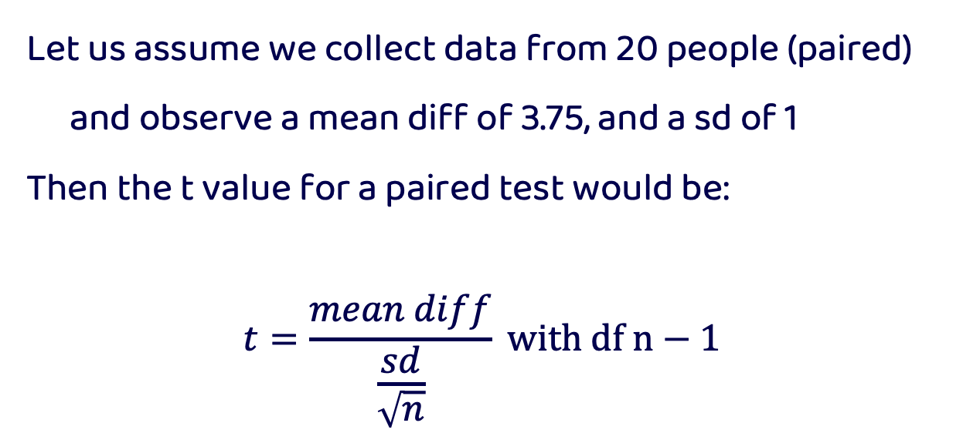
T-tests
Let us assume we collect data from 20 people (paired) and observe a mean diff of 3.75, and a sd of 1
Then the t value for a paired test would be:
$$t=\frac{mean diff}{\frac{sd}{\sqrt{n}}} with df n−1$$

Slide 26
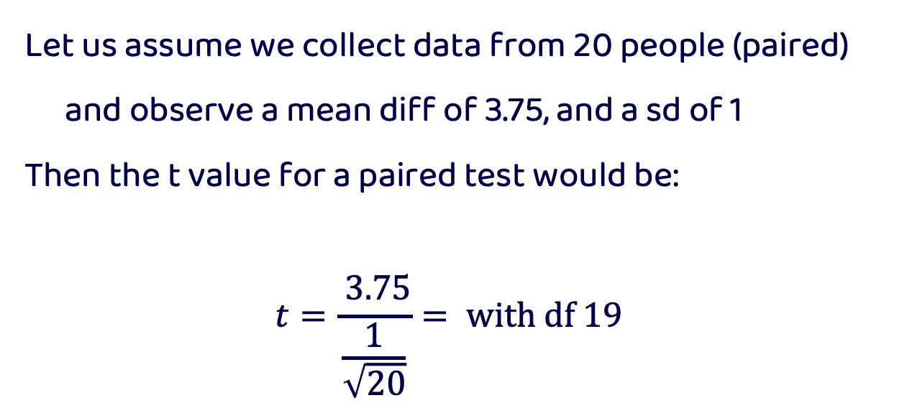
T-tests
Let us assume we collect data from 20 people (paired) and observe a mean diff of 3.75, and a sd of 1
Then the t value for a paired test would be:
$$t=\frac{ 3.75}{\frac{1}{\sqrt{20}}}= with df 19$$

Slide 27
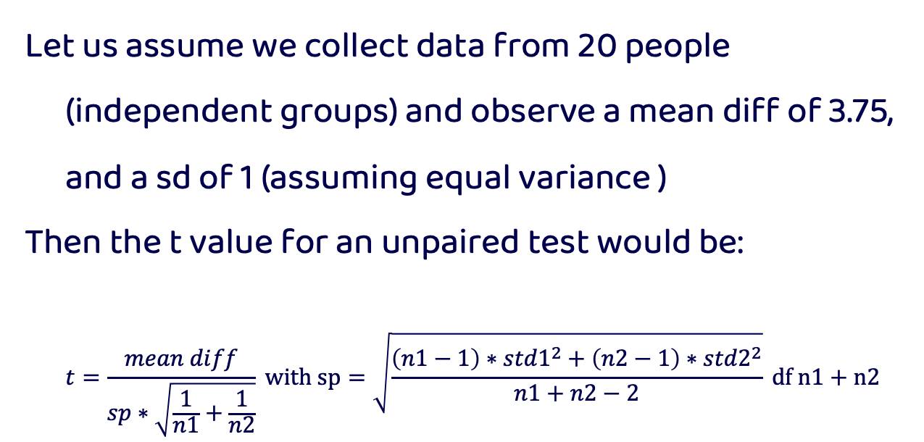
T-tests
Let us assume we collect data from 20 people (independent groups) and observe a mean diff of 3.75, and a sd of 1 (assuming equal variance )
Then the t value for an unpaired test would be:
$$t=\frac{mean diff}{sp∗\sqrt{\frac{1}{n1}+\frac{1}{n2}}} with sp=\sqrt{\frac{\left(n1−1\right)∗{std1}^{2}+\left(n2−1\right)∗{std2}^{2}}{n1+n2−2}} df n1+n2−2$$

Slide 28
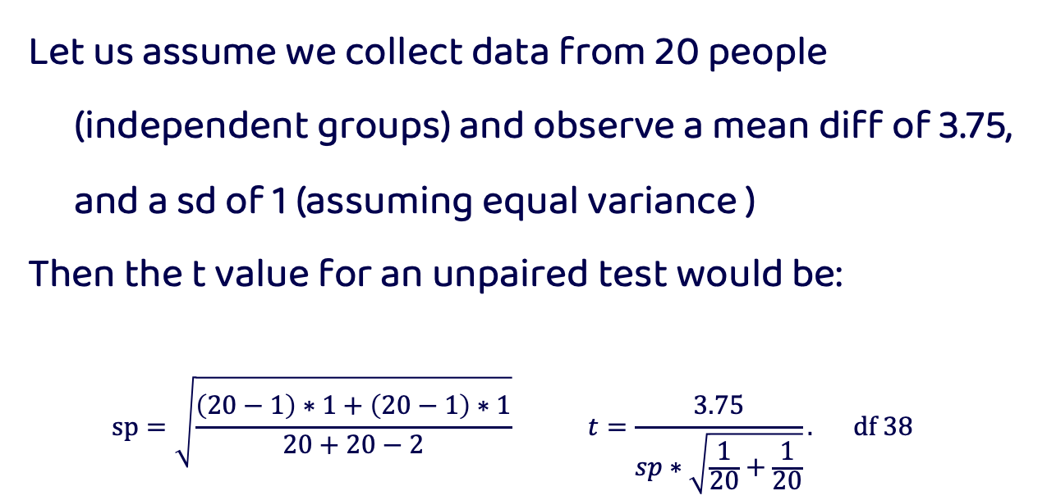
T-tests
Let us assume we collect data from 20 people (independent groups) and observe a mean diff of 3.75, and a sd of 1 (assuming equal variance )
Then the t value for an unpaired test would be:
$$sp=\sqrt{\frac{\left(20−1\right)∗1+\left(20−1\right)∗1}{20+20−2}} t=\frac{3.75}{sp∗\sqrt{\frac{1}{20}+\frac{1}{20}}}. df 38$$

Slide 29
T-tests
T value for paired is larger, in comparison to t values of unpaired or independent tests
This is because within-person designs have more power as they control for more noise by observing the same person twice

Slide 30
Non-parametric tests
In stats there are some tests that are non-parametric, by this statisticians mean that the test does not require assuming a specific model or distribution for your data
These are sometimes referred to as non-distributional tests
These tests are used when you do not want to assume a specific distribution (e.g., violation), or do not know the distribution of your data

Slide 31
Non-parametric t-tests
Regular t-tests assume your data is normally distributed
There is a non-parametric equivalent of a t-test called the permutation t-test. This test works on the premise that you can observe a null distribution from your own data by randomly permuting groups.
Reminder: a null distribution is the distribution when the null hypothesis is true

Slide 32
permutations
Group A Group B
Permutations build a null distribution of data based on your observations under the assumption that randomly shuffling your data will void the effect of interest. Thus, you can measure how surprising the effect you observe is given your data based on the computed null distribution
A
B
Permute data
A
B

Slide 33
permutations
Group A Group B
This technique is very similar to bootstrapping without replacement (i.e., no duplicate observations).
A
B
Permute data
A
B

Slide 34
permutations
Group A Group B
A
B
Permute data
A
B

Slide 35
Bootstrapping
A very similar concept in statistics is the idea of bootstrapping to get a measure of uncertainty around an estimate (e.g., CI)
Bootstrapping is like permutations in that they resample your data, however bootstrapping requires replacement
It is often used to calculate the error associated to an estimate, effect, or performance of an algorithm and allows you to know if one given data point is driving the effect you see

Slide 36
Bootstrapping
Bootstrapping is like permutations in that they resample your data, however bootstrapping requires replacement
A
B1
B2
B3
Avg _{obs}
Avg _{b1}
Avg _{b2}
Avg _{b3}

Slide 37
Bootstrapping
The computed Avg for each bootstrap will allow you to get an idea of what range of values you could expect given your data
A
B1
B2
B3
Avg _{obs}
Avg _{b1}
Avg _{b2}
Avg _{b3}

Slide 38
Signal Detection Theory
An analytic tool used to analyze data in it’s ability to discriminate between two signals or signal and noise
Assumes there is an inherent uncertainty in the classification
We will look at the case where there are two classes to categorize

Slide 39
Signal Detection Theory
There are two parameters that describe signal detection theory
The criterion: where you draw the boundary between signal and noise
Sensitivity: one’s ability to discriminate between signal and noise

Slide 40
Signal Detection Theory

Slide 41
Signal Detection Theory
D prime or sensitivity
criterion

Slide 42
Signal Detection Theory
Present Absent | Signal Noise
 | Hits | False Alarms
 | Misses | Correct Rejection

Slide 43
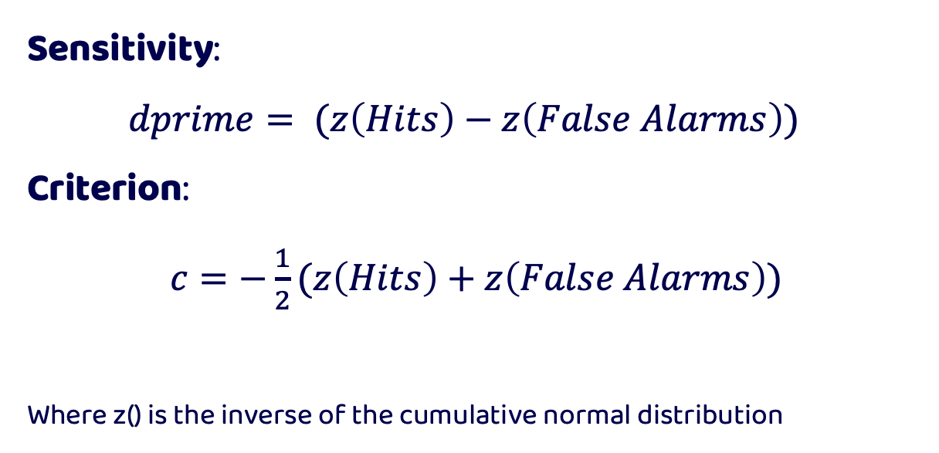
Signal Detection Theory
Sensitivity:
$dprime= (z\left(Hits\right)−z\left(False Alarms\right))$
Criterion:
$c=−\frac{1}{2}(z\left(Hits\right)+z\left(False Alarms\right))$
Where z() is the inverse of the cumulative normal distribution

Slide 44
Signal Detection Theory
What to do when you get values of 0 or 1 as probabilities?
You cannot take the inverse cumulative normal distribution of 0 or 1 as it returns infinite values.
We therefore must apply a correction to our data

Slide 45
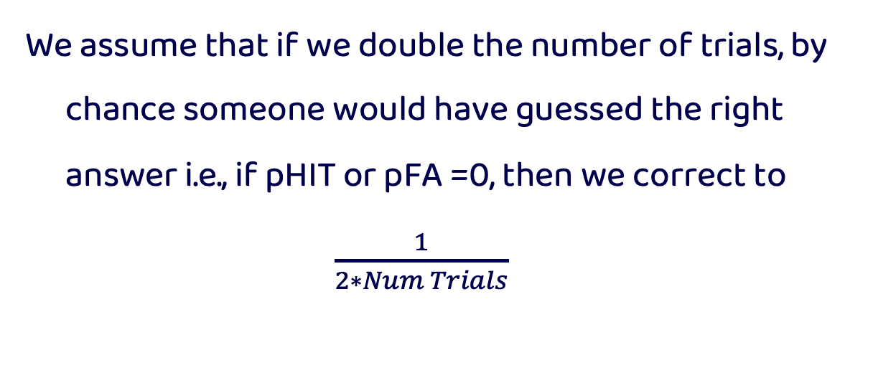
Signal Detection Theory
We assume that if we double the number of trials, by chance someone would have guessed the right answer i.e., if pHIT or pFA =0, then we correct to
$\frac{1}{2∗Num Trials}$

Slide 46
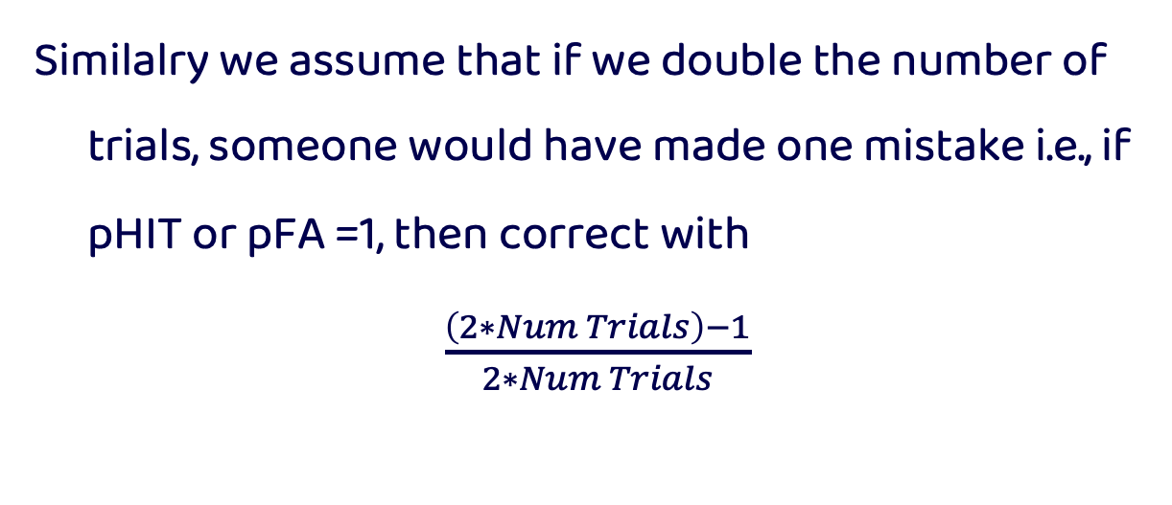
Signal Detection Theory
Similalry we assume that if we double the number of trials, someone would have made one mistake i.e., if pHIT or pFA =1, then correct with
$\frac{\left(2∗Num Trials\right)−1}{2∗Num Trials}$

Slide 47
Receiver Operating Characteristic Curves
Is a diagnostic plot that helps visualize the ability of a binary classifier to separate two classes
This is achieved by plotting the rate of True Positives against false positives

Slide 48
Receiver Operating Characteristic Curves

Slide 49
Receiver Operating Characteristic Curves

Slide 50
Receiver Operating Characteristic Curves

Slide 51
Receiver Operating Characteristic Curves

Slide 52
Receiver Operating Characteristic Curves

Slide 53
Receiver Operating Characteristic Curves

Slide 54
Area Under the Curve
Measures the area under the ROC curve and reflects one’s ability to classify classes given a variable
AUC of 1 or 0 is perfect classification while 0.5 is chance level (i.e., along the diagonal)

Slide 55
Area Under the Curve

Slide 56
ROC in MATLAB
[X,Y,T,AUC] = perfcurve( labels, scores, posclass)
labels—the two classes to be discriminated
scores—the ‘x’ values used in discrimination
posclass—which class is larger of the two

Slide 57
ROC in MATLAB
[X,Y,T,AUC] = perfcurve( labels, scores, posclass)
X— x values of ROC curve
Y— y values of ROC curve
T—array of thresholds used
AUC—returns the value of AUC

