Slide 1


CompTIA Linux+ V8 TTT Session 2:
Filesystem Navigation, Working with Text Files, File Management
September 11, 2025
@TeachCompTIA #Linux+TTT

Slide 2
Certificate of Attendance
Slides
Bios
Q&A
Call to Action
Multimedia
Today’s Resources
ON24 Help
Group Chat
Survey

Slide 3


Linux+ Team
Guest:
Jason Eckert
Dean of Technology
triOS College
jason.eckert@trios.com
Host:
Stephen Schneiter
Instructor Network Program Director
CompTIA
sschneiter@comptia.org

Slide 4



The CompTIA Instructor Network (CIN) is a worldwide community for instructors who provide CompTIA certification training.
Benefits of being a community member include:
Communicate and collaborate with CompTIA staff and other instructors.
Access resources for students to understand the value of getting certified.
Receive complimentary training and tools from CompTIA to enrich your classroom.
Become proficient at teaching CompTIA standards.
Share best practices and resources with each other.
https://cin.comptia.org

Slide 5




CIN The Pulse: Managing critical space cybersecurity: Guarding against the failure of imagination
What: One-hour webinar investigating concepts such as the different mindsets that OT and IT workers have, as well as implementing secure by design principles
When: Wednesday, October 1, 2025, 11:00 a.m. CDT (1 hour)
Where: ON24
Who: James Stanger, Chief Technology Evangelist, Renee Wynn, former CIO of NASA
Register: https://bit.ly/CIN-ThePulse-Oct25
@TeachCompTIA

Slide 6
Linux+ V8 TTT Session Outline
Date | Topic
09/09/2025 | Linux overview, setup, shell navigation, getting help
09/11/2025 | Filesystem navigation, working with text files, file management
09/16/2025 | File permissions, filesystem administration
09/18/2025 | Shell features (BASH), shell scripting, Python scripting, Git
09/23/2025 | System initialization, localization, compression, backup and software
09/25/2025 | Managing processes, kernel modules, users and logs
09/30/2025 | Network configuration and remote management
10/02/2025 | Configuring network services, cloud and automation (part 1)
10/07/2025 | Cloud and automation (part 2), security
10/09/2025 | Troubleshooting, performance , preparing for Linux+
✓
✓

Slide 7
Filesystem navigation

Slide 8
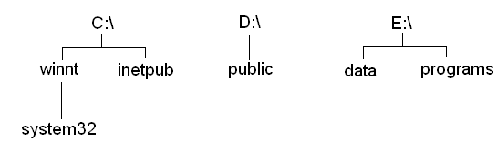
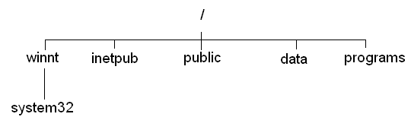
Filesystems & Mounting
C:\winnt\system32 C:\inetpub D:\public E:\data E:\programs /winnt/system32 /inetpub /public /data /programs

Slide 9
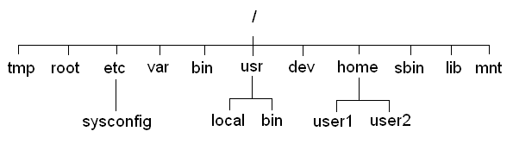
Filesystems & Mounting

Slide 10
/tmp | Stores temporary files used by programs
/root | The home directory for the "root" user
/etc | Contains most system configuration
/etc/sysconfig | Contains device and service specific system configuration
/var | Contains log files, spools and other files that vary between similar systems
/bin | Contains binary programs that any user may execute
/usr | Contains user software packages
/usr/local | Common location for installed software
/usr/bin | Contains binary programs that any user may execute
/dev | Contains pointers to device drivers in the kernel
/home/ | Default location for all regular user home directories
/home/user1 | The home directory for the user named "user1"
/home/user2 | The home directory for the user named "user2"
/sbin | Contains binary programs that only the superuser (root) may execute
/lib | Contains C program libraries
/mnt or /media | An empty directory used for mounting DVD and other removable media devices
/proc | A special (pseudo) filesystem in RAM that stores kernel, hardware and process info
/sys | A special (pseudo) filesystem in RAM that stores device info used by the Linux kernel

Slide 11
Viewing Directory Contents
Hidden files start with a . (period) – two special hidden files per directory: . current directory .. parent directory
pwd cd .. Relative pathname cd home/woot Relative pathname cd /home/woot Absolute pathname cd /etc/systemd/network cd /e[tab]/systn[tab]/n[tab]
cd ~bob cd ~ (or just cd)

Slide 12
Viewing Directory Contents
binary data files | Contain data in binary form
text files | Files which contain ASCII text
block device files | Represent a device driver in the Linux kernel that transfers data block by block (fast)
character (raw) device files | Represent a device driver in the Linux kernel that transfers data character by character
executable files | Files which have execute permission – they may be binary programs, or shell scripts
linked files | Files that are linked to other files on the filesystem; they may be shortcuts to other files (called symbolic links), or copies of other files (hard links) – discussed later!
directories | Special files that contain a list of files and subdirectories within them
named pipes | Files that allow one process to save to them while another process reads from them
sockets | Named pipes where one of the processes writes/reads from across a network

Slide 13
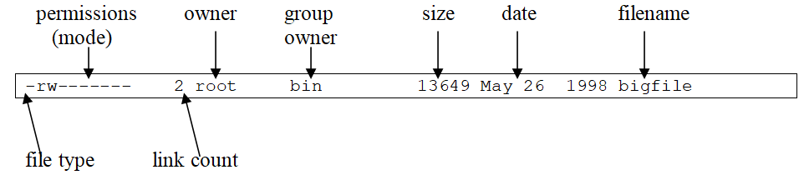
Viewing Directory Contents
255 characters, avoid metacharacters ( _ and – are fine, this$file is not)
cd classfiles dir ls ls –F letter (*execute, @symlink, /dir, |named pipe, =socket) ls –l letter (dir, block device, char device, named pipe, socket, symlink)

Slide 14
Viewing Directory Contents
ll letter (alias) stat letter file letter file pro* (wildcard)
ls –a (hidden) ls –R Poems (recursive)
tree
* | Specifies zero or more characters | let* matches let, let5, letter…..
? | Specifies one character (any character) | let? matches let1, let2, let3, letA…..
[1238] | Specifies one character (1,2,3 or 8 only) | let[12] matches let1 and let2
[!1238] | Specifies one character (anything except 1,2,3 or 8 only) | let[!12] matches let3, let4, letA…..
[a-zA-Z] | Specifies one character (an alphabetical character only) | let[A-C] matches letA, letB and letC
[0-9] | Specifies one character (a numeric character only) | let[1-3] matches let1, let2 and let3

Slide 15

working with text files

Slide 16
Viewing Text File Contents
cat proposal1 tac proposal1
cat proposal2 more proposal2 less proposal2 head letter head –2 letter tail –2 letter tail –f /var/log/logfilename
strings /bin/bash od –x /bin/bash
wc letter wc –l letter sort letter sort –r letter

Slide 17
Regular Expressions
* | Specifies zero or more of the previous character | let* matches le, let, lett, lettt…..
? | Specifies zero or one of the previous character | let? matches le and let
+ | Specifies one or more of the previous character | let+ matches let, lett, lettt……
. | Specifies one character (any character) | let. matches let1, let2, let3, letA…..
[1238] | Specifies one character (1,2,3 or 8 only) | let[12] matches let1 and let2
[^1238] | Specifies one character (anything except 1,2,3 or 8 only) | let[^12] matches let3, let4, letA…..
[a-zA-Z] | Specifies one character (an alphabetical character only) | let[A-C] matches letA, letB and letC
[0-9] | Specifies one character (a numeric character only) | let[1-3] matches let1, let2 and let3
{3} | Specifies three occurrences of the previous character | let{3} matches lettt
{1,3} | Specifies one to three occurrences of the previous character | let{1-3} matches let, lett and lettt
^hello | Matches the word hello if it is at the beginning of the line
hello$ | Matches the word hello if it is at the end of the line
(the|end) | Matches the word "the" or "end"
grep Mother letter grep –c Mother letter grep –v Mother letter grep –i mother letter grep t.e letter grep 'Sherman$' letter egrep '(Mother|Father)' letter fgrep Mother letter

Slide 18
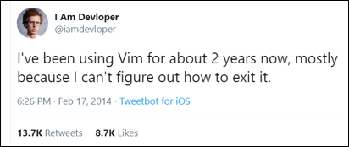
Editing Text Files
nano letter
vi letter
vim letter
dnf install vim (to get the full vim editor, including vimtutor)
vi ~/.vimrc (add a set number line)
Want to learn more? https://jasoneckert.github.io/myblog/how-to-learn-vi-vim/

Slide 19
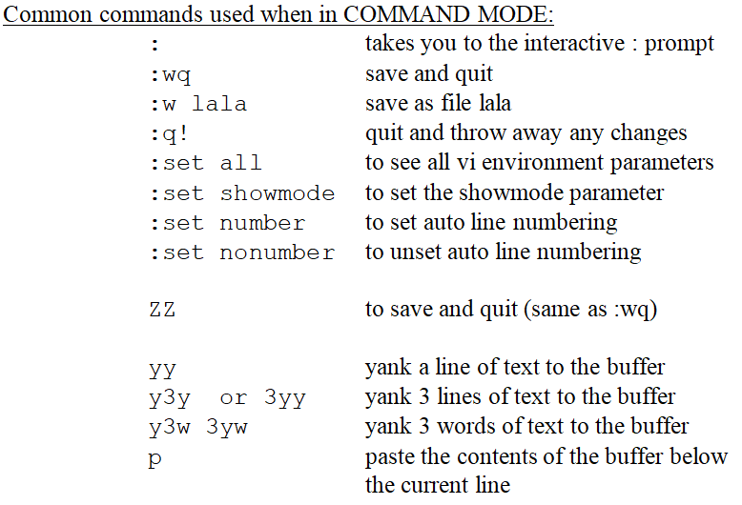
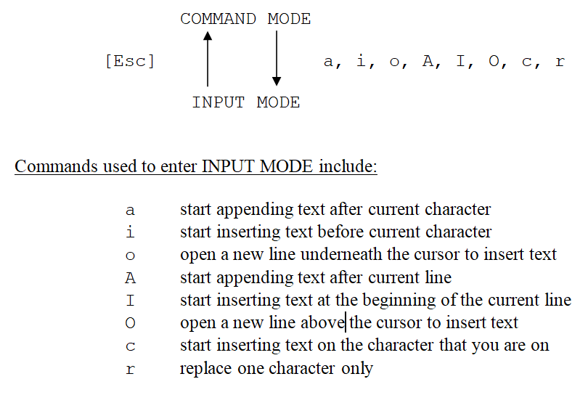
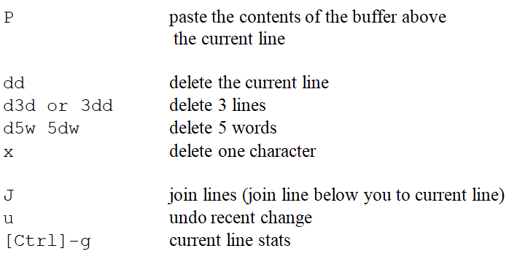
vi/vim Reference:

Slide 20
file management

Slide 21
Managing Files & Directories
cp letter /etc/sysconfig cp letter /etc/sysconfig/letter2 mv letter /etc/sysconfig (alias to view –i) rm –f /etc/sysconfig/letter* (or unlink) touch newletter mkdir lala mkdir lala/po mkdir –p lala/po rmdir lala (empty only) rm –R lala

Slide 22
Finding Files
locate hosts locate newletter updatedb (/var/lib/plocate/plocate.db) echo $PATH which grep (or whereis grep) find /directory –criteria value find /root –name “let*” find /home –user woot find /var –size +8192k find / –name “core” –exec rm {} \; -print

Slide 23
-atime -n -atime +n | Searches for files that were accessed less than n days ago Searches for files that were accessed more than n days ago
-group n | Searches for files who are owned by a certain group or GID (n)
-inum n | Searches for files who have an inode number of n
-ls | May be used with other search options to perform a long file listing for files and directories found during the search
-mtime -n -mtime +n | Searches for files that were modified less than n days ago Searches for files that were modified more than n days ago
-name n | Searches for a certain filename n (n may contain wildcards)
-perm n -perm -n -perm +n | Searches for files and directories that have a certain permission set of n (e.g. 600 or u=rw as described later) Searches for files and directories that contain at least the permissions described by n. Searches for files and directories that contain any of the permissions described by n.
-regexp n | Searches for certain filenames using regular expressions instead of wildcard metacharacters
-size -n -size n -size +n | Searches for files with a size less than n Searches for files with a size of n Searches for files with a size greater than n
-type n | Searches for files of type n where n is: b for block files c for character files d for directory files p for named pipes f for regular files l for symbolic links (shortcuts) s for sockets
-user n | Searches for files owned by a certain user or UID (n)

Slide 24
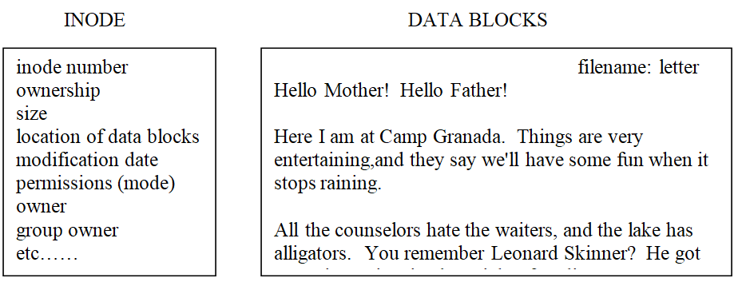
Linking Files
Hard links (same filesystem): same inode, increment the link count Symlinks (shortcuts): data section points to the target file/directory ln letter letterh ln –s letter letters ll –i letter* find . –inum _____

Slide 25
Homework Labs

Slide 26
Homework Labs
Refer to the optional exercises for this introductory session, available at https://github.com/jasoneckert/LinuxTTT: 3 - Session 2 Exercises - Working with Files

Slide 27

Discussion time: Please type your questions in chat
Questions over content.
Share you experience.
What would you like to see different moving forward?
Let’s keep the conversation going in the CompTIA Instructor Forum: https://cin.comptia.org

