Slide 1

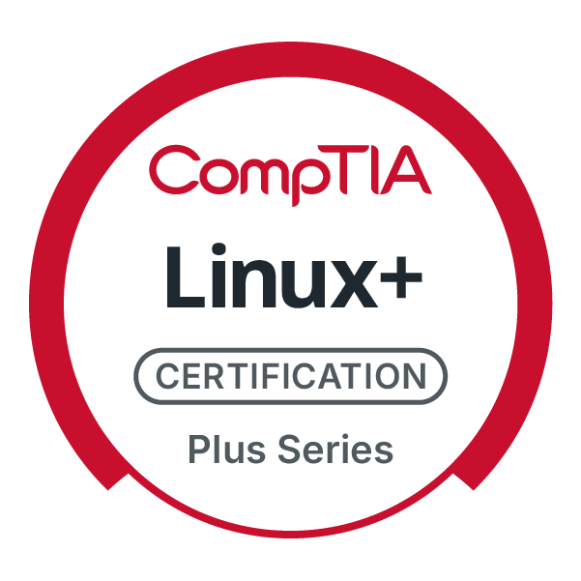
CompTIA Linux+ V8 TTT Session 3:
File Permissions, Filesystem Administration
September 16, 2025
@TeachCompTIA #Linux+TTT

Slide 2
Certificate of Attendance
Slides
Bios
Q&A
Call to Action
Multimedia
Today’s Resources
ON24 Help
Group Chat
Survey

Slide 3


Linux+ Team
Guest:
Jason Eckert
Dean of Technology
triOS College
jason.eckert@trios.com
Host:
Stephen Schneiter
Instructor Network Program Director
CompTIA
sschneiter@comptia.org

Slide 4



The CompTIA Instructor Network (CIN) is a worldwide community for instructors who provide CompTIA certification training.
Benefits of being a community member include:
Communicate and collaborate with CompTIA staff and other instructors.
Access resources for students to understand the value of getting certified.
Receive complimentary training and tools from CompTIA to enrich your classroom.
Become proficient at teaching CompTIA standards.
Share best practices and resources with each other.
https://cin.comptia.org

Slide 5




CIN The Pulse: Managing critical space cybersecurity: Guarding against the failure of imagination
What: One-hour webinar investigating concepts such as the different mindsets that OT and IT workers have, as well as implementing secure by design principles
When: Wednesday, October 1, 2025, 11:00 a.m. CDT (1 hour)
Where: ON24
Who: James Stanger, Chief Technology Evangelist, Renee Wynn, former CIO of NASA
Register: https://bit.ly/CIN-ThePulse-Oct25
@TeachCompTIA

Slide 6
Linux+ V8 TTT Session Outline
Date | Topic
09/09/2025 | Linux overview, setup, shell navigation, getting help
09/11/2025 | Filesystem navigation, working with text files, file management
09/16/2025 | File permissions, filesystem administration
09/18/2025 | Shell features (BASH), shell scripting, Python scripting, Git
09/23/2025 | System initialization, localization, compression, backup and software
09/25/2025 | Managing processes, kernel modules, users and logs
09/30/2025 | Network configuration and remote management
10/02/2025 | Configuring network services, cloud and automation (part 1)
10/07/2025 | Cloud and automation (part 2), security
10/09/2025 | Troubleshooting, performance , preparing for Linux+
✓
✓
✓

Slide 7
File permissions

Slide 8
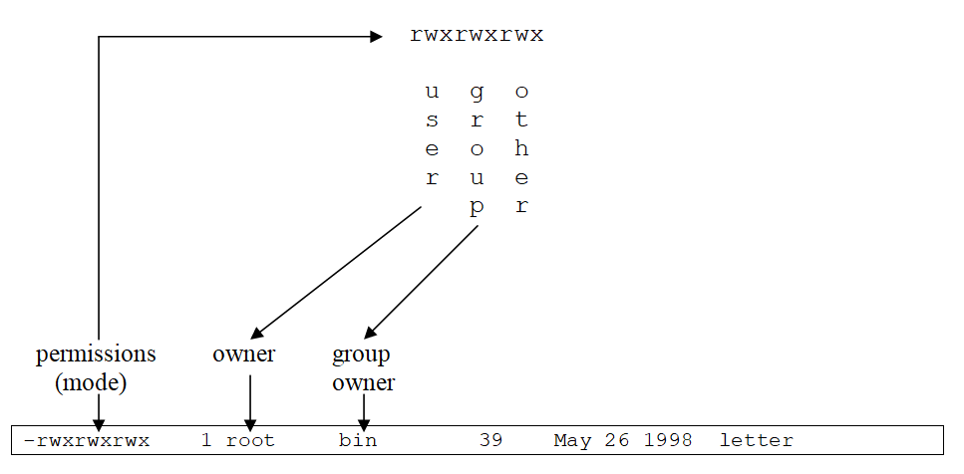
Permissions and Ownership

Slide 9
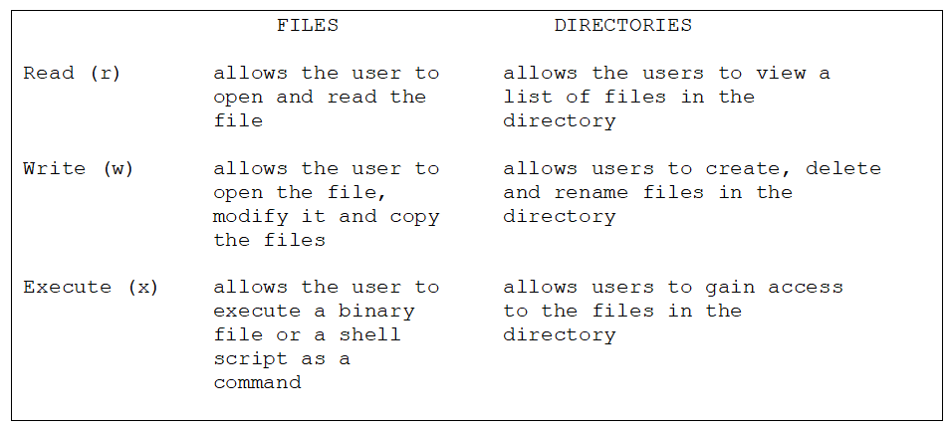
Permissions and Ownership

Slide 10
Permissions and Ownership
Root can change ownership
chown woot letter ; chgrp sys letter chown woot:sys letter
Changing the mode (symbolic): chmod u-wx,g-w,o+rx letter chmod a=rwx letter Changing the mode (absolute, r=4, w=2, x=1): chmod 444 letter chmod 777 letter chmod 000 letter chmod 644 letter

Slide 11
Default Permissions
The system gives new files 666, and new directories 777 (insecure) The UMASK is applied at file creation to take away permissions umask touch file1 ; mkdir dir1 ll file1 ; ll –d dir1 (file1=644, dir1=755) umask 077 touch file2 ; mkdir dir2 ll file2 ; ll –d dir2 (file1=600, dir1=700)

Slide 12
Special Permissions
chmod 7777 letter
chmod u+s,g+s,o+t letter Gives all 3 permissions (rwsrwsrwt): SUID (4), SGID (2) and Sticky Bit (1)
Relies on underlying execute permission
SUID/SGID sets user/group to owner/group owner during execution
Sticky Bit prevents uses from deleting files they don’t own
ll /usr/bin/passwd mkdir /public ; chmod 1777 /public

Slide 13
Special Permissions
Extra notes:
Setting the SGID on a directory ensures that files copied/moved or created in that directory retain the ownership of that group (e.g., Apache)
The Linux kernel prevents shell scripts from running with SUID and SGID privileges for security reasons.

Slide 14
Beyond User, Group & Other: ACLs
setfacl -m u:bob:r-- proposal1 ll proposal1 (note the + following the mode) getfacl proposal1 setfacl -b proposal1 The mask:
Compared to additional entries in the ACL (more restrictive wins)
It is cleared when you copy files to a new directory (clearing additional ACL permissions) as a safety precaution

Slide 15
Superceding Permissions: File attributes
Implemented by file subsystem driver
Immutable = i
Append-only = a
lsattr proposal1 chattr +i proposal1 chattr -i proposal1

Slide 16

filesystem administration

Slide 17
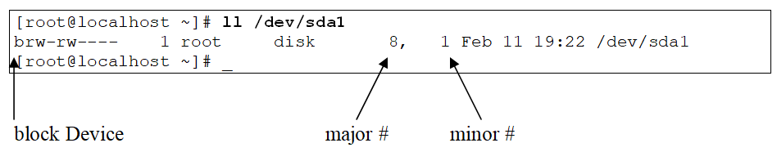
Device Files in the /dev directory
Used to denote device drivers in the Linux kernel
No data section (only inodes)
Can be block or character/raw
Automatically created by udev daemon
ll /dev/sda* lsblk ls /sys/block/*

Slide 18
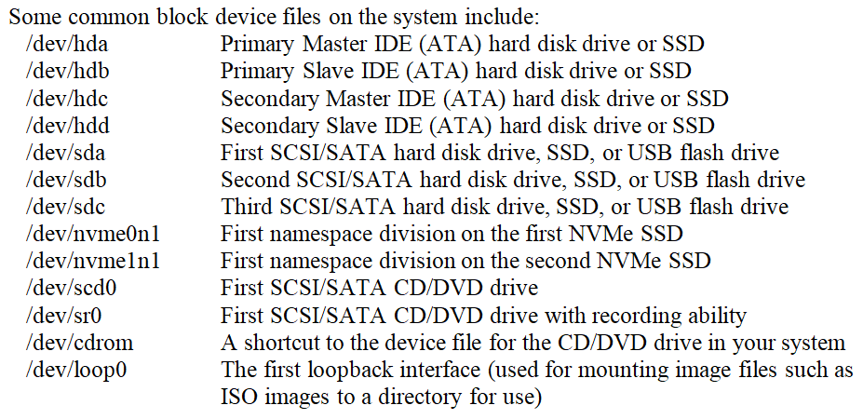

Slide 19
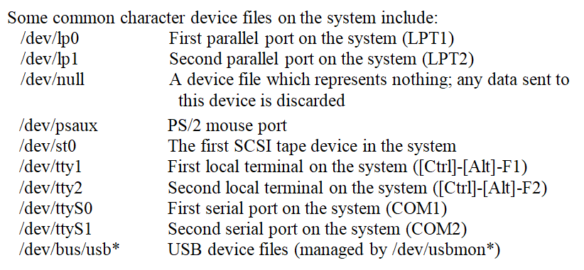

Slide 20
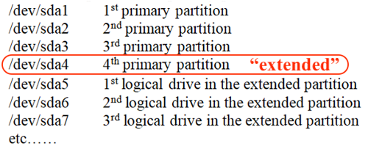
Device Files for HDD/SSD Partitions
Partitioning with MBR?
Partitioning with GPT? (/dev/sda1 to sda128)
NVMe SSDs support namespaces (/dev/nvme0n1p1 to nvmen1p128)

Slide 21
Filesystem Types
btrfs | B-tree File System – a filesystem developed by Oracle for large-scale systems with some features similar to ZFS. It is currently in development and not commonly used in production environments as a result.
exfat | Extended FAT filesystem – a version of the FAT32 filesystem with very large file support and commonly used on large removeable storage devices such as USB hard drives and USB flash drives that are larger than 32GB.
ext2 | Second extended filesystem – the traditional Linux file system; it supports Access Control Lists (individual user permissions). As well, it retains its name from being the new version of the original extended file system, based on the Minix filesystem.
ext3 | Third extended filesystem – a variation on ext2 that has journaling and thus a faster startup and recovery time.
ext4 | Fourth extended filesystem – a variation on ext3 that has larger filesystem support and speed enhancements.
hfs, hfs+, apfs | Hierarchical File System and Apple File System – filesystems native to Apple computers (apfs was added in macOS 10.13)

Slide 22
iso9660 | The CDROM filesystem – originated from the International Standards Organization recommendation 9660 and used to access data stored on CDROMs. This filesystem is also used by ISO images that may be mounted to a directory in Linux.
jfs | Journaling File System – a journaling file system created by IBM for their AIX UNIX systems.
msdos | The DOS FAT filesystem – it can support up to 32-bit FAT tables (FAT32)
ntfs | New Technology File System - a Microsoft proprietary filesystem developed for its NT4 and Windows 2000/XP/2003 operating systems. You can currently only mount NTFS filesystems as read-only in Linux due to legal restrictions put in place by Microsoft.
reiserfs | The REISERFS filesystem – a journalizing filesystem similar to ext3 more suited for use with databases
udf | The DVD File System – the filesystem used on DVDs. This filesystem can also be used to mount DVD ISO images to local directories in Linux.
ufs | The UNIX File System – a high-performance journaling file system used by Sun Solaris and macOS.
vfat | The DOS FAT filesystem with long file name support (it can support up to FAT32)

Slide 23
vxfs | The Veritas File System – a high-performance journaling file system created by Veritas and used on many UNIX systems including SCO Unixware and Sun Solaris.
xfs | The X File System – a high-performance journaling file system created by Silicon Graphics and used on their IRIX UNIX systems. It is very common on production Linux and UNIX servers today.
zfs | The Zettabyte File System – a very high-performance, high scalability file system created by Sun Microsystems. It’s commonly used by the largest Linux systems in the world.

Slide 24
Working with Removable Media
lsblk
mount (/etc/mtab) df –hT or df –i (inode exhaustion?) mount –t exfat /dev/sdb1 /mnt GUI automounter (/dev/sdb1→/run/media/username/label) umount /mnt (no users must be within /mnt) fuser –u /mnt (no users must be within /mnt) mount /dev/cdrom /mnt eject

Slide 25
Working with HDDs/SSDs (Standard Partitions)
fdisk –l /dev/sdb fdisk /dev/sdb or cfdisk /dev/sdb or parted /dev/sdb
partprobe mkfs –t ext4 /dev/sdb1
mkdir /data1
mount /dev/sdb1 /data1 df –hT ls /data1 (lost+found directory only) du –ks /data1

Slide 26
Working with HDDs/SSDs (Standard Partitions)
If /dev/sdb1 should be a swap partition: mkswap /dev/sdb1 swapon /dev/sdb1 free

Slide 27
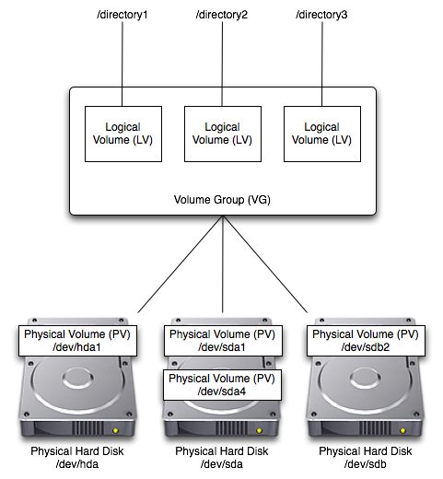
Working with HDDs/SSDs (Logical Volume Manager)

Slide 28
Working with HDDs/SSDs (Logical Volume Manager)
pvcreate /dev/hda1 /dev/sda1 /dev/sda4 /dev/sdb2 pvdisplay (or pvscan or pvs) vgcreate vg00 /dev/hda1 /dev/sda1 /dev/sda4 /dev/sdb2 vgdisplay
lvcreate –L 8GB –n data vg00 lvcreate –L 12GB –n data vg00 lvcreate –L 20GB –n data vg00 lvdisplay

Slide 29
Working with HDDs/SSDs (Logical Volume Manager)
Uses the Device Mapper (DM) /dev/vg00/data = /dev/mapper/vg00-data /sys/block/dm* directories store the configuration mkfs –t ext4 /dev/vg00/data mkdir /data mount /dev/vg00/data /data

Slide 30
Working with HDDs/SSDs (Logical Volume Manager)
Now you can add more storage online! pvcreate /dev/sdc1 vgextend vg00 /dev/sdc1 lvextend –L +30GB –r vg00/data
If the –r (resize) option does not work, use resize2fs (for ext2/3/4) or xfs_info or xfs_growfs (for xfs)
You can then use the dumpe2fs (for ext2/3/4) or xfs_info to view/verify the new filesystem parameters

Slide 31
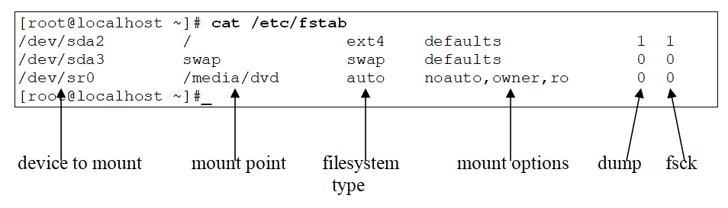
Mounting Filesystems at Boot Time
Devices are often identified with filesystem GUIDs today lsblk --fs or blkid or ls /dev/disk/by-uuid/
vi /etc/fstab (converts to Systemd mount unit)

Slide 32
Checking Filesystems
umount /data fsck -f /dev/vg00/data btrfs check /dev/vg00/data xfs_db /dev/vg00/data (check) xfs_repair /dev/vg00/data (check and repair) xfs_fsr /dev/vg00/data (optimize) HDD? badblocks /dev/vg00/data

Slide 33
Software RAID
Level 0 (striping), 1 (mirroring), 5 (striping with parity) ~ servers?
mdadm --create /dev/md0 --level=5 --raid-devices=3 /dev/sdb /dev/sdc /dev/sdd mkfs –t ext4 /dev/md0 mkdir /raid5 mount /dev/md0 /raid5 vi /etc/fstab
cat /proc/mdstat mdadm --detail /dev/md0

Slide 34
BTRFS
A filesystem that provides built-in RAID (among other enterprise features) for both data blocks (data) and inode tables (metadata) mkfs.btrfs -m raid5 -d raid5 /dev/sdb /dev/sdc /dev/sdd -f mkdir /btrfs
mount /dev/sdb /btrfs
vi /etc/fstab
btrfs filesystem df /btrfs
btrfs device add –f /dev/sde /btrfs btrfs filesystem balance /btrfs

Slide 35
BTRFS
BTRFS subvolumes: btrfs subvolume create /btrfs/stuff btrfs subvolume list /btrfs cp somefiles /btrfs/stuff
mkdir /stuff mount -o subvol=stuff,compress=lzo /dev/sdb /stuff df –hT ls –l /stuff Specify any device file in a BTRFS volume for mounting checking: btrfs check /dev/sdb

Slide 36
Homework Labs

Slide 37
Homework Labs
Refer to the optional exercises for this introductory session, available at https://github.com/jasoneckert/LinuxTTT: 4 - Ubuntu Server Setup
5 - Session 3 Exercises - Permissions and Filesystem Admin

Slide 38

Discussion time: Please type your questions in chat
Questions over content.
Share you experience.
What would you like to see different moving forward?
Let’s keep the conversation going in the CompTIA Instructor Forum: https://cin.comptia.org

