Slide 1


CompTIA Linux+ V8 TTT Session 4:
Shell Features (BASH), Shell Scripting, Python Scripting, Git
September 18, 2025
@TeachCompTIA #Linux+TTT

Slide 2
Certificate of Attendance
Slides
Bios
Q&A
Call to Action
Multimedia
Today’s Resources
ON24 Help
Group Chat
Survey

Slide 3


Linux+ Team
Guest:
Jason Eckert
Dean of Technology
triOS College
jason.eckert@trios.com
Host:
Stephen Schneiter
Instructor Network Program Director
CompTIA
sschneiter@comptia.org

Slide 4
Linux+ V8 TTT Session Outline
Date | Topic
09/09/2025 | Linux overview, setup, shell navigation, getting help
09/11/2025 | Filesystem navigation, working with text files, file management
09/16/2025 | File permissions, filesystem administration
09/18/2025 | Shell features (BASH), shell scripting, Python scripting, Git
09/23/2025 | System initialization, localization, compression, backup and software
09/25/2025 | Managing processes, kernel modules, users and logs
09/30/2025 | Network configuration and remote management
10/02/2025 | Configuring network services, cloud and automation (part 1)
10/07/2025 | Cloud and automation (part 2), security
10/09/2025 | Troubleshooting, performance , preparing for Linux+
✓
✓
✓
✓

Slide 5
Shell Features (BASH)

Slide 6
Redirection
File descriptors represent input and output:
stdin = 0
stdout = 1 (intended output)
stderr = 2 (errors)
command >file command >>file command 2>file command 2>>file command >file 2>file2 command >file 2>&1
command <file command <<LABEL (type text lines until LABEL, called a here document)
command <<< "string" (called a here string)

Slide 7
Piping
Redirects stdout to next command:
somebigcommand | less df –hT | grep –v tmp
cat sonnet* | grep –i love | tee lovefile | uniq | sort –r | pr –d | less sort (sorts a file by the first character) wc (displays the total characters, words and lines in a file) pr (formats a file for printing) tr A B (changes all A characters to B characters) uniq (omits duplicate lines) xargs (converts stdin to command line arguments)
tee (saves output to a file AND sends it to stdout)

Slide 8
Environment Variables
set | less (all variables)
env | less (exported variables are available to subshells)
echo $PATH PATH=$PATH:/opt/bin MYVAR=cool (not exported) export MYVAR export MYVAR=cool unset MYVAR

Slide 9
Special Variables
umask 077 umask
alias alias c=clear alias bye='echo Goodbye ; sleep 5 ; exit'
unalias bye

Slide 10
Environment Files
/etc/profile
~/.bash_profile
~/.profile
~/.bashrc (also in each subshell – usually contains aliases)
After editing, log out/in again or:
source .bashrc
. .bashrc
Restricted BASH shell (no absolute paths, no cd outside home directory, no changing environment variables, etc.): bash –r

Slide 11

Shell & Python Scripting

Slide 12
Simple Shell Script
vi script1.sh #!/bin/bash #This script creates a report of our disk configuration FILENAME=$(hostname) echo "Disk report saved to $FILENAME.report" lvs >>$FILENAME.report vgs >>$FILENAME.report pvs >>$FILENAME.report lsblk >>$FILENAME.report df -hT | grep -v tmp >>$FILENAME.report

Slide 13
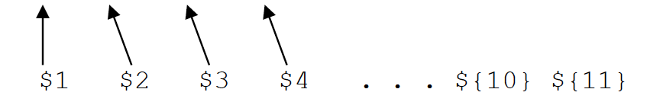
Executing Shell Scripts
./script1.sh (r+x) bash script1.sh (r)
Arguments (positional parameters):
./script1.sh one two three four

Slide 14
Simple Shell Script that takes Arguments
vi script1.sh #!/bin/bash #This script creates a report of our disk configuration FILENAME=$(hostname) echo "Disk report saved to $1" lvs >>$1
vgs >>$1 pvs >>$1 lsblk >>$1 df -hT | grep -v tmp >>$1

Slide 15
Simple Shell Script that takes Arguments
vi script1.sh #!/bin/bash #This script creates a report of our disk configuration if [ $# -ne 1 ]
then
echo "Usage is $0 <filename to save the report to>"
exit 255
fi
FILENAME=$(hostname) echo "Disk report saved to $1" lvs >>$1
…

Slide 16
Special Variables
$0 = command name
$# = number of positional parameters
$? = exit status of last command (0=true, 1-255=false)
$$ = PID of shell (=random number)
$(command) = `command` ${!pattern} syntax returns variable names that match a pattern ${VAR:=value} syntax creates a VAR variable and sets its value

Slide 17
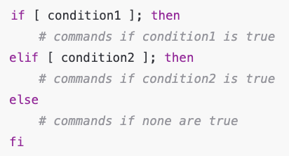
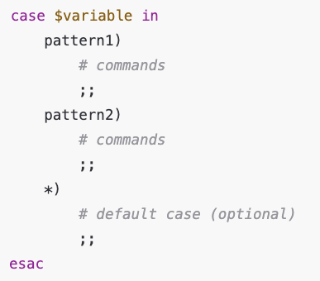
Decision Constructs

Slide 18
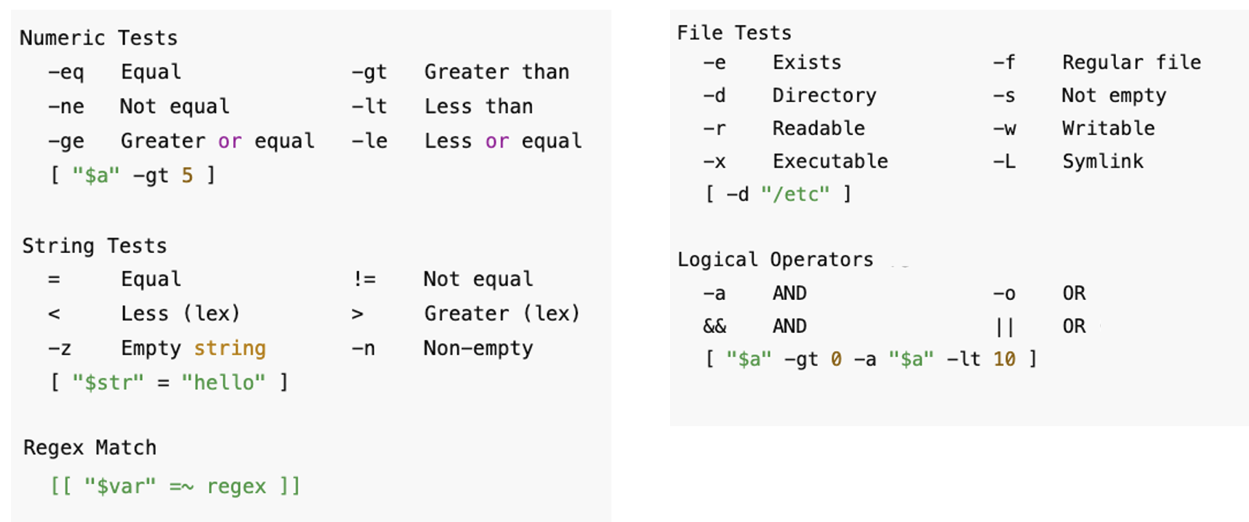
[ condition ] is a Test Statement

Slide 19
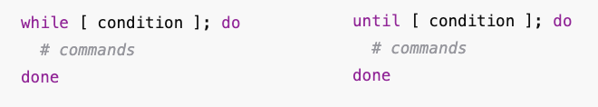
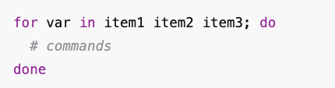
Loop Constructs

Slide 20
Advanced Text Tools
Common within scripts (e.g., script2pretty.sh in today’s lab exercise)
sed s/target/replacement/g cut –d: –f3 /etc/passwd > p1 sed 1s/Mother/Grandma/ letter cut –d: –f6 /etc/passwd > p2 sed /Mother/s/the/BILLY/g letter paste p1 p2 sed s#/bin/bash#/bin/zsh#g /etc/passwd printf "Hello\nWorld\n" awk 'pattern {action}' diff file1 file2
awk '/Mother/ {print $1, $4}' letter sdiff file1 file2 awk –F: '/root/ {print $3, $5}' /etc/passwd

Slide 21
Real World Shell Scripting Today
Most shell scripts today only include regular Linux commands, and are scheduled to run periodically to perform maintenance (e.g., script3.sh in today’s lab exercise)
Anything beyond that, you’ll likely leverage AI ☺
Thus, modern Linux admins only need to know how to read (trace) shell scripts – and the same is true for Python (next)

Slide 22
Python
Python is cross-platform shell scripting!
Example: script1.py
Starts with #!/usr/bin/env python3
Can include data types (String, Integer, Boolean, etc.)
Keep each line to 79 characters, four spaces per indent, my_var (PEP 8 style guide)

Slide 23
Python is Cross-Platform Shell Scripting
Modules provide for specific functionality (many built-in ones!):
Install with pip command & reference in script using import lines
Optionally create isolated environments for running Python scripts that include only the modules you want (not for admins): dnf install python3-pip
pip install virtualenv
virtualenv myenv
source myenv/bin/activate (install modules with pip, run scripts)
deactivate

Slide 24
Git

Slide 25
What is Git?
Git is a version control system that tracks changes to files over time
Commonly used for scripts and other files (e.g., Ansible playbooks)
It also allows for collaboration, showing who changed what and when
Uses commits to capture snapshots of your project (repository/repo)
Each commit records changes since the last one, allowing easy rollback or recovery, like a system restore point

Slide 26
Configuring Git
You must tell Git about yourself in order to create commits: git config --global user.name "Jason Eckert" git config --global user.email "jason.eckert@trios.com" Create and configure a repo: git init (creates Git repo in current directory & .git subdirectory) git status git add . (tells Git to track all files in current dir = adds to staging area) git status git commit –m "First commit" (creates snapshot)

Slide 27
Configuring Git
After changing a script in the repo: git status git add . git commit –m "Added X feature to myscript.sh" Rollback to previous version: git log git reset --hard 53f9566

Slide 28
Using Git Collaboratively (mostly for developers)
Other users can clone your Git repository to work on their own copy
A branch is like a separate workspace within your project
By default, changes are made on the main (formerly master) branch
You can create a new branch to experiment without affecting the main code
Changes are pushed to the shared repo (origin) for others to review
If approved, the branch is merged into the main branch
Other collaborators can then pull the latest version of the main branch

Slide 29
Using Git Collaboratively (mostly for developers)
Clone a repo, create a branch, make changes and push it to the origin: git clone /home/jason/scripts cd scripts git checkout -b NEW (run git checkout main/NEW to change later) git branch vi somescriptfile git add . git commit –m "Added X changes to scripts" git push origin NEW

Slide 30
Using Git Collaboratively (mostly for developers)
On the origin (/home/jason/scripts): git checkout NEW (view & test changes made) git checkout main git merge NEW Other users can pull an updated copy of the main branch: git pull origin main

Slide 31
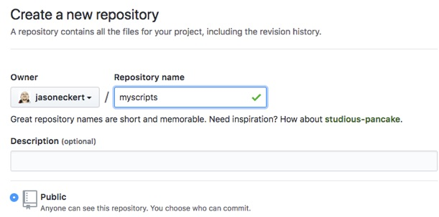
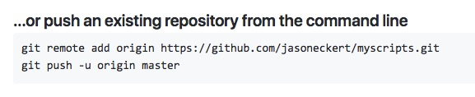
Using GitHub as your Origin

Slide 32
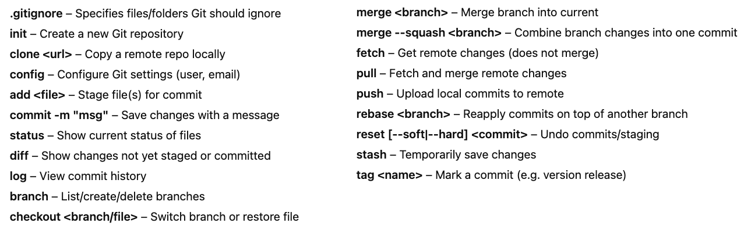
Git Command Reference

Slide 33
Homework Labs

Slide 34
Homework Labs
Refer to the optional exercises for this introductory session, available at https://github.com/jasoneckert/LinuxTTT: 6 - Session 4 Exercises - Working with BASH, Scripting, and Git

Slide 35

Discussion time: Please type your questions in chat
Questions over content.
Share you experience.
What would you like to see different moving forward?
Let’s keep the conversation going in the CompTIA Instructor Forum: https://cin.comptia.org

