Slide 1

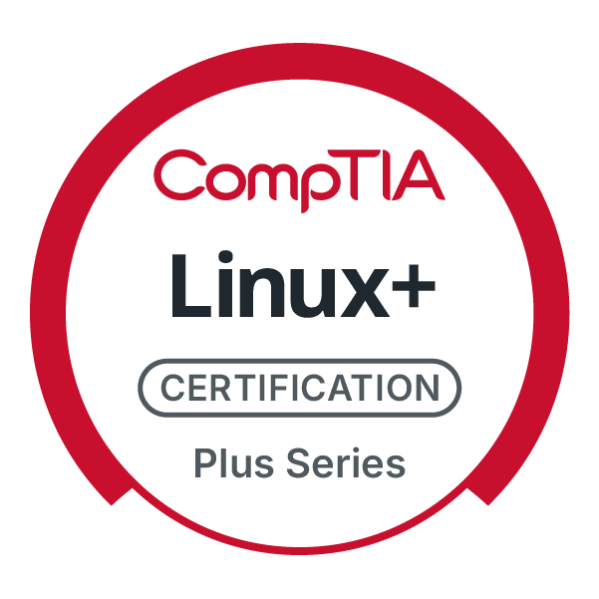
CompTIA Linux+ V8 TTT Session 6:
Managing Processes, Kernel Modules, Users and Logs
September 25, 2025
@TeachCompTIA #Linux+TTT

Slide 2
Certificate of Attendance
Slides
Bios
Q&A
Call to Action
Multimedia
Today’s Resources
ON24 Help
Group Chat
Survey

Slide 3

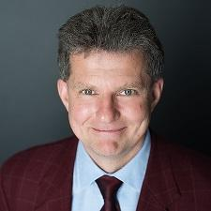
Linux+ Team
Guest:
Jason Eckert
Dean of Technology
triOS College
jason.eckert@trios.com
Host:
Stephen Schneiter
Instructor Network Program Director
CompTIA
sschneiter@comptia.org

Slide 4
Linux+ V8 TTT Session Outline
Date | Topic
09/09/2025 | Linux overview, setup, shell navigation, getting help
09/11/2025 | Filesystem navigation, working with text files, file management
09/16/2025 | File permissions, filesystem administration
09/18/2025 | Shell features (BASH), shell scripting, Python scripting, Git
09/23/2025 | System initialization, localization, compression, backup and software
09/25/2025 | Managing processes, kernel modules, users and logs
09/30/2025 | Network configuration and remote management
10/02/2025 | Configuring network services, cloud and automation (part 1)
10/07/2025 | Cloud and automation (part 2), security
10/09/2025 | Troubleshooting, performance , preparing for Linux+
✓
✓
✓
✓
✓
✓

Slide 5

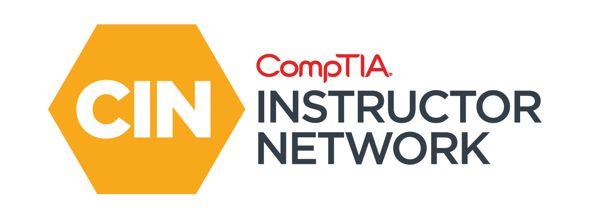

The CompTIA Instructor Network (CIN) is a worldwide community for instructors who provide CompTIA certification training.
Benefits of being a community member include:
Communicate and collaborate with CompTIA staff and other instructors.
Access resources for students to understand the value of getting certified.
Receive complimentary training and tools from CompTIA to enrich your classroom.
Become proficient at teaching CompTIA standards.
Share best practices and resources with each other.
https://cin.comptia.org

Slide 6

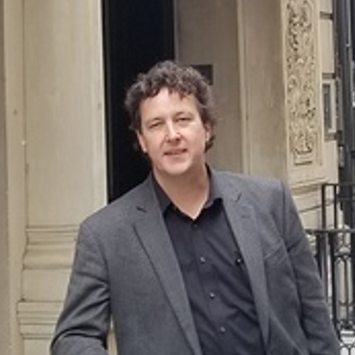
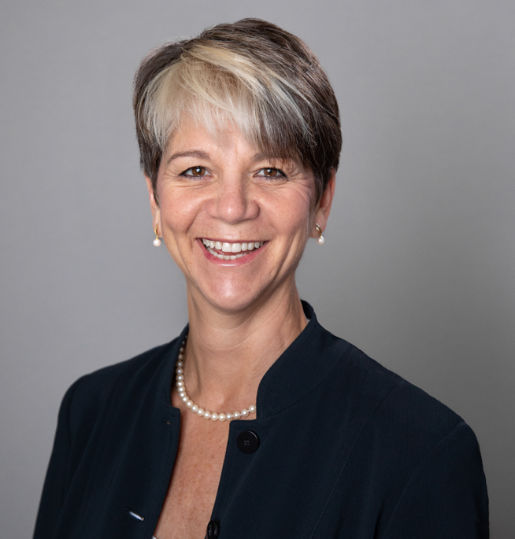

https://cin.comptia.org
CIN The Pulse: Managing critical space cybersecurity: Guarding against the failure of imagination
What: One-hour webinar investigating concepts such as the different mindsets that OT and IT workers have, as well as implementing secure by design principles
When: Wednesday, October 1, 2025, 11:00 a.m. CDT (1 hour)
Where: ON24
Who: James Stanger, Chief Technology Evangelist, Renee Wynn, former CIO of NASA
Register: https://bit.ly/CIN-ThePulse-Oct25
@TeachCompTIA

Slide 7
Processes

Slide 8
Process Terminology
Program vs process
Processes:
Can be user processes or daemons (services)
Can have 1 parent but many children
Have a PID and PPID
Systemd is the parent of all processes (PID=1, PPID=0)
Can turn into rogues or zombies

Slide 9
Viewing Processes
ps ps –ef | less Entire system, full list of columns ps –el | grep Z Entire system, long list of columns (state=zombie) ps aux | grep Z top, htop, btop, atop
pstree

Slide 10
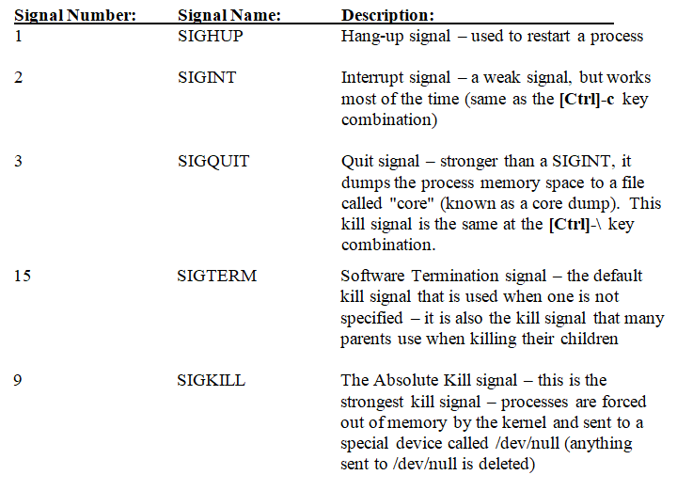
Killing Processes
kill –l kill –3 4582 kill –SIGQUIT 4582 killall –3 firefox fuser –k /dev/tty3 pgrep –u woot "^http" Returns PIDs pkill –u woot -9 "^http" Kills PIDs

Slide 11
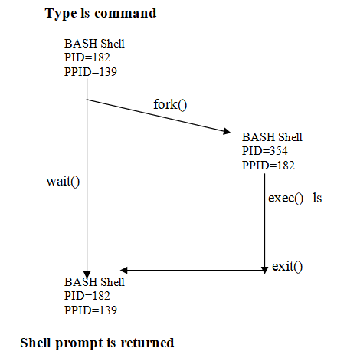
Background Processes
sleep 500000000 & jobs fg %1 [Ctrl]+z bg %1 kill –3 %1 timeconsumingcommand & nohup timeconsumingcommand & firefox &

Slide 12
Processes Priorities
Priority (PRI) = 0 (high priority) to 127 (low priority) – set by kernel!
You can indirectly influence PRI using a nice value (NI)
-20 (higher priority) to +19 (lower priority), default = 0
Regular users can raise their nice value (to be nice to others)
root user can raise or lower their nice value
nice –n 19 cathena & cathena & renice +19 8677

Slide 13
Scheduling Processes (atd)
at 9:15pm 09/26/2025 (enter list of commands, end with [Ctrl]+d) Redirect output to a file! Users in /etc/at.allow & /etc/at.deny atq or at –l at –c 1 atrm 1 or at –d

Slide 14
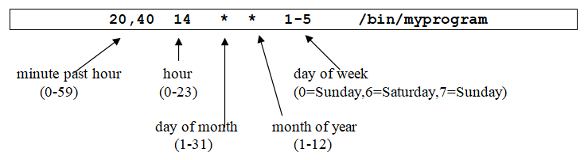
Scheduling Processes (crond)
crontab –e (users in /etc/cron.allow & /etc/cron.deny) crontab –l crontab –r /etc/crontab = system cron table (prefix program with username) /etc/cron.hourly/* = scripts run hourly (also daily, weekly, monthly) /etc/cron.d/* = miscellaneous cron tables

Slide 15
The /proc Filesystem
ls /proc less /proc/cpuinfo echo 1 > /proc/sys/net/ipv4/ip_forward echo 1 > /proc/sys/net/ipv6/conf/all/forwarding sysctl –w net.ipv4.ip_forward=1
sysctl –w net.ipv6.conf.all.forwarding=1
vi /etc/sysctl.conf and add lines: net.ipv4.ip_forward = 1 net.ipv6.conf.all.forwarding=1

Slide 16

Kernel Modules

Slide 17
Kernel Modules
Kernel and udev detect and set up hardware at boot time:
Common devices (/dev/sda) have drivers within the kernel
Other devices have a driver inserted into the kernel as a module from /lib/modules/<kernelversion>/
Some hardware can’t be detected, so it must be loaded manually:
Entries in /etc/modprobe.conf or /etc/modprobe.d/* → modprobe
If storage-related, a new initrd must be built → dracut/mkinitrd
Other commands: insmod, lsmod, rmmod, modinfo, depmod -v

Slide 18
Kernel Modules
How to know if you need to look for and install a driver?
lscpu, lsmem, lsdev, lspci, lsusb, lsscsi, lsblk
dmesg | grep hardware
dmidecode
lshw –class video
Where do you get it?
Vendor site as a package you install (e.g., dnf)
Adds module to /lib/modules, adds file to /etc/modprobe.d/, may rebuild new initrd and GRUB2 bootloader

Slide 19
Users

Slide 20
User and Group Databases
/etc/passwd (user info & primary group) bob:x:1001:1001:Bob Doe:/home/bob:/bin/bash /etc/shadow (password info) bob:$1$9xgNeKZP$IYvIN2pu1F2y90:13150:0:99999:7::: /etc/group (groups & members) bob:x:1001:sue,mary id

Slide 21
Creating and Managing Users
useradd –m bob (defaults from /etc/default/useradd & /etc/login.defs, home directory files from /etc/skel/*) passwd bob usermod –e "01/01/2026" bob chage –m 2 –M 40 –W 5 bob (use chage –l bob to list) chfn bob chsh –s /bin/zsh bob userdel –r bob passwd –l bob passwd –u bob

Slide 22
Creating and Managing Groups
groupadd groupies (also groupmod and groupdel) usermod –aG acctg bob (add bob to acctg group) usermod –g acctg bob (set bob’s primary group in /etc/passwd) newgrp sys (temporarily change primary group)

Slide 23
Logs

Slide 24
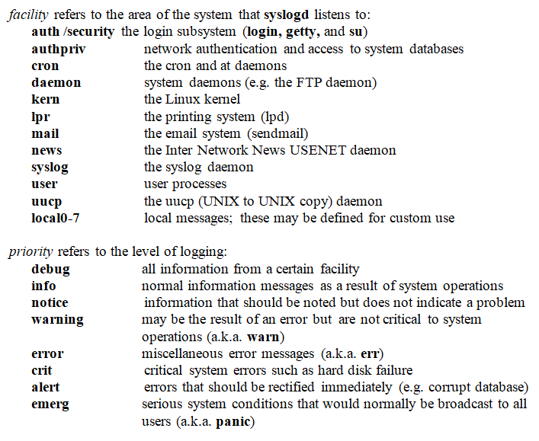
Log File Management (Traditional Syslog)
/var/log/file /var/log/daemon/file /etc/rsyslog.conf /etc/rsyslog.d/* facility.priority /var/log/file mail.err -/var/log/mail cron.=crit @192.168.1.1

Slide 25
Log File Management (Modern Systemd)
Uses systemd-journald database /etc/systemd/journald.conf (ForwardToSyslog=yes, SystemMaxUse=100MB, Storage=volatile) journalctl _COMM=crond journalctl --unit=crond.service
journalctl --unit=crond.service --since "13:00" --until "14:00"
journalctl --since "13:00" | grep –i bluetooth Generating events (e.g., within a shell script): echo "something" | systemd-cat logger "something" (If using rsyslogd, add –p facility.priority)

Slide 26
Rotating Logs in /var/log
logrotate (scheduled daily via cron) /etc/logrotate.conf & /etc/logrotate.d/* e.g., /etc/logrotate.d/wtmp: /var/log/wtmp { monthly create 0664 root utmp minsize 1M rotate 1 }

Slide 27
Homework Labs

Slide 28
Homework Labs
Refer to the optional exercises for this introductory session, available at https://github.com/jasoneckert/LinuxTTT: 8 - Session 6 Exercises - Processes, Kernel Modules, Users, and Logs

Slide 29

Discussion time: Please type your questions in chat
Questions over content.
Share you experience.
What would you like to see different moving forward?
Let’s keep the conversation going in the CompTIA Instructor Forum: https://cin.comptia.org

