Slide 1

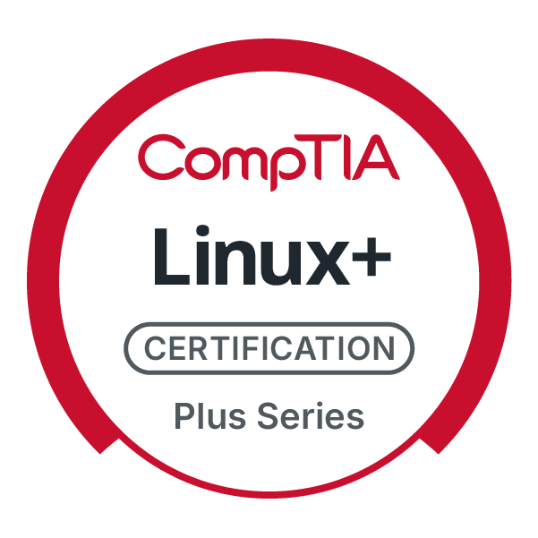
CompTIA Linux+ V8 TTT Session 7:
Network Configuration and Remote Management
September 30, 2025
@TeachCompTIA #Linux+TTT

Slide 2
Certificate of Attendance
Slides
Bios
Q&A
Call to Action
Multimedia
Today’s Resources
ON24 Help
Group Chat
Survey

Slide 3


Linux+ Team
Guest:
Jason Eckert
Dean of Technology
triOS College
jason.eckert@trios.com
Host:
Stephen Schneiter
Instructor Network Program Director
CompTIA
sschneiter@comptia.org

Slide 4



The CompTIA Instructor Network (CIN) is a worldwide community for instructors who provide CompTIA certification training.
Benefits of being a community member include:
Communicate and collaborate with CompTIA staff and other instructors.
Access resources for students to understand the value of getting certified.
Receive complimentary training and tools from CompTIA to enrich your classroom.
Become proficient at teaching CompTIA standards.
Share best practices and resources with each other.
https://cin.comptia.org

Slide 5




https://cin.comptia.org
CIN The Pulse: Managing critical space cybersecurity: Guarding against the failure of imagination
What: One-hour webinar investigating concepts such as the different mindsets that OT and IT workers have, as well as implementing secure by design principles
When: Wednesday, October 1, 2025, 11:00 a.m. CDT (1 hour)
Where: ON24
Who: James Stanger, Chief Technology Evangelist, Renee Wynn, former CIO of NASA
Register: https://bit.ly/CIN-ThePulse-Oct25
@TeachCompTIA

Slide 6
Linux+ V8 TTT Session Outline
Date | Topic
09/09/2025 | Linux overview, setup, shell navigation, getting help
09/11/2025 | Filesystem navigation, working with text files, file management
09/16/2025 | File permissions, filesystem administration
09/18/2025 | Shell features (BASH), shell scripting, Python scripting, Git
09/23/2025 | System initialization, localization, compression, backup and software
09/25/2025 | Managing processes, kernel modules, users and logs
09/30/2025 | Network configuration and remote management
10/02/2025 | Configuring network services, cloud and automation (part 1)
10/07/2025 | Cloud and automation (part 2), security
10/09/2025 | Troubleshooting, performance , preparing for Linux+
✓
✓
✓
✓
✓
✓
✓

Slide 7
Network Configuration

Slide 8
Viewing Network Interfaces
Network interface drivers are inserted as modules and aliased
Traditional aliases = eth0, eth1 (wired) or wlan0, wlan1 (wireless) = VMs!
Systemd = enp0s2 (wired, slot 2 on first PCI bus), wlp0s2 (wireless)
lshw –class network ip address show (or ip addr) ifconfig (install net-tools package!) ethtool –S enp0s2 iwconfig enp0s3 channel 6 ethtool –i enp0s2
netstat –i

Slide 9
Common Network Commands
arp, rarp, ping, ping6, whois
nmap –sT localhost Verifying service connections
netstat Verifying sockets/connections ss –u –a ss –t –a iftop iperf3 –s Start server iperf3 –c IPaddress Connect to server

Slide 10
Configuring IP on a Network Interface (manual)
Immediate configuration:
ip addr add 192.168.1.1/24 dev eth0 or ifconfig eth0 192.168.1.1
ip link set eth1 down or ifconfig eth0 down
ip link set eth0 up or ifconfig eth0 up
dhclient eth0

Slide 11
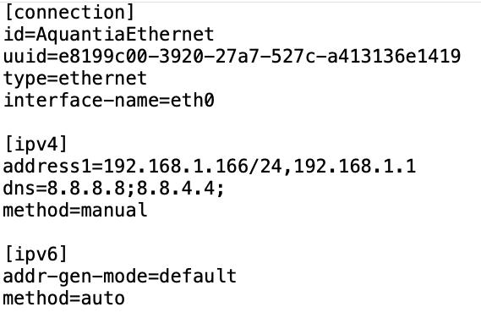
Configuring IP on a Network Interface (NetworkManager)
Fedora Workstation uses the NetworkManager network renderer
/etc/NetworkManager/system-connections/AquantiaEthernet.nmconnection

Slide 12
Configuring IP on a Network Interface (NetworkManager)
Reboot or reactive interface after:
nmcli connection down name.nmconnection
nmcli connection up name.nmconnection
nmcli
nmcli connection show
nm-connection-editor & (in GUI)

Slide 13
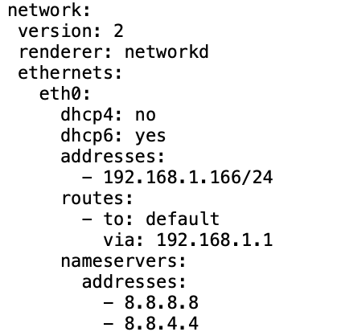
Configuring IP on a Network Interface (Systemd-Networkd)
Ubuntu Server uses the Systemd-Networkd network renderer
/etc/netplan/50-cloud-init.yaml
netplan try
netplan apply
netplan status
networkctl

Slide 14
Configuring Routes
If Linux configured as router in /etc/sysctl.conf: net.ipv4.ip_forward = 1 (or net.ipv6.conf.all.forwarding = 1) ip route, route, netstat –r ip route add 5.0.0.0/8 via 3.0.82.2 ip route add 6.0.0.1 via 3.0.82.4 route add -net 5.0.0.0 netmask 255.0.0.0 gw 3.0.82.2 route add -host 6.0.0.1 gw 3.0.82.4 traceroute, traceroute6, tracepath, tracepath6, mtr

Slide 15
Name Resolution
hostname hostname lala.whatever.com hostnamectl set-hostname lala.whatever.com (in /etc/hostname) grep hosts /etc/nsswitch.conf cat /etc/hosts cat /etc/resolv.conf (set to Systemd-resolved=127.0.0.53,
which is configured by network renderer) resolvectl status

Slide 16
Name Resolution
host lala.whatever.com nslookup lala.whatever.com dig lala.whatever.com dig whatever.com ANY
resolvectl query lala.whatever.com

Slide 17
Network Services (Daemons)
Network services (daemons) listen on a port to client requests grep –i ssh /etc/services Daemons that listen on well-known ports (0-1023) are typically run as the root user, thus may require additional security In the past, some network daemons were started on demand by xinetd to save RAM – if you want to do this today, you configure it as a Systemd socket unit (e.g., telnet.socket)

Slide 18
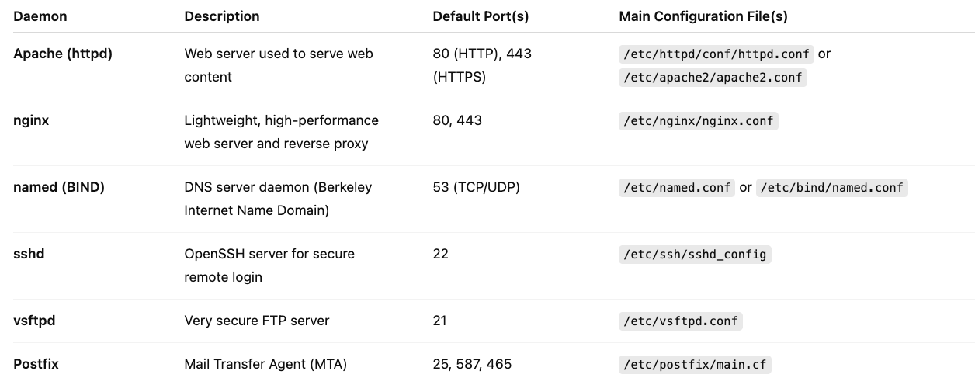
Network Services (Daemons – next session!)

Slide 19
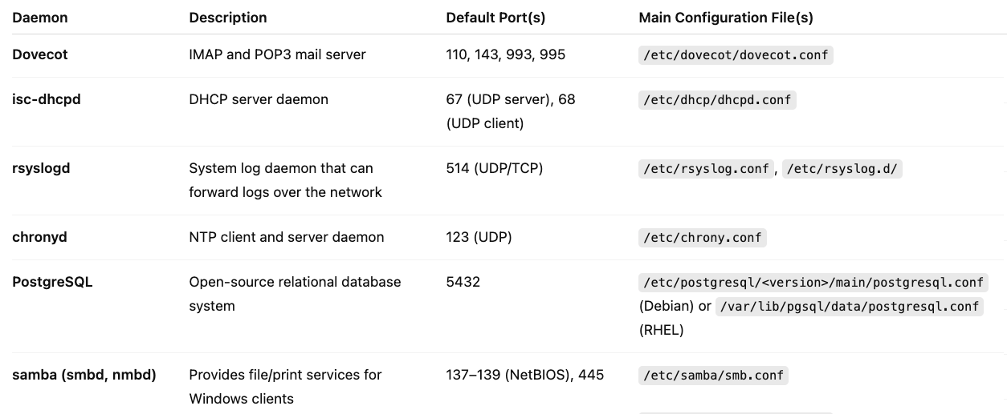
Network Services (Daemons – next session!)

Slide 20
When Setting up Any Network Service
1. Install, configure and start the appropriate daemon
(dnf/apt, systemctl start, systemctl enable) 2. Ensure that the service is listening on the port/socket
(netstat or ss or nmap)
3. Test a local connection (127.0.0.1) 4. Test remote connections (allow in firewall if necessary)
Workstations generally have a firewall enabled by default,
servers generally do not (they rely on network firewalls!) 5. Monitor traffic, bandwidth, etc.

Slide 21

Remote Management

Slide 22
Telnet (legacy, unencrypted)
dnf install telnet-server telnet systemctl start telnet.socket ; systemctl enable telnet.socket
ss –t –a
nmap –sT localhost telnet localhost/IP telnet remotehost/IP

Slide 23
SSH (modern, encrypted)
Installed and enabled by default on server distributions May need to be enabled on workstation distributions (e.g., Fedora) systemctl enable sshd.service ; systemctl start sshd.service /etc/ssh/sshd_config options – e.g.,
PermitRootLogin yes
ForwardX11 no
AllowUsers woot bob sue jane
AllowGroups stooges

Slide 24
SSH (modern, encrypted)
Session is symmetrically encrypted (e.g., AES) using a random session-generated key protected by asymmetric (public/private) host keys (e.g., RSA, DSA, ECDSA or ED25519) – e.g.,
/etc/ssh/ssh_host_rsa_key /etc/ssh/ssh_host_rsa_key.pub

Slide 25
SSH Remote Login and File Copy
ssh username@192.168.1.1 (or ssh –l username 192.168.1.1) Accept SSH host keys (cached in ~/.ssh/known_hosts)
Downloading files: ssh woot@server1 cat /etc/lala > /data scp woot@server1:/etc/lala /data
Uploading files: ssh woot@server1 cat </etc/lala ">" /data scp /etc/lala woot@server1:/data

Slide 26
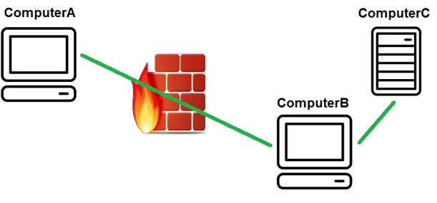
SSH Tunneling
ssh –X username@192.168.1.1 (graphical tunneling) Most commands support SSH tunneling (e.g., sftp, rsync –e) ssh computerB –L 443:computerC:443 ssh homeserver –L 443:lala.com:443 ssh -D 8080 homeserver

Slide 27
SSH User Keys (Authentication – required for cloud!)
ssh-keygen (generated user keys stored locally in ~/.ssh/) ssh-copy-id woot@server1 (copies to ~/.ssh/authorized_keys on server1) ssh woot@server1 (no password needed!) Note: ssh-keygen can protect private SSH user key with a passphrase that can be managed by a password manager program (e.g., ssh-agent)

Slide 28
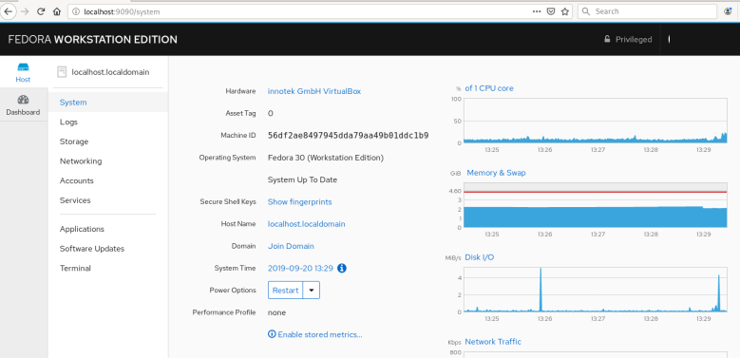
Cockpit Web Management Console
Listens on https :9090, started on demand as a socket (like telnet)

Slide 29
Homework Labs

Slide 30
Homework Labs
Refer to the optional exercises for this introductory session, available at https://github.com/jasoneckert/LinuxTTT: 9 - Session 7 Exercises - Network Configuration and Remote Management

Slide 31

Discussion time: Please type your questions in chat
Questions over content.
Share you experience.
What would you like to see different moving forward?
Let’s keep the conversation going in the CompTIA Instructor Forum: https://cin.comptia.org

