Slide 1

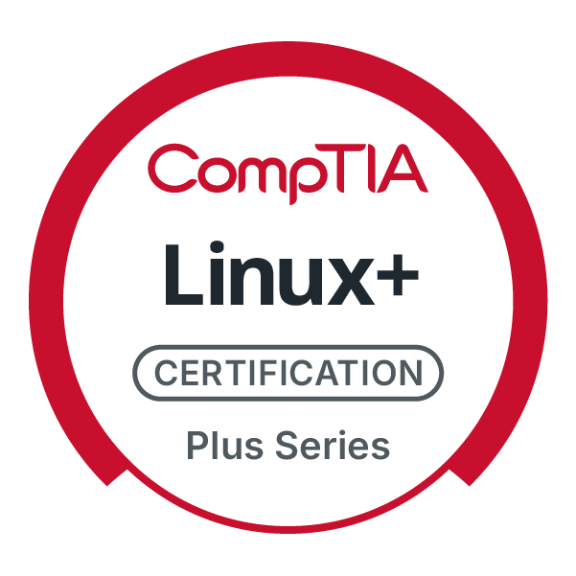
CompTIA Linux+ V8 TTT Session 5:
System Initialization, Localization, Compression, Backup and Software
September 23, 2025
@TeachCompTIA #Linux+TTT

Slide 2
Certificate of Attendance
Slides
Bios
Q&A
Call to Action
Multimedia
Today’s Resources
ON24 Help
Group Chat
Survey

Slide 3


Linux+ Team
Guest:
Jason Eckert
Dean of Technology
triOS College
jason.eckert@trios.com
Host:
Stephen Schneiter
Instructor Network Program Director
CompTIA
sschneiter@comptia.org

Slide 4
Linux+ V8 TTT Session Outline
Date | Topic
09/09/2025 | Linux overview, setup, shell navigation, getting help
09/11/2025 | Filesystem navigation, working with text files, file management
09/16/2025 | File permissions, filesystem administration
09/18/2025 | Shell features (BASH), shell scripting, Python scripting, Git
09/23/2025 | System initialization, localization, compression, backup and software
09/25/2025 | Managing processes, kernel modules, users and logs
09/30/2025 | Network configuration and remote management
10/02/2025 | Configuring network services, cloud and automation (part 1)
10/07/2025 | Cloud and automation (part 2), security
10/09/2025 | Troubleshooting, performance , preparing for Linux+
✓
✓
✓
✓
✓

Slide 5
System Initialization

Slide 6
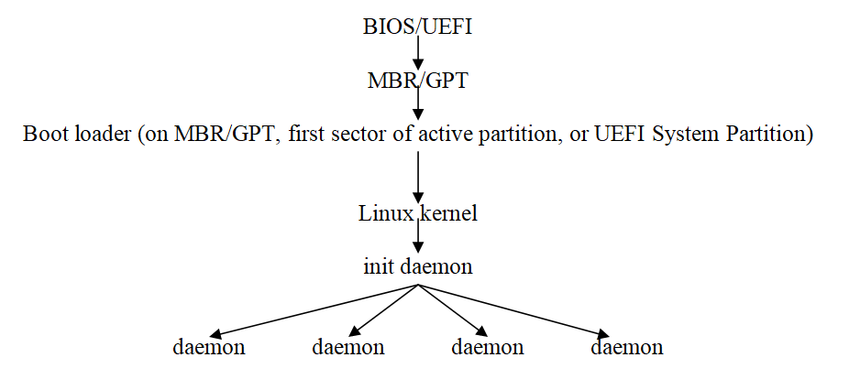
The Boot Process

Slide 7
The GRUB2 Boot Loader
/boot/grub2/grub.cfg (legacy BIOS)
/boot/efi/EFI/fedora/grub.cfg (UEFI BIOS)
Supports secure boot via a Microsoft shim
Built by entries in /etc/default/grub & /etc/grub.d/* vi /etc/default/grub (common options), then grub2-mkconfig -o /boot/grub2/grub.cfg
BootLoaderSpec? Entries under /boot/loader/entries/*
GRUB2 corrupted?
grub2-install /dev/sda (MBR/GPT) or
grub2-install /dev/sda1 (EFI System Partition)

Slide 8
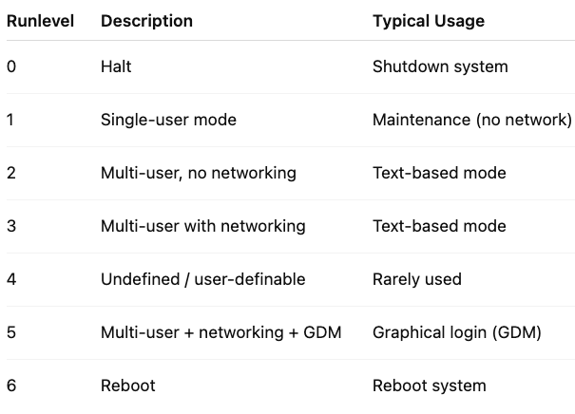
Daemon Initialization (legacy SysV)
runlevels determine system state /etc/inittab (default runlevel) runlevel init 3 or telinit 3

Slide 9
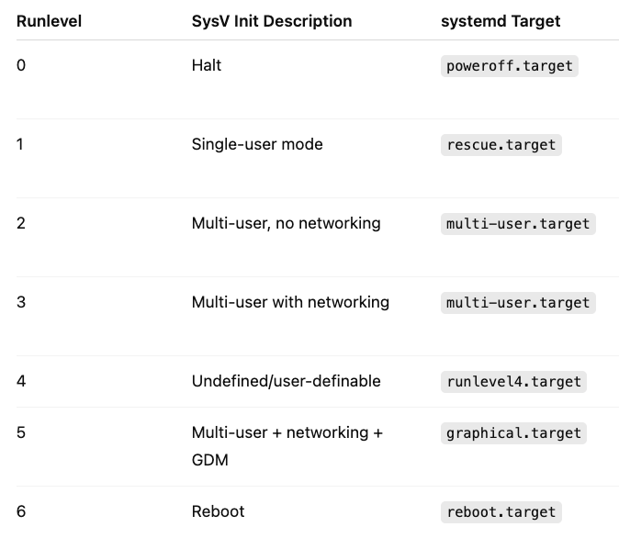
Daemon Initialization (modern Systemd)
Systemd extends to all areas (or “units”) of Linux:
Daemons = service units
Runlevels = target units
Others: mount units, timer units

Slide 10
Daemon Initialization (modern Systemd)
Systemd searches for unit files in priority order:
/etc/systemd/system/ (admin override location)
/run/systemd/system/ (generated by tools, cleared on reboot)
/usr/lib/systemd/system/ (default system unit files – don’t edit!)
systemctl start/stop/restart/reload/status crond.service
systemctl daemon-reload
systemctl enable/disable crond.service (start/stop in default runlevel)
systemctl mask/unmask crond.service (completely disable/enable)
systemctl edit crond.service (e.g. add Environment=“MYVAR=cool”)

Slide 11
Daemon Initialization (modern Systemd)
systemctl set-default graphical.target (sets default runlevel) systemctl isolate multi-user.target (changes runlevel == runlevel command) systemctl isolate runlevel3.target systemctl –a | grep service | less systemctl daemon-reload systemd-analyze blame

Slide 12
System Initialization Logs
dmesg | less less /var/log/boot.log less /var/log/messages journalctl –b journalctl –k journalctl --unit crond.service

Slide 13

Localization

Slide 14
Time & Timezone Localization
Default time taken from system clock via BIOS/UEFI hwclock --set --date='2025-11-02 00:00:00' date –s '2025-11-02 00:00:00' ; hwclock –w Kernel stores time as EPOCH (# of seconds since Jan 1st, 1970) Translation to/from EPOCH depends on time zone relative to GMT date +%s ls –l /etc/localtime (symlink to timezone file) timedatectl set-timezone 'America/Toronto' export TZ='America/Toronto’ (in a shell script)

Slide 15
Format Localization
9,25$ vs $9.25 YYYYMMDD vs DDMMYYYY French Canadian vs. US English keyboard Character set affects your format localization ASCII, ISO-8859, Unicode, UTF-8 Locale = unique combination of language, character set, and regional formats

Slide 16
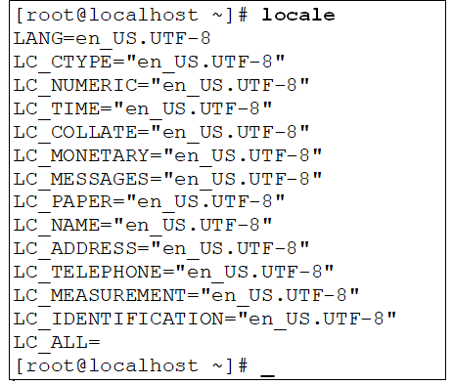
Format Localization
locale or localectl locale –a or localectl list-locales localectl set-locale LANG="en_US.UTF-8"
localectl list-keymaps localectl set-keymap <layout>

Slide 17
Compression & Backup

Slide 18
Compression Utilities
Lempel-Ziv algorithm-based: • zip (.zip) • gzip (.gz) • 7z (.7z) • xz (.xz)
Burrows-Wheeler Block Sorting Huffman Coding algorithm: • bzip2 (.bz2)

Slide 19
Compression Utilities (Lempel-Ziv algorithm)
zip -v bigfile.zip bigfile unzip bigfile.zip
7z a bigfile.7z bigfile 7z e -aoa bigfile.7z
gzip -v9 bigfile (1=fast, 9=best) zcat bigfile.gz (or zmore or zless)
gunzip -v bigfile.gz xz -v9 bigfile (must use xzcat, xzmore or xzless) unxz -v bigfile.gz

Slide 20
Compression Utilities (Burrows-Wheeler algorithm)
bzip2 -v bigfile (must use bzcat, bzmore or bzless) bunzip2 -v bigfile.bz2

Slide 21
Backup (tar)
tar -cvf /mystuff.tar Poems tar -tvf /mystuff.tar tar -xvf /mystuff.tar tar -zcvf /mystuff.tar.gz Poems (z=gzip, J=xz, j=bzip2) = tarball tar -tvf /mystuff.tar.gz tar -xvf /mystuff.tar.gz Copy /mystuff.tar.gz to NAS/cloud afterwards! (scp, sftp, rsync, etc.)

Slide 22
Backup (cpio & dd)
find classfiles/Poems | cpio -vocBL -O /mystuff.cpio cpio -Bitv -I /mystuff.cpio cpio -vicdumB -I /mystuff.cpio dd if=/dev/sda1 of=sda1_backup.dd (image backup)
*Use ddrescue if you are creating an image from failed device

Slide 23
Software

Slide 24
Compile From Source Code
Obtain the source code: git clone somegitrepo OR download source tarball, tar -zxvf tarball
cd directory
less README or less INSTALL
./configure (creates Makefile)
make (compiles program)
make install (copies compiled program to $PATH, etc.)

Slide 25
Red Hat Package Manager
rpm –i filename.rpm Install RPM package rpm –qa | less Query all installed packages rpm –qi packagename List package info rpm –qc packagename List configuration files rpm –ql packagename List files in package rpm –qf /path/to/a/file Find package for a particular file rpm –V packagename Verify package contents rpm –e packagename Erase/uninstall package

Slide 26
Red Hat Package Manager (dnf/yum)
dnf install packagename Install RPM package dnf install @groupname Install RPM package package group (from online repo, includes dependencies!)
dnf info packagename Installed package information dnf upgrade package Upgrade installed packages dnf repolist List RPM repo (/etc/yum.repos.d/*) dnf list --available List available packages
dnf list --installed List installed packages
dnf group list --available List available package groups
dnf remove packagename Remove RPM package

Slide 27
Debian Package Manager
dpkg –i filename.deb Install dpkg –l List installed packages dpkg –L packagename Lists file contents dpkg –S /path/to/a/file Find package name for a file dpkg –V packagename Verify package contents dpkg –r packagename Remove/uninstall dpkg –P packagename Remove/uninstall (including config files)

Slide 28
Debian Package Manager (apt/apt-get)
apt install packagename Install DPM package (from online repo,
includes dependencies!)
apt show packagename Installed package information apt upgrade package Upgrade installed packages
apt update Refresh DPM repos (/etc/apt/sources.list & /etc/apt/sources.list.d/*) apt search name List available packages
apt remove packagename Remove DPM package
apt purge packagename Remove DPM package & configuration files

Slide 29
Sandboxed Package Managers (Flatpak)
flatpak remote-add URL (adds repo)
flatpak remote-ls
flatpak install name
flatpak run name
flatpak list flatpak info name flatpak uninstall name

Slide 30
Sandboxed Package Managers (Snap & AppImage)
snap search name
snap install name (--classic if app can’t be 100% sandboxed) snap list snap info name snap remove name
Download name.AppImage (e.g., from AppImageHub website)
chmod 755 name.AppImage
./name.AppImage (uses FUSE filesystem)

Slide 31
Homework Labs

Slide 32
Homework Labs
Refer to the optional exercises for this introductory session, available at https://github.com/jasoneckert/LinuxTTT: 7 - Session 5 Exercises - System Initialization, Localization, Compression, Backup, and Software

Slide 33

Discussion time: Please type your questions in chat
Questions over content.
Share you experience.
What would you like to see different moving forward?
Let’s keep the conversation going in the CompTIA Instructor Forum: https://cin.comptia.org

