Slide 1
Mission and Money: The Two-Good Framework and College Athletics
EDLF 3420/5420
Fall 2014

Slide 2
The Two-Good Framework: Mission and Money
“Every college and university is some combination of a socially conscious provider of educational services (mission) and a business searching for revenues and cost cutting methods (money)”
“Schools provide teaching and basic research, even when they are unprofitable for the individual schools, and finance these mission activities through conventional businesslike revenue-generating activities.”
Weisbrod, Ballou, & Asch, 2008, pg. 2

Slide 3
Where Do We Get the Money For Teaching, Research and Service?
Tuition and Student Fees
State and Federal Subsidies
Endowments
Contracts, grants, patents, licensing
Auxiliary Enterprise Income
Gifts/Donative Revenue

Slide 4
The Importance of Cross-Subsidies
One for All and All for One
Each Tub On Its Own Bottom
Examples of Cross-Subsidy: Financial Aid, Athletics, Undergraduate/Graduate Studies

Slide 5
Mission and Money: Intercollegiate Athletics
Educational enterprise or commercial enterprise?
“Intercollegiate athletics are an amalgam of profitable revenue-good activities and unprofitable mission-good activities.” (p. 219)
Tax-exempt status – does the activity “contribute to the accomplishment of the university’s purpose, other than through the production of income?” (p. 222)

Slide 6
Mission and Money: Intercollegiate Athletics
“For the 422 schools playing in NCAA Division III there is apparently no money-making element….they report losses on average from every sport,” (p. 219).
“For schools reporting losses on specific sports but nonetheless continuing to support them, the contribution of those sports to the school’s mission appears to be preeminent…” (p. 219).

Slide 7
Where Are the Cross-Subsidies?
In D-I, Football and Men’s Basketball May Generate a Surplus of Revenue Over Expenses.
All Other Men’s and Women’s Sports (Except Men’s Ice Hockey) Generally Do Not.

Slide 8
i>Clicker question
Are intercollegiate athletics in NCAA Division I?
Mission goods
Revenue goods
Both mission and revenue goods
Neither mission nor revenue goods

Slide 9
i>Clicker question
Are intercollegiate athletics in NCAA Division III?
Mission goods
Revenue goods
Both mission and revenue goods
Neither mission nor revenue goods

Slide 10
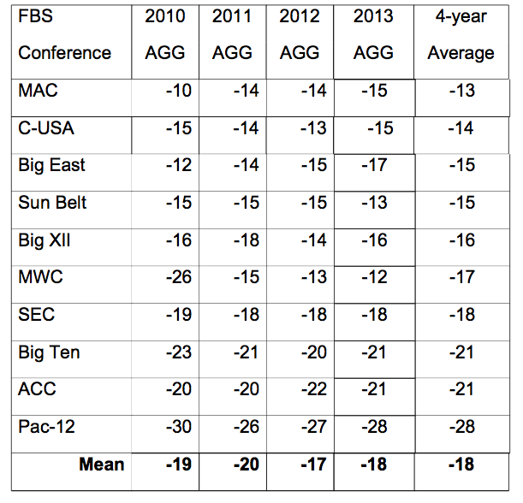
Four-Year Average FBS Adjusted Graduation Gaps Men’s Football – College Sport Research Institute

Slide 11
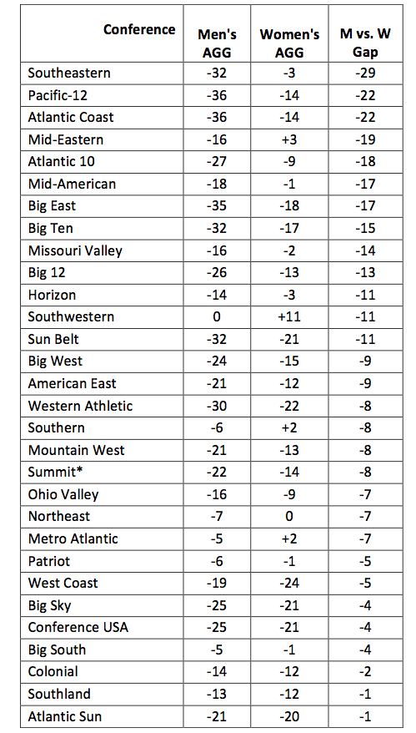
2012 Division I Men’s and Women’s Basketball AGG (2001-2004) 4-Class Cohort – College Sport Research Institute

Slide 12
i>Clicker Question
Indicate the extent to which you agree with the following statement.
Academic Graduation Gaps for student athletes should be a significant concern of university leaders.
A. Strongly Agree
B. Agree
C. Undecided
D. Disagree
E. Strongly Disagree

Slide 13
Intercollegiate Athletics: Mission And/Or Money?
“Viewing intercollegiate athletics as a whole, our conclusion is that the pursuit of both mission and money matter in explaining schools’ actions. But it is clear also that football and men’s basketball in the highly competitive Division 1(and Division 1A) schools are best understood as revenue driven. In that sense, those schools are like private firms, seeking profit from those sports. Other sports, and even football and basketball at schools where competitive measures and athlete recruitment are far more restricted – in particular at the NCAA Division III schools – can be understood as mission driven, operating with no prospect of financial profit and indeed, deemed worthy of subsidization.”
Weisbrod et al., 2008, p. 249-50.

Slide 14
The Bigness of Big Time
EDLF 3420/5420
Athletics in the University
Fall 2014

Slide 15
i>Clicker question
Which of the following was the first sport played between American universities?
Baseball
Basketball
Boat racing
Football
Track and field

Slide 16
Strikingly similar throughout history
Many aspects were established by 1929
Rules
Fight songs
School colors
Mascots
Stadiums
College athletics hotly debated in 1920s
Commercialization
Lack of faculty control
Inattention to the academic missions
Coaches’ salaries

Slide 17
Consistent Elite Participation
Of the 100 biggest names in college football in 1920, 60 were ranked in the top 100 in 2009
Of the other 40, 33 still have football teams
In 2009, University of Michigan played 5 teams that were also on its schedule in 1929
College football has become firmly established as “an iconic feature of popular devotion.”

Slide 18
NCAA
In 1906, established to regulate football injuries
NCAA strictly controlled televised college football games
In 1984, Supreme Court ruled NCAA was engaged in an illegal monopoly

Slide 19
i>Clicker Question
Do you follow the NCAA men’s basketball championship tournament?
Never
Rarely
Sometimes
Often
Always

Slide 20
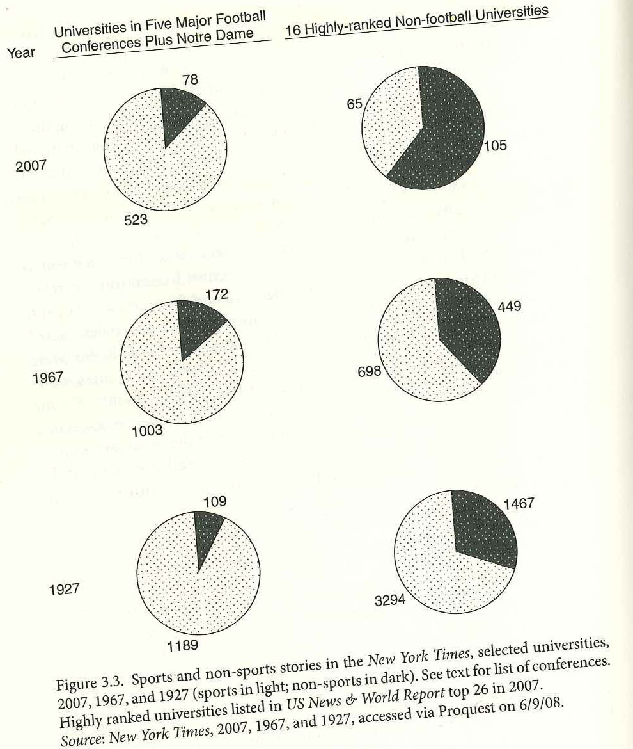
Role of the Media
Journalism about American higher education is dominated by intercollegiate athletics
Growth of popularity due to radio and television
Power of March Madness on research activity and pattern of work in research libraries

Slide 21
Coaches and Presidents
Based on search engine hits, big-time football coaches are better known than college presidents
The big-time coach has been described as the “Colossus of the Campus”
Gordon Gee, former Ohio State University president, (speaking of head football coach Jim Tressel) said: “I hope he doesn’t fire me.”

Slide 22
i>Clicker question
Could you name any of the following?
At least two U.Va. Presidents
At least two U.Va. Football Head Coaches
At least two U.Va. Men’s Basketball Head Coaches
None of the above
Some of the above

Slide 23
Clotfelter on Bigness of Big-Time
Regarding big-time college sports, “it is likely that more hours are spent by fans attending games or viewing them on TV than are spent by students, faculty, and staff engaged in the traditional tasks of research, teaching, learning, and service” Clotfelter, 2011, pg. 65).

Slide 24
i>Clicker question
Indicate the extent to which you find the quote from Clotfelter a matter of concern for university leaders.
A. Strongly Agree
B. Agree
C. Undecided
D. Disagree
E. Strongly Disagree

