Slide 1
Aircraft Engine Failure
Helicopter Gearbox Faults
Fraudulent Telephone Calls
Customer Churn
Diagnosis of Cancerous Cells
What’s common in all these datasets?

Slide 2
Models are biased towards majority class

Slide 3
Predicting U.S. population income level
– an imbalanced classification problem
                Fei Wang
                2016/12/21
A presentation with materials shamelessly borrowed from many others

Slide 4
Agenda
Problem Statement
Methodology
EDA & Data Munging
Model Estimation & Assessment
Future Work & References
Q&A

Slide 5
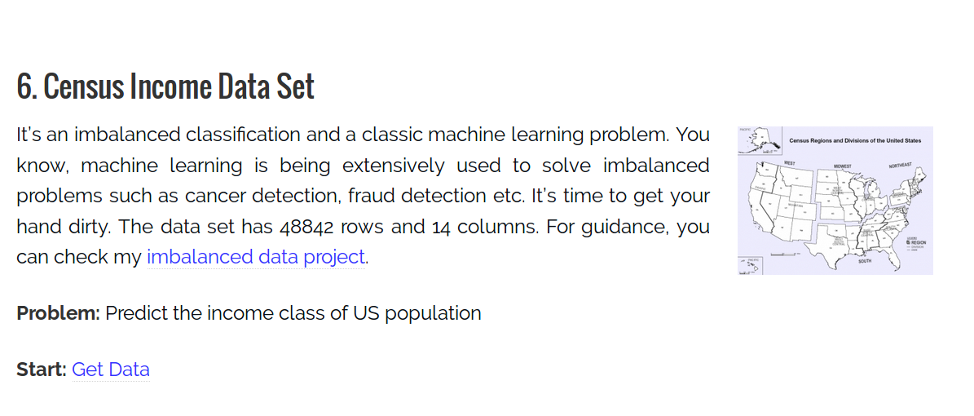
Problem Statement

Slide 6
Problem Statement
Task: correctly predict the income level of given US worker into “50K+” or “50K-” category
Goal: Reach high performance despite of severely biased class
Result: Prediction accuracy for minority class increased from 31% to 89%

Slide 7
Methodology
Possible Classifiers:
  Discrete Classifiers: only outputs a class label
    Decision Tree, KNN, etc.
  Probabilistic Classifiers: outputs a numeric value that represents the degree to which an instance is a member of a class (ROC available)
    Logistic Regression, Naive Bayes, SVM, etc.

Slide 8
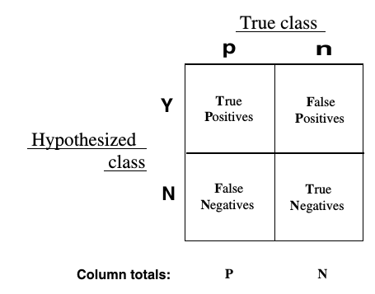
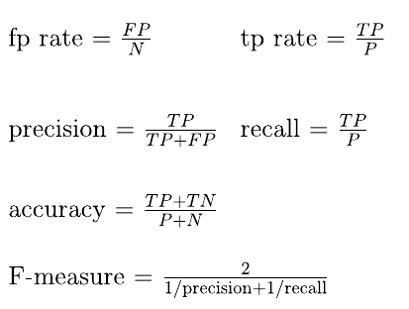
Methodology
Possible Metrics for model assessment:
  Accuracy Score ( (TP + TN) / (P + N) )
  Precision, Recall, F-measure
  ROC curve (TPR vs. FPR), AUC
  TPR, TNR

Slide 9
Methodology
Model Estimation:
  Logistic Regression Binary Classification via Scikit-Learn
Model Assessment:
  AUC
    Not affected by the choice of any particular cut-off threshold
    Insensitive to changes in class distribution
  TPR, TNR
    Monitor the model’s performance on predicting both class correctly

Slide 10
EDA
Dataset Summary:
  1994 and 1995 current population surveys by U.S. Census Bureau
    data source
  41 columns: (40 features + Class Label of Annual Income)
  Class Label: < $50K and > $50K
  Training Dataset: 199,523 rows
  Test Dataset: 99,762 rows
  Class Distribution (neg vs. pos): 93.8% vs. 6.2%

Slide 11
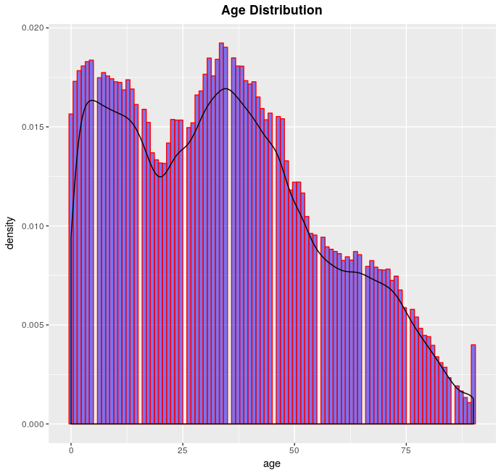
EDA

Slide 12
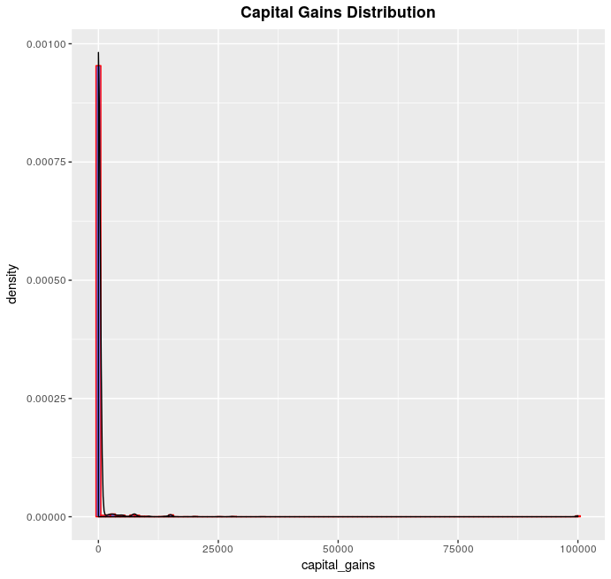
EDA

Slide 13
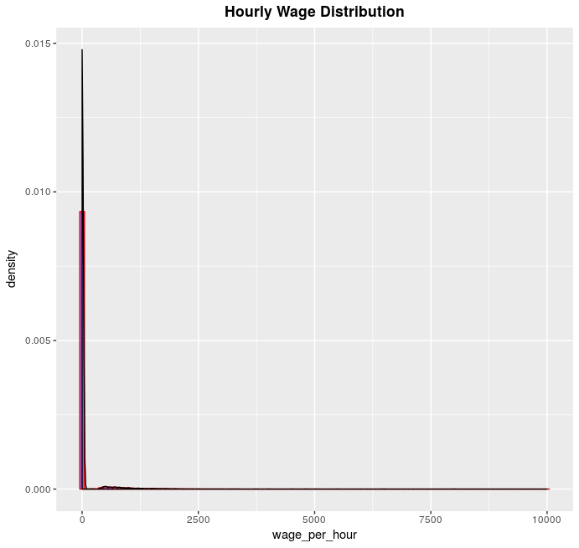
EDA

Slide 14
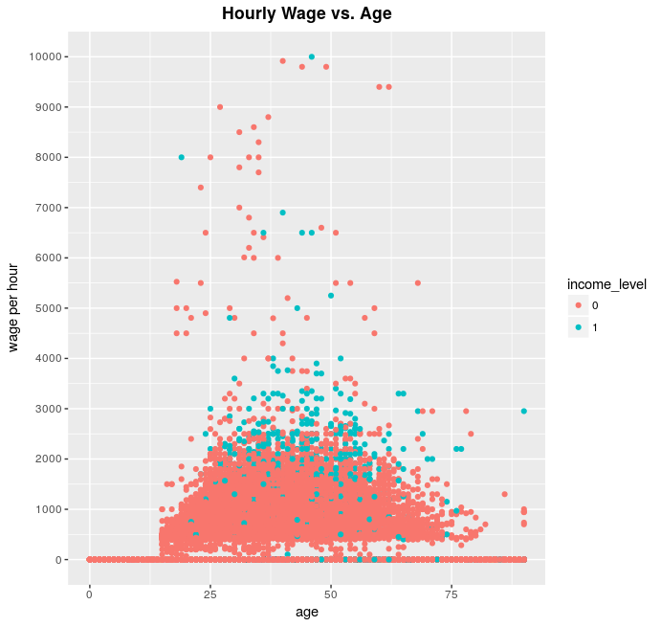
EDA

Slide 15
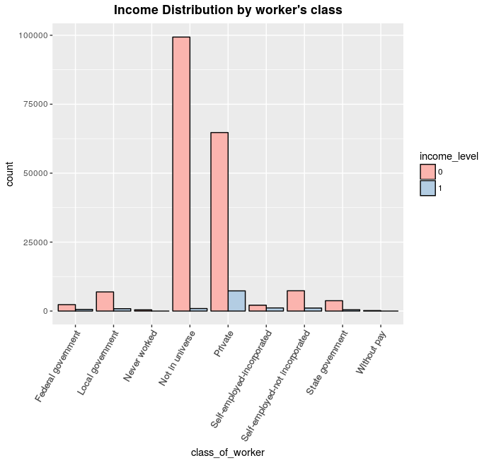
EDA

Slide 16
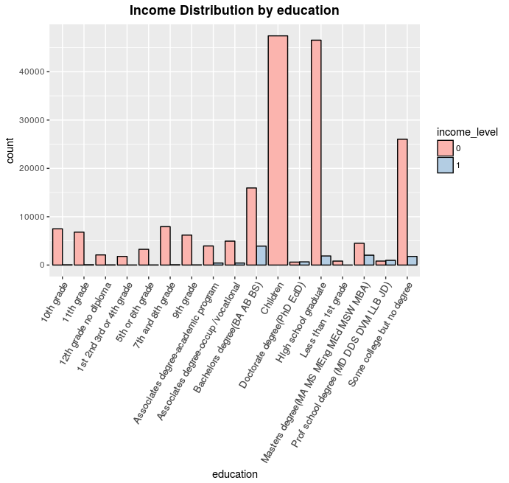
EDA

Slide 17
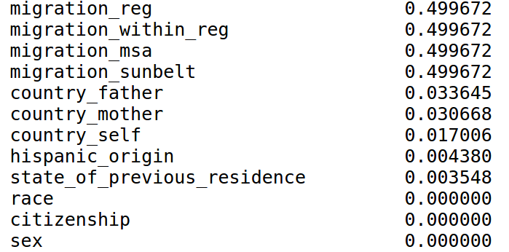
Data Munging
Check missing values:
  numerical features:
    No missing value for both training and test sets
  Categorical features:

Slide 18
Data Munging
Drop columns of high missing value rate
Combine categories of <5% population in categorical features
  Worker’s class, education, etc.
Bucketing continuous features to simplify model
  Age, wage/hour, capital gains/losses, dividends, etc.
Remove redundant feature of high correlation with another

Slide 19
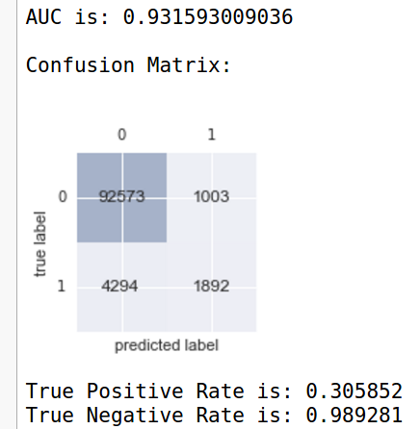
Model Estimation & Assessment
Use Logistic Regression binary classification
Use Original Training and Test datasets
Result:

Slide 20
Model Estimation & Assessment
Ways to approach Imbalanced dataset:
Learning level: strengthening the learning process towards the minority class
  Give different classification costs
  Write your own algorithm
  Testing classification threshold
  Ensemble methods
Data level: altering the class distribution to get a more balanced dataset
  Under-sampling the majority class
  Over-sampling the minority class
  Both

Slide 21
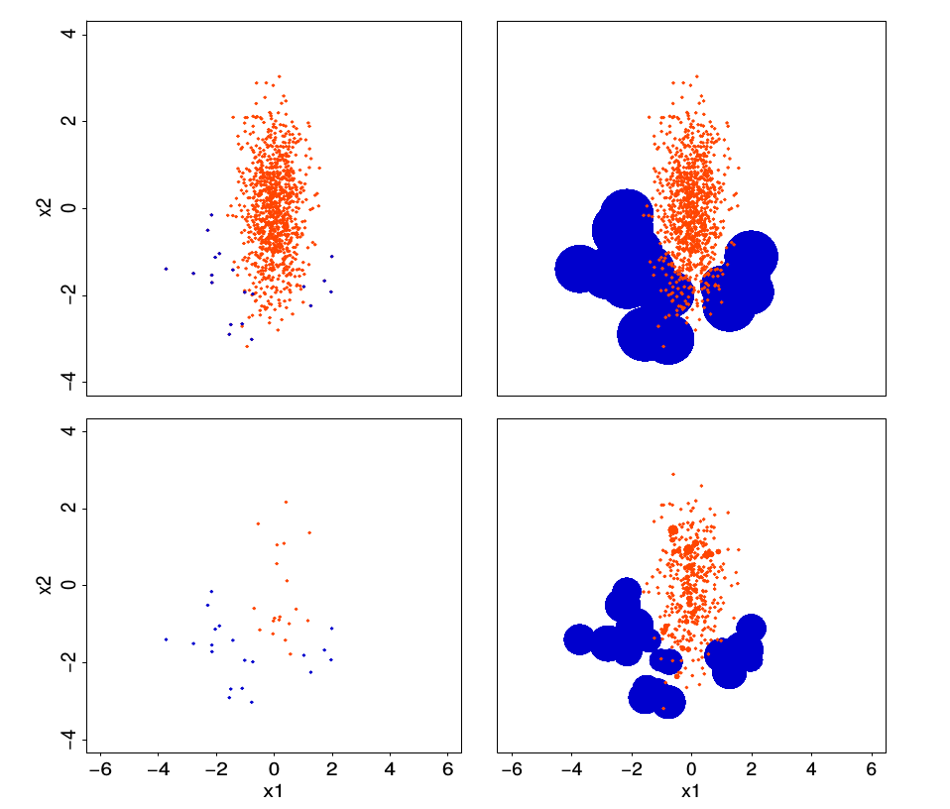
Model Estimation & Assessment
Data Balancing Mechanisms

Slide 22
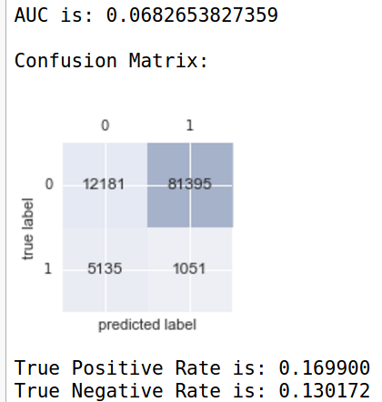
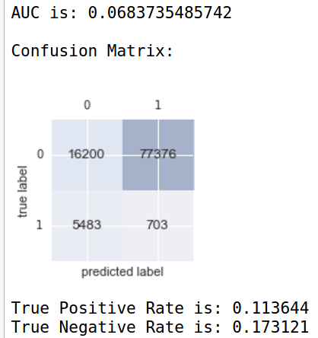
Model Estimation & Assessment
Under-Sampling Majority Class Over-Sampling Minority Class

Slide 23
Okay, I have heard of all above. Tell me something I don’t know...

Slide 24
Informed over-sampling of the minority class with random under-sampling of the majority class

Slide 25
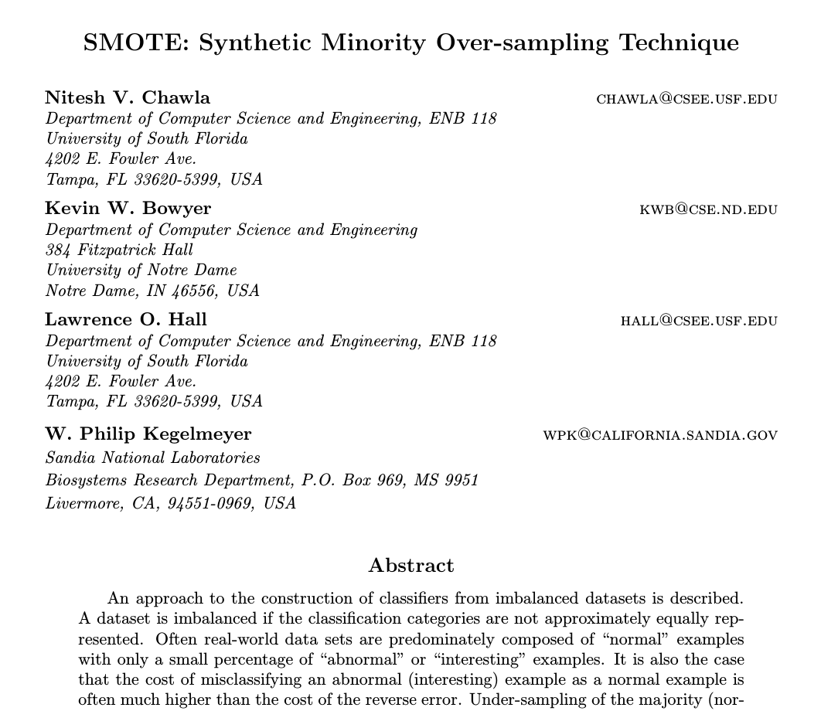
Model Estimation & Assessment

Slide 26
Model Estimation & Assessment
What is SMOTE?
  Instead of over-sampling the minority class with replacement, it adds artificial data points similar to the ones in minority class until reaching a balance of classes
  For one data point in the feature space (A), randomly choose one of its nearest neighbors (B), then take a random point between A and B, say C and add C to the training set

Slide 27
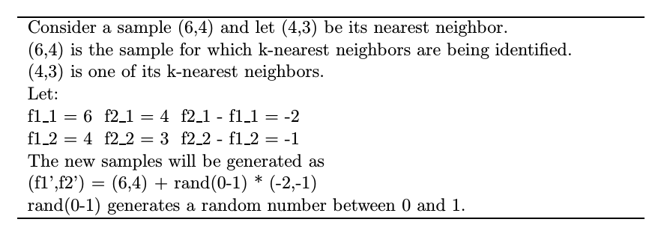
Model Estimation & Assessment
Example of SMOTING
How to implement SMOTE?
  Python: Imbalanced-learn
  R: DMwR

Slide 28
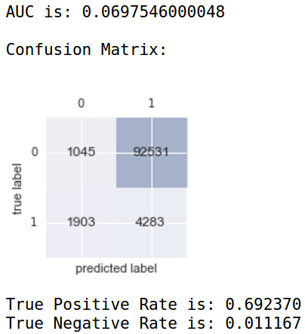
Model Estimation & Assessment
“SMOTING” the minority class and under-sampling the majority class
result

Slide 29
Is there a better way?

Slide 30
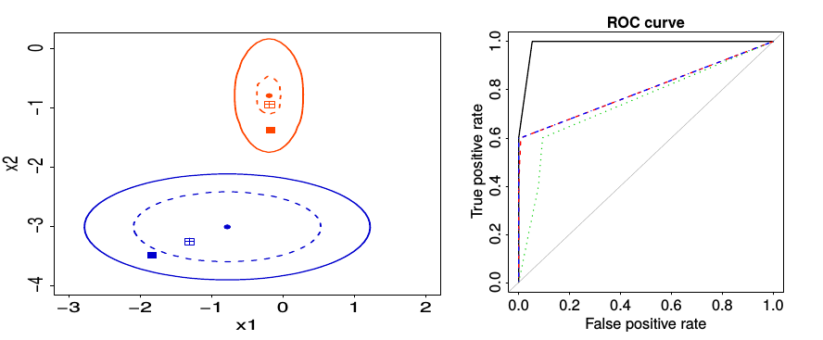
Model Estimation & Assessment
Torelli N, Menardi G (2012) Training and assessing classification rules with imbalanced data. Data Mining and Knowledge Discovery 28
ROSE: Randomized Over-Sampling Examples (based on a smoothed bootstrap re-sampling technique)

Slide 31
Model Estimation & Assessment
Torelli N, Menardi G (2012) Training and assessing classification rules with imbalanced data. Data Mining and Knowledge Discovery 28
Why is ROSE better than SMOTE:
  Sound theoretical basis (Kernel Density Estimation)
  Less parameter inputs
  Predict better according to the authors :)

Slide 32
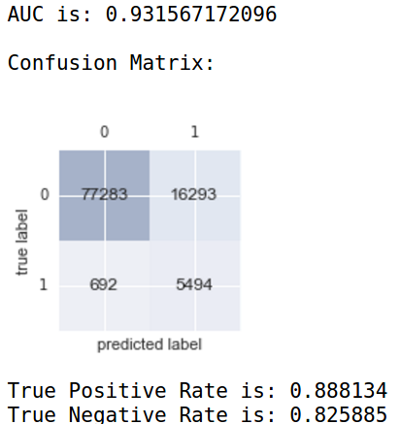
Model Estimation & Assessment
“ROSING” the minority class and under-sampling the majority class
result

Slide 33
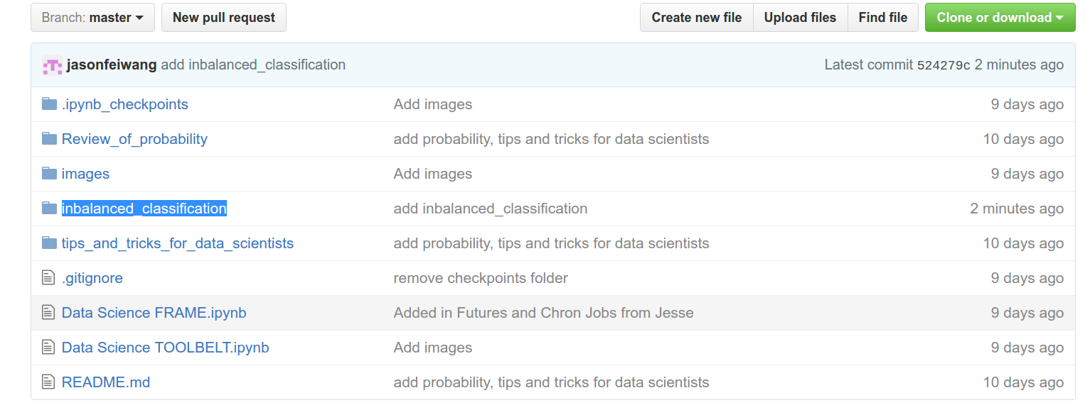
Future Work
More Feature Engineering
SMOTE + Other Models + Boosting Method
ROSE + Boosting/Bagging Method

Slide 34
References
Chawla NV, Bowyer KW, Kegelmeyer WP (2002) SMOTE: synthetic minority over-sampling technique. Journal of Artificial Intelligence Research 16:321–357
Fawcett T (2006) An introduction to ROC Analysis. Journal of Pattern Recognition Letters 27:861-874
Torelli N, Menardi G (2012) Training and assessing classification rules with imbalanced data. Data Mining and Knowledge Discovery 28
Lunardon N, Mendardi G, Torelli N (2014) ROSE: A package for Binary Imbalanced Learning. The R Journal 6/1, June 2014

Slide 35
Thank you!

Slide 36
Q&A

