Slide 1
WWTP I&I Story — Daily Readings
Period: 2015-04-01 to 2025-06-30

Slide 2
At a Glance
Dry-weather baseline ≈ 0.080 MGD
Regression (Flow = a + b·P0 + c·P1 + d·P2): R² ≈ 0.14
Overall I&I volume ≈ 226.6 MG (42.5% of total flow)
Multiple wet-weather responses identified with distinct recession to baseline.

Slide 3
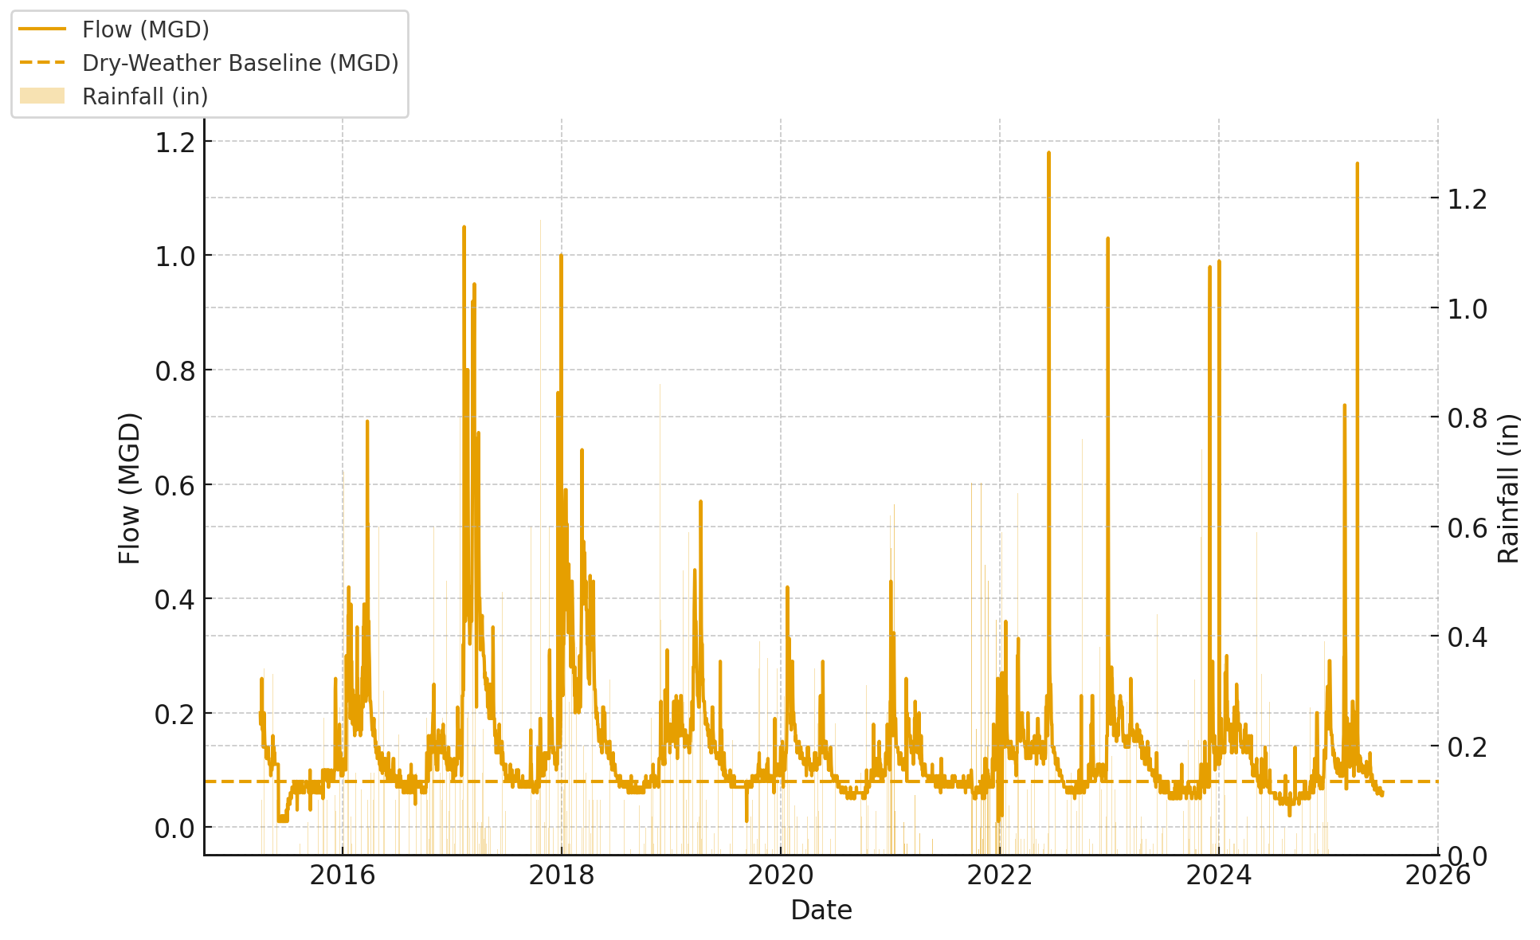
Flows & Rainfall

Slide 4
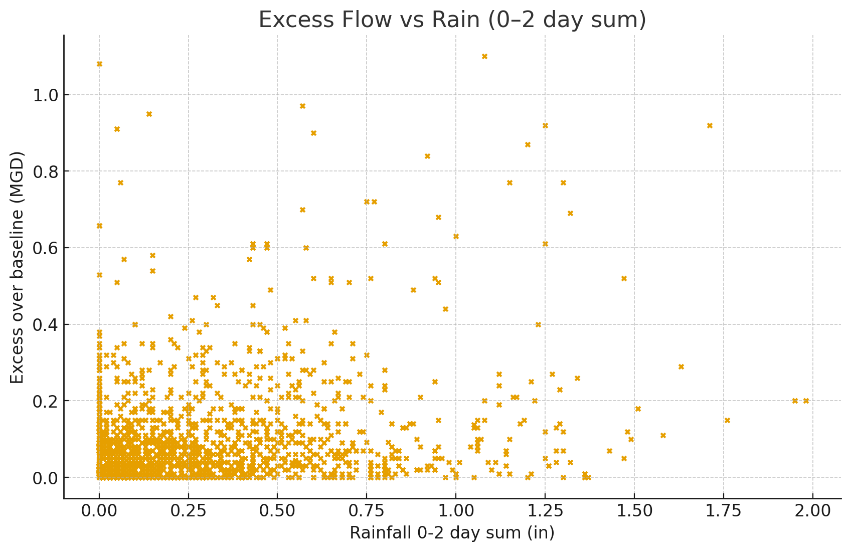
Excess Flow vs Rain (0–2 day sum)

Slide 5
What the Lags Say
P0 (same-day) coefficient ≈ 0.209 MGD/in
P1 (1-day lag) coefficient ≈ 0.124 MGD/in
P2 (2-day lag) coefficient ≈ 0.116 MGD/in
Interpretation: positive same-day signal suggests inflow; positive lagged terms indicate infiltration.

Slide 6
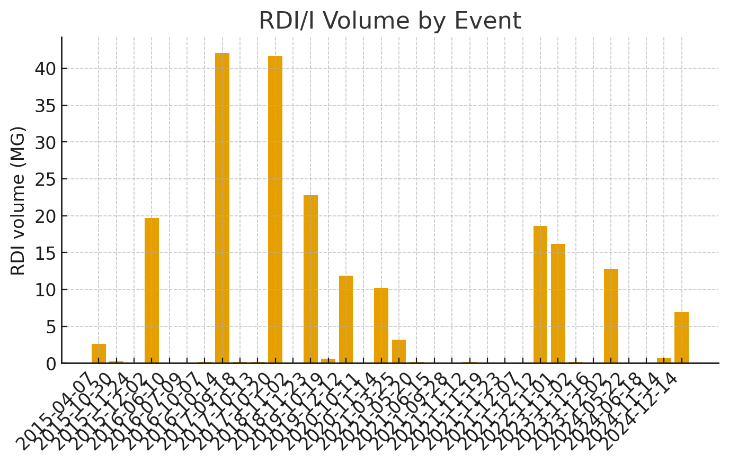
RDI/I Volume by Event

Slide 7
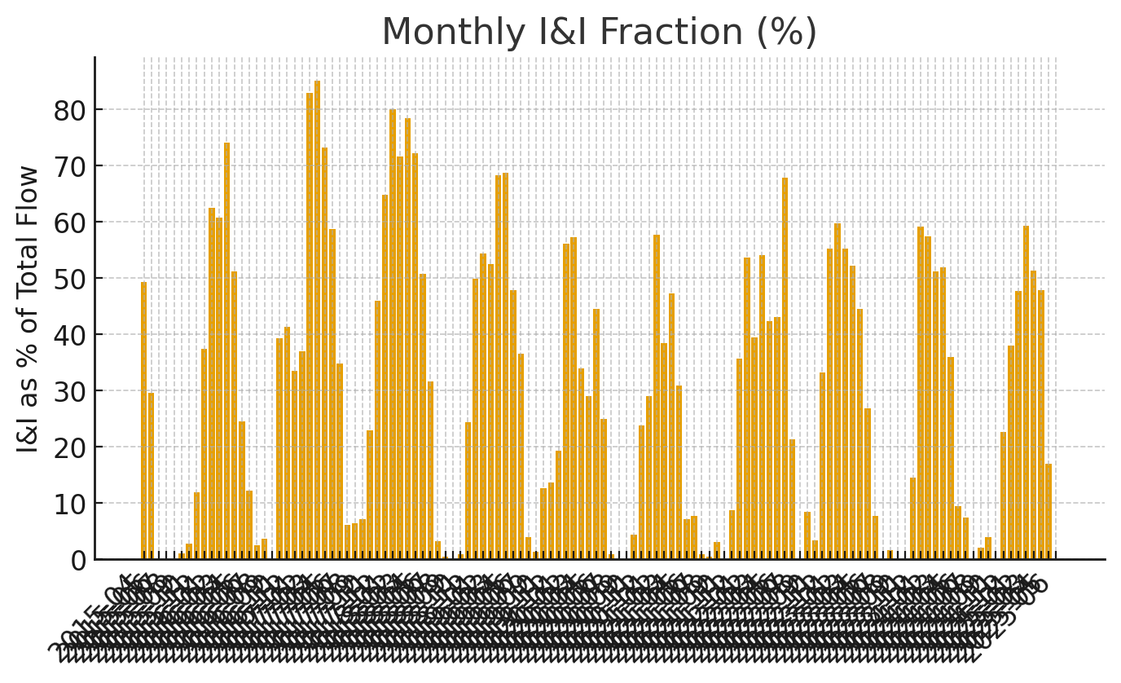
Monthly I&I Fraction (%)

Slide 8
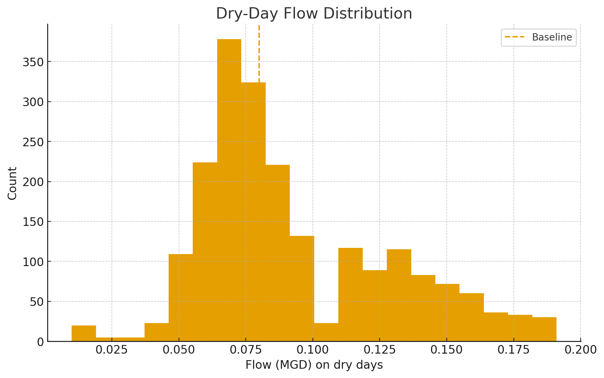
Dry-Day Flow Distribution

Slide 9
Recommended Next Steps
Target sources: roof/yard drains, sump pumps (inflow) near quick spikes; leaky sewers/manholes (infiltration) where lag is strong.
Plan SSES: smoke testing during dry weather; CCTV and nighttime flow isolation in basins with highest event volumes.
Correlate rainfall hyetographs with sub-basin meters to pinpoint fast-response areas.

