Slide 1
Denoising Diffusion Probabilistic Models
20201216

Slide 2
CONTENTS
Diffusion
Diffusion Traning
Lsimple
Latent space interpolation vs. Pixel space interpolation
Lantent Diffusion

Slide 3
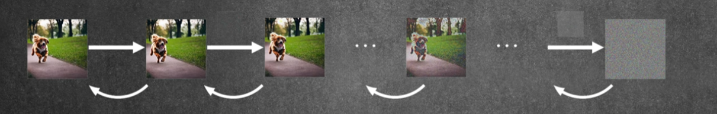
Diffusion
Gaussian noise

Slide 4
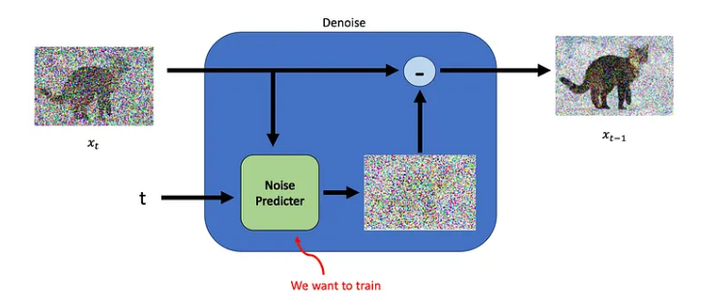
Diffusion Traning
Stochastic Differential Equation
Probability density function

Slide 5
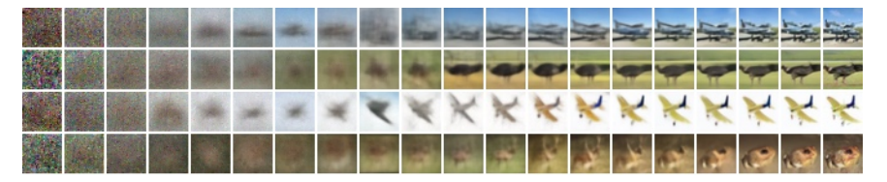
Lsimple(Progressive generatio)

Slide 6
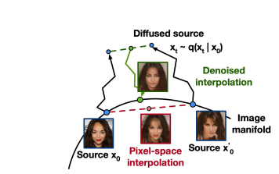
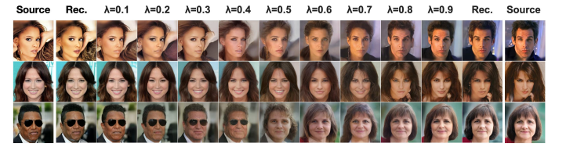
Latent space interpolation vs. Pixel space interpolation

Slide 7
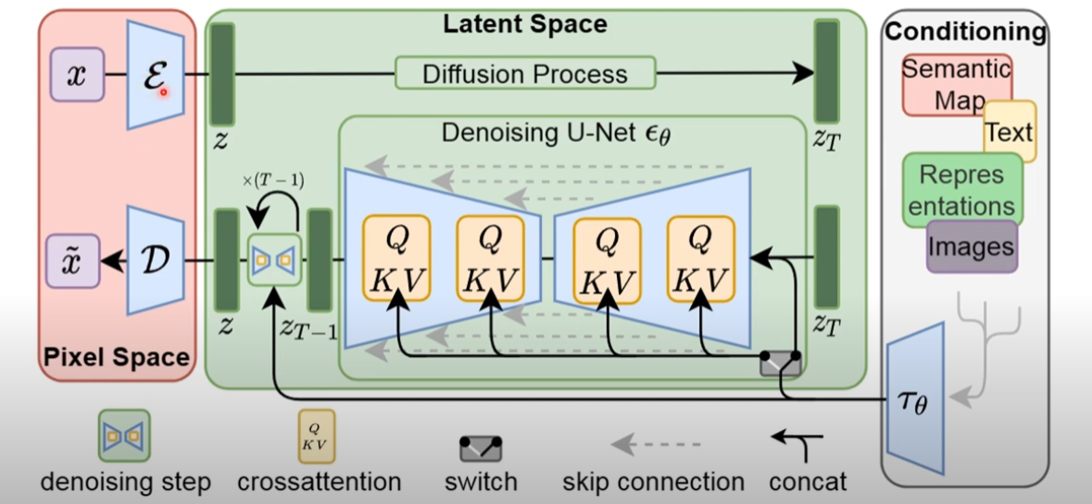
Latent Diffusion

Slide 8
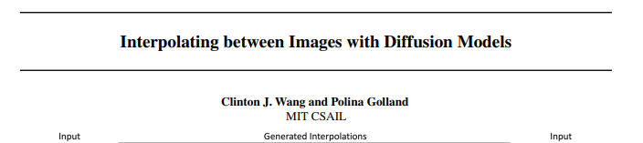
Why latent space?
Space: latent space<< pixel space
Style change: enable domain adaptation, style transfer
Enable out-of-distribution prompts
Notes:
潛在空間的維度通常比原始資料空間低。這種維度縮減有助於簡化建模過程，使其更易於處理，特別是對於複雜和高維度的資料
interpolate pairs of images with diverse styles, layouts, and subjects.

Slide 9
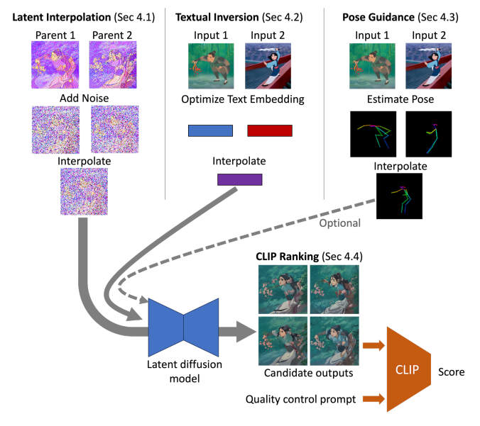
Diffusion for Interpolating Images
Notes:
用三種資料進入latent diffusion model

Slide 10
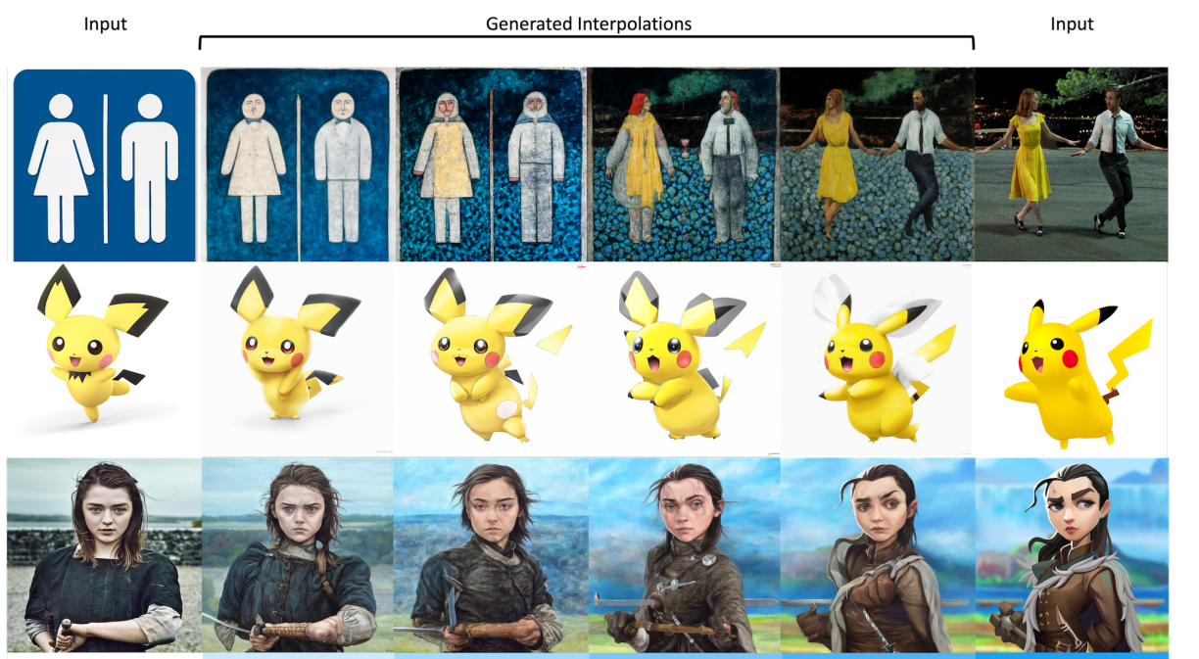
Diffusion for Interpolating Images
result

