Slide 1
Interpolating between Images with Diffusion Models
20201216

Slide 2
CONTENTS
Introduction
Literature Review
Methodology
Results
Discussion
Conclusion

Slide 3
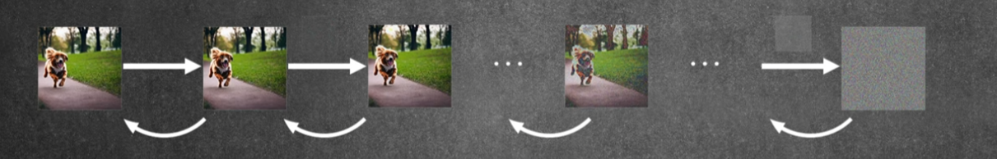
Introduction : Diffusion
Gaussian noise
Notes:
擴散模型是一種生成模型，其概念是透過逐步向數據添加隨機雜訊，直到數據完全變成雜訊，然後學習如何逆轉這個過程，從雜訊中逐步恢復原始數據
如圖在每個時間步長，都會向圖像中添加少量的高斯雜訊，使得圖像逐漸變得模糊和失真。
如圖所示，狗的圖像從清晰逐漸變得模糊，最終變成一團雜訊。
逆向去噪過程:這是擴散模型學習的關鍵部分。 模型會學習如何從帶有雜訊的圖像中去除雜訊，從而逐步恢復原始圖像。
透過學習這個逆向過程，模型能夠從隨機雜訊開始，逐步生成出新的、逼真的圖像。

Slide 4
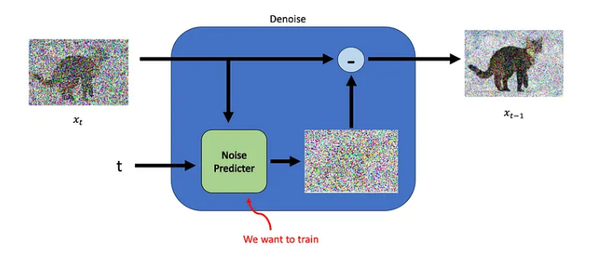
Diffusion Training
Stochastic Differential Equation
Probability density function
Notes:
Xt是一張有雜訊的圖片，透過中間一個預測器，將圖片逐步去噪音

Slide 5
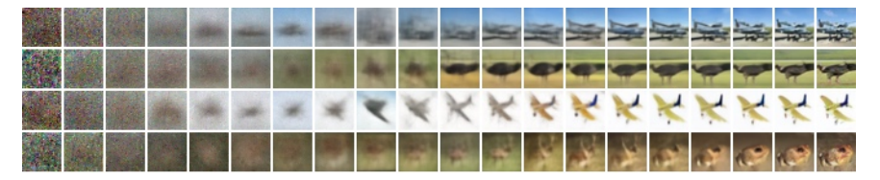
Progressive generation
Notes:
未來在預測新圖時 即可以用一個亂生成的雜訊 最終生成一個合理的圖 這邊是cifar的範例

Slide 6
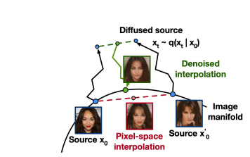
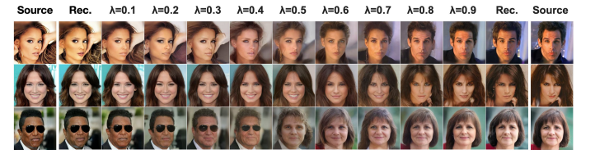
Literature Review: Latent space interpolation vs. Pixel space interpolation
Latent space: data compression, high efficiency
Pixel space: high dimension, not smooth
Why latent space?
Space: latent space<< pixel space
Style change: enable domain adaptation, style transfer
Enable out-of-distribution prompts
Notes:
Latent Space 通常在生成過程中是更高效、更平滑且更穩定的選擇，特別是在像擴散模型這樣的情境下，能夠更好地捕捉數據的結構性特徵。
Pixel space 雖然能夠保留更多的細節，在高維度數據的問題，計算成本高且容易出現不穩定和不自然的過渡

Slide 7
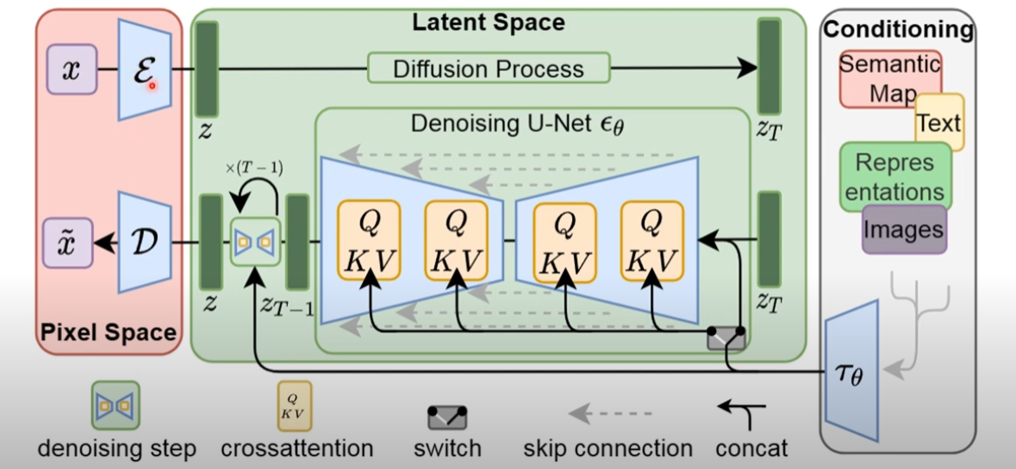
Latent Diffusion

Slide 8
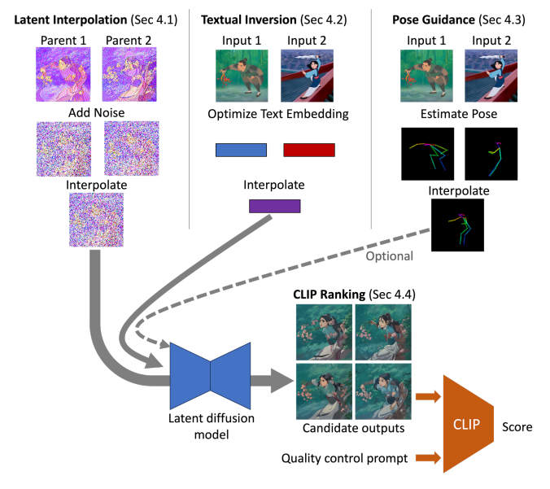
Diffusion for Interpolating Images
Notes:
用三種資料進入latent diffusion model

Slide 9
Noise schedule
DDIM sampling
200 time steps
<25% schedule: resemble an alpha composite of their parent images
>65% schedule: deviate significantly from their parent
Choose 25%~65% schedule
Notes:
DDIM是denoising diffusion implicit models

Slide 10
Textual inversion
interpolated text embeddings
Initial Encoding: The text prompt is encoded as usual
Fine-Tuning: The prompt embedding is fine-tuned
Condition: The fine-tuning process minimizes the LDM error at random noise levels
Conditioning Input: The resulting is used as a conditioning input for the LDM's denoising U-Net

Slide 11
Textual inversion
Item | Detail Description | Source
Prompt Types | Both positive and negative text prompts are used and optimized during the process.
Scope of Optimization | Since the task (e.g., image interpolation) does not require a custom token, the decision is made to optimize the entire text embedding.
Handling Complexity | The number of iterations can be increased for images with complicated layouts or styles, as these are harder to represent with a text prompt.

Slide 12
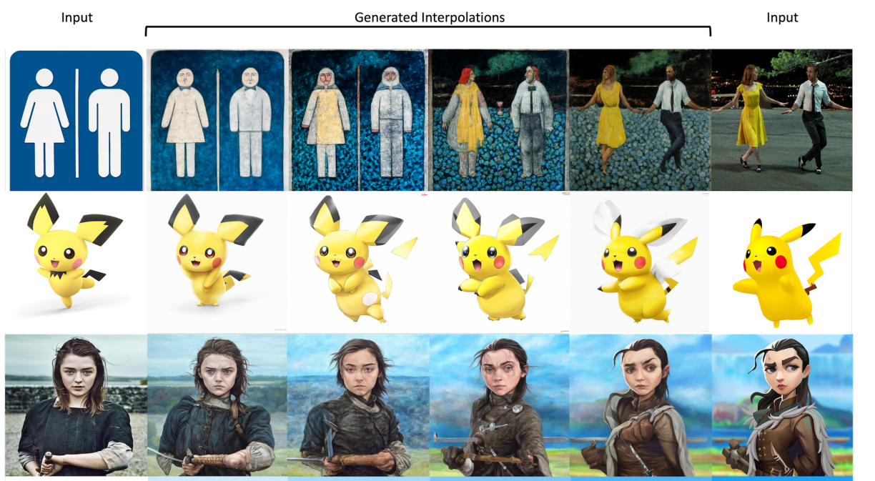
Diffusion for Interpolating Images
result

