Slide 1
Interpolating between Images with Diffusion Models
20201216

Slide 2
CONTENTS
Introduction
Literature Review
Methodology
Results
Discussion
Conclusion

Slide 3
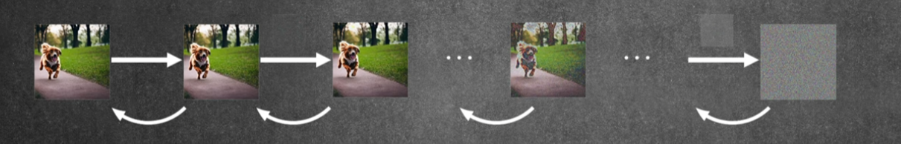
Introduction : Diffusion
Gaussian noise

Slide 4
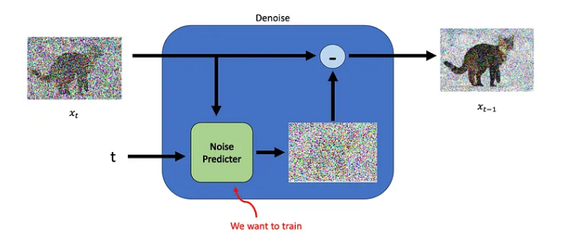
Diffusion Training
Stochastic Differential Equation
Probability density function

Slide 5
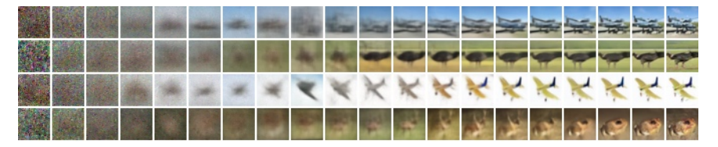
Progressive generation

Slide 6
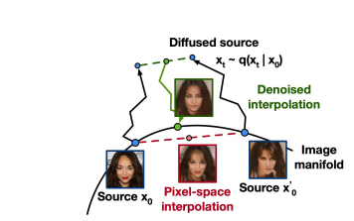
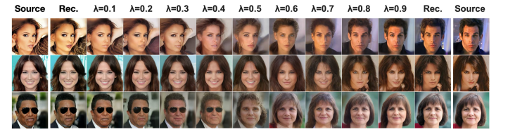
Literature Review: Latent space interpolation vs. Pixel space interpolation
Latent space: data compression, high efficiency
Pixel space: high dimension, not smooth
Why latent space?
Space: latent space<< pixel space
Style change: enable domain adaptation, style transfer
Enable out-of-distribution prompts
Notes:
Latent Space 通常在生成過程中是更高效、更平滑且更穩定的選擇，特別是在像擴散模型這樣的情境下，能夠更好地捕捉數據的結構性特徵。
Pixel space 雖然能夠保留更多的細節，在高維度數據的問題，計算成本高且容易出現不穩定和不自然的過渡

Slide 7
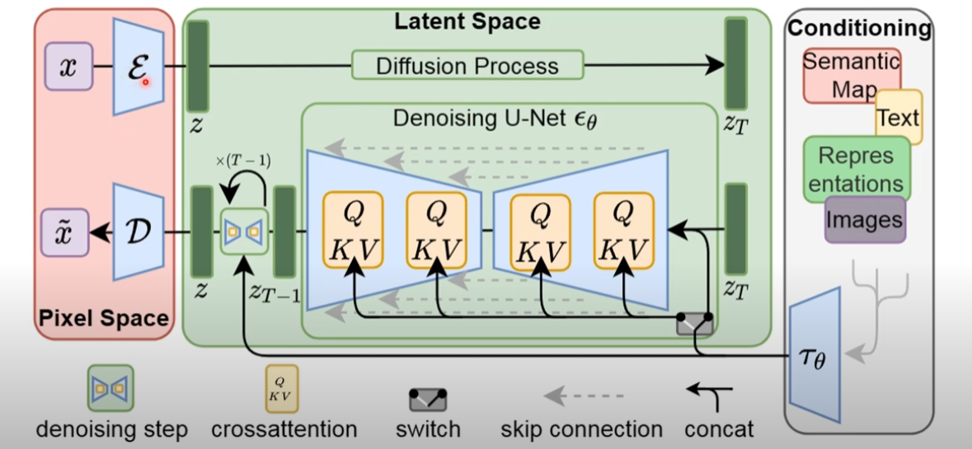
Latent Diffusion

Slide 8
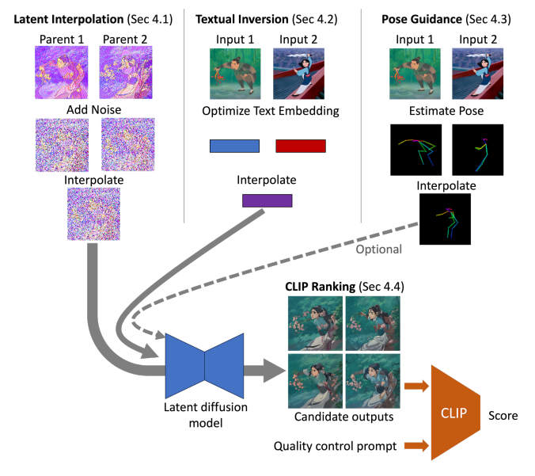
Diffusion for Interpolating Images
Notes:
用三種資料進入latent diffusion model

Slide 9
Noise schedule
DDIM sampling
200 time steps
<25% schedule: resemble an alpha composite of their parent images
>65% schedule: deviate significantly from their parent
Choose 25%~65% schedule

Slide 10
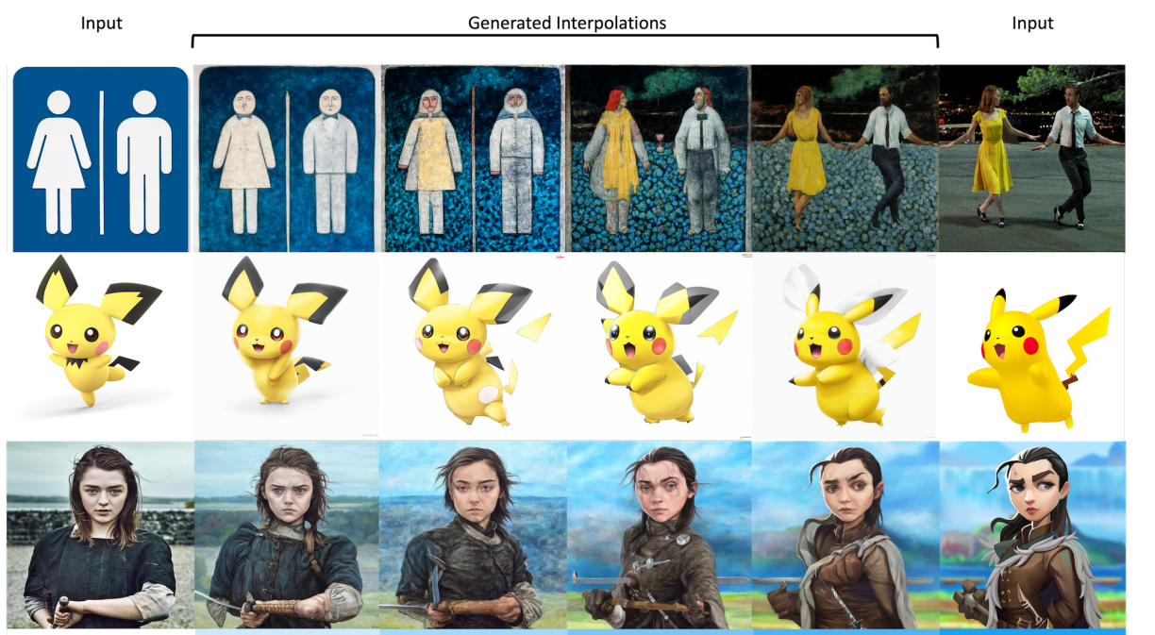
Diffusion for Interpolating Images
result

