Slide 1
VTimeLLM: Empower LLM to Grasp
Video Moments
Bin Huang, Xin Wang*, Hong Chen, Zihan Song, Wenwu Zhu*
Tsinghua University
Proceedings of the IEEE/CVF Conference on Computer Vision and Pattern Recognition (CVPR), 2024.
*Corresponding Authors.

Slide 2
Outline
Introduction
Related Works
Method
Experiment
Conclusion

Slide 3
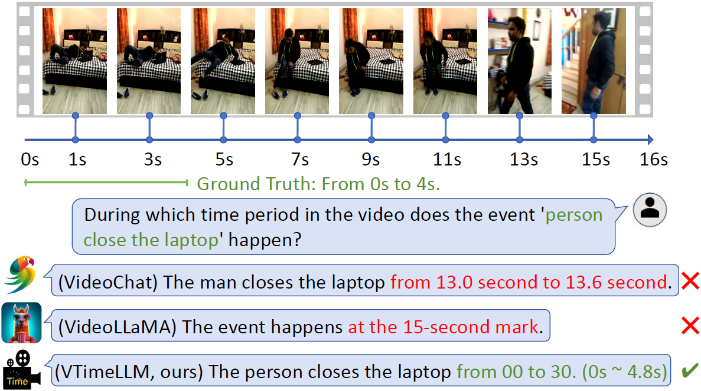
Introduction
Figure 1. Existing Video LLMs, such as VideoChat and VideoLLaMA, exhibit a deficiency in boundary awareness, leading to challenges in accurately capturing the precise timestamps of specific events.
Notes:
現有的影片大型語言模型（像是 VideoChat 和 VideoLLaMA）對事件的時間界定靈敏度不足，因此在準確掌握特定事件的時間點上會遇到困難。

Slide 4
Introduction
Existing large language models (LLMs) can process visual information but struggle to precisely localize specific moments in long videos.
Most models generate coarse summaries and fail to identify accurate start and end timestamps.
Notes:
現有的大型語言模型（LLM）雖然能理解視覺資訊，但還是難以在長影片中準確抓出特定時間點。
大多數模型只能生成粗略的摘要，沒辦法準確找出事件的開始和結束時間。

Slide 5
Introduction
Challenging Tasks
  Temporal Video Grounding (TVG): Locate video segments based on text.
  Dense Video Captioning (DVC): Generate descriptions for multiple events in a video.
Task Requirements
  fine-grained temporal and semantic alignment.
Notes:
根據文字內容找出對應的影片片段。
為影片中的多個事件產生文字描述。
精細的時間與語意對齊。

Slide 6
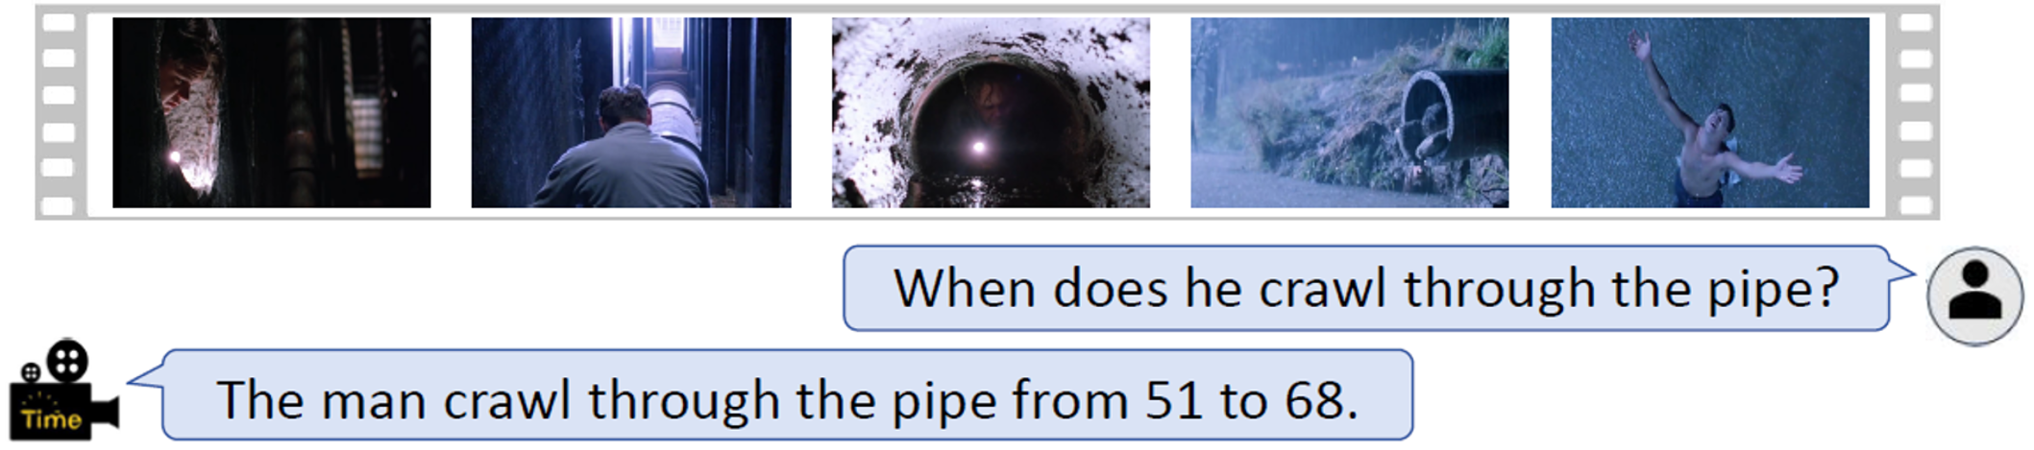
Introduction (Temporal Video Grounding)
Model Capability
  Identifies the video segment corresponding to the textual query “Ti” and provides its precise start and end timestamps.
Key Point
  Accurate alignment between textual descriptions and video time segments.
Ti: Text description
Notes:
找出與文字查詢「Ti」對應的影片片段，並提供精準的開始與結束時間。
將文字描述與影片時間片段準確對齊。

Slide 7
Introduction (Dense Video Captioning)
Model Capability
  Identifies multiple temporal segments in the video and generates semantically rich captions for each.
Key Point
  Combines temporal localization with semantic captioning to provide structured understanding of multi-event videos.
Notes:
辨識出影片中的多個時間片段，並為每個片段生成語意豐富的描述。
結合時間定位與語意描述，為多事件影片提供有結構的理解。

Slide 8
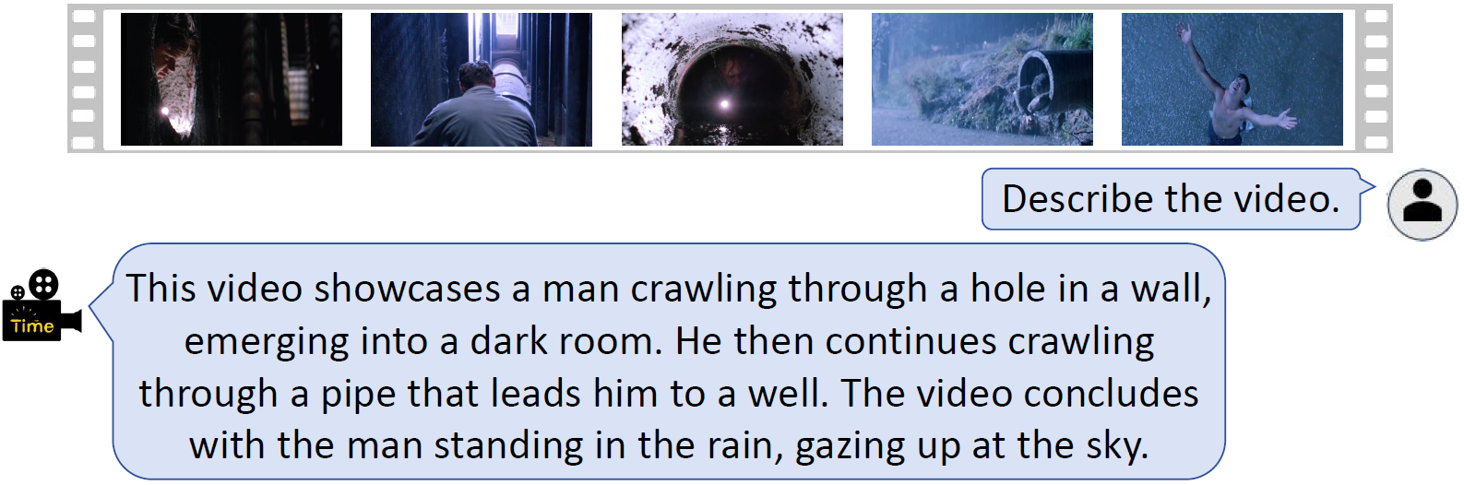
Introduction (Dense Video Captioning)
(1)
(2)
(3)
(4)
(5)
Notes:
這段影片展示了一個男人爬過牆上的一個洞，進入一個黑暗的房間。接著，他繼續爬過一根通往井口的管子。影片最後，男人站在雨中，仰望著天空。

Slide 9
Outline
Introduction
Related Works
  Video-ChatGPT: Towards Detailed Video Understanding via Large Vision and Language Models
  LoRA: Low-Rank Adaptation of Large Language Models
Method
Experiment
Conclusion

Slide 10
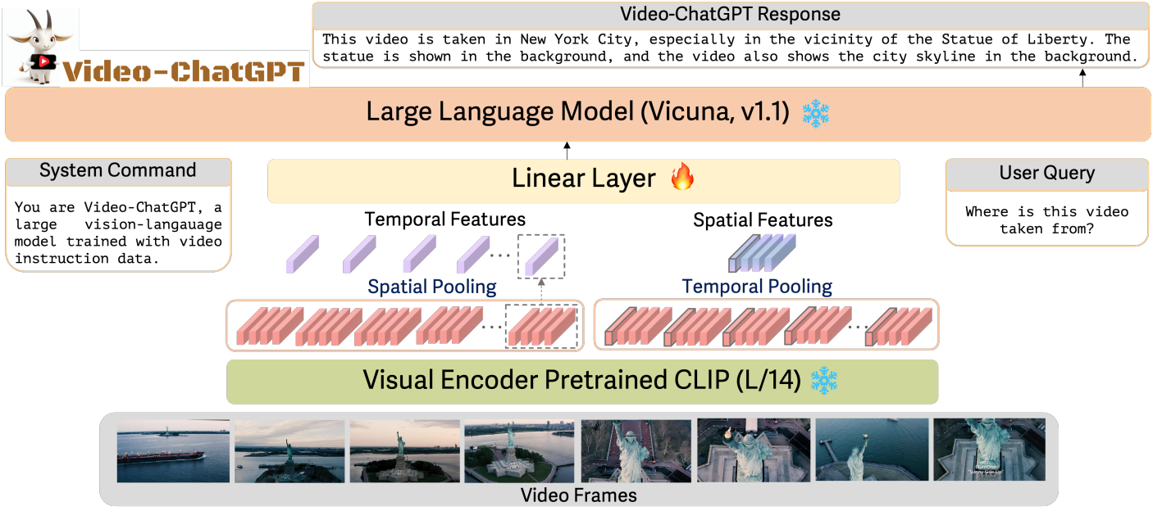



Video-ChatGPT
Figure 1: Video-ChatGPT leverages the CLIP-L/14 visual encoder to extract both spatial and temporal video features. This is accomplished by averaging frame-level features across temporal and spatial dimensions respectively. The computed spatiotemporal features are then fed into a learnable linear layer, which projects them into the LLMs input space.
:aggregated temporal features
W, H: 224x224
Patch size: 14x14
Patch number: 16x16
:aggregated spatial features
:patch features extracted from each image after segmentation
Muhammad Maaz et al. Video-ChatGPT: Towards Detailed Video Understanding via Large Vision and Language Models. ACL, 2024
Notes:
想法:圖片是靜態的，但是影片是動態的，且具有前後邏輯，也就是影片需考慮時序的因素。所以作者想透過建立時序關係讓語言模型看懂影片。透過CLIP預訓練好的image encoder去提取影片中每一個frame的特徵向量，然後透過spatial pooling和temporal pooling建立起時序關係，接著透過一個可訓練的layer(fully connected)把提取到的資訊轉換成LLM可以接受的輸入格式，讓LLM能夠看懂影片，接著設計問答模板，進一步讓模型學會如何根據問題以及輸入的影片相關資訊產生正確且保持前後邏輯連貫的描述。
Video-ChatGPT 利用 CLIP-L/14 視覺編碼器提取影片的空間與時間特徵。具體做法是分別對每一幀的時間維度和空間維度的特徵進行平均，得到時空特徵。接著，這些時空特徵會送入一個可學習的線性層，將其投射到大型語言模型（LLM）的輸入空間。

Slide 11



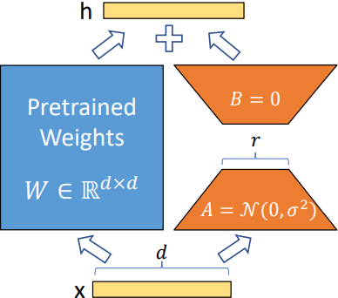



LoRA: Low-Rank Adaptation
Figure 1: Our reparameterization. We only train A and B.
Pretrained Weights
Dimensions
Edward J Hu et al. Lora: Low-rank adaptation of large language models. ICLR, 2022
Notes:
x是一個d維的向量。藍色是模型的pretrained weights，維度是d*d，這邊W是保持凍結的。A是維度為r*d的矩陣，初始化為高斯分布，B是維度為d*r的矩陣，初始化為0，最終的輸出h是Wx + BAx。那這邊就是只透過訓練A和B兩個矩陣，達到更新權重的目的。如果調整整個W，那參數量為d*d，可是只訓練A和B兩個矩陣的話，參數量為2*d*r。

Slide 12
Outline
Introduction
Related Works
Method
  Stage 1 : Feature Alignment
  Stage 2 : Boundary Perception
  Stage 3 : Instruction Tuning
Experiment
Conclusion

Slide 13
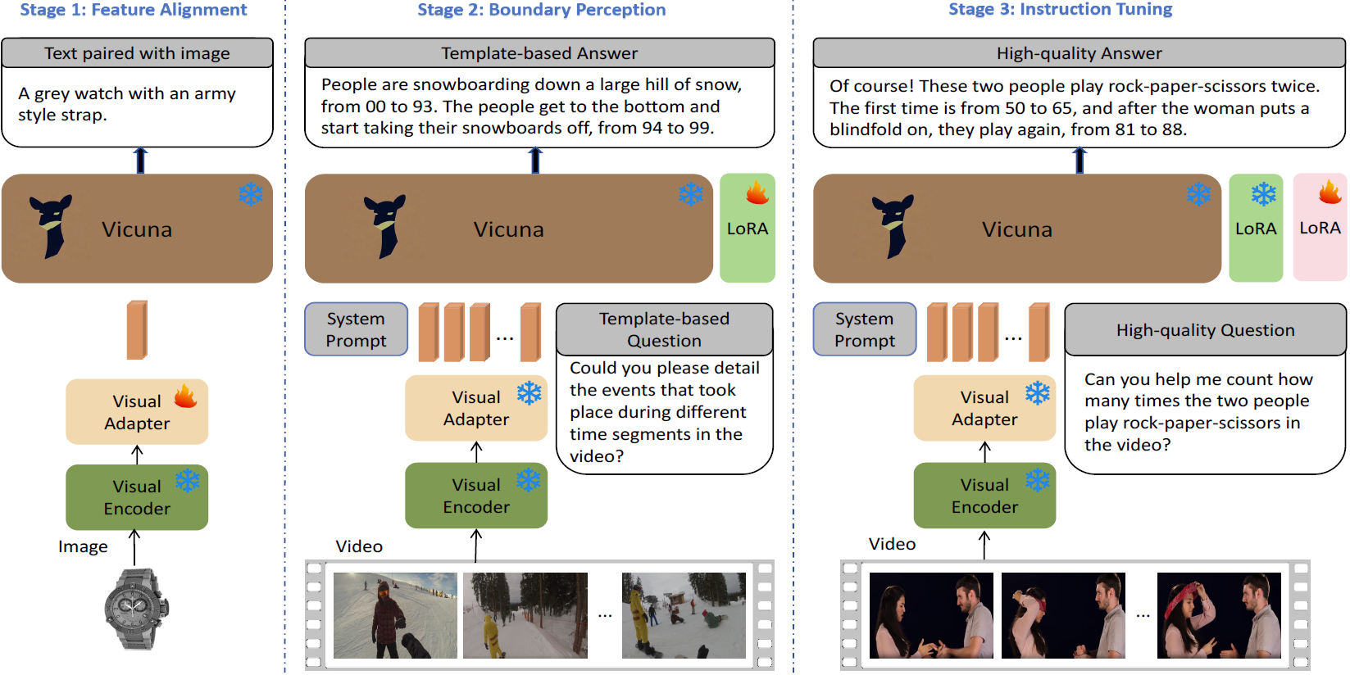
Method
Figure 2. Our boundary-aware three-stage training framework. In the first stage, visual features are aligned with LLM’s semantic space through image-text training.
Notes:
這篇作者的想法是針對不同的目的提出三個訓練階段。Stage1作者想透過訓練一個visual adapter，讓視覺特徵可以有效地和LLM的語意做對齊。Visual encoder 是使用CLIP預訓練好的image encoder。Visual adapter的用途是將visual encoder提取到的CLS token轉換成LLM所能接受的輸入格式，這邊訓練的目的是讓visual adapter學習如何更準確的把CLS token轉換成LLM可以接受的輸入格式。

Slide 14
Method
Figure 2. In the second stage, we transform a large-scale multi-event dataset into a QA format based on templates, training VTimeLLM to possess temporal boundary awareness and understand events within the boundaries.
Notes:
Stage2作者想針對提升模型對時間的敏感度以及讓模型能夠理解特定時間段內發生的事件做訓練。輸入為影片拆解成數個frame，然後透過Visual encode提取CLS token，透過Visaual adapter轉換，這邊的visual adapte因為在stage1已經訓練過了，所以在這個stage會保持凍結，然後搭配自行設計的問答模板和system prompt，以及新增一個可訓練的LORA模組，在原始模型的Multi-head attention層引入額外更新權重（ΔW），在凍結預訓練模型參數基礎上，能夠針對此階段的任務做微調。

Slide 15
Method
Figure 2. In the third stage, we create a high-quality dialogue dataset for instruction tuning, which aligns VTimeLLM with human intent and also enables more precise video temporal understanding.
Notes:
Stage3作者想進一步增強模型與人類的對話能力，使模型能夠根據問題了解人類的意圖，因為stage2訓練完畢之後，由於大量使用制式的問答模板，導致模型有Overfitting的問題，如果換種方式問，那模型的回答就會不符合問句內容，例如 : 問模型“What color is the coat of the man” 時，它可能會回答「from 00 to 10」。為了解決這類問題，作者使用了比stage2更準確的dataset，這些dataset經過研究團隊使用了人工標註的方式，提升了dataset提供的ground truth準確度。然後將這些dataset中影片的時間標註及其對應的caption透過其他LLM生成模擬對話的資料集，再提供給stage3當作訓練資料。且凍結了前一個stage的LORA模組，額外再新增了一個LORA模組去針對這部分做訓練。

Slide 16
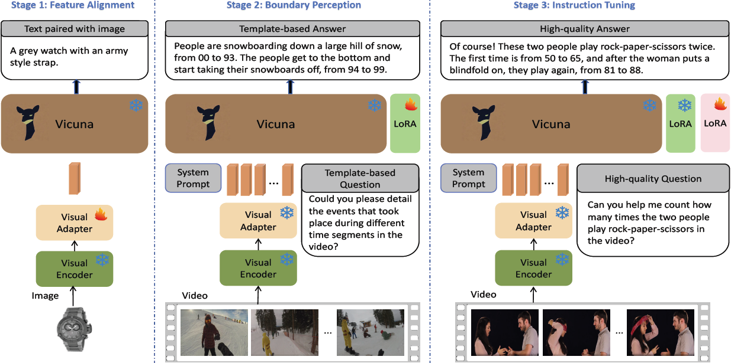

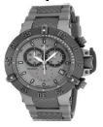




Stage 1: Feature Alignment
ViT: visual encoder (CLIP ViT-L/14)
f: visual adapter
wi ∈ Rd is the embedding for each word and M is the word number.
I
f
LLM
ViT
Z_{I}
Text paired with image
Vicuna
Image
❄️
A gray watch with an army style strap.
❄️
🔥
Visual
Encoder
Visual
Adapter
Item | Description
Input | Image I
Special Token | A <image> token is prepended to the text; its embedding is derived from the image via ViT and Adapter
Feature Extraction
Input to LLM
Training Objective | Train the Adapter f using the language model’s autoregressive task (e.g., text generation)
Notes:
透過 ViT 和 Adapter 從圖片提取出來的 <image> token 會加在文字前面。
使用語言模型的自回歸任務（例如文字生成）來訓練 Adapter F。
Autoregressive task : 根據已知的token，預測下一個token。
這邊訓練visual adapter的方法是 : 假設w1 = A, w2 = gray，那麼模型就必須根據Zi預測w1是什麼，如果預測的是錯的，那就跟ground truth計算cross entropy，透過反向傳播更新adapter，然後再讓模型以正確的token繼續預測下一個token，目的是不要讓模型在錯誤的基礎上預測下一個token，這樣可能會導致越錯越多。

Slide 17
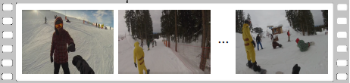
Stage 2: Boundary Perception
Template-based Answer
People are snowboarding down a large hill of snow,
from 00 to 93. The people get to the bottom and
start taking their snowboards off, from 94 to 99.
Vicuna
🔥
❄️
LoRA
Item | Description
Video Event Format | {sᵢ, eᵢ, Tᵢ}, where sᵢ and eᵢ are timestamps (0–99), and Tᵢ is the textual description.
QA Dialogue Formatting | Each set of video events is converted into dialogue form {Q₁, A₁, Q₂, A₂, ...} for LLM training.
System Prompt
Template-based Question
❄️
Could you please detail the events that took place during different time segments in the video?
Visual
Adapter
❄️
Visual
Encoder
Video
Notes:
輸入是把整段video平均採樣100個frame，然後每一個frame透過visual encode提取每一個frame的CLS token，然後透過前一個stage訓練好的visual adapter把CLS token轉換成LLM可以接受的輸入格式，搭配作者自己設計的問答模板，這邊問答模板的設計是根據影片的ground truth去設計的。每一段影片都有提供每一個事件的start time和end time以及對應事件的描述。

Slide 18
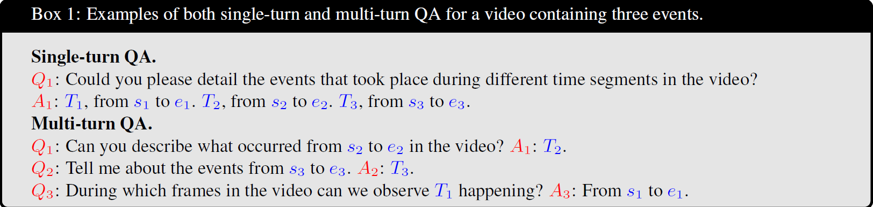
Stage 2: Boundary Perception
QA Dialogue Types in VTimeLLM Training
  Single-turn QA
  Multi-turn QA
T_{i} : distinct events occurring in the video
s_{i} : start time point of the event
e_{i} : end time point of the event
Notes:
這邊作者把影片轉換成單輪QA和多輪QA兩種形式，單輪QA占所有訓練集影片的20%，多輪QA占80%。
多輪QA占比比較高的原因是因為比較注重在讓模型有和使用者對話的能力，以及能產生前後邏輯順暢的回應，不受限於只能按照事件的順序提問才能回答正確的描述。

Slide 19
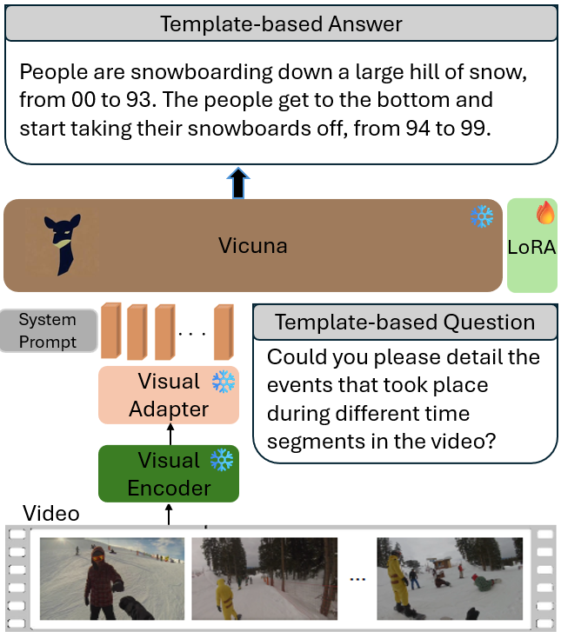
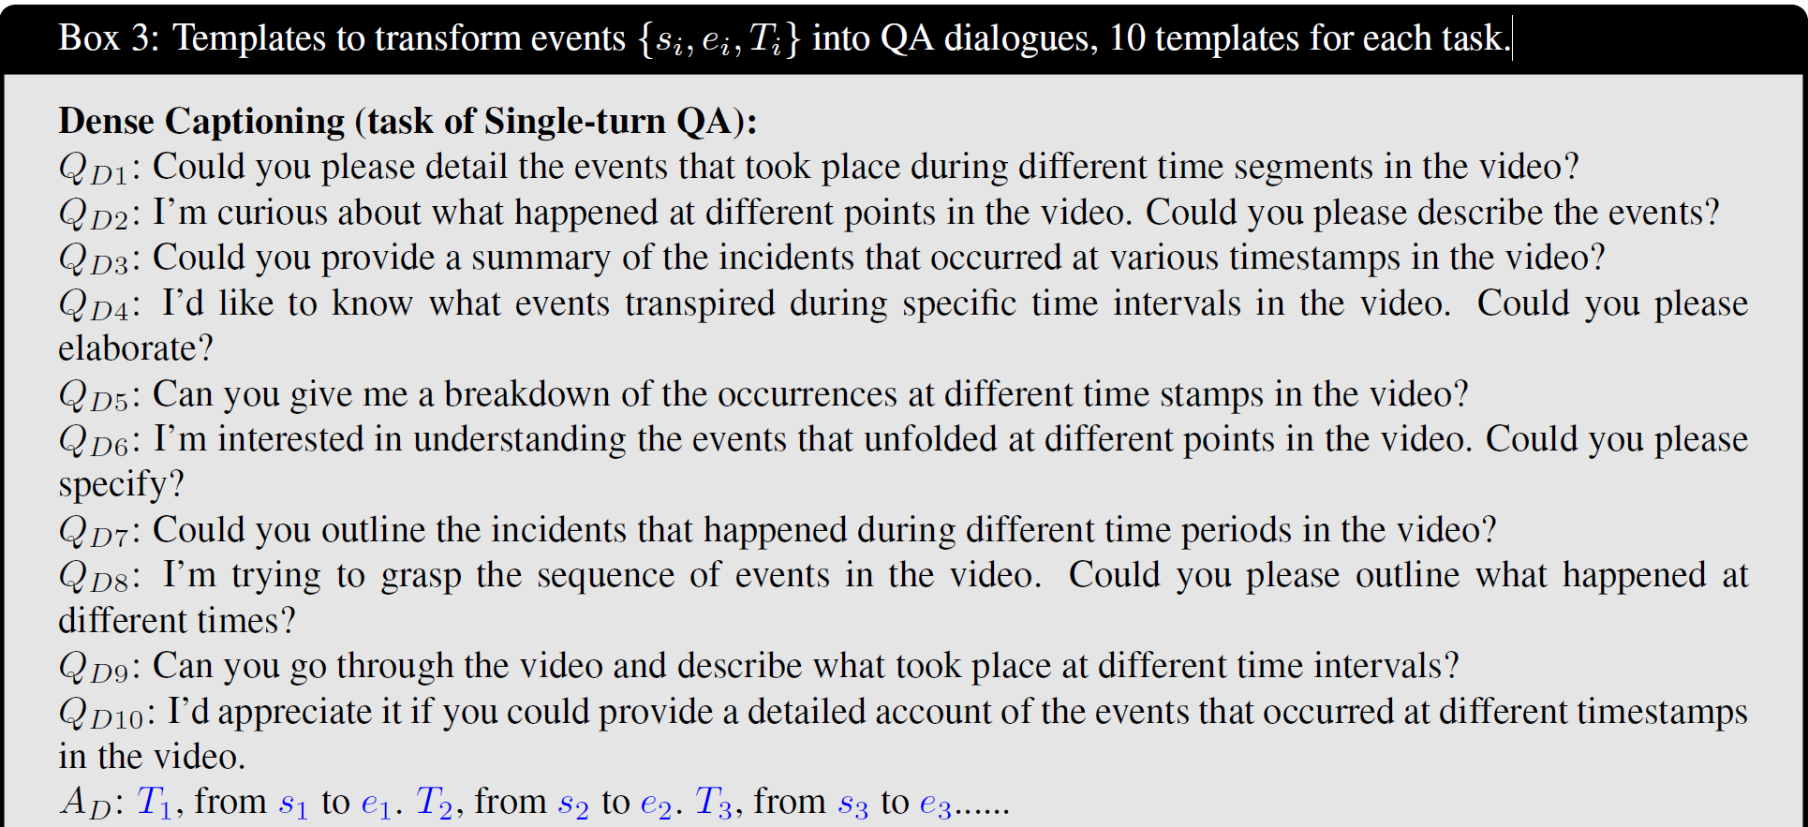

Stage 2: Boundary Perception
Templates to transform events {si, ei, Ti} into QA dialogues, 10 templates for each task.
Box 3: Templates to transform events {si, ei, Ti} into QA dialogues, 10 templates for each task.
Dense Captioning (task of Single-turn QA):
Q_{D1}: Could you please detail the events that took place during different time segments in the video?
Q_{D2}: I’m curious about what happened at different points in the video. Could you please describe the events?
Q_{D3}: Could you provide a summary of the incidents that occurred at various timestamps in the video?
Q_{D10}: I’d appreciate it if you could provide a detailed account of the events that occurred at different timestamps in the video.
A_{D}: T₁, from s₁ to e₁. T₂, from s₂ to e₂. T₃, from s₃ to e₃......
Notes:
這邊作者分成三種不同形式的任務個別產生10種問答模板，總共包含30種問答模板。這邊訓練方式是一段影片使用一種任務的模板(10種類型的問題)去做訓練的。
第一種任務類型是dense captioning 以單輪問答的形式設計的

Slide 20
Stage 2: Boundary Perception
Templates to transform events {si, ei, Ti} into QA dialogues, 10 templates for each task.
Box 3: Templates to transform events {si, ei, Ti} into QA dialogues, 10 templates for each task.
Event Captioning (One task in Multi-turn QA):
Q_{E1}: Can you describe what occurred from s_{i} to e_{i} in the video?
Q_{E2}: Could you tell me what happened from s_{i} to e_{i} in the video?
Q_{E3}: What transpired from s_{i} to e_{i} in the video?
Q_{E4}: Describe what took place from s_{i} to e_{i} in the video.
Q_{E5}: Tell me about the events from s_{i} to e_{i} in the video.
Q_{E6}: What was going on from s_{i} to e_{i} in the video?
Q_{E7}: Please recount what occurred from s_{i} to e_{i} in the video.
Q_{E10}: Share what transpired from s_{i} to e_{i} in the video.
A_{E}: T_{i}.
Notes:
這邊是第二種任務 event caption 多輪問答的形式

Slide 21
Stage 2: Boundary Perception
Templates to transform events {si, ei, Ti} into QA dialogues, 10 templates for each task.
Box 3: Templates to transform events {si, ei, Ti} into QA dialogues, 10 templates for each task.
Temporal Grounding (One task in Multi-turn QA):
Q_{T1}: During which frames can we see T_{i} happening in the video?
Q_{T2}: Between which frames is T_{i} visible in the video?
Q_{T3}: At what point in the video can we observe T_{i} taking place?
Q_{T4}: Between which two frames can we witness T_{i} occurring in the video?
Q_{T5}: During which frames in the video can we observe T_{i} happening?
Q_{E6}: At which time interval in the video can we see T_{i} occurring?
Q_{T10}: During which frames does T_{i} occur in the video?
A_{T}: From s_{i} to e_{i}.
Notes:
這邊是第三種任務 temporal grounding 多輪問答的形式

Slide 22
Stage 2: Boundary Perception
The inputs to VTimeLLM in Stage 2
Box 2: The inputs to VTimeLLM in Stage 2 and Stage 3
A chat between a curious user and an artificial intelligence assistant. The assistant gives helpful, detailed, and polite answers to the user’s questions.
USER: This is a video with 100 frames: <video>\n Q1 ASSISTANT: A1</s>
USER: Q2
ASSISTANT: A2</s>......
Notes:
這邊system prompt包含前面設計的問答模板，這裡的<video>代表透過visual adapter轉換過後的影片中每一個frame的feature vector，這些feature vector會按照frame的輸入順序排列。這邊只針對A1, A2的部分計算cross entropy，然後透過反向傳播更新LORA模組。

Slide 23
Stage 2: Boundary Perception
Template-based Answer
People are snowboarding down a large hill of snow,
from 00 to 93. The people get to the bottom and
start taking their snowboards off, from 94 to 99.
Vicuna
🔥
❄️
Item | Description
Name | LoRA (Low-Rank Adaptation)
Goal | Fine-tune models for new tasks without modifying the original parameters
Core Concept | Replace full-rank weight updates with the product of two low-rank matrices, reducing training parameters
Operation | Update weights as W′ = W + AB; train only A, B; keep original W frozen
LoRA
System Prompt
Template-based Question
❄️
Could you please detail the events that took place during different time segments in the video?
Visual
Adapter
❄️
Visual
Encoder
Video
Notes:
這邊的LORA是透過問答模板中的Answer去和模型產生描述的過程中逐個token去算cross entropy，再透過反向傳播更新權重。這邊一樣是透過模型的Autoregressive task能力去做訓練，過程中一樣會讓模型以正確的token去預測下一個token，不會讓模型以自己預測的token再去預測下一個token。

Slide 24
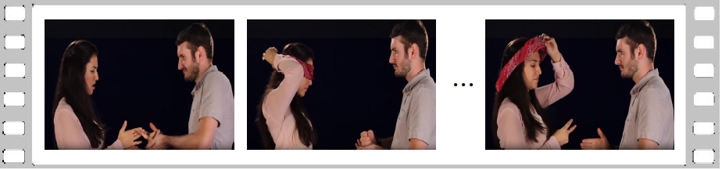
Stage 3: Instruction Tuning
High-quality Answer
Of course! These two people play rock-paper scissors twice. The first time is from 50 to 65, and after the woman puts a blindfold on, they play again, from 81 to 88.
Vicuna
❄️
🔥
❄️
LoRA
LoRA
Item | Description
Stage Objective | Address two main issues from Stage 2: (1) overfitting to answer templates leading to unnatural dialogue, and (2) noisy, inaccurate labels from auto-annotated data.
Solution Strategy | Introduce high-quality, human-aligned video-based QA dialogues for instruction tuning, allowing the model to better follow human queries and reason over video content.
QA Statistics | For each video, 2 sets of QA dialogues are generated.
System Prompt
High-quality Question
❄️
Can you help me count how many times the two people play rock-paper scissors in the video?
Visual
Adapter
❄️
Visual
Encoder
Video
Notes:
stage3是為了解決stage2訓練完所產生的問題。
模型太依賴答案的模板，導致對話變得不自然；(2) satge2使用的資料集為自動標註的資料，資料中有雜訊，且標記不準確。
解決辦法就是使用人工標註的高品質dataset以及符合人類表達方式的問答對話，讓模型更能理解人類的提問，並且更好地推理影片內容。
每段影片產生兩組QA對話

Slide 25
Stage 3: Instruction Tuning
Prompt for LLM in Stage 3, designed to transform a series of events into high-quality dialogue.
Box 4: Prompt for LLM in Stage 3, designed to transform a series of events into high-quality dialogue.
You are an AI visual assistant with the task of analyzing a single video. Craft a conversation between yourself and a user discussing the video’s content……. Utilize the timestamps <s?>and <t?>to create contextual questions considering the temporal relationships between events. The conversations should be concise.
Here’s an illustrative example:
=== example start ===
Events:
from <s1>to <e1>: A man and woman play rock paper scissors, the woman wins and smiles.
from <s2>to <e2>: The woman puts a blindfold on.
from <s3>to <e3>: The woman continues playing rock-paper-scissors with the man and wins again.
from <s4>to <e4>: The woman gives the man a hug.
Notes:
這邊產生對話的方式是透過其他LLM產生的。給LLM一個指定的角色，”你是一個視覺 AI 助手，負責分析一段影片。請設計一段你和使用者之間討論影片內容的對話……請利用timestamps<s?> 和 <t?>，來根據事件之間的時間關係提出有情境的問題。整段對話應該簡潔扼要。”
然後且將影片中每一個事件的start time和end time以及對應的描述整理成一個list輸入給LLM

