Slide 1
Inclusion / Exclusion principle
CMSC 250

Slide 2
Schedule
Today: We practice the addition rule
Generalizing into inclusion – exclusion principle.
We follow up with more combinatorial practice, introducing probability in the mix!

Slide 3

Inclusion / Exclusion principle
The inclusion / exclusion principle is effectively a generalization of the “law of addition / subtraction”.
It allows us to calculate the cardinalities (sizes) of unions:
$A_{1}∪A_{2}∪…A_{n}$
2 sets
3 sets
4 sets
….

Slide 4
Picking passwords
Suppose that we want to register for some website, and we have to pick a password.
The website’s pretty old-tech, so it tells us that the password should be between 4 and 6 symbols long, with English lowercase or uppercase characters, digits, as well as any one of the “special” characters #, *, _, -, @, &, !

Slide 5
Picking passwords
Suppose that we want to register for some website, and we have to pick a password.
The website’s pretty old-tech, so it tells us that the password should be between 4 and 6 symbols long, with English lowercase or uppercase characters, digits, as well as any one of the “special” characters #, *, _, -, @, &, !
How many different passwords can the website store in its database?

Slide 6

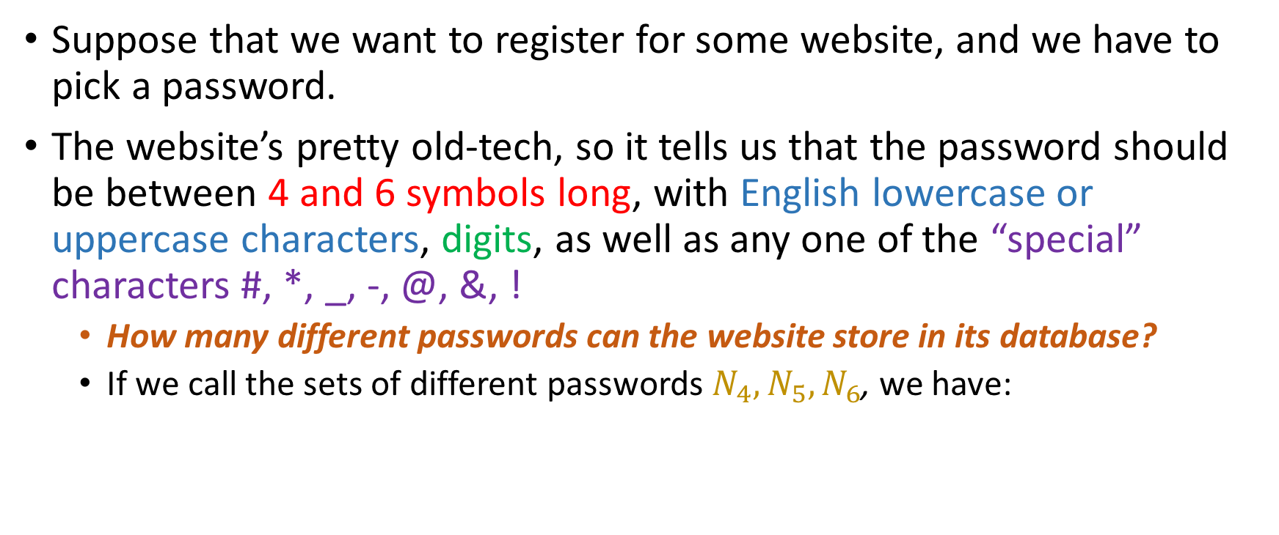


Picking passwords
Suppose that we want to register for some website, and we have to pick a password.
The website’s pretty old-tech, so it tells us that the password should be between 4 and 6 symbols long, with English lowercase or uppercase characters, digits, as well as any one of the “special” characters #, *, _, -, @, &, !
How many different passwords can the website store in its database?
If we call the sets of different passwords $N_{4}, N_{5}, N_{6}$, we have:
$$|N_{4}|$$
$$|N_{5}|$$
$${|N}_{6}|$$

Slide 7
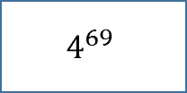

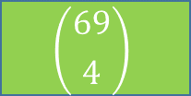
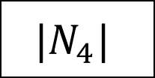
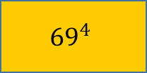
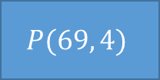
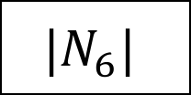
Calculating…
Letters, lowercase and uppercase
Digits
#, *, _, -, @, &, !
$${|N}_{4}|$$
$$P(69, 4)$$
$${69}^{4}$$
$$\left({69 \atop 4}\right)$$
$$4^{69}$$
$${|N}_{5}|$$
$${|N}_{6}|$$

Slide 8

Calculating…
Letters, lowercase and uppercase
Digits
#, *, _, -, @, &, !
$${|N}_{4}|$$
$${69}^{4}$$
$$P(69, 4)$$
$${69}^{4}$$
$$\left({69 \atop 4}\right)$$
$$4^{69}$$
$${|N}_{5}|$$
$${|N}_{6}|$$

Slide 9



Calculating…
Letters, lowercase and uppercase
Digits
#, *, _, -, @, &, !
$${|N}_{4}|$$
$${69}^{4}$$
$$P(69, 4)$$
$${69}^{4}$$
$$\left({69 \atop 4}\right)$$
$$4^{69}$$
$${|N}_{5}|$$
$${69}^{5}$$
$${|N}_{6}|$$
$${69}^{6}$$

Slide 10

Calculating…
Letters, lowercase and uppercase
Digits
#, *, _, -, @, &, !
$${|N}_{4}|$$
$${69}^{4}$$
$$P(69, 4)$$
$${69}^{4}$$
$$\left({69 \atop 4}\right)$$
$$4^{69}$$
$${|N}_{5}|$$
$${69}^{5}$$
That’s about 109.5 billion different passwords!
$${|N}_{6}|$$
$${69}^{6}$$

Slide 11
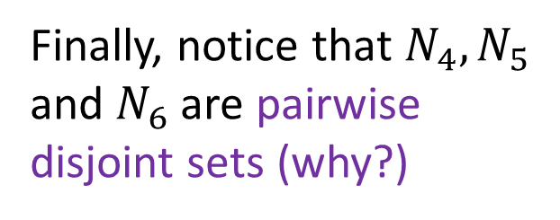
Calculating…
Letters, lowercase and uppercase
Digits
#, *, _, -, @, &, !
$${|N}_{4}|$$
$${69}^{4}$$
$$P(69, 4)$$
$${69}^{4}$$
$$\left({69 \atop 4}\right)$$
$$4^{69}$$
$${|N}_{5}|$$
$${69}^{5}$$
That’s about 109.5 billion different passwords!
Finally, notice that $N_{4},N_{5}$ and $N_{6}$ are pairwise disjoint sets (why?)
$${|N}_{6}|$$
$${69}^{6}$$

Slide 12




Picking different passwords
Suppose now that the website tells us that our passwords should not have repeated characters.
Call our new sets $M_{4},M_{5},M_{6}.$
The total #passwords is still yielded as:
$$|M_{4}|$$
$${|M}_{5}|$$
$$|M_{6}|$$

Slide 13
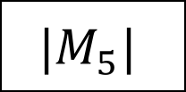
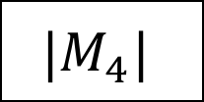
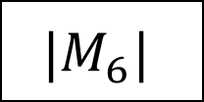
Calculating…
Letters, lowercase and uppercase
Digits
#, *, _, -, @, &, !
NO REPEATED CHARS
$${|M}_{4}|$$
$$P(69, 4)$$
$${69}^{4}$$
$$\left({69 \atop 4}\right)$$
$$4^{69}$$
$${|M}_{5}|$$
$${|M}_{6}|$$

Slide 14

Calculating…
Letters, lowercase and uppercase
Digits
#, *, _, -, @, &, !
NO REPEATED CHARS
$${|M}_{4}|$$
$$P(69, 4)$$
$${69}^{4}$$
$$\left({69 \atop 4}\right)$$
$$4^{69}$$
$${P(69, 4)}^{ }$$
$${|M}_{5}|$$
$${|M}_{6}|$$

Slide 15


Calculating…
Letters, lowercase and uppercase
Digits
#, *, _, -, @, &, !
NO REPEATED CHARS
$${|M}_{4}|$$
$$P(69, 4)$$
$${69}^{4}$$
$$\left({69 \atop 4}\right)$$
$$4^{69}$$
$${P(69, 4)}^{ }$$
$${|M}_{5}|$$
$${P(69, 5)}^{ }$$
$${|M}_{6}|$$
$$P(69, 6)$$

Slide 16

Calculating…
Letters, lowercase and uppercase
Digits
#, *, _, -, @, &, !
NO REPEATED CHARS
$${|M}_{4}|$$
$$P(69, 4)$$
$${69}^{4}$$
$$\left({69 \atop 4}\right)$$
$$4^{69}$$
$${P(69, 4)}^{ }$$
$${|M}_{5}|$$
$${P(69, 5)}^{ }$$
That’s about 87.5 billion different passwords!
$${|M}_{6}|$$
$$P(69, 6)$$

Slide 17
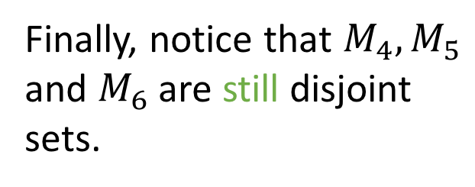
Calculating…
Letters, lowercase and uppercase
Digits
#, *, _, -, @, &, !
NO REPEATED CHARS
$${|M}_{4}|$$
$$P(69, 4)$$
$${69}^{4}$$
$$\left({69 \atop 4}\right)$$
$$4^{69}$$
$${P(69, 4)}^{ }$$
$${|M}_{5}|$$
$${P(69, 5)}^{ }$$
That’s about 87.5 billion different passwords!
Finally, notice that $M_{4},M_{5}$ and $M_{6}$ are still disjoint sets.
$${|M}_{6}|$$
$$P(69, 6)$$

Slide 18
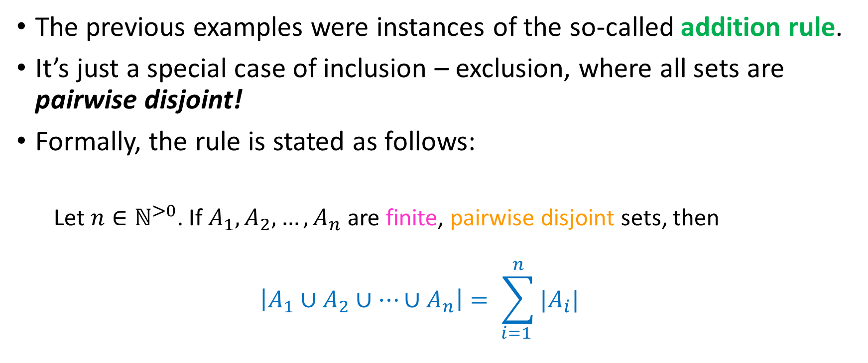
The addition rule:a special case
The previous examples were instances of the so-called addition rule.
It’s just a special case of inclusion – exclusion, where all sets are pairwise disjoint!
Formally, the rule is stated as follows:
Let $n∈ℕ^{>0}$. If $A_{1}, A_{2},…,A_{n}$ are finite, pairwise disjoint sets, then
$$\left|A_{1}∪A_{2}∪…∪A_{n}\right|= \sum_{i=1 }^{n}{|A_{i}|}$$

Slide 19
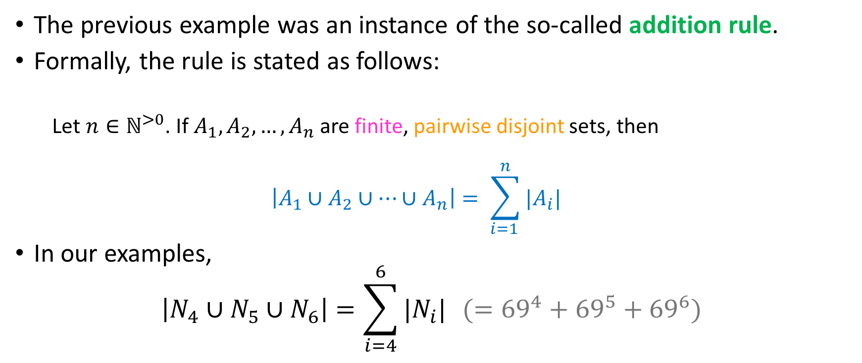
The addition rule:a special case
The previous example was an instance of the so-called addition rule.
Formally, the rule is stated as follows:
Let $n∈ℕ^{>0}$. If $A_{1}, A_{2},…,A_{n}$ are finite, pairwise disjoint sets, then
$$\left|A_{1}∪A_{2}∪…∪A_{n}\right|= \sum_{i=1 }^{n}{|A_{i}|}$$
In our examples,
$$\left|N_{4}∪N_{5}∪N_{6}\right|=\sum_{i=4}^{6}{|N_{i}|} (={69}^{4}+{69}^{5}+{69}^{6})$$

Slide 20
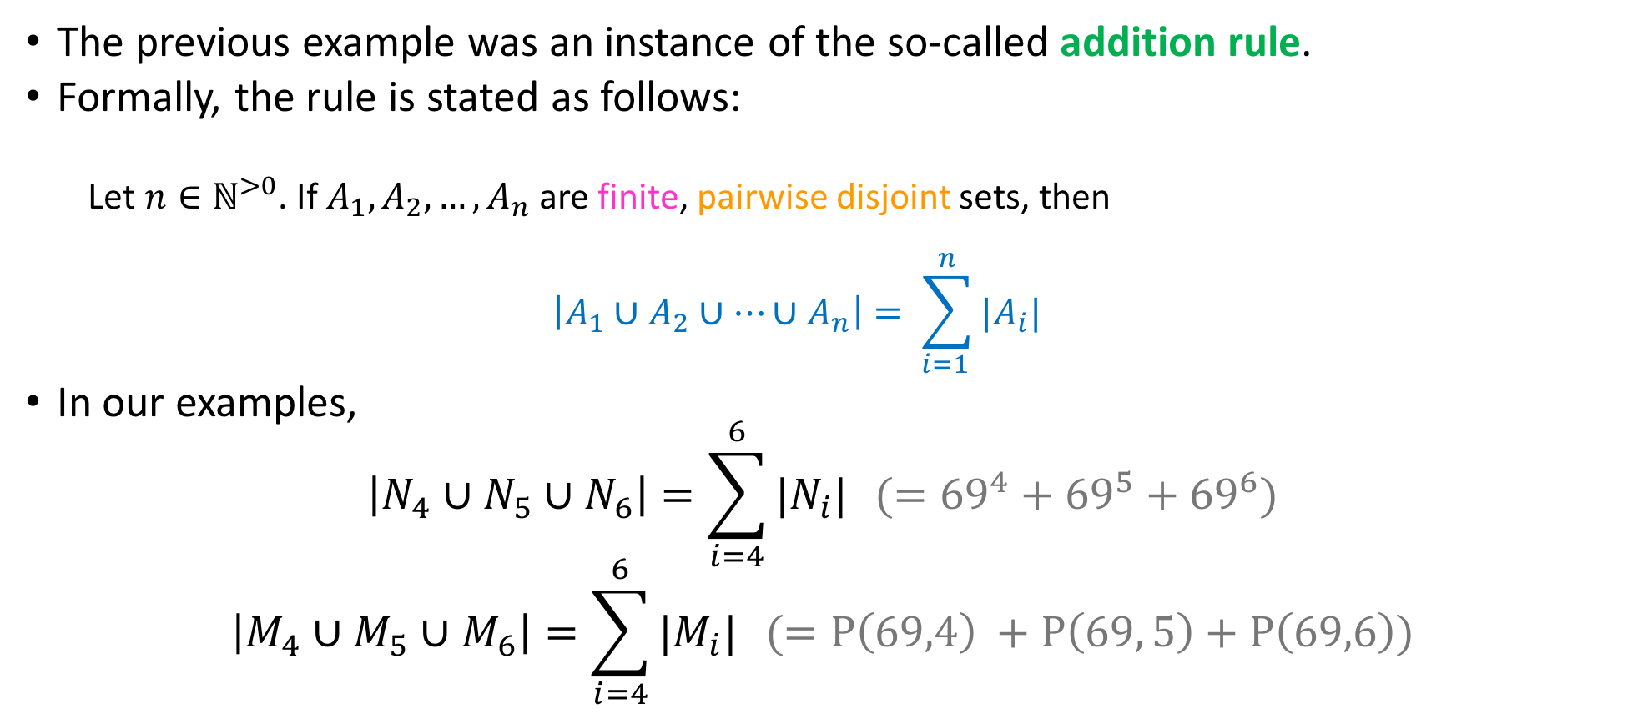
The addition rule:a special case
The previous example was an instance of the so-called addition rule.
Formally, the rule is stated as follows:
Let $n∈ℕ^{>0}$. If $A_{1}, A_{2},…,A_{n}$ are finite, pairwise disjoint sets, then
$$\left|A_{1}∪A_{2}∪…∪A_{n}\right|= \sum_{i=1 }^{n}{|A_{i}|}$$
In our examples,
$$\left|N_{4}∪N_{5}∪N_{6}\right|=\sum_{i=4}^{6}{|N_{i}|} (={69}^{4}+{69}^{5}+{69}^{6})$$
$$\left|M_{4}∪M_{5}∪M_{6}\right|=\sum_{i=4}^{6}{|M_{i}|} (={P\left(69,4\right)}^{ }+P\left(69, 5\right)+P\left(69,6\right))$$

Slide 21
A not – so – special case
Once again, our passwords can use: English lowercase or uppercase characters, digits, as well as any one of the “special” characters #, *, _, -, @, &, !
69 characters total.
Alice likes passwords of length 6 that start with an ‘A’.
Bob likes passwords of length 6 that end with a ‘B’.
Both are security-conscious, so they never use the same character.

Slide 22
A not – so – special case
Once again, our passwords can use: English lowercase or uppercase characters, digits, as well as any one of the “special” characters #, *, _, -, @, &, !
69 characters total.
Alice likes passwords of length 6 that start with an ‘A’.
Bob likes passwords of length 6 that end with a ‘B’.
Both are security-conscious, so they never use the same character.
What is the total number of passwords that either Alice or Bob use?

Slide 23

A not – so – special case
Call the sets of passwords that Alice uses $P_{A}$.

Slide 24




A not – so – special case
Call the sets of passwords that Alice uses $P_{A}$.
What is ${|P}_{A}|$?
$$P(69, 6)$$
$$P(69, 5)$$
$${69}^{5}$$
Something Else

Slide 25

A not – so – special case
Call the sets of passwords that Alice uses $P_{A}$.
What is ${|P}_{A}|$?
$$P(69, 6)$$
$$P(69, 5)$$
$${69}^{5}$$
Something Else
$$P(68, 5)$$

Slide 26

A not – so – special case
Call the sets of passwords that Alice uses $P_{A}$.
What is ${|P}_{A}|$?
Similarly, $\left|P_{B}\right|=P(68, 5)$
$$P(69, 6)$$
$$P(69, 5)$$
$${69}^{5}$$
Something Else
$$P(68, 5)$$

Slide 27





A not – so – special case
Call the sets of passwords that Alice uses $P_{A}$.
What is ${|P}_{A}|$?
Similarly, $\left|P_{B}\right|=P\left(68, 5\right)$
What am I looking for?
$$P(69, 6)$$
$$P(69, 5)$$
$${69}^{5}$$
Something Else
$$P(68, 5)$$
$$|P_{A}∩P_{B}|$$
$$|P_{A}∪P_{B}|$$
$$|P_{A}−P_{B}|$$
$$|P_{B}−P_{A}|$$

Slide 28
A not – so – special case
Call the sets of passwords that Alice uses $P_{A}$.
What is ${|P}_{A}|$?
Similarly, $\left|P_{B}\right|=P\left(68, 5\right)$
What am I looking for?
$$P(69, 6)$$
$$P(69, 5)$$
$${69}^{5}$$
Something Else
$$P(68, 5)$$
Remember: I’m looking for the #passwords that either Alice OR Bob use.
$$|P_{A}∩P_{B}|$$
$$|P_{A}∪P_{B}|$$
$$|P_{A}−P_{B}|$$
$$|P_{B}−P_{A}|$$

Slide 29

Practice
You told us that we’re looking for $\left|P_{A}∪P_{B}\right|$
By the addition rule, $\left|P_{A}∪P_{B}\right|=\left|P_{A}\right|+\left|P_{B}\right|=2∗P(68, 5)$

Slide 30

Practice
You told us that we’re looking for $\left|P_{A}∪P_{B}\right|$
By the addition rule, $\left|P_{A}∪P_{B}\right|=\left|P_{A}\right|+\left|P_{B}\right|=2∗P\left(68, 5\right)$
$A1234B$ was counted twice!
You’ve been fooled!

Slide 31
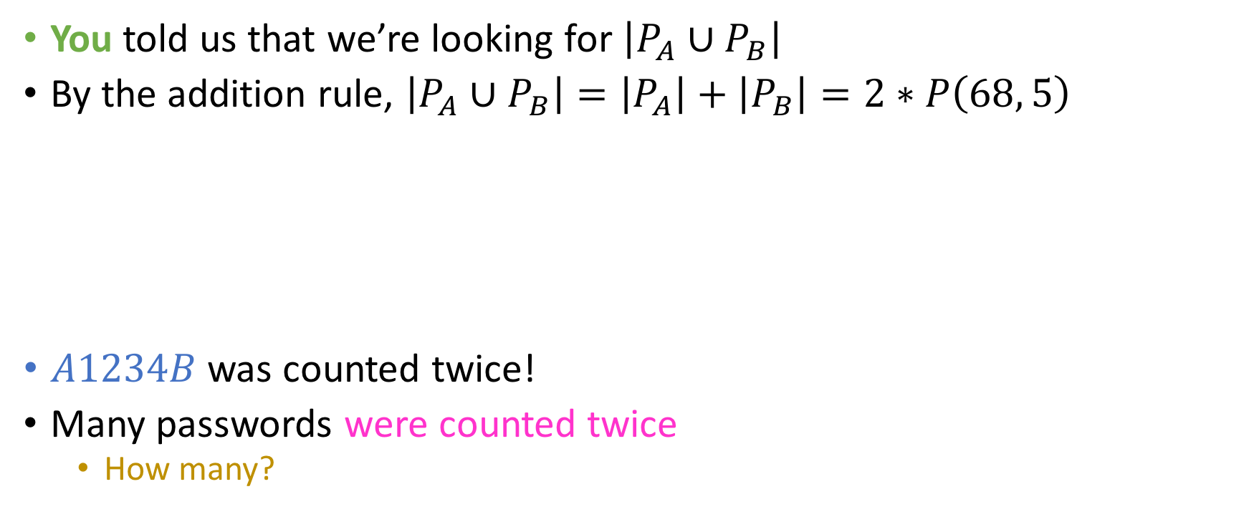
Practice
You told us that we’re looking for $\left|P_{A}∪P_{B}\right|$
By the addition rule, $\left|P_{A}∪P_{B}\right|=\left|P_{A}\right|+\left|P_{B}\right|=2∗P\left(68, 5\right)$
$A1234B$ was counted twice!
Many passwords were counted twice
How many?
You’ve been fooled!

Slide 32

Need $|P_{A}∩P_{B}|$
How many passwords do both Alice and Bob like?

Slide 33



Need $|P_{A}∩P_{B}|$
How many passwords do both Alice and Bob like?
$$P(69, 4)$$
$$P(68, 4)$$
$$P(67, 4)$$
Something Else

Slide 34

Need $|P_{A}∩P_{B}|$
How many passwords do both Alice and Bob like?
$$P(69, 4)$$
$$P(68, 4)$$
$$P(67, 4)$$
Something Else
A _ _ _ _ B
4 positions
Cannot choose ’A’ and ‘B’ because they’ve been used already!
So 67 characters available
Order matters.

Slide 35


$$|P_{A}∪P_{B}|$$
From the rule we supplied earlier:
$$\left|P_{A}∪P_{B}\right|=\left|P_{A}\right|+\left|P_{B}\right|−\left|P_{A}∩P_{B}\right|=2∗P\left(68, 5\right)−P\left(67, 4\right)=$$

Slide 36


$$|P_{A}∪P_{B}|$$
From the rule we supplied earlier:
$$\left|P_{A}∪P_{B}\right|=\left|P_{A}\right|+\left|P_{B}\right|−\left|P_{A}∩P_{B}\right|=2∗P\left(68, 5\right)−P\left(67, 4\right)=$$
NOPE, WE’RE BUSY PEOPLE

Slide 37
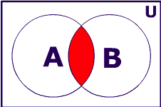

General Rule
For any finite sets $A, B:$
$$\left|A∪B\right|=\left|A\right|+\left|B\right|−|A∩B|$$

Slide 38
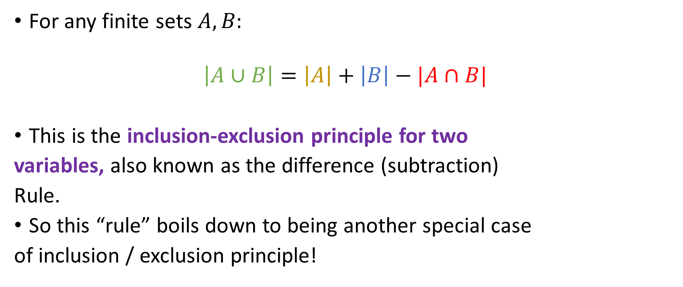
General Rule
For any finite sets $A, B:$
$$\left|A∪B\right|=\left|A\right|+\left|B\right|−|A∩B|$$
This is the inclusion-exclusion principle for two
variables, also known as the difference (subtraction)
Rule.
So this “rule” boils down to being another special case
of inclusion / exclusion principle!

Slide 39
A number-theoretic problem
How many numbers between 1 and 1000 are divisible by either 2 or 3?

Slide 40
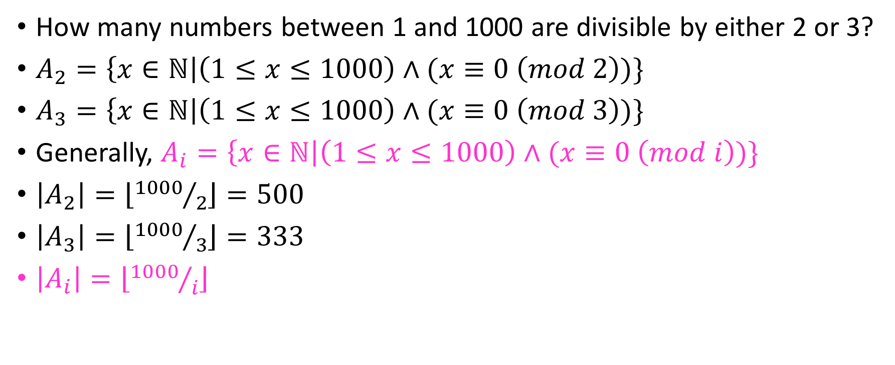
A number-theoretic problem
How many numbers between 1 and 1000 are divisible by either 2 or 3?
$A_{2}=\left\{x∈ℕ\right|\left(1≤x≤1000\right)∧(x≡0 \left(mod 2\right))\}$
$A_{3}=\left\{x∈ℕ\right|\left(1≤x≤1000\right)∧(x≡0 \left(mod 3\right))\}$
Generally, $A_{i}=\left\{x∈ℕ\right|\left(1≤x≤1000\right)∧(x≡0 \left(mod i\right))\}$
$\left|A_{2}\right|=\left\lfloor {1000}/2\right\rfloor =500$
$\left|A_{3}\right|=\left\lfloor {1000}/3\right\rfloor =333$
$\left|A_{i}\right|=\left\lfloor {1000}/i\right\rfloor$

Slide 41


$$\text{A} \text{number}\text{−}\text{theoretic} \text{problem}$$
$\left|A_{2}∪A_{3}\right|=\left|A_{2}\right|+\left|A_{3}\right|−\left|A_{2}∩A_{3}\right|=833 −|A_{2}∩A_{3}|$

Slide 42

$$\text{A} \text{number}\text{−}\text{theoretic} \text{problem}$$
$\left|A_{2}∪A_{3}\right|=\left|A_{2}\right|+\left|A_{3}\right|−\left|A_{2}∩A_{3}\right|=833 −\left|A_{2}∩A_{3}\right|$
What is the set $A_{2}∩A_{3}$?

Slide 43
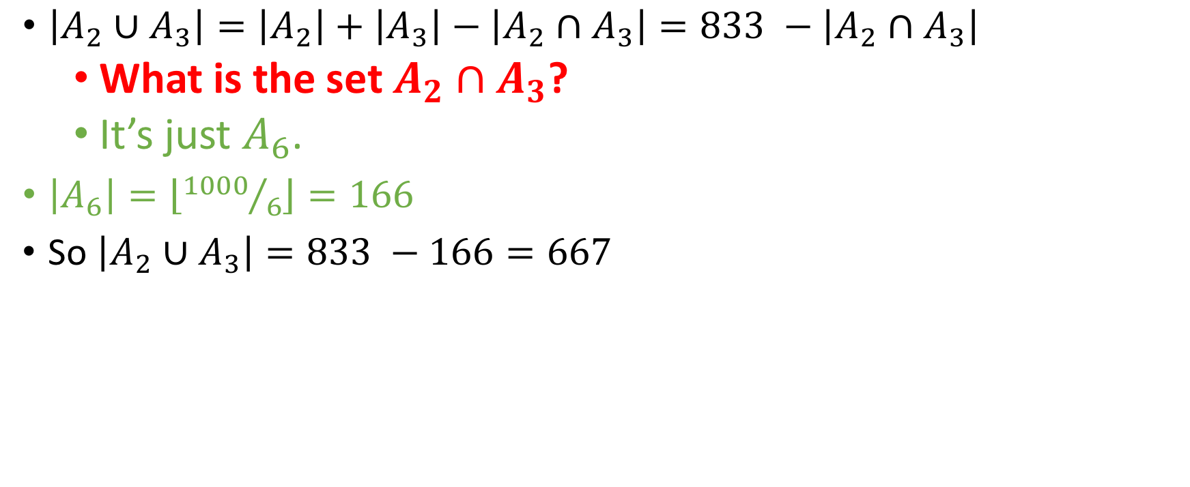
$$\text{A} \text{number}\text{−}\text{theoretic} \text{problem}$$
$\left|A_{2}∪A_{3}\right|=\left|A_{2}\right|+\left|A_{3}\right|−\left|A_{2}∩A_{3}\right|=833 −\left|A_{2}∩A_{3}\right|$
What is the set $A_{2}∩A_{3}$?
It’s just $A_{6}$.
$\left|A_{6}\right|=\left\lfloor {1000}/6\right\rfloor =166$
So $\left|A_{2}∪A_{3}\right|=833 −166=667$

Slide 44
What about 3 variables?
Some Discrete Mathematics students were polled about their past Computer Science & Mathematics course experience.
30 had taken precalculus
18 had taken calculus
26 had taken Java
9 had taken both precalculus and calculus
16 had taken both precalculus and Java
8 had taken both calculus and Java
5 had taken all three courses

Slide 45
What about 3 variables?
Some Discrete Mathematics students were polled about their past Computer Science & Mathematics course experience.
30 had taken precalculus
18 had taken calculus
26 had taken Java
9 had taken both precalculus and calculus
16 had taken both precalculus and Java
8 had taken both calculus and Java
5 had taken all three courses
How many students were polled?
Precalc
Calc
Java

Slide 46
What about 3 variables?
Some Discrete Mathematics students were polled about their past Computer Science & Mathematics course experience.
30 had taken precalculus
18 had taken calculus
26 had taken Java
9 had taken both precalculus and calculus
16 had taken both precalculus and Java
8 had taken both calculus and Java
5 had taken all three courses
How many students were polled?
VENN DIAGRAM TIME!

Slide 47

What about 3 variables?
P = precalc, J = Java, C = calc
Is $\left|P∪J∪C\right|=\left|P\right|+\left|J\right|+\left|C\right|$?

Slide 48

What about 3 variables?
P = precalc, J = Java, C = calc
Is $\left|P∪J∪C\right|=\left|P\right|+\left|J\right|+\left|C\right|$? NO. Overcounting strikes again.
We count students in $(P∩J), (P∩C), (J∩C)$ twice.
Is $\left|P∪J∪C\right|=\left|P\right|+\left|J\right|+\left|C\right|−\left(\left|P∩J\right|+\left|P∩C\right|+\left|J∩C\right|\right)$?
Precalc
Calc
Java

Slide 49
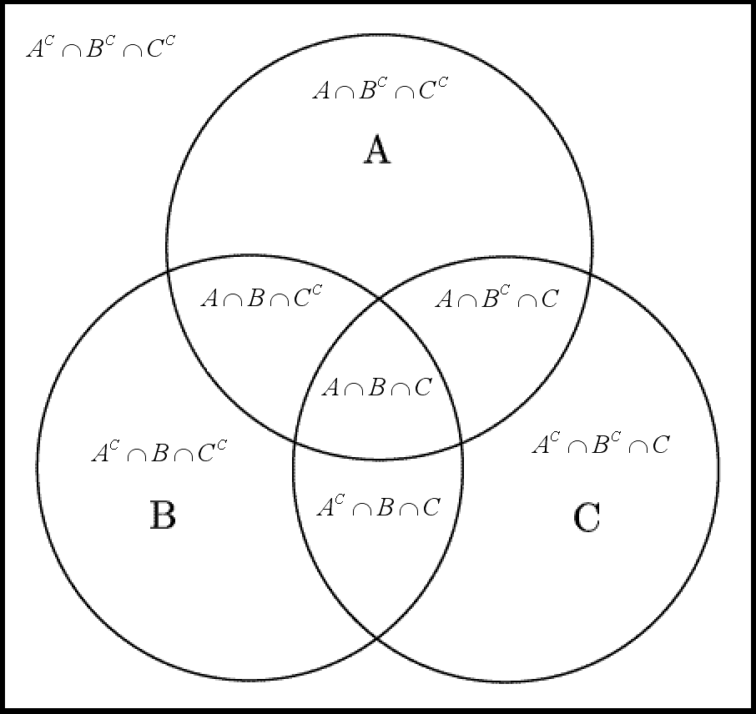
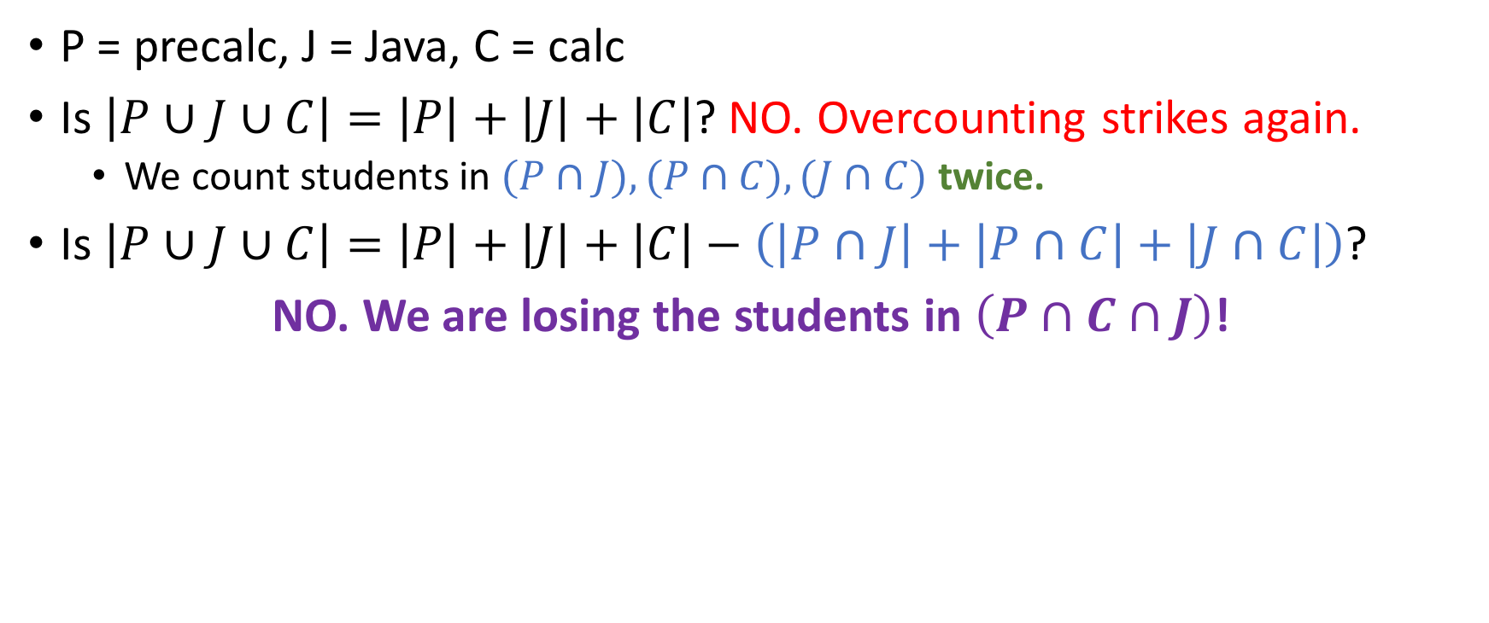
What about 3 variables?
P = precalc, J = Java, C = calc
Is $\left|P∪J∪C\right|=\left|P\right|+\left|J\right|+\left|C\right|$? NO. Overcounting strikes again.
We count students in $(P∩J), (P∩C), (J∩C)$ twice.
Is $\left|P∪J∪C\right|=\left|P\right|+\left|J\right|+\left|C\right|−\left(\left|P∩J\right|+\left|P∩C\right|+\left|J∩C\right|\right)$?
NO. We are losing the students in $\left(P∩C∩J\right)$!

Slide 50
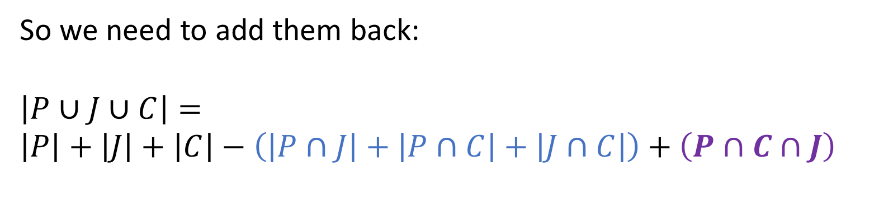
What about 3 variables?
P = precalc, J = Java, C = calc
Is $\left|P∪J∪C\right|=\left|P\right|+\left|J\right|+\left|C\right|$? NO. Overcounting strikes again.
We count students in $(P∩J), (P∩C), (J∩C)$ twice.
Is $\left|P∪J∪C\right|=\left|P\right|+\left|J\right|+\left|C\right|−\left(\left|P∩J\right|+\left|P∩C\right|+\left|J∩C\right|\right)$?
NO. We are losing the students in $\left(P∩C∩J\right)$!
So we need to add them back:
$$\left|P∪J∪C\right|= \\ \left|P\right|+\left|J\right|+\left|C\right|−\left(\left|P∩J\right|+\left|P∩C\right|+\left|J∩C\right|\right)+\left(P∩C∩J\right)$$

Slide 51
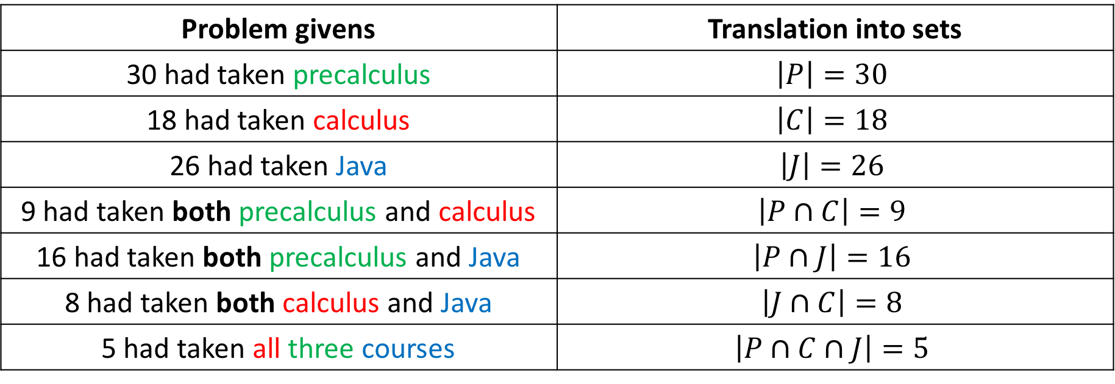
What about 3 variables?
Problem givens | Translation into sets
30 had taken precalculus | $$\left|P\right|=30$$
18 had taken calculus | $$\left|C\right|=18$$
26 had taken Java | $$\left|J\right|=26$$
9 had taken both precalculus and calculus | $$\left|P∩C\right|=9$$
16 had taken both precalculus and Java | $$\left|P∩J\right|=16$$
8 had taken both calculus and Java | $$\left|J∩C\right|=8$$
5 had taken all three courses | $$\left|P∩C∩J\right|=5$$

Slide 52
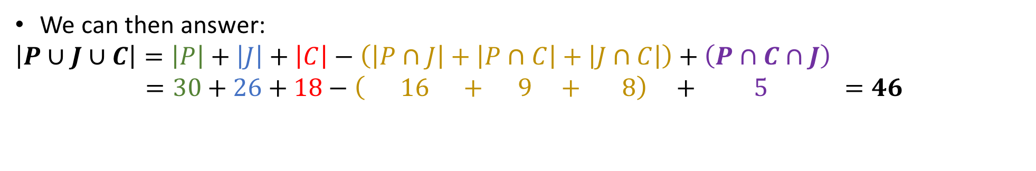
What about 3 variables?
Problem givens | Translation into sets
30 had taken precalculus | $$\left|P\right|=30$$
18 had taken calculus | $$\left|C\right|=18$$
26 had taken Java | $$\left|J\right|=26$$
9 had taken both precalculus and calculus | $$\left|P∩C\right|=9$$
16 had taken both precalculus and Java | $$\left|P∩J\right|=16$$
8 had taken both calculus and Java | $$\left|J∩C\right|=8$$
5 had taken all three courses | $$\left|P∩C∩J\right|=5$$
We can then answer:
$$\left|P∪J∪C\right|=\left|P\right|+\left|J\right|+\left|C\right|−\left(\left|P∩J\right|+\left|P∩C\right|+\left|J∩C\right|\right)+\left(P∩C∩J\right)$$
$=30+26+18−\left( 16 + 9 + 8\right) + 5 =46$

Slide 53
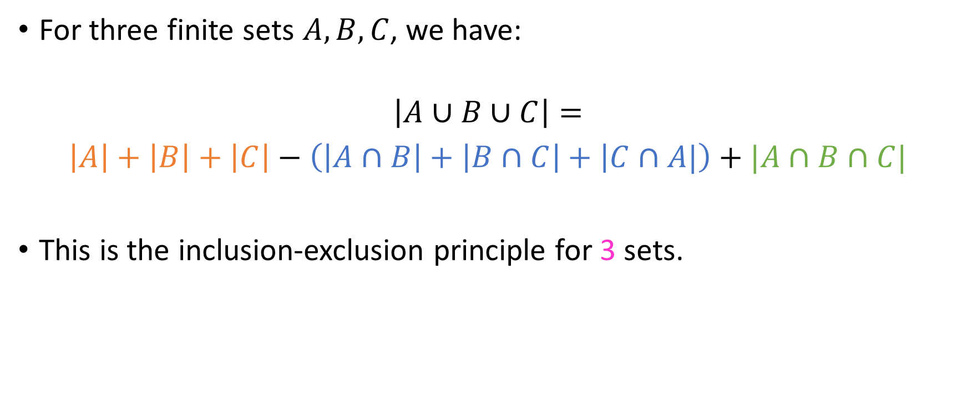
A generalizable framework
For three finite sets $A, B, C$, we have:
$$\left|A∪B∪C\right|=$$
$\left|A\right|+\left|B\right|+\left|C\right|−\left(\left|A∩B\right|+\left|B∩C\right|+ | C∩A|\right)+|A∩B∩C|$
This is the inclusion-exclusion principle for 3 sets.

Slide 54
Another divisibility problem
How many numbers between 1 and 1000 are divisible by 2,3 or 5?

Slide 55

Another divisibility problem
How many numbers between 1 and 1000 are divisible by 2,3 or 5?
Recall: $A_{i}=\left\{x∈ℕ \right| \left(1≤x≤1000\right)∧(x≡0 (mod i)\}$

Slide 56
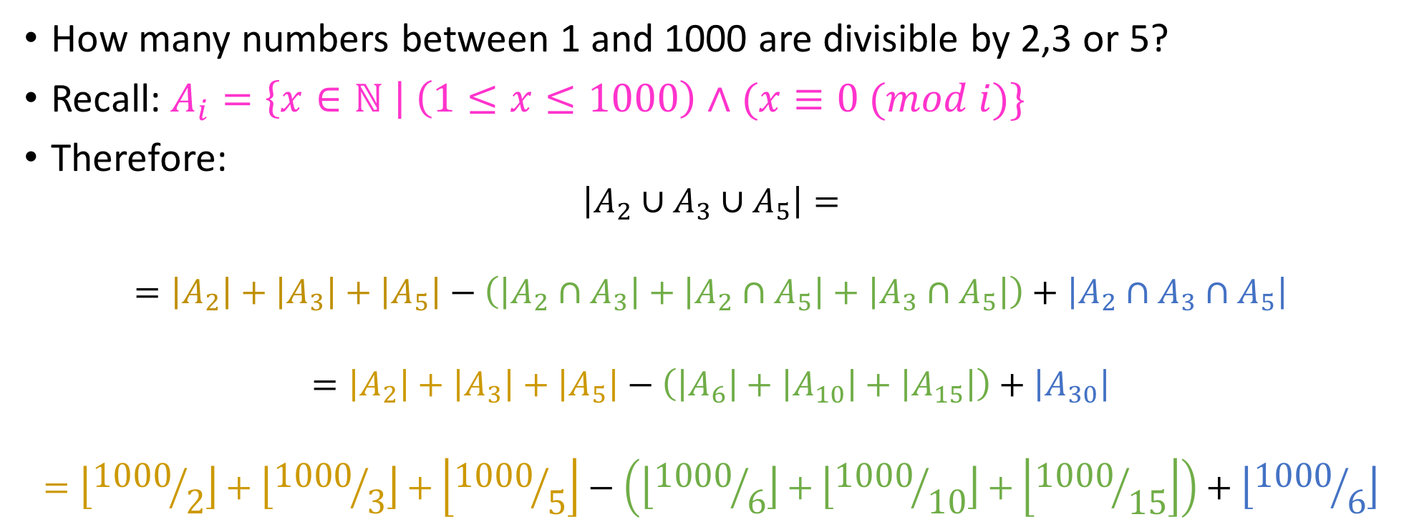
Another divisibility problem
How many numbers between 1 and 1000 are divisible by 2,3 or 5?
Recall: $A_{i}=\left\{x∈ℕ \right| \left(1≤x≤1000\right)∧(x≡0 (mod i)\}$
Therefore:
$$\left|A_{2}∪A_{3}∪A_{5}\right|=$$
$$=\left|A_{2}\right|+\left|A_{3}\right|+\left|A_{5}\right|−\left(\left|A_{2}∩A_{3}\right|+\left|A_{2}∩A_{5}\right|+\left|A_{3}∩A_{5}\right|\right)+\left|A_{2}∩A_{3}∩A_{5}\right|$$
$$=\left|A_{2}\right|+\left|A_{3}\right|+\left|A_{5}\right|−\left(\left|A_{6}\right|+\left|A_{10}\right|+\left|A_{15}\right|\right)+\left|A_{30}\right|$$
$$=\left\lfloor {1000}/2\right\rfloor +\left\lfloor {1000}/3\right\rfloor +\left\lfloor {1000}/5\right\rfloor −\left(\left\lfloor {1000}/6\right\rfloor +\left\lfloor {1000}/{10}\right\rfloor +\left\lfloor {1000}/{15}\right\rfloor \right)+\left\lfloor {1000}/6\right\rfloor$$

Slide 57
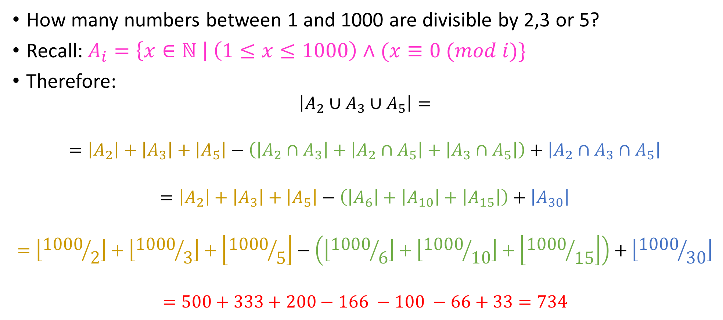

Another divisibility problem
How many numbers between 1 and 1000 are divisible by 2,3 or 5?
Recall: $A_{i}=\left\{x∈ℕ \right| \left(1≤x≤1000\right)∧(x≡0 (mod i)\}$
Therefore:
$$\left|A_{2}∪A_{3}∪A_{5}\right|=$$
$$=\left|A_{2}\right|+\left|A_{3}\right|+\left|A_{5}\right|−\left(\left|A_{2}∩A_{3}\right|+\left|A_{2}∩A_{5}\right|+\left|A_{3}∩A_{5}\right|\right)+\left|A_{2}∩A_{3}∩A_{5}\right|$$
$$=\left|A_{2}\right|+\left|A_{3}\right|+\left|A_{5}\right|−\left(\left|A_{6}\right|+\left|A_{10}\right|+\left|A_{15}\right|\right)+\left|A_{30}\right|$$
$$=\left\lfloor {1000}/2\right\rfloor +\left\lfloor {1000}/3\right\rfloor +\left\lfloor {1000}/5\right\rfloor −\left(\left\lfloor {1000}/6\right\rfloor +\left\lfloor {1000}/{10}\right\rfloor +\left\lfloor {1000}/{15}\right\rfloor \right)+\left\lfloor {1000}/{30}\right\rfloor$$
$$=500+333+200−166 −100 −66+33=734$$

Slide 58





Here’s one for you
Inclusion-Exclusion rule for 4 (four) sets $A_{1},A_{2},A_{3}, A_{4}$
$$A_{1}$$
$$A_{2}$$
$$A_{3}$$
$$A_{4}$$

Slide 59

Here’s one for you
Inclusion-Exclusion rule for 4 (four) sets $A_{1},A_{2},A_{3}, A_{4}$
$$\left|A_{1}∪A_{2}∪A_{3}∪A_{4}\right|=$$
$$\left|A_{1}\right|+\left|A_{2}\right|+\left|A_{3}\right|+\left|A_{4}\right|$$
$$−\left(\left|A_{1}∩A_{2}\right|+\left|A_{1}∩A_{3}\right|+\left|A_{1}∩A_{4}\right|+\left|A_{2}∩A_{3}\right|+{|A}_{2}∩A_{4}|+|A_{3}∩A_{4}|\right)$$
$$+\left(\left|A_{1}∩A_{2}∩A_{3}\right|+\left|A_{1}∩A_{2}∩A_{4}\right|+\left|A_{2}∩A_{3}∩A_{4}\right|+|A_{1}∩A_{3}∩A_{4}|\right)$$
$$−|A_{1}∩A_{2}∩A_{3}∩A_{4}|$$
$$A_{1}$$
$$A_{2}$$
$$A_{3}$$
$$A_{4}$$

