Slide 1
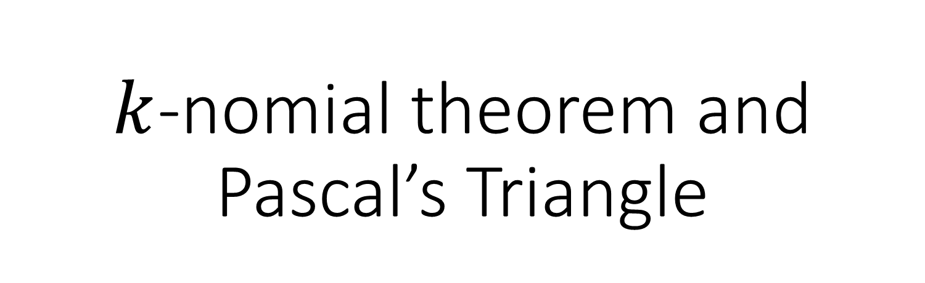
$k$-nomial theorem and Pascal’s Triangle
CMSC 250

Slide 2

The binomial theorem
Recall the following identities from highschool:
${\left(x+y\right)}^{2}=x^{2}+2xy+y^{2}$
${\left(x+y\right)}^{3}=x^{3}+3x^{2}y+3xy^{2}+y^{3}$
${\left(x+y\right)}^{4}=x^{4}+4x^{3}y^{1}+6x^{2}y^{2}+4x^{1}y^{3}+y^{4}$

Slide 3
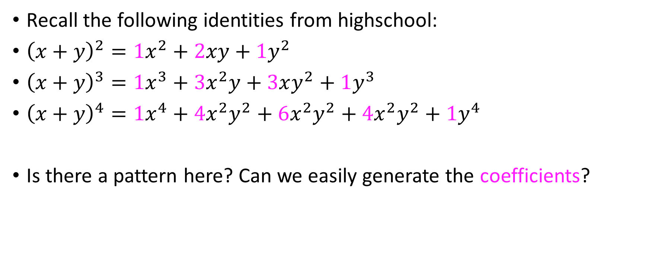
The binomial theorem
Recall the following identities from highschool:
${\left(x+y\right)}^{2}={1x}^{2}+2xy+{1y}^{2}$
${\left(x+y\right)}^{3}=1x^{3}+3x^{2}y+3xy^{2}+1y^{3}$
${\left(x+y\right)}^{4}=1x^{4}+4x^{2}y^{2}+6x^{2}y^{2}+4x^{2}y^{2}+1y^{4}$
Is there a pattern here? Can we easily generate the coefficients?

Slide 4
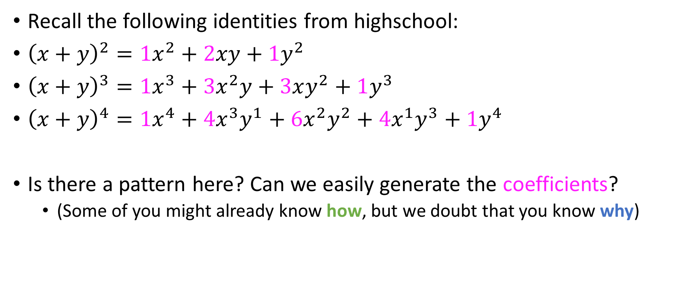
The binomial theorem
Recall the following identities from highschool:
${\left(x+y\right)}^{2}={1x}^{2}+2xy+{1y}^{2}$
${\left(x+y\right)}^{3}=1x^{3}+3x^{2}y+3xy^{2}+1y^{3}$
${\left(x+y\right)}^{4}=1x^{4}+4x^{3}y^{1}+6x^{2}y^{2}+4x^{1}y^{3}+1y^{4}$
Is there a pattern here? Can we easily generate the coefficients?
(Some of you might already know how, but we doubt that you know why)

Slide 5


$${\left(x+y\right)}^{5}$$
${\left(x+y\right)}^{5}={\left(x+y\right)⋅\left(x+y\right)⋅}^{ }\left(x+y\right)⋅\left(x+y\right)⋅\left(x+y\right)$
What is the coefficient of $x^{2}y^{3}?$

Slide 6
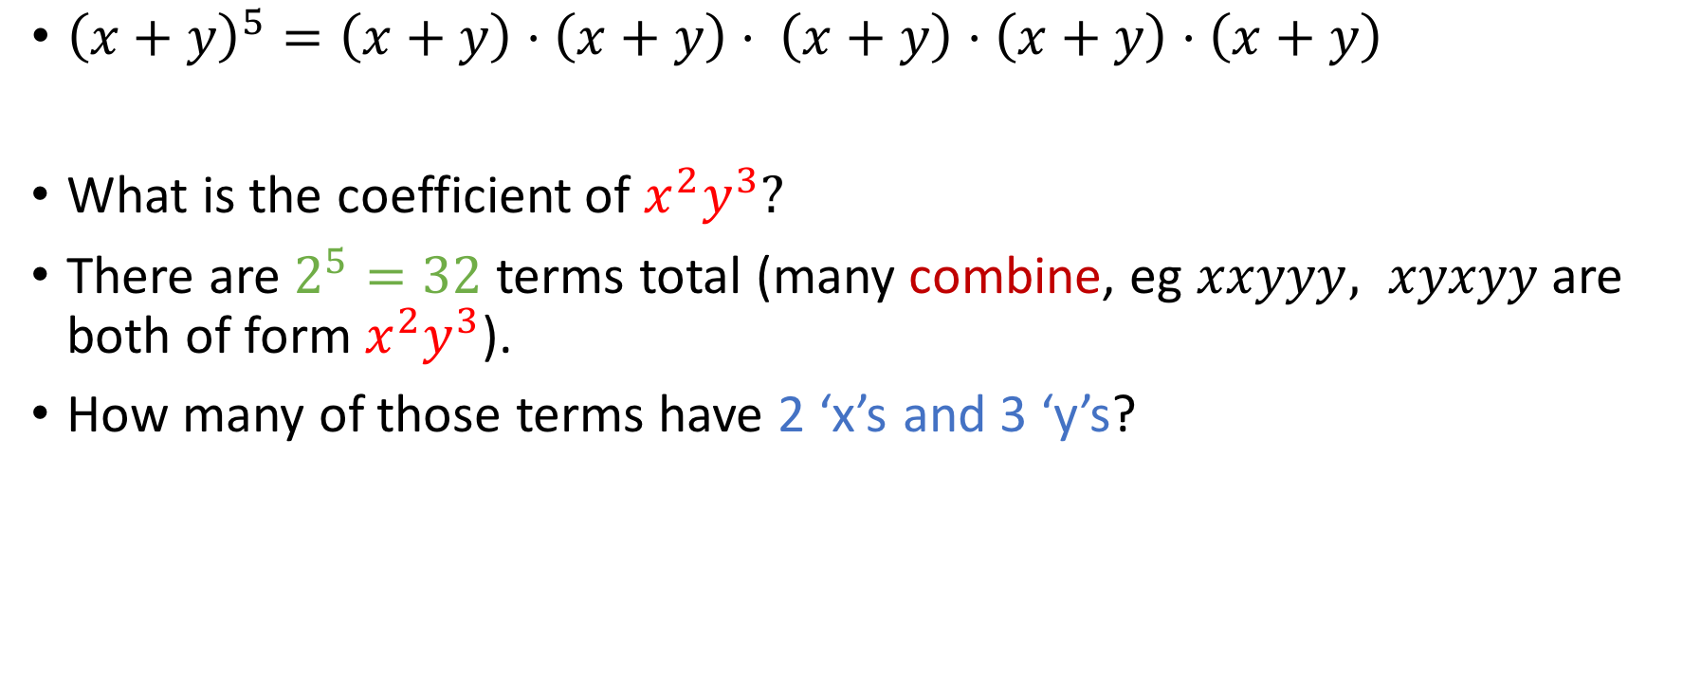
$${\left(x+y\right)}^{5}$$
${\left(x+y\right)}^{5}={\left(x+y\right)⋅\left(x+y\right)⋅}^{ }\left(x+y\right)⋅\left(x+y\right)⋅\left(x+y\right)$
What is the coefficient of $x^{2}y^{3}?$
There are $2^{5}=32$ terms total (many combine, eg $xxyyy, xyxyy$are both of form $x^{2}y^{3}$).
How many of those terms have 2 ‘x’s and 3 ‘y’s?

Slide 7


$${\left(x+y\right)}^{5}$$
${\left(x+y\right)}^{5}={\left(x+y\right)⋅\left(x+y\right)⋅}^{ }\left(x+y\right)⋅\left(x+y\right)⋅\left(x+y\right)$
$$xxyyy, xyxyy, xyyxy, xyyyx, \\ yxxyy, yxyxy, yxyyx,$$ $yyxxy, yyxyx,$
$yyyxx$

Slide 8
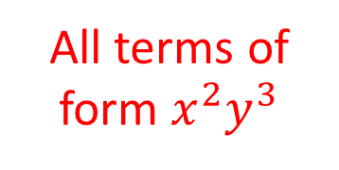
$${\left(x+y\right)}^{5}$$
${\left(x+y\right)}^{5}={\left(x+y\right)⋅\left(x+y\right)⋅}^{ }\left(x+y\right)⋅\left(x+y\right)⋅\left(x+y\right)$
$$xxyyy, xyxyy, xyyxy, xyyyx, \\ yxxyy, yxyxy, yxyyx,$$ $yyxxy, yyxyx,$
$yyyxx$
All terms of form $x^{2}y^{3}$

Slide 9
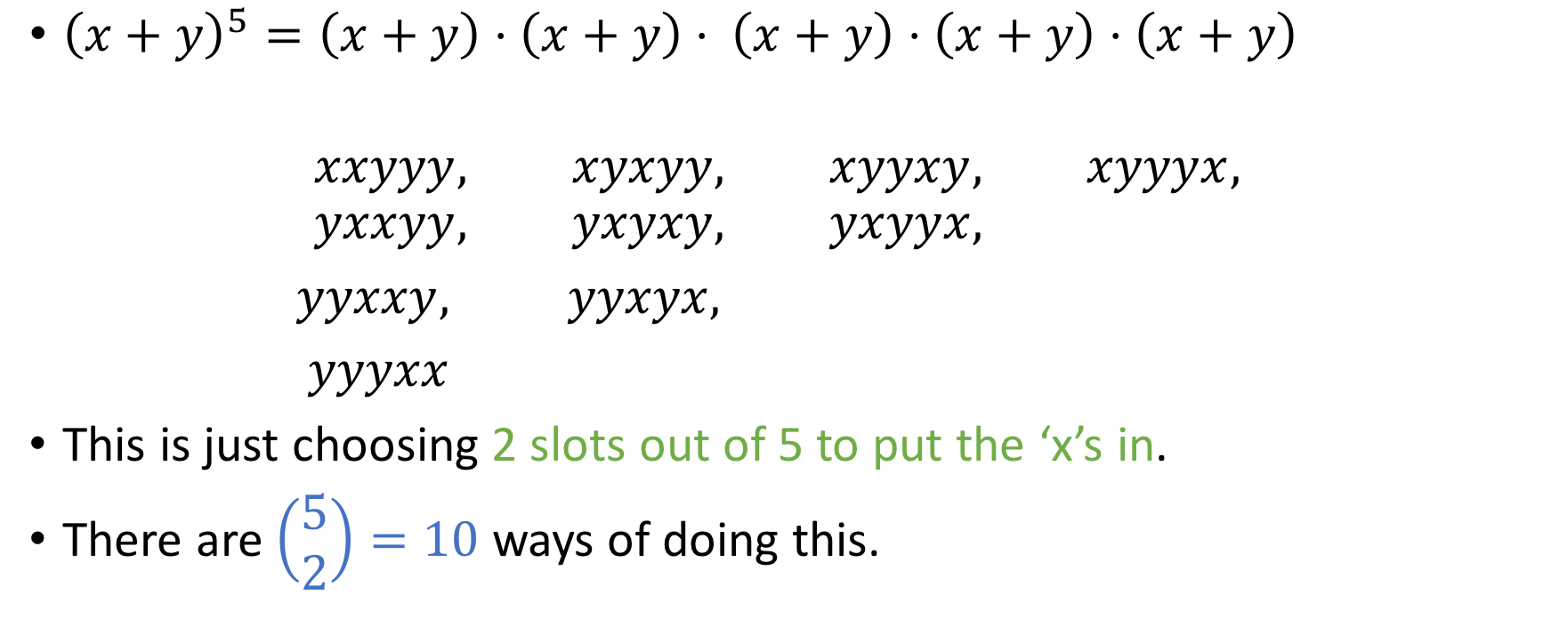
$${\left(x+y\right)}^{5}$$
${\left(x+y\right)}^{5}={\left(x+y\right)⋅\left(x+y\right)⋅}^{ }\left(x+y\right)⋅\left(x+y\right)⋅\left(x+y\right)$
$$xxyyy, xyxyy, xyyxy, xyyyx, \\ yxxyy, yxyxy, yxyyx,$$ $yyxxy, yyxyx,$
$yyyxx$
This is just choosing 2 slots out of 5 to put the ‘x’s in.
There are $\left(\begin{aligned}5 \\ 2\end{aligned}\right)=10$ ways of doing this.
All terms of form $x^{2}y^{3}$

Slide 10

You do this now
What is the coefficient of $x^{3}y^{4}$ in ${\left(x+y\right)}^{7}$?

Slide 11
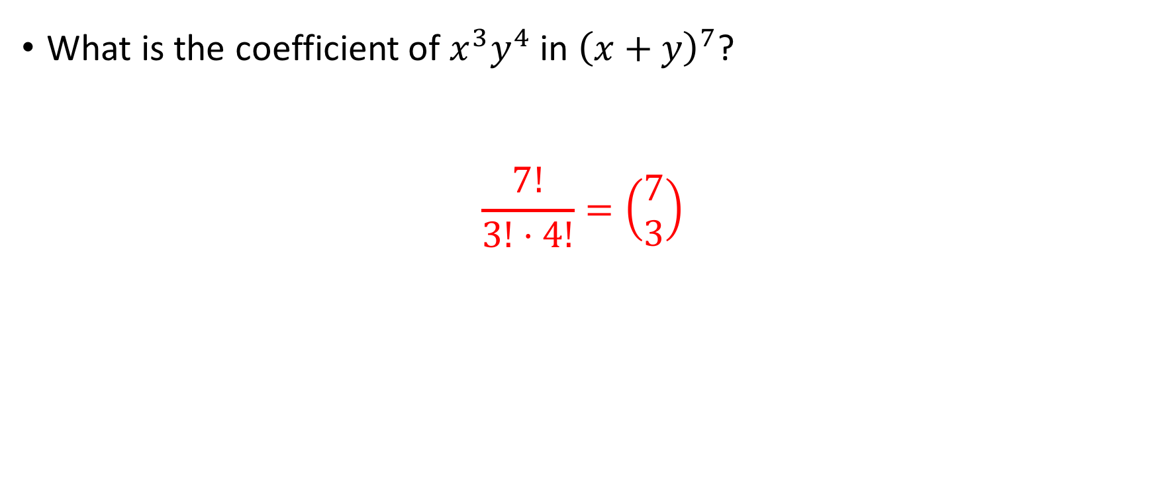
You do this now
What is the coefficient of $x^{3}y^{4}$ in ${\left(x+y\right)}^{7}$?
$$\frac{7!}{3!⋅4!}=\left(\begin{aligned}7 \\ 3\end{aligned}\right)$$

Slide 12


$${\left(x+y\right)}^{n}$$
We now generalize the previous results:
${\left(x+y\right)}^{n}={\left(x+y\right)⋅\left(x+y\right)⋅…⋅}^{ }\left(x+y\right)$
Co-efficient of $x^{r}y^{n−r}=$ # of ways to select r ‘x’s from n slots = $\left(\begin{aligned}n \\ r\end{aligned}\right)$

Slide 13
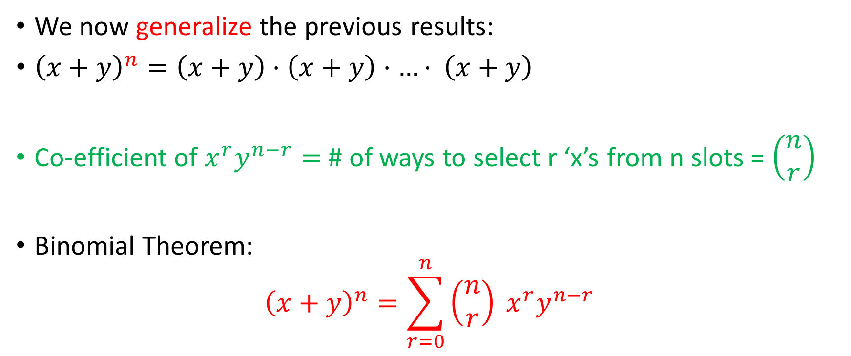
$${\left(x+y\right)}^{n}$$
We now generalize the previous results:
${\left(x+y\right)}^{n}={\left(x+y\right)⋅\left(x+y\right)⋅…⋅}^{ }\left(x+y\right)$
Co-efficient of $x^{r}y^{n−r}=$ # of ways to select r ‘x’s from n slots = $\left(\begin{aligned}n \\ r\end{aligned}\right)$
Binomial Theorem:
$${\left(x+y\right)}^{n}=\sum_{r=0}^{n}{\left(\begin{aligned}n \\ r\end{aligned}\right) x^{r}y^{n−r}}$$

Slide 14
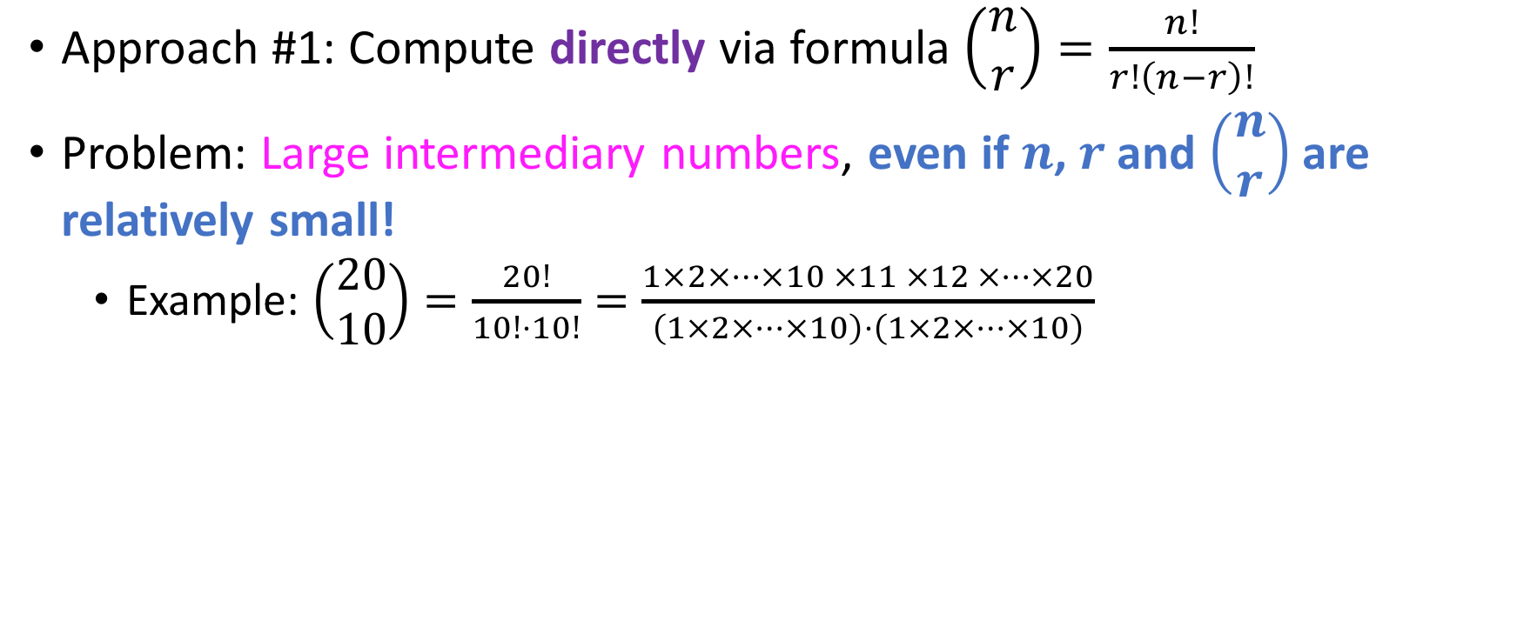
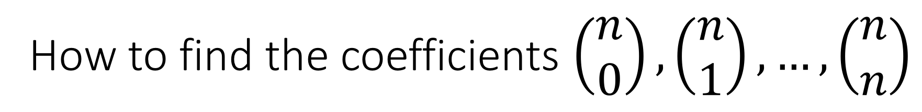
How to find the coefficients $\left(\begin{aligned}n \\ 0\end{aligned}\right),\left(\begin{aligned}n \\ 1\end{aligned}\right),…,\left(\begin{aligned}n \\ n\end{aligned}\right)$
Approach #1: Compute directly via formula $\left(\begin{aligned}n \\ r\end{aligned}\right)=\frac{n!}{r!\left(n−r\right)!}$
Problem: Large intermediary numbers, even if $n$,$r$ and $\left(\begin{aligned}n \\ r\end{aligned}\right)$ are relatively small!
Example: $\left(\begin{aligned}20 \\ 10\end{aligned}\right)=\frac{20!}{10!⋅10!}=\frac{1×2×…×10 ×11 ×12 ×…×20}{\left(1×2×…×10\right)⋅\left(1×2×…×10\right)}$

Slide 15
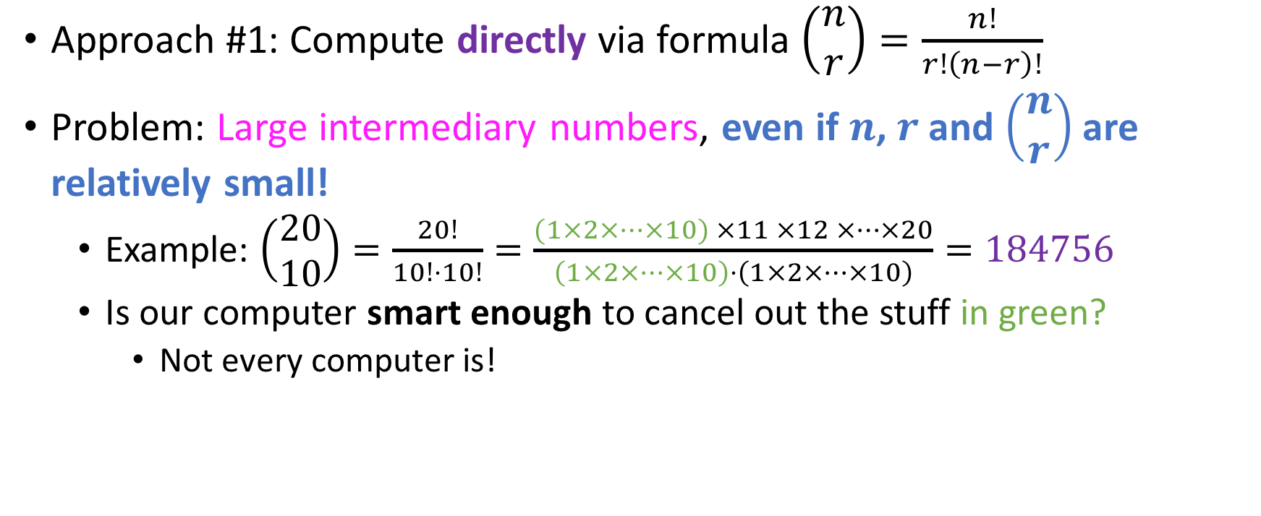
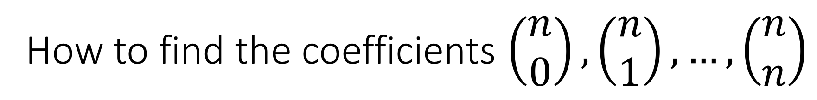
How to find the coefficients $\left(\begin{aligned}n \\ 0\end{aligned}\right),\left(\begin{aligned}n \\ 1\end{aligned}\right),…,\left(\begin{aligned}n \\ n\end{aligned}\right)$
Approach #1: Compute directly via formula $\left(\begin{aligned}n \\ r\end{aligned}\right)=\frac{n!}{r!\left(n−r\right)!}$
Problem: Large intermediary numbers, even if $n$,$r$ and $\left(\begin{aligned}n \\ r\end{aligned}\right)$ are relatively small!
Example: $\left(\begin{aligned}20 \\ 10\end{aligned}\right)=\frac{20!}{10!⋅10!}=\frac{(1×2×…×10) ×11 ×12 ×…×20}{\left(1×2×…×10\right)⋅\left(1×2×…×10\right)}=184756$
Is our computer smart enough to cancel out the stuff in green?
Not every computer is!
Not too large!

Slide 16
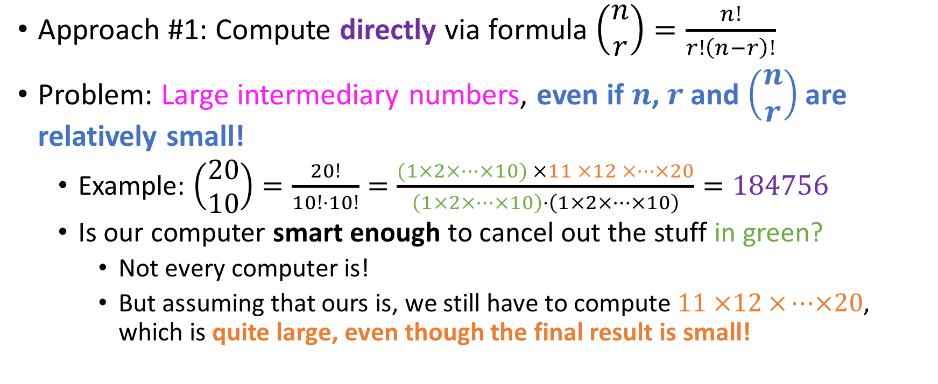
How to find the coefficients $\left(\begin{aligned}n \\ 0\end{aligned}\right),\left(\begin{aligned}n \\ 1\end{aligned}\right),…,\left(\begin{aligned}n \\ n\end{aligned}\right)$
Approach #1: Compute directly via formula $\left(\begin{aligned}n \\ r\end{aligned}\right)=\frac{n!}{r!\left(n−r\right)!}$
Problem: Large intermediary numbers, even if $n$,$r$ and $\left(\begin{aligned}n \\ r\end{aligned}\right)$ are relatively small!
Example: $\left(\begin{aligned}20 \\ 10\end{aligned}\right)=\frac{20!}{10!⋅10!}=\frac{(1×2×…×10) ×11 ×12 ×…×20}{\left(1×2×…×10\right)⋅\left(1×2×…×10\right)}=184756$
Is our computer smart enough to cancel out the stuff in green?
Not every computer is!
But assuming that ours is, we still have to compute $11 ×12 ×…×20$, which is quite large, even though the final result is small!
Not too large!

Slide 17
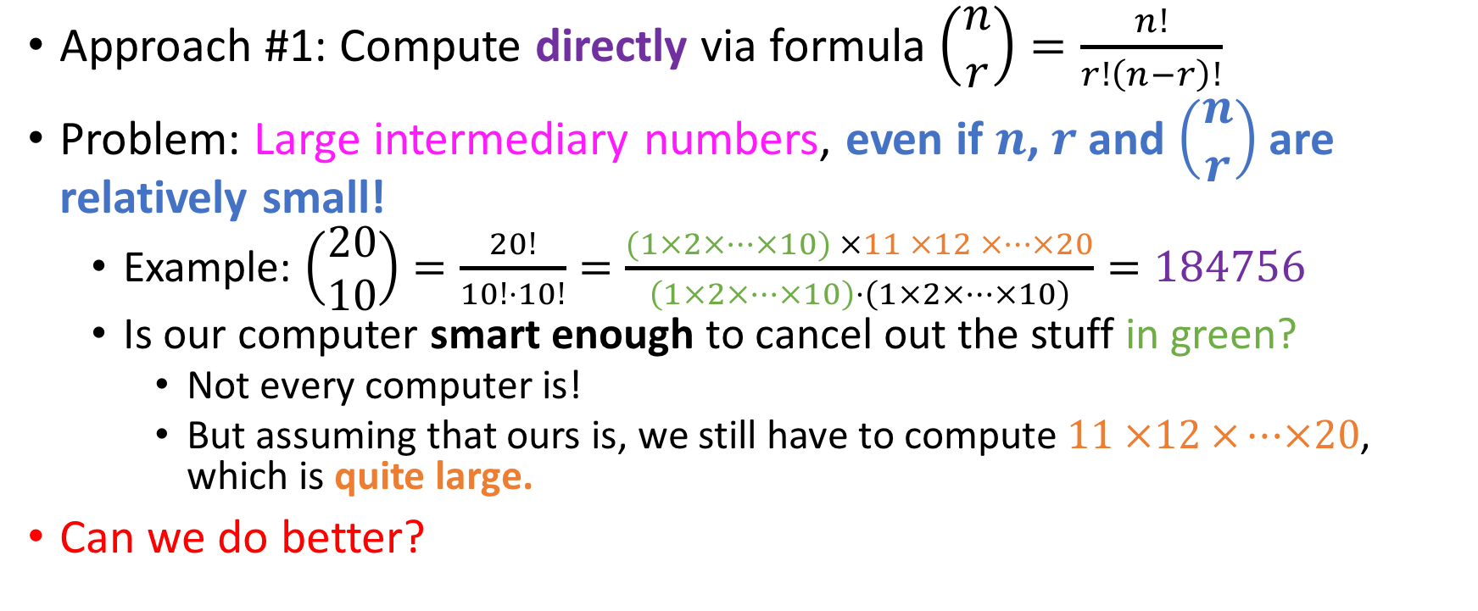
How to find the coefficients $\left(\begin{aligned}n \\ 0\end{aligned}\right),\left(\begin{aligned}n \\ 1\end{aligned}\right),…,\left(\begin{aligned}n \\ n\end{aligned}\right)$
Approach #1: Compute directly via formula $\left(\begin{aligned}n \\ r\end{aligned}\right)=\frac{n!}{r!\left(n−r\right)!}$
Problem: Large intermediary numbers, even if $n$,$r$ and $\left(\begin{aligned}n \\ r\end{aligned}\right)$ are relatively small!
Example: $\left(\begin{aligned}20 \\ 10\end{aligned}\right)=\frac{20!}{10!⋅10!}=\frac{(1×2×…×10) ×11 ×12 ×…×20}{\left(1×2×…×10\right)⋅\left(1×2×…×10\right)}=184756$
Is our computer smart enough to cancel out the stuff in green?
Not every computer is!
But assuming that ours is, we still have to compute $11 ×12 ×…×20$, which is quite large.
Can we do better?
Not too large!

Slide 18
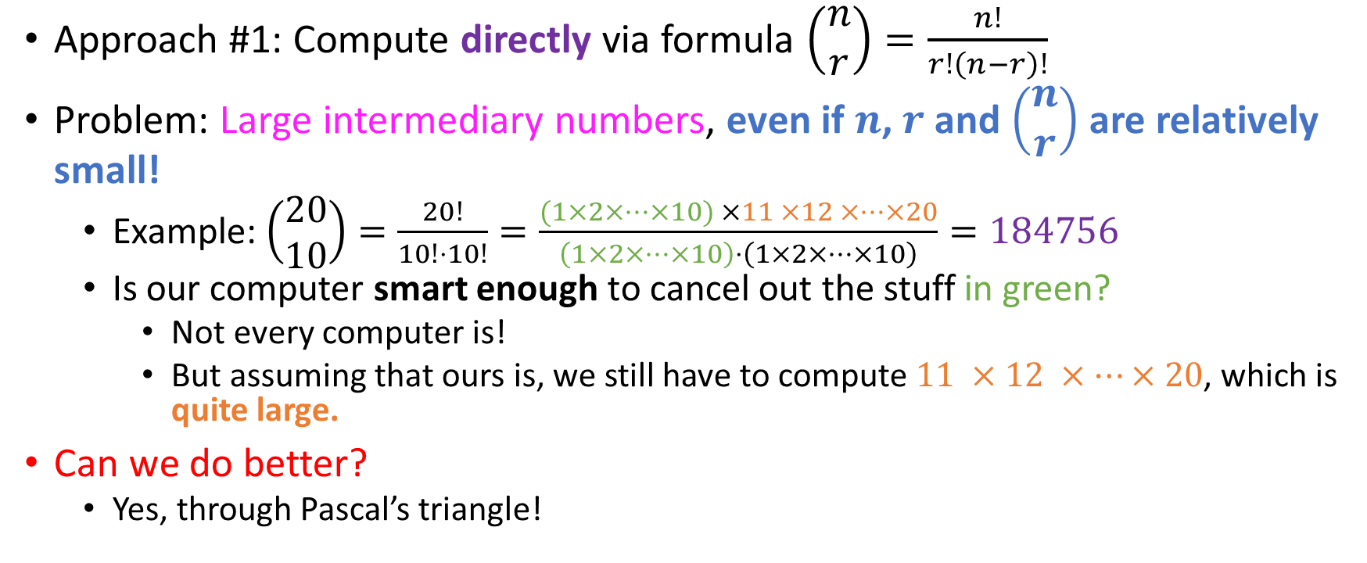
How to find the coefficients $\left(\begin{aligned}n \\ 0\end{aligned}\right),\left(\begin{aligned}n \\ 1\end{aligned}\right),…,\left(\begin{aligned}n \\ n\end{aligned}\right)$
Approach #1: Compute directly via formula $\left(\begin{aligned}n \\ r\end{aligned}\right)=\frac{n!}{r!\left(n−r\right)!}$
Problem: Large intermediary numbers, even if $n$,$r$ and $\left(\begin{aligned}n \\ r\end{aligned}\right)$ are relatively small!
Example: $\left(\begin{aligned}20 \\ 10\end{aligned}\right)=\frac{20!}{10!⋅10!}=\frac{(1×2×…×10) ×11 ×12 ×…×20}{\left(1×2×…×10\right)⋅\left(1×2×…×10\right)}=184756$
Is our computer smart enough to cancel out the stuff in green?
Not every computer is!
But assuming that ours is, we still have to compute $11 ×12 ×…×20$, which is quite large.
Can we do better?
Yes, through Pascal’s triangle!
Not too large!

Slide 19

An easy combinatorial identity
We will prove that
$\left(∀n, r∈ℕ\right)[\left(r≤n\right)⇒\left(\begin{aligned}n \\ r\end{aligned}\right)=$ $\left(\begin{aligned}n \\ n−r\end{aligned}\right)]$
in two different ways!

Slide 20

Another combinatorial identity
$$\left(∀n, r∈ℕ^{≥1}\right)\left[\left(r≤n\right)⇒\left(\begin{aligned}n \\ r\end{aligned}\right)=\left(\begin{aligned}n−1 \\ r−1\end{aligned}\right)+\left(\begin{aligned}n−1 \\ r\end{aligned}\right)\right]$$

Slide 21

Another combinatorial identity
$$\left(∀n, r∈ℕ^{≥1}\right)\left[\left(r≤n\right)⇒\left(\begin{aligned}n \\ r\end{aligned}\right)=\left(\begin{aligned}n−1 \\ r−1\end{aligned}\right)+\left(\begin{aligned}n−1 \\ r\end{aligned}\right)\right]$$
Algebraic proof
Combinatorial proof!

Slide 22
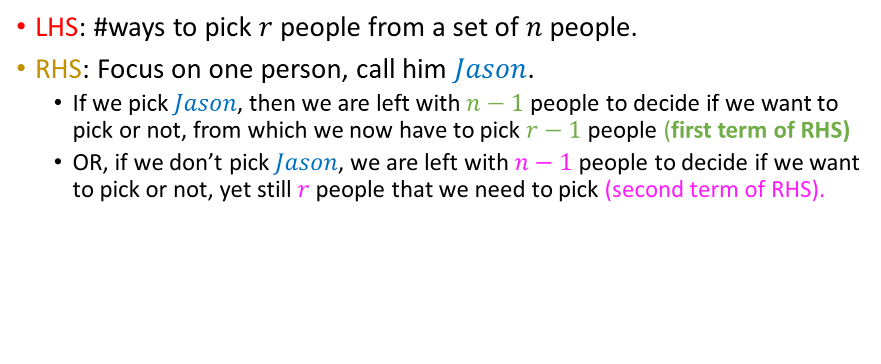
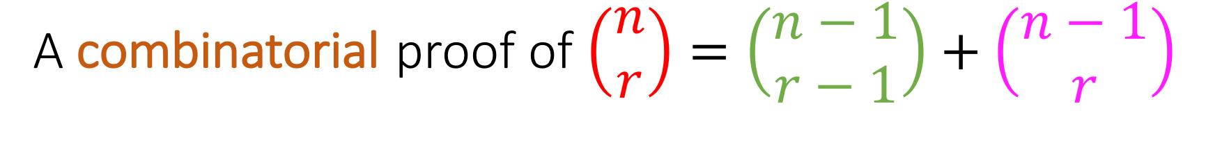
A combinatorial proof of $\left(\begin{aligned}n \\ r\end{aligned}\right)=\left(\begin{aligned}n−1 \\ r−1\end{aligned}\right)+\left(\begin{aligned}n−1 \\ r\end{aligned}\right)$
LHS: #ways to pick $r$ people from a set of $n$ people.
RHS: Focus on one person, call him $Jason$.
If we pick $Jason$, then we are left with $n−1$people to decide if we want to pick or not, from which we now have to pick $r−1$ people (first term of RHS)
OR, if we don’t pick $Jason$, we are left with $n−1$people to decide if we want to pick or not, yet still $r$ people that we need to pick (second term of RHS).

Slide 23
A combinatorial proof of $\left(\begin{aligned}n \\ r\end{aligned}\right)=\left(\begin{aligned}n−1 \\ r−1\end{aligned}\right)+\left(\begin{aligned}n−1 \\ r\end{aligned}\right)$
LHS: #ways to pick $r$ people from a set of $n$ people.
RHS: Focus on one person, call him $Jason$.
If we pick $Jason$, then we are left with $n−1$people to decide if we want to pick or not, from which we now have to pick $r−1$ people (first term of RHS)
OR, if we don’t pick $Jason$, we are left with $n−1$people to decide if we want to pick or not, yet still $r$ people that we need to pick (second term of RHS).

Slide 24
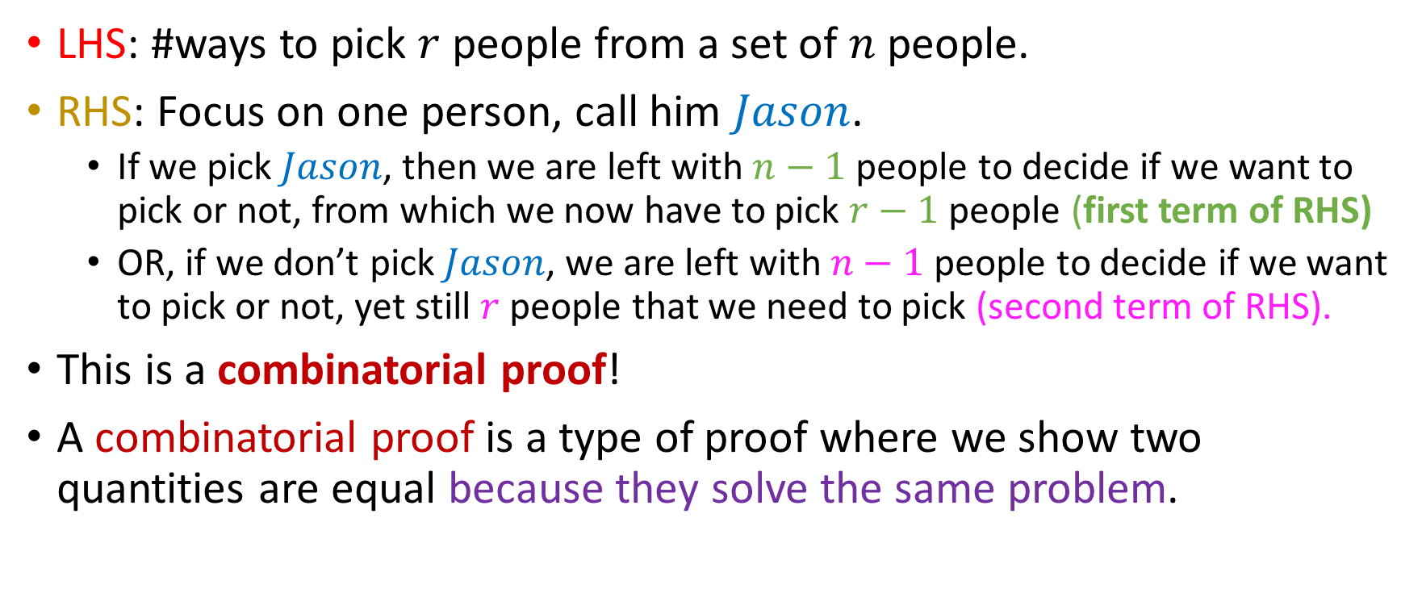
A combinatorial proof of $\left(\begin{aligned}n \\ r\end{aligned}\right)=\left(\begin{aligned}n−1 \\ r−1\end{aligned}\right)+\left(\begin{aligned}n−1 \\ r\end{aligned}\right)$
LHS: #ways to pick $r$ people from a set of $n$ people.
RHS: Focus on one person, call him $Jason$.
If we pick $Jason$, then we are left with $n−1$people to decide if we want to pick or not, from which we now have to pick $r−1$ people (first term of RHS)
OR, if we don’t pick $Jason$, we are left with $n−1$people to decide if we want to pick or not, yet still $r$ people that we need to pick (second term of RHS).
This is a combinatorial proof!
A combinatorial proof is a type of proof where we show two quantities are equal because they solve the same problem.

Slide 25










Pascal’s Triangle
$$\left(\begin{aligned}0 \\ 0\end{aligned}\right)$$
$$\left(\begin{aligned}1 \\ 0\end{aligned}\right)$$
$$\left(\begin{aligned}1 \\ 1\end{aligned}\right)$$
$$\left(\begin{aligned}2 \\ 0\end{aligned}\right)$$
$$\left(\begin{aligned}2 \\ 1\end{aligned}\right)$$
$$\left(\begin{aligned}2 \\ 2\end{aligned}\right)$$
$$\left(\begin{aligned}3 \\ 0\end{aligned}\right)$$
$$\left(\begin{aligned}3 \\ 1\end{aligned}\right)$$
$$\left(\begin{aligned}3 \\ 2\end{aligned}\right)$$
$$\left(\begin{aligned}3 \\ 3\end{aligned}\right)$$

Slide 26













Pascal’s Triangle
$\left(\begin{aligned}0 \\ 0\end{aligned}\right)$=1
$\left(\begin{aligned}1 \\ 0\end{aligned}\right)$=1
$\left(\begin{aligned}1 \\ 1\end{aligned}\right)$=1
$$1+1=2$$
$\left(\begin{aligned}2 \\ 0\end{aligned}\right)$=1
$\left(\begin{aligned}2 \\ 1\end{aligned}\right)$=2
$\left(\begin{aligned}2 \\ 2\end{aligned}\right)$=1
$$1+2=3$$
$$2+1=3$$
$\left(\begin{aligned}3 \\ 0\end{aligned}\right)$=1
$\left(\begin{aligned}3 \\ 1\end{aligned}\right)$=3
$\left(\begin{aligned}3 \\ 2\end{aligned}\right)$=3
$\left(\begin{aligned}3 \\ 3\end{aligned}\right)$=1

Slide 27

Upshot
Use combinatorial identity
generate Pascal’s triangle
generate binomial coefficients $\left(\begin{aligned}n \\ 0\end{aligned}\right),\left(\begin{aligned}n \\ 1\end{aligned}\right), …,\left(\begin{aligned}n \\ n\end{aligned}\right)$
use in the expansion of ${\left(x+y\right)}^{n}$

Slide 28

Efficiency of Pascal’s triangle
We avoid the intermediary large numbers problem
$i^{th}$ level of triangle gives us all coefficients $\left(\begin{aligned}i \\ 0\end{aligned}\right),\left(\begin{aligned}i \\ 1\end{aligned}\right), …,\left(\begin{aligned}i \\ i\end{aligned}\right)$
Compute the value of every node as the sum of its two parents
Note that the diagonal “edges” of the triangle always 1.

Slide 29

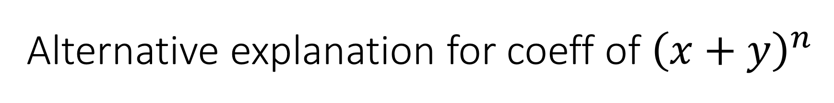
Alternative explanation for coeff of ${\left(x+y\right)}^{n}$
${\left(x+y\right)}^{n}$ has terms of form $x^{a}y^{b}$.
As discussed, many simplify

Slide 30
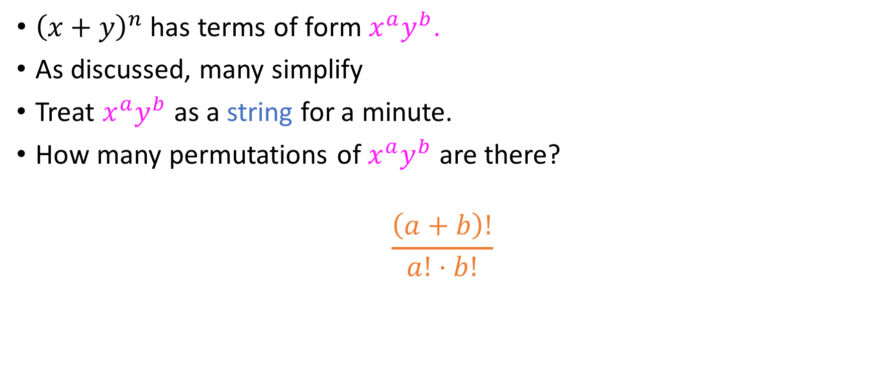
Alternative explanation for coeff of ${\left(x+y\right)}^{n}$
${\left(x+y\right)}^{n}$ has terms of form $x^{a}y^{b}$.
As discussed, many simplify
Treat $x^{a}y^{b}$ as a string for a minute.
How many permutations of $x^{a}y^{b}$ are there?
$$\frac{\left(a+b\right)!}{a!⋅b!}$$

Slide 31
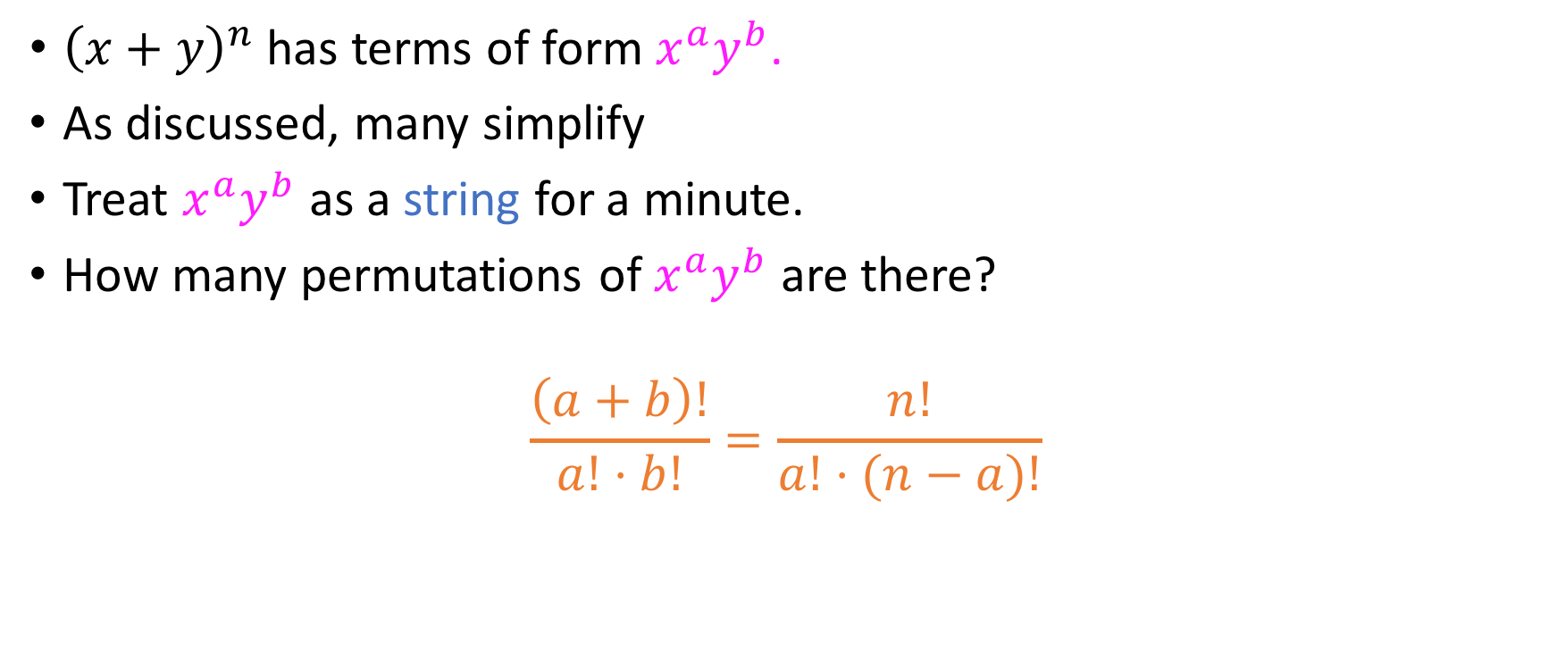
Alternative explanation for coeff of ${\left(x+y\right)}^{n}$
${\left(x+y\right)}^{n}$ has terms of form $x^{a}y^{b}$.
As discussed, many simplify
Treat $x^{a}y^{b}$ as a string for a minute.
How many permutations of $x^{a}y^{b}$ are there?
$$\frac{\left(a+b\right)!}{a!⋅b!}=\frac{n!}{a!⋅(n−a)!}$$

Slide 32

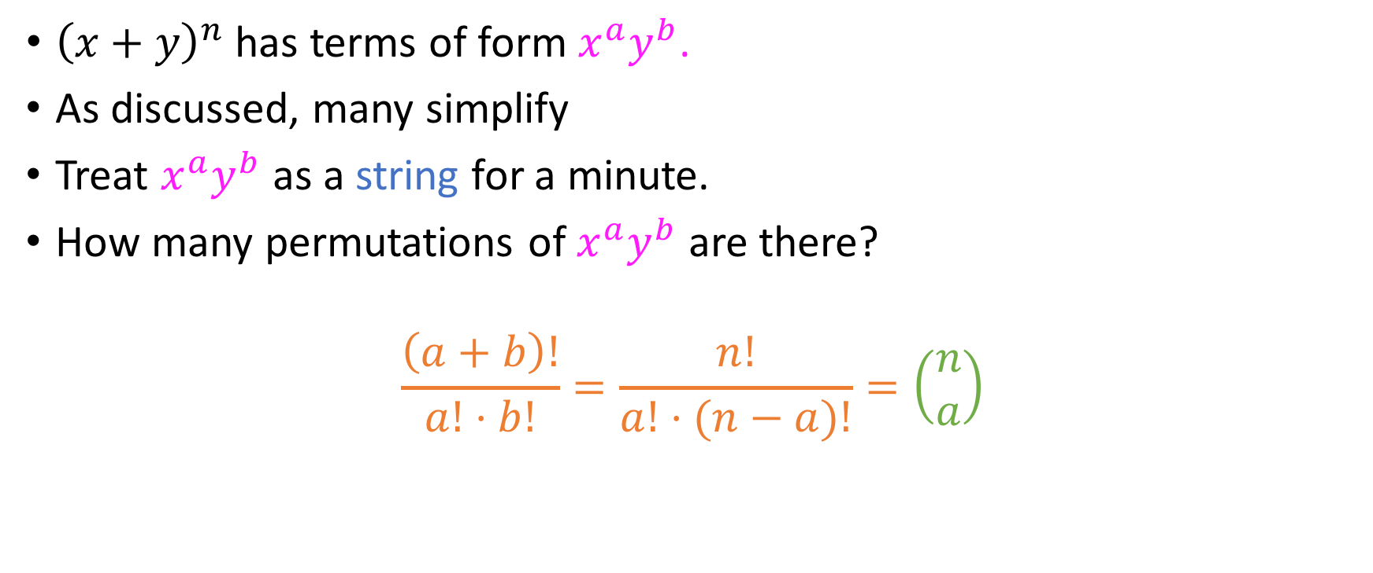
Alternative explanation for coeff of ${\left(x+y\right)}^{n}$
${\left(x+y\right)}^{n}$ has terms of form $x^{a}y^{b}$.
As discussed, many simplify
Treat $x^{a}y^{b}$ as a string for a minute.
How many permutations of $x^{a}y^{b}$ are there?
$$\frac{\left(a+b\right)!}{a!⋅b!}=\frac{n!}{a!⋅(n−a)!}=\left(\begin{aligned}n \\ a\end{aligned}\right)$$

Slide 33

An exercise for you to do now
Expand ${\left(x+y+z\right)}^{2}$

Slide 34

An exercise for you to do now
Expand ${\left(x+y+z\right)}^{2}$
$$x^{2}+y^{2}+z^{2}+2xy+2xz+2yz$$

Slide 35
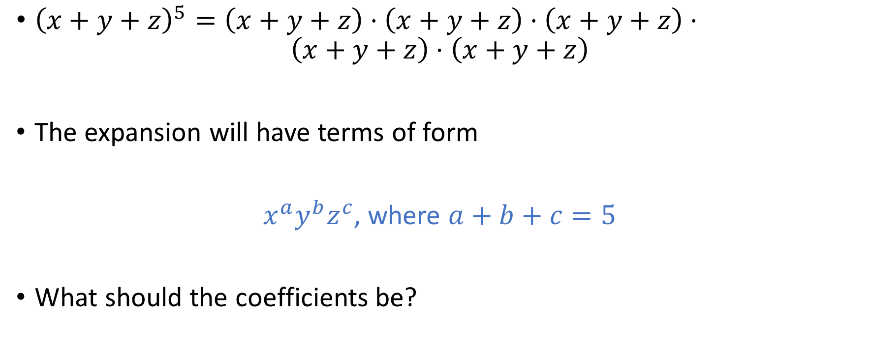
Trinomial theorem
${\left(x+y+z\right)}^{5}=\left(x+y+z\right)⋅\left(x+y+z\right)⋅\left(x+y+z\right)⋅$ $\left(x+y+z\right)⋅\left(x+y+z\right)$
The expansion will have terms of form
$x^{a}y^{b}z^{c}$, where $a+b+c=5$
What should the coefficients be?

Slide 36

Trinomial theorem
$x^{a}y^{b}z^{c}$, where $a+b+c=5$
Once again, let’s view $x^{a}y^{b}z^{c}$ as a string.
#permutations of this string =
$$\frac{\left(a+b+c\right)!}{a!⋅b!⋅c!}$$

Slide 37

Trinomial theorem
$x^{a}y^{b}z^{c}$, where $a+b+c=5$
Once again, let’s view $x^{a}y^{b}z^{c}$ as a string.
#permutations of this string =
$$\frac{\left(a+b+c\right)!}{a!⋅b!⋅c!}=\frac{5!}{a!⋅b!⋅c!}$$

Slide 38

Trinomial theorem
$${\left(x+y+z\right)}^{n}=\sum_{\begin{aligned}a+b+c=n \\ 0≤a,b,c≤n\end{aligned}}^{ }{\frac{n!}{a!b!c!}x^{a}y^{b}z^{c}}$$

Slide 39
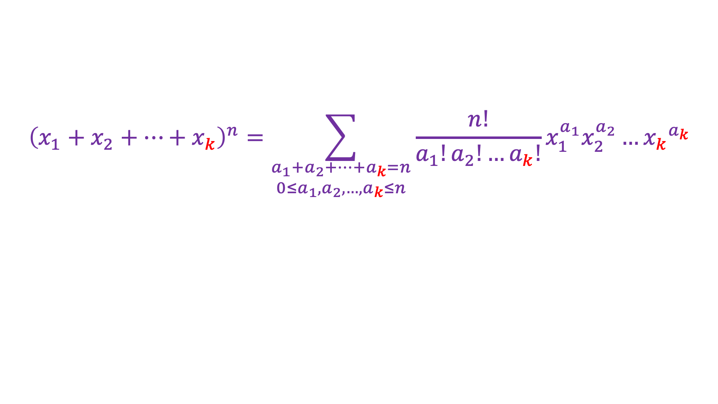

$k$-nomial theorem
$${\left(x_{1}+x_{2}+…+x_{k}\right)}^{n}=\sum_{\begin{aligned}a_{1}+a_{2}+…+a_{k}=n \\ 0≤a_{1},a_{2},…, a_{k}≤n\end{aligned}}^{ }{\frac{n!}{a_{1}!a_{2}!…a_{k}!}x_{1}^{a_{1}}x_{2}^{a_{2}}{…x_{k}}^{a_{k}}}$$

Slide 40
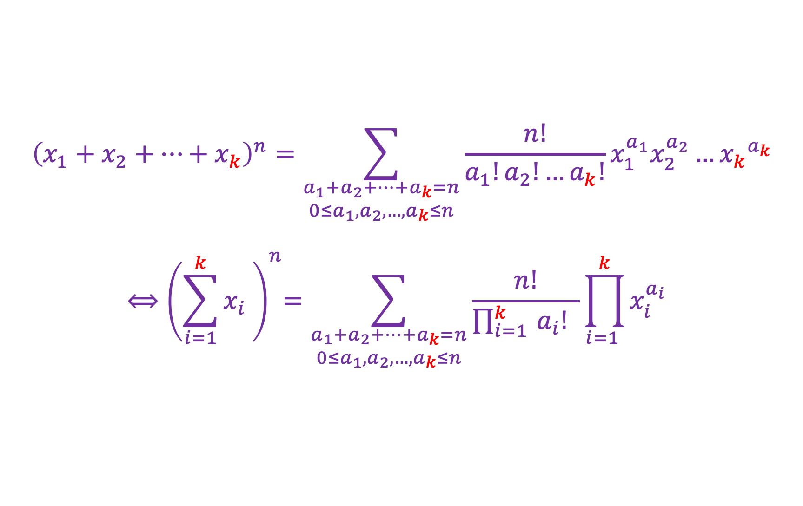
$k$-nomial theorem
$${\left(x_{1}+x_{2}+…+x_{k}\right)}^{n}=\sum_{\begin{aligned}a_{1}+a_{2}+…+a_{k}=n \\ 0≤a_{1},a_{2},…, a_{k}≤n\end{aligned}}^{ }{\frac{n!}{a_{1}!a_{2}!…a_{k}!}x_{1}^{a_{1}}x_{2}^{a_{2}}{…x_{k}}^{a_{k}}}$$
$${⟺\left(\sum_{i=1}^{k}{x_{i} }\right)}^{n}=\sum_{\begin{aligned}a_{1}+a_{2}+…+a_{k}=n \\ 0≤a_{1},a_{2},…, a_{k}≤n\end{aligned}}^{ }{\frac{n!}{{\prod_{i=1 }^{k}{a_{i}!}}_{ } }{{\prod_{i=1 }^{k}{x_{i}^{a_{i}}}}_{ }}_{ }^{ }}$$

