Slide 1
Sequences, Series and Summation / Product Notation
CMSC 250

Slide 2
Reminders
Assumed facts list announced on Friday here.
Homework 8 problem 1 not graded
Helpful explanation video posted yesterday.
Today: Sequences / series / etc
Thursday onward: induction, induction, induction

Slide 3
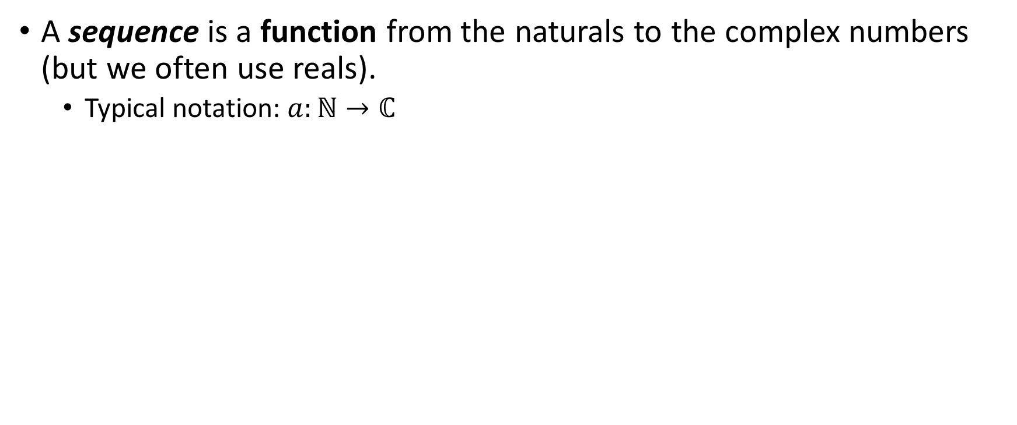
Sequences and series

Slide 4
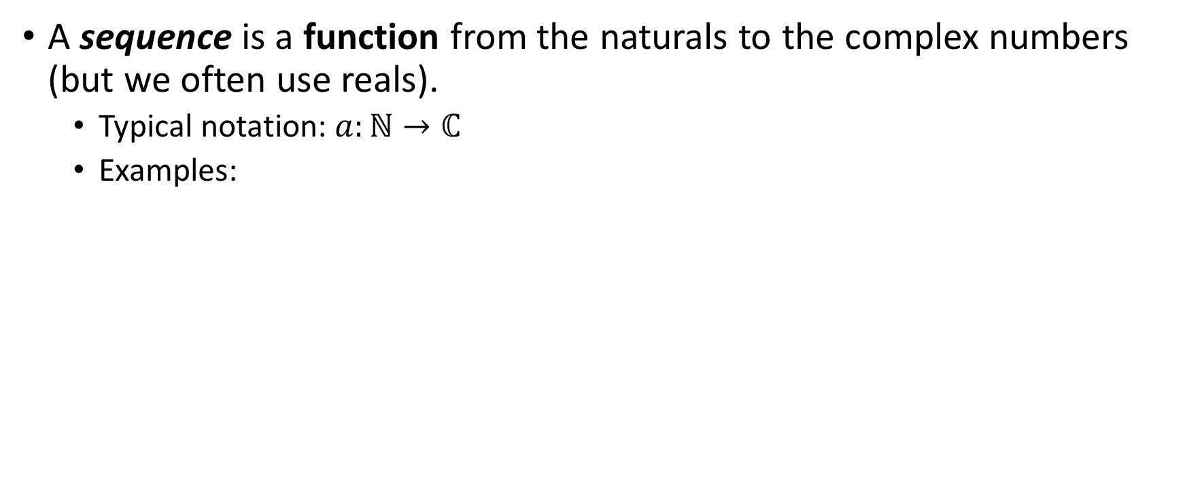
Sequences and series

Slide 5
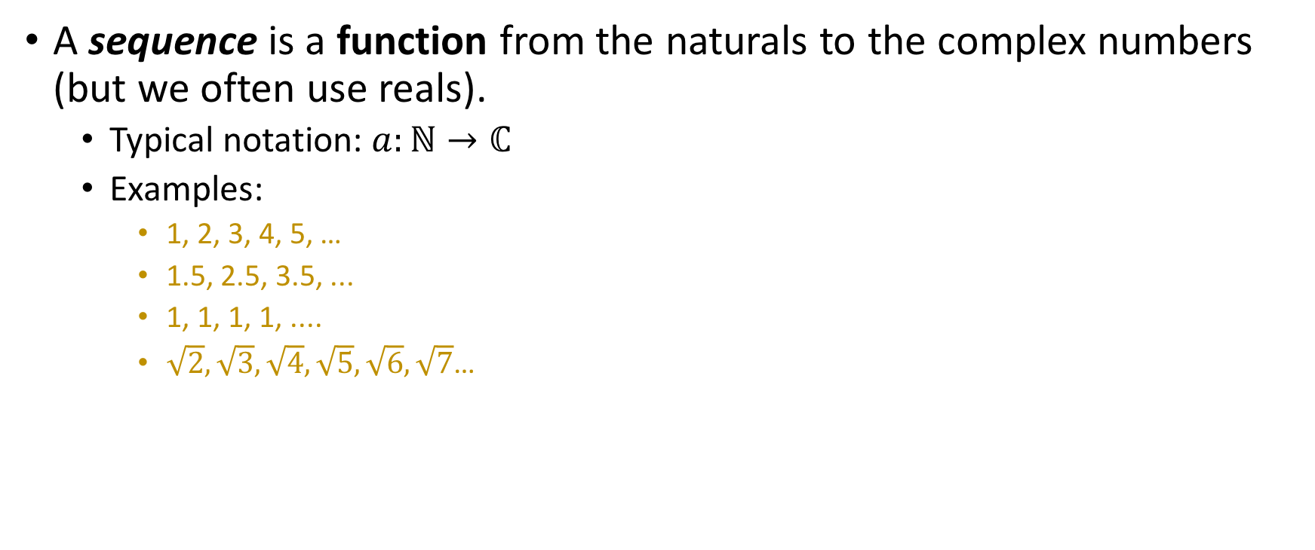
Sequences and series
Outlining terms

Slide 6
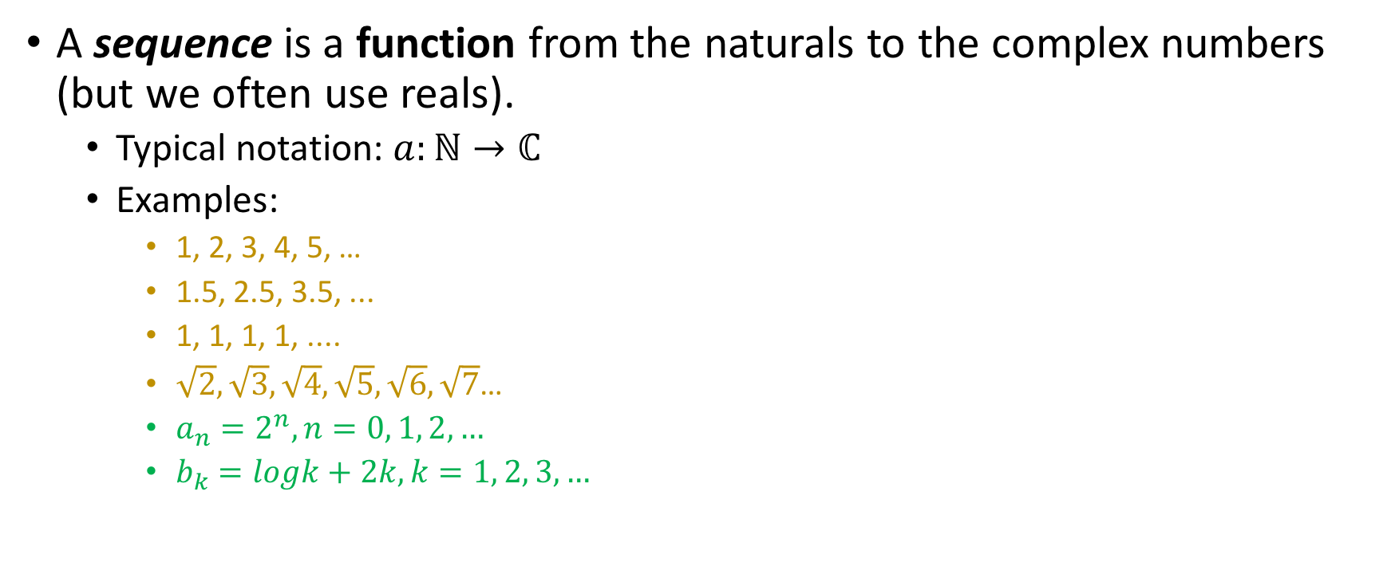
Sequences and series
Outlining terms
“Closed form” formula

Slide 7
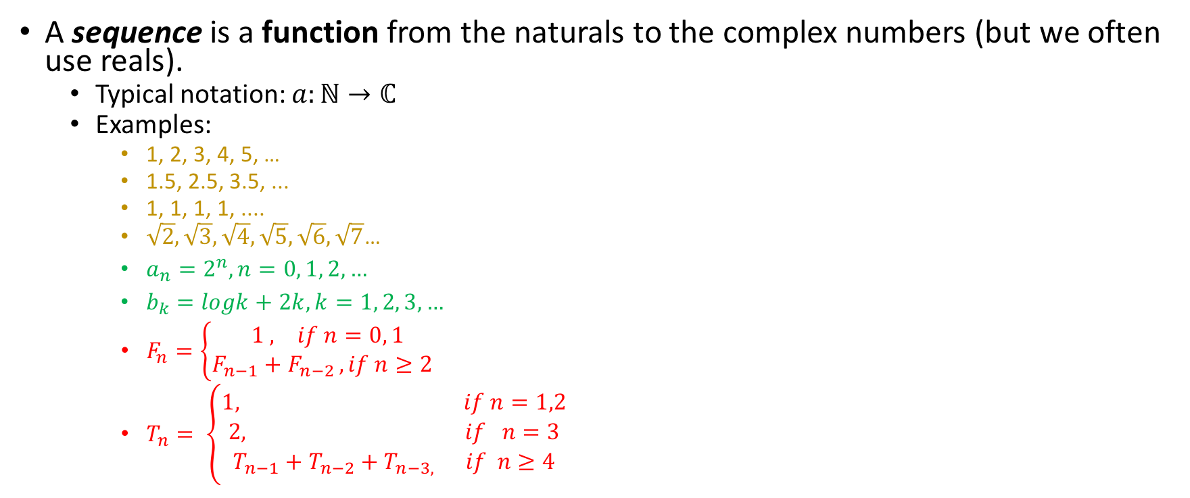
Sequences and series
Outlining terms
“Closed form” formula
Recursive formula

Slide 8
Sequences and series
Outlining terms
“Closed form” formula
All of those are valid ways to describe a sequence!
Recursive formula

Slide 9
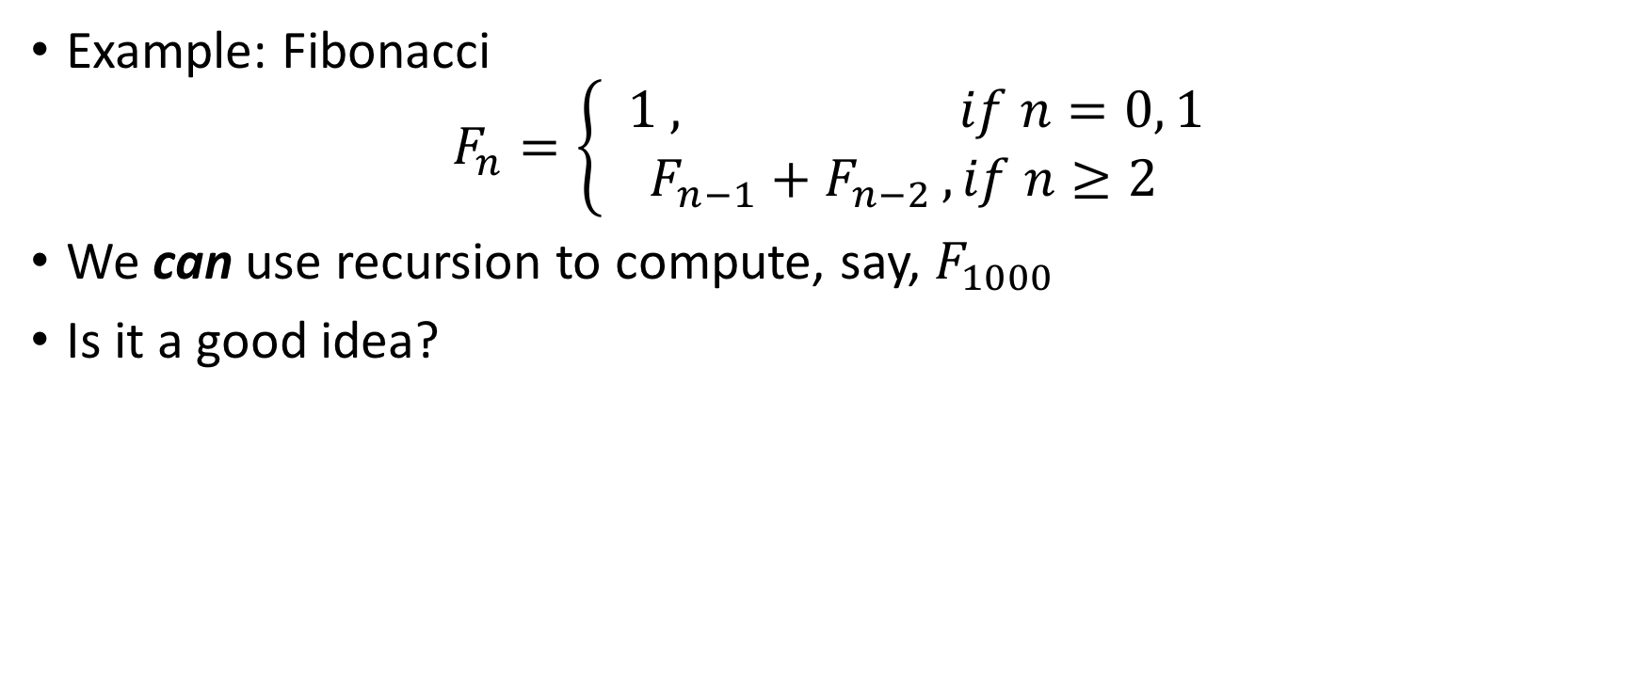
Recursion: good idea?
Yes
No
Something Else

Slide 10
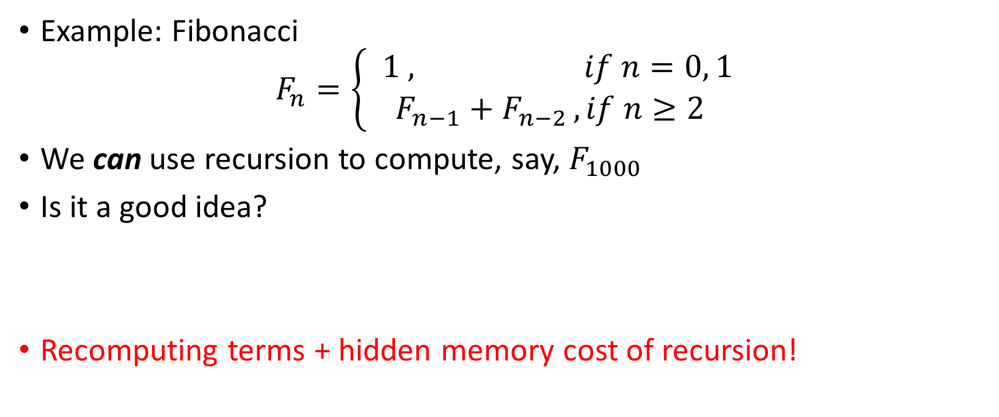
Recursion: good idea?
Yes
No
Something Else

Slide 11

Recursion: Done right
Yes
No
Something Else

Slide 12
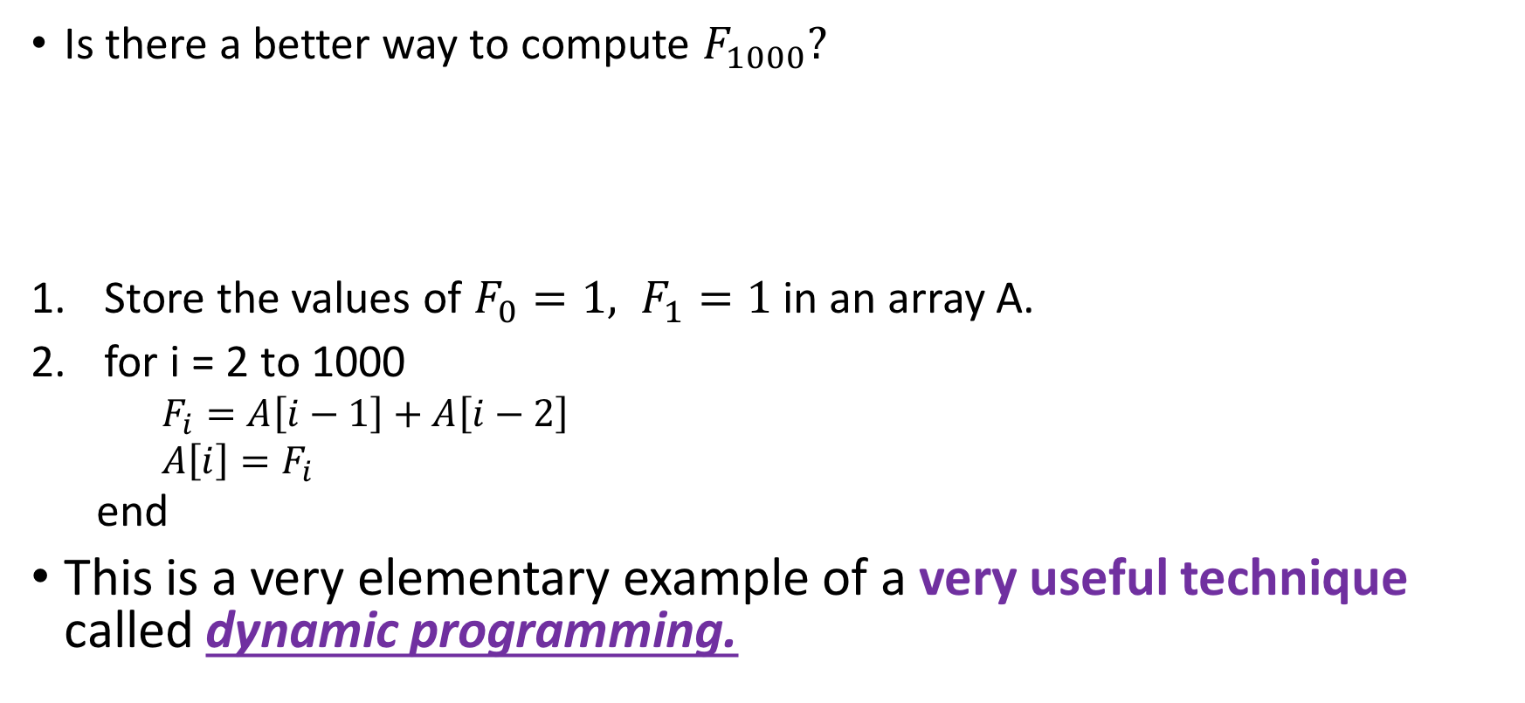
Recursion: Done right
Yes
No
Something Else

Slide 13
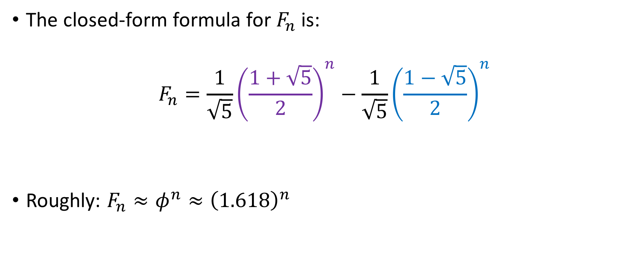


Closed formula for Fibonacci

Slide 14
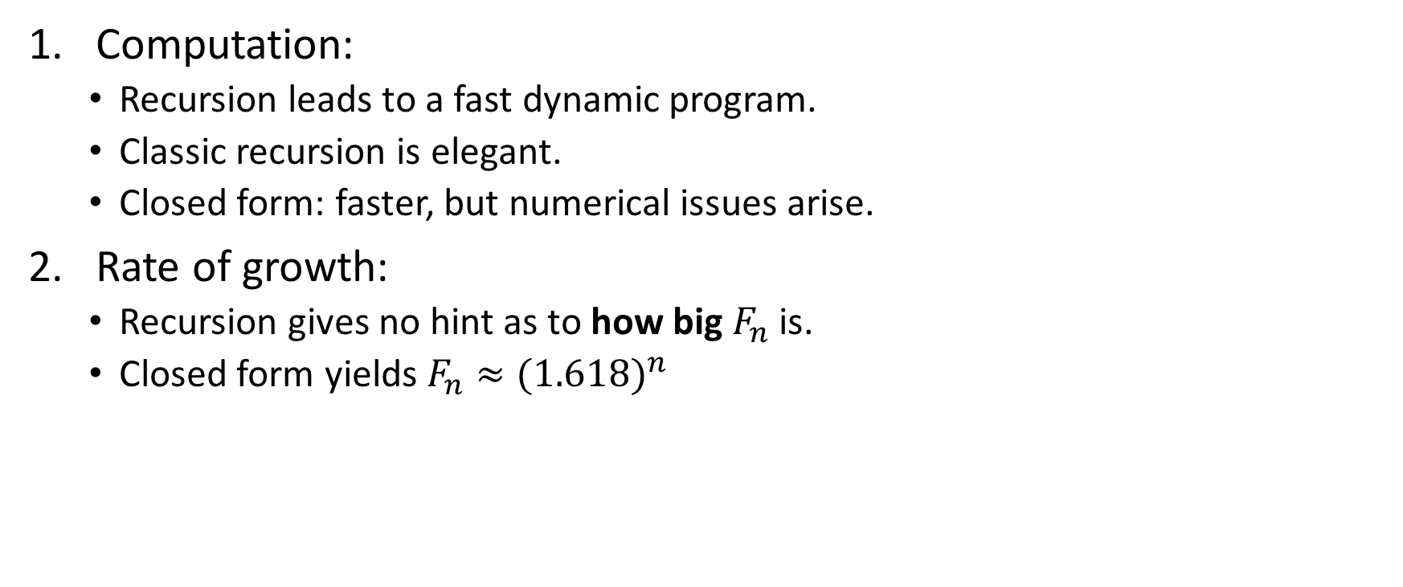
Recursion vs closed formula

Slide 15
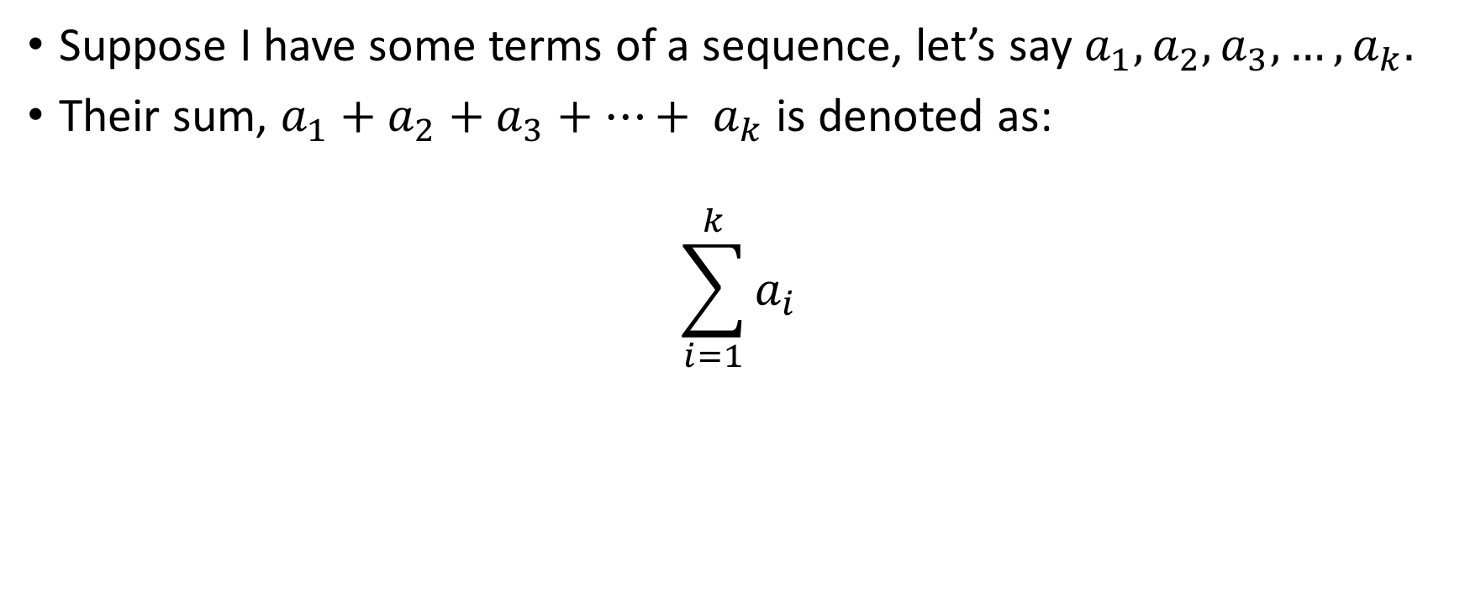
Summation notation

Slide 16
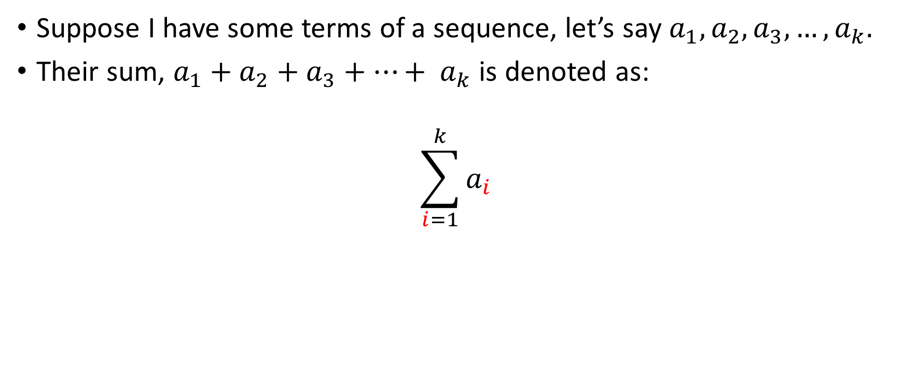
Summation notation
Index of last term to be included in the sum
Index of term with which the sum begins

Slide 17
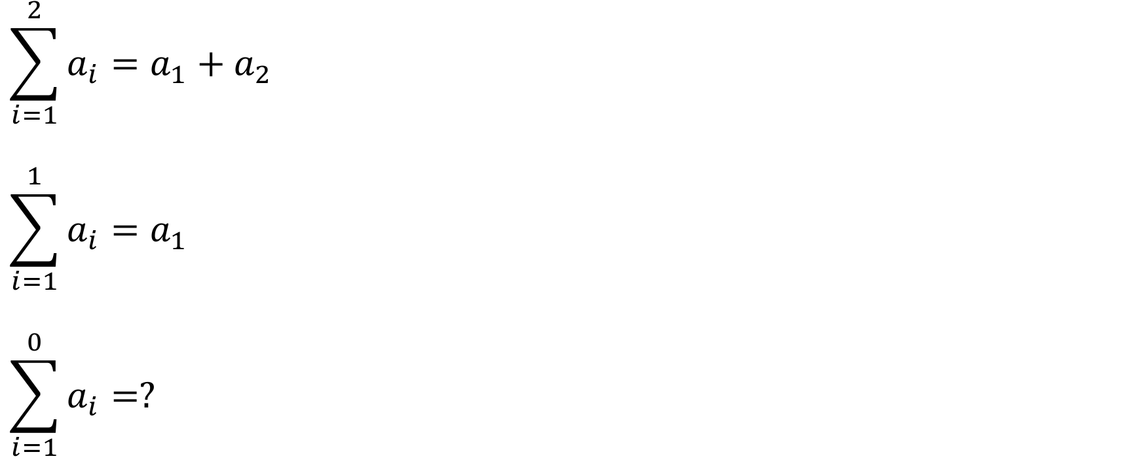
Examples
0
1
Something Else

Slide 18
Examples
0
1
Something Else

Slide 19

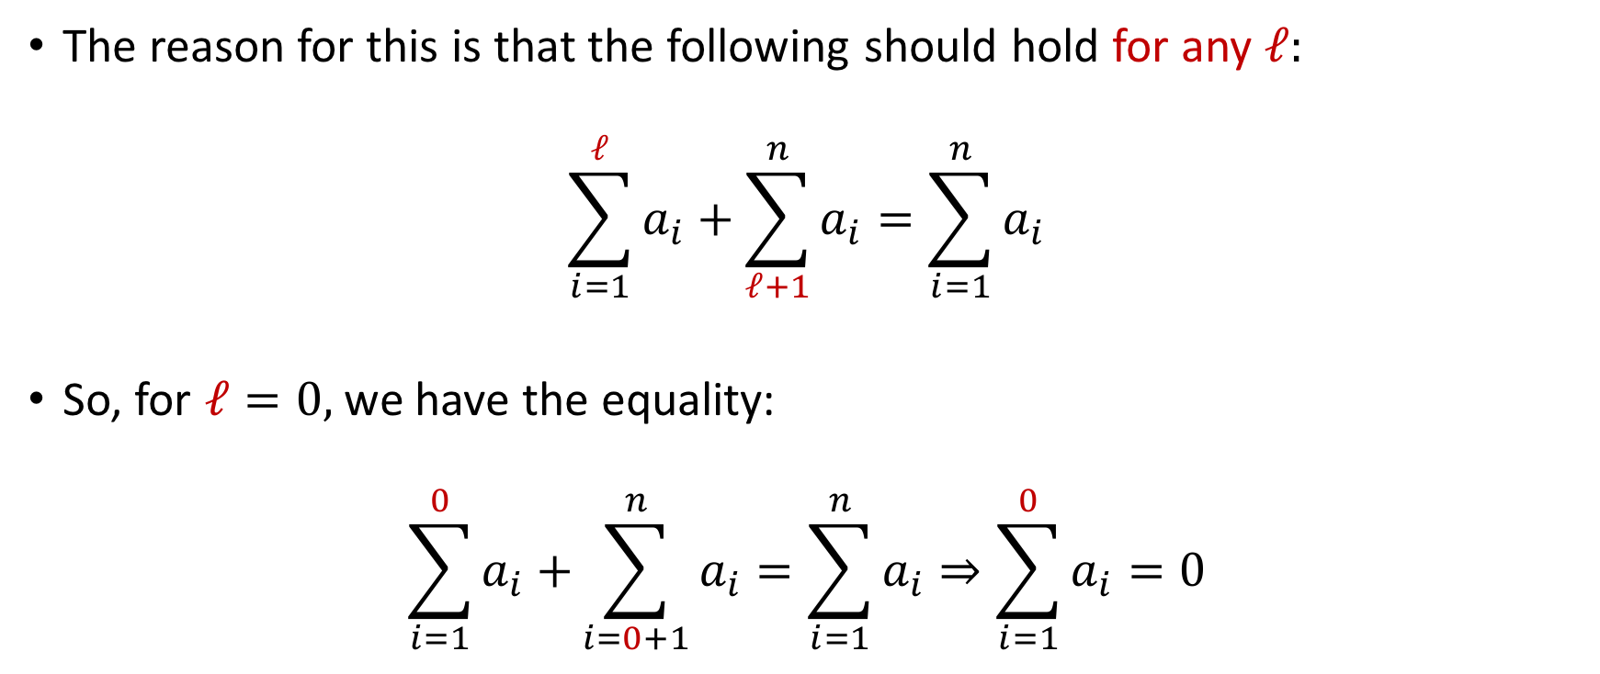

Slide 20
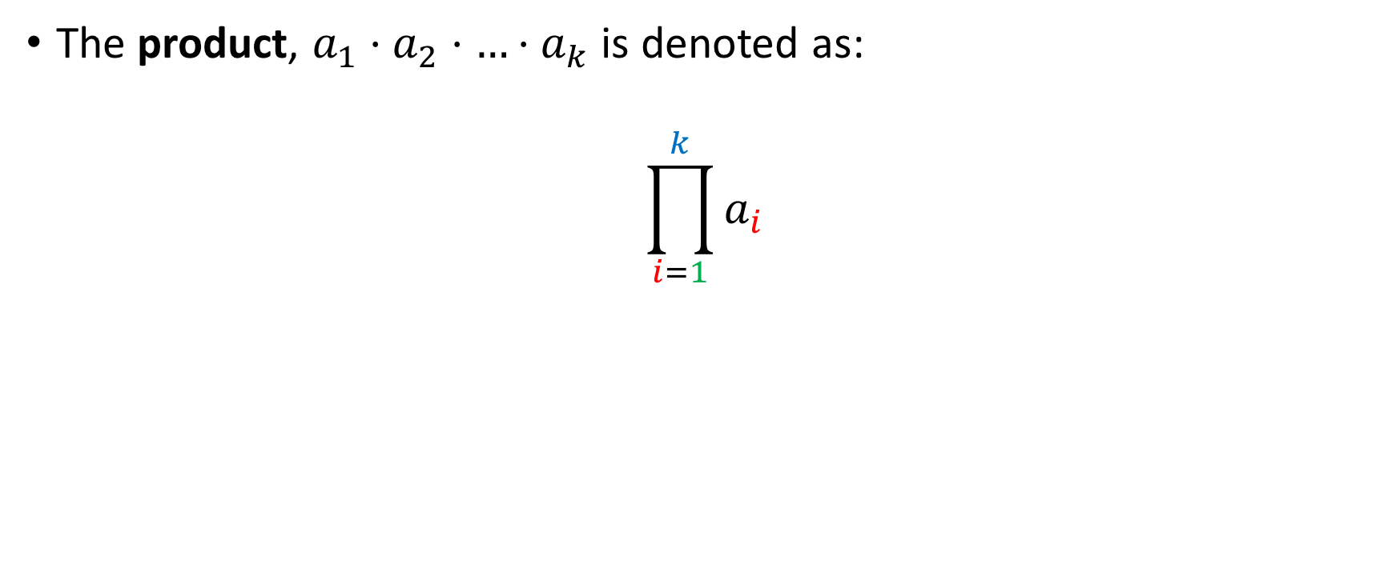
Product Notation
Index of last term to be included in the product
Index of term with which the product begins

Slide 21
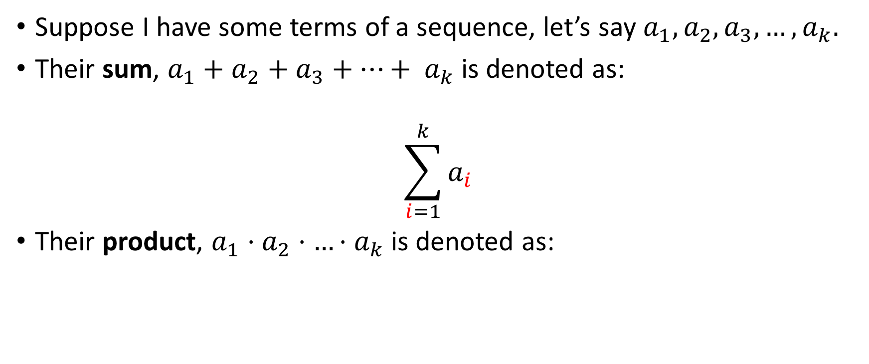
Sum / Product notation
Index of last term to be included in the sum
Index of term with which the sum begins

Slide 22
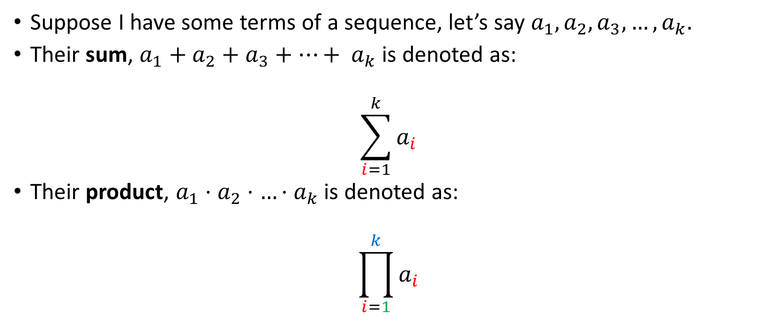
Sum / Product notation
Index of last term to be included in the sum
Index of term with which the sum begins
Index of last term to be included in the product
Index of term with which the product begins

Slide 23
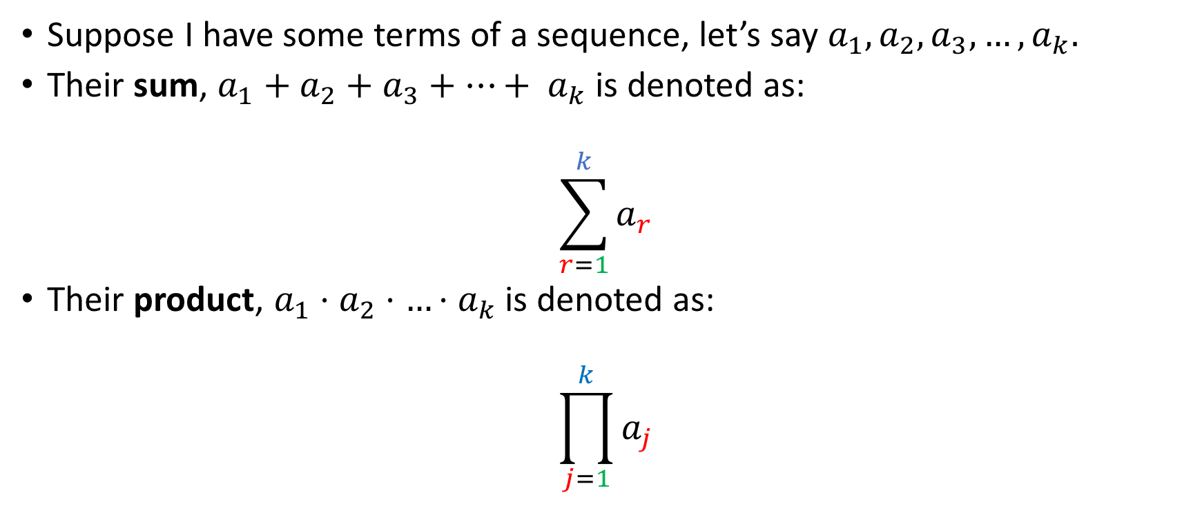
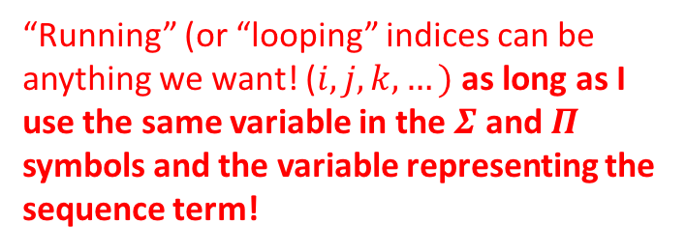
Sum / Product notation

Slide 24
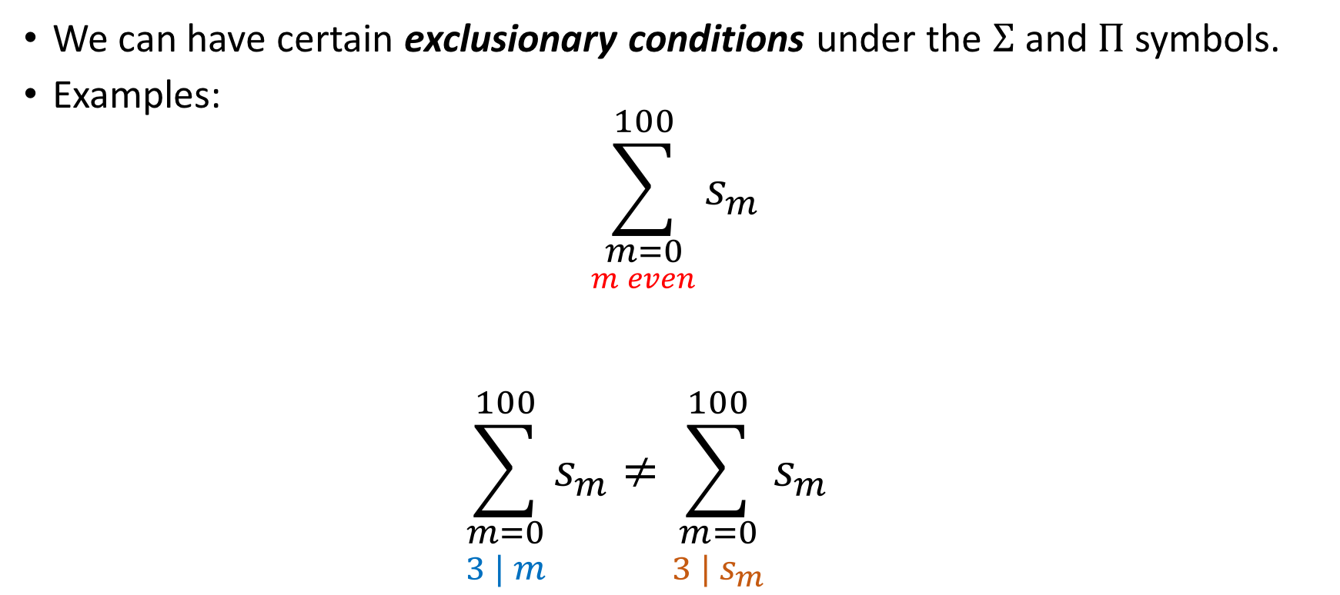
Sum-Product notation

Slide 25
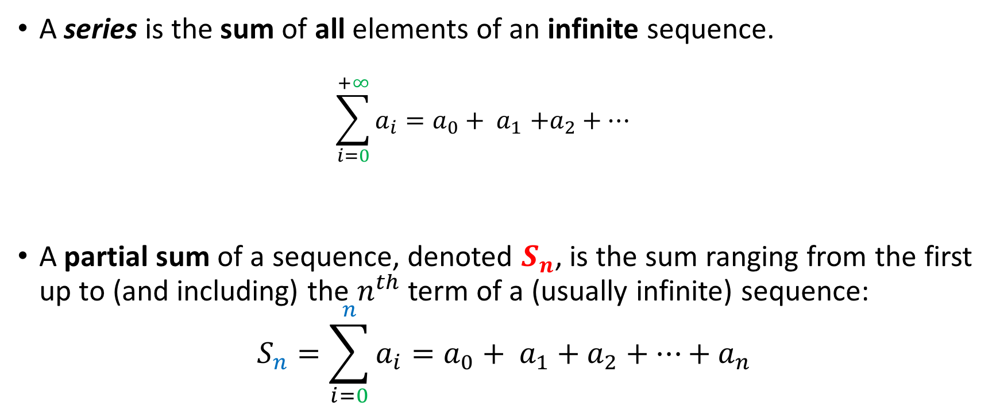
Series and partial sums
Or 1, if we start at 1
Or 1, if we start at 1

Slide 26
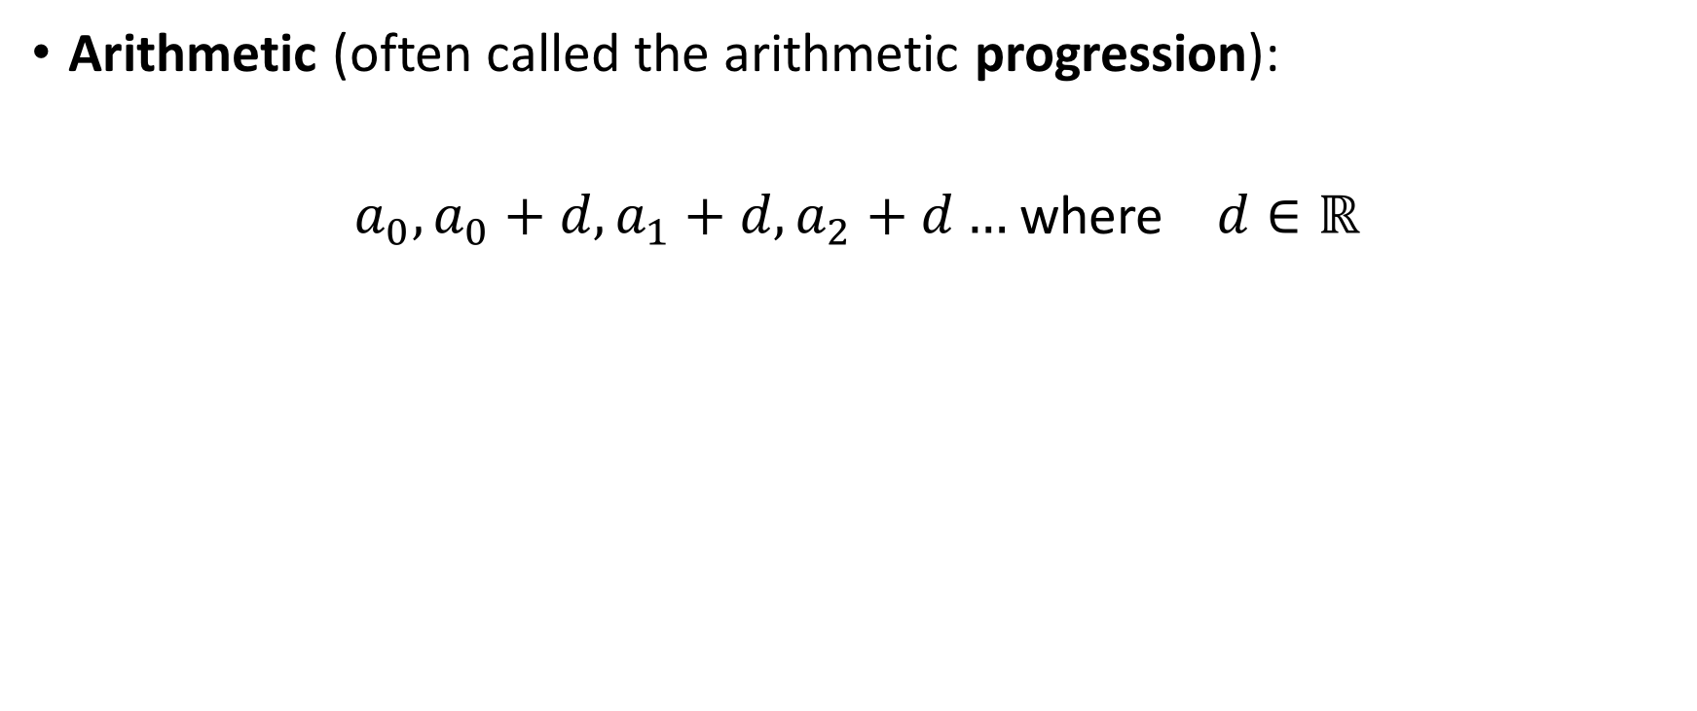



Famous sequences

Slide 27
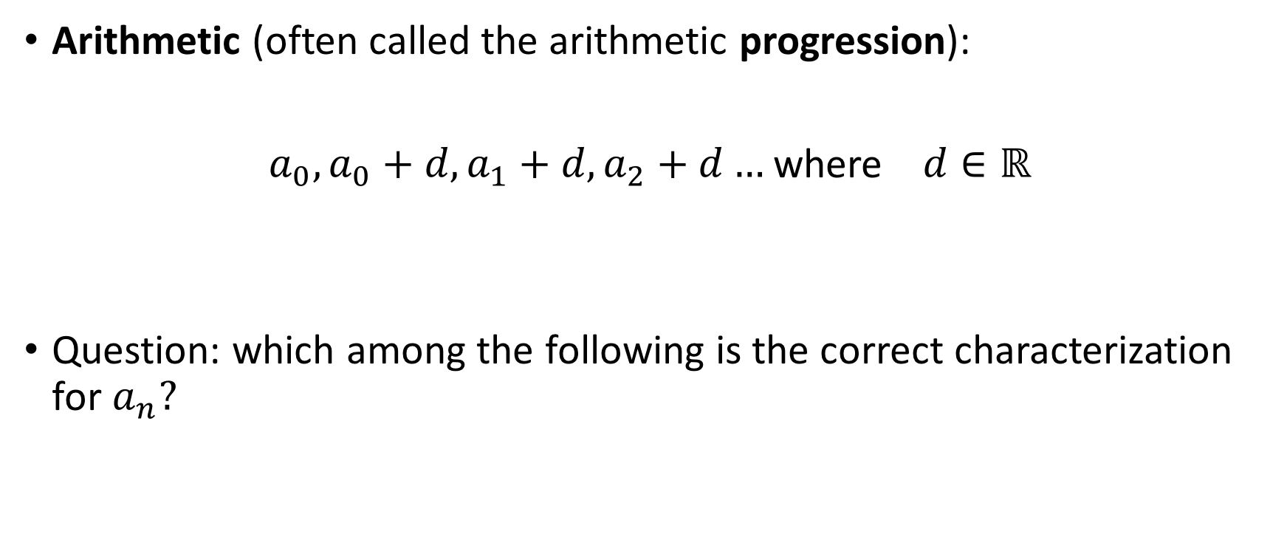
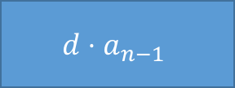
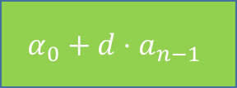
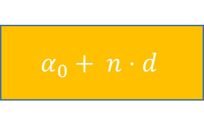
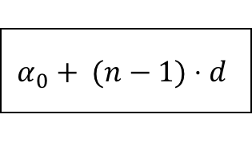
Famous sequences

Slide 28
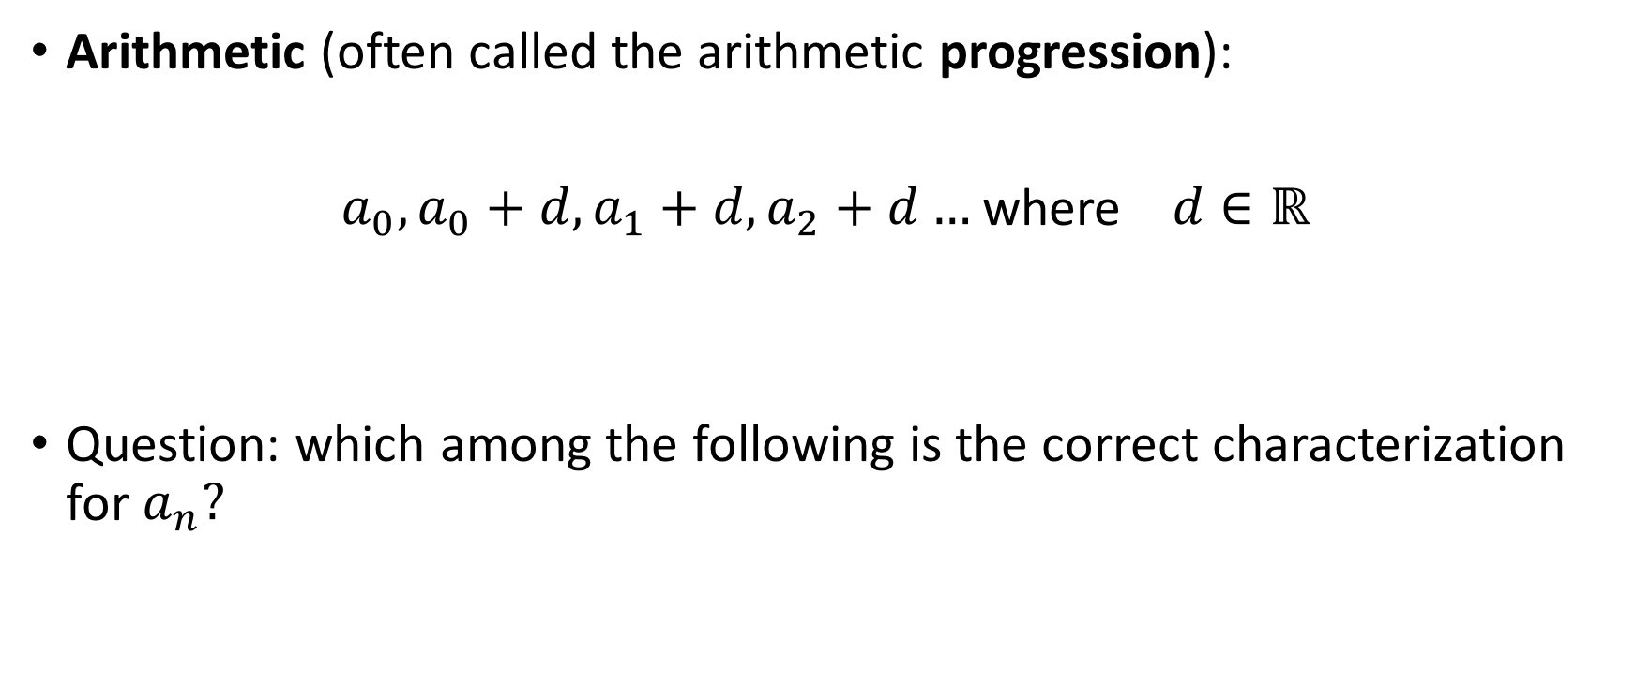

Famous sequences

Slide 29
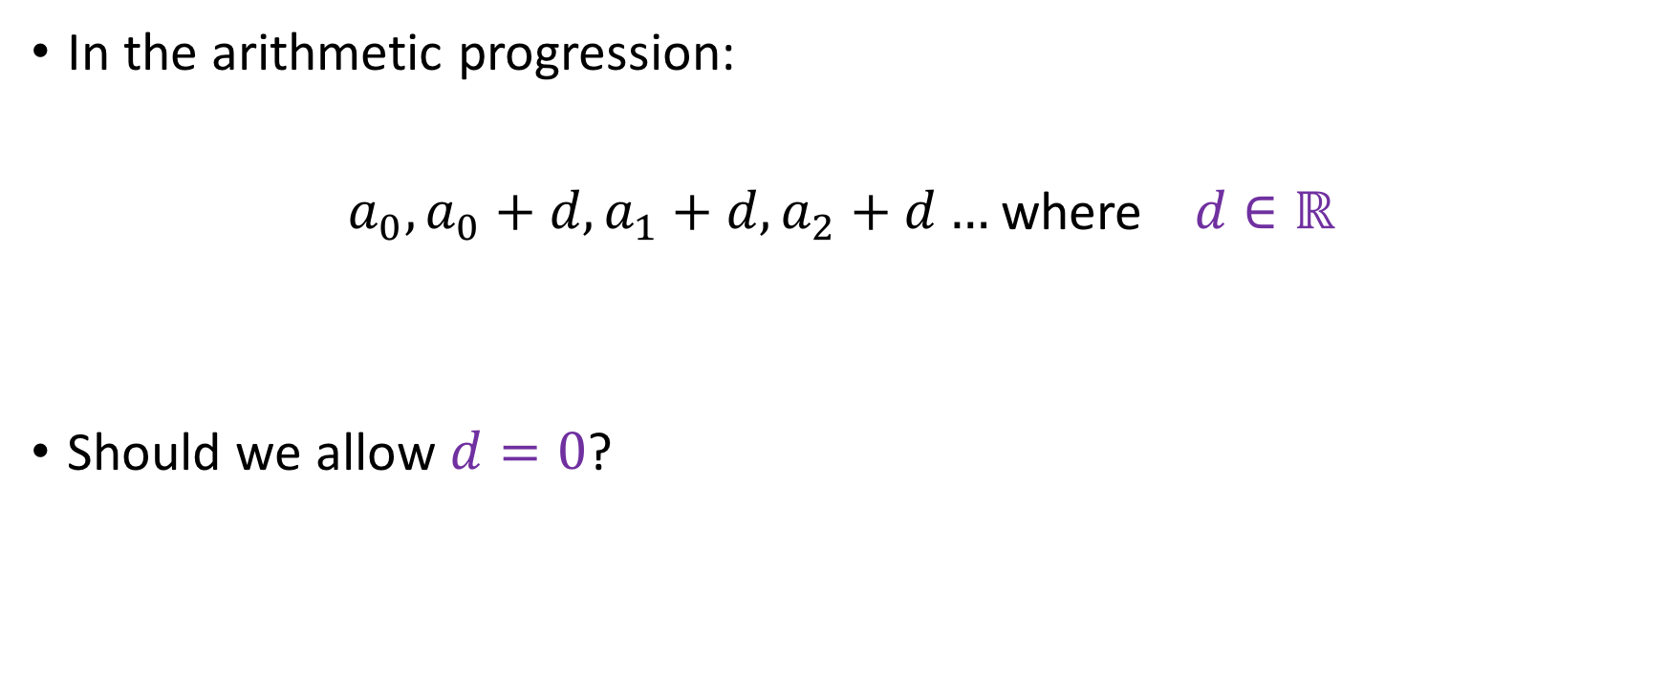
A question for you
YES
NO

Slide 30
A question for you
It will be a pretty boring sequence, but it will still be a sequence!
YES
NO

Slide 31
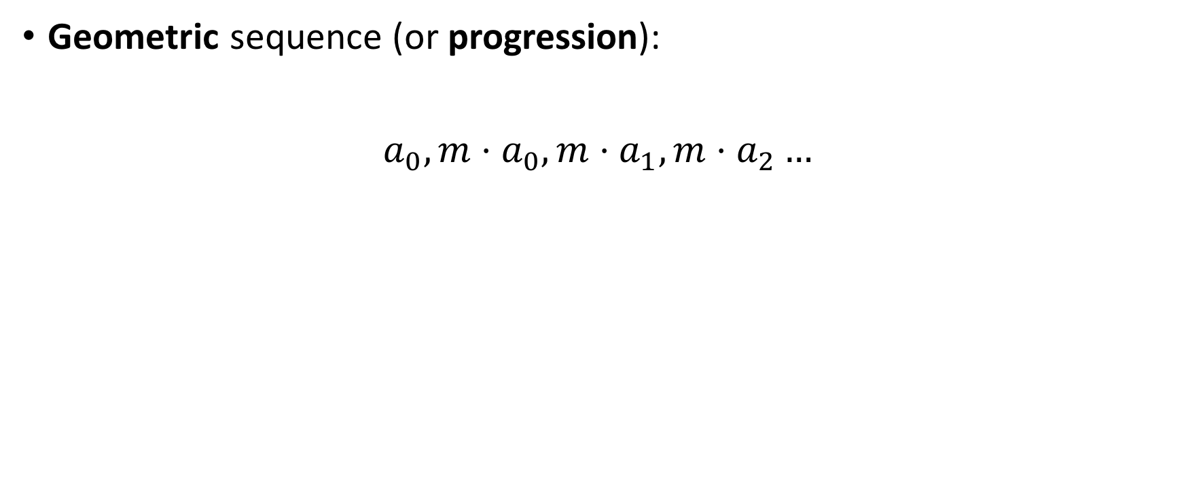



Famous Sequences

Slide 32
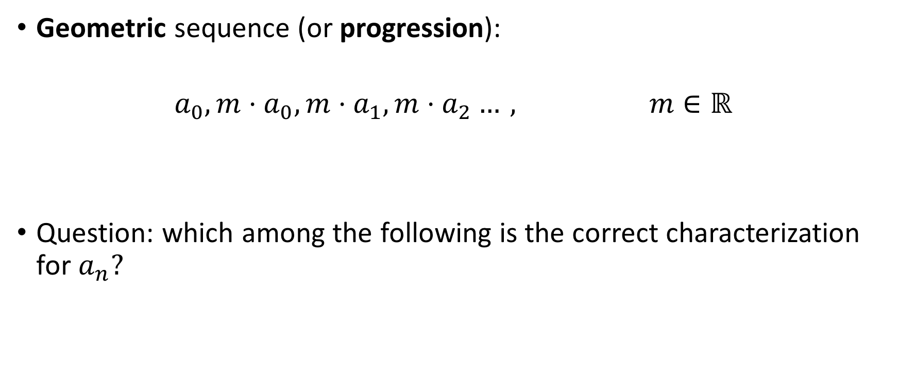



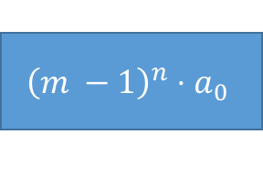


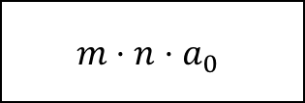
Famous Sequences

Slide 33
Famous Sequences

Slide 34
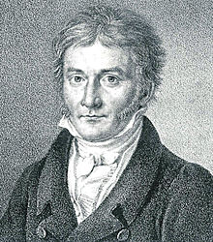
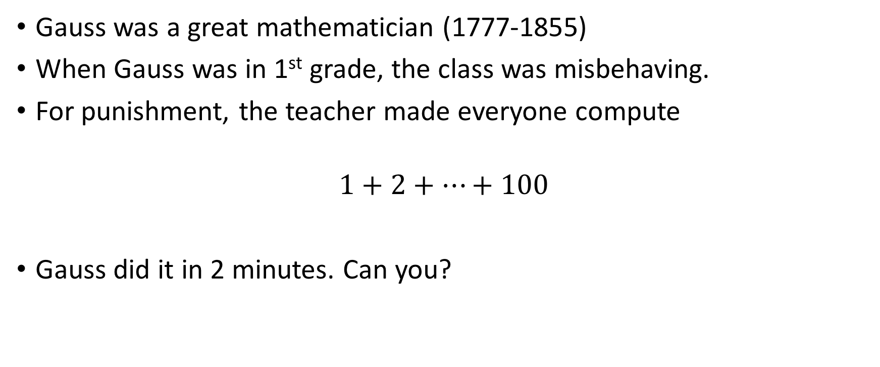
The Gauss story

Slide 35
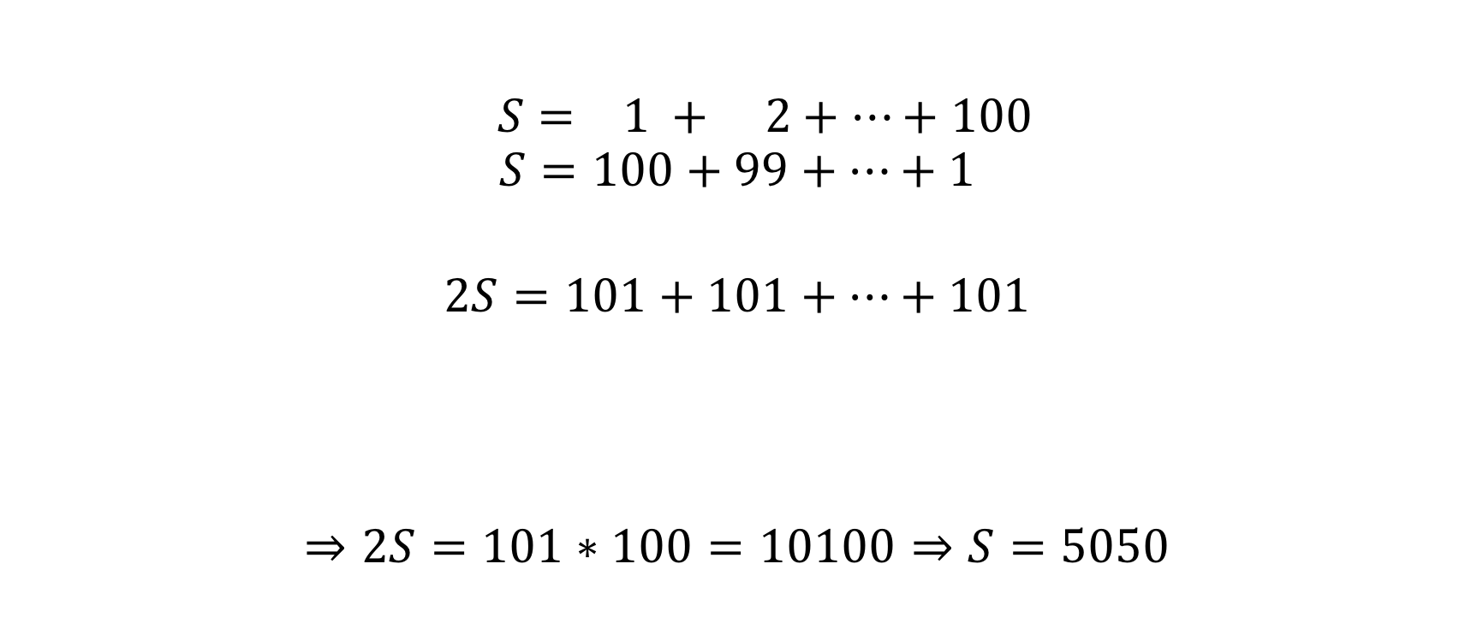

The Gauss trick

Slide 36
And now the rest of the story

Slide 37
And now the rest of the story
This is a complete fabrication!
This is how this story has progressed over time:

Slide 38
And now the rest of the story
This is a complete fabrication!
This is how this story has progressed over time:
YEAR | GRADE | SERIES

Slide 39
And now the rest of the story
This is a complete fabrication!
This is how this story has progressed over time:
YEAR | GRADE | SERIES
1960 | 5th | 1 + 2 + … + 60

Slide 40
And now the rest of the story
This is a complete fabrication!
This is how this story has progressed over time:
YEAR | GRADE | SERIES
1960 | 5th | 1 + 2 + … + 60
1980 | 3rd | 1 + 2 + … + 80

Slide 41
And now the rest of the story
This is a complete fabrication!
This is how this story has progressed over time:
YEAR | GRADE | SERIES
1960 | 5th | 1 + 2 + … + 60
1980 | 3rd | 1 + 2 + … + 80
2000s | 1st | 1 + 2 + … + 100

Slide 42
And now the rest of the story
This is a complete fabrication!
This is how this story has progressed over time:
YEAR | GRADE | SERIES
1960 | 5th | 1 + 2 + … + 60
1980 | 3rd | 1 + 2 + … + 80
2000s | 1st | 1 + 2 + … + 100
2020 | Nursery School | 1 + 2 + … + 120
Probably:

Slide 43
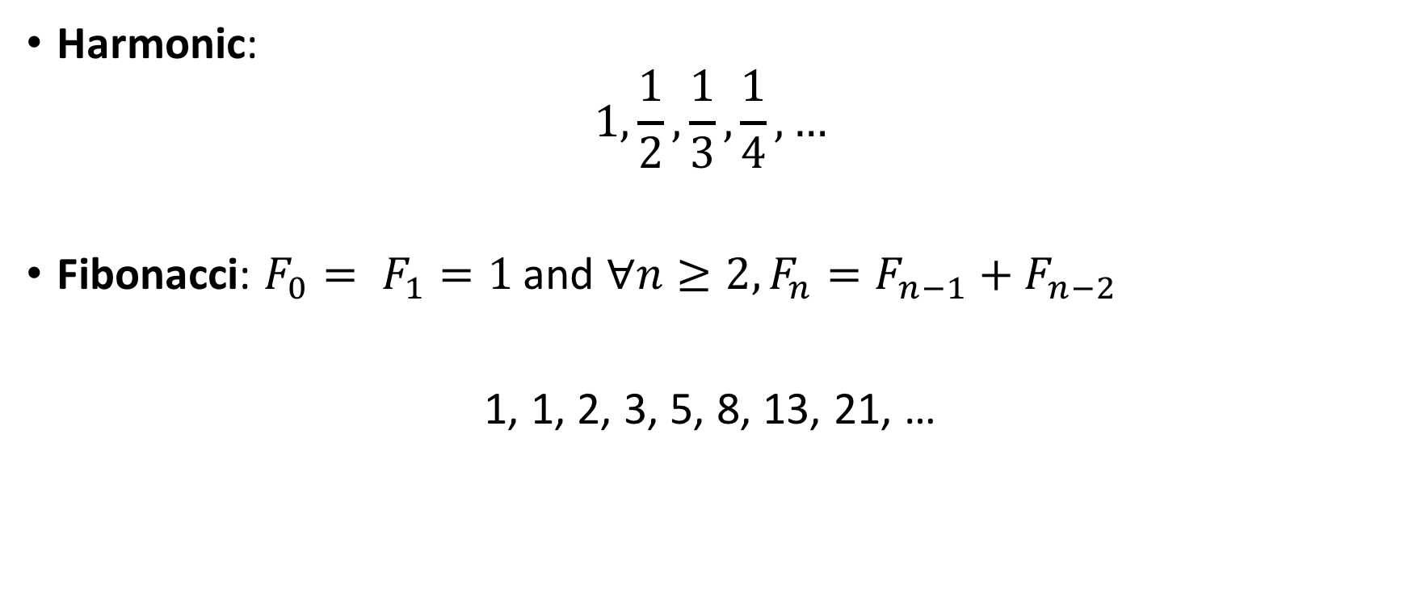
Famous Sequences

Slide 44
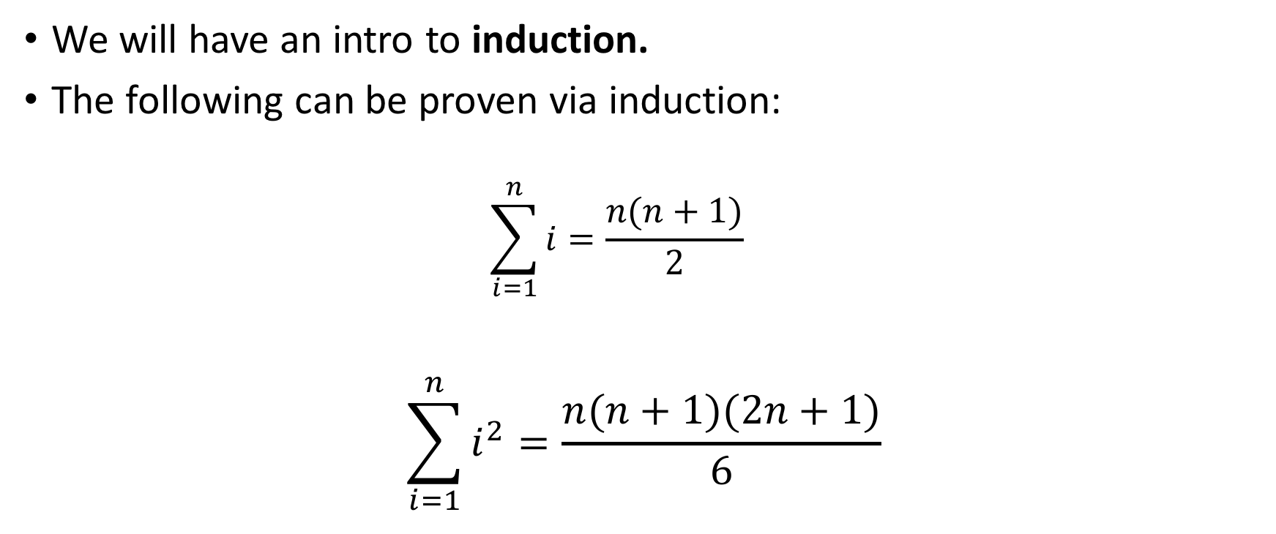
What we’ll do next

