Slide 1
Logical Equivalence
CMSC250

Slide 2
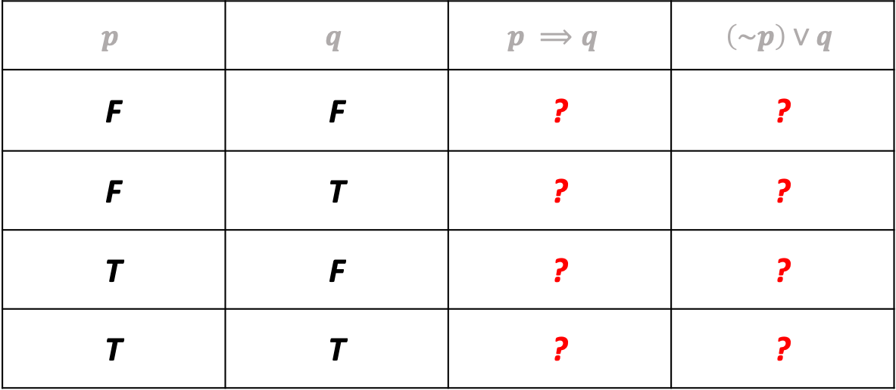
An important equivalence
Please fill – in the following truth table:
$$p$$ | $$q$$ | $$p ⟹q$$ | $$\left(\sim p\right)∨q$$
F | F | ? | ?
F | T | ? | ?
T | F | ? | ?
T | T | ? | ?

Slide 3


$⇔$ vs $≡$
$⇔$ (“if and only if”) is used to form statements, e.g
$p⇔\left(q∧(\sim r)\right)$
$≡$ (“logically equivalent to”) compares two statements, e.g
$(p∧q)≡(q∧p)$

Slide 4
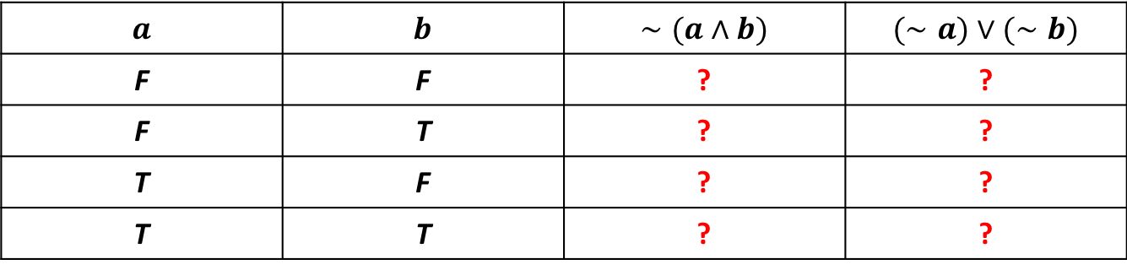
Another important equivalence
Let’s fill in the following truth table :
$$a$$ | $$b$$ | $$∼(a∧b)$$ | $$(∼a)∨(∼b)$$
F | F | ? | ?
F | T | ? | ?
T | F | ? | ?
T | T | ? | ?

Slide 5
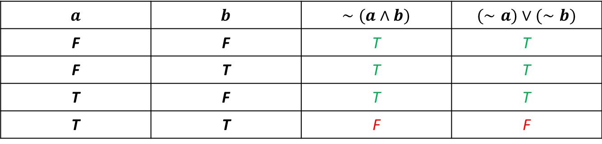
Another important equivalence
Let’s fill in the following truth table :
$$a$$ | $$b$$ | $$∼(a∧b)$$ | $$(∼a)∨(∼b)$$
F | F | T | T
F | T | T | T
T | F | T | T
T | T | F | F

Slide 6

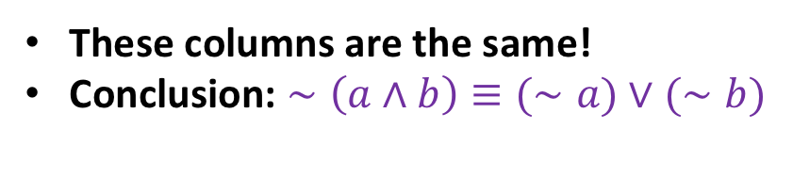
Another important equivalence
Let’s fill in the following truth table :
$$a$$ | $$b$$ | $$∼(a∧b)$$ | $$(∼a)∨(∼b)$$
F | F | T | T
F | T | T | T
T | F | T | T
T | T | F | F
These columns are the same!
Conclusion: $∼\left(a∧b\right)≡(∼a)∨(∼b)$

Slide 7
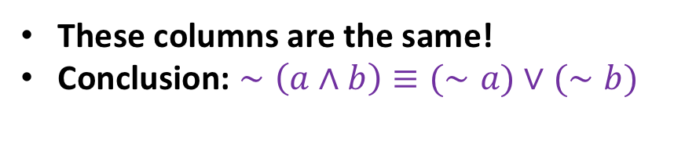
Another important equivalence
Let’s fill in the following truth table :
$$a$$ | $$b$$ | $$∼(a∧b)$$ | $$(∼a)∨(∼b)$$
F | F | T | T
F | T | T | T
T | F | T | T
T | T | F | F
This result is known as
De Morgan’s law
These columns are the same!
Conclusion: $∼\left(a∧b\right)≡(∼a)∨(∼b)$

Slide 8

Understanding De Morgan’s Law
$\sim (“Alice is Blonde”∧“Alice wears Green Dress”)$: Clearly true

Slide 9
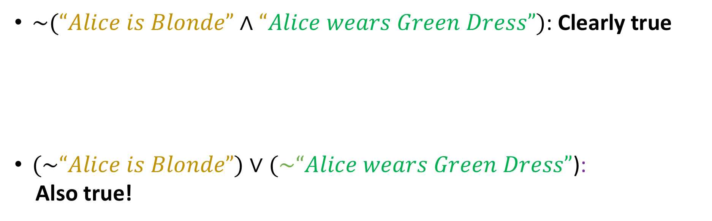
Understanding De Morgan’s Law
$\sim (“Alice is Blonde”∧“Alice wears Green Dress”)$: Clearly true
$(\sim “Alice is Blonde”)∨(\sim “Alice wears Green Dress”$):
Also true!

Slide 10
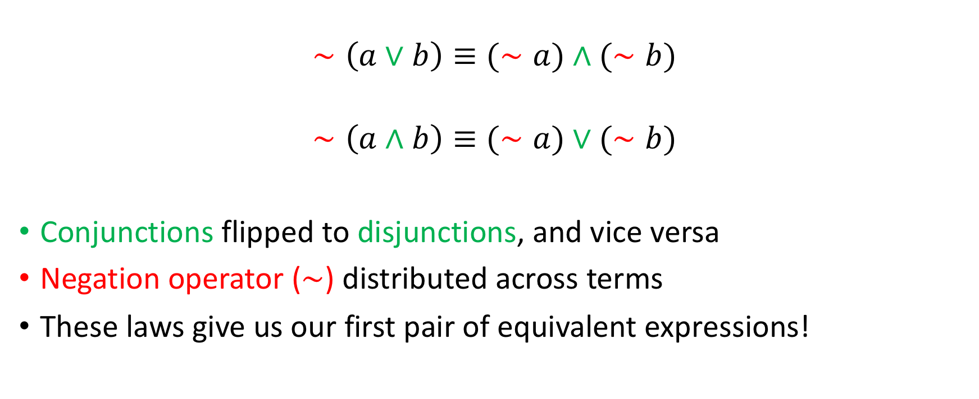
De Morgan’s Laws (there’s two of them)
$$∼\left(a∨b\right)≡(∼a)∧(∼b)$$
$$∼\left(a∧b\right)≡(∼a)∨(∼b)$$
Conjunctions flipped to disjunctions, and vice versa
Negation operator ($∼$) distributed across terms
These laws give us our first pair of equivalent expressions!

Slide 11
Are these correct equivalences?
$$a⇒b≡(∼b)⇒(∼a)$$ | $$a⇒b≡\left(∼a\right)⇒\left(∼b\right)$$ | $$a⇔b≡\left(\left(∼a\right)∨b\right)∧((∼b)∨a)$$
Middle column
Right column
Left column

Slide 12
Proving equivalences
How do we prove an equivalence? (e.g $\sim \left(a∧b\right)≡\left(\sim a\right) ∨(\sim b)$)

Slide 13

Proving equivalences
How do we prove an equivalence? (e.g $\sim \left(a∧b\right)≡\left(\sim a\right) ∨(\sim b)$)
Truth tables
One major problem: for $n$ variables, $2^{n}$ rows (input combinations) to enumerate!

Slide 14

Proving equivalences
How do we prove an equivalence? (e.g $\sim \left(a∧b\right)≡\left(\sim a\right) ∨(\sim b)$)
Truth tables
One major problem: for $n$ variables, $2^{n}$ rows (input combinations) to enumerate!
Can we do better?

Slide 15
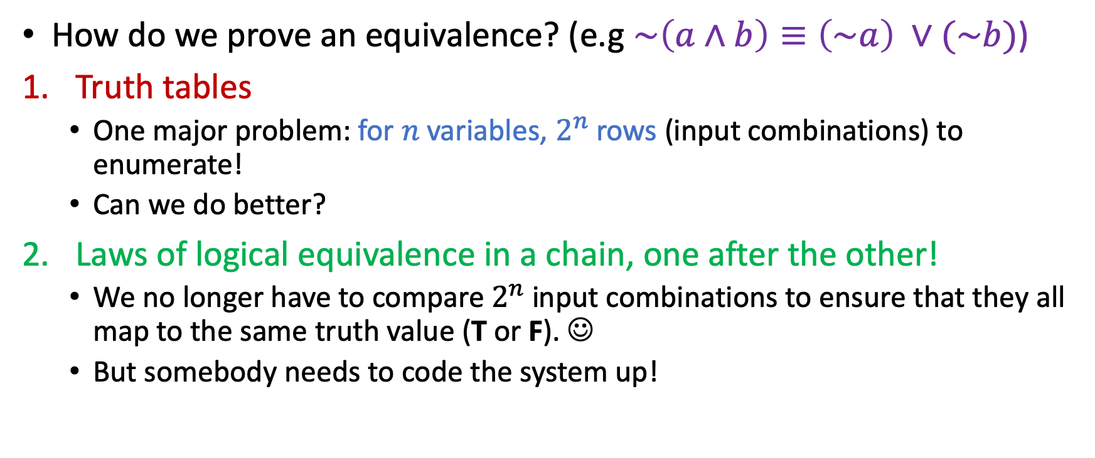
Proving equivalences
How do we prove an equivalence? (e.g $\sim \left(a∧b\right)≡\left(\sim a\right) ∨(\sim b)$)
Truth tables
One major problem: for $n$ variables, $2^{n}$ rows (input combinations) to enumerate!
Can we do better?
Laws of logical equivalence in a chain, one after the other!
We no longer have to compare $2^{n}$ input combinations to ensure that they all map to the same truth value (T or F). ☺
But somebody needs to code the system up!

Slide 16
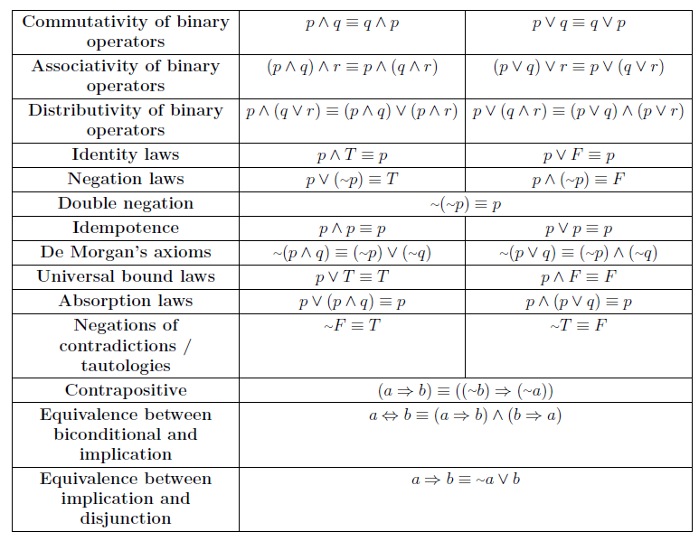
Boolean Logic Cheat Sheet

Slide 17
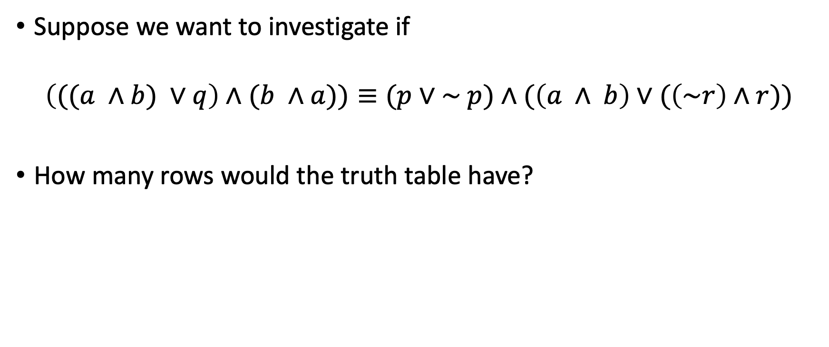
Proving equivalences using laws
Suppose we want to investigate if
$$\left(((a ∧b) ∨q\right)∧(b ∧a))≡(p∨\sim p)∧(\left(a ∧ b\right)∨(\left(\sim r\right)∧r))$$
How many rows would the truth table have?

Slide 18
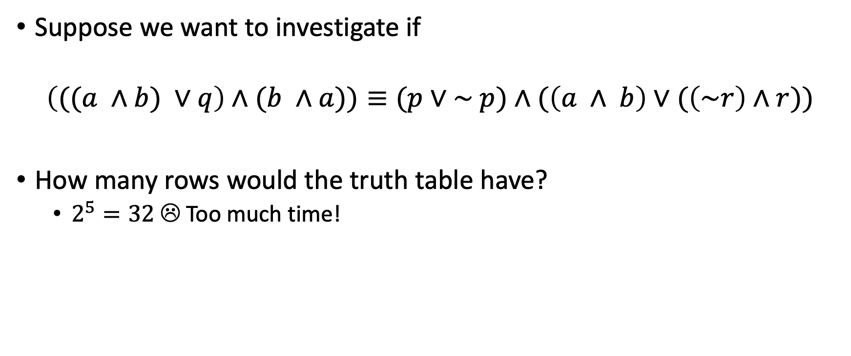
Proving equivalences using laws
Suppose we want to investigate if
$$\left(((a ∧b) ∨q\right)∧(b ∧a))≡(p∨\sim p)∧(\left(a ∧ b\right)∨(\left(\sim r\right)∧r))$$
How many rows would the truth table have?
$2^{5}=32$ ☹ Too much time!

Slide 19
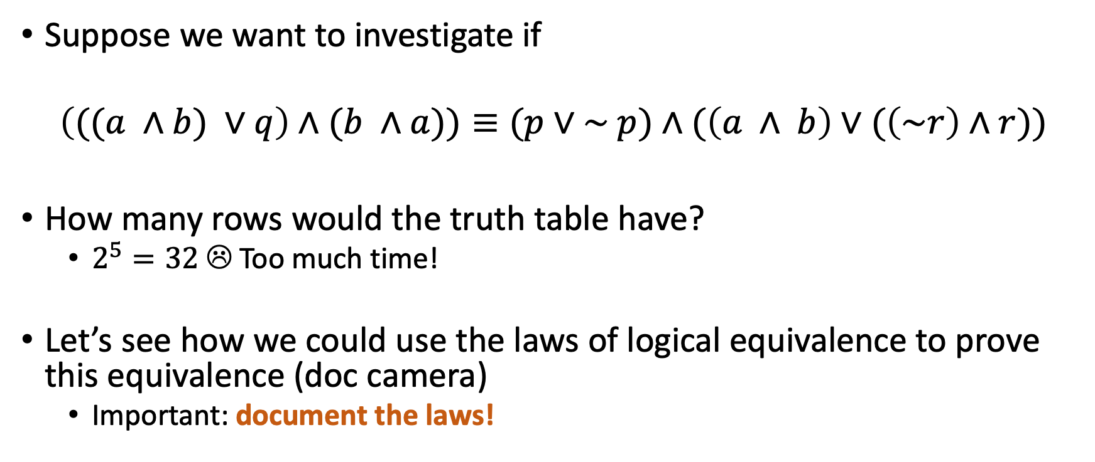
Proving equivalences using laws
Suppose we want to investigate if
$$\left(((a ∧b) ∨q\right)∧(b ∧a))≡(p∨\sim p)∧(\left(a ∧ b\right)∨(\left(\sim r\right)∧r))$$
How many rows would the truth table have?
$2^{5}=32$ ☹ Too much time!
Let’s see how we could use the laws of logical equivalence to prove this equivalence (doc camera)
Important: document the laws!

Slide 20
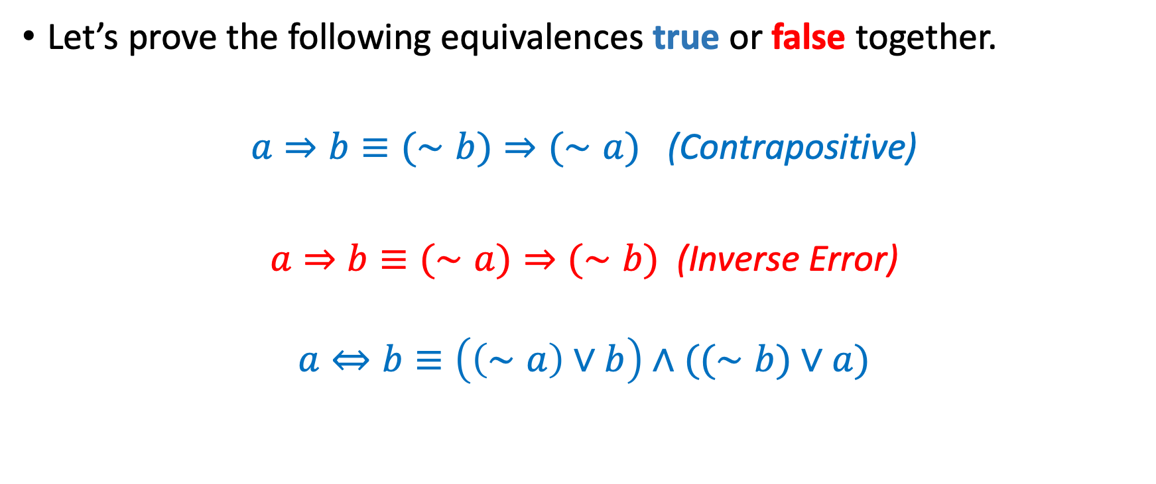
More equivalences
Let’s prove the following equivalences true or false together.
$a⇒b≡(∼b)⇒(∼a)$ (Contrapositive)
$a⇒b≡(∼a)⇒(∼b)$ (Inverse Error)
$$a⇔b≡\left(\left(∼a\right)∨b\right)∧((∼b)∨a)$$

Slide 21

Simplifying expressions
Large expressions can often be simplified using the equivalences we discussed earlier.
Example: Let’s simplify $p∧\left(p∨q\right)∧\left(p∧q\right)$

Slide 22
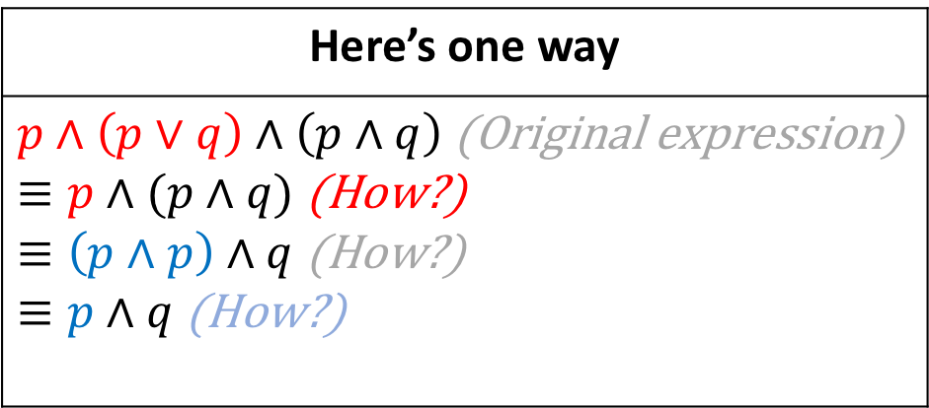

Simplifying expressions
Large expressions can often be simplified using the equivalences we discussed earlier.
Example: Let’s simplify $p∧\left(p∨q\right)∧\left(p∧q\right)$
Here’s one way
$p∧\left(p∨q\right)∧\left(p∧q\right)$ (Original expression) $≡p∧(p∧q)$ (How?) $≡\left(p∧p\right)∧q$ (How?) $≡p∧q$ (How?)

Slide 23
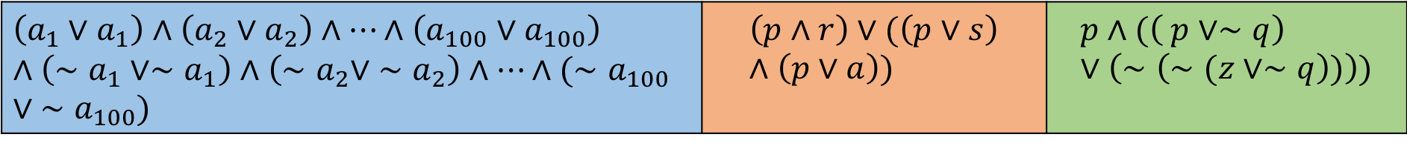
Your turn, class!
Let’s simplify the following three expressions.
$$\left(a_{1}∨a_{1}\right)∧\left(a_{2}∨a_{2}\right)∧…∧\left(a_{100}∨a_{100}\right)∧\left(∼a_{1}∨∼a_{1}\right)∧\left({∼a}_{2}∨ ∼a_{2}\right)∧…∧({∼a}_{100}∨ ∼a_{100})$$ | $$\left(p∧r\right)∨(\left(p∨s\right)∧\left(p∨a\right))$$ | $$p∧(\left( p∨∼q\right)∨\left(∼\left(∼(z∨∼q\right))\right))$$
Jason needs to project the table with the equivalences while you solve this exercise. If he doesn’t, berate him appropriately

Slide 24
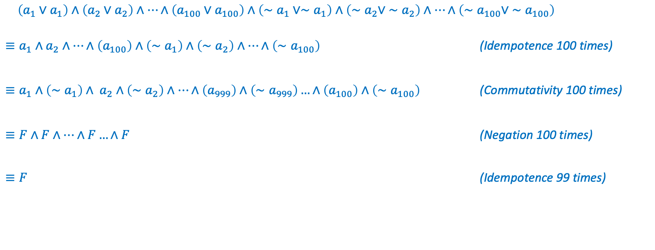
Solution to 1
$\left(a_{1}∨a_{1}\right)∧\left(a_{2}∨a_{2}\right)∧…∧\left(a_{100}∨a_{100}\right)∧\left(∼a_{1}∨∼a_{1}\right)∧\left({∼a}_{2}∨ ∼a_{2}\right)∧…∧\left({∼a}_{100}∨ ∼a_{100}\right)$
$≡a_{1}∧a_{2}∧…∧\left(a_{100}\right)∧\left(∼a_{1}\right)∧\left({∼a}_{2}\right)∧…∧\left({∼a}_{100}\right)$ (Idempotence 100 times)
$≡a_{1}∧\left(∼a_{1}\right)∧ a_{2}∧\left({∼a}_{2}\right)∧…∧\left(a_{999}\right)∧\left({∼a}_{999}\right)…∧\left(a_{100}\right)∧\left({∼a}_{100}\right)$ (Commutativity 100 times)
$≡F∧F∧…∧F…∧F$ (Negation 100 times)
$≡F$ (Idempotence 99 times)

Slide 25
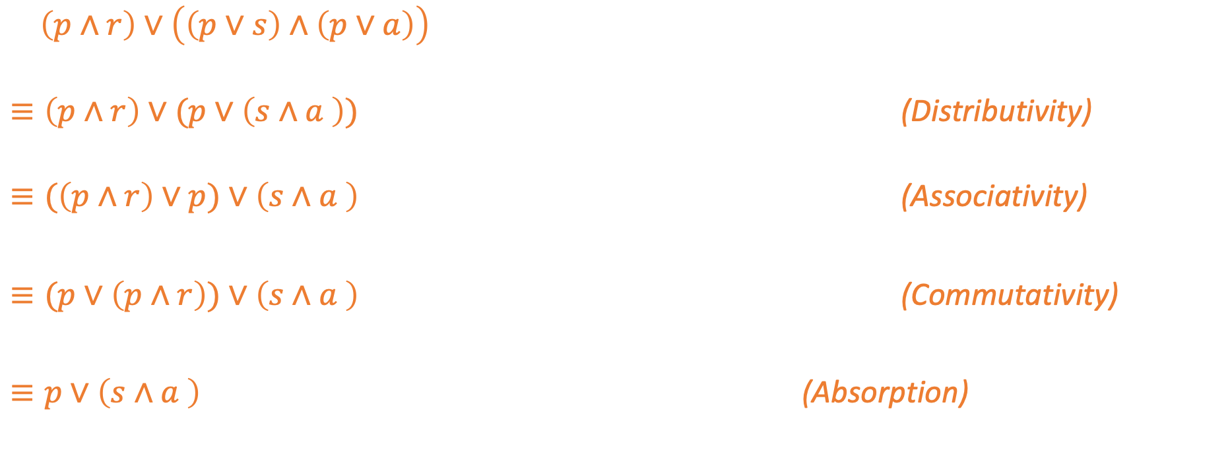
Solution to 2
$\left(p∧r\right)∨\left(\left(p∨s\right)∧\left(p∨a\right)\right)$
$≡\left(p∧r\right)∨(p∨\left(s∧a \right))$ (Distributivity)
$≡(\left(p∧r\right)∨p)∨\left(s∧a \right)$ (Associativity)
$≡(p∨\left(p∧r\right))∨\left(s∧a \right)$ (Commutativity)
$≡p∨\left(s∧a \right)$ (Absorption)

Slide 26
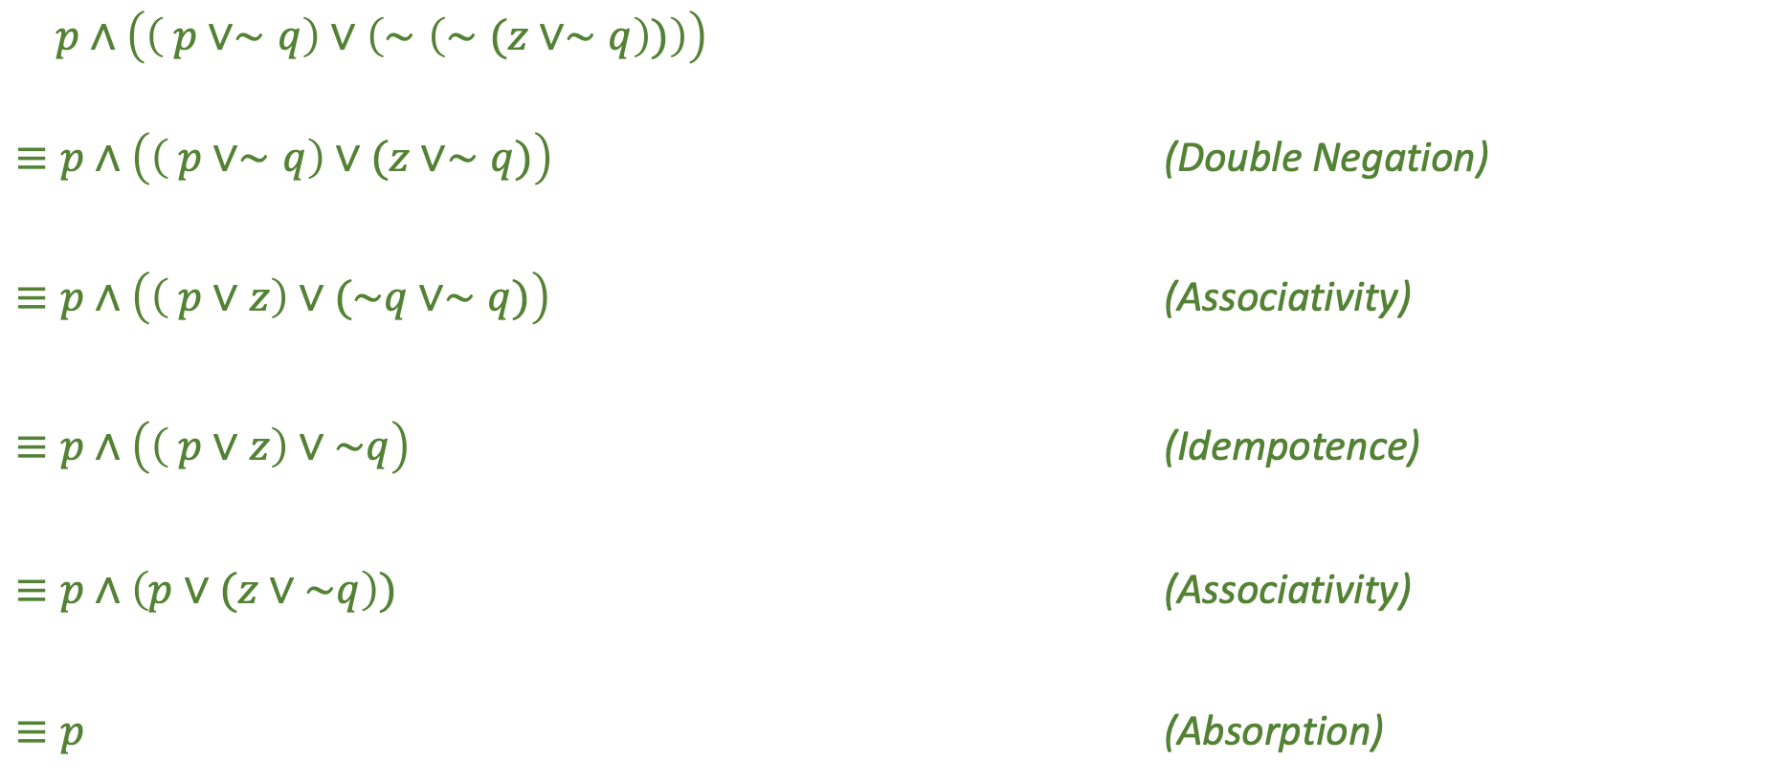
Solution to 3
$p∧\left(\left( p∨∼q\right)∨\left(∼\left(∼(z∨∼q\right))\right)\right)$
$≡p∧\left(\left( p∨∼q\right)∨(z∨∼q)\right)$ (Double Negation)
$≡p∧\left(\left( p∨z\right)∨(\sim q∨∼q)\right)$ (Associativity) $≡p∧\left(\left( p∨z\right)∨\sim q\right)$ (Idempotence) $≡p∧\left(p∨(z∨\sim q\right))$ (Associativity) $≡p$ (Absorption)

