Slide 1
Propositional Logic
CMSC 250

Slide 2
Reminders
Midterm in a week, 03 – 03
Announcement of 02-17 details schedule.
Material: everything from start through Thursday 2-25.
Grade breakdown reflects weeks of coverage ☺
About 80% combinatorics, 20% logic

Slide 3
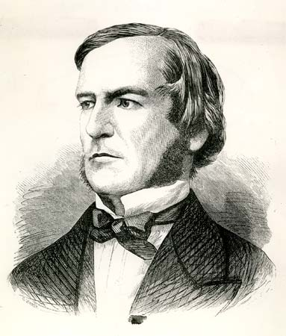
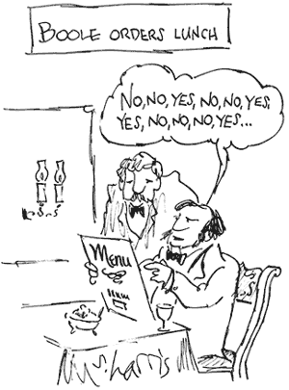
Propositional Logic
The most elementary kind of logic in Computer Science
Also known as Boolean Logic, by virtue of George Boole (1815 – 1864)

Slide 4
Propositional Symbols
The building blocks of propositional logic.
Think of them as bits or boxes that hold a value of 1 (True) or 0 (False)
Denoted using a lowercase english letter (p, q, … , a)
p

Slide 5
Operations in boolean logic
There are three basic operations in boolean logic
Conjunction (AND)
Disjunction (OR)
Negation (NOT)
Other operations can be defined in terms of those three.

Slide 6

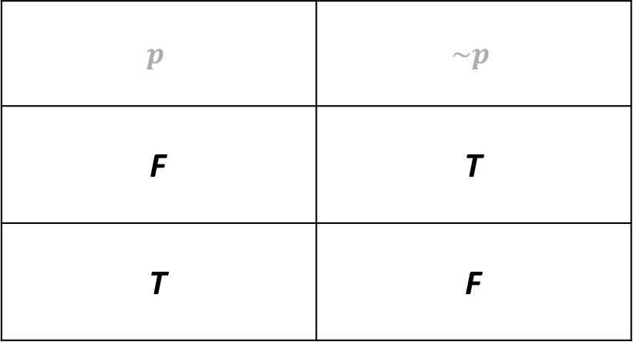


Negation $(NOT, \sim , ¬)$
$$p$$
~
$$\sim p$$
$$p$$ | $$\sim p$$
F | T
T | F

Slide 7

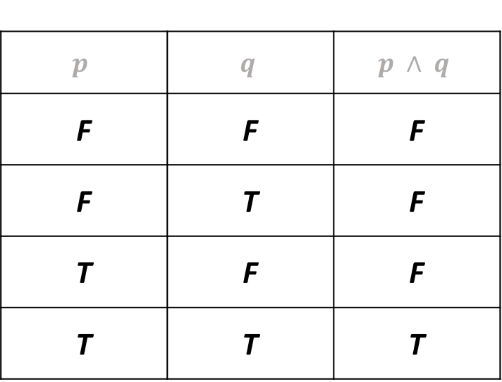


Conjunction (^)
$$p$$
^
$$p∧q$$
$$q$$
$$p$$ | $$q$$ | $$p ∧ q$$
F | F | F
F | T | F
T | F | F
T | T | T
Notes:
AND, OR, NOT is the so-called “natural set” of binary operators

Slide 8

Conjunction (^)
$$p$$
^
$$p∧q$$
$$q$$
$$p$$ | $$q$$ | $$p ∧ q$$
F | F | F
F | T | F
T | F | F
T | T | T
Rule of thumb: p and q must be 1

Slide 9
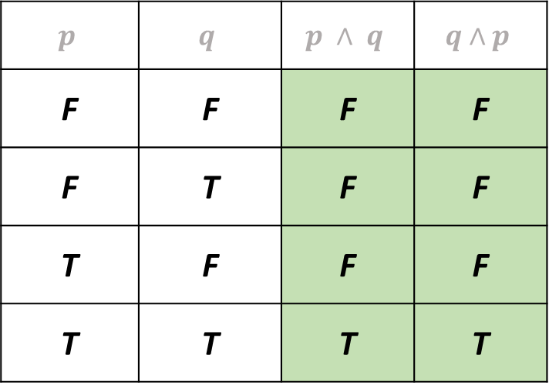



Conjunction (^)
$$p$$
^
$$p∧q$$
$$q$$
$$p$$ | $$q$$ | $$p ∧ q$$ | $$q∧p$$
F | F | F | F
F | T | F | F
T | F | F | F
T | T | T | T
Conjunction is commutative!

Slide 10
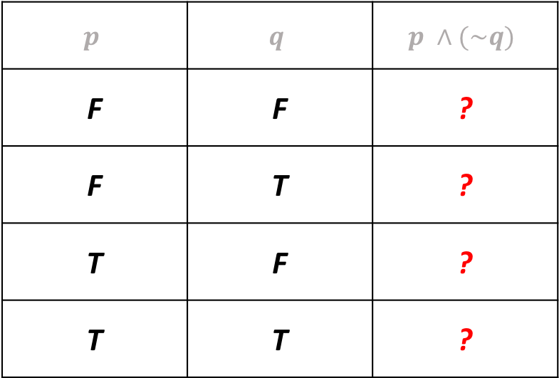
Fun exercise
Fill-in the following truth table:
$$p$$ | $$q$$ | $$p ∧(\sim q)$$
F | F | ?
F | T | ?
T | F | ?
T | T | ?

Slide 11
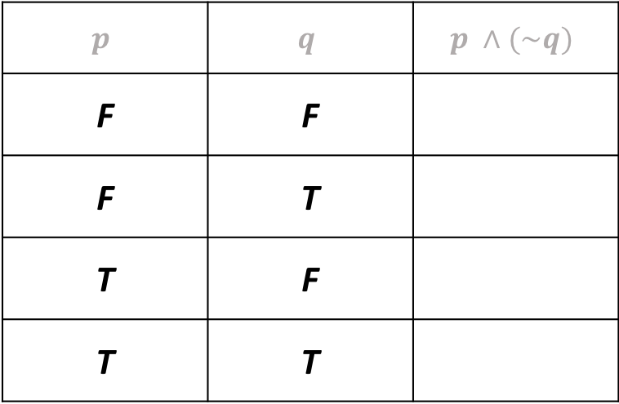
Fun exercise
Fill-in the following truth table:
$$p$$ | $$q$$ | $$p ∧(\sim q)$$
F | F
F | T
T | F
T | T

Slide 12
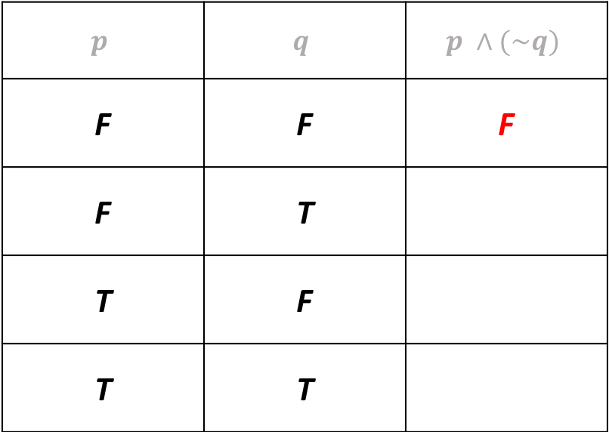
Fun exercise
Fill-in the following truth table:
$$p$$ | $$q$$ | $$p ∧(\sim q)$$
F | F | F
F | T
T | F
T | T

Slide 13
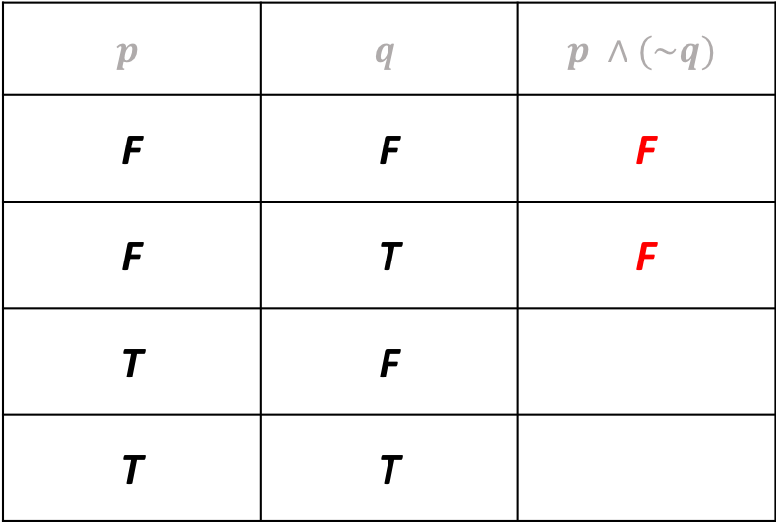
Fun exercise
Fill-in the following truth table:
$$p$$ | $$q$$ | $$p ∧(\sim q)$$
F | F | F
F | T | F
T | F
T | T

Slide 14
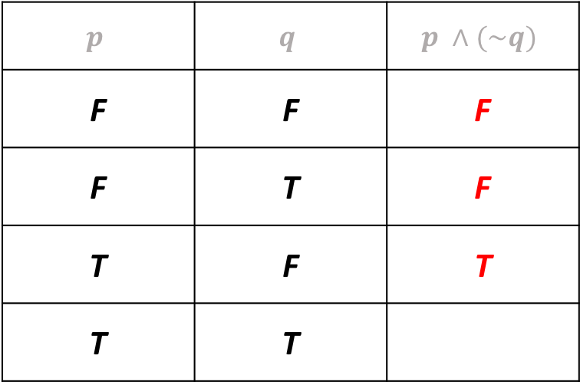
Fun exercise
Fill-in the following truth table:
$$p$$ | $$q$$ | $$p ∧(\sim q)$$
F | F | F
F | T | F
T | F | T
T | T

Slide 15
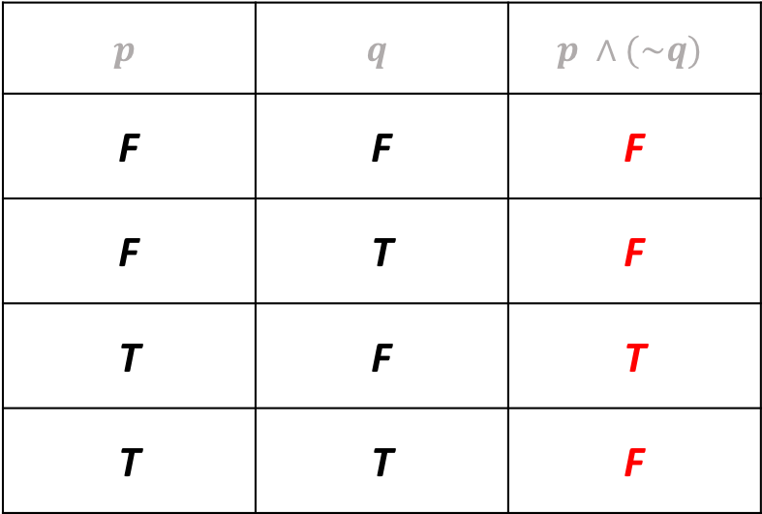
Fun exercise
Fill-in the following truth table:
$$p$$ | $$q$$ | $$p ∧(\sim q)$$
F | F | F
F | T | F
T | F | T
T | T | F
Notes:
Make a note about why the parenthesis is important (commutativity)

Slide 16
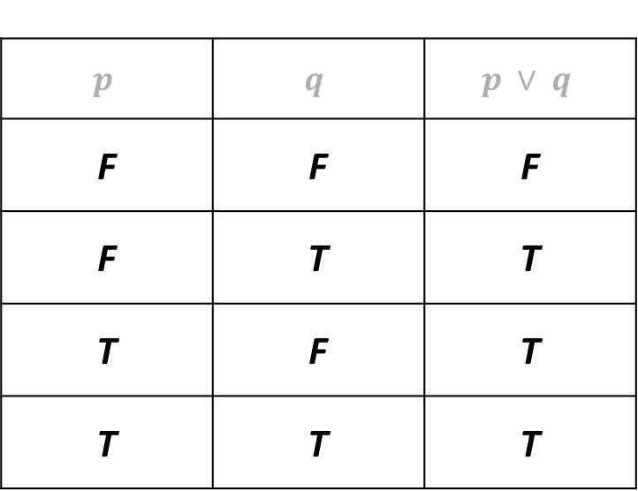

Disjunction
$$p$$
v
$$p∨q$$
$$q$$
$$p$$ | $$q$$ | $$p ∨ q$$
F | F | F
F | T | T
T | F | T
T | T | T
Notes:
V for “vel” which is “or” in latin

Slide 17

Disjunction
$$p$$
v
$$p∨q$$
$$q$$
$$p$$ | $$q$$ | $$p ∨ q$$
F | F | F
F | T | T
T | F | T
T | T | T
Rule of thumb:
one of p or q
must be 1

Slide 18
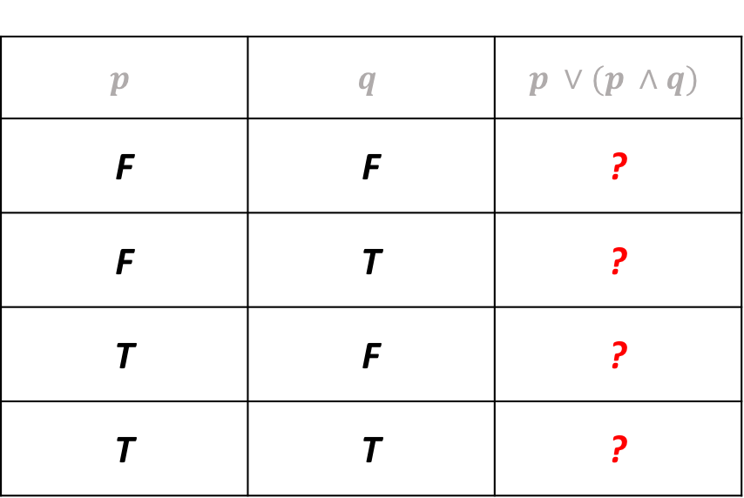
Fun exercise
Fill-in the following truth table:
$$p$$ | $$q$$ | $$p ∨(p ∧q)$$
F | F | ?
F | T | ?
T | F | ?
T | T | ?

Slide 19
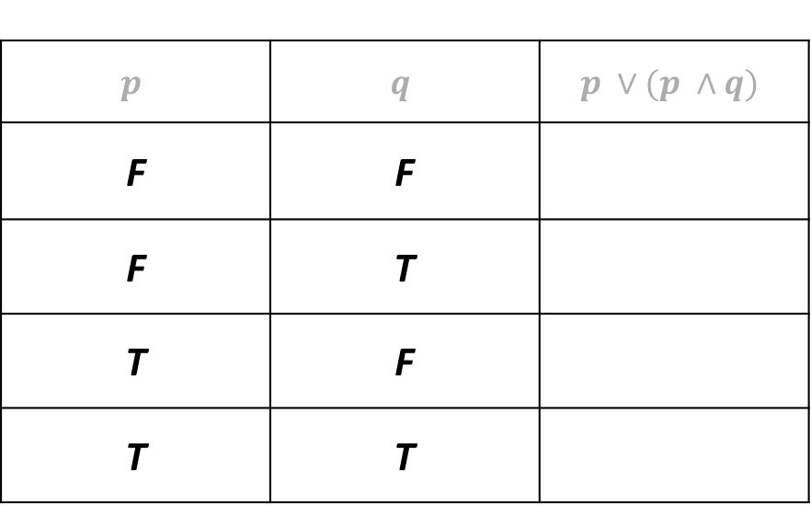
Fun exercise
Fill-in the following truth table:
$$p$$ | $$q$$ | $$p ∨(p ∧q)$$
F | F
F | T
T | F
T | T

Slide 20
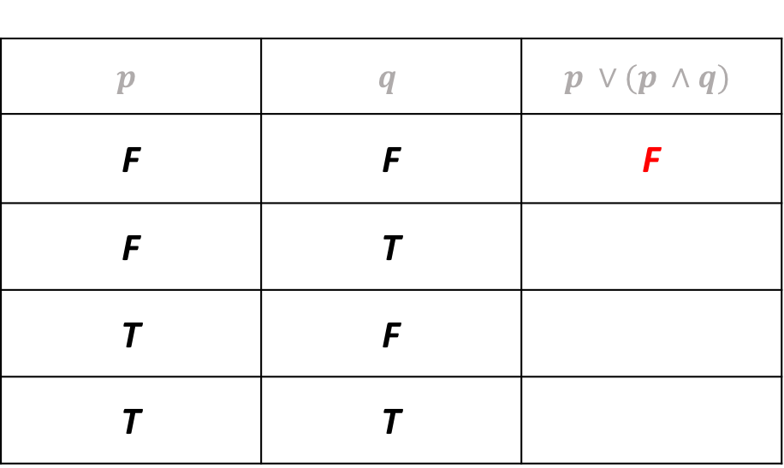
Fun exercise
Fill-in the following truth table:
$$p$$ | $$q$$ | $$p ∨(p ∧q)$$
F | F | F
F | T
T | F
T | T

Slide 21
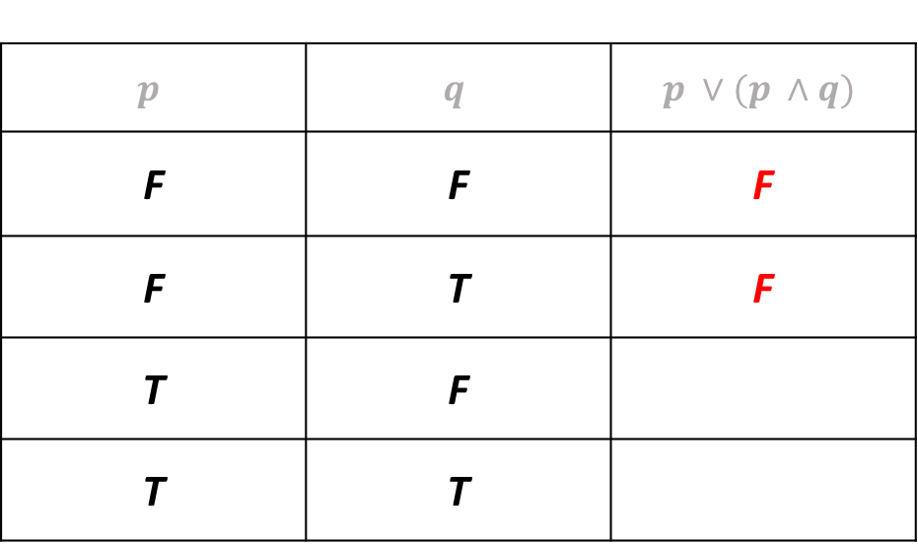
Fun exercise
Fill-in the following truth table:
$$p$$ | $$q$$ | $$p ∨(p ∧q)$$
F | F | F
F | T | F
T | F
T | T

Slide 22
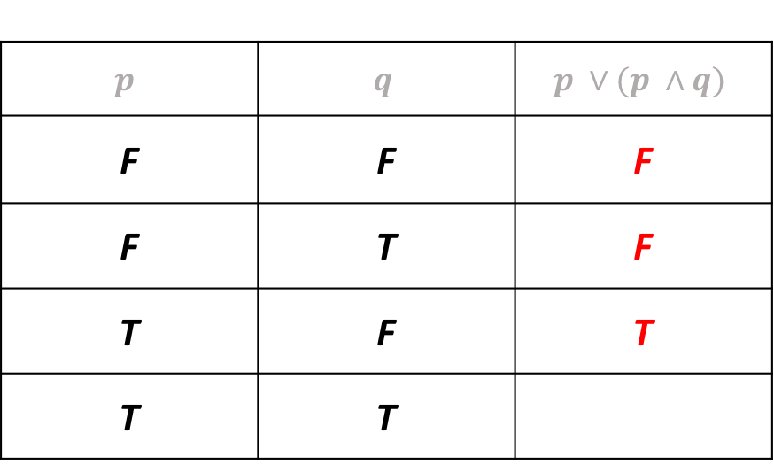
Fun exercise
Fill-in the following truth table:
$$p$$ | $$q$$ | $$p ∨(p ∧q)$$
F | F | F
F | T | F
T | F | T
T | T

Slide 23
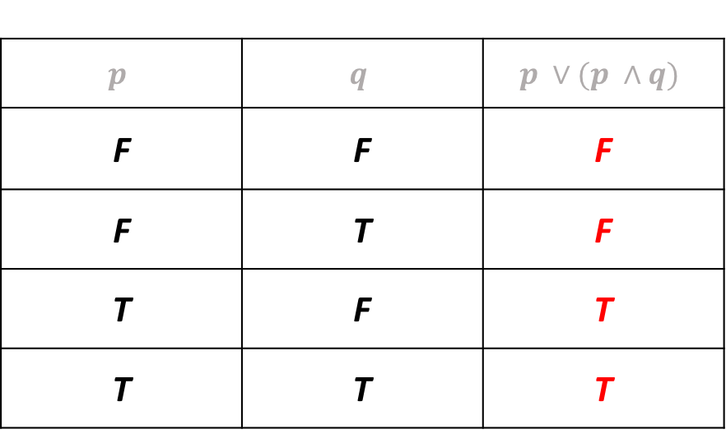
Fun exercise
Fill-in the following truth table:
$$p$$ | $$q$$ | $$p ∨(p ∧q)$$
F | F | F
F | T | F
T | F | T
T | T | T

Slide 24
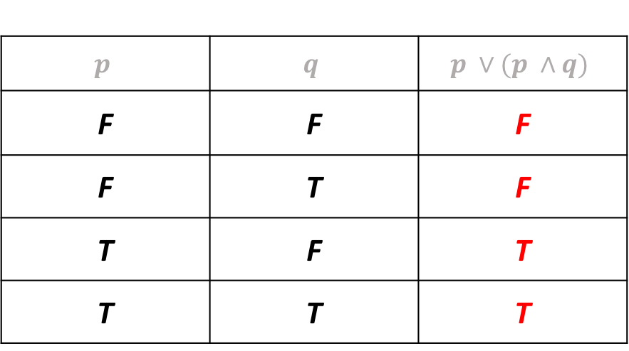
Fun exercise
Fill-in the following truth table:
Anything interesting here?
$$p$$ | $$q$$ | $$p ∨(p ∧q)$$
F | F | F
F | T | F
T | F | T
T | T | T

Slide 25
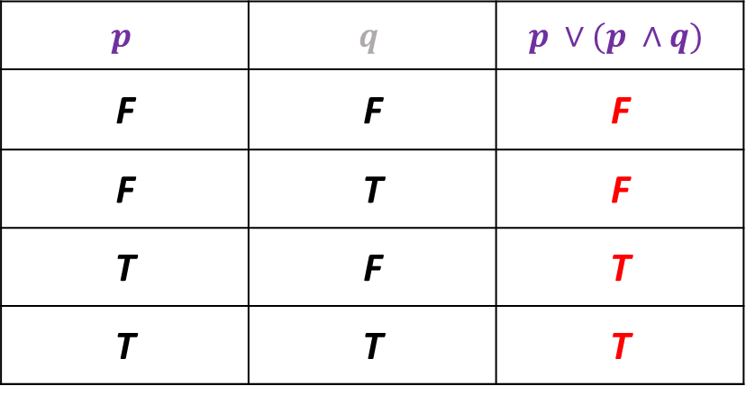
Fun exercise
Fill-in the following truth table:
Anything interesting here?
$$p$$ | $$q$$ | $$p ∨(p ∧q)$$
F | F | F
F | T | F
T | F | T
T | T | T

Slide 26
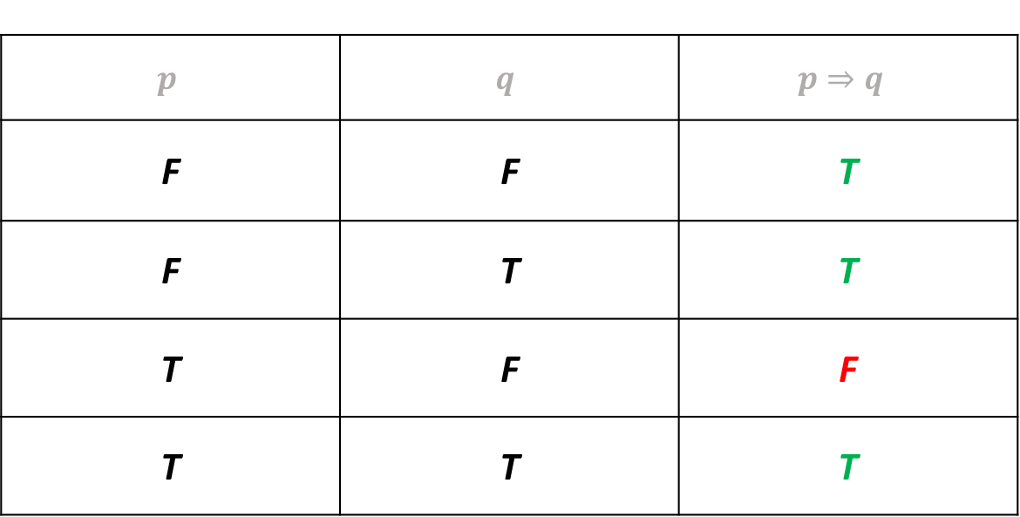

Implication ($⟹$)
“If –then”
$$p$$ | $$q$$ | $$p⇒q$$
F | F | T
F | T | T
T | F | F
T | T | T

Slide 27

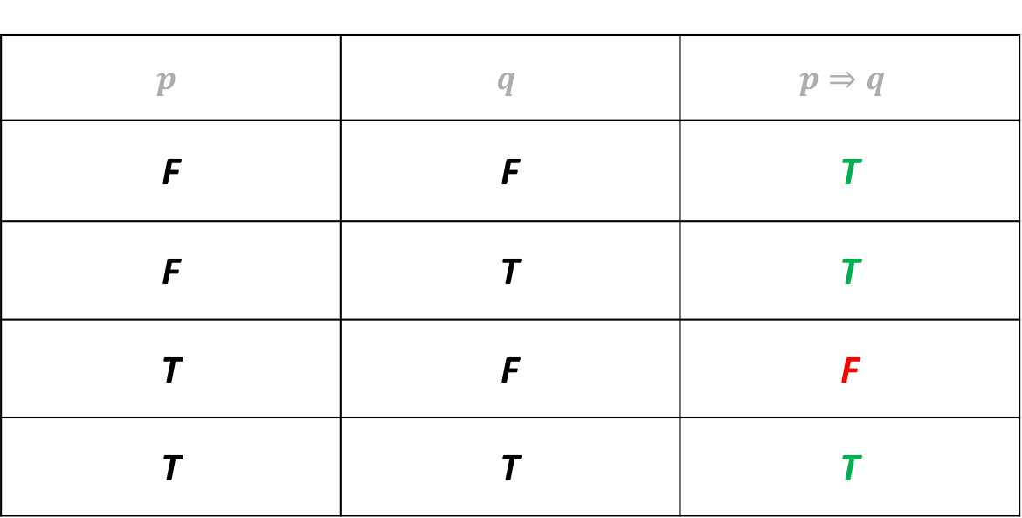
Implication ($⟹$)
“If –then”
$$p$$ | $$q$$ | $$p⇒q$$
F | F | T
F | T | T
T | F | F
T | T | T

Slide 28

Gorslax learns about birds
Gorslax, an alien from the Andromeda Galaxy, visits planet Earth on a scientific expedition.
Gorslax’s planet has a very strong gravitational field which does not allow for the evolution of aviary life.
So he starts studying Earth’s birds.

Slide 29
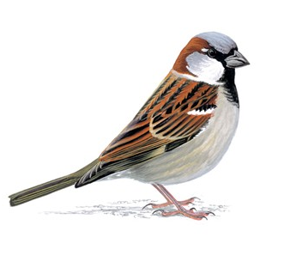
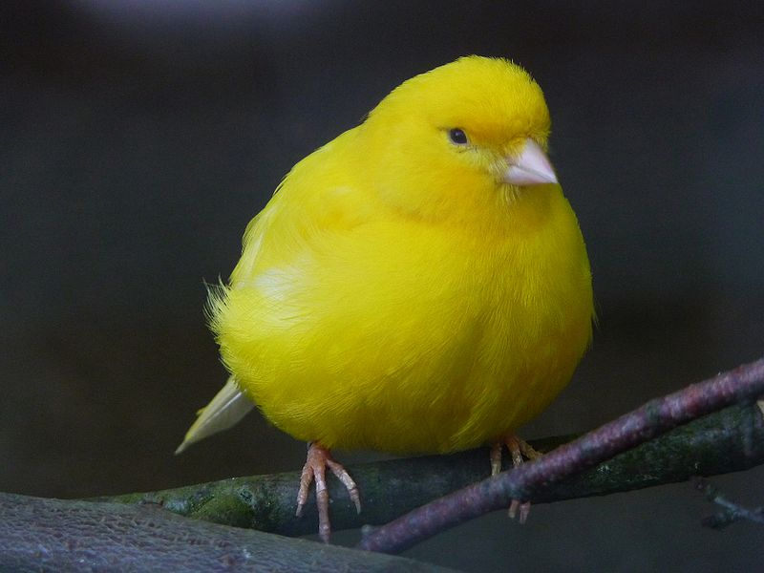

Gorslax learns about birds

Slide 30
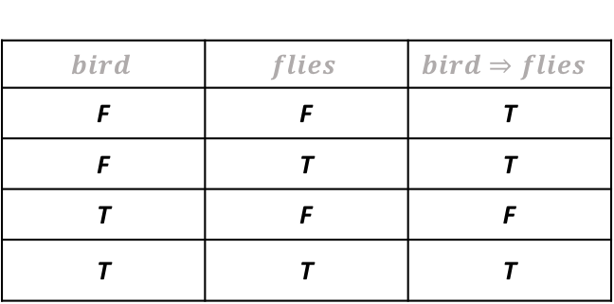
Gorslax learns about birds
Hmmm… From what I see until now, it seems as if all birds fly
$$bird$$ | $$flies$$ | $$bird⇒flies$$
F | F | T
F | T | T
T | F | F
T | T | T

Slide 31
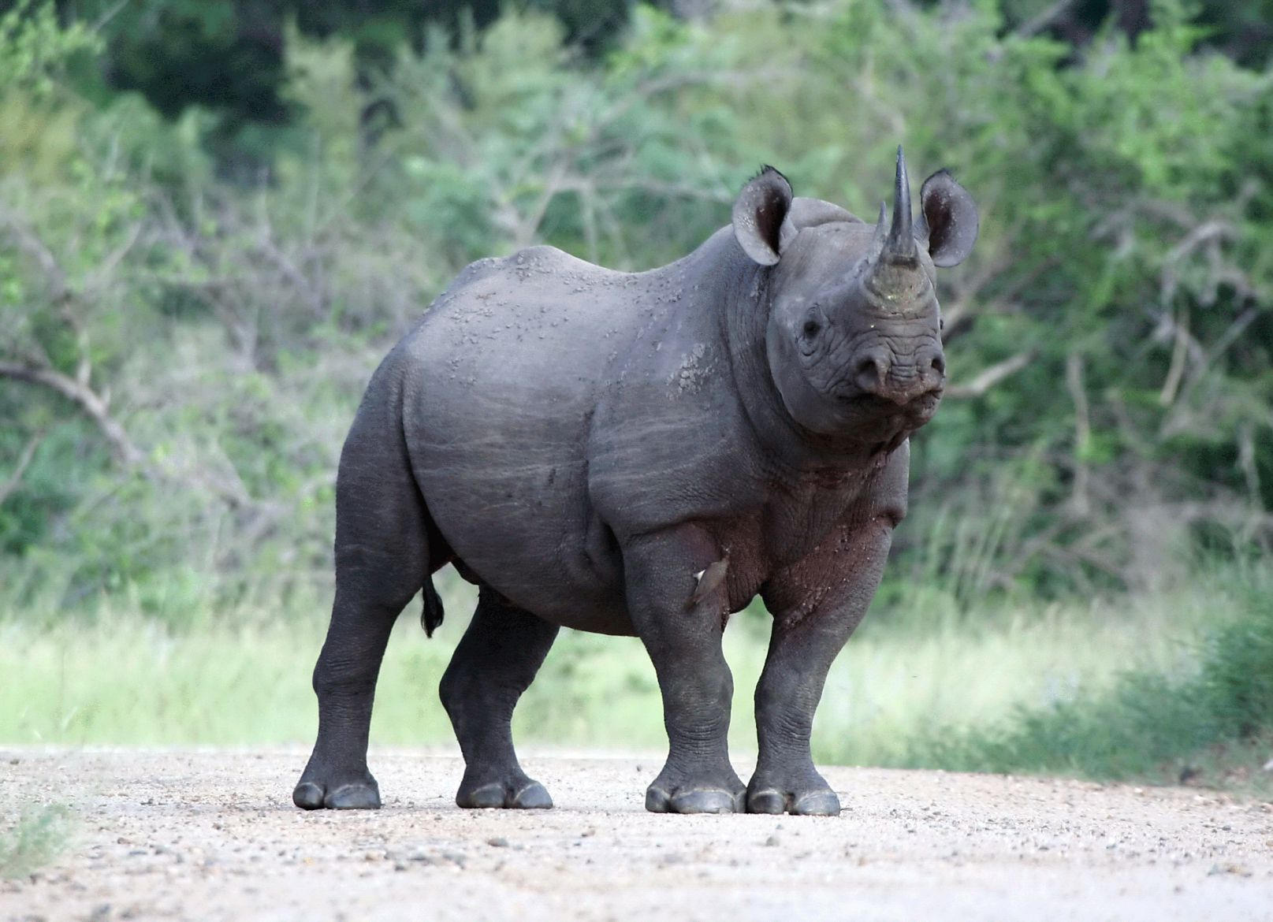
Gorslax learns about birds
Well this thing clearly doesn’t fly, but it’s also not a bird, so I don’t care; I still believe that all birds fly!
$$bird$$ | $$flies$$ | $$bird⇒flies$$
F | F | T
F | T | T
T | F | F
T | T | T

Slide 32
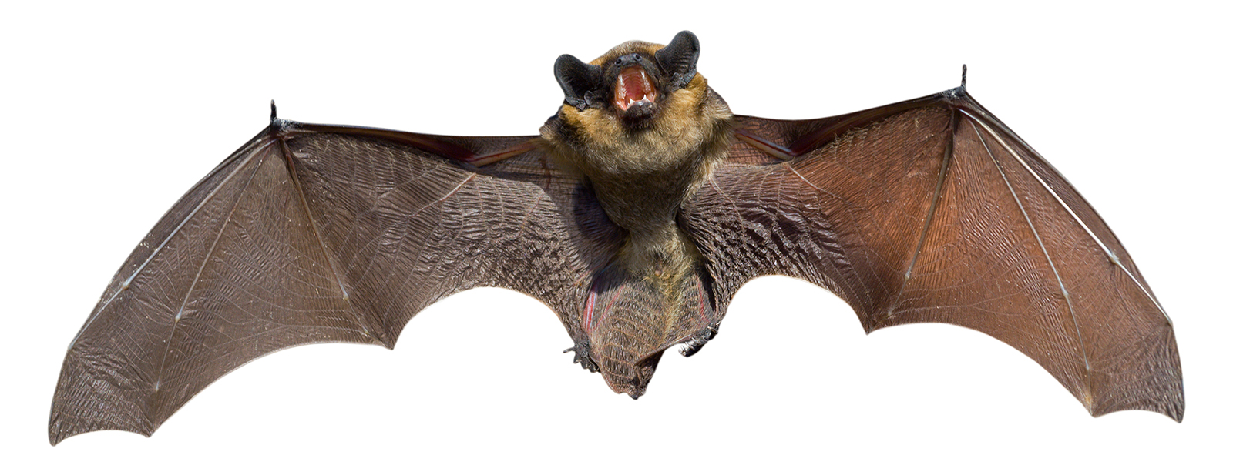
Gorslax learns about birds
While this thing does fly, it’s not a bird, so I don’t care; I still believe that all birds fly!
$$bird$$ | $$flies$$ | $$bird⇒flies$$
F | F | T
F | T | T
T | F | F
T | T | T

Slide 33
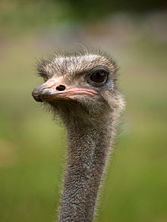
Gorslax learns about birds
Whoops! Here’s at least one bird that doesn’t fly! So my syllogism “if bird then flies” does not universally apply!
$$bird$$ | $$flies$$ | $$bird⇒flies$$
F | F | T
F | T | T
T | F | F
T | T | T

Slide 34
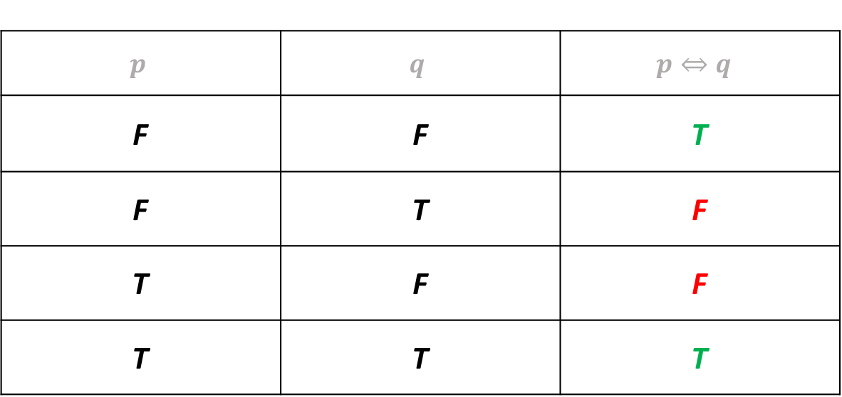

Bi-conditional ($⟺$)
“If and only if”
$$p$$ | $$q$$ | $$p⇔q$$
F | F | T
F | T | F
T | F | F
T | T | T

Slide 35
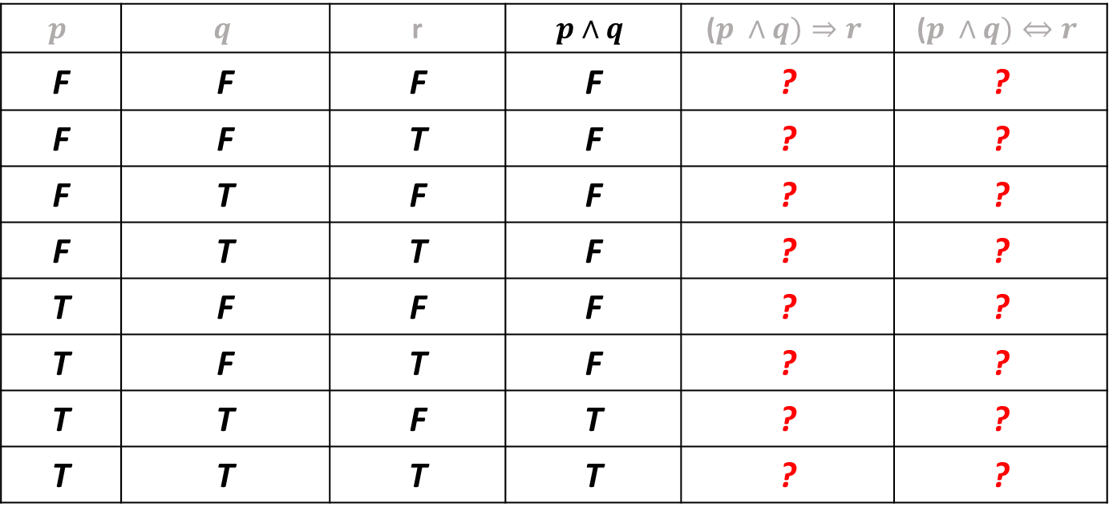
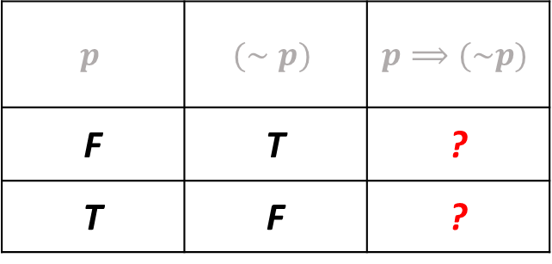
Practice
$$p$$ | $$(∼p)$$ | $$p⟹(\sim p)$$
F | T | ?
T | F | ?
Fill in the following truth tables:
$$p$$ | $$q$$ | r | $$p∧q$$ | ($p ∧q)⇒r$ | ($p ∧q)⇔r$
F | F | F | F | ? | ?
F | F | T | F | ? | ?
F | T | F | F | ? | ?
F | T | T | F | ? | ?
T | F | F | F | ? | ?
T | F | T | F | ? | ?
T | T | F | T | ? | ?
T | T | T | T | ? | ?

Slide 36

Contradictions / Tautologies
Examine the statements:
$p ∧(\sim p)$
$p ∨(\sim p)$
What can you say about those statements?

Slide 37
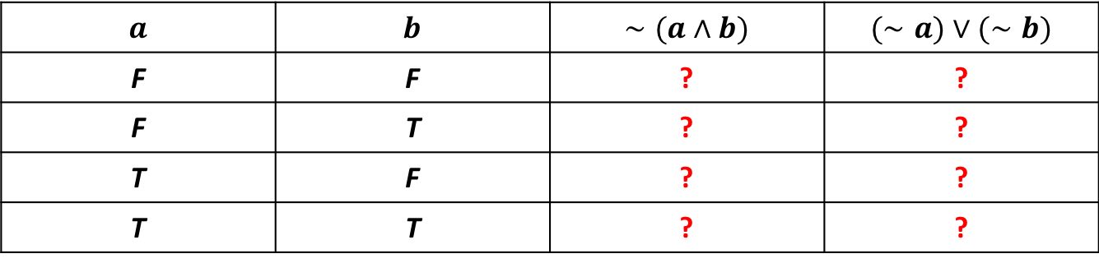
Another important equivalence
Let’s fill in the following truth table :
$$a$$ | $$b$$ | $$∼(a∧b)$$ | $$(∼a)∨(∼b)$$
F | F | ? | ?
F | T | ? | ?
T | F | ? | ?
T | T | ? | ?

Slide 38
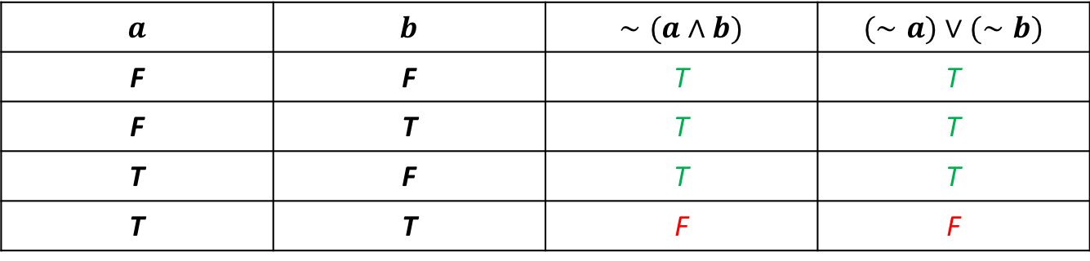
Another important equivalence
Let’s fill in the following truth table :
$$a$$ | $$b$$ | $$∼(a∧b)$$ | $$(∼a)∨(∼b)$$
F | F | T | T
F | T | T | T
T | F | T | T
T | T | F | F

Slide 39

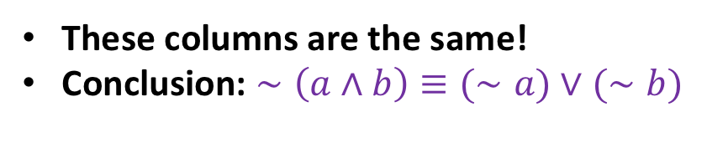
Another important equivalence
Let’s fill in the following truth table :
$$a$$ | $$b$$ | $$∼(a∧b)$$ | $$(∼a)∨(∼b)$$
F | F | T | T
F | T | T | T
T | F | T | T
T | T | F | F
These columns are the same!
Conclusion: $∼\left(a∧b\right)≡(∼a)∨(∼b)$

Slide 40
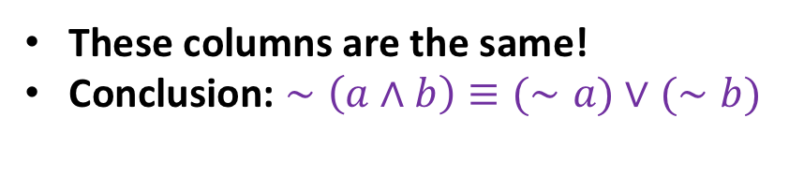
Another important equivalence
Let’s fill in the following truth table :
$$a$$ | $$b$$ | $$∼(a∧b)$$ | $$(∼a)∨(∼b)$$
F | F | T | T
F | T | T | T
T | F | T | T
T | T | F | F
This result is known as
De Morgan’s law
These columns are the same!
Conclusion: $∼\left(a∧b\right)≡(∼a)∨(∼b)$

Slide 41

Understanding De Morgan’s Law
$\sim (“Alice is Blonde”∧“Alice wears Green Dress”)$: Clearly true

Slide 42
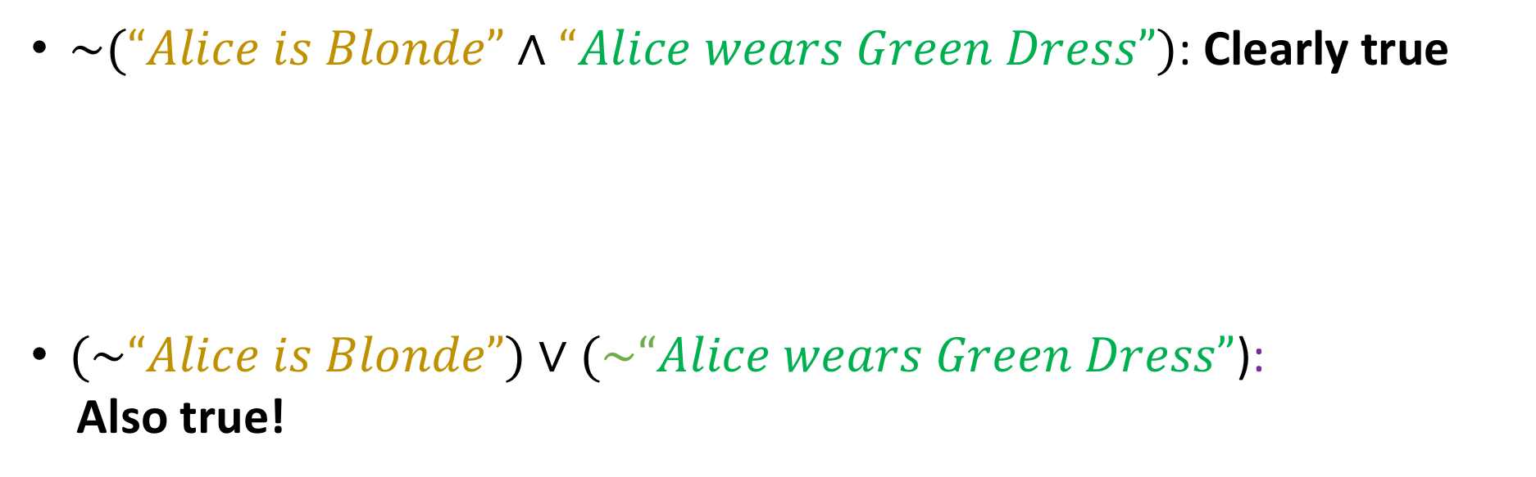
Understanding De Morgan’s Law
$\sim (“Alice is Blonde”∧“Alice wears Green Dress”)$: Clearly true
$(\sim “Alice is Blonde”)∨(\sim “Alice wears Green Dress”$):
Also true!

Slide 43
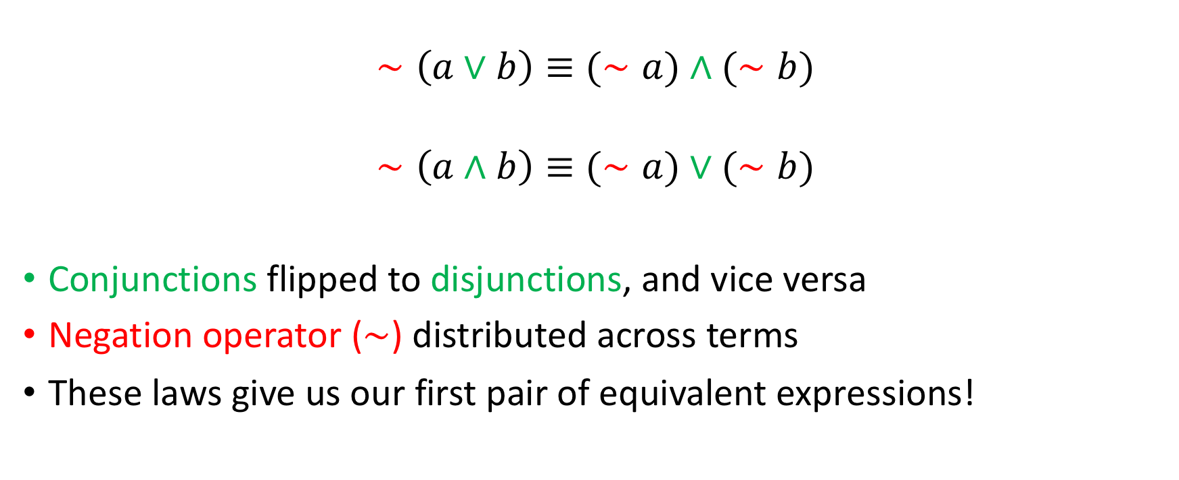
De Morgan’s Laws (there’s two of them)
$$∼\left(a∨b\right)≡(∼a)∧(∼b)$$
$$∼\left(a∧b\right)≡(∼a)∨(∼b)$$
Conjunctions flipped to disjunctions, and vice versa
Negation operator ($∼$) distributed across terms
These laws give us our first pair of equivalent expressions!

Slide 44
Proving equivalences
How do we prove an equivalence? (e.g $\sim \left(a∧b\right)≡\left(\sim a\right) ∨(\sim b)$)

Slide 45

Proving equivalences
How do we prove an equivalence? (e.g $\sim \left(a∧b\right)≡\left(\sim a\right) ∨(\sim b)$)
Truth tables
One major problem: for $n$ variables, $2^{n}$ rows (input combinations) to enumerate!

Slide 46

Proving equivalences
How do we prove an equivalence? (e.g $\sim \left(a∧b\right)≡\left(\sim a\right) ∨(\sim b)$)
Truth tables
One major problem: for $n$ variables, $2^{n}$ rows (input combinations) to enumerate!
Can we do better?

Slide 47
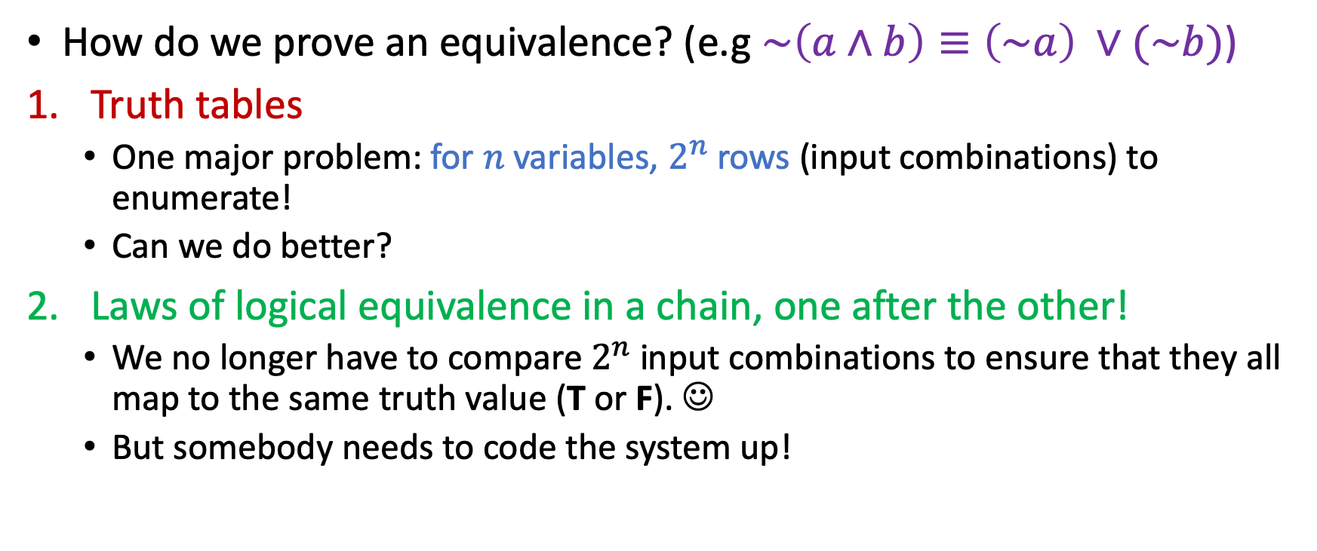
Proving equivalences
How do we prove an equivalence? (e.g $\sim \left(a∧b\right)≡\left(\sim a\right) ∨(\sim b)$)
Truth tables
One major problem: for $n$ variables, $2^{n}$ rows (input combinations) to enumerate!
Can we do better?
Laws of logical equivalence in a chain, one after the other!
We no longer have to compare $2^{n}$ input combinations to ensure that they all map to the same truth value (T or F). ☺
But somebody needs to code the system up!

Slide 48
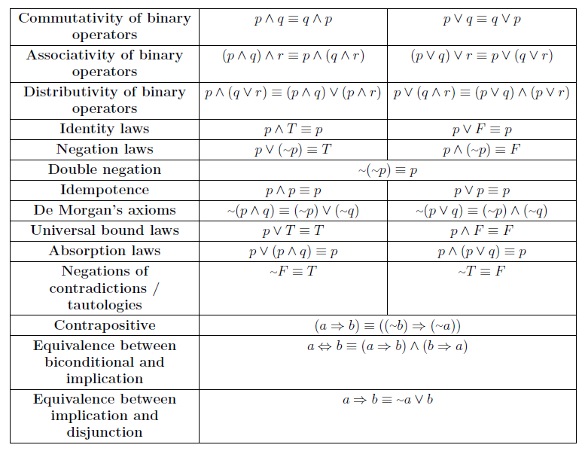
Boolean Logic Cheat Sheet

Slide 49
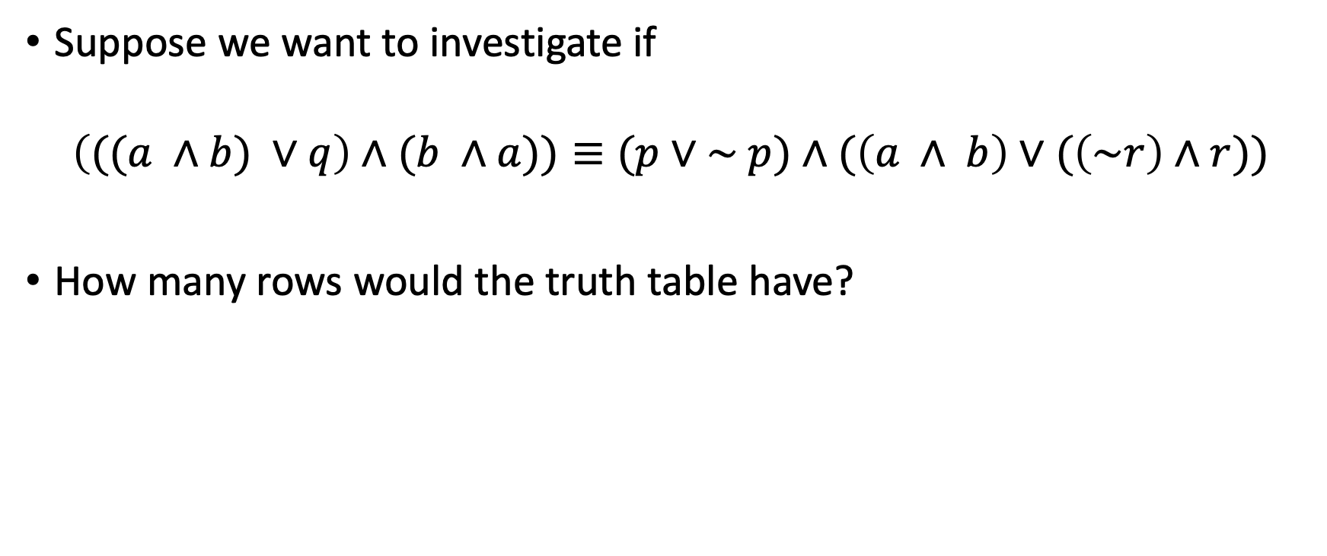
Proving equivalences using laws
Suppose we want to investigate if
$$\left(((a ∧b) ∨q\right)∧(b ∧a))≡(p∨\sim p)∧(\left(a ∧ b\right)∨(\left(\sim r\right)∧r))$$
How many rows would the truth table have?

Slide 50
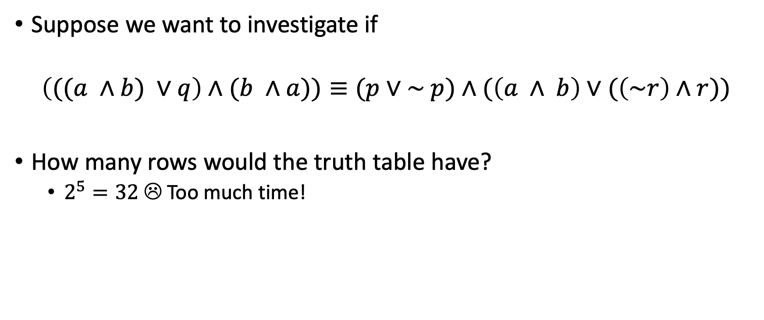
Proving equivalences using laws
Suppose we want to investigate if
$$\left(((a ∧b) ∨q\right)∧(b ∧a))≡(p∨\sim p)∧(\left(a ∧ b\right)∨(\left(\sim r\right)∧r))$$
How many rows would the truth table have?
$2^{5}=32$ ☹ Too much time!

Slide 51
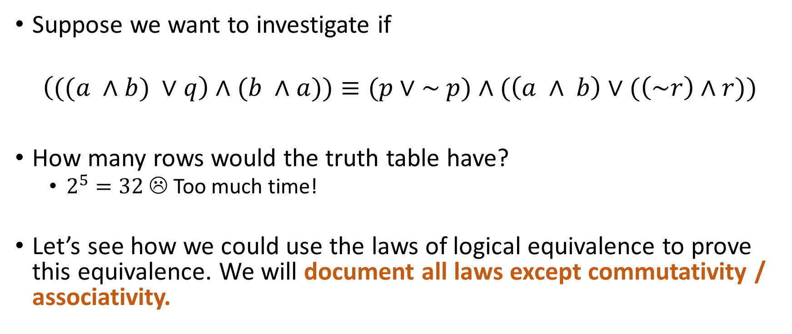
Proving equivalences using laws
Suppose we want to investigate if
$$\left(((a ∧b) ∨q\right)∧(b ∧a))≡(p∨\sim p)∧(\left(a ∧ b\right)∨(\left(\sim r\right)∧r))$$
How many rows would the truth table have?
$2^{5}=32$ ☹ Too much time!
Let’s see how we could use the laws of logical equivalence to prove this equivalence. We will document all laws except commutativity / associativity.

Slide 52

More equivalences
Please prove the following equivalences true or false!
$$a⇒b≡(∼b)⇒(∼a)$$
$$a⇒b≡(∼a)⇒(∼b)$$
$$a⇔b≡\left(\left(∼a\right)∨b\right)∧((∼b)∨a)$$

Slide 53
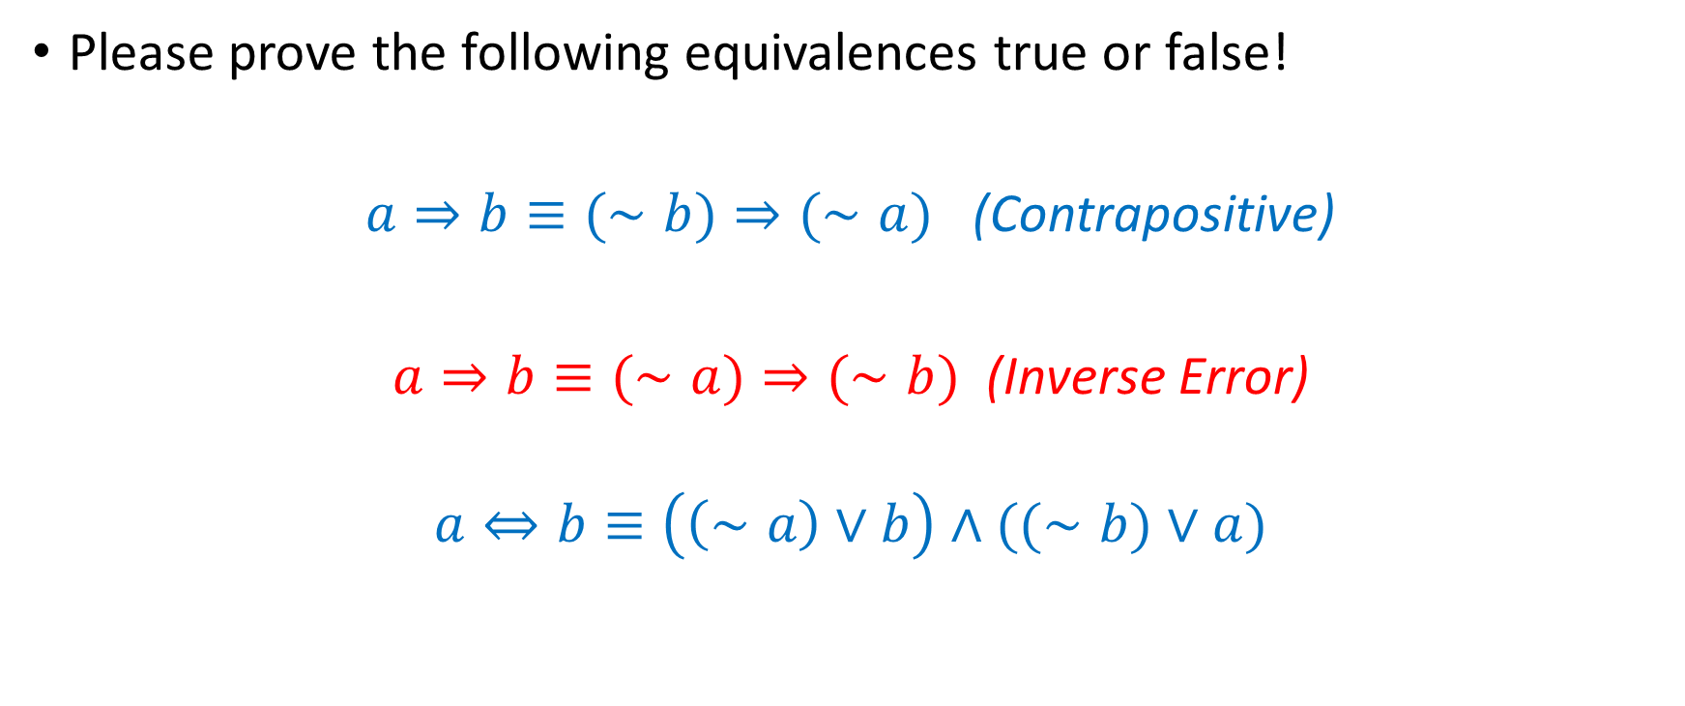
More equivalences
Please prove the following equivalences true or false!
$a⇒b≡(∼b)⇒(∼a)$ (Contrapositive)
$a⇒b≡(∼a)⇒(∼b)$ (Inverse Error)
$$a⇔b≡\left(\left(∼a\right)∨b\right)∧((∼b)∨a)$$

Slide 54

Simplifying expressions
Large expressions can often be simplified using the equivalences we discussed earlier.
Example: Let’s simplify $p∧\left(p∨q\right)∧\left(p∧q\right)$

Slide 55
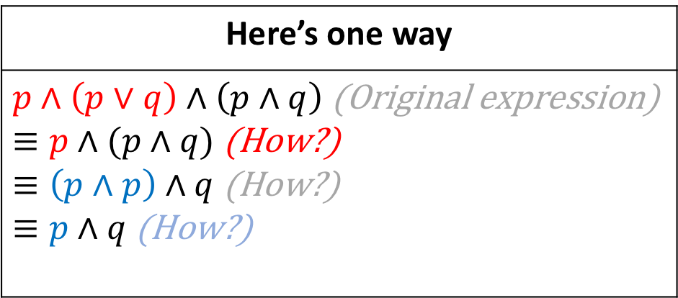

Simplifying expressions
Large expressions can often be simplified using the equivalences we discussed earlier.
Example: Let’s simplify $p∧\left(p∨q\right)∧\left(p∧q\right)$
Here’s one way
$p∧\left(p∨q\right)∧\left(p∧q\right)$ (Original expression) $≡p∧(p∧q)$ (How?) $≡\left(p∧p\right)∧q$ (How?) $≡p∧q$ (How?)

Slide 56

Your turn, class!
Let’s simplify the following three expressions.
$$\left(a_{1}∨a_{1}\right)∧\left(a_{2}∨a_{2}\right)∧…∧\left(a_{100}∨a_{100}\right)∧\left(∼a_{1}∨∼a_{1}\right)∧\left({∼a}_{2}∨ ∼a_{2}\right)∧…∧({∼a}_{100}∨ ∼a_{100})$$ | $$\left(p∧r\right)∨(\left(p∨s\right)∧\left(p∨a\right))$$ | $$p∧(\left( p∨∼q\right)∨\left(∼\left(∼(z∨∼q\right))\right))$$
Jason needs to project the cheat sheet while you solve this exercise. If he doesn’t, berate him appropriately

Slide 57

Solution to 1
$\left(a_{1}∨a_{1}\right)∧\left(a_{2}∨a_{2}\right)∧…∧\left(a_{100}∨a_{100}\right)∧\left(∼a_{1}∨∼a_{1}\right)∧\left({∼a}_{2}∨ ∼a_{2}\right)∧…∧\left({∼a}_{100}∨ ∼a_{100}\right)$
$≡a_{1}∧a_{2}∧…∧\left(a_{100}\right)∧\left(∼a_{1}\right)∧\left({∼a}_{2}\right)∧…∧\left({∼a}_{100}\right)$ (Idempotence 100 times)
$≡a_{1}∧\left(∼a_{1}\right)∧ a_{2}∧\left({∼a}_{2}\right)∧…∧\left(a_{999}\right)∧\left({∼a}_{999}\right)…∧\left(a_{100}\right)∧\left({∼a}_{100}\right)$ (Commutativity 100 times)
$≡F∧F∧…∧F…∧F$ (Negation 100 times)
$≡F$ (Idempotence 99 times)

Slide 58

Solution to 2
$\left(p∧r\right)∨\left(\left(p∨s\right)∧\left(p∨a\right)\right)$
$≡\left(p∧r\right)∨(p∨\left(s∧a \right))$ (Distributivity)
$≡(\left(p∧r\right)∨p)∨\left(s∧a \right)$ (Associativity)
$≡(p∨\left(p∧r\right))∨\left(s∧a \right)$ (Commutativity)
$≡p∨\left(s∧a \right)$ (Absorption)

Slide 59

Solution to 3
$p∧\left(\left( p∨∼q\right)∨\left(∼\left(∼(z∨∼q\right))\right)\right)$
$≡p∧\left(\left( p∨∼q\right)∨(z∨∼q)\right)$ (Double Negation)
$≡p∧\left(\left( p∨z\right)∨(\sim q∨∼q)\right)$ (Associativity) $≡p∧\left(\left( p∨z\right)∨\sim q\right)$ (Idempotence) $≡p∧\left(p∨(z∨\sim q\right))$ (Associativity) $≡p$ (Absorption)

Slide 60

Boolean satisfiability problem
At the core of computer science lies a pesky little nugget, and that nugget is SAT.
Simplified problem statement:
Given a Boolean formula $F(x_{1},x_{2},…,x_{n})$ over $n$ propositional symbols $x_{i}$, is there a truth assignment to the $x_{i}$ that makes $F$ true?

Slide 61

Well… is there?
$x_{1}∧x_{2}∧…∧x_{n}$

Slide 62

Well… is there?
$x_{1}∧x_{2}∧…∧x_{n}$ Y
$x_{1}∧\left(∼x_{2}\right)∧\left(x_{3}\right)∧…∧(∼x_{n})$ (if n is even, otherwise $x_{n}$)

Slide 63

Well… is there?
$x_{1}∧x_{2}∧…∧x_{n}$ Y
$x_{1}∧\left(∼x_{2}\right)∧\left(x_{3}\right)∧…∧(∼x_{n})$ (if n is even, otherwise $x_{n}$) Y
$x_{1}∧\left(∼x_{2}\right)∧\left(x_{3}\right)∧…∧(∼x_{1})$

Slide 64

Well… is there?
$x_{1}∧x_{2}∧…∧x_{n}$ Y
$x_{1}∧\left(∼x_{2}\right)∧\left(x_{3}\right)∧…∧(∼x_{n})$ (if n is even, otherwise $x_{n}$) Y
$x_{1}∧\left(∼x_{2}\right)∧\left(x_{3}\right)∧…∧(∼x_{1})$ N
$x_{1}∨x_{2}∨…∨x_{n}$

Slide 65

Well… is there?
$x_{1}∧x_{2}∧…∧x_{n}$ Y
$x_{1}∧\left(∼x_{2}\right)∧\left(x_{3}\right)∧…∧(∼x_{n})$ (if n is even, otherwise $x_{n}$) Y
$x_{1}∧\left(∼x_{2}\right)∧\left(x_{3}\right)∧…∧(∼x_{1})$ N
$x_{1}∨x_{2}∨…∨x_{n}$ Y
$x_{1}⇒(x_{2}⇒\left(…{(x}_{n}⇒{(∼x}_{1})\right)…))$

Slide 66

Well… is there?
$x_{1}∧x_{2}∧…∧x_{n}$ Y
$x_{1}∧\left(∼x_{2}\right)∧\left(x_{3}\right)∧…∧(∼x_{n})$ (if n is even, otherwise $x_{n}$) Y
$x_{1}∧\left(∼x_{2}\right)∧\left(x_{3}\right)∧…∧(∼x_{1})$ N
$x_{1}∨x_{2}∨…∨x_{n}$ Y
$x_{1}⇒(x_{2}⇒\left(…{(x}_{n}⇒{(∼x}_{1})\right)…))$ Y

Slide 67

Well… is there?
$x_{1}∧x_{2}∧…∧x_{n}$ Y
$x_{1}∧\left(∼x_{2}\right)∧\left(x_{3}\right)∧…∧(∼x_{n})$ (if n is even, otherwise $x_{n}$) Y
$x_{1}∧\left(∼x_{2}\right)∧\left(x_{3}\right)∧…∧(∼x_{1})$ N
$x_{1}∨x_{2}∨…∨x_{n}$ Y
$x_{1}⇒(x_{2}⇒\left(…{(x}_{n}⇒{(∼x}_{1})\right)…))$ Y
How easy was it to determine the last one? Did you have to mentally build a truth table?

Slide 68


The problem
We can always find Boolean formulae for which we might need to calculate an entire truth table to find satisfiability!
There is no known algorithm that can solve satisfiability reliably, in all instances, in time that is a $poly(n)$.
So we can always find Boolean formulae that need exponential time to find the satisfiability of ☹
Efficient heuristic algorithms that work well in many cases:
WalkSAT
MaxWalkSAT

Slide 69

SAT and P vs NP
Most people believe that there is no algorithm that is guaranteed to solve every instance of SAT in time $poly(n)$.
Polynomial reduction: A process that takes a problem and its input size $n$, and transforms it into SAT in time $poly(n)$.
If a problem can be reduced to SAT in polynomial time, then it is widely speculated that there is no way to solve every instance of it in time $poly(n)$.
Those are called NP-Hard problems.

Slide 70
SAT and P vs NP
If we found a polynomial algorithm for SAT, that would imply that every NP-Hard problem (so, the “hardest” in the class NP) could be solved in polynomial time.
So P would be NP
Major computational implications re: cryptography, search….
More reading:
NP – Hardness on Wikipedia
Cormen, Leiserson, Rivest, Stein, Introduction to Algorithms, Chapter 34
Kleinberg & Tardos, Algorithm Design, Chapter 8

