Slide 1
Valid and invalid Reasoning
CMSC250

Slide 2
Reminder
HW1 has been posted on ELMS.
Submission on Gradescope.
  You must have been automatically added with your ELMS e-mail address!
Various submission methods.
  Handwritten, LaTeX, Word,…
Printed extra copies outside my office
  In a cardboard box.
Have had to cancel tomorrow’s office hours
Thursday: lecture cover on circuits by Dr. Eastman

Slide 3
Valid reasoning
We’ve talked about
  Basic Syntax: Propositional symbols (p, q, r), operators and connectives (v, Λ, = >, <=>)
  Handling Boolean Expressions: Truth tables, equivalences
Now we’re going to talk about creating new information from existing premises using valid rules of reasoning!
Additional Knowledge
Existing knowledge
Valid reasoning

Slide 4
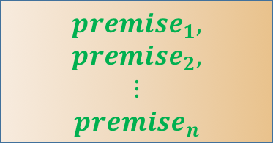




Template
$$premise_{1}$$
$$premise_{2}$$
$$⋮$$
$$premise_{n}$$
$$___________$$
$$∴conclusion$$
Rule $r$
$conclusion$,
$$premise_{1},$$
$$premise_{2},$$
$$⋮$$
$$premise_{n}$$
$$premise_{1},$$
$$premise_{2},$$
$$⋮$$
$$premise_{n}$$
Rule $r$

Slide 5
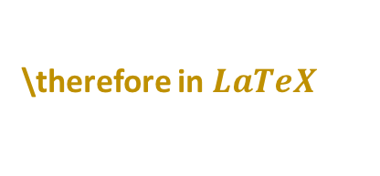
Template
$$premise_{1}$$
$$premise_{2}$$
$$⋮$$
$$premise_{n}$$
$$___________$$
$$∴conclusion$$
Rule $r$
\therefore in $LaTeX$
$conclusion$,
$$premise_{1},$$
$$premise_{2},$$
$$⋮$$
$$premise_{n}$$
$$premise_{1},$$
$$premise_{2},$$
$$⋮$$
$$premise_{n}$$
Rule $r$

Slide 6
Modus Ponens
The most basic valid rule of inference is “Modus Ponens”.
Example:
  All bears love honey
  Claws is a bear
  Therefore, Claws loves honey

Slide 7

Modus Ponens
The most basic valid rule of inference is “Modus Ponens”.
Example:
  All bears love honey $(p⇒q)$
  Claws is a bear $(p)$
  Therefore, Claws loves honey $(q)$

Slide 8

Modus Ponens
The most basic valid rule of inference is “Modus Ponens”.
Example:
  All bears love honey $(p⇒q)$
  Claws is a bear $(p)$
  Therefore, Claws loves honey $(q)$
  $$p⇒q$$
  $$p \\ ________$$
  $$∴q$$

Slide 9
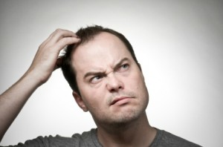
Modus Ponens
The most basic valid rule of inference is “Modus Ponens”.
Example:
  All bears love honey $(p⇒q)$
  Claws is a bear $(p)$
  Therefore, Claws loves honey $(q)$
  $$p⇒q$$
  $$p \\ ________$$
  $$∴q$$
So what makes modus ponens valid?

Slide 10
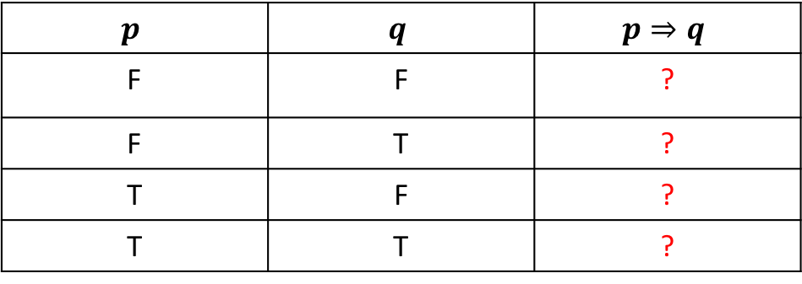
Determining validity
$$p$$ | $$q$$ | $$p⇒q$$
F | F | ?
F | T | ?
T | F | ?
T | T | ?

Slide 11
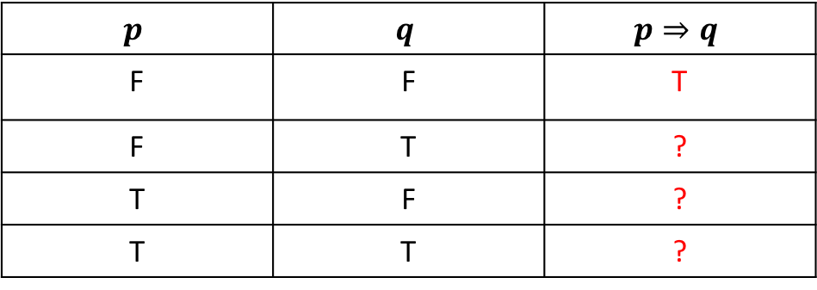
Determining validity
$$p$$ | $$q$$ | $$p⇒q$$
F | F | T
F | T | ?
T | F | ?
T | T | ?

Slide 12
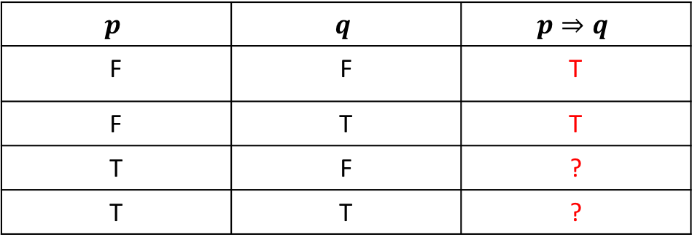
Determining validity
$$p$$ | $$q$$ | $$p⇒q$$
F | F | T
F | T | T
T | F | ?
T | T | ?

Slide 13
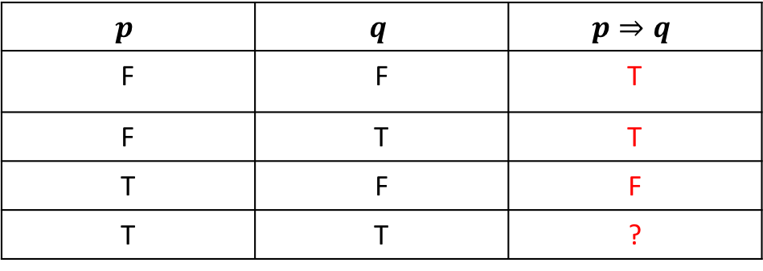
Determining validity
$$p$$ | $$q$$ | $$p⇒q$$
F | F | T
F | T | T
T | F | F
T | T | ?

Slide 14
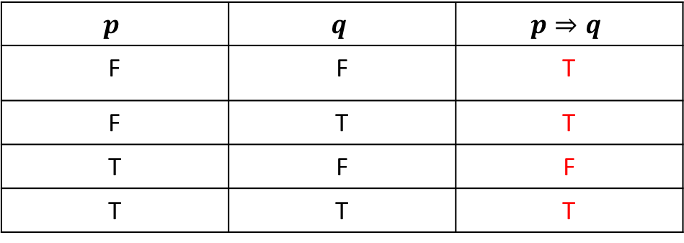
Determining validity
$$p$$ | $$q$$ | $$p⇒q$$
F | F | T
F | T | T
T | F | F
T | T | T

Slide 15
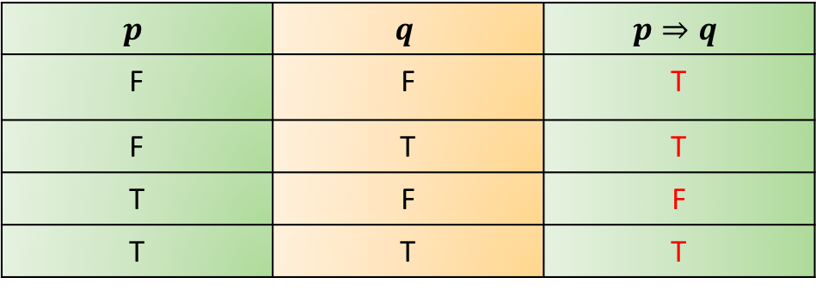
Determining validity
$$p$$ | $$q$$ | $$p⇒q$$
F | F | T
F | T | T
T | F | F
T | T | T
Conclusion
Premises

Slide 16
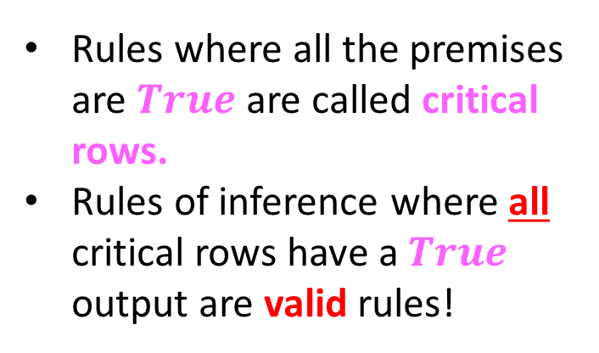
Determining validity
$$p$$ | $$q$$ | $$p⇒q$$
F | F | T
F | T | T
T | F | F
T | T | T
Conclusion
Rules where all the premises are $True$are called critical rows.
Rules of inference where all critical rows have a $True$ output are valid rules!
Premises

Slide 17
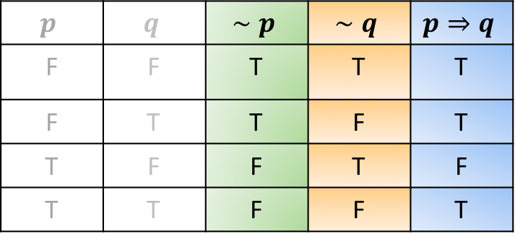

Is there “invalid” reasoning?
Sure! Here’s one we already talked about: The inverse error!
  $$p⇒q$$
  $$∼p \\ ________$$
  $$∴ ∼q$$
Two critical rows…
$$p$$ | $$q$$ | $$∼p$$ | $$∼q$$ | $$p⇒q$$
F | F | T | T | T
F | T | T | F | T
T | F | F | T | F
T | T | F | F | T

Slide 18
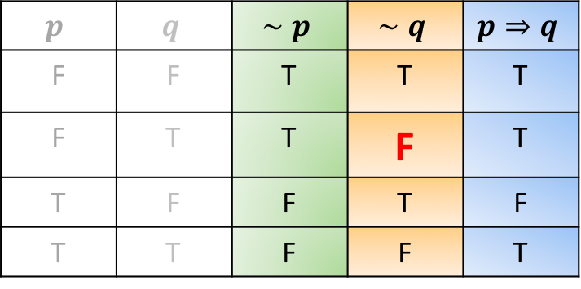
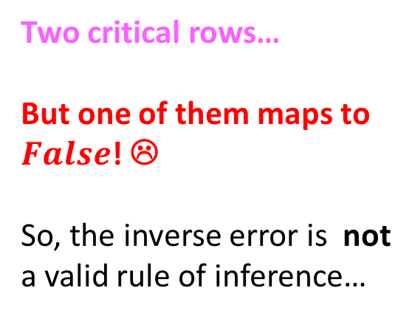
Is there “invalid” reasoning?
Sure! Here’s one we already talked about: The inverse error!
  $$p⇒q$$
  $$∼p \\ ________$$
  $$∴ ∼q$$
Two critical rows…
But one of them maps to $False$! ☹
So, the inverse error is not a valid rule of inference…
$$p$$ | $$q$$ | $$∼p$$ | $$∼q$$ | $$p⇒q$$
F | F | T | T | T
F | T | T | F | T
T | F | F | T | F
T | T | F | F | T

Slide 19

Are the following valid or invalid?
Determine if these rules of inference are valid or invalid:
$$p⇒q$$ | $$p⇒q$$
$$q$$ | $$∼q$$
$$∴p$$ | $$∴∼p$$

Slide 20
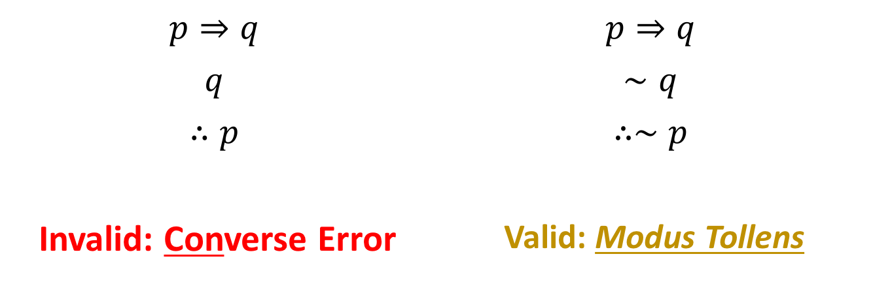
Are the following valid or invalid?
Determine if these rules of inference are valid or invalid:
$$p⇒q$$ | $$p⇒q$$
$$q$$ | $$∼q$$
$$∴p$$ | $$∴∼p$$
Invalid: Converse Error | Valid: Modus Tollens

Slide 21

Quiz
Let a rule $r$ have premises $p_{1}, p_{2},…,p_{n}$ and conclusion $conc$.
Statement: $r$ is a valid if, and only if, $\left(p_{1}∧p_{2}∧…∧p_{n}\right)⇒conc$ is a tautology.
True
False

Slide 22
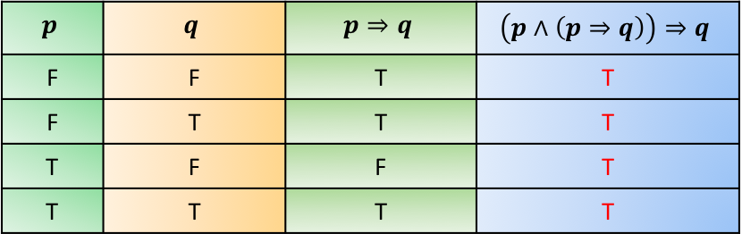

Quiz
Let a rule $r$ have premises $p_{1}, p_{2},…,p_{n}$ and conclusion $conc$.
Statement: $r$ is a valid if, and only if, $\left(p_{1}∧p_{2}∧…∧p_{n}\right)⇒conc$ is a tautology.
Example: Modus Ponens
True
False
$$p$$ | $$q$$ | $$p⇒q$$ | $$\left(p∧\left(p⇒q\right)\right)⇒q$$
F | F | T | T
F | T | T | T
T | F | F | T
T | T | T | T

Slide 23
Exercise
Let’s apply this technique to Modus Tollens and the Inverse Error!

Slide 24
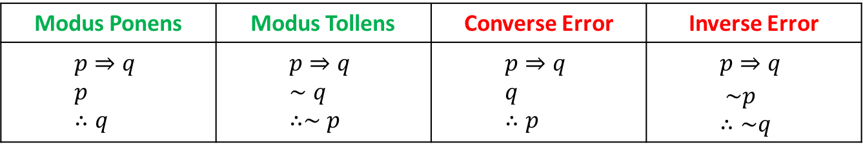
What we know so far…
What makes a rule valid
What makes it invalid
The following 4 (2 valid, 2 invalid)
Modus Ponens | Modus Tollens | Converse Error | Inverse Error
$$p⇒q \\ p \\ ∴q$$ | $$p⇒q \\ ∼q \\ ∴∼p$$ | $$p⇒q \\ q \\ ∴p$$ | $$p⇒q \\ \sim p \\ ∴\sim q$$

Slide 25

Here’s couple more!
Disjunctive addition
$$p \\ ∴p∨q$$
Convince yourselves of validity!

Slide 26

Conjunctive addition
$$p \\ q \\ ∴p∧q$$

Slide 27

Conjunctive Simplification
$$p∧q \\ ∴p, q$$

Slide 28

Disjunctive Syllogism
$$p∨q \\ ∼p \\ ∴q$$

Slide 29

Hypothetical Syllogism
$$p⇒q \\ q⇒r \\ ∴p⇒r$$

Slide 30

Division into cases
$$p∨q \\ p⇒r \\ q⇒r \\ ∴r$$

Slide 31

Proof by contradiction
$$(∼p)⇒c \\ ∴p$$
Fundamental rule of inference, terrifically useful in formal proofs!
Let’s convince ourselves of validity!

Slide 32

Resolution
$$p∨q \\ (∼q)∨z \\ ∴p∨z$$
Resolution is terrifically important in AI!

Slide 33
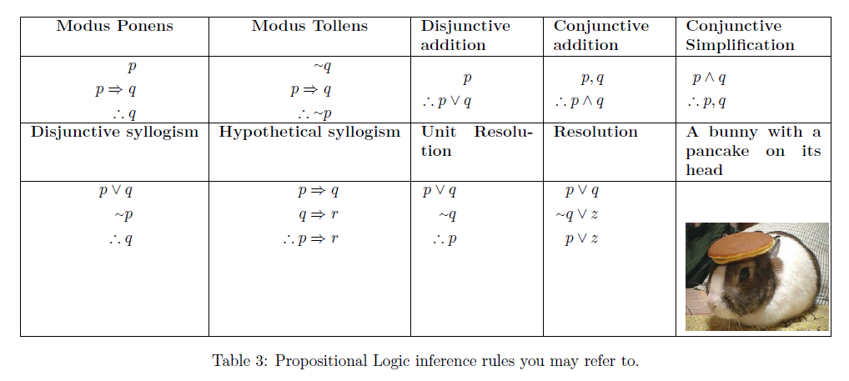
Cheat Sheet for rules of inference

Slide 34
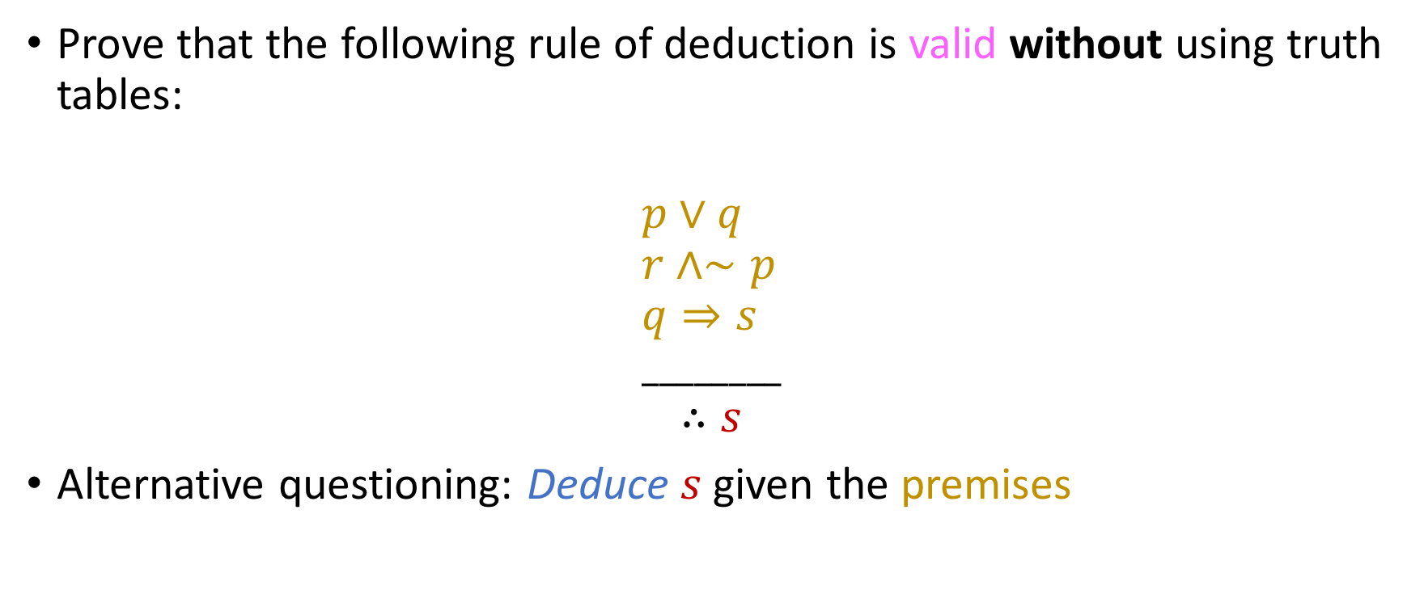
Complex applications of rules of deduction
Prove that the following rule of deduction is valid without using truth tables:
$$p∨q \\ r∧∼p \\ q⇒s \\ ________$$
$$∴s$$
Alternative questioning: Deduce $s$ given the premises

Slide 35

Complex applications of rules of deduction
From conjunctive simplification we have:
$$r∧∼p \\ ____________ \\ ∴r, ∼p$$
From disjunctive syllogism we have:
$$p∨q \\ ∼p \\ ______$$
$$∴q$$
From modus ponens we have
$$q$$
$$q⇒s \\ ________$$
$$∴s$$

Slide 36

Here’s a tougher one!
From the premises
$(∼p)⇒(r∧(∼s))$
$k⇒s$
$3. u⇒(∼p)$
$4. ∼w$
$5. u∨w$
Deduce $∼k$.

Slide 37

Solution
Through disjunctive syllogism we have:
$$\sim w \\ u∨w \\ ∴u$$
Through modus ponens we have:
$$u⇒(\sim p) \\ u \\ ∴\sim p$$
3. Through modus ponens we have:
$$\sim p \\ \sim p⇒(r ∧\left(∼s\right)) \\ ∴r ∧\left(∼s\right)$$

Slide 38

Solution
Through conjunctive simplification we have:
$$r ∧\left(∼s\right) \\ ∴r,∼s$$
Through modus tollens we have:
$$k⇒s \\ \sim s$$
$$∴\sim k$$
which is the desired conclusion.

Slide 39

Multiple proofs!
Try this exercise on your own for a bit (not a worksheet exercise).
Given the premises
$\left(\sim a\right)⇒\left(\sim b\right)$
$$q⇒m$$
$m⇒b$
$q$
$a∨k$
$$(\sim k)∨(z ∧ℓ)$$
$$\left(\sim z\right)∨(\sim ℓ)$$
Deduce $a.$

Slide 40

Proof #1
Through hypothetical syllogism we have that $q⇒m$
$m⇒b$
$∴q⇒b$
Through modus ponens we have that $q⇒b$
$$q \\ ∴b$$
From modus tollens we have that $\left(\sim a\right)⇒\sim b$
$\sim (\sim b)$
$∴\sim (\sim a)$
From the law of double negation (yes, of course we can still use those ☺ ) we have that $\sim (\sim a)≡a$.
Done.

Slide 41

Proof #2
Through resolution we have that $a ∨k$
$\left(∼k\right)∨(z ∧ℓ)$
$∴a∨(z ∧ℓ)$
By applying De Morgan’s Law we have that $\left(\sim z\right)∨(\sim ℓ)≡\sim (z ∧ℓ)$
From disjunctive syllogism (sometimes called unit resolution) we have that
$\sim (z ∧ℓ)$
$a∨(z ∧ℓ)$
$$∴a$$
Done.

Slide 42

Worksheet time!
Please complete exercises 1(a) and 1(b) in your worksheet!

Slide 43
Identifying rules of natural deduction in real-life arguments
Socrates is a man. All men are mortal. Therefore, Socrates is mortal.

Slide 44



Identifying rules of natural deduction in real-life arguments
Socrates is a man. All men are mortal. Therefore, Socrates is mortal.
$$p$$
$$p⇒q$$
$$q$$

Slide 45

Identifying rules of natural deduction in real-life arguments
Socrates is a man. All men are mortal. Therefore, Socrates is mortal.
$$p$$
$$p⇒q$$
$$q$$
Modus ponens!

Slide 46
Identifying rules of natural deduction in real-life arguments
The defendant can be either innocent or guilty. We have just proven he is not guilty. He is therefore innocent.

Slide 47
Identifying rules of natural deduction in real-life arguments
The defendant can be either innocent or guilty. We have just proven he is not guilty. He is therefore innocent.
Disjunctive Syllogism

Slide 48
Identifying rules of natural deduction in real-life arguments
The defendant can be either innocent or guilty. We have just proven he is not guilty. He is therefore innocent.
If you are tall, then you can enter the team. You can also enter the team if you’re a good shooter. Since I’m 7’4”, I can enter the team.
Disjunctive Syllogism

Slide 49
Identifying rules of natural deduction in real-life arguments
The defendant can be either innocent or guilty. We have just proven he is not guilty. He is therefore innocent.
If you are tall, then you can enter the team. You can also enter the team if you’re a good shooter. Since I’m 7’4”, I can enter the team.
Disjunctive Syllogism
Div. into cases

Slide 50
Identifying rules of natural deduction in real-life arguments
The defendant can be either innocent or guilty. We have just proven he is not guilty. He is therefore innocent.
If you are tall, then you can enter the team. You can also enter the team if you’re a good shooter. Since I’m 7’4”, I can enter the team.
All smokers have bad teeth. Since Susan doesn’t have bad teeth, she is not a smoker.
Disjunctive Syllogism
Div. into cases

Slide 51
Identifying rules of natural deduction in real-life arguments
The defendant can be either innocent or guilty. We have just proven he is not guilty. He is therefore innocent.
If you are tall, then you can enter the team. You can also enter the team if you’re a good shooter. Since I’m 7’4”, I can enter the team.
All smokers have bad teeth. Since Susan doesn’t have bad teeth, she is not a smoker.
Disjunctive Syllogism
Div. into cases
Modus Tollens (note: it is not up to us to criticize the premise “all smokers have bad teeth”!)

Slide 52
Identifying rules of natural deduction in real-life arguments
The defendant can be either innocent or guilty. We have just proven he is not guilty. He is therefore innocent.
If you are tall, then you can enter the team. You can also enter the team if you’re a good shooter. Since I’m 7’4”, I can enter the team.
All smokers have bad teeth. Since Susan doesn’t have bad teeth, she is not a smoker.
If you’re a Computer Scientist, then you’re smart. If you’re smart, then you make good money. So, if you’re a Computer Scientist, then you make good money.
Disjunctive Syllogism
Div. into cases
Modus Tollens (note: it is not up to us to criticize the premise “all smokers have bad teeth”!)

Slide 53
Identifying rules of natural deduction in real-life arguments
The defendant can be either innocent or guilty. We have just proven he is not guilty. He is therefore innocent.
If you are tall, then you can enter the team. You can also enter the team if you’re a good shooter. Since I’m 7’4”, I can enter the team.
All smokers have bad teeth. Since Susan doesn’t have bad teeth, she is not a smoker.
If you’re a Computer Scientist, then you’re smart. If you’re smart, then you make good money. So, if you’re a Computer Scientist, then you make good money.
Disjunctive Syllogism
Div. into cases
Modus Tollens (note: it is not up to us to criticize the premise “all smokers have bad teeth”!)
Hypothetical Syllogism (same point)

Slide 54
Identifying rules of natural deduction in real-life arguments
The defendant can be either innocent or guilty. We have just proven he is not guilty. He is therefore innocent.
If you are tall, then you can enter the team. You can also enter the team if you’re a good shooter. Since I’m 7’4”, I can enter the team.
All smokers have bad teeth. Since Susan doesn’t have bad teeth, she is not a smoker.
If you’re a Computer Scientist, then you’re smart. If you’re smart, then you make good money. So, if you’re a Computer Scientist, then you make good money.
If you play for the Cavaliers, then you make good money. Chris Paul makes good money, so he plays for the Cavaliers.
Disjunctive Syllogism
Div. into cases
Modus Tollens (note: it is not up to us to criticize the premise “all smokers have bad teeth”!)
Hypothetical Syllogism (same point)

Slide 55
Identifying rules of natural deduction in real-life arguments
The defendant can be either innocent or guilty. We have just proven he is not guilty. He is therefore innocent.
If you are tall, then you can enter the team. You can also enter the team if you’re a good shooter. Since I’m 7’4”, I can enter the team.
All smokers have bad teeth. Since Susan doesn’t have bad teeth, she is not a smoker.
If you’re a Computer Scientist, then you’re smart. If you’re smart, then you make good money. So, if you’re a Computer Scientist, then you make good money.
If you play for the Cavaliers, then you make good money. Chris Paul makes good money, so he plays for the Cavaliers.
Disjunctive Syllogism
Div. into cases
Modus Tollens (note: it is not up to us to criticize the premise “all smokers have bad teeth”!)
Hypothetical Syllogism (same point)
Converse Error

Slide 56
Identifying rules of natural deduction in real-life arguments
The defendant can be either innocent or guilty. We have just proven he is not guilty. He is therefore innocent.
If you are tall, then you can enter the team. You can also enter the team if you’re a good shooter. Since I’m 7’4”, I can enter the team.
All smokers have bad teeth. Since Susan doesn’t have bad teeth, she is not a smoker.
If you’re a Computer Scientist, then you’re smart. If you’re smart, then you make good money. So, if you’re a Computer Scientist, then you make good money.
If you play for the Cavaliers, then you make good money. Chris Paul makes good money, so he plays for the Cavaliers.
Disjunctive Syllogism
V
A
L
I
D
Div. into cases
Modus Tollens (note: it is not up to us to criticize the premise “all smokers have bad teeth”!)
Hypothetical Syllogism (same point)
Converse Error
INVALID

