Slide 1
Quantifiers
CMSC250

Slide 2
Reminders
Midterm grades: You can expect them tomorrow (Friday 03-12) midnight the latest.
Through Friday 03-19 midnight you can submit regrades.
HW4 grades have been posted; check for any regrade requests you might want to make. Usual Friday 11:59pm deadline for those.

Slide 3
Reminders
HW5 posted last Monday, due Monday 03-22 11:59pm
Normal length, though.
Please work on it before Monday 22nd ☹
Tomorrow: Quiz 6
Due also after Springbreak (Monday 03-22 11:59pm).
Normal, miniscule, length.
Slides, textbook chapters and select exercises for material of week of 03-22 available since end of last week.
Big-Oh notation
Intro to proofs (big cheese in the class)

Slide 4
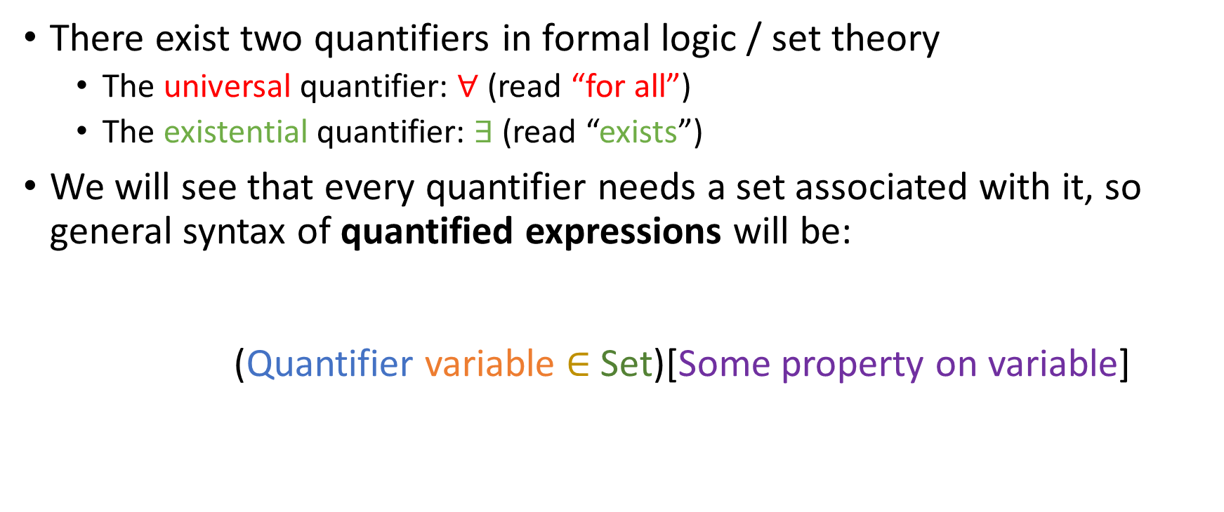
Existential / universal quantifier
There exist two quantifiers in formal logic / set theory
The universal quantifier: $∀$ (read “for all”)
The existential quantifier: $∃$ (read “exists”)
We will see that every quantifier needs a set associated with it, so general syntax of quantified expressions will be: (Quantifier variable $∈$ Set)[Some property on variable]

Slide 5


“There exists” $(∃)$
Examples:
$(∃x∈ ℝ)$ [$8x=1]$

Slide 6

“There exists” $(∃)$
Examples:
$(∃x∈ ℝ)$ [$8x=1]$ True

Slide 7

“There exists” $(∃)$
Examples:
$(∃x∈ ℝ)$ [$8x=1]$ True
$\left(∃n∈ℤ\right)[n^{2}=−1]$

Slide 8

“There exists” $(∃)$
Examples:
$(∃x∈ ℝ)$ [$8x=1]$ True
$\left(∃n∈ℤ\right)[n^{2}=−1]$ False

Slide 9

“There exists” $(∃)$
Examples:
$(∃x∈ ℝ)$ [$8x=1]$ True
$\left(∃n∈ℤ\right)[n^{2}=−1]$ False
Is there a domain D where $\left(∃n∈D\right)[n^{2}=−1]$ is true?
Yes
No
Something else

Slide 10
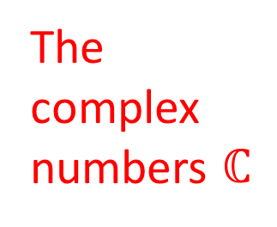
“There exists” $(∃)$
Examples:
$(∃x∈ ℝ)$ [$8x=1]$ True
$\left(∃n∈ℤ\right)[n^{2}=−1]$ False
Is there a domain D where $\left(∃n∈D\right)[n^{2}=−1]$ is true?
The complex numbers $ℂ$
Yes
No
Something else

Slide 11

“For all”
The symbol $∀$ (LaTeX: \forall) is read “for all”.
Examples:
($∀x∈ℕ) [(\left(x>2\right)∧\left(x is prime\right))⇒(x is odd)]$

Slide 12

“For all”
The symbol $∀$ (LaTeX: \forall) is read “for all”.
Examples:
($∀x∈ℕ) [(\left(x>2\right)∧\left(x is prime\right))⇒(x is odd)]$ True

Slide 13
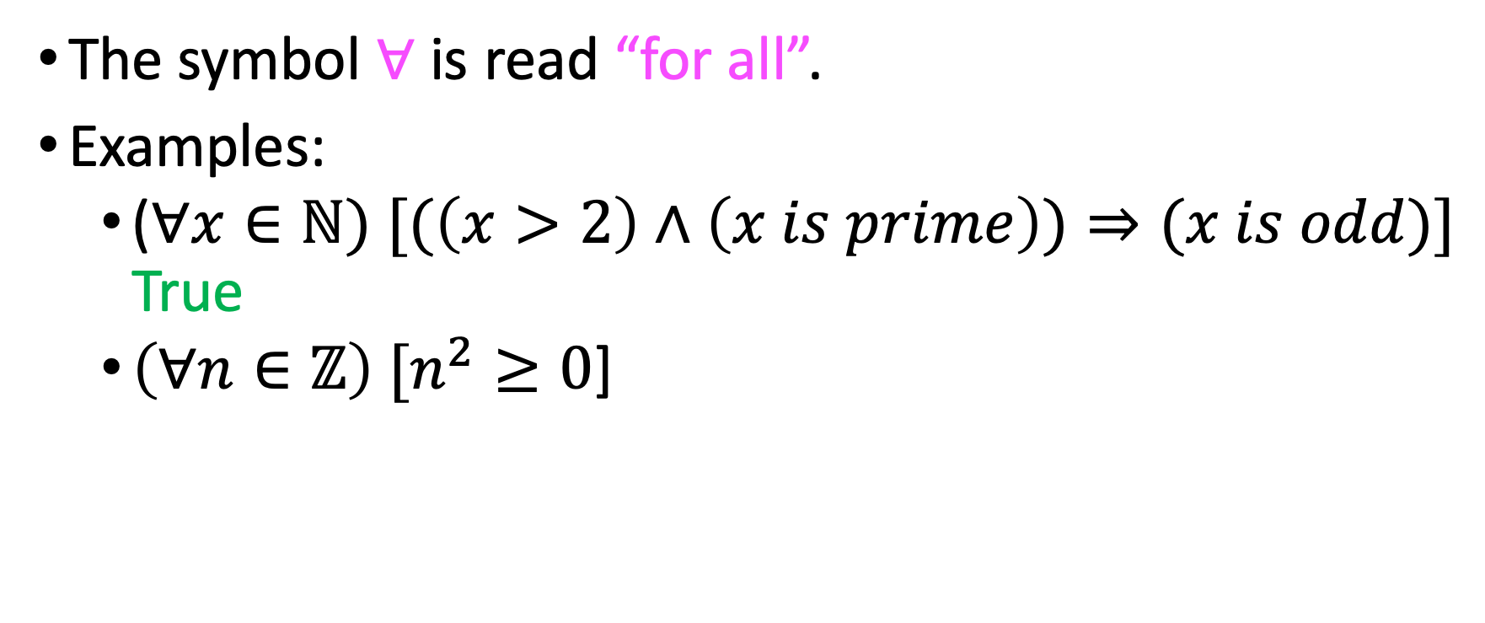
“For all”
The symbol $∀$ is read “for all”.
Examples:
($∀x∈ℕ) [(\left(x>2\right)∧\left(x is prime\right))⇒(x is odd)]$ True
$\left(∀n∈ℤ\right) [n^{2}≥0$]

Slide 14
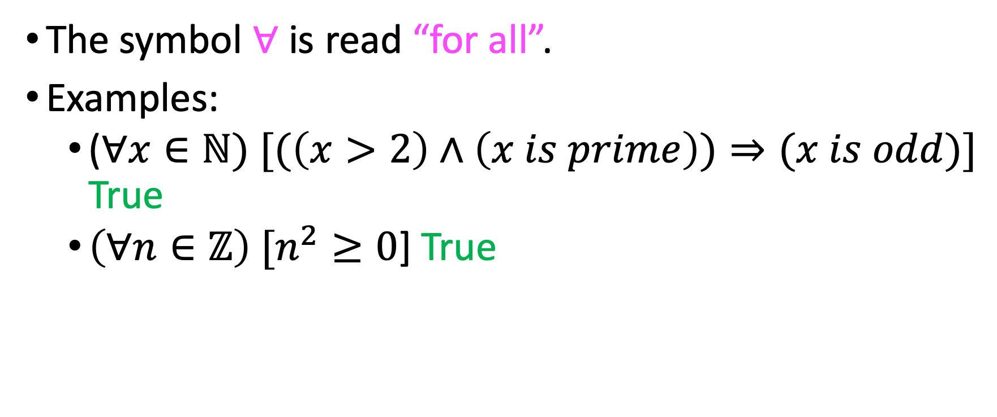
“For all”
The symbol $∀$ is read “for all”.
Examples:
($∀x∈ℕ) [(\left(x>2\right)∧\left(x is prime\right))⇒(x is odd)]$ True
$\left(∀n∈ℤ\right) [n^{2}≥0$] True

Slide 15

“For all”
Let D be the set of all students in this class who are over 8 feet tall.
$\left(∀x∈D\right)[x has perfect attendance so far!]$
True
False
Something else

Slide 16
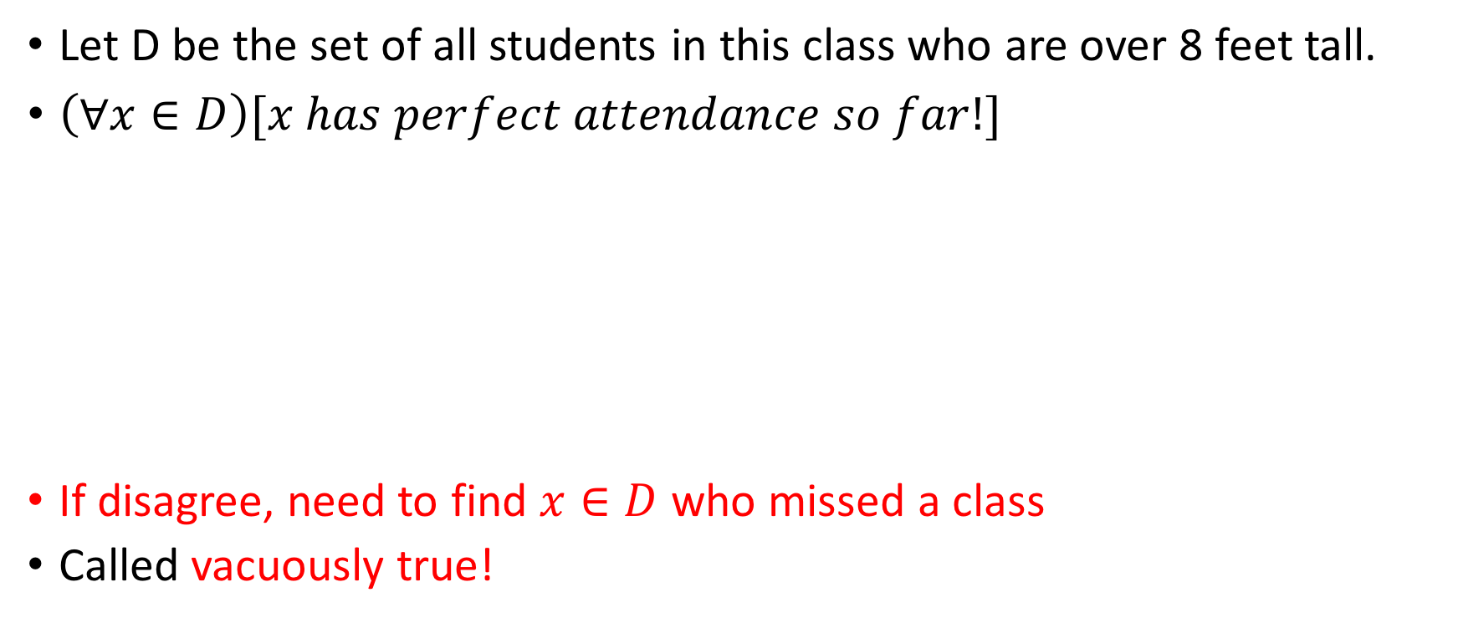
“For all”
Let D be the set of all students in this class who are over 8 feet tall.
$\left(∀x∈D\right)[x has perfect attendance so far!]$
If disagree, need to find $x∈D$ who missed a class
Called vacuously true!
True
False
Something else

Slide 17

Nesting quantifiers
$\left(∃x∈ℕ\right)\left(∃y∈ℕ\right)[x+2y=3x+y=4]$

Slide 18

Nesting quantifiers
$\left(∃x∈ℕ\right)\left(∃y∈ℕ\right)\left[x+2y=3x+y=4\right]$ False

Slide 19

Nesting quantifiers
$\left(∃x∈ℕ\right)\left(∃y∈ℕ\right)\left[x+2y=3x+y=4\right]$ False
$\left(∃x∈ℚ\right)\left(∃y∈ℚ\right)\left[x+2y=3x+y=4\right]$

Slide 20

Nesting quantifiers
$\left(∃x∈ℕ\right)\left(∃y∈ℕ\right)\left[x+2y=3x+y=4\right]$ False
$\left(∃x∈ℚ\right)\left(∃y∈ℚ\right)\left[x+2y=3x+y=4\right]$
True, $x= \frac{4}{5}, y=\frac{8}{5}$

Slide 21
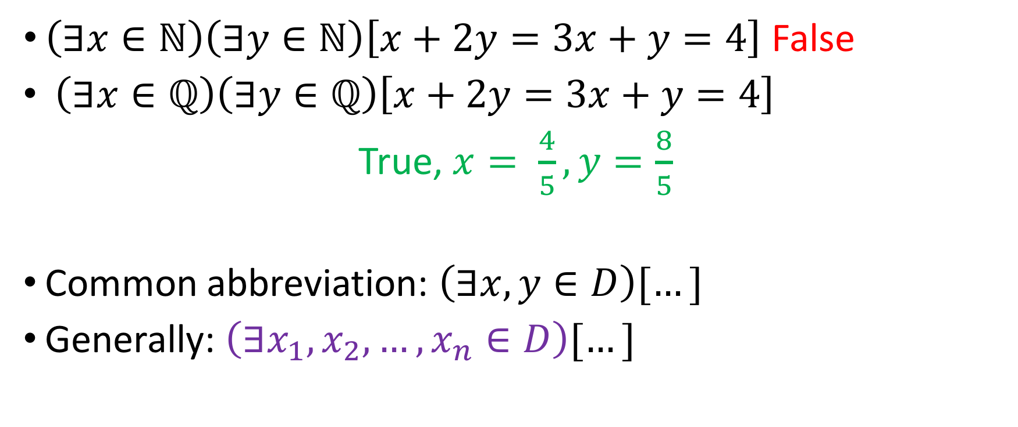
Nesting quantifiers
$\left(∃x∈ℕ\right)\left(∃y∈ℕ\right)\left[x+2y=3x+y=4\right]$ False
$\left(∃x∈ℚ\right)\left(∃y∈ℚ\right)\left[x+2y=3x+y=4\right]$
True, $x= \frac{4}{5}, y=\frac{8}{5}$
Common abbreviation: $\left(∃x,y∈D\right)[…]$
Generally: $\left(∃x_{1},x_{2}, …, x_{n}∈D\right)[…]$

Slide 22

Alternating nested quantifiers
Notice the differences between the following:
$\left(∀x∈ℕ\right)\left(∃y∈ℕ\right)[x<y]$
$\left(∃x∈ℕ\right)\left(∀y∈ℕ\right)[x<y]$

Slide 23
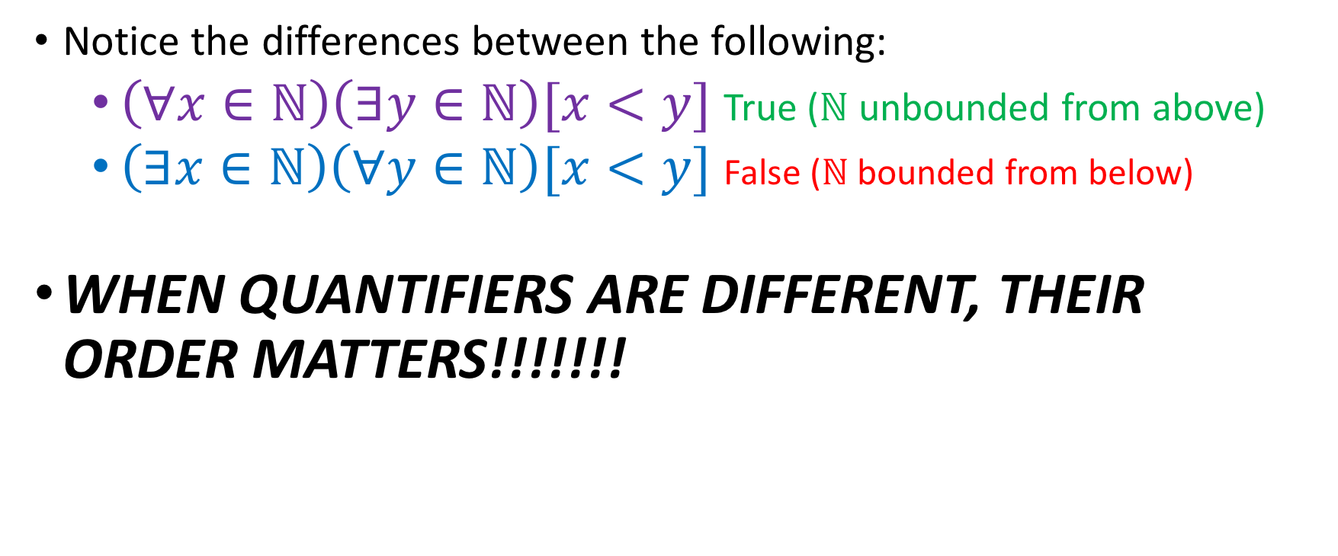
Alternating nested quantifiers
Notice the differences between the following:
$\left(∀x∈ℕ\right)\left(∃y∈ℕ\right)[x<y]$ True ($ℕ$ unbounded from above)
$\left(∃x∈ℕ\right)\left(∀y∈ℕ\right)[x<y]$ False ($ℕ$ bounded from below)
WHEN QUANTIFIERS ARE DIFFERENT, THEIR ORDER MATTERS!!!!!!!

Slide 24
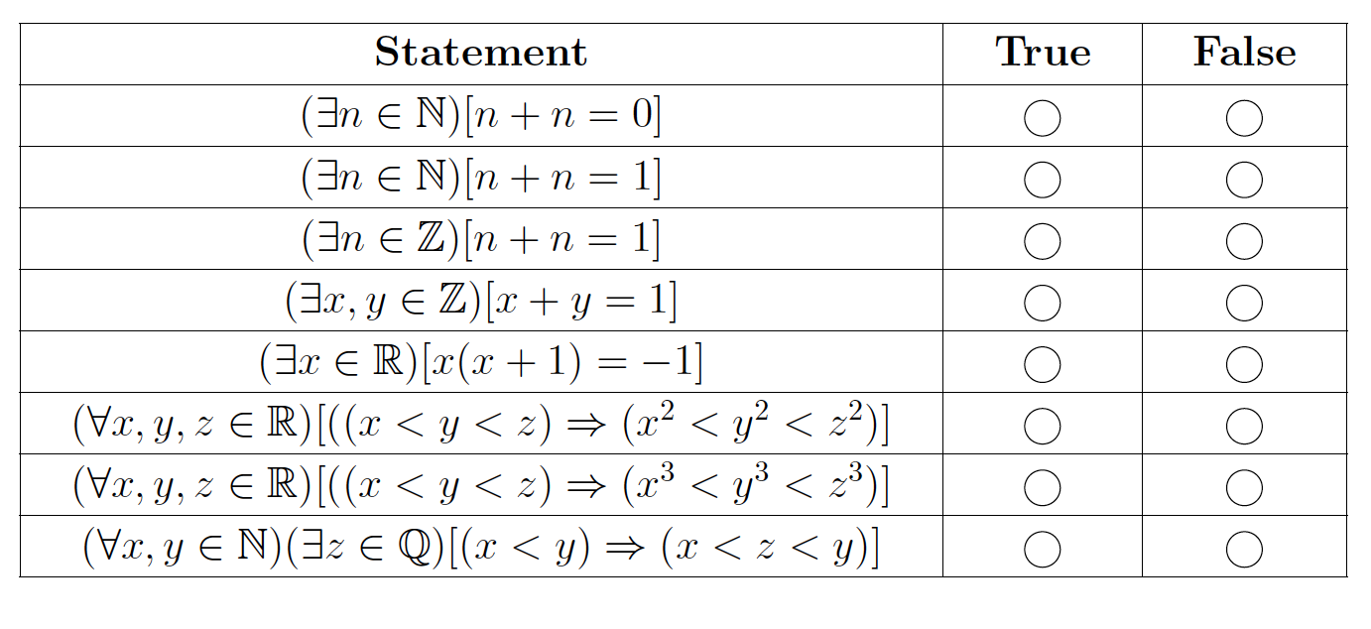
Fill this in!

Slide 25

Finding domains
Give infinite sets D such that $\left(∀x∈D\right)\left(∃y∈D\right)[x<y]$
Is true

Slide 26

Finding domains
Give infinite sets D such that $\left(∀x∈D\right)\left(∃y∈D\right)[x<y]$
Is true ($D=ℕ,$ select $y=x+1$)

Slide 27

Finding domains
Give infinite sets D such that $\left(∀x∈D\right)\left(∃y∈D\right)[x<y]$
Is true ($D=ℕ,$ select $y=x+1$)
Is false

Slide 28

Finding domains
Give infinite sets D such that $\left(∀x∈D\right)\left(∃y∈D\right)[x<y]$
Is true ($D=ℕ,$ select $y=x+1$)
Is false ($D=ℤ^{≤0}$, counter-example is 0)

Slide 29
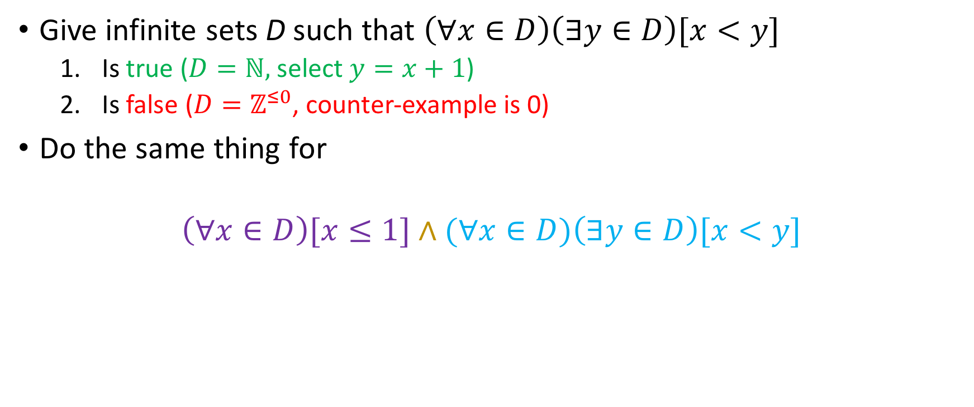
Finding domains
Give infinite sets D such that $\left(∀x∈D\right)\left(∃y∈D\right)[x<y]$
Is true ($D=ℕ,$ select $y=x+1$)
Is false ($D=ℤ^{≤0}$, counter-example is 0)
Do the same thing for
$$\left(∀x∈D\right)[x≤1]∧(∀x∈D)\left(∃y∈D\right)[x<y]$$

Slide 30
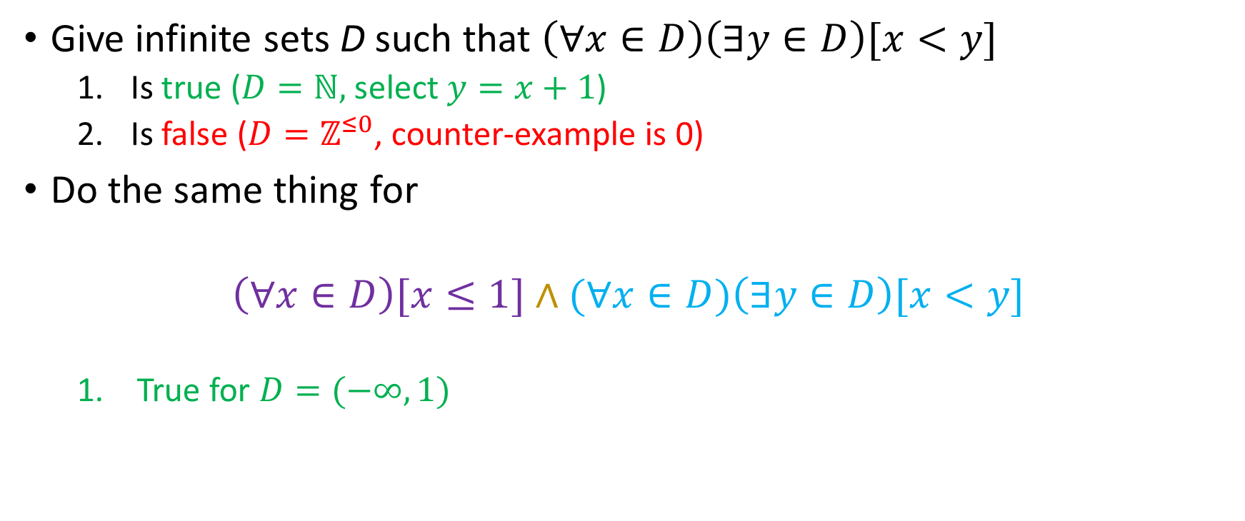
Finding domains
Give infinite sets D such that $\left(∀x∈D\right)\left(∃y∈D\right)[x<y]$
Is true ($D=ℕ,$ select $y=x+1$)
Is false ($D=ℤ^{≤0}$, counter-example is 0)
Do the same thing for
$$\left(∀x∈D\right)[x≤1]∧(∀x∈D)\left(∃y∈D\right)[x<y]$$
True for $D=(−∞, 1)$

Slide 31
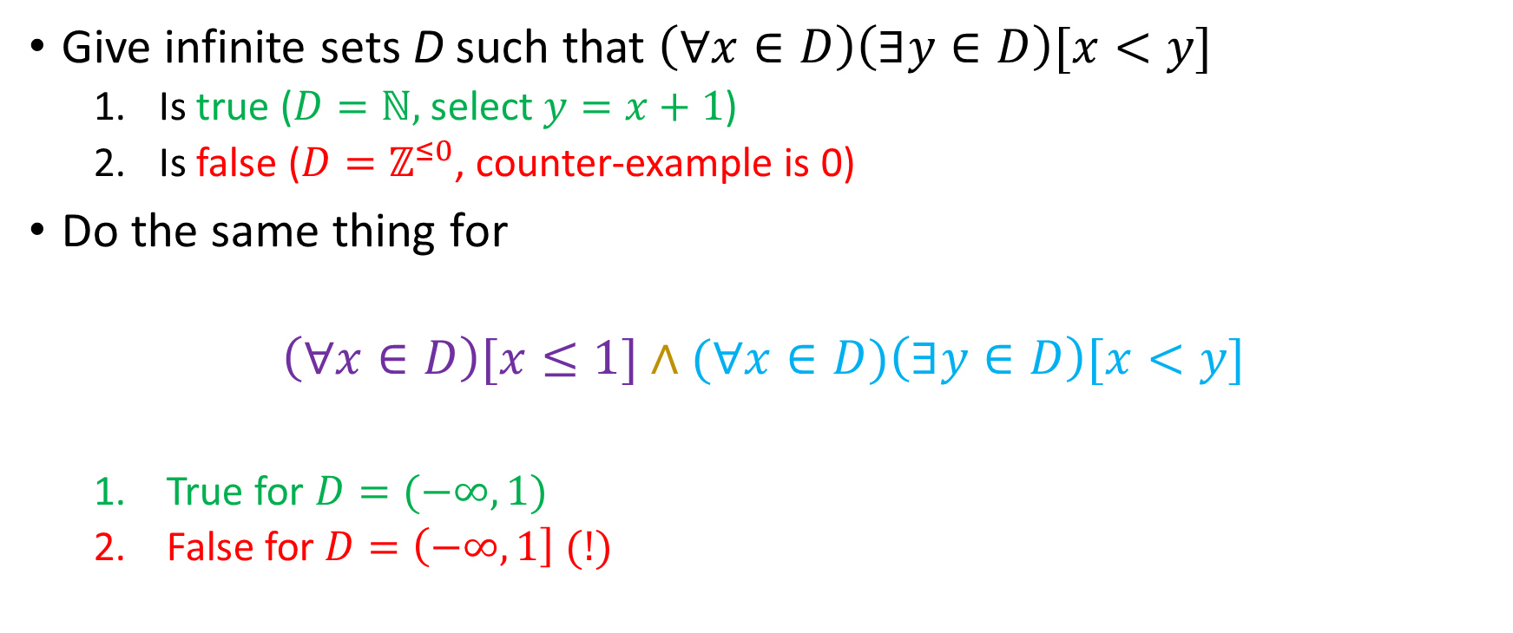
Finding domains
Give infinite sets D such that $\left(∀x∈D\right)\left(∃y∈D\right)[x<y]$
Is true ($D=ℕ,$ select $y=x+1$)
Is false ($D=ℤ^{≤0}$, counter-example is 0)
Do the same thing for
$$\left(∀x∈D\right)[x≤1]∧(∀x∈D)\left(∃y∈D\right)[x<y]$$
True for $D=(−∞, 1)$
False for $D=\left(−∞, 1\right] (!)$

Slide 32
Negated Quantifiers
It is not the case that Alice comes to all office hours.
There is an office hour that Alice does not come to.
Logically Equivalent
Not Logically Equivalent
Something else (what?)

Slide 33
Negated Quantifiers
It is not the case that Alice comes to all office hours.
There is an office hour that Alice does not come to.
Logically Equivalent
Not Logically Equivalent
Something else (what?)

Slide 34
Negated Quantifiers
We can therefore reach the following logical equivalences:
$$∼\left(∀x∈D\right)\left[P\left(x\right)\right]≡(∃x∈D)[\sim P\left(x\right)]$$
$$\sim \left(∃x∈D\right)\left[P\left(x\right)\right]≡(∀x∈D)[\sim P\left(x\right)]$$

Slide 35

Negating nested quantifiers
Observe how we can negate
$$\left(∀x∈D\right)[(∃y∈D)[x<y]]$$

Slide 36

Negating nested quantifiers
Observe how we can negate
$$\left(∀x∈D\right)[(∃y∈D)[x<y]]$$
$$∼\left(∀x∈D\right)\left[\left(∃y∈D\right)\left[x<y\right]\right]≡$$

Slide 37

Negating nested quantifiers
Observe how we can negate
$$\left(∀x∈D\right)[(∃y∈D)[x<y]]$$
$$∼\left(∀x∈D\right)\left[\left(∃y∈D\right)\left[x<y\right]\right]≡$$
$$\left(∃x∈D\right)\left[∼\left(∃y∈D\right)\left[x<y\right]\right]≡$$

Slide 38
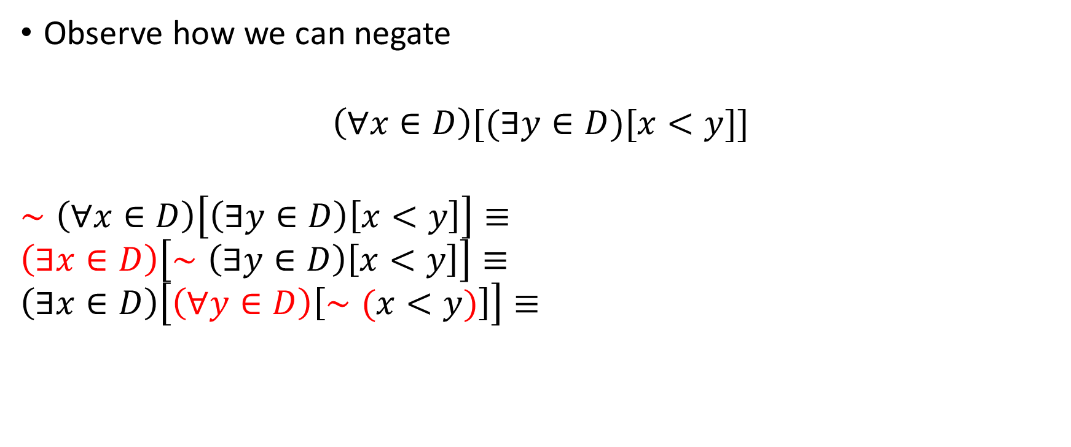
Negating nested quantifiers
Observe how we can negate
$$\left(∀x∈D\right)[(∃y∈D)[x<y]]$$
$$∼\left(∀x∈D\right)\left[\left(∃y∈D\right)\left[x<y\right]\right]≡$$
$$\left(∃x∈D\right)\left[∼\left(∃y∈D\right)\left[x<y\right]\right]≡ \\ \left(∃x∈D\right)\left[\left(∀y∈D\right)\left[∼(x<y)\right]\right]≡$$

Slide 39
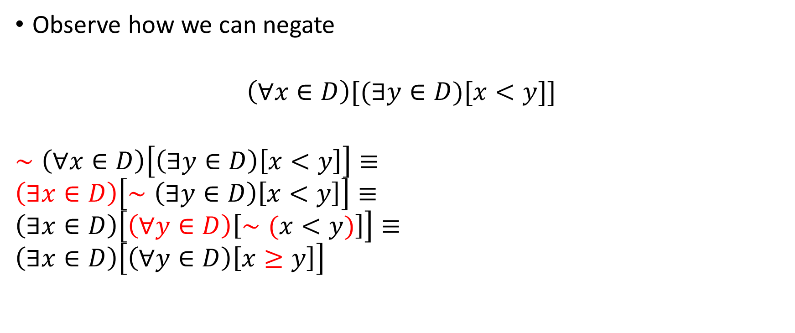
Negating nested quantifiers
Observe how we can negate
$$\left(∀x∈D\right)[(∃y∈D)[x<y]]$$
$$∼\left(∀x∈D\right)\left[\left(∃y∈D\right)\left[x<y\right]\right]≡$$
$$\left(∃x∈D\right)\left[∼\left(∃y∈D\right)\left[x<y\right]\right]≡ \\ \left(∃x∈D\right)\left[\left(∀y∈D\right)\left[∼(x<y)\right]\right]≡$$
$$\left(∃x∈D\right)\left[\left(∀y∈D\right)\left[x≥y\right]\right]$$
Notes:
Verbally tell the students that the negation of arithmetic statements is an arithmetic statement

Slide 40
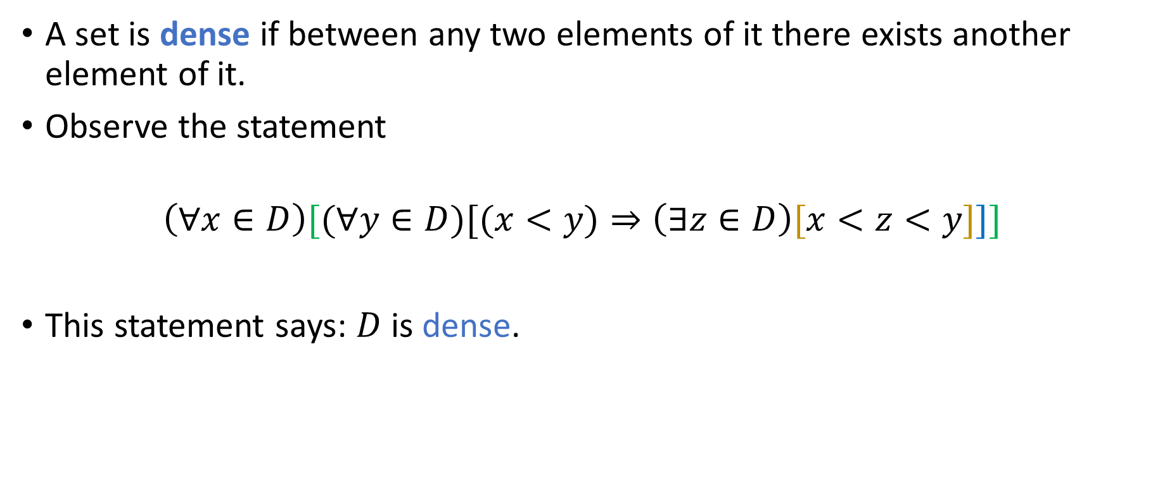
Another example
A set is dense if between any two elements of it there exists another element of it.
Observe the statement
$$\left(∀x∈D\right)[(∀y∈D)[(x<y)⇒\left(∃z∈D\right)[x<z<y]]]$$
This statement says: $D$ is dense.
Notes:
Verbally tell the students that the negation of arithmetic statements is an arithmetic statement

Slide 41

Another example
Observe the statement
$$\left(∀x∈D\right)[(∀y∈D)[(x<y)⇒\left(∃z∈D\right)[x<z<y]]]$$
Give a D where the statement is true.
Give a D where the statement is false.
Negate the statement.
Notes:
Verbally tell the students that the negation of arithmetic statements is an arithmetic statement

Slide 42

Another example
Observe the statement
$$\left(∀x∈D\right)[(∀y∈D)[(x<y)⇒\left(∃z∈D\right)[x<z<y]]]$$
Give a D where the statement is true.
Give a D where the statement is false
Negate the statement
Answers:
Notes:
Verbally tell the students that the negation of arithmetic statements is an arithmetic statement

Slide 43

Another example
Observe the statement
$$\left(∀x∈D\right)[(∀y∈D)[(x<y)⇒\left(∃z∈D\right)[x<z<y]]]$$
Give a D where the statement is true.
Give a D where the statement is false
Negate the statement
Answers:
$D=ℝ$
Notes:
Verbally tell the students that the negation of arithmetic statements is an arithmetic statement

Slide 44

Another example
Observe the statement
$$\left(∀x∈D\right)[(∀y∈D)[(x<y)⇒\left(∃z∈D\right)[x<z<y]]]$$
Give a D where the statement is true.
Give a D where the statement is false
Negate the statement
Answers:
$D=ℝ$
$D= ℕ$
Notes:
Verbally tell the students that the negation of arithmetic statements is an arithmetic statement

Slide 45

Another example
Observe the statement
$$\left(∀x∈D\right)[(∀y∈D)[(x<y)⇒\left(∃z∈D\right)[x<z<y]]]$$
Give a D where the statement is true.
Give a D where the statement is false
Negate the statement
Answers:
$D=ℝ$
$D= ℕ$
(See next slide)
Notes:
Verbally tell the students that the negation of arithmetic statements is an arithmetic statement

Slide 46

Negating the statement
$$∼\left(∀x∈D\right)\left[\left(∀y∈D\right)\left[(x<y)⇒\left(∃z∈D\right)\left[x<z<y\right]\right]\right]≡$$

Slide 47

Negating the statement
$$∼\left(∀x∈D\right)\left[\left(∀y∈D\right)\left[(x<y)⇒\left(∃z∈D\right)\left[x<z<y\right]\right]\right]≡ \\ \left(∃x∈D\right)∼\left[\left(∀y∈D\right)\left[(x<y)⇒\left(∃z∈D\right)\left[x<z<y\right]\right]\right]$$

Slide 48

Negating the statement
$$∼\left(∀x∈D\right)\left[\left(∀y∈D\right)\left[(x<y)⇒\left(∃z∈D\right)\left[x<z<y\right]\right]\right]≡ \\ \left(∃x∈D\right)∼\left[\left(∀y∈D\right)\left[(x<y)⇒\left(∃z∈D\right)\left[x<z<y\right]\right]\right]≡\left(∃x∈D\right)\left[\left(∃y∈D\right)∼\left[(x<y)⇒\left(∃z∈D\right)\left[x<z<y\right]\right]\right]$$

Slide 49
Negating the statement
$$∼\left(∀x∈D\right)\left[\left(∀y∈D\right)\left[(x<y)⇒\left(∃z∈D\right)\left[x<z<y\right]\right]\right]≡ \\ \left(∃x∈D\right)∼\left[\left(∀y∈D\right)\left[(x<y)⇒\left(∃z∈D\right)\left[x<z<y\right]\right]\right]≡\left(∃x∈D\right)\left[\left(∃y∈D\right)∼\left[(x<y)⇒\left(∃z∈D\right)\left[x<z<y\right]\right]\right]$$
How do we negate an implication?

Slide 50
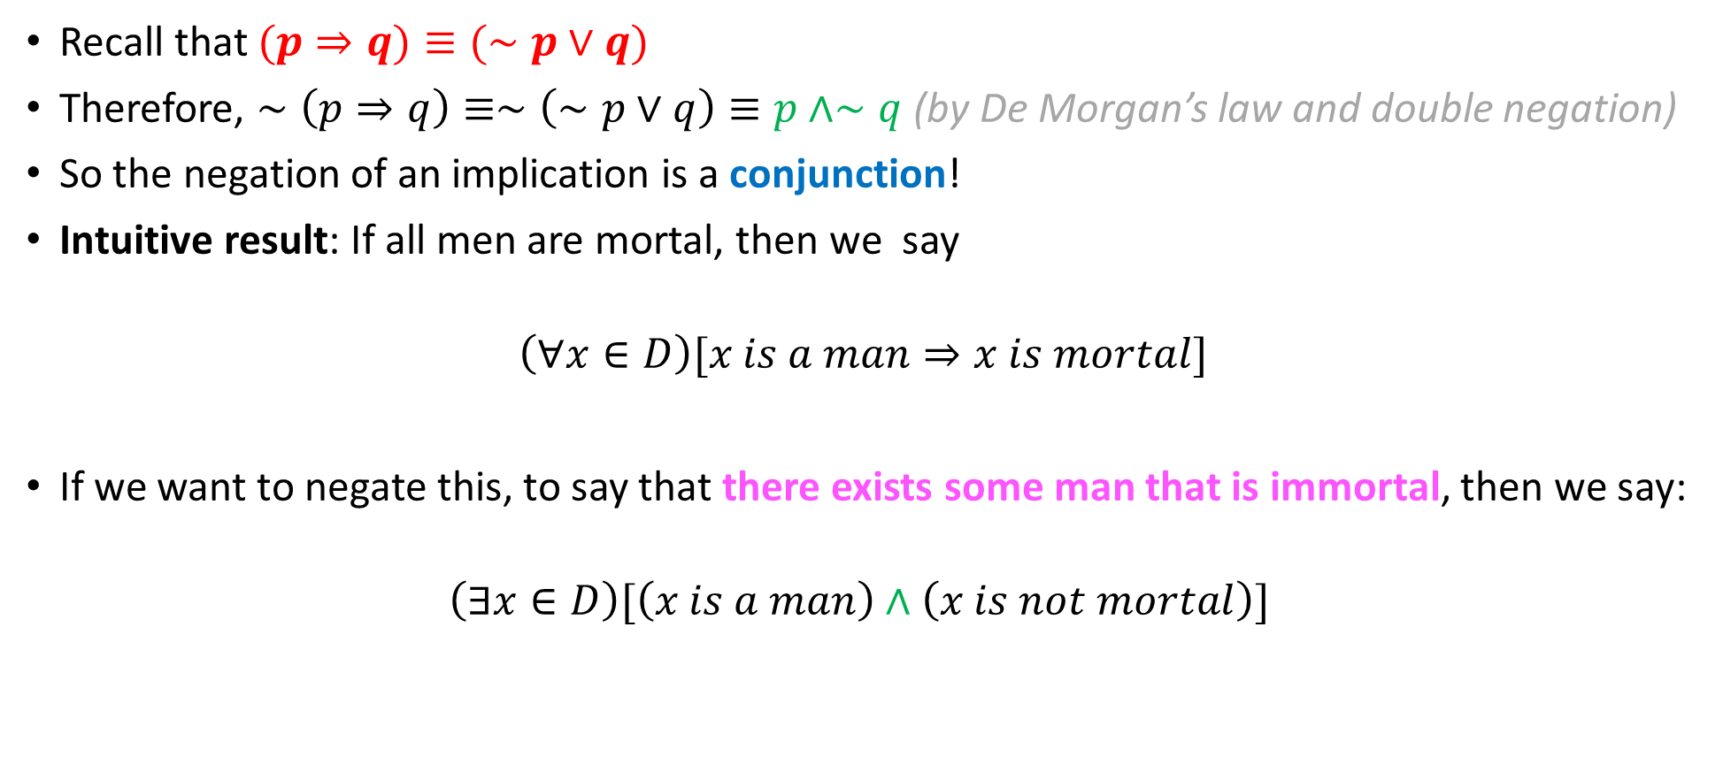
Negating implications
Recall that $(p⇒q)≡(∼p∨q)$
Therefore, $∼\left(p⇒q\right)≡∼\left(∼p∨q\right)≡p∧∼q$ (by De Morgan’s law and double negation)
So the negation of an implication is a conjunction!
Intuitive result: If all men are mortal, then we say
$$\left(∀x∈D\right)[x is a man⇒x is mortal]$$
If we want to negate this, to say that there exists some man that is immortal, then we say:
$$\left(∃x∈D\right)[\left(x is a man\right)∧\left(x is not mortal\right)]$$
AND!

Slide 51

Back to our example
$$∼\left(∀x∈D\right)\left[\left(∀y∈D\right)\left[(x<y)⇒\left(∃z∈D\right)\left[x<z<y\right]\right]\right]≡$$
$$\left(∃x∈D\right)∼\left[\left(∀y∈D\right)\left[(x<y)⇒\left(∃z∈D\right)\left[x<z<y\right]\right]\right]≡$$
$$\left(∃x∈D\right)\left[\left(∃y∈D\right)∼\left[(x<y)⇒\left(∃z∈D\right)\left[x<z<y\right]\right]\right]$$

Slide 52

Back to our example
$$∼\left(∀x∈D\right)\left[\left(∀y∈D\right)\left[(x<y)⇒\left(∃z∈D\right)\left[x<z<y\right]\right]\right]≡$$
$$\left(∃x∈D\right)∼\left[\left(∀y∈D\right)\left[(x<y)⇒\left(∃z∈D\right)\left[x<z<y\right]\right]\right]≡$$
$$\left(∃x∈D\right)\left[\left(∃y∈D\right)∼\left[(x<y)⇒\left(∃z∈D\right)\left[x<z<y\right]\right]\right]≡$$
$$\left(∃x∈D\right)\left[\left(∃y∈D\right)\left[(x<y)∧(∼\left(∃z∈D\right)\left[x<z<y\right])\right]\right]≡$$

Slide 53
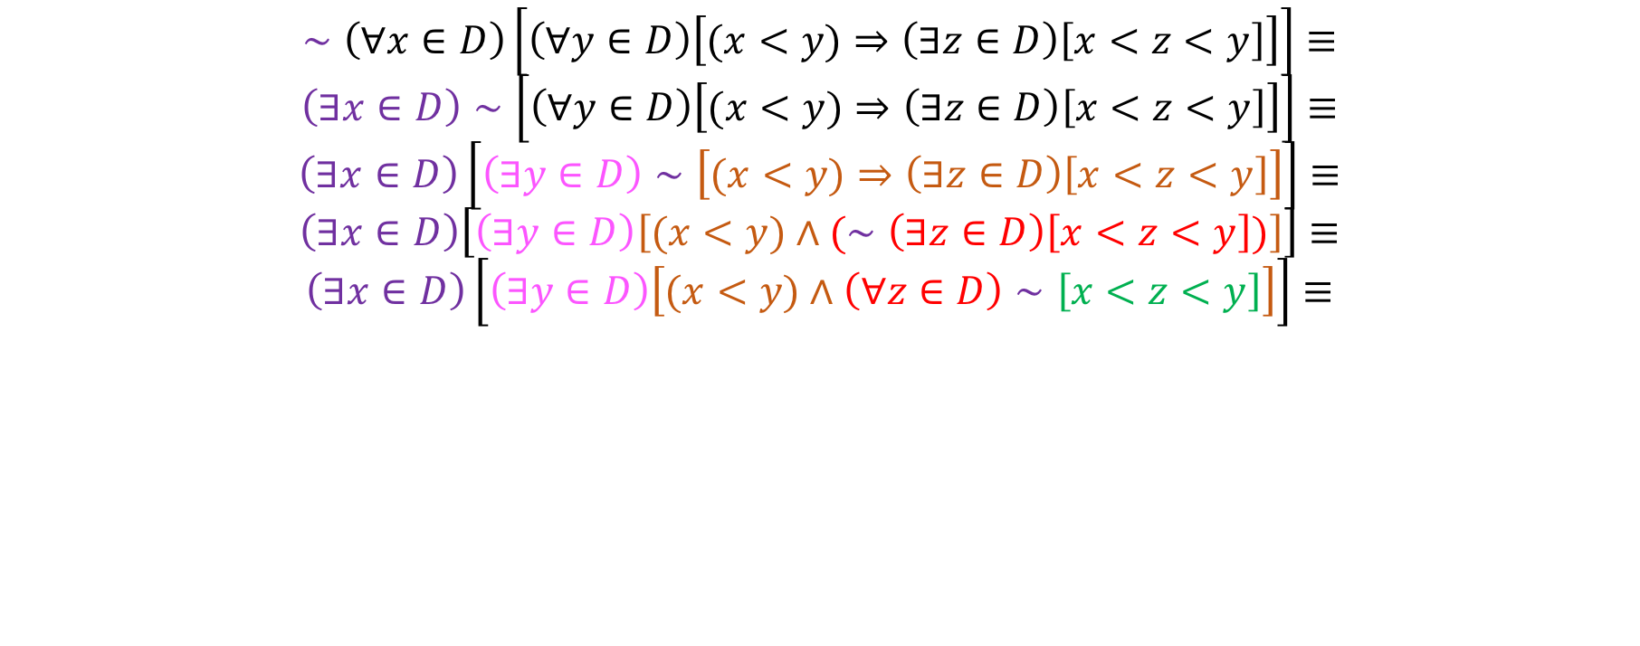
Back to our example
$$∼\left(∀x∈D\right)\left[\left(∀y∈D\right)\left[(x<y)⇒\left(∃z∈D\right)\left[x<z<y\right]\right]\right]≡$$
$$\left(∃x∈D\right)∼\left[\left(∀y∈D\right)\left[(x<y)⇒\left(∃z∈D\right)\left[x<z<y\right]\right]\right]≡$$
$$\left(∃x∈D\right)\left[\left(∃y∈D\right)∼\left[(x<y)⇒\left(∃z∈D\right)\left[x<z<y\right]\right]\right]≡$$
$$\left(∃x∈D\right)\left[\left(∃y∈D\right)\left[(x<y)∧(∼\left(∃z∈D\right)\left[x<z<y\right])\right]\right]≡$$
$$\left(∃x∈D\right)\left[\left(∃y∈D\right)\left[(x<y)∧\left(∀z∈D\right)∼\left[x<z<y\right]\right]\right]≡$$

Slide 54
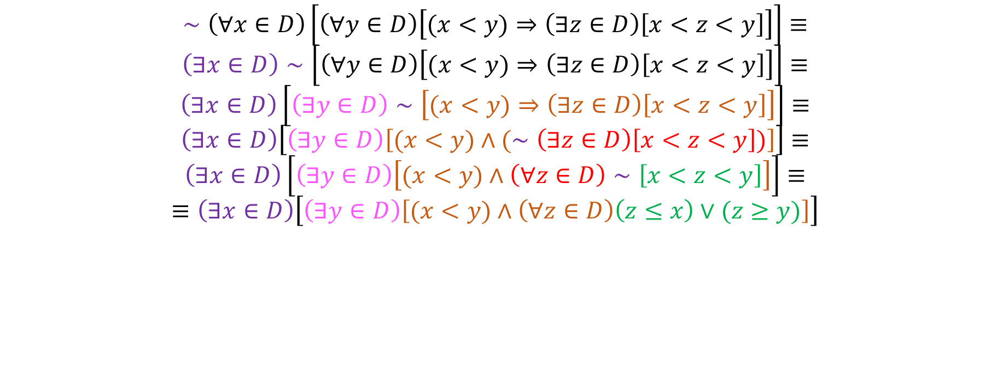
Back to our example
$$∼\left(∀x∈D\right)\left[\left(∀y∈D\right)\left[(x<y)⇒\left(∃z∈D\right)\left[x<z<y\right]\right]\right]≡$$
$$\left(∃x∈D\right)∼\left[\left(∀y∈D\right)\left[(x<y)⇒\left(∃z∈D\right)\left[x<z<y\right]\right]\right]≡$$
$$\left(∃x∈D\right)\left[\left(∃y∈D\right)∼\left[(x<y)⇒\left(∃z∈D\right)\left[x<z<y\right]\right]\right]≡$$
$$\left(∃x∈D\right)\left[\left(∃y∈D\right)\left[(x<y)∧(∼\left(∃z∈D\right)\left[x<z<y\right])\right]\right]≡$$
$$\left(∃x∈D\right)\left[\left(∃y∈D\right)\left[(x<y)∧\left(∀z∈D\right)∼\left[x<z<y\right]\right]\right]≡$$
$$≡\left(∃x∈D\right)\left[\left(∃y∈D\right)\left[(x<y)∧\left(∀z∈D\right)\left(z≤x\right)∨(z≥y)\right]\right]$$
Notes:
Tell the students that we are now negation symbol-free and we like that.

