Slide 1
Set Theory
CMSC250

Slide 2

What is a set?
A set is a collection of distinct objects.
We use the notation $x∈S$ to say that S contains x.
We’d like to know if $x∈S$ fast!
Unless explicitly specified otherwise, sets are unordered.
S
x

Slide 3
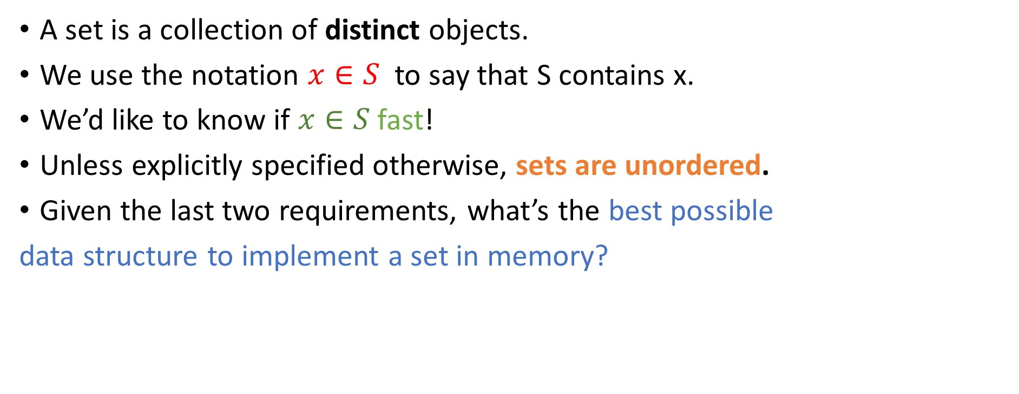
What is a set?
A set is a collection of distinct objects.
We use the notation $x∈S$ to say that S contains x.
We’d like to know if $x∈S$ fast!
Unless explicitly specified otherwise, sets are unordered.
Given the last two requirements, what’s the best possible
data structure to implement a set in memory?
S
x
Doubly Linked List
Binary Tree
Stack
Something else (what?)

Slide 4
What is a set?
A set is a collection of distinct objects.
We use the notation $x∈S$ to say that S contains x.
We’d like to know if $x∈S$ fast!
Unless explicitly specified otherwise, sets are unordered.
Given the last two requirements, what’s the best possible
data structure to implement a set in memory?
S
x
Doubly Linked List
Binary Tree
Stack
Something else (what?)
Hash table!

Slide 5
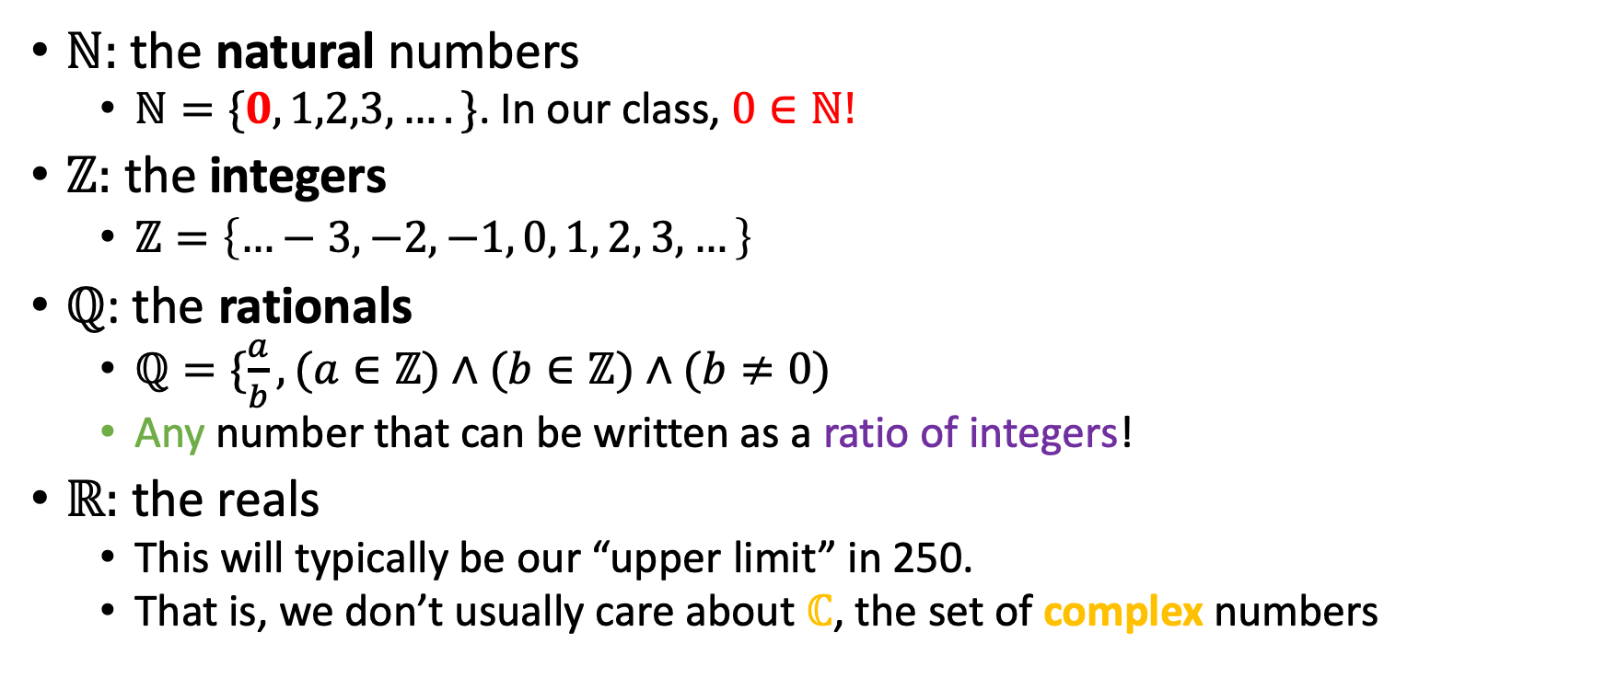
Elementary number sets
$ℕ:$ the natural numbers
$ℕ=\{0,1,2,3,….\}$. In our class, $0∈ℕ!$
$ℤ:$ the integers
$ℤ=\left\{…−3, −2, −1, 0, 1, 2, 3,…\right\}$
$ℚ$: the rationals
$ℚ=\{\frac{a}{b}, (a∈ℤ)∧(b∈ℤ)∧(b≠0)$
Any number that can be written as a ratio of integers!
$ℝ:$ the reals
This will typically be our “upper limit” in 250.
That is, we don’t usually care about $ℂ$, the set of complex numbers

Slide 6
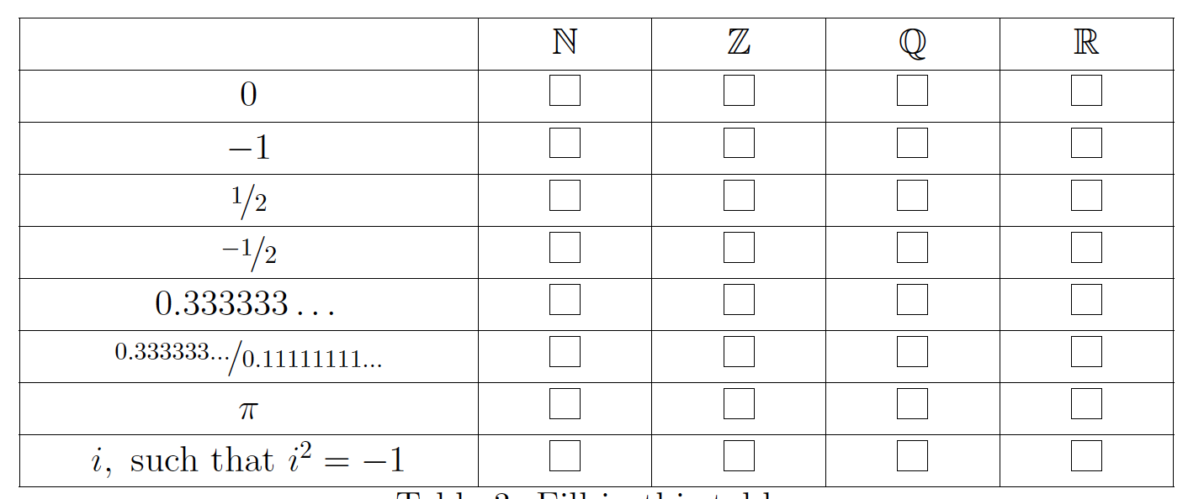
Fill those in!

Slide 7
Venn Diagrams
U
U
A
B
A
B
C
U
A
B
C

Slide 8
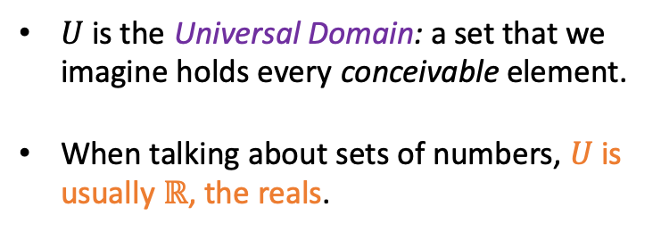
Venn Diagrams
U
U
A
B
A
B
C
U
$U$ is the Universal Domain: a set that we imagine holds every conceivable element.
When talking about sets of numbers, $U$ is usually $ℝ$, the reals.
A
B
C

Slide 9
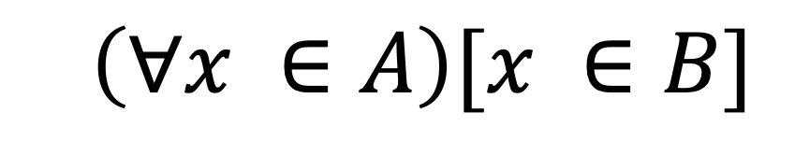

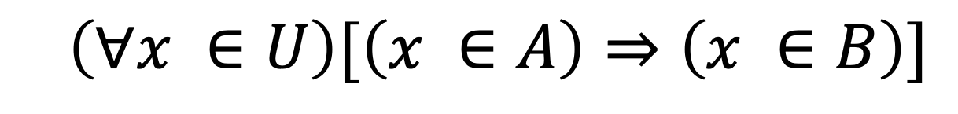

Subset
We say that $A$ is a subset of $B$ $(A ⊆B)$ iff
U
$$\left(∀x ∈A\right)[x ∈B]$$
B
A
$$⇔$$
$$\left(∀x ∈U\right)[\left(x ∈A\right)⇒\left(x ∈B\right)]$$

Slide 10

Superset and proper subset/superset
We say that $B$ is a superset of $A$ $(B⊇A)$ iff $A ⊆B.$
We say that $A$ is a proper subset of $B$ $(A⊂B)$ iff $(A ⊆B)∧(A≠B)$.
We say that $B$ is a proper superset of $A$ $(B⊃A)$ iff $A⊂B$
U
B
A

Slide 11

Union
$$A ∪B=\{\left(x ∈A\right)∨\left(x ∈B\right)\}$$
U
A
B

Slide 12
Union
$$A ∪B=\{\left(x ∈A\right)∨\left(x ∈B\right)\}$$
U
Connection between union and logical disjunction!
A
B

Slide 13

Intersection
$$A ∩B=\{\left(x ∈A\right)∧\left(x ∈B\right)\}$$
U
A
B

Slide 14

Absolute complement
$$A^{c}= \left\{\left(x ∉A\right)\right\}=\left\{\left(x ∈U\right)∧(\sim \left(x ∈ A\right))\right\}$$
U
A

Slide 15
Absolute complement
$$A^{c}= \left\{\left(x ∉A\right)\right\}=\left\{\left(x ∈U\right)∧(\sim \left(x ∈ A\right))\right\}$$
U
Connection between absolute complement and logical negation!
A

Slide 16
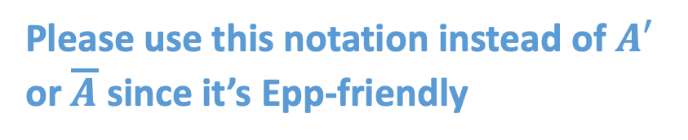
Absolute complement
$$A^{c}= \left\{\left(x ∉A\right)\right\}=\left\{\left(x ∈U\right)∧(\sim \left(x ∈ A\right))\right\}$$
Please use this notation instead of $A′$ or $\overline{A}$ since it’s Epp-friendly
U
Connection between absolute complement and logical negation!
A

Slide 17

Relative Complement
$$A−B=\{\left(x ∈A\right)∧(x∉B)\}$$
U
A
B

Slide 18
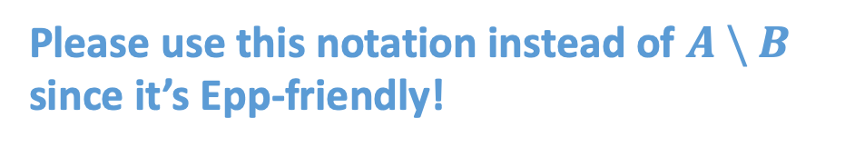
Relative Complement
$$A−B=\{\left(x ∈A\right)∧(x∉B)\}$$
U
A
B
Please use this notation instead of $A \backslash B$ since it’s Epp-friendly!

Slide 19
Careful about membership and subset!
Be careful to distinguish between members of a set and subsets of a set…
True
False

Slide 20

Careful about membership and subset!
Be careful to distinguish between members of a set and subsets of a set…
$1∈\{−2, 0, 1, 3\}$
True
False

Slide 21

Careful about membership and subset!
Be careful to distinguish between members of a set and subsets of a set…
$1∈\{−2, 0, 1, 3\}$ T
$1∈\{−2, 0, \{1\}, 3\}$
True
False

Slide 22

Careful about membership and subset!
Be careful to distinguish between members of a set and subsets of a set…
$1∈\{−2, 0, 1, 3\}$ T
$1∈\{−2, 0, \{1\}, 3\}$ F
$1⊆\{−2, 0, \{1\}, 3\}$
True
False

Slide 23
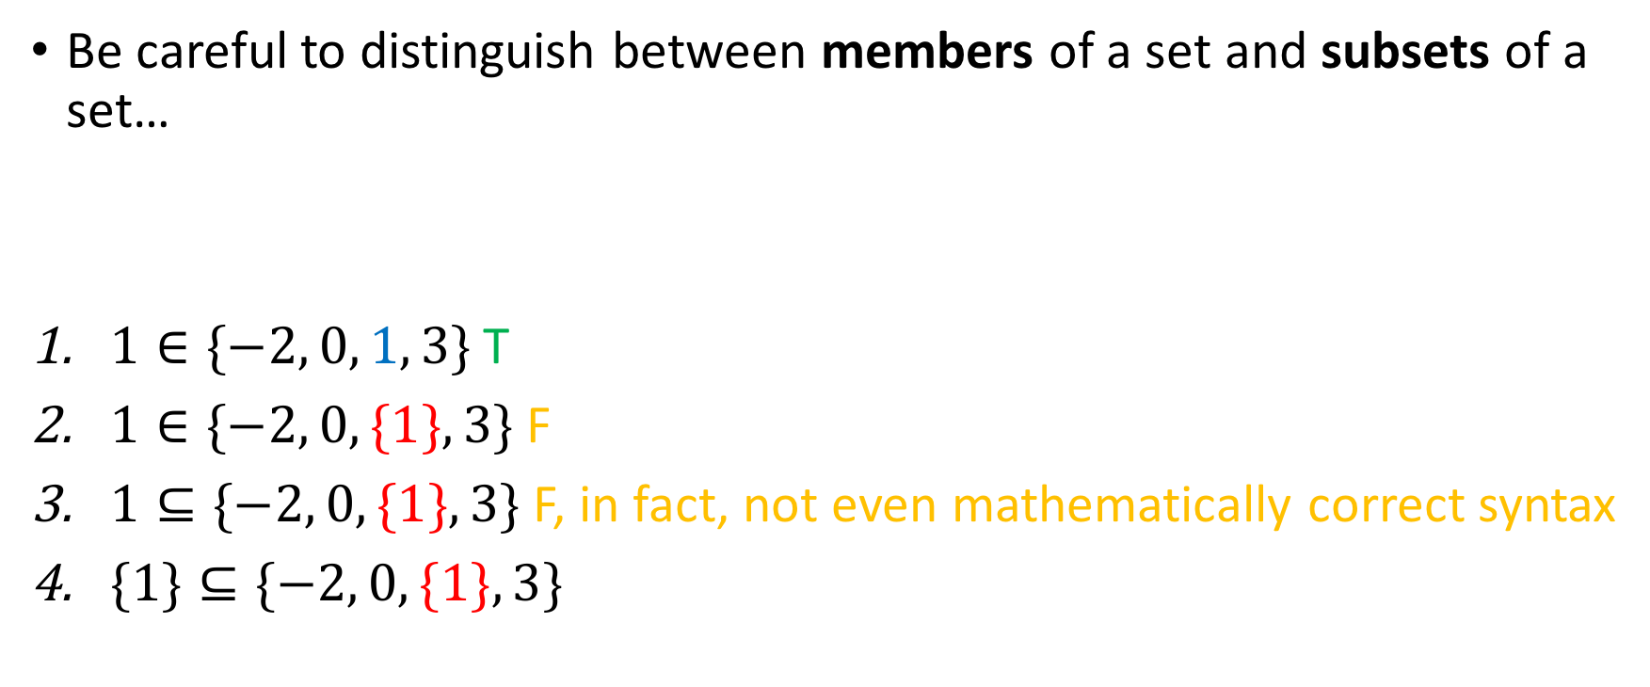
Careful about membership and subset!
Be careful to distinguish between members of a set and subsets of a set…
$1∈\{−2, 0, 1, 3\}$ T
$1∈\{−2, 0, \{1\}, 3\}$ F
$1⊆\{−2, 0, \{1\}, 3\}$ F, in fact, not even mathematically correct syntax
$\{1\}⊆\{−2, 0, \{1\}, 3\}$
True
False

Slide 24
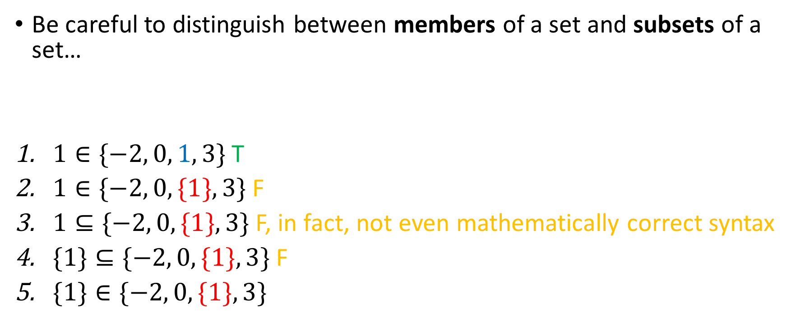
Careful about membership and subset!
Be careful to distinguish between members of a set and subsets of a set…
$1∈\{−2, 0, 1, 3\}$ T
$1∈\{−2, 0, \{1\}, 3\}$ F
$1⊆\{−2, 0, \{1\}, 3\}$ F, in fact, not even mathematically correct syntax
$\{1\}⊆\{−2, 0, \{1\}, 3\} \text{F}$
$\{1\}∈\{−2, 0, \{1\}, 3\}$
True
False

Slide 25
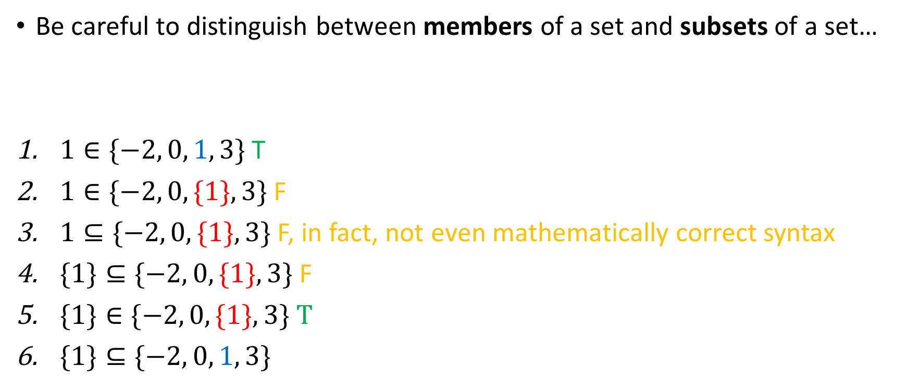
Careful about membership and subset!
Be careful to distinguish between members of a set and subsets of a set…
$1∈\{−2, 0, 1, 3\}$ T
$1∈\{−2, 0, \{1\}, 3\}$ F
$1⊆\{−2, 0, \{1\}, 3\}$ F, in fact, not even mathematically correct syntax
$\{1\}⊆\{−2, 0, \{1\}, 3\} \text{F}$
$\{1\}∈\{−2, 0, \{1\}, 3\} T$
$\{1\}⊆\{−2, 0, 1, 3\}$
True
False

Slide 26
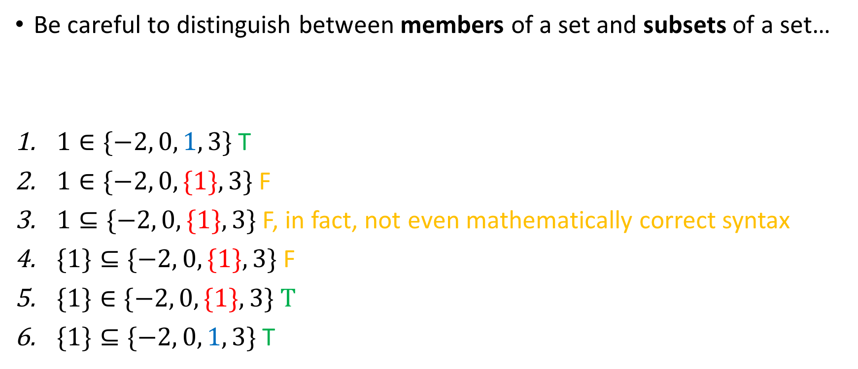
Careful about membership and subset!
Be careful to distinguish between members of a set and subsets of a set…
$1∈\{−2, 0, 1, 3\}$ T
$1∈\{−2, 0, \{1\}, 3\}$ F
$1⊆\{−2, 0, \{1\}, 3\}$ F, in fact, not even mathematically correct syntax
$\{1\}⊆\{−2, 0, \{1\}, 3\} \text{F}$
$\{1\}∈\{−2, 0, \{1\}, 3\} T$
$\{1\}⊆\{−2, 0, 1, 3\}$ T
True
False

Slide 27


The empty set ($∅, \{ \}$)
The empty set, denoted either $∅$ or { }, is the unique set with no elements.
Uniqueness can be proven, through a proof by contradiction!

Slide 28
The empty set ($∅, \{ \}$)
The empty set, denoted either $∅$ or { }, is the unique set with no elements.
Uniqueness can be proven, through a proof by contradiction!
True
False

Slide 29
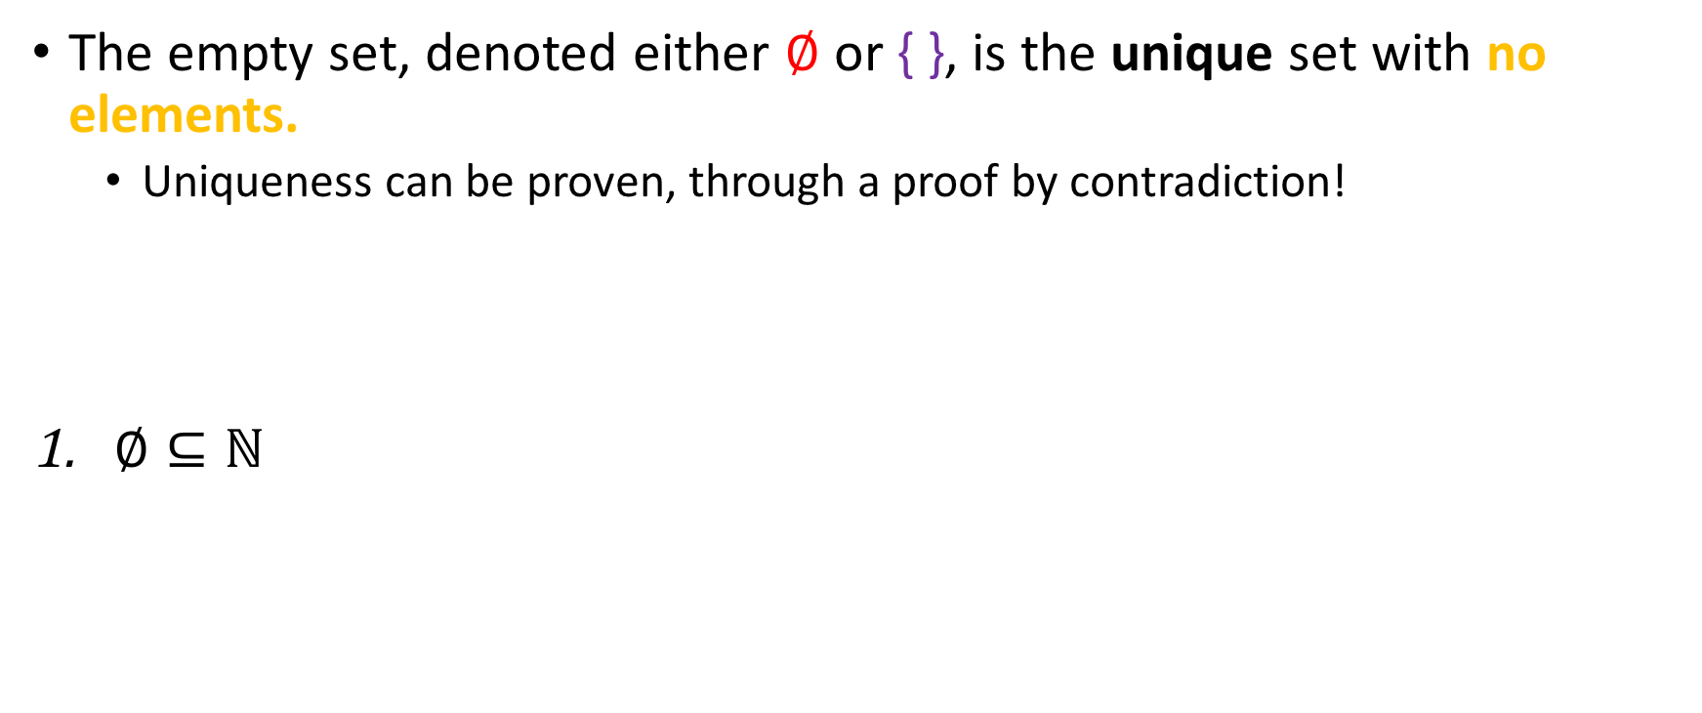
The empty set ($∅, \{ \}$)
The empty set, denoted either $∅$ or { }, is the unique set with no elements.
Uniqueness can be proven, through a proof by contradiction!
$∅⊆ℕ$
True
False

Slide 30
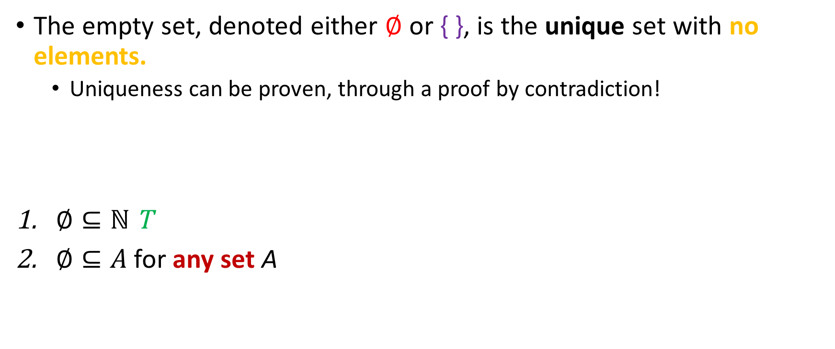
The empty set ($∅, \{ \}$)
The empty set, denoted either $∅$ or { }, is the unique set with no elements.
Uniqueness can be proven, through a proof by contradiction!
$∅⊆ℕ$ T
$∅⊆A$ for any set A
True
False

Slide 31
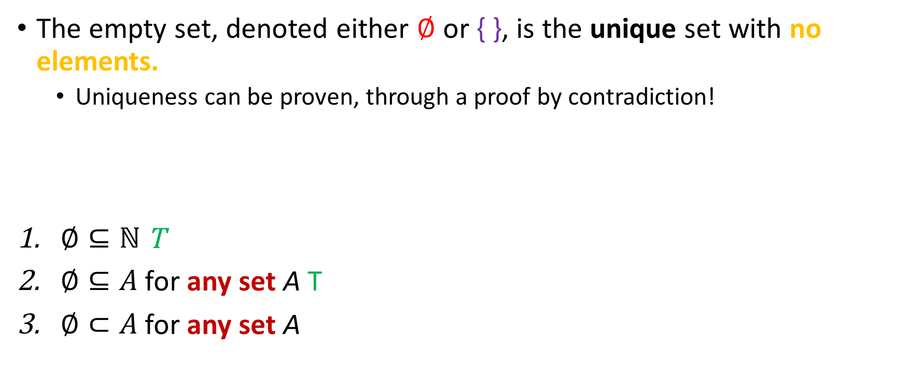
The empty set ($∅, \{ \}$)
The empty set, denoted either $∅$ or { }, is the unique set with no elements.
Uniqueness can be proven, through a proof by contradiction!
$∅⊆ℕ$ T
$∅⊆A$ for any set A T
$∅⊂A$ for any set A
True
False

Slide 32
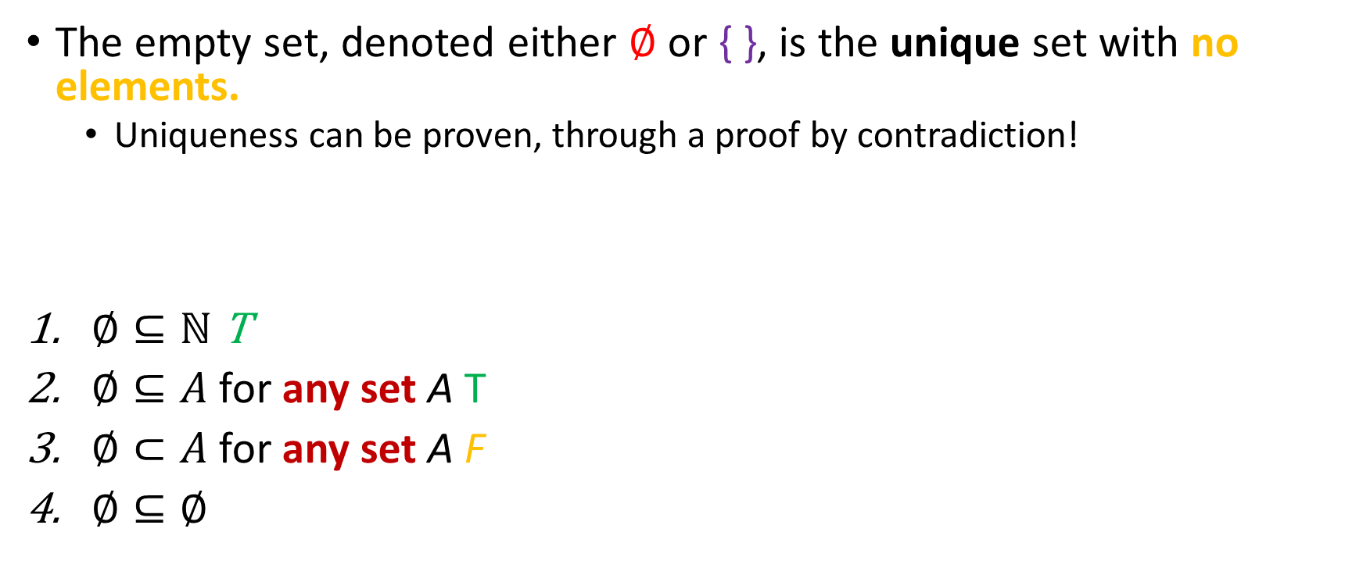
The empty set ($∅, \{ \}$)
The empty set, denoted either $∅$ or { }, is the unique set with no elements.
Uniqueness can be proven, through a proof by contradiction!
$∅⊆ℕ$ T
$∅⊆A$ for any set A T
$∅⊂A$ for any set A F
$∅⊆∅$
True
False

Slide 33
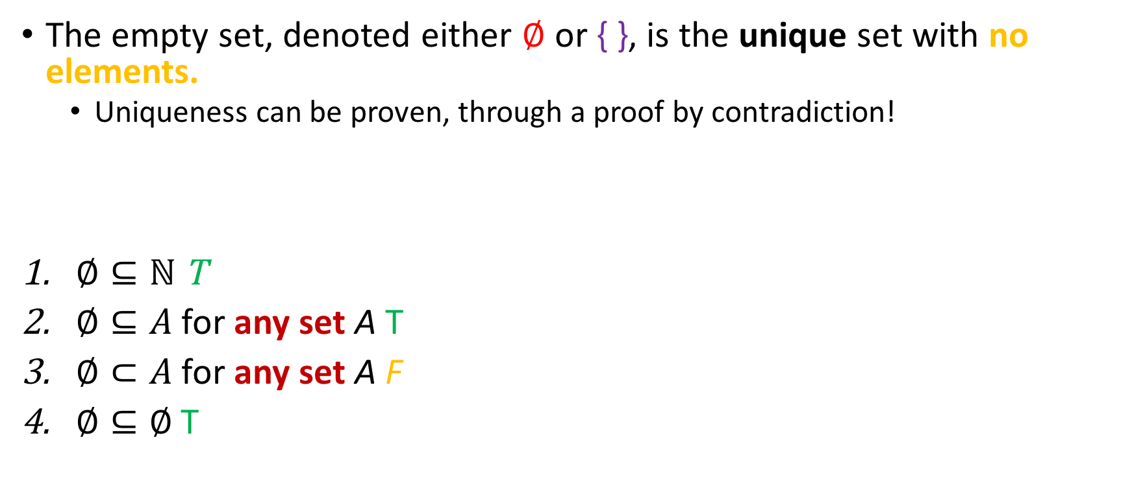
The empty set ($∅, \{ \}$)
The empty set, denoted either $∅$ or { }, is the unique set with no elements.
Uniqueness can be proven, through a proof by contradiction!
$∅⊆ℕ$ T
$∅⊆A$ for any set A T
$∅⊂A$ for any set A F
$∅⊆∅$ T
True
False

Slide 34

The empty set ($∅, \{ \}$)
The empty set, denoted either $∅$ or { }, is the unique set with no elements.
Uniqueness can be proven, through a proof by contradiction!
$∅⊆ℕ$ T
$∅⊆A$ for any set A T
$∅⊂A$ for any set A F
$∅⊆∅$ T
True
False

Slide 35
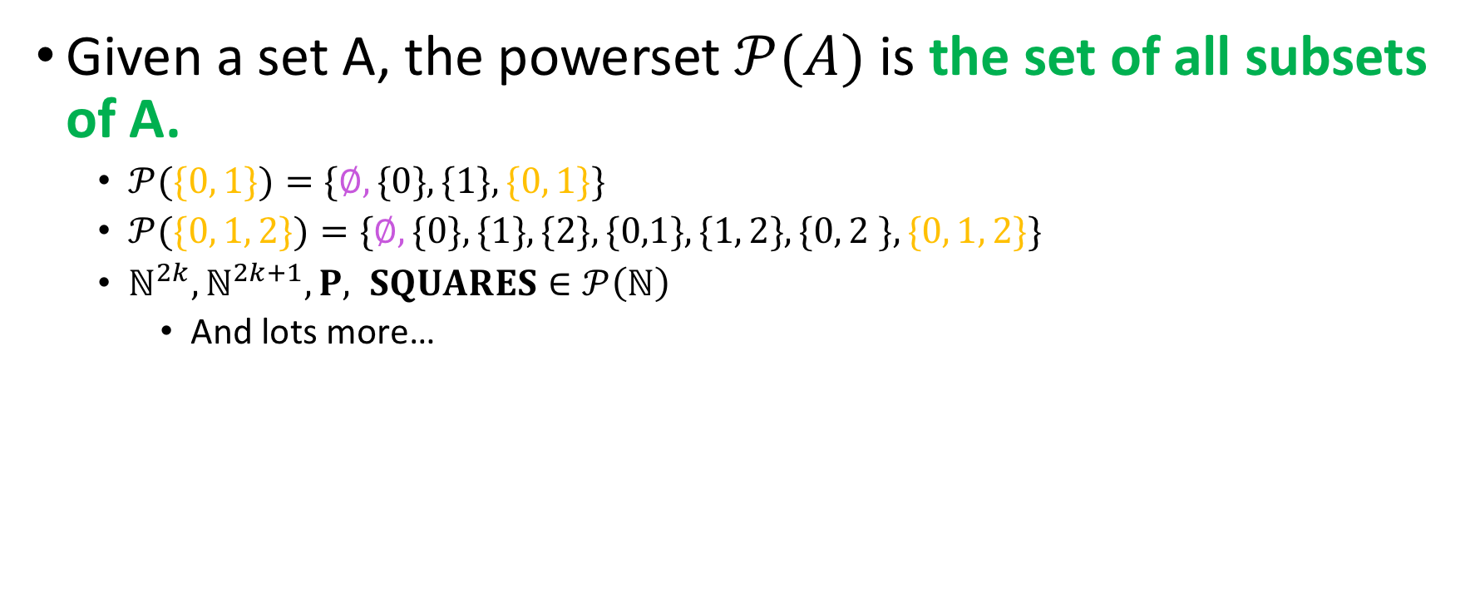
The powerset
Given a set A, the powerset $𝒫(A)$ is the set of all subsets of A.
$𝒫(\{0, 1\})=\{∅, \{0\}, \{1\}, \{0, 1\}\}$
$𝒫(\{0, 1, 2\})=\{∅, \{0\}, \{1\}, \{2\}, \{0,1\}, \{1, 2\}, \{0, 2 \}, \{0, 1, 2\}\}$
$ℕ^{2k}, ℕ^{2k+1}, P, SQUARES∈𝒫\left(ℕ\right)$
And lots more…

Slide 36

Facts about the powerset
The following are facts about the powerset:
Since $∅⊆A$ for all sets $A$, $∅∈$ $𝒫$(A) for all sets A
Since $A⊆A$ for all sets $A$, $A∈$ $𝒫$(A) for all sets A

Slide 37
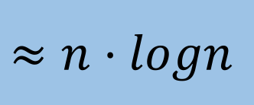

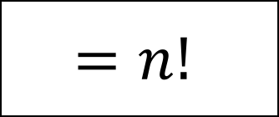
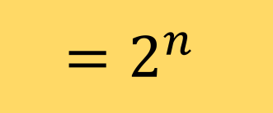
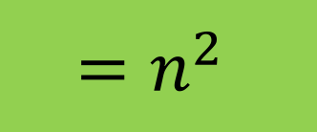
Powerset quizzing
Let $A= \{1, 2, …, n\}$
Then, $\left|P\left(A\right)\right|$
$$≈n⋅logn$$
$$=n^{2}$$
$$=2^{n}$$
$$=n!$$

Slide 38
Powerset quizzing
Let $A= \{1, 2, …, n\}$
Then, $\left|P\left(A\right)\right|$
$$≈n⋅logn$$
$$=n^{2}$$
$$=2^{n}$$
$$=n!$$

Slide 39

Powerset quizzing
$P(\{1\})=$

Slide 40

Powerset quizzing
$P(\{1\})= \{∅, \{1\}\}$
$P\left(P\left(\{1 \right\}\right))=$

Slide 41

Powerset quizzing
$P(\{1\})= \{∅, \{1\}\}$
$P\left(P\left(\{1 \right\}\right))=\{∅, \{∅\}, \{\{1\}\}, \{∅, \{1\}\}\}$
$P\left(∅\right)=$

Slide 42

Powerset quizzing
$P(\{1\})= \{∅, \{1\}\}$
$P\left(P\left(\{1 \right\}\right))=\{∅, \{∅\}, \{\{1\}\}, \{∅, \{1\}\}\}$
$P\left(∅\right)=\{∅\}$
$P(\{∅\})=$

Slide 43

Powerset quizzing
$P(\{1\})= \{∅, \{1\}\}$
$P\left(P\left(\{1 \right\}\right))=\{∅, \{∅\}, \{\{1\}\}, \{∅, \{1\}\}\}$
$P\left(∅\right)=\{∅\}$
$P(\{∅\})=\{∅, \{∅\}\}$

