Slide 1
2-3 trees
CMSC 420

Slide 2
Maintain the pros, kill the cons
Is there any way we can maintain mission-critical logarithmic worst-case complexity for search, while simultaneously shedding the storage cost and rotation overhead of AVL Trees?

Slide 3
Maintain the pros, kill the cons
Is there any way we can maintain mission-critical logarithmic worst-case complexity for search, while simultaneously shedding the storage cost and rotation overhead of AVL Trees?
Yup! Three solutions:
2-3 (“two-three”) trees (usually implemented via Red-Black Binary Search Trees (RBBSTs))
B-Trees (short, fat)
SkipLists

Slide 4
Maintain the pros, kill the cons
Today, we examine the simplest B-tree, known as a 2-3 tree
When done, we will discuss an interesting alternative implementation of it as an RBBST.

Slide 5
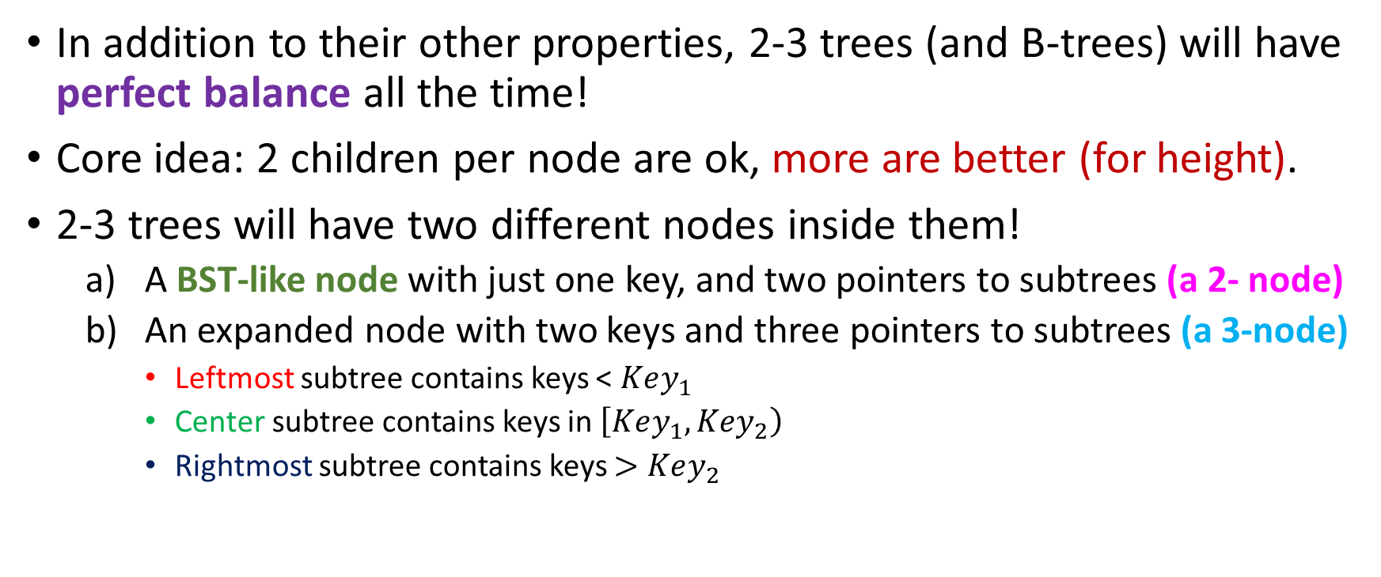
2-3 Trees
In addition to their other properties, 2-3 trees (and B-trees) will have perfect balance all the time!
Core idea: 2 children per node are ok, more are better (for height).
2-3 trees will have two different nodes inside them!
A BST-like node with just one key, and two pointers to subtrees (a 2- node)
An expanded node with two keys and three pointers to subtrees (a 3-node)
Leftmost subtree contains keys < $Key_{1}$
Center subtree contains keys in $\left[Key_{1}, Key_{2}\right)$
Rightmost subtree contains keys $>Key_{2}$

Slide 6
2-3 Tree example
30
40
10, 20
8
15
25
35
80

Slide 7
2-3 Tree example
30
3-node! ☺
40
10, 20
8
15
25
35
80

Slide 8
Search
30
40
10, 20
8
15
25
35
80
Searching a 2-3-Tree is done in exactly the same way as a BST.
Go left, between, or right!
Notes:
Make the point that 2-3 trees where keys and nodes are differentiated.

Slide 9
Insertion
Let’s recall insertion in AVL trees…
Might trigger rotations to re-balance the tree according to the AVL condition.
Tree not guaranteed to be perfect.
Only exception: Insertion places node in the only empty position at the leaves.

Slide 10
Insertion
Insertion on both of these trees has two phases…
A search phase, where we go down to search for an empty position to put the key in (if it’s not already in there), and
A rotation phase where we go up to rebalance subtrees.

Slide 11
Insertion
Insertion on both of these trees has two phases…
A search phase, where we go down to search for an empty position to put the key in (if it’s not already in there), and
A rotation phase where we go up to rebalance subtrees.
2-3 trees never rotate nodes. Never. Ever. Instead…

Slide 12
Insertion
Insertion on both of these trees has two phases…
A search phase, where we go down to search for an empty position to put the key in (if it’s not already in there), and
A rotation phase where we go up to rebalance subtrees.
2-3 trees never rotate nodes. Never. Ever. Instead…
They rotate keys…. (we will disallow this a few lectures down the road)

Slide 13
Insertion
Insertion on both of these trees has two phases…
A search phase, where we go down to search for an empty position to put the key in (if it’s not already in there), and
A rotation phase where we go up to rebalance subtrees.
2-3 trees never rotate nodes. Never. Ever. Instead…
They rotate keys…. we will disallow this a few lectures down the road)
They also sometimes make nodes fatter or slimmer…

Slide 14

Insertion
Insertion on both of these trees has two phases…
A search phase, where we go down to search for an empty position to put the key in (if it’s not already in there), and
A rotation phase where we go up to rebalance subtrees.
2-3 trees never rotate nodes. Never. Ever. Instead…
They rotate keys…. (we will disallow this a few lectures down the road)
They also sometimes make nodes fatter or slimmer…
Also, they sometimes make new nodes appear or old ones disappear

Slide 15
Insertion
Insert 18
30
40
10, 20
8
15
25
35
80

Slide 16
Insertion
Insert 18
We search first
30
40
10, 20
8
15
25
35
80

Slide 17
Insertion
Insert 18
We search first
Last node encountered
is 2-node: make it a 3-node!
30
40
10, 20
8
15, 18
25
35
80

Slide 18

Insertion
Insert 18
We search first
Last node encountered
is 2-node: make it a 3-node!
Done! ☺
30
40
10, 20
8
15, 18
25
35
80

Slide 19

Insertion
Insert 18
We search first
Last node encountered
is 2-node: make it a 3-node!
Done! ☺
But what if I now wanted to insert 17? I don’t have space for it!
30
40
10, 20
8
15, 18
25
35
80

Slide 20

Insertion: Key Rotations
30
But what if I now wanted to insert 17? I don’t have space for it!
Solution: Rotate 18 and 20 to the right to make space!
Could also rotate 15 and 10 to the left instead.
40
10, 18, 20
8
15, 18
20, 25
35
80

Slide 21
Insertion: Key Rotations
30
But what if I now wanted to insert 17? I don’t have space for it!
Solution: Rotate 18 and 20 to the right to make space!
Could also rotate 15 and 10 to the left instead.
Now the node has space for 17, so we can insert it ☺
40
10, 18
8
15, 17
20, 25
35
80

Slide 22
Insertion: Key Rotations
Let’s now insert 43 in this tree…
15, 30
40, 50
10
20, 26

Slide 23
Insertion: Key Rotations
Let’s now insert 43 in this tree…
Searching leads us to the right child…
15, 30
40, 50
10
20, 26

Slide 24
Insertion: Key Rotations
Let’s now insert 43 in this tree…
Searching leads us to the right child…
But there’s no space ☹
15, 30
40, 50
10
20, 26

Slide 25
Insertion: Key Rotations
Let’s now insert 43 in this tree…
Searching leads us to the right child…
But there’s no space ☹
My sibling’s also out of space! ☹
15, 30
40, 50
10
20, 26

Slide 26

Insertion: Key Rotations
Let’s now insert 43 in this tree…
Searching leads us to the right child…
But there’s no space ☹
My sibling’s also out of space! ☹
But my “second” sibling does!
15, 30
40, 50
10
20, 26

Slide 27
Insertion: Key Rotations
Let’s now insert 43 in this tree…
Searching leads us to the right child…
But there’s no space ☹
My sibling’s also out of space! ☹
But my “second” sibling does!
20, 40
50
10, 15
26, 30
Rotate twice!

Slide 28

Insertion: Key Rotations
Let’s now insert 43 in this tree…
Searching leads us to the right child…
But there’s no space ☹
My sibling’s also out of space! ☹
But my “second” sibling does!
20, 40
And now I have space to insert 43! ☺
43, 50
10, 15
26, 30
Rotate twice!

Slide 29
Insertion
Suppose we want to Insert 15 in this 2-3 tree…
30
40, 50
10, 20

Slide 30
Insertion
Suppose we want to Insert 15 in this 2-3 tree…
30
Searching leads us to the left child of the root…
40, 50
10, 20

Slide 31
Insertion
Suppose we want to Insert 15 in this 2-3 tree…
30
Searching leads us to the left child of the root…
Which doesn’t have space ☹
40, 50
10, 20

Slide 32
Insertion
Suppose we want to Insert 15 in this 2-3 tree…
30
Searching leads us to the left child of the root…
Which doesn’t have space ☹
40, 50
10, 20
There’s only one sibling, and it doesn’t have space either ☹

Slide 33

Insertion
Suppose we want to Insert 15 in this 2-3 tree…
30
Searching leads us to the left child of the root…
Which doesn’t have space ☹
40, 50
10, 20
There’s only one sibling, and it doesn’t have space either ☹

Slide 34
Insertion : Can’t rotate key
To understand what to do in this case, consider inserting 5 in this “stub” 2-3 tree.
1 8
x
x
x

Slide 35
Insertion : Can’t rotate key
To understand what to do in this case, consider inserting 5 in this “stub” 2-3 tree.
5
1 8
x
x
x

Slide 36
Insertion : Can’t rotate key
To understand what to do in this case, consider inserting 5 in this “stub” 2-3 tree.
1 5 8
Temporarily assume we can expand the 3-node to a 4-node!
x
x
x
x

Slide 37
Insertion : Can’t rotate key
To understand what to do in this case, consider inserting 5 in this “stub” 2-3 tree.
1 5 8
Temporarily assume we can expand the 3-node to a 4-node!
k>8
k<1
(if the links were non-null, those would be the subtrees / key ranges they would point to)
1<k<5
5<k<8

Slide 38
Insertion : Can’t rotate key
To understand what to do in this case, consider inserting 5 in this “stub” 2-3 tree.
1 5 8
Of course, this is unacceptable. Our solution:
k>8
k<1
1<k<5
5<k<8

Slide 39


Insertion : Can’t rotate key
To understand what to do in this case, consider inserting 5 in this “stub” 2-3 tree.
1 5 8
Of course, this is unacceptable. Our solution: Blow the node apart!
k>8
k<1
1<k<5
5<k<8

Slide 40

Insertion : Can’t rotate key
To understand what to do in this case, consider inserting 5 in this “stub” 2-3 tree.
1 5 8
Once the dust settles….
k>8
k<1
1<k<5
5<k<8

Slide 41

Insertion : Can’t rotate key
To understand what to do in this case, consider inserting 5 in this “stub” 2-3 tree.
5
1
8
We are left with three 2-nodes that point to the correct subtrees!
k>8
k<1
1<k<5
5<k<8

Slide 42
Insertion: Can’t rotate key
Task: Insert 15
30
40, 50
10, 20

Slide 43
Insertion: Can’t rotate key
Task: Insert 15
1. Search
30
40, 50
10, 20

Slide 44
Insertion: Can’t rotate key
Task: Insert 15
Search
Pretend
30
10, 15, 20
40, 50

Slide 45
Insertion: Can’t rotate key
Task: Insert 15
Search
Pretend
Kaboom
30
15
40, 50
10
20

Slide 46
Insertion: Can’t rotate key
Task: Insert 15
Search
Pretend
Kaboom
Merge with 2-node root, distributing children accordingly!
15, 30
40, 50
10
20

Slide 47
A more complex example
Suppose that we have the following 2-3 tree and we want to insert 15:
10, 30
40, 50
2, 5
13, 18

Slide 48
A more complex example
Suppose that we have the following 2-3 tree and we want to insert 15:
Search
10, 30
40, 50
2, 5
13, 18

Slide 49
A more complex example
Suppose that we have the following 2-3 tree and we want to insert 15:
Search
Investigate whether overflow occurs (it does in this case)
10, 30
40, 50
2, 5
13, 18

Slide 50
A more complex example
Suppose that we have the following 2-3 tree and we want to insert 15:
Search
Investigate whether overflow occurs (it does in this case)
Examine right sibling (full)
10, 30
40, 50
2, 5
13, 18

Slide 51
A more complex example
Suppose that we have the following 2-3 tree and we want to insert 15:
Search
Investigate whether overflow occurs (it does in this case)
Examine right sibling (full)
Examine left sibling (full)
10, 30
40, 50
2, 5
13, 18

Slide 52
A more complex example
Suppose that we have the following 2-3 tree and we want to insert 15:
Search
Investigate whether overflow occurs (it does in this case)
Examine right sibling (full)
Examine left sibling (full)
Temporarily pretend a 4-node is possible
10, 30
40, 50
2, 5
13, 15, 18

Slide 53
A more complex example
Suppose that we have the following 2-3 tree and we want to insert 15:
Search
Investigate whether overflow occurs (it does in this case)
Examine right sibling (full)
Examine left sibling (full)
Temporarily pretend a 4-node is possible
Split it, elevating middle key (15) to parent.
10, 15, 30
40, 50
2, 5
13
18

Slide 54
A more complex example
Suppose that we have the following 2-3 tree and we want to insert 15:
Search
Investigate whether overflow occurs (it does in this case)
Examine right sibling (full)
Examine left sibling (full)
Temporarily pretend a 4-node is possible
Split it, elevating middle key (15) to parent.
10, 15, 30
But now we have an overflow at the parent ☹
40, 50
2, 5
13
18

Slide 55

A more complex example
Suppose that we have the following 2-3 tree and we want to insert 15:
Search
Investigate whether overflow occurs (it does in this case)
Examine right sibling (full)
Examine left sibling (full)
Temporarily pretend a 4-node is possible
Split it, elevating middle key (15) to parent.
10, 15, 30
But now we have an overflow at the parent ☹
40, 50
2, 5
13
18
The solution: Recursively apply the checks 2, 3 and 4 for the parent node, to somehow deal with the overflow!

Slide 56
A more complex example
Suppose that we have the following 2-3 tree and we want to insert 15:
15
Search
Investigate whether overflow occurs (it does in this case)
Examine right sibling (full)
Examine left sibling (full)
Temporarily pretend a 4-node is possible
Split it, elevating middle key (15) to parent.
10
30
But now we have an overflow at the parent ☹
2, 5
13
18
40, 50
The solution: Recursively apply the checks 2, 3 and 4 for the parent node, to somehow deal with the overflow!
In this case, a node split is the only possibility, since we have
no siblings at the root!

Slide 57
A more complex example
Suppose that we have the following 2-3 tree and we want to insert 15:
15
Search
Investigate whether overflow occurs (it does in this case)
Examine right sibling (full)
Examine left sibling (full)
Temporarily pretend a 4-node is possible
Split it, elevating middle key (15) to parent.
10
30
But now we have an overflow at the parent ☹
2, 5
13
18
40, 50
The solution: Recursively apply the checks 2, 3 and 4 for the parent node, to somehow deal with the overflow!
In this case, a node split is the only possibility, since we have
no siblings at the root!
And this is an example of how 2-3 trees increase their height ☺

Slide 58
Mixing up splittings and rotations!
53
Task: Insert 32
10, 30
65
2, 5
13, 18
40, 50
58, 60
70, 73

Slide 59
Mixing up splittings and rotations!
53
Task: Insert 32
10, 30
65
2, 5
13, 18
40, 50
58, 60
70, 73

Slide 60
Mixing up splittings and rotations!
53
Task: Insert 32
10, 30
65
2, 5
13, 18
40, 50
58, 60
70, 73

Slide 61
Mixing up splittings and rotations!
53
Task: Insert 32
10, 30
65
2, 5
13, 18
40, 50
58, 60
70, 73

Slide 62
Mixing up splittings and rotations!
53
Task: Insert 32
10, 30
65
2, 5
13, 18
32, 40, 50
58, 60
70, 73

Slide 63
Mixing up splittings and rotations!
53
Task: Insert 32
10, 30, 40
65
2, 5
13, 18
32
50
58, 60
70, 73
Note: It is always the middle key that should be elevated (40 in this case). Otherwise, the BST property is not maintained!

Slide 64
Mixing up splittings and rotations!
53
Task: Insert 32
10, 30, 40
65
Note that this node, however, has a sibling with space to rotate a key to!
2, 5
13, 18
32
50
58, 60
70, 73

Slide 65
Mixing up splittings and rotations!
40
Task: Insert 32
10, 30,
53, 65
Note that this node, however, has a sibling with space to rotate a key to!
2, 5
13, 18
32
50
58, 60
70, 73
Don’t forget to re-distribute subtrees! When rotating keys above the leaf level, there are non-null subtrees that need to be re-distributed!

Slide 66
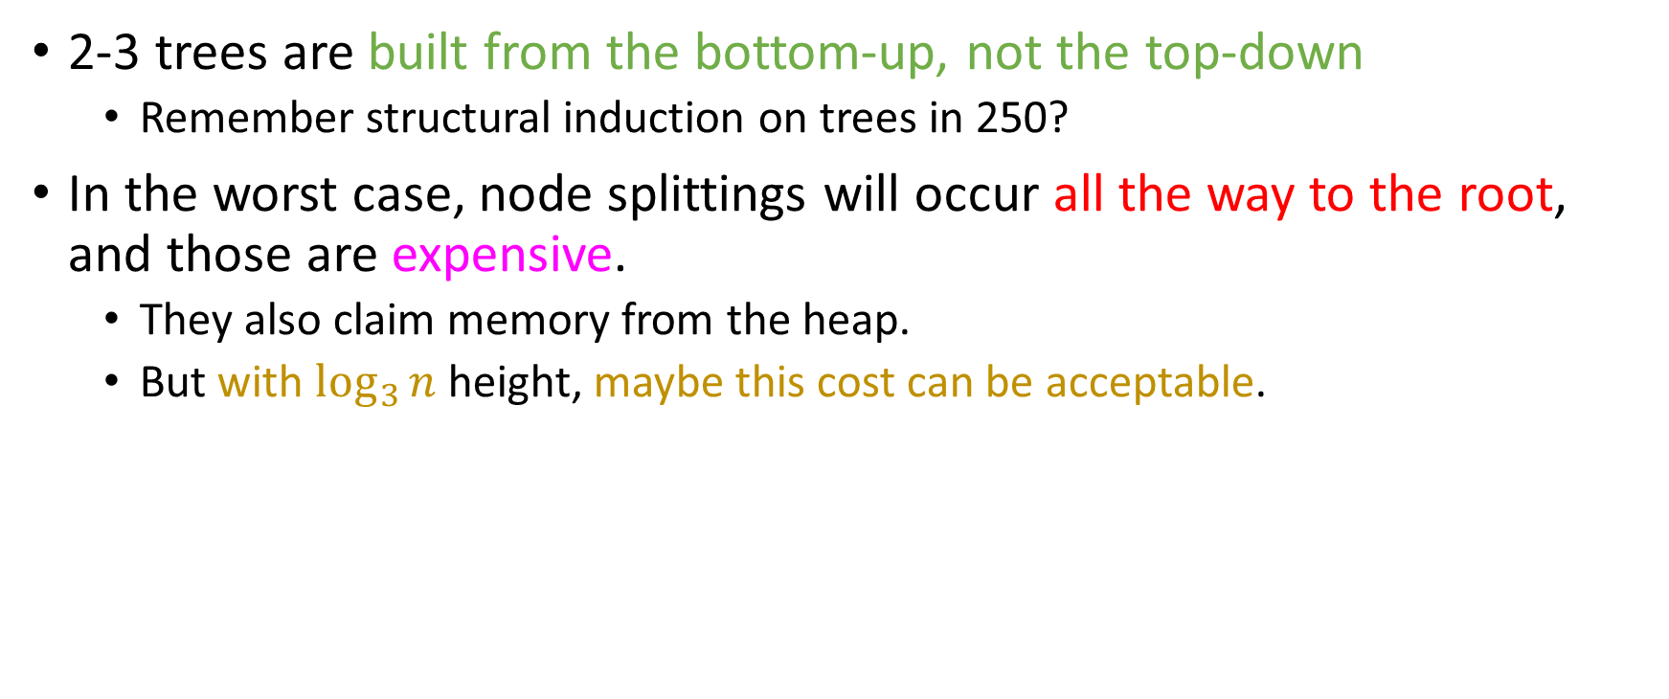
Take-home message #1
2-3 trees are built from the bottom-up, not the top-down
Remember structural induction on trees in 250?
In the worst case, node splittings will occur all the way to the root, and those are expensive.
They also claim memory from the heap.
But with $\log_{3}{n}$ height, maybe this cost can be acceptable.

Slide 67
Deletion
Insertions in 2-3 trees might transform a 2-node into a 3-node, or blow up a temporary 4-node into 3 2-nodes.
Deletions, on the other hand, have the potential of not just making 3-nodes into 2-nodes, but making 2-nodes into …

Slide 68

Deletion
Insertions in 2-3 trees might transform a 2-node into a 3-node, or blow up a temporary 4-node into 3 2-nodes.
Deletions, on the other hand, have the potential of not just making 3-nodes into 2-nodes, but making 2-nodes into … ?

Slide 69

Deletion
Insertions in 2-3 trees might transform a 2-node into a 3-node, or blow up a temporary 4-node into 3 2-nodes.
Deletions, on the other hand, have the potential of not just making 3-nodes into 2-nodes, but making 2-nodes into … ?
We’ll see what the result of that will be soon.

Slide 70
Deletion
Insertions in 2-3 trees might transform a 2-node into a 3-node, or blow up a temporary 4-node into 3 2-nodes.
Deletions, on the other hand, have the potential of not just making 3-nodes into 2-nodes, but making 2-nodes into … ?
We’ll see what the result of that will be soon.
Key point: Since deleting an inner node always ends
up being a deletion at the leaf level, we only care about leaf deletions.

Slide 71
Deletion
30, 50
15
33, 46
53, 66
10
20, 26
32
49
52
60, 61
70
39

Slide 72
Deletion
Delete 61
30, 50
15
33, 46
53, 66
10
20, 26
32
49
52
60, 61
70
39

Slide 73
Deletion
Delete 61
1. Search
30, 50
15
33, 46
53, 66
10
20, 26
32
49
52
60, 61
70
39

Slide 74

Deletion
Delete 61
Search
Since node that contains 61 is a 3-node, we just remove 61, make it a 2-node and we’re done! ☺
30, 50
15
33, 46
53, 66
10
20, 26
32
49
52
60
70
39

Slide 75
Deletion
Delete 10
30, 50
15
33, 46
53, 66
10
20, 26
32
39
49
52
60
70

Slide 76
Deletion
Delete 10
1. Search
30, 50
15
33, 46
53, 66
10
20, 26
32
39
49
52
60
70

Slide 77
Deletion
Delete 10
Search
Deleting 10 leads to a node underflow… ☹
30, 50
15
33, 46
53, 66
10
20, 26
32
39
49
52
60
70

Slide 78
Deletion
Delete 10
Search
Deleting 10 leads to a node underflow… ☹
The solution: rotate a key from our sibling! ☺
30, 50
15
33, 46
53, 66
20, 26
32
39
49
52
60
70

Slide 79
Deletion
Delete 10
Search
Deleting 10 leads to a node underflow… ☹
The solution: rotate a key from our sibling! ☺
30, 50
20
33, 46
53, 66
15
26
32
39
49
52
60
70

Slide 80
Deletion
Delete 10
Search
Deleting 10 leads to a node underflow… ☹
The solution: rotate a key from our sibling! ☺
30, 50
20
33, 46
53, 66
15
26
32
39
49
52
60
70
These operations are called “key rotations”, to disambiguate them from the node rotations that occur in AVL and Splay trees.

Slide 81
Deletion
Delete 49
30, 50
20
33, 46
53, 66
15
26
32
39
49
52
60
70

Slide 82
Deletion
Delete 49
1. Search
30, 50
20
33, 46
53, 66
15
26
32
39
49
52
60
70

Slide 83
Deletion
Delete 49
Search
49 is contained in a 2-node, and both our siblings are 2-nodes as well… ☹
30, 50
20
33, 46
53, 66
15
26
32
39
49
52
60
70
Notes:
Might be useful to tell the students of the case where the second sibling has enough keys (whiteboard this)

Slide 84
Deletion
Delete 49
Search
49 is contained in a 2-node, and both our siblings are 2-nodes as well… ☹
Solution: Merge parent separator with relevant sibling
30, 50
33, 46
53, 66
20
32
49
52
60
70
39
15
26

Slide 85

Deletion
Delete 49
Search
49 is contained in a 2-node, and both our siblings are 2-nodes as well… ☹
Solution: Merge parent separator with relevant sibling!
30, 50
20
33
53, 66
32
39, 46
52
60
70
15
26

Slide 86
Deletion
Delete 66
30, 50
15
33
53, 66
10
20, 26
32
39, 46
52
60
70

Slide 87
Deletion
Delete 66
1. Search
30, 50
15
33
53, 66
10
20, 26
32
39, 46
52
60
70

Slide 88
Deletion
Delete 66
1. Search 2. Have to replace key (e.g with inorder successor…)
30, 50
15
33
53, 70
10
20, 26
32
39, 46
52
60
70

Slide 89
Deletion
Delete 66
1. Search 2. Have to replace key (e.g with inorder successor…) 3. Have to delete the inorder succesor
30, 50
15
33
53, 70
10
20, 26
32
39, 46
52
60
70

Slide 90
Deletion
Delete 66
1. Search 2. Have to replace key (e.g with inorder successor…)
3. Have to delete the inorder succesor
30, 50
15
33
53, 70
Siblings can’t rotate keys to us…. ☹
10
20, 26
32
39, 46
52
60

Slide 91
Deletion
Delete 66
1. Search 2. Have to replace key (e.g with inorder successor…)
3. Have to delete the inorder succesor
30, 50
15
33
53
So we will have to merge our parent and sibling!
10
20, 26
32
39, 46
52
60, 70

Slide 92
Deletion
Delete 66
1. Search 2. Have to replace key (e.g with inorder successor…)
3. Have to delete the inorder succesor
30, 50
15
33
53
So we will have to merge our parent and sibling!
10
20, 26
32
39, 46
52
60, 70

Slide 93
Deletion
Let’s delete 33 real quick to make a point…
30, 50
15
33
53
10
20, 26
32
39, 46
51, 52
70

Slide 94
Deletion
Let’s delete 33 real quick to make a point…
30, 50
15
33
53
10
20, 26
32
39, 46
51, 52
70

Slide 95
Deletion
Let’s delete 33 real quick to make a point…
30, 50
15
33
53
10
20, 26
32
39, 46
51, 52
70

Slide 96
Deletion
Let’s delete 33 real quick to make a point…
30, 50
15
39
53
10
20, 26
32
39, 46
51, 52
70

Slide 97
Deletion
Let’s delete 33 real quick to make a point…
30, 50
15
39
53
10
20, 26
32
39, 46
51, 52
70

Slide 98
Deletion
Let’s delete 33 real quick to make a point…
30, 50
15
39
53
10
20, 26
32
46
51, 52
70

Slide 99
Deletion
Let’s delete 33 real quick to make a point…
And now let’s delete 46.
30, 50
15
39
53
10
20, 26
32
46
51, 52
70

Slide 100
Deletion
Let’s delete 33 real quick to make a point…
And now let’s delete 46.
1. Search
30, 50
15
39
53
10
20, 26
32
46
51, 52
70

Slide 101
Deletion
Let’s delete 33 real quick to make a point…
And now let’s delete 46.
Search
Sibling and parent have no keys to spare! ☹
30, 50
15
39
53
10
20, 26
32
46
51, 52
70

Slide 102
Deletion
Let’s delete 33 real quick to make a point…
And now let’s delete 46.
Search
Sibling and parent have no keys to spare! ☹
Merge parent and sibling into a 3-node…
30, 50
15
53
10
20, 26
32, 39
51, 52
70

Slide 103
Deletion
Let’s delete 33 real quick to make a point…
And now let’s delete 46.
Search
Sibling and parent have no keys to spare! ☹
Merge parent and sibling into a 3-node…
Deal with the new empty node recursively!
30, 50
15
53
10
20, 26
32, 39
51, 52
70

Slide 104
Deletion
If we can merge with both siblings, let’s follow the convention of merging with the right child.
Let’s delete 33 real quick to make a point…
And now let’s delete 46.
Search
Sibling and parent have no keys to spare! ☹
Merge parent and sibling into a 3-node…
Deal with the new empty node recursively!
Merge parent and sibling into a 3-node…
30, 50
15
53
10
20, 26
32, 39
51, 52
70

Slide 105

Problem 2 please!

Slide 106
Deletion
Let’s delete 33 real quick to make a point…
And now let’s delete 46.
Search
Sibling and parent have no keys to spare! ☹
Merge parent and sibling into a 3-node…
Deal with the new empty node recursively!
Merge parent and sibling into a 3-node…
30
50, 53
15
10
20, 26
32, 39
51, 52
70

Slide 107
Take-home message #2
Deletions in 2- 3 trees can propagate all the way up to the root.
They are very expensive.
Reason: Need to maintain very useful property of perfect balance.
It’s worth it. Data will be searched much more often than it will be deleted.
Mark-and-sweep schemes very popular in AVL trees and 2-3 trees
(And B-Trees and Red-Black Trees)

Slide 108

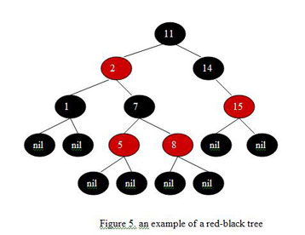
Implementing 2-3 Trees
It turns out we can implement 2-3 trees as binary trees!
This tree will be known as a Red-Black binary search tree (RBBST)
We will talk about it starting next time.

