Slide 1
Splay Trees
CMSC 420 Splay trees were not covered in Spring 2019, yet we are still posting those slides for your knowledge.

Slide 2
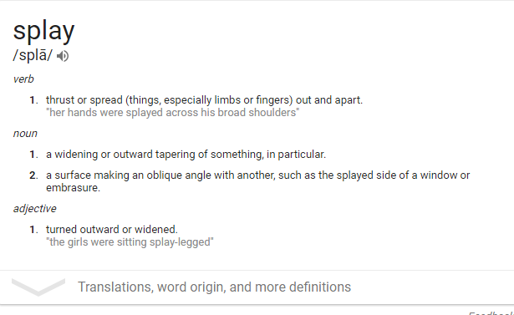
“Splaying”

Slide 3
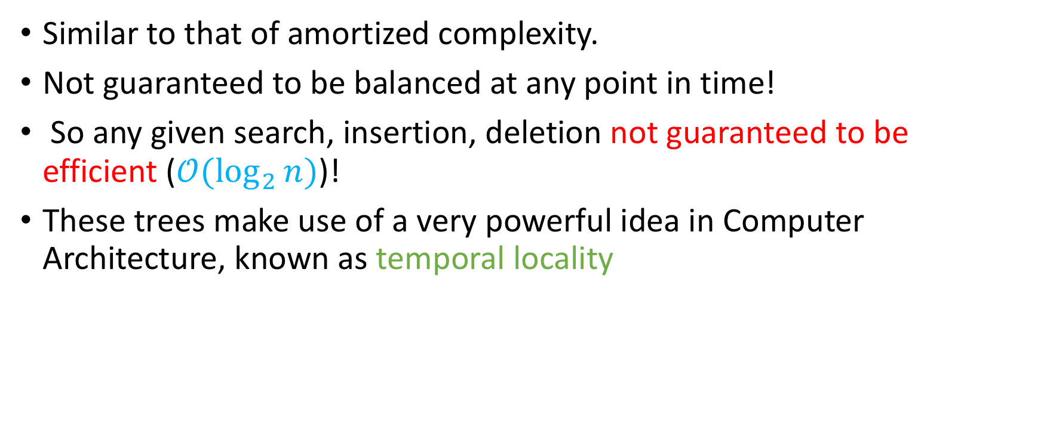
Core idea of splay trees
Similar to that of amortized complexity.
Not guaranteed to be balanced at any point in time!
So any given search, insertion, deletion not guaranteed to be efficient ($𝒪(\log_{2}{n})\text{)}$!
These trees make use of a very powerful idea in Computer Architecture, known as temporal locality

Slide 4
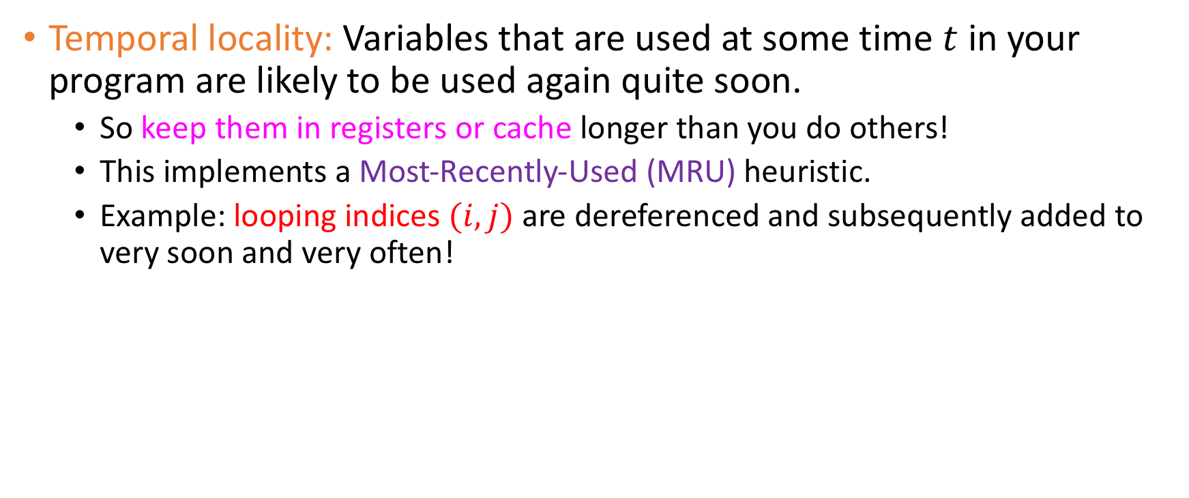
Principle of locality
Temporal locality: Variables that are used at some time $t$ in your program are likely to be used again quite soon.
So keep them in registers or cache longer than you do others!
This implements a Most-Recently-Used (MRU) heuristic.
Example: looping indices $(i, j)$ are dereferenced and subsequently added to very soon and very often!

Slide 5
Principle of locality
Spatial locality: Variables whose memory addresses are relatively close to the address of the currently manipulated variable are likely to be used soon.
So, once again, pull them to the faster levels of our memory hierarchy!
Examples: Arrays, class fields,…
Recall: RandomAccessBag

Slide 6
Locality and splay trees
Splay trees try to emulate this idea by keeping the key that was operated on as well as its neighbors in the tree close to the root after the operation!
In the case of a deletion, only the neighborhood will be pulled close to the root.

Slide 7
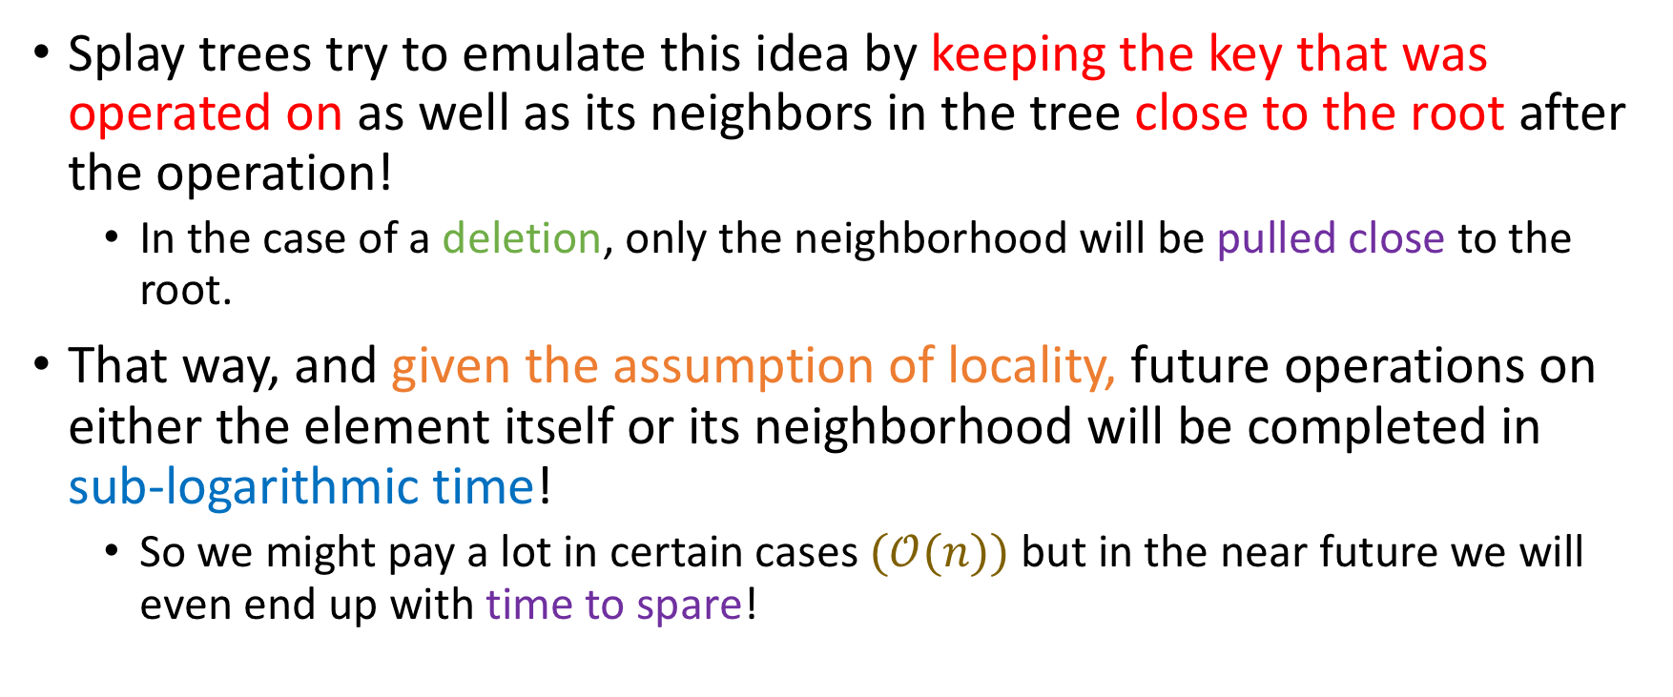
Locality and splay trees
Splay trees try to emulate this idea by keeping the key that was operated on as well as its neighbors in the tree close to the root after the operation!
In the case of a deletion, only the neighborhood will be pulled close to the root.
That way, and given the assumption of locality, future operations on either the element itself or its neighborhood will be completed in sub-logarithmic time!
So we might pay a lot in certain cases $(𝒪(n))$ but in the near future we will even end up with time to spare!

Slide 8
Wait… what do you mean “pulled close”?
Via successive rotations!
Recall that those preserve the BST property.
We’ll see some examples right now.
Remember: Splay Trees are not guaranteed to be balanced at any given point in time!
In fact, in all but the most trivial examples, they will not be.

Slide 9
“Splaying” a node
We will define a new operation called splaying.
Splaying is like searching with steroids.
It searches for the node first, very much like classic BST searching.
Then, two options exist:
Either we will find the node
Or we won’t, but we will have found its parent node!
Spatial locality would then say: “Make access to this parent node and maybe his close neighborhood easier for an application, since he is likely to be needed soon”!

Slide 10

The “steroids” part
Irrespective of which node we reached, our splaying operation will then start pulling the node upwards towards the root of our tree!
It will accomplish this through slightly altered rotations.
We will see how this works through some examples.
In those examples, we have an existing BST on the root of which we call our splay routine: splay(key, root)
We do not insert or remove nodes from the tree: we are just searching for a key, with the stated intent of lifting it or its parent to the root.

Slide 11
Splay Tree rotations
Since our goal is to pull the splayed key as close to the root as we can, we will try to do this faster than simple sequences of left and right rotations.
Maintain three pointers:
C, representing the child node
P, representing the parent node
G, representing the grandparent node
SIX different kinds of rotations:
Left (a simple AVL-like left rotation)
Right (a simple AVL-like left rotation)

Slide 12
Splay Tree rotations
Since our goal is to pull the splayed key as close to the root as we can, we will try to do this faster than simple sequences of left and right rotations.
Maintain three pointers:
C, representing the child node
P, representing the parent node
G, representing the grandparent node
SIX different kinds of rotations:
Left (a simple AVL-like left rotation)
Right (a simple AVL-like left rotation)
Left-Right (“ZIG-ZAG”, like AVL LR rotation)
Right-Left (“ZAG-ZIG”, like AVL RL rotation)

Slide 13
Splay Tree rotations
Since our goal is to pull the splayed key as close to the root as we can, we will try to do this faster than simple sequences of left and right rotations.
Maintain three pointers:
C, representing the child node
P, representing the parent node
G, representing the grandparent node
SIX different kinds of rotations:
Left (a simple AVL-like left rotation)
Right (a simple AVL-like left rotation)
Left-Right (“ZIG-ZAG”, like AVL LR rotation)
Right-Left (“ZAG-ZIG”, like AVL RL rotation)
Left-Left (“ZIG-ZIG”, does not happen in an AVL tree)
Right-Right (“ZAG-ZAG”, does not happen in an AVL tree)

Slide 14
Splay Tree rotations
AVL Terminology | Splay Terminology
L | “ZIG”
R | “ZAG”
LR | “ZIGZAG”
RL | “ZAGZIG”
LL (never used in AVL Trees) | “ZIGZIG”
RR (never used in AVL Trees) | “ZAGZAG”
It’s not important that you remember that “Zig” means left and “Zag” means right. Just remember that there exist two patterns: one that looks like pulling on a rope (zig-zig, zag-zag) and one that looks like a ”zig-zag” pattern (zig-zag, zag-zig).
In fact, Schaffer calls both “ZAGZAG” and “ZIGZIG” “ZIGZIG”, and the other two he calls “ZIGZAG”!
The rotations that look like “zig-zags” are exactly the RL and LR rotations we have seen in AVL trees!

Slide 15
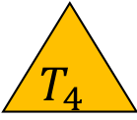
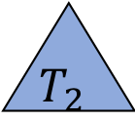
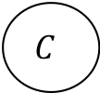
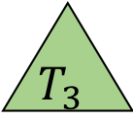



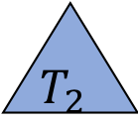
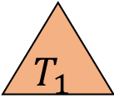
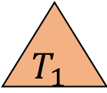
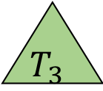
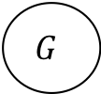
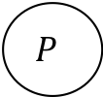
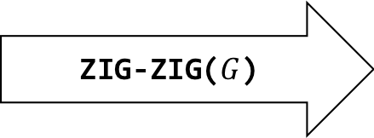
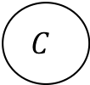
ZIG-ZIG
$$C$$
$$G$$
$$T_{4}$$
$$P$$
ZIG-ZIG($G$)
$$P$$
$$T_{1}$$
$$C$$
$$T_{2}$$
$$G$$
$$T_{3}$$
$$T_{3}$$
$$T_{4}$$
$$T_{1}$$
$$T_{2}$$

Slide 16
ZIG-ZIG
$$C$$
$$G$$
$$T_{4}$$
$$P$$
ZIG-ZIG($G$)
$$P$$
$$T_{1}$$
$$C$$
$$T_{2}$$
$$G$$
$$T_{3}$$
$$T_{3}$$
$$T_{4}$$
$$T_{1}$$
$$T_{2}$$
Make sure the subtree re-distributions make sense to you!

Slide 17
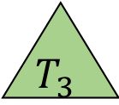
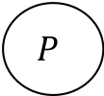


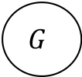
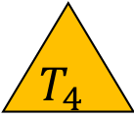

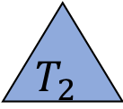
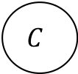


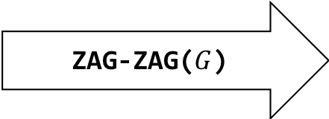



ZAG-ZAG
$$G$$
$$C$$
$$T_{4}$$
$$P$$
$$P$$
$$T_{1}$$
ZAG-ZAG($G$)
$$G$$
$$T_{2}$$
$$C$$
$$T_{3}$$
$$T_{3}$$
$$T_{4}$$
$$T_{1}$$
$$T_{2}$$

Slide 18



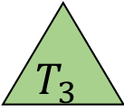

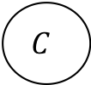
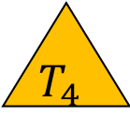



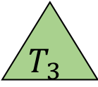

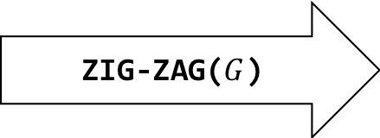

ZIG-ZAG
$$G$$
$$C$$
$$T_{4}$$
$$P$$
$$P$$
$$G$$
ZIG-ZAG($G$)
$$T_{1}$$
$$C$$
$$T_{1}$$
$$T_{2}$$
$$T_{3}$$
$$T_{4}$$
$$T_{2}$$
$$T_{3}$$

Slide 19
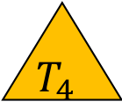


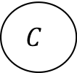


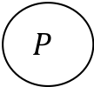
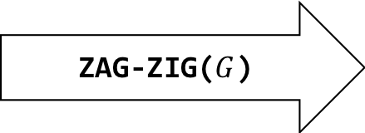

ZAG-ZIG
$$G$$
$$C$$
$$T_{1}$$
$$P$$
$$G$$
$$P$$
ZAG-ZIG($G$)
$$C$$
$$T_{4}$$
$$T_{1}$$
$$T_{2}$$
$$T_{3}$$
$$T_{4}$$
$$T_{2}$$
$$T_{3}$$

Slide 20
Splaying example
root
15
20
8
13
22
10
14
11

Slide 21
Splaying example
splay(15, root)
root
15
15 is already at the root, so there is nothing to do (best case scenario for search!)
20
8
13
22
10
14
11

Slide 22
Splaying example
splay(8, root)
root
15
20
8
13
22
10
14
11

Slide 23
Splaying example
splay(8, root)
root
root
When we splay an element right below the root, a simple AVL-like right rotation will work!
8
15
x
15
20
8
20
13
x
22
13
10
14
22
10
14
11
11

Slide 24
Splaying example
splay(12, root)
root
Note that 12 is not in the tree!
8
15
20
13
10
14
22
11

Slide 25
Splaying example
splay(12, root)
root
Note that 12 is not in the tree!
The descending part of the splaying routine will reach 11.
8
15
20
13
10
14
22
11

Slide 26
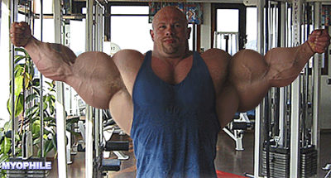
Splaying example
splay(12, root)
root
Note that 12 is not in the tree!
The descending part of the splaying routine will reach 11.
Ascending part (steroids): Bring 11 to the root!
8
15
20
13
10
14
22
11

Slide 27
Bringing 11 to the root…
AVL Terminology | Splay Terminology
L | “ZIG”
R | “ZAG”
LR | “ZIGZAG”
RL | “ZAGZIG”
LL (never used in AVL Trees) | “ZIGZIG”
RR (never used in AVL Trees) | “ZAGZAG”
root
8
15
Zig-zag!
20
13
10
14
22
11

Slide 28
Bringing 11 to the root…
AVL Terminology | Splay Terminology
L | “ZIG”
R | “ZAG”
LR | “ZIGZAG”
RL | “ZAGZIG”
LL (never used in AVL Trees) | “ZIGZIG”
RR (never used in AVL Trees) | “ZAGZAG”
root
8
15
Zig-zag!
11
20
13
10
14
22

Slide 29
Bringing 11 to the root…
AVL Terminology | Splay Terminology
L | “ZIG”
R | “ZAG”
LR | “ZIGZAG”
RL | “ZAGZIG”
LL (never used in AVL Trees) | “ZIGZIG”
RR (never used in AVL Trees) | “ZAGZAG”
root
Zag-Zig
8
15
11
20
13
10
14
22

Slide 30
Bringing 11 to the root…
root
Notice how 10, 13 and 14, all close neighbors of 11 before we splayed it, are now one level closer to the root?
11
8
15
20
10
13
22
14

Slide 31
Splaying example #2
splay(10, root)
root
8
15
20
13
10
14
22
11

Slide 32

Splaying example #2
splay(10, root)
root
10
ALERT: If you came up with this tree, instead of ZIGZIG / ZIG-ZAG / ZAG- ZIG / ZAG – ZAG rotations, you performed AVL-Style rotations!
8
15
13
20
22
11
14

Slide 33

Thought experiment
splay(10, root)
THIS is the correct tree!
root
10
8
13
11
15
14
20
22

Slide 34
Searching a splay tree
Assuming splay(Key key, Node node) implemented, develop a routine search(Key key) now, in your notes!
Your search method should return null if the key is not there and the key itself if it is.
Assume your splay tree class begins like this:

Slide 35
Searching a splay tree
Assuming splay(Key key, Node node) implemented, develop a routine search(Key key) now, in your notes!
Your search method should return null if the key is not there and the key itself if it is.
Assume your splay tree class begins like this:
public class SplayTree<Key extends Comparable<Key>> {
private class Node {
Key key;
Node left, right;
}
private Node root;
private Node splay(Key key, Node node){/* This is assumed implemented */}

Slide 36
Search routine
public Key search(Key key){
if(root == null)
return null;
root = splay(key, root);
if(root.key.compareTo(key) == 0)
return root.key;
else
return null;
}

Slide 37
Search routine
public Key search(Key key){
if(root == null)
return null;
root = splay(key, root);
if(root.key.compareTo(key) == 0)
return root.key;
else
return null;
}
search() is a breeze given splay() ☺

Slide 38
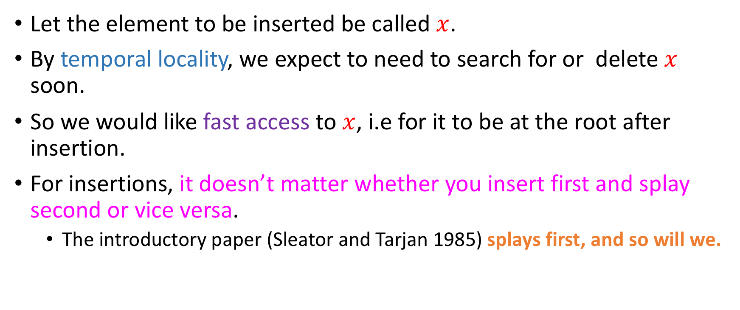
Insertion in a splay tree
Let the element to be inserted be called $x$.
By temporal locality, we expect to need to search for or delete $x$ soon.
So we would like fast access to $x$, i.e for it to be at the root after insertion.
For insertions, it doesn’t matter whether you insert first and splay second or vice versa.
The introductory paper (Sleator and Tarjan 1985) splays first, and so will we.

Slide 39
Insertion
Suppose that we don’t allow duplicates in our splay tree
Consistent with using the structure as a dictionary (database of <K, V> pairs)! ☺
Then, here’s how insertion will work:
Splay the root node with the key to be inserted.
Compare new root’s key with key to be inserted.
If they’re equal, do nothing, since we don’t allow duplicates.
If the new root’s key is the biggest key in the set smaller than our new key (inorder predecessor), then name this case #1.
If the new root’s key is the smallest key in the set bigger than our new key (inorder successor), then name this case #2.

Slide 40



Case #1: Inorder Predecessor
We wanted to insert key $x$, so first we splay the root with key $x$.
Let the node of the new root be called $u$. We assume $u<x$, which by the nature of the splaying operation means that$u$ is $x$’s inorder predecessor.
$$x$$
$$u$$

Slide 41


Case #1: Inorder Predecessor
We wanted to insert key $x$, so first we splay the root with key $x$.
Let the node of the new root be called $u$. We assume $u<x$, which by the nature of the splaying operation means that$u$ is $x$’s inorder predecessor.
$$x$$
$$u$$
$$u$$
x

Slide 42


Case #1: New root’s key is Inorder Predecessor
We wanted to insert key $x$, so first we splay the root with key $x$.
Let the node of the new root be called $u$. We assume $u<x$, which by the nature of the splaying operation means that$u$ is $x$’s inorder predecessor.
$$x$$
We satisfy the BST property.
Newly inserted key immediately available: leveraging locality!
$$u$$
$$u$$
x

Slide 43




Case #2: New root’s key is inorder successor
Symmetric case ($x < u$):
$$x$$
$$u$$
$$u$$
x

Slide 44
Examples
Insert ‘D’ in the following splay tree.
Q
C
R
V
B
Z

Slide 45
Examples
Insert ‘D’ in the following splay tree.
D is not in the tree.
Last node visited is ‘C’
Splay the root with key ‘C’
Insert ‘D’ as a new root that is the inorder successor of ‘C’
D
Q
C
R
B
V
Z

Slide 46
Practice
Now go ahead and insert ‘P’.
D
Q
C
R
B
V
Z

Slide 47
Practice
Now go ahead and insert ‘P’.
P is not in the tree.
Last node visited is ‘Q’
Splay the root with key ‘P’
Insert ‘P’ as a new root that is the inorder predecessor of ‘Q’
P
Q
D
C
R
V
B
Z

Slide 48
Examples
Insert ‘Q’ in the following splay tree:
V
R
Z
B
C
Q

Slide 49
Examples
Insert ‘Q’ in the following splay tree:
Q is already in the tree, so no actual insertion will take place!
However, we will splay the root with key ‘Q’, causing the leaf node that contains ‘Q’ to ascend to the root (1 zig-zig and 1 zag-zag)
Q
C
R
V
B
Z

Slide 50
Deletion
Deletion is similar to addition
Splay trees have, the easiest (and most efficient) deletion process among all dynamic binary trees that we will discuss!

Slide 51
Deletion
Process (roughly)
Splay the root with the key to be deleted
If the root doesn’t contain the key to be deleted, nothing to do. We did, however, significantly improve access to an inorder predecessor or successor.
If the root does actually contain the key, split between cases:
(Easy case): If the left child is null, we splayed the root with the minimum key in the tree. Just replace the root with its right child.
(Hard case): If not, splay the (non-null) left child of the root with the key to be deleted once again! This will bring the key’s inorder predecessor as the left child of the old root, and we can then replace the root with that particular child!

Slide 52
Deletion examples
root
Let’s delete ‘B’
P
Q
D
C
R
V
B
Z

Slide 53
Deletion examples
root
Let’s delete ‘B’
Once splayed, ‘B’ will be at the root!
After that, it’s a simple pointer assignment to change the root to point to it.
B
P
Q
C
R
D
V
Z

Slide 54
Deletion examples
root
Let’s delete ‘B’
Once splayed, ‘B’ will be at the root!
After that, it’s a simple pointer assignment to change the root to point to its right child, ‘P’.
The neighborhood of ‘B’ (‘C’, ‘D’) still remain close to the root.
B
P
Q
C
R
D
V
Z

Slide 55
Deletion examples
Let’s now delete ‘R’!
root
P
Q
C
R
D
V
Z

Slide 56
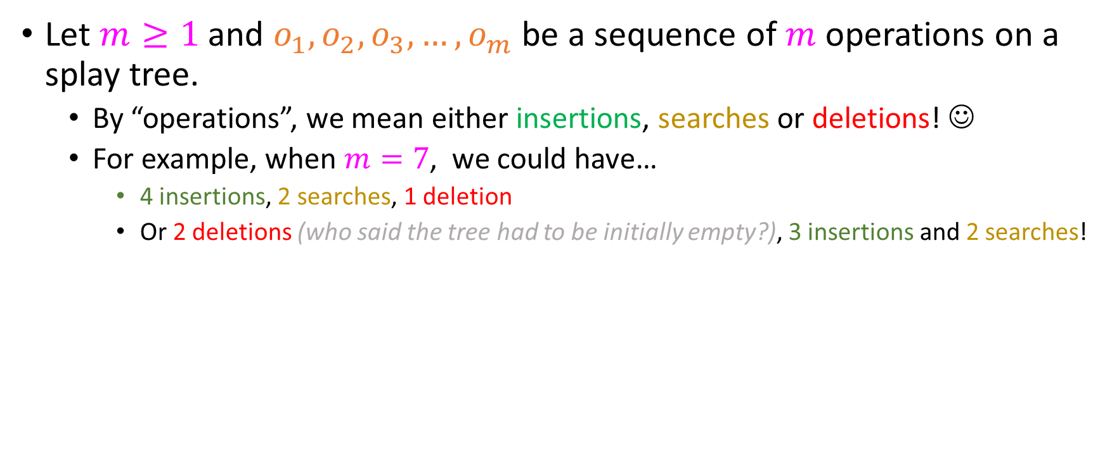
Theory behind splay trees
Let $m≥1$ and $o_{1},o_{2},o_{3},…,o_{m}$ be a sequence of $m$ operations on a splay tree.
By “operations”, we mean either insertions, searches or deletions! ☺
For example, when $m=7$, we could have…
4 insertions, 2 searches, 1 deletion
Or 2 deletions (who said the tree had to be initially empty?), 3 insertions and 2 searches!

Slide 57
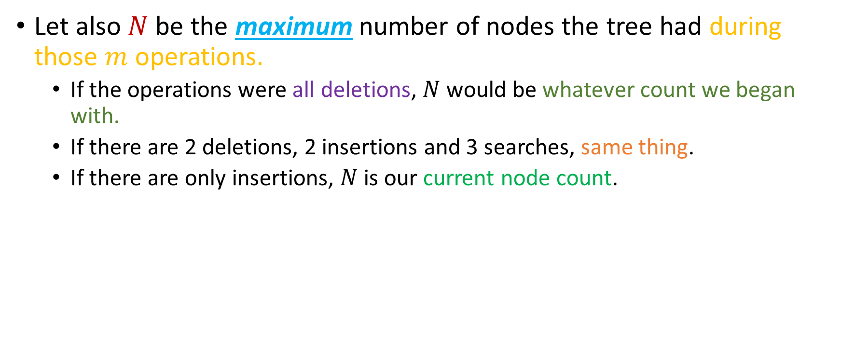
Theory behind splay trees
Let also $N$ be the maximum number of nodes the tree had during those $m$ operations.
If the operations were all deletions, $N$ would be whatever count we began with.
If there are 2 deletions, 2 insertions and 3 searches, same thing.
If there are only insertions, $N$ is our current node count.

Slide 58

Theory behind splay trees
Then, the total time for completing all of those $m$ operations is:
$$𝒪(m⋅\log_{2}{N})$$

Slide 59
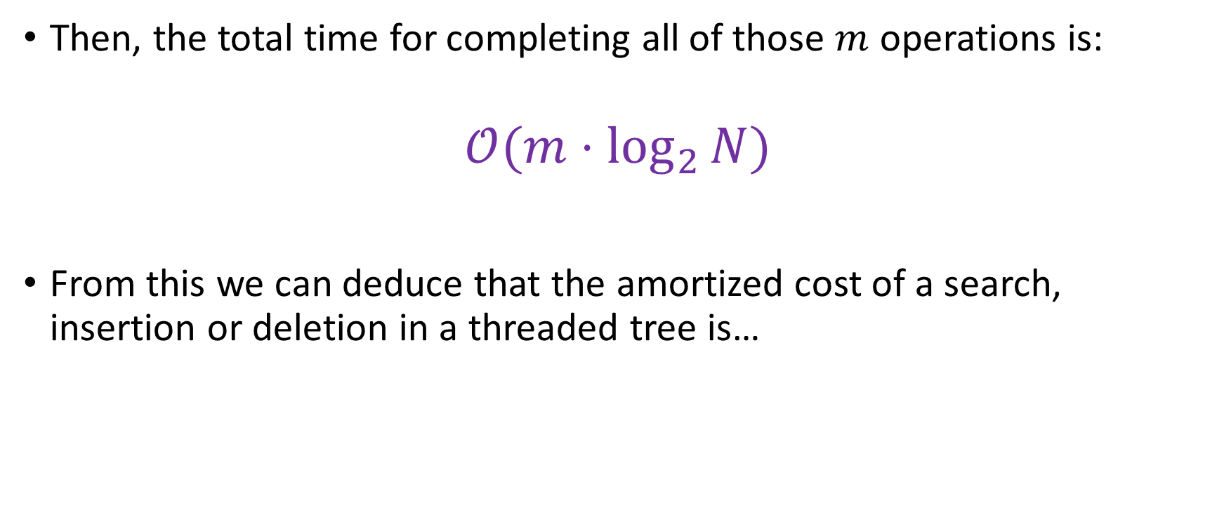
Theory behind splay trees
Then, the total time for completing all of those $m$ operations is:
$$𝒪(m⋅\log_{2}{N})$$
From this we can deduce that the amortized cost of a search, insertion or deletion in a threaded tree is…
Amortized Constant
Amortized Linear
Amortized Logarithmic
Something else
(what?)

Slide 60
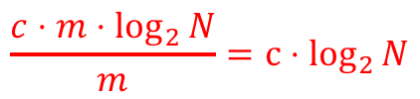
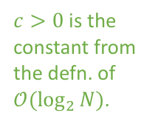
Theory behind splay trees
Then, the total time for completing all of those $m$ operations is:
$$𝒪(m⋅\log_{2}{N})$$
From this we can deduce that the amortized cost of a search, insertion or deletion in a threaded tree is…
$c>0$ is the constant from the defn. of $𝒪(\log_{2}{N)}$.
$$\frac{c⋅m⋅\log_{2}{N}}{m}={c⋅log}_{2}{N}$$
Amortized Constant
Amortized Linear
Amortized Logarithmic
Something else
(what?)

Slide 61
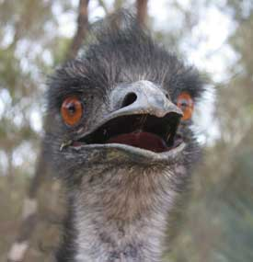
Theory behind splay trees
Then, the total time for completing all of those $m$ operations is:
$$𝒪(m⋅\log_{2}{N})$$
From this we can deduce that the amortized cost of a search, insertion or deletion in a threaded tree is…
And here we see what we pay, on average: the base 2 logarithm of the maximum amount of nodes ever present in the sequence!
$$\frac{c⋅m⋅\log_{2}{N}}{m}={c⋅log}_{2}{N}$$
Amortized Constant
Amortized Linear
Amortized Logarithmic
Something else
(what?)

Slide 62
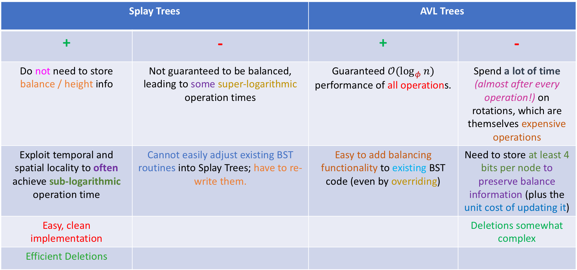
Take-home message
Splay Trees |  | AVL Trees
+ | - | + | -
Do not need to store balance / height info | Not guaranteed to be balanced, leading to some super-logarithmic operation times | Guaranteed $𝒪(\log_{φ}{n)}$ performance of all operations. | Spend a lot of time (almost after every operation!) on rotations, which are themselves expensive operations
Exploit temporal and spatial locality to often achieve sub-logarithmic operation time | Cannot easily adjust existing BST routines into Splay Trees; have to re-write them. | Easy to add balancing functionality to existing BST code (even by overriding) | Need to store at least 4 bits per node to preserve balance information (plus the unit cost of updating it)
Easy, clean implementation |  |  | Deletions somewhat complex
Efficient Deletions
Expensive searches
… … …
… … …
… … …

