Slide 1
Collision – Resolution strategies for hashing
CMSC 420

Slide 2



Formal problem definition
Let $A$ and $B$ be two finite sets with $|A|>|B|$. Then, there exists no injection $f:A↦B$.
A
B
$$⋮$$
$$⋮$$

Slide 3

In hashing…
In our problem, set A is our dataset and B is our available memory.
$|A|>>|B|$(one of the major computational problems of modern CS)

Slide 4

In hashing…
In our problem, set A is our dataset and B is our available memory.
$|A|>>|B|$(one of the major computational problems of modern CS)
Silver lining: many times we don’t need the entirety of the data stored in a single machine…

Slide 5
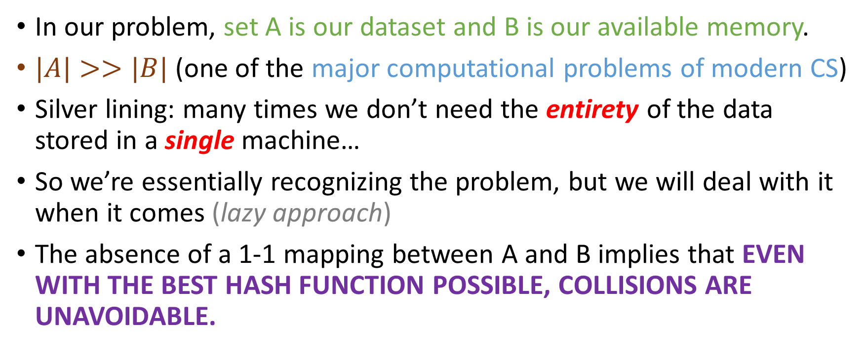
In hashing…
In our problem, set A is our dataset and B is our available memory.
$|A|>>|B|$(one of the major computational problems of modern CS)
Silver lining: many times we don’t need the entirety of the data stored in a single machine…
So we’re essentially recognizing the problem, but we will deal with it when it comes (lazy approach)
The absence of a 1-1 mapping between A and B implies that EVEN WITH THE BEST HASH FUNCTION POSSIBLE, COLLISIONS ARE UNAVOIDABLE.

Slide 6
Visually
0
1
2
3
4
5
6
7
8
9
“Muhammad”
“Mark””
“Stacey”
“Li”
“Xintong”
“Hauvik”
“James”
“Lucy”
“Jared”
“Nakeesha”
0
1
2
3
4
5
6

Slide 7

Quiz
Let $n$ be the size of our data (in records) and $M$ be our hash table size, with $n≫M$.

Slide 8

Quiz
Let $n$ be the size of our data (in records) and $M$ be our hash table size, with $n≫M$.
True or False: our first collision will happen at the $(M+1)$th insertion (this would mean that we’d need to resize our table if we want more keys to fit)

Slide 9
Quiz
Let $n$ be the size of our data (in records) and $M$ be our hash table size, with $n≫M$.
True or False: our first collision will happen at the $(M+1)$th insertion (this would mean that we’d need to resize our table if we want more keys to fit)
True
False

Slide 10
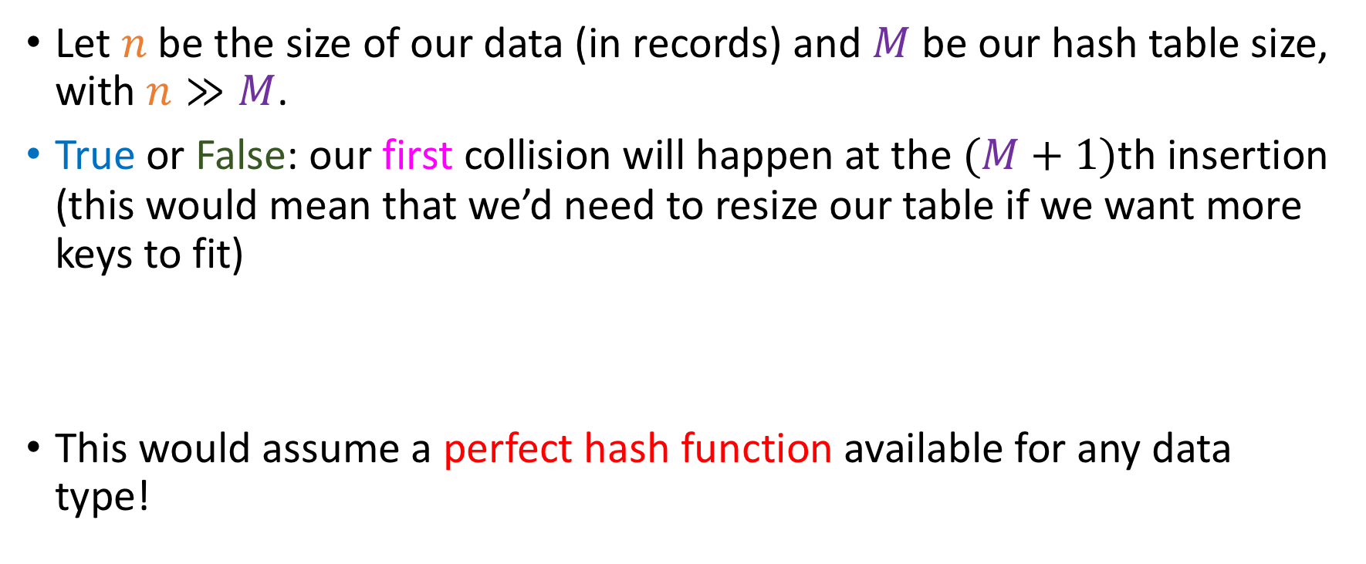
Quiz
Let $n$ be the size of our data (in records) and $M$ be our hash table size, with $n≫M$.
True or False: our first collision will happen at the $(M+1)$th insertion (this would mean that we’d need to resize our table if we want more keys to fit)
This would assume a perfect hash function available for any data type!
True
False

Slide 11
A terrible hash function for strings
0
1
2
3
4
5
6
7
8
9
“Muhammad”
“Mark””
“Stacey”
“Li”
“Xintong”
“Hauvik”
“James”
“Lucy”
“Jared”
“Nakeesha”
0
1
2
3
4
5
6

Slide 12
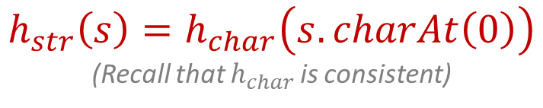
A terrible hash function for strings
0
1
2
3
4
5
6
7
8
9
“Muhammad”
“Mark””
“Stacey”
“Li”
“Xintong”
“Hauvik”
“James”
“Lucy”
“Jared”
“Nakeesha”
0
1
2
3
4
5
6
$$h_{str}\left(s\right)=h_{char}\left(s.charAt\left(0\right)\right)$$
(Recall that $h_{char }$is consistent)
We have a collision immediately ☹

Slide 13
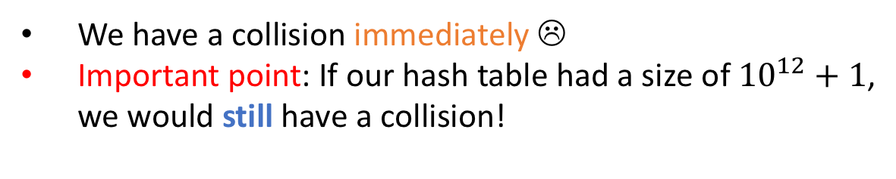
A terrible hash function for strings
0
1
2
3
4
5
6
7
8
9
“Muhammad”
“Mark””
“Stacey”
“Li”
“Xintong”
“Hauvik”
“James”
“Lucy”
“Jared”
“Nakeesha”
0
1
2
3
4
5
6
$$h_{str}\left(s\right)=h_{char}\left(s.charAt\left(0\right)\right)$$
(Recall that $h_{char }$is consistent)
We have a collision immediately ☹
Important point: If our hash table had a size of ${10}^{12}+1$, we would still have a collision!

Slide 14
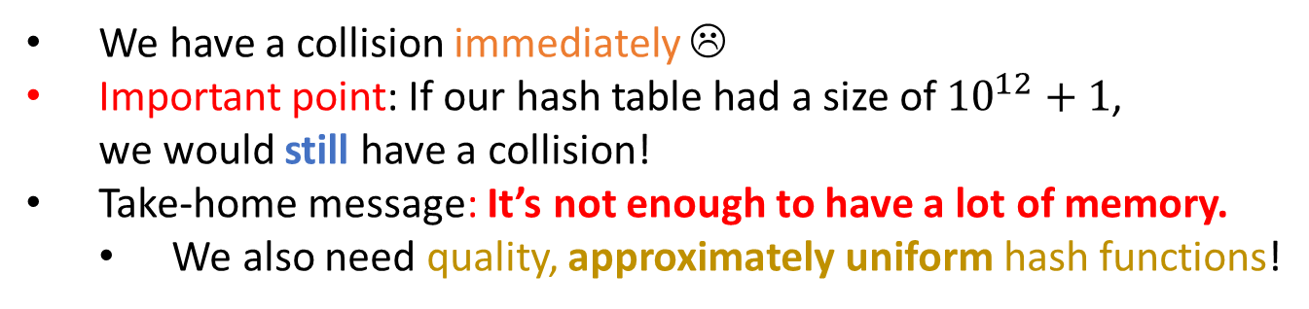
A terrible hash function for strings
0
1
2
3
4
5
6
7
8
9
“Muhammad”
“Mark””
“Stacey”
“Li”
“Xintong”
“Hauvik”
“James”
“Lucy”
“Jared”
“Nakeesha”
0
1
2
3
4
5
6
$$h_{str}\left(s\right)=h_{char}\left(s.charAt\left(0\right)\right)$$
(Recall that $h_{char }$is consistent)
We have a collision immediately ☹
Important point: If our hash table had a size of ${10}^{12}+1$, we would still have a collision!
Take-home message: It’s not enough to have a lot of memory.
We also need quality, approximately uniform hash functions!

Slide 15
Probes
Suppose that we want to insert a key k in our hash table.
Every memory access we need to make until we find an empty position (including the first and last accesses) we will call a probe
Goal of collision resolution: minimize probes while not requiring frequent array resizings
With two seemingly contradicting goals, it is a challenge to come up with good solutions to this problem!

Slide 16
Separate Chaining
0
1
2
3
4
5
6
7
8
9
“Muhammad”
“Mark”
“Stacey”
“Li”
“Xintong”
“Hauvik”
“James”
“Lucy”
“Jared”
“Nakeesha”
0
1
2
3
4
5
6

Slide 17
Separate Chaining
0
1
2
3
4
5
6
7
8
9
“Muhammad”
“Mark”
“Stacey”
“Li”
“Xintong”
“Hauvik”
“James”
“Lucy”
“Jared”
“Nakeesha”
0
1
2
3
4
5
6
Lucy
Insert Lucy

Slide 18
Separate Chaining
0
1
2
3
4
5
6
7
8
9
“Muhammad”
“Mark”
“Stacey”
“Li”
“Xintong”
“Hauvik”
“James”
“Lucy”
“Jared”
“Nakeesha”
0
1
2
3
4
5
6
Mark
Lucy
Insert Mark

Slide 19
Separate Chaining
0
1
2
3
4
5
6
7
8
9
“Muhammad”
“Mark”
“Stacey”
“Li”
“Xintong”
“Hauvik”
“James”
“Lucy”
“Jared”
“Nakeesha”
0
1
2
3
4
5
6
Mark
Li
Lucy
Insert Li

Slide 20
Separate Chaining
0
1
2
3
4
5
6
7
8
9
“Muhammad”
“Mark”
“Stacey”
“Li”
“Xintong”
“Hauvik”
“James”
“Lucy”
“Jared”
“Nakeesha”
0
1
2
3
4
5
6
Mark
Li
Lucy
Suppose that inserting Nakeesha causes a collision…

Slide 21
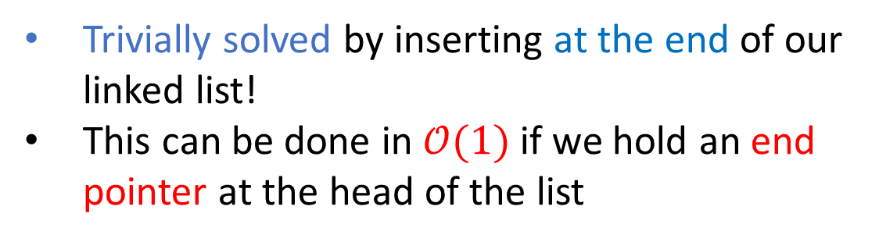
Separate Chaining
0
1
2
3
4
5
6
7
8
9
“Muhammad”
“Mark”
“Stacey”
“Li”
“Xintong”
“Hauvik”
“James”
“Lucy”
“Jared”
“Nakeesha”
0
1
2
3
4
5
6
Mark
Li
Lucy
Nakeesha
Trivially solved by inserting at the end of our linked list!
This can be done in $𝒪(1)$ if we hold an end pointer at the head of the list

Slide 22
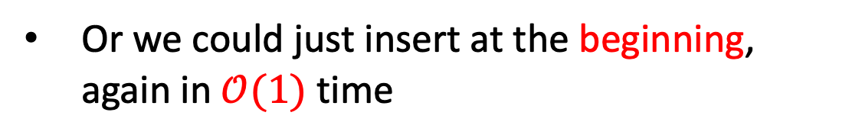
Separate Chaining
0
1
2
3
4
5
6
7
8
9
“Muhammad”
“Mark”
“Stacey”
“Li”
“Xintong”
“Hauvik”
“James”
“Lucy”
“Jared”
“Nakeesha”
0
1
2
3
4
5
6
Mark
Li
Nakeesha
Lucy
Or we could just insert at the beginning, again in $𝒪(1)$ time

Slide 23
(Ordered!) Separate Chaining
Jared probes buffer[0] = node containing Mark, compares name with Mark’s, immediately returns false after a single probe!
0
1
2
3
4
5
6
7
8
9
“Muhammad”
“Mark”
“Stacey”
“Li”
“Xintong”
“Hauvik”
“James”
“Lucy”
“Jared”
“Nakeesha”
0
1
2
3
4
5
6
Mark
Nigel
Rohan
Li
Lucy
Nakeesha
OR, we can accept linear insertion cost to keep the buckets sorted
Then, searches doomed to fail will do so fast!
This is an example of ordered hashing ☺

Slide 24

Separate Chaining with a perfectly uniform hash function….
For all keys $k,$ $[h\left(k\right)\sim UNIFORM\left(\left\{0, 1, 2, …, M−1\right\}\right)]$
At the limit, all of the lists will have $n/M$ keys per bucket!
This happens at the limit of infinite insertions (don’t fall for the gambler’s fallacy)

Slide 25
Average worst-case search in a Separately Chained HT
Let’s remember something about BSTs…

Slide 26

Average worst-case search in a Separately Chained HT
Let’s remember something about BSTs…
We were told that the best possible height we could expect to make our search fast would be $\log_{2}{n}$.

Slide 27
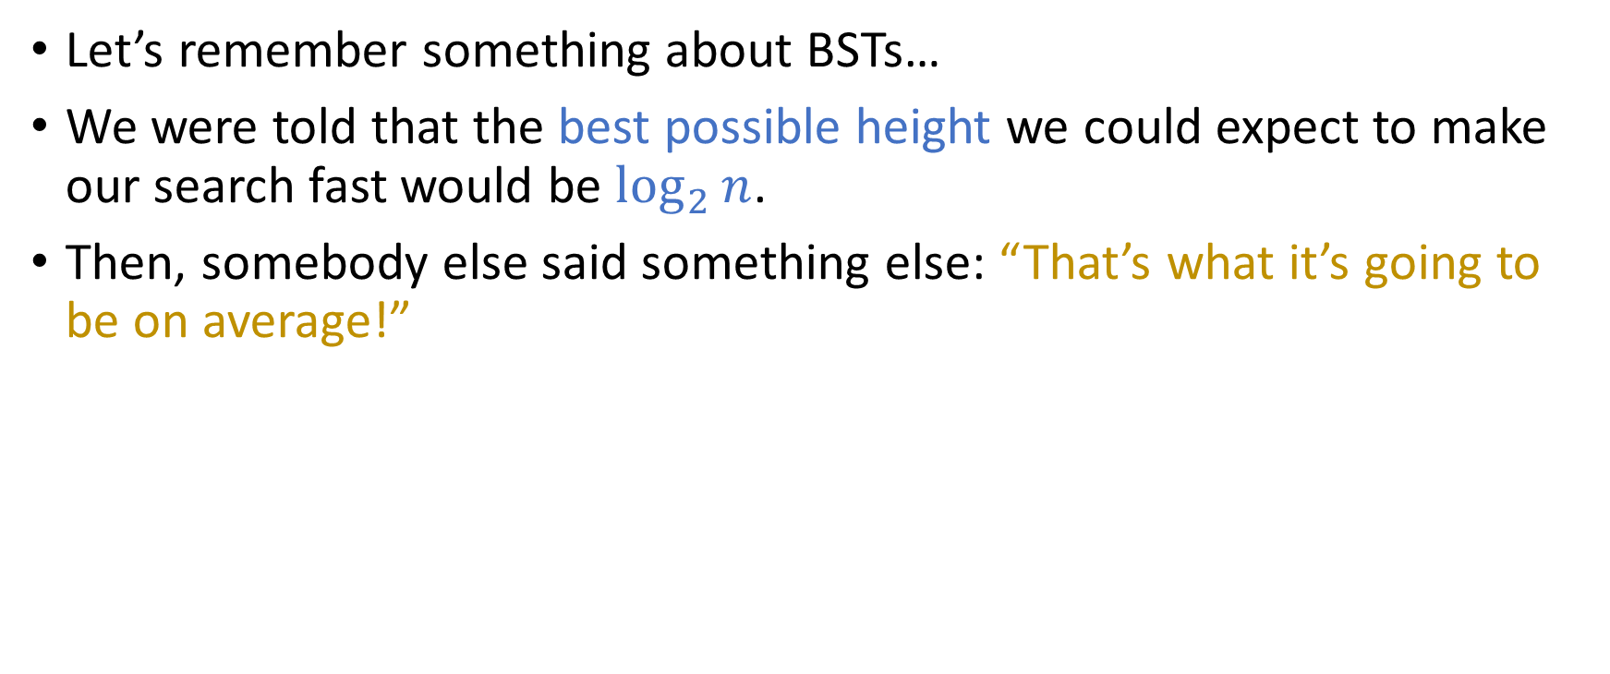
Average worst-case search in a Separately Chained HT
Let’s remember something about BSTs…
We were told that the best possible height we could expect to make our search fast would be $\log_{2}{n}$.
Then, somebody else said something else: “That’s what it’s going to be on average!”

Slide 28
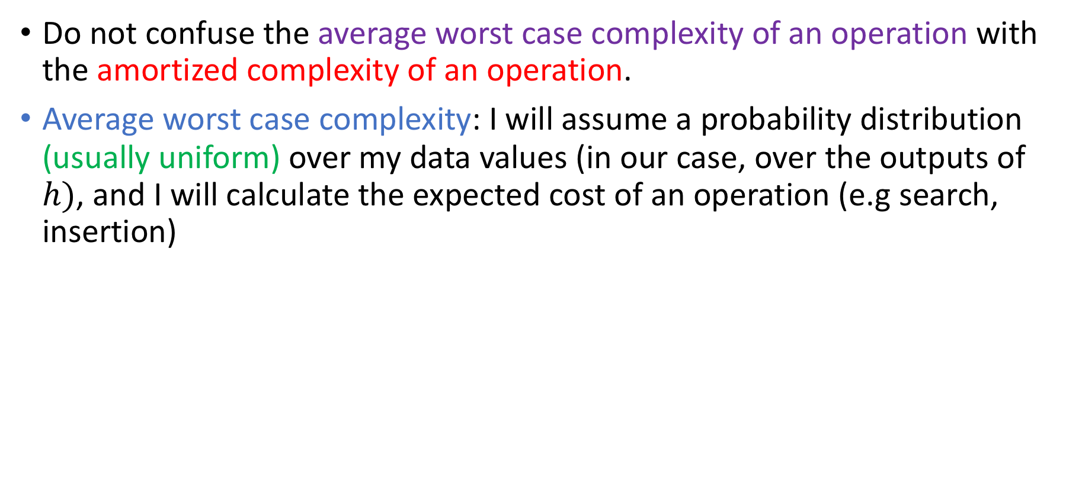
Average worst case vs amortized
Do not confuse the average worst case complexity of an operation with the amortized complexity of an operation.
Average worst case complexity: I will assume a probability distribution (usually uniform) over my data values (in our case, over the outputs of $h)$, and I will calculate the expected cost of an operation (e.g search, insertion)

Slide 29
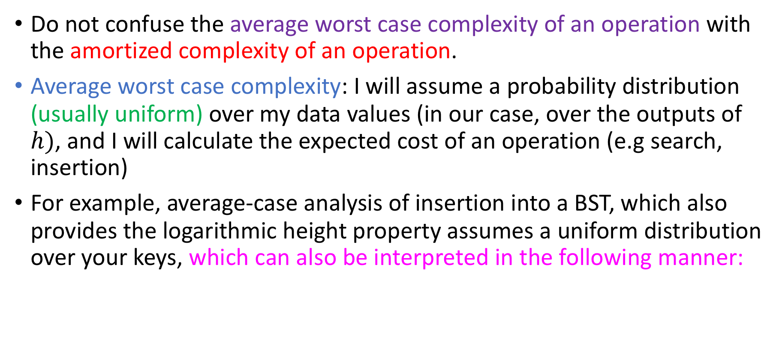
Average worst case vs amortized
Do not confuse the average worst case complexity of an operation with the amortized complexity of an operation.
Average worst case complexity: I will assume a probability distribution (usually uniform) over my data values (in our case, over the outputs of $h)$, and I will calculate the expected cost of an operation (e.g search, insertion)
For example, average-case analysis of insertion into a BST, which also provides the logarithmic height property assumes a uniform distribution over your keys, which can also be interpreted in the following manner:

Slide 30
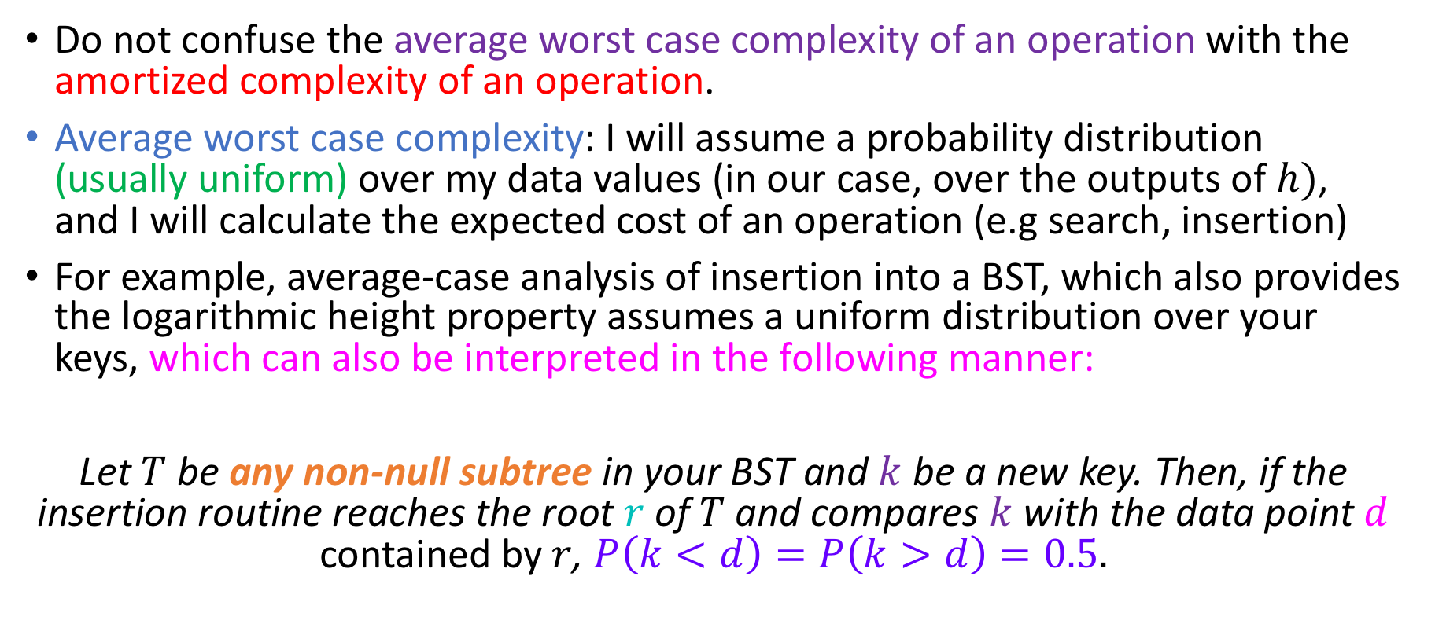
Average worst case vs amortized
Do not confuse the average worst case complexity of an operation with the amortized complexity of an operation.
Average worst case complexity: I will assume a probability distribution (usually uniform) over my data values (in our case, over the outputs of $h)$, and I will calculate the expected cost of an operation (e.g search, insertion)
For example, average-case analysis of insertion into a BST, which also provides the logarithmic height property assumes a uniform distribution over your keys, which can also be interpreted in the following manner:
Let $T$ be any non-null subtree in your BST and $k$ be a new key. Then, if the insertion routine reaches the root $r$ of $T$ and compares $k$ with the data point $d$ contained by $r$, $P\left(k<d\right)=P\left(k>d\right)=0.5.$

Slide 31
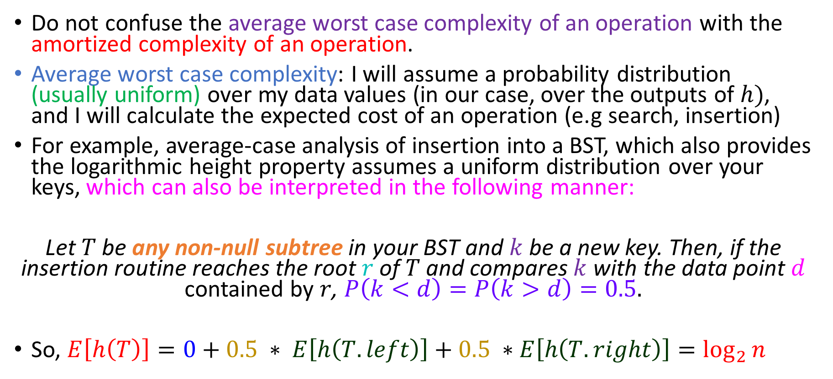
Average worst case vs amortized
Do not confuse the average worst case complexity of an operation with the amortized complexity of an operation.
Average worst case complexity: I will assume a probability distribution (usually uniform) over my data values (in our case, over the outputs of $h)$, and I will calculate the expected cost of an operation (e.g search, insertion)
For example, average-case analysis of insertion into a BST, which also provides the logarithmic height property assumes a uniform distribution over your keys, which can also be interpreted in the following manner:
Let $T$ be any non-null subtree in your BST and $k$ be a new key. Then, if the insertion routine reaches the root $r$ of $T$ and compares $k$ with the data point $d$ contained by $r$, $P\left(k<d\right)=P\left(k>d\right)=0.5.$
So, $E\left[h\left(T\right)\right]=0+0.5 ∗ E\left[h\left(T.left\right)\right]+0.5 ∗E\left[h\left(T.right\right)\right]=\log_{2}{n}$
(Same derivation as binary search!)

Slide 32
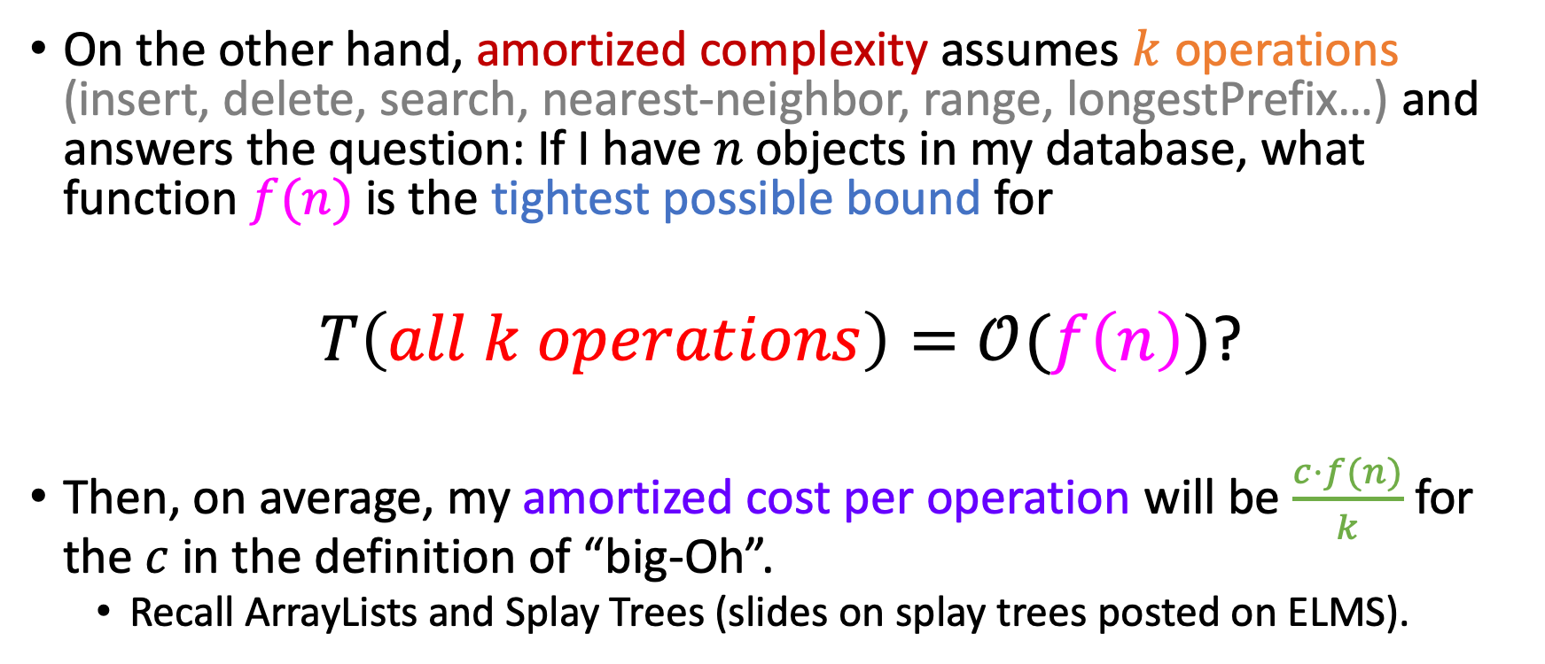
Average worst case vs amortized
On the other hand, amortized complexity assumes $k$ operations (insert, delete, search, nearest-neighbor, range, longestPrefix…) and answers the question: If I have $n$ objects in my database, what function $f(n)$ is the tightest possible bound for
$T\left(all k operations\right)=𝒪(f\left(n\right))$?
Then, on average, my amortized cost per operation will be $\frac{c⋅f(n)}{k}$ for the $c$ in the definition of “big-Oh”.
Recall ArrayLists and Splay Trees (slides on splay trees posted on ELMS).

Slide 33
Pros of Separate Chaining
Implementable in 2 minutes
Allows us to retrieve pointer to storage medium for K-V pairs (maybe the V is another hash!)
Great idea for estimating quality of hash function!
Non-contiguous memory allocation of keys adds flexibility of memory allocation of keys
Important when we are memory starved
Trade-off between insertion speed and (failed) search average probes…
Remember: data will be searched much, much more than it will be mutated!

Slide 34
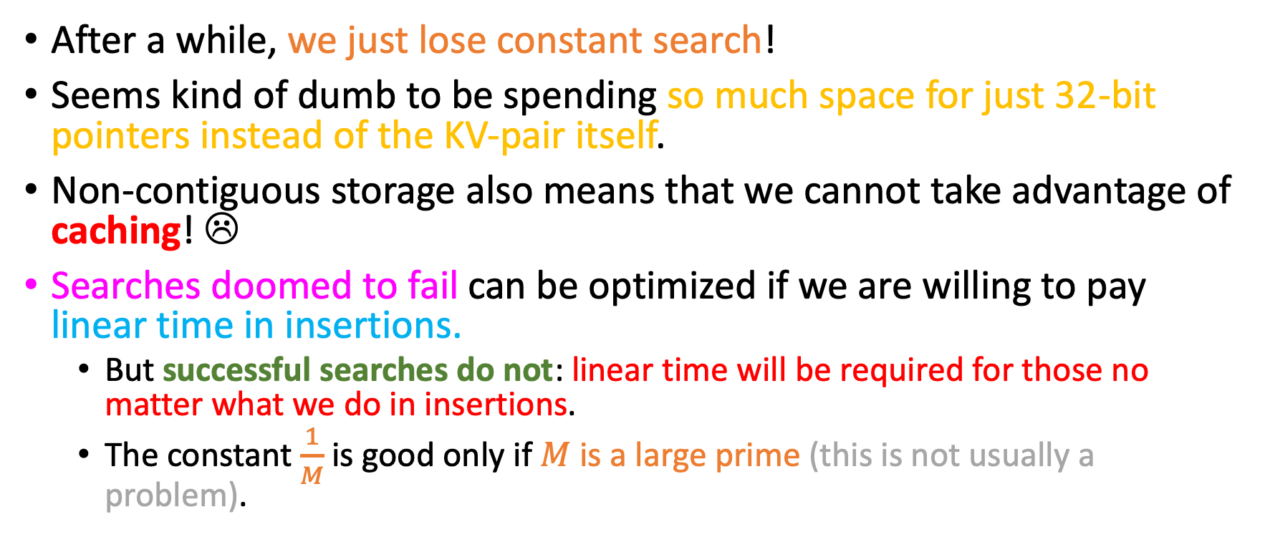
Cons of Separate Chaining
After a while, we just lose constant search!
Seems kind of dumb to be spending so much space for just 32-bit pointers instead of the KV-pair itself.
Non-contiguous storage also means that we cannot take advantage of caching! ☹
Searches doomed to fail can be optimized if we are willing to pay linear time in insertions.
But successful searches do not: linear time will be required for those no matter what we do in insertions.
The constant $\frac{1}{M}$ is good only if $M$ is a large prime (this is not usually a problem).

Slide 35
Memory mis—use…
If we look at a separated chaining – based hash table closely:
Hauvik
Mark
Xintong
Li
Lucy
Nakeesha

Slide 36
Memory mis—use…
If we look at a separated chaining – based hash table closely:
It might seem kind of dumb even that we aren’t using the contiguous storage already offered to us to store the keys, instead of wasting space for pointers!
Hauvik
Mark
Xintong
Li
Lucy
Nakeesha
Hauvik
Mark
Xintong
Li
Lucy
Nakeesha

Slide 37
Memory mis—use…
If we look at a separated chaining – based hash table closely:
It might seem kind of dumb even that we aren’t using the contiguous storage already offered to us to store the keys, instead of wasting space for pointers!
Hauvik
Mark
Xintong
Li
Lucy
Nakeesha
Hauvik
Mark
Xintong
We will soon see that those pointers are actually implicit (i.e we don’t actually have to store <key, pointer> pairs (that would not improve storage!)
Li
Lucy
Nakeesha

Slide 38
Open Addressing methods
It turns out that this is something done a lot in hashing!
All methods that perform collision resolution in the internal buffer itself are known as open addressing or closed hashing methods (relatively confusing, sorry).

Slide 39
Open Addressing methods
It turns out that this is something done a lot in hashing!
All methods that perform collision resolution in the internal buffer itself are known as open addressing or closed hashing methods (relatively confusing, sorry).
The simplest Open Addressing method is linear probing.
Logic of linear probing:
When inserting, if we encounter a collision, keep walking into the buffer by making one step forward at a time, wrapping around at the end.
The first empty buffer cell is where you will store your key! ☺

Slide 40

Insertion
Suppose that we want to hash integers based on a simple modular hash function $h$:
$$h\left(n\right)=n \% M$$
22 | 0
 | 1
35 | 2
 | 3
 | 4
 | 5
 | 6
 | 7
 | 8
20 | 9
 | 10

Slide 41
Insertion
Suppose that we want to hash integers based on a simple modular hash function $h$:
$$h\left(n\right)=n \% M$$
Insert 29
22 | 0
 | 1
35 | 2
 | 3
 | 4
 | 5
 | 6
 | 7
 | 8
20 | 9
 | 10

Slide 42

Insertion
Suppose that we want to hash integers based on a simple modular hash function $h$:
$$h\left(n\right)=n \% M$$
Insert 29
22 | 0
 | 1
35 | 2
 | 3
 | 4
 | 5
 | 6
29 | 7
 | 8
20 | 9
 | 10
$$h$$

Slide 43
Insertion
Suppose that we want to hash integers based on a simple modular hash function $h$:
$$h\left(n\right)=n \% M$$
Insert 29
22 | 0
 | 1
35 | 2
 | 3
 | 4
 | 5
 | 6
29 | 7
 | 8
20 | 9
 | 10
$$h$$
We’re done! We stored 29 with a single probe! ☺

Slide 44
Insertion
Suppose that we want to hash integers based on a simple modular hash function $h$:
$$h\left(n\right)=n \% M$$
Insert 13
22 | 0
 | 1
35 | 2
 | 3
 | 4
 | 5
 | 6
29 | 7
 | 8
20 | 9
 | 10

Slide 45

Insertion
Suppose that we want to hash integers based on a simple modular hash function $h$:
$$h\left(n\right)=n \% M$$
Insert 13
$$h$$
22 | 0
 | 1
35 | 2
 | 3
 | 4
 | 5
 | 6
29 | 7
 | 8
20 | 9
 | 10
We have a collision ☹

Slide 46
Insertion
Suppose that we want to hash integers based on a simple modular hash function $h$:
$$h\left(n\right)=n \% M$$
Insert 13
$$h$$
22 | 0
 | 1
35 | 2
13 | 3
 | 4
 | 5
 | 6
29 | 7
 | 8
20 | 9
 | 10
We have a collision ☹ Linear probing will resolve this by moving one step forward! ☺

Slide 47
Insertion
Suppose that we want to hash integers based on a simple modular hash function $h$:
$$h\left(n\right)=n \% M$$
Insert 9
22 | 0
 | 1
35 | 2
13 | 3
 | 4
 | 5
 | 6
29 | 7
 | 8
20 | 9
 | 10

Slide 48

Insertion
Suppose that we want to hash integers based on a simple modular hash function $h$:
$$h\left(n\right)=n \% M$$
Insert 9
22 | 0
 | 1
35 | 2
13 | 3
 | 4
 | 5
 | 6
29 | 7
 | 8
20 | 9
 | 10
Collision ☹
$$h$$

Slide 49
Insertion
Suppose that we want to hash integers based on a simple modular hash function $h$:
$$h\left(n\right)=n \% M$$
Insert 9
22 | 0
 | 1
35 | 2
13 | 3
 | 4
 | 5
 | 6
29 | 7
 | 8
20 | 9
9 | 10
Collision ☹ No problem!
$$h$$

Slide 50
Insertion
Suppose that we want to hash integers based on a simple modular hash function $h$:
$$h\left(n\right)=n \% M$$
Insert 31
22 | 0
 | 1
35 | 2
13 | 3
 | 4
 | 5
 | 6
29 | 7
 | 8
20 | 9
9 | 10

Slide 51
Insertion
Suppose that we want to hash integers based on a simple modular hash function $h$:
$$h\left(n\right)=n \% M$$
Insert 31
22 | 0
 | 1
35 | 2
13 | 3
 | 4
 | 5
 | 6
29 | 7
 | 8
20 | 9
9 | 10
$$h$$
Collision

Slide 52
Insertion
Suppose that we want to hash integers based on a simple modular hash function $h$:
$$h\left(n\right)=n \% M$$
Insert 31
22 | 0
 | 1
35 | 2
13 | 3
 | 4
 | 5
 | 6
29 | 7
 | 8
20 | 9
9 | 10
$$h$$
Collision
Another collision!

Slide 53
Insertion
Suppose that we want to hash integers based on a simple modular hash function $h$:
$$h\left(n\right)=n \% M$$
Insert 31
22 | 0
 | 1
35 | 2
13 | 3
 | 4
 | 5
 | 6
29 | 7
 | 8
20 | 9
9 | 10
$$h$$
Collision
Another collision!
Another collision!

Slide 54
Insertion
Suppose that we want to hash integers based on a simple modular hash function $h$:
$$h\left(n\right)=n \% M$$
Insert 31
22 | 0
31 | 1
35 | 2
13 | 3
 | 4
 | 5
 | 6
29 | 7
 | 8
20 | 9
9 | 10
$$h$$
Collision
Another collision!
Another collision!
But we finally find an empty cell ☺

Slide 55
Insertion
Suppose that we want to hash integers based on a simple modular hash function $h$:
$$h\left(n\right)=n \% M$$
Insert 11
22 | 0
31 | 1
35 | 2
13 | 3
 | 4
 | 5
 | 6
29 | 7
 | 8
20 | 9
9 | 10

Slide 56

Insertion
Suppose that we want to hash integers based on a simple modular hash function $h$:
$$h\left(n\right)=n \% M$$
$$h$$
Insert 11
22 | 0
31 | 1
35 | 2
13 | 3
 | 4
 | 5
 | 6
29 | 7
 | 8
20 | 9
9 | 10
We’d need 5 probes total…

Slide 57
Insertion
Suppose that we want to hash integers based on a simple modular hash function $h$:
$$h\left(n\right)=n \% M$$
Insert 11
22 | 0
31 | 1
35 | 2
13 | 3
 | 4
 | 5
 | 6
29 | 7
 | 8
20 | 9
9 | 10

Slide 58
Insertion
Suppose that we want to hash integers based on a simple modular hash function $h$:
$$h\left(n\right)=n \% M$$
Insert 11
22 | 0
31 | 1
35 | 2
13 | 3
 | 4
 | 5
 | 6
29 | 7
 | 8
20 | 9
9 | 10
Aren’t things getting a bit too crowded in the buffer?

Slide 59
Insertion
Suppose that we want to hash integers based on a simple modular hash function $h$:
$$h\left(n\right)=n \% M$$
Insert 11
22 | 0
31 | 1
35 | 2
13 | 3
 | 4
 | 5
 | 6
29 | 7
 | 8
20 | 9
9 | 10
The solution: Expand the size of the buffer and re-insert all keys, before we insert 11!

Slide 60

Insertion
Suppose that we want to hash integers based on a simple modular hash function $h$:
$$h\left(n\right)=n \% M$$
Insert 11
22 | 0
31 | 1
35 | 2
13 | 3
 | 4
 | 5
 | 6
29 | 7
 | 8
20 | 9
9 | 10
Load factor $α=\frac{7}{11}=0.63$
In practice, we expand immediately after we detect $α=0.5$
The solution: Expand the size of the buffer and re-insert all keys, before we insert 11!

Slide 61
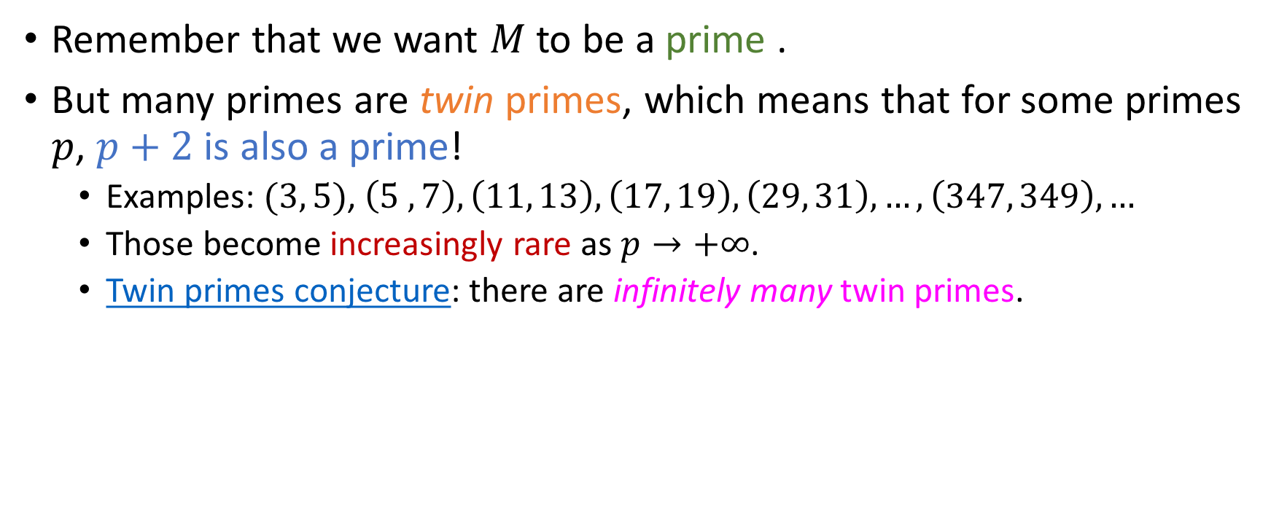
Resizing our buffer
Remember that we want $M$ to be a prime .
But many primes are twin primes, which means that for some primes $p$, $p+2$ is also a prime!
Examples: $(3, 5)$, $\left(5 , 7\right), \left(11, 13\right), \left(17, 19\right), \left(29, 31\right), …,\left(347, 349\right),…$
Those become increasingly rare as $p→+∞$.
Twin primes conjecture: there are infinitely many twin primes.

Slide 62
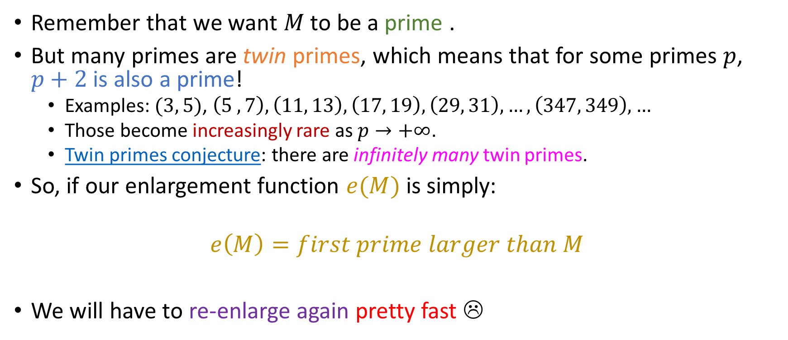
Resizing our buffer
Remember that we want $M$ to be a prime .
But many primes are twin primes, which means that for some primes $p$, $p+2$ is also a prime!
Examples: $(3, 5)$, $\left(5 , 7\right), \left(11, 13\right), \left(17, 19\right), \left(29, 31\right), …,\left(347, 349\right),…$
Those become increasingly rare as $p→+∞$.
Twin primes conjecture: there are infinitely many twin primes.
So, if our enlargement function $e(M)$ is simply:
$$e\left(M\right)=first prime larger than M$$
We will have to re-enlarge again pretty fast ☹

Slide 63
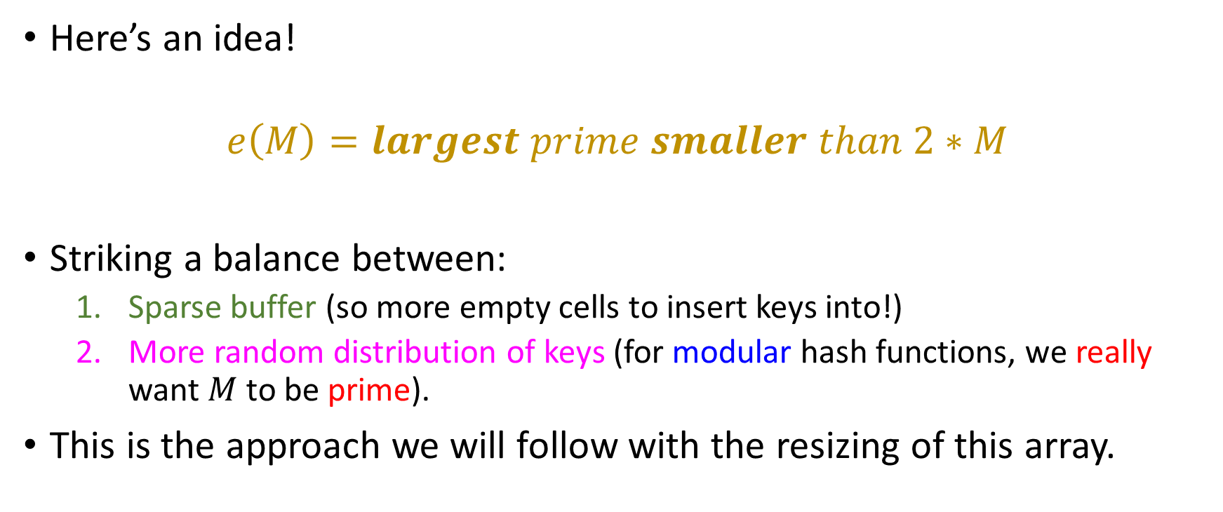
Resizing our buffer
Here’s an idea!
$$e\left(M\right)=largest prime smaller than 2∗M$$
Striking a balance between:
Sparse buffer (so more empty cells to insert keys into!)
More random distribution of keys (for modular hash functions, we really want $M$ to be prime).
This is the approach we will follow with the resizing of this array.

Slide 64


Resizing our buffer
 | 0
 | 1
 | 2
 | 3
 | 4
 | 5
 | 6
 | 7
 | 8
 | 9
 | 10
 | 11
 | 12
 | 13
 | 14
 | 15
 | 16
 | 17
 | 18
$$h\left(n\right)=n \% M$$
22 | 0
31 | 1
35 | 2
13 | 3
 | 4
 | 5
 | 6
29 | 7
 | 8
20 | 9
9 | 10
Please reinsert all keys for me real quick ☺
$$e$$

Slide 65

Resizing our buffer
 | 0
20 | 1
 | 2
22 | 3
 | 4
 | 5
 | 6
35 | 7
 | 8
9 | 9
29 | 10
 | 11
31 | 12
13 | 13
 | 14
 | 15
 | 16
 | 17
 | 18
$$h\left(n\right)=n \% M$$
22 | 0
31 | 1
35 | 2
13 | 3
 | 4
 | 5
 | 6
29 | 7
 | 8
20 | 9
9 | 10
No collisions during re-insertion, and pretty random distribution of keys!
$$e$$

Slide 66

Back to insertion….
$$h\left(n\right)=n \% M$$
 | 0
20 | 1
 | 2
22 | 3
 | 4
 | 5
 | 6
 | 7
 | 8
9 | 9
29 | 10
 | 11
31 | 12
13 | 13
 | 14
 | 15
35 | 16
 | 17
 | 18
Insert 11

Slide 67


Back to insertion….
$$h\left(n\right)=n \% M$$
 | 0
20 | 1
 | 2
22 | 3
 | 4
 | 5
 | 6
35 | 7
 | 8
9 | 9
29 | 10
11 | 11
31 | 12
13 | 13
 | 14
 | 15
35 | 16
 | 17
 | 18
Insert 11
$$h$$
Now our table can accommodate new keys! ☺
Until we have to resize again, of course… ☹

Slide 68
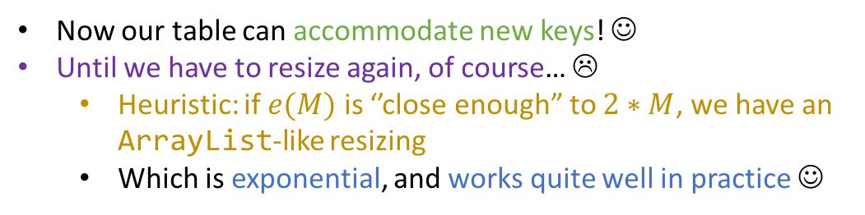
Back to insertion….
$$h\left(n\right)=n \% M$$
 | 0
20 | 1
 | 2
22 | 3
 | 4
 | 5
 | 6
35 | 7
 | 8
9 | 9
29 | 10
11 | 11
31 | 12
13 | 13
 | 14
 | 15
35 | 16
 | 17
 | 18
Insert 11
$$h$$
Now our table can accommodate new keys! ☺
Until we have to resize again, of course… ☹
Heuristic: if $e(M)$ is ‘’close enough” to $2∗M$, we have an ArrayList-like resizing
Which is exponential, and works quite well in practice ☺

Slide 69

“Clusters” and “chains”
$$h\left(n\right)=n \% M$$
Insert 4, 23, 5
 | 0
 | 1
 | 2
 | 3
 | 4
 | 5
 | 6
 | 7
 | 8
 | 9
 | 10
 | 11
 | 12
 | 13
 | 14
 | 15
 | 16
 | 17
 | 18

Slide 70
“Clusters” and “chains”
$$h\left(n\right)=n \% M$$
 | 0
 | 1
 | 2
 | 3
4 | 4
 | 5
 | 6
 | 7
 | 8
 | 9
 | 10
 | 11
 | 12
 | 13
 | 14
 | 15
 | 16
 | 17
 | 18
Insert 4, 23, 5

Slide 71
“Clusters” and “chains”
$$h\left(n\right)=n \% M$$
 | 0
 | 1
 | 2
 | 3
4 | 4
23 | 5
 | 6
 | 7
 | 8
 | 9
 | 10
 | 11
 | 12
 | 13
 | 14
 | 15
 | 16
 | 17
 | 18
Insert 4, 23, 5
After colliding with 4…

Slide 72
“Clusters” and “chains”
$$h\left(n\right)=n \% M$$
 | 0
 | 1
 | 2
 | 3
4 | 4
23 | 5
 | 6
 | 7
 | 8
 | 9
 | 10
 | 11
 | 12
 | 13
 | 14
 | 15
 | 16
 | 17
 | 18
Insert 4, 23, 5
We then say that 23 is in 4’s “collision chain”
After colliding with 4…

Slide 73
“Clusters” and “chains”
$$h\left(n\right)=n \% M$$
 | 0
 | 1
 | 2
 | 3
4 | 4
23 | 5
5 | 6
 | 7
 | 8
 | 9
 | 10
 | 11
 | 12
 | 13
 | 14
 | 15
 | 16
 | 17
 | 18
Insert 4, 23, 5
After colliding with 23…

Slide 74
“Clusters” and “chains”
$$h\left(n\right)=n \% M$$
 | 0
 | 1
 | 2
 | 3
4 | 4
23 | 5
5 | 6
 | 7
 | 8
 | 9
 | 10
 | 11
 | 12
 | 13
 | 14
 | 15
 | 16
 | 17
 | 18
Insert 4, 23, 5
5 is in 23’s collision chain only! Not 4’s!
After colliding with 23…

Slide 75
“Clusters” and “chains”
$$h\left(n\right)=n \% M$$
 | 0
 | 1
 | 2
 | 3
4 | 4
23 | 5
5 | 6
 | 7
 | 8
 | 9
 | 10
 | 11
 | 12
 | 13
 | 14
 | 15
 | 16
 | 17
 | 18
Insert 4, 23, 5
Insert 19, 38, 0

Slide 76
“Clusters” and “chains”
$$h\left(n\right)=n \% M$$
19 | 0
38 | 1
0 | 2
 | 3
4 | 4
23 | 5
5 | 6
 | 7
 | 8
 | 9
 | 10
 | 11
 | 12
 | 13
 | 14
 | 15
 | 16
 | 17
 | 18
Which collision chains do these keys belong to?
Insert 4, 23, 5
Insert 19, 38, 0

Slide 77
“Clusters” and “chains”
$$h\left(n\right)=n \% M$$
19 | 0
38 | 1
0 | 2
 | 3
4 | 4
23 | 5
5 | 6
 | 7
 | 8
 | 9
 | 10
 | 11
 | 12
 | 13
 | 14
 | 15
 | 16
 | 17
 | 18
Which collision chains do these keys belong to?
Insert 4, 23, 5
Insert 19, 38, 0
Since 38 collides with 19, it’s in 19’s collision chain.
Since 0 collides with both 19 and 38 (after one forward step), it is in both collision chains!

Slide 78
“Clusters” and “chains”
$$h\left(n\right)=n \% M$$
19 | 0
38 | 1
0 | 2
 | 3
4 | 4
23 | 5
5 | 6
 | 7
 | 8
 | 9
 | 10
 | 11
 | 12
 | 13
 | 14
 | 15
 | 16
 | 17
 | 18
Insert 4, 23, 5
Insert 19, 38, 0
Insert 27, 9, 48

Slide 79
“Clusters” and “chains”
$$h\left(n\right)=n \% M$$
19 | 0
38 | 1
0 | 2
 | 3
4 | 4
23 | 5
5 | 6
 | 7
27 | 8
9 | 9
48 | 10
 | 11
 | 12
 | 13
 | 14
 | 15
 | 16
 | 17
 | 18
Insert 4, 23, 5
Insert 19, 38, 0
Insert 27, 9, 48
Insert 26

Slide 80
“Clusters” and “chains”
$$h\left(n\right)=n \% M$$
19 | 0
38 | 1
0 | 2
 | 3
4 | 4
23 | 5
5 | 6
26 | 7
27 | 8
9 | 9
48 | 10
 | 11
 | 12
 | 13
 | 14
 | 15
 | 16
 | 17
 | 18
Insert 4, 23, 5
Insert 19, 38, 0
Insert 27, 9, 48
Insert 26

Slide 81
“Clusters” and “chains”
$$h\left(n\right)=n \% M$$
19 | 0
38 | 1
0 | 2
 | 3
4 | 4
23 | 5
5 | 6
26 | 7
27 | 8
9 | 9
48 | 10
 | 11
 | 12
 | 13
 | 14
 | 15
 | 16
 | 17
 | 18
Insert 4, 23, 5
Insert 19, 38, 0
Insert 27, 9, 48
Insert 26
all those different collision chains have merged into a cluster of keys!

Slide 82
“Clusters” and “chains”
$$h\left(n\right)=n \% M$$
19 | 0
38 | 1
0 | 2
 | 3
4 | 4
23 | 5
5 | 6
26 | 7
27 | 8
9 | 9
48 | 10
 | 11
 | 12
 | 13
 | 14
 | 15
 | 16
 | 17
 | 18
Insert 4, 23, 5
Insert 19, 38, 0
Insert 27, 9, 48
Insert 26
all those different collision chains have merged into a cluster of keys!
AND IT GETS WORSE!

Slide 83
“Clusters” and “chains”
$$h\left(n\right)=n \% M$$
19 | 0
38 | 1
0 | 2
 | 3
4 | 4
23 | 5
5 | 6
26 | 7
27 | 8
9 | 9
48 | 10
 | 11
 | 12
 | 13
 | 14
 | 15
 | 16
 | 17
 | 18
Insert 4, 23, 5
Insert 19, 38, 0
Insert 27, 9, 48
Insert 26
Insert 60

Slide 84
“Clusters” and “chains”
$$h\left(n\right)=n \% M$$
19 | 0
38 | 1
0 | 2
60 | 3
4 | 4
23 | 5
5 | 6
26 | 7
27 | 8
9 | 9
48 | 10
 | 11
 | 12
 | 13
 | 14
 | 15
 | 16
 | 17
 | 18
Insert 4, 23, 5
Insert 19, 38, 0
Insert 27, 9, 48
Insert 26
Insert 60
Inserting 60 led us to a “mega-cluster” where all the different collision chains are intermixed!

Slide 85
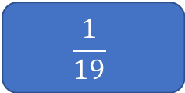
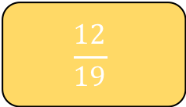
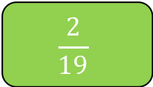
“Clusters” and “chains”
$$h\left(n\right)=n \% M$$
19 | 0
38 | 1
0 | 2
60 | 3
4 | 4
23 | 5
5 | 6
26 | 7
27 | 8
9 | 9
48 | 10
 | 11
 | 12
 | 13
 | 14
 | 15
 | 16
 | 17
 | 18
Insert 4, 23, 5
Insert 19, 38, 0
Insert 27, 9, 48
Insert 26
Insert 60
Assuming uniformly distributed input, what’s the probability that the next insertion will enlarge this cluster?
$$\frac{1}{19}$$
$$\frac{2}{19}$$
$$\frac{12}{19}$$
Something else (what?)

Slide 86

“Clusters” and “chains”
$$h\left(n\right)=n \% M$$
19 | 0
38 | 1
0 | 2
60 | 3
4 | 4
23 | 5
5 | 6
26 | 7
27 | 8
9 | 9
48 | 10
 | 11
 | 12
 | 13
 | 14
 | 15
 | 16
 | 17
 | 18
Insert 4, 23, 5
Insert 19, 38, 0
Insert 27, 9, 48
Insert 26
Insert 60
Assuming uniformly distributed input, what’s the probability that the next insertion will enlarge this cluster?
11 of these…
$$\frac{1}{19}$$
$$\frac{2}{19}$$
This…
$$\frac{12}{19}$$
Something else (what?)
Total of 13!
$$\frac{13}{19}$$
And This! ☺

Slide 87
“Clusters” and “chains”
$$h\left(n\right)=n \% M$$
19 | 0
38 | 1
0 | 2
60 | 3
4 | 4
23 | 5
5 | 6
26 | 7
27 | 8
9 | 9
48 | 10
 | 11
 | 12
 | 13
 | 14
 | 15
 | 16
 | 17
 | 18
Insert 4, 23, 5
Insert 19, 38, 0
Insert 27, 9, 48
Insert 26
Insert 60
Statement: If instead of adding 1 every time we added something else (e.g 3) we would avoid clusters
11 of these…
True
False
This…
Total of 13!
And This! ☺

Slide 88
“Clusters” and “chains”
$$h\left(n\right)=n \% M$$
19 | 0
38 | 1
0 | 2
60 | 3
4 | 4
23 | 5
5 | 6
26 | 7
27 | 8
9 | 9
48 | 10
 | 11
 | 12
 | 13
 | 14
 | 15
 | 16
 | 17
 | 18
Insert 4, 23, 5
Insert 19, 38, 0
Insert 27, 9, 48
Insert 26
Insert 60
Statement: If instead of adding 1 every time we added something else (e.g 3) we would avoid clusters
11 of these…
True
False
This…
Total of 13!
The “clusters” then end up just being “discontinuous” in the array! :O
Only solution: Resize the array, reinserting all elements afterwards ☹
And This! ☺

Slide 89
Take-home message
As the table progressively gets fuller, collision chains form key clusters.
The probability that those clusters merge into mega-clusters increases with every insertion that occupies spaces between the clusters… ☹

Slide 90
Take-home message
As the table progressively gets fuller, collision chains form key clusters.
The probability that those clusters merge into mega-clusters increases with every insertion that occupies spaces between the clusters… ☹
Problem compounded if we remove the uniform hashing assumption.
Solution offered by linear probing: Resize the table (e.g through our previous approach), re-hash and re-insert all keys.

Slide 91
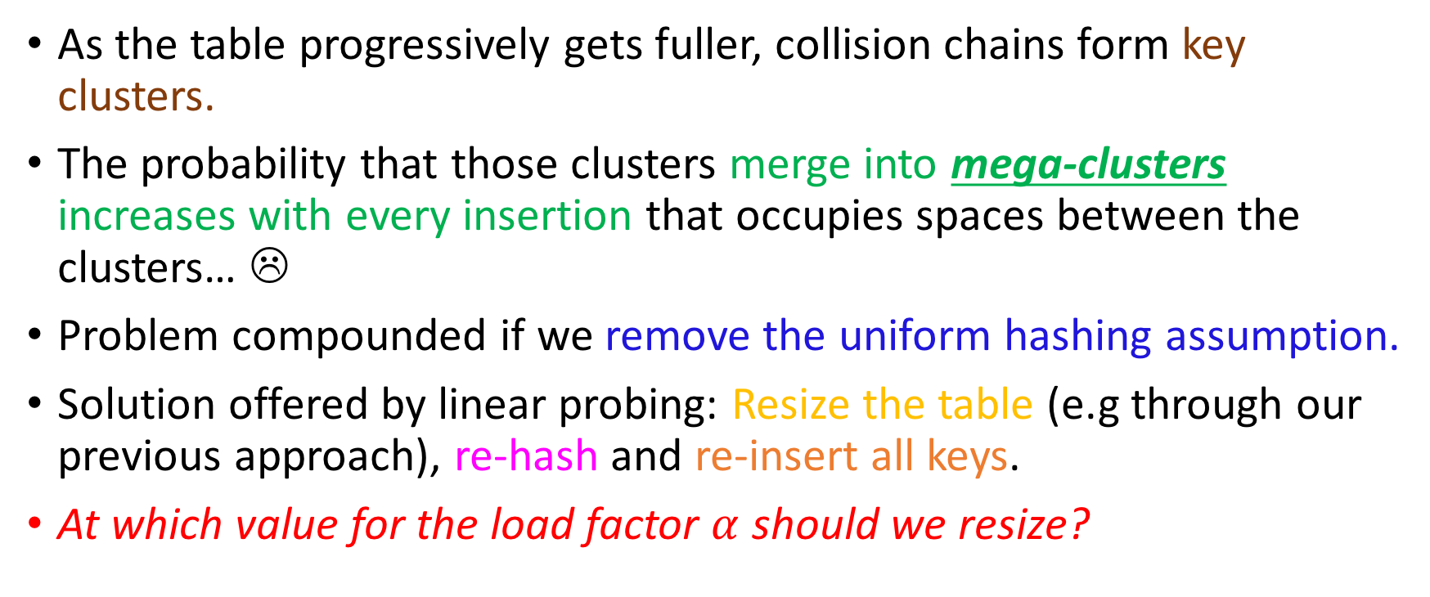
Take-home message
As the table progressively gets fuller, collision chains form key clusters.
The probability that those clusters merge into mega-clusters increases with every insertion that occupies spaces between the clusters… ☹
Problem compounded if we remove the uniform hashing assumption.
Solution offered by linear probing: Resize the table (e.g through our previous approach), re-hash and re-insert all keys.
At which value for the load factor $α$ should we resize?

Slide 92
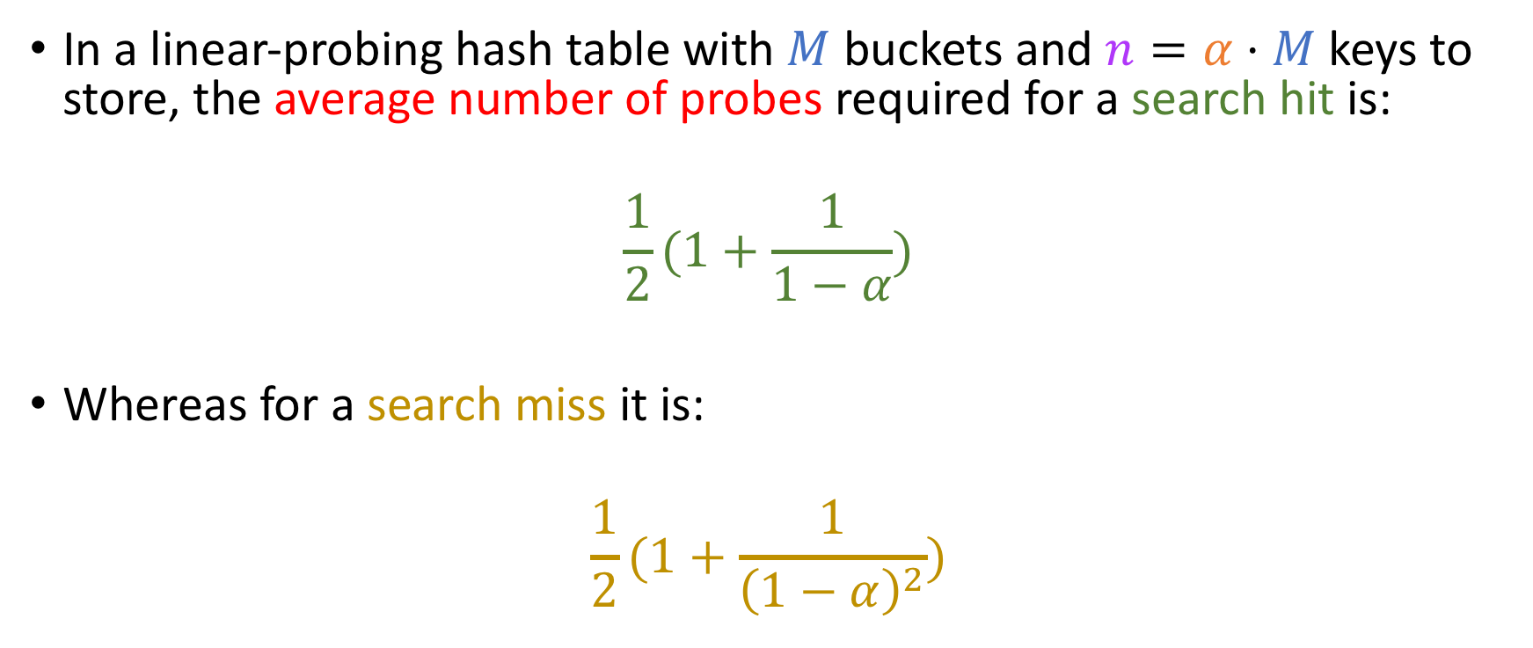
Knuth’s seminal result
In a linear-probing hash table with $M$ buckets and $n=α⋅M$ keys to store, the average number of probes required for a search hit is:
$$\frac{1}{2}(1+\frac{1}{1−α})$$
Whereas for a search miss it is:
$$\frac{1}{2}(1+\frac{1}{{\left(1−α\right)}^{2}})$$

Slide 93

Knuth’s seminal result
$$a∈(0, 1)$$
In a linear-probing hash table with $M$ buckets and $n=α⋅M$ keys to store, the average number of probes required for a search hit is:
$$\frac{1}{2}(1+\frac{1}{1−α})$$
Whereas for a search miss it is:
$$\frac{1}{2}(1+\frac{1}{{\left(1−α\right)}^{2}})$$
Psst! Perfectly uniform hash!

Slide 94
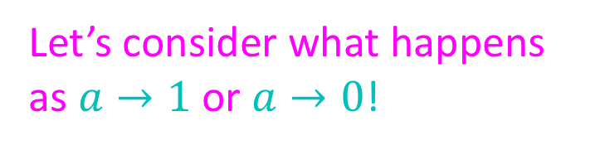
Knuth’s seminal result
$$a∈(0, 1)$$
In a linear-probing hash table with $M$ buckets and $n=α⋅M$ keys to store, the average number of probes required for a search hit is:
$$\frac{1}{2}(1+\frac{1}{1−α})$$
Whereas for a search miss it is:
$$\frac{1}{2}(1+\frac{1}{{\left(1−α\right)}^{2}})$$
Psst! Perfectly uniform hash!
Let’s consider what happens as $a→1$ or $a→0$!

Slide 95

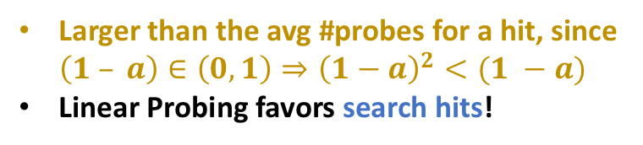

Knuth’s seminal result
$$a∈(0, 1)$$
In a linear-probing hash table with $M$ buckets and $N=α⋅M$ keys to store, the average number of probes required for a search hit is:
$$\frac{1}{2}(1+\frac{1}{1−α})$$
Whereas for a search miss it is:
$$\frac{1}{2}(1+\frac{1}{{\left(1−α\right)}^{2}})$$
Psst! Perfectly uniform hash!
Let’s consider what happens as $a→1$ or $a→0$!
Larger than the avg #probes for a hit, since $\left(1 – a\right)∈\left(0, 1\right)⇒{\left(1−a\right)}^{2}<(1 −a)$
Linear Probing favors search hits!

Slide 96
Search
Search in a Linear Probing hash table consists of first hashing the key to be searched.
Then, we loop through the buffer until:
We find the key (search hit) ☺, OR
We encounter an empty cell (search miss) ☹

Slide 97
Search
Search in a Linear Probing hash table consists of first hashing the key to be searched.
Then, we loop through the buffer until:
We find the key (search hit) ☺, OR
We encounter an empty cell (search miss) ☹
As previously mentioned, linear probing favors search hits over search misses.
Is this reasonable? What can we expect in practice?

Slide 98
Search
Search in a Linear Probing hash table consists of first hashing the key to be searched.
Then, we loop through the buffer until:
We find the key (search hit) ☺, OR
We encounter an empty cell (search miss) ☹
As previously mentioned, linear probing favors search hits over search misses.
Is this reasonable? What can we expect in practice?
More search hits
More search misses
About the same number of hits and misses

Slide 99
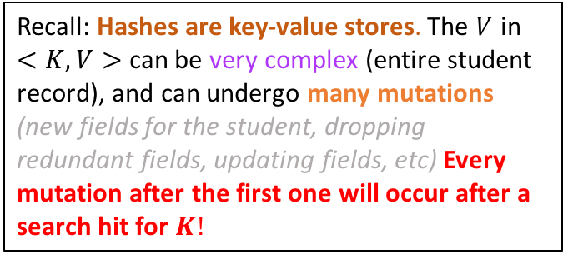
Search
Search in a Linear Probing hash table consists of first hashing the key to be searched.
Then, we loop through the buffer until:
We find the key (search hit) ☺, OR
We encounter an empty cell (search miss) ☹
As previously mentioned, linear probing favors search hits over search misses.
Is this reasonable? What can we expect in practice?
Recall: Hashes are key-value stores. The $V$ in
$<K, V>$ can be very complex (entire student record), and can undergo many mutations (new fields for the student, dropping redundant fields, updating fields, etc) Every mutation after the first one will occur after a search hit for $K!$
MANY MORE SEARCH HITS!
More search hits
More search misses
About the same number of hits and misses

Slide 100
Deletion
Toughest operation!

Slide 101
Deletion
Toughest operation!
“Hard” deletion: by setting reference to null, you break the path to other keys ☹
Only solution: Loop through rest of cluster, nullifying references but simultaneously re-inserting the key in the table

Slide 102
Deletion
Toughest operation!
“Hard” deletion: by setting reference to null, you break the path to other keys ☹
Only solution: Loop through rest of cluster, nullifying references but simultaneously re-inserting the key in the table.
“Soft” deletion: Tombstones!
A special value which contributes to the current size (key count) of the table, but is available if a value wants the cell for an insertion!

Slide 103
Deletion
Toughest operation!
“Hard” deletion: by setting reference to null, you break the path to other keys ☹
Only solution: Loop through rest of cluster, nullifying references but simultaneously re-inserting the key in the table.
“Soft” deletion: Tombstones!
A special value which contributes to the current size (key count) of the table, but is available if a value wants the cell for an insertion!
In your project, you will implement both kinds of deletion.

Slide 104
Hard Deletion exercise!
19 | 0
38 | 1
0 | 2
60 | 3
4 | 4
23 | 5
5 | 6
26 | 7
27 | 8
9 | 9
48 | 10
 | 11
 | 12
 | 13
50 | 14
15 | 15
 | 16
 | 17
 | 18
Let’s try to delete 19….

Slide 105
Hard Deletion exercise!
 | 0
38 | 1
0 | 2
60 | 3
4 | 4
23 | 5
5 | 6
26 | 7
27 | 8
9 | 9
48 | 10
 | 11
50 | 12
 | 13
 | 14
15 | 15
 | 16
 | 17
 | 18
Let’s try to delete 19….
Erase it from the table (nullify reference if key is an Object)

Slide 106
Hard Deletion exercise!
 | 0
38 | 1
0 | 2
60 | 3
4 | 4
23 | 5
5 | 6
26 | 7
27 | 8
9 | 9
48 | 10
 | 11
50 | 12
 | 13
 | 14
15 | 15
 | 16
 | 17
 | 18
Let’s try to delete 19….
Erase it from the table (nullify reference if key is an Object)
Loop through the rest of the cluster, erase and re-insert all keys :O

Slide 107
Hard Deletion exercise!
 | 0
38 | 1
0 | 2
60 | 3
4 | 4
23 | 5
5 | 6
26 | 7
27 | 8
9 | 9
48 | 10
 | 11
50 | 12
 | 13
 | 14
15 | 15
 | 16
 | 17
 | 18
Let’s try to delete 19….
Erase it from the table (nullify reference if key is an Object)
Loop through the rest of the cluster, erase and re-insert all keys :O
Note: those keys are in a different cluster, so they are not touched.

Slide 108
Hard Deletion exercise!
 | 0
38 | 1
0 | 2
60 | 3
4 | 4
23 | 5
5 | 6
26 | 7
27 | 8
9 | 9
48 | 10
 | 11
50 | 12
 | 13
 | 14
15 | 15
 | 16
 | 17
 | 18
Let’s try to delete 19….
Erase it from the table (nullify reference if key is an Object)
Loop through the rest of the cluster, erase and re-insert all keys :O
Let’s do this exercise together ☺
Note: those keys are in a different cluster, so they are not touched.

