Slide 1
Finding good hash functions
CMSC 420

Slide 2
Hash function requirements
Uniformly distribute keys (at least approximately)
Reduces “collisions” on the table, allowing for efficient operations.
Easy to compute
Will be used all the time to delete, insert, search for keys, so it had better be fast to compute.
Consistent (“equal” keys should lead to “equal” hashes)
Otherwise, search is broken (a key that has been inserted can no longer be found)

Slide 3

Form of a hash function
Recall the PHP associative array “incision” we made:
$ages
Internal Buffer
0
1
2
3
4
5
6
7
27
55
26
31
23
78
34
18
2
26
$$h$$
“Sravanthi”

Slide 4



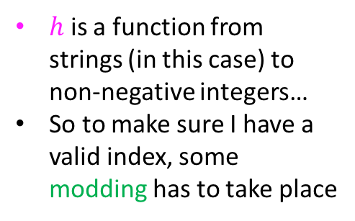
Form of a hash function
Recall the PHP associative array “incision” we made:
$ages
Internal Buffer
0
1
2
3
4
5
6
7
27
55
26
31
23
78
34
18
2
26
$$h$$
“Sravanthi”
$$g$$
$$\%8$$
$h$ is a function from strings (in this case) to non-negative integers…
So to make sure I have a valid index, some modding has to take place

Slide 5
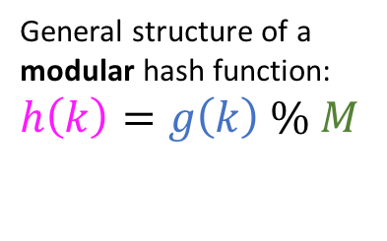
Form of a hash function
Recall the PHP associative array “incision” we made:
$ages
Internal Buffer
0
1
2
3
4
5
6
7
27
55
26
31
23
78
34
18
2
26
$$h$$
“Sravanthi”
$$g$$
$$\%8$$
$h$ is a function from strings (in this case) to non-negative integers…
So to make sure I have a valid index, some modding has to take place
General structure of a modular hash function: $h\left(k\right)=g\left(k\right) \% M$

Slide 6
Choice of hash table size
Which among the following is the best choice for M, the hash table size?
18
97
1000
2000

Slide 7

Choice of hash table size
Which among the following is the best choice for M, the hash table size?
The only given choice that is a prime number!
18
97
1000
2000

Slide 8

Choice of hash table size
Which among the following is the best choice for M, the hash table size?
The only given choice that is a prime number!
Let’s see why this is important…
18
97
1000
2000

Slide 9

A simple example
Suppose that my keys are base-10 integers and my array size is 100.
Assuming $g$ the identity function, my function formula is
$$h\left(k\right)=k\%100$$

Slide 10

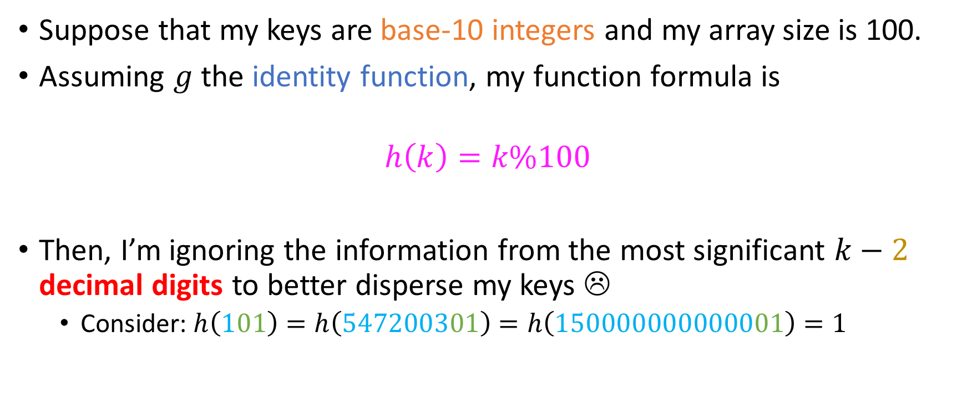
A simple example
Suppose that my keys are base-10 integers and my array size is 100.
Assuming $g$ the identity function, my function formula is
$$h\left(k\right)=k\%100$$
Then, I’m ignoring the information from the most significant $k−2$ decimal digits to better disperse my keys ☹
Consider: $h\left(101\right)=h\left(547200301\right)=h\left(150000000000001\right)=1$
$${10}^{2}$$

Slide 11
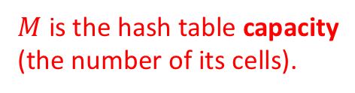
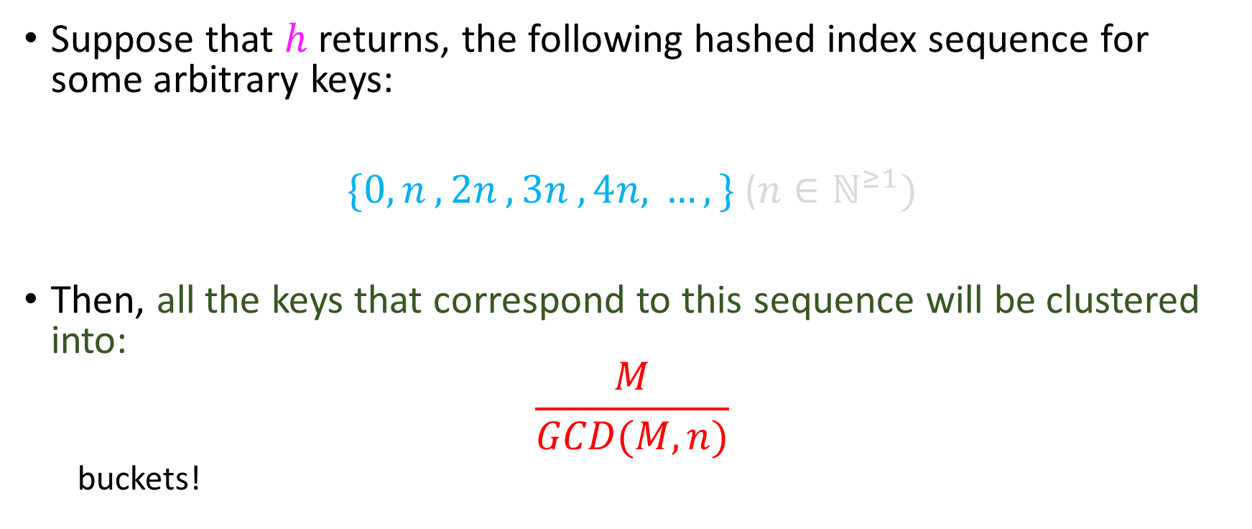
Formal argument
Suppose that $h$ returns, the following hashed index sequence for some arbitrary keys:
$\{{0, n}_{ },2n_{ },3n_{ },4{n,}_{ }…,\}$ ($n∈ℕ^{≥1})$
Then, all the keys that correspond to this sequence will be clustered into:
$$\frac{M}{GCD(M, n)}$$
buckets!
$M$ is the hash table capacity (the number of its cells).

Slide 12
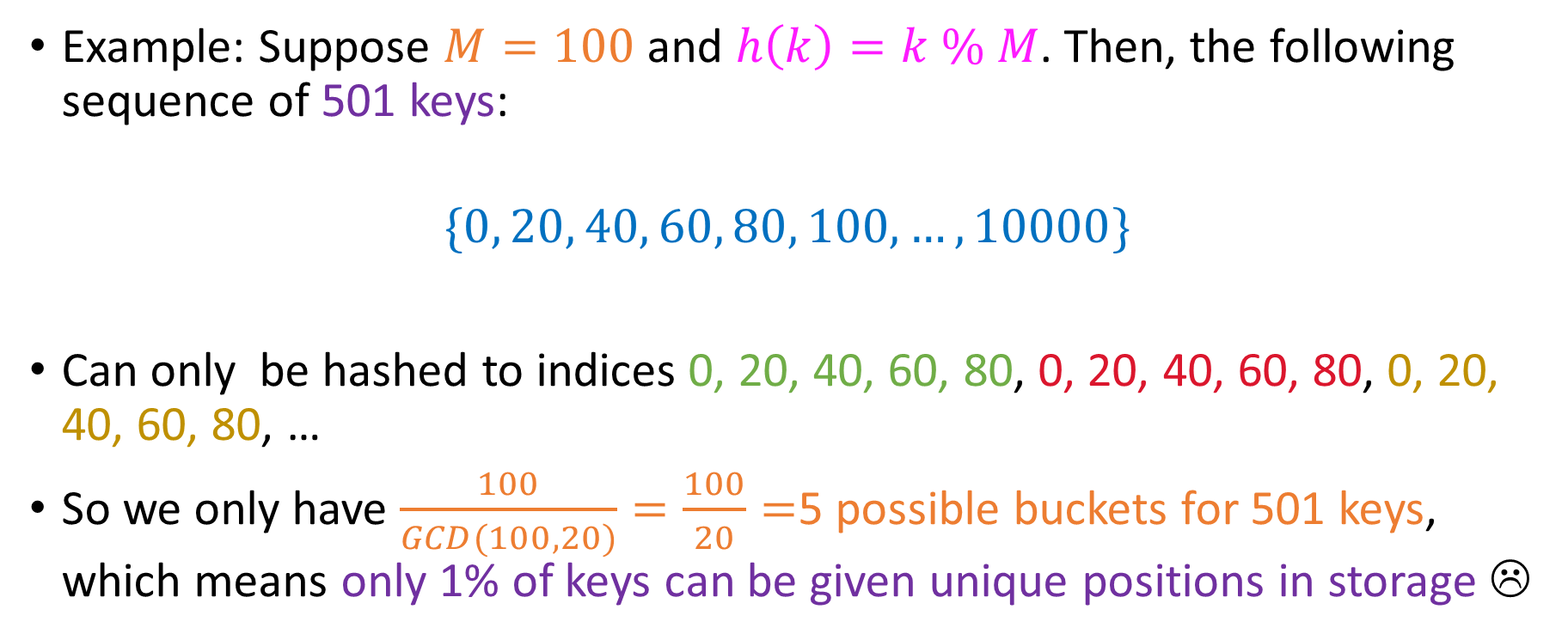
Evaluating the argument
Example: Suppose $M=100$ and $h\left(k\right)=k \% M$. Then, the following sequence of 501 keys:
$$\{0, 20, 40, 60, 80, 100, …, 10000\}$$
Can only be hashed to indices 0, 20, 40, 60, 80, 0, 20, 40, 60, 80, 0, 20, 40, 60, 80, …
So we only have $\frac{100}{GCD(100, 20)}=\frac{100}{20}=$5 possible buckets for 501 keys, which means only 1% of keys can be given unique positions in storage ☹

Slide 13
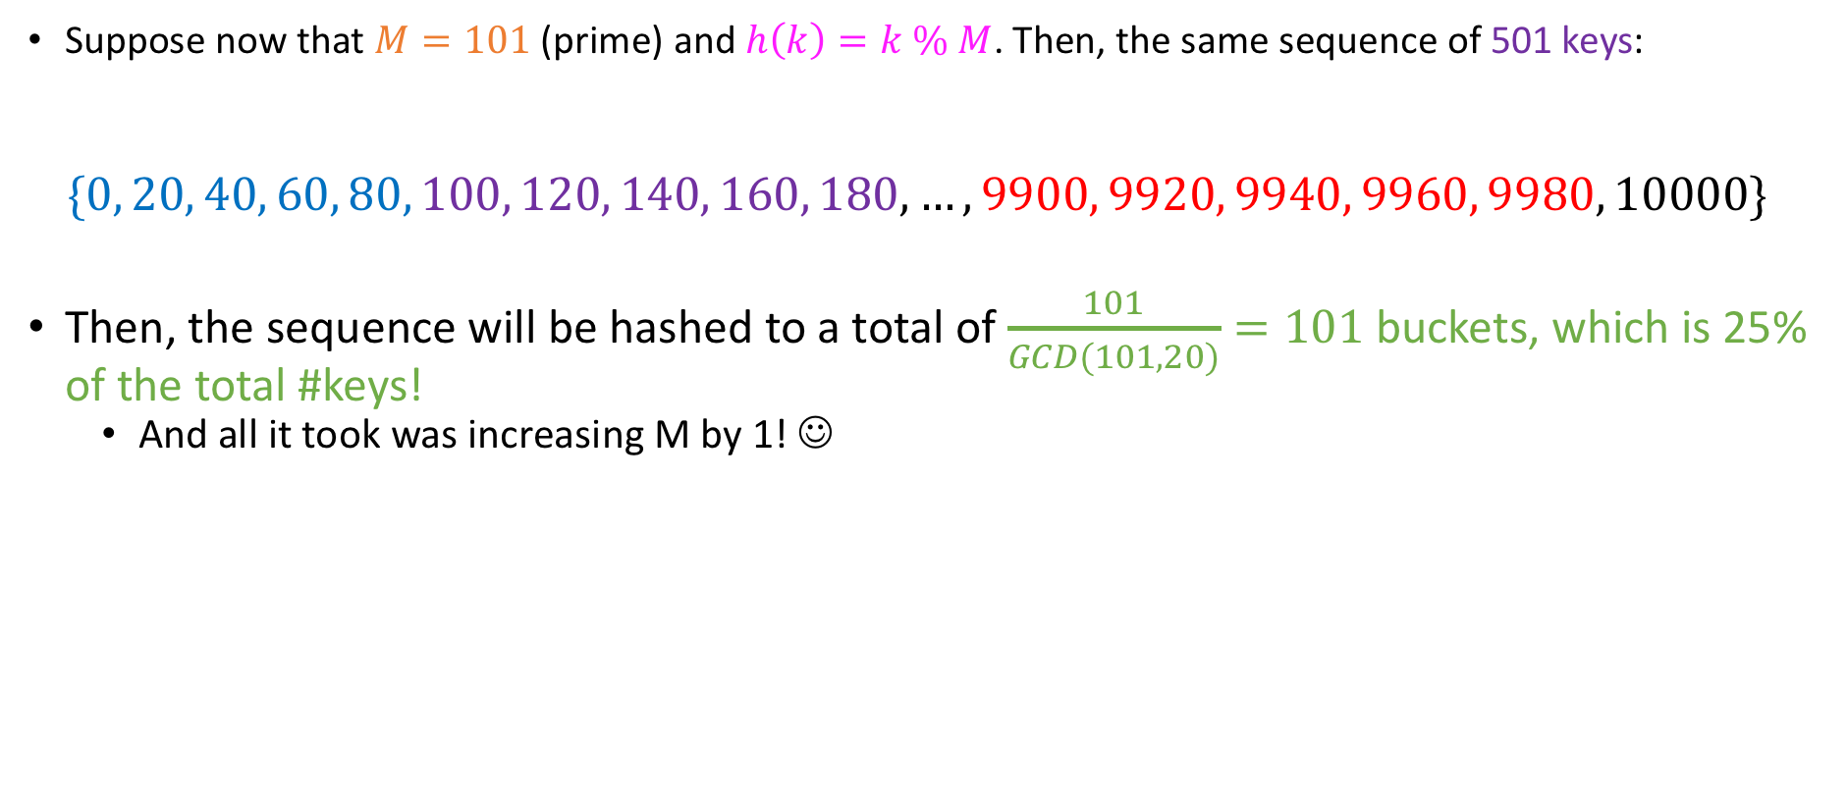
Evaluating the argument
Suppose now that $M=101$ (prime) and $h\left(k\right)=k \% M$. Then, the same sequence of 501 keys:
$$\{0, 20, 40, 60, 80, 100, 120, 140, 160, 180, …, 9900, 9920, 9940, 9960, 9980, 10000\}$$
Then, the sequence will be hashed to a total of $\frac{101}{GCD(101, 20)}=101$buckets, which is 25% of the total #keys!
And all it took was increasing M by 1! ☺

Slide 14
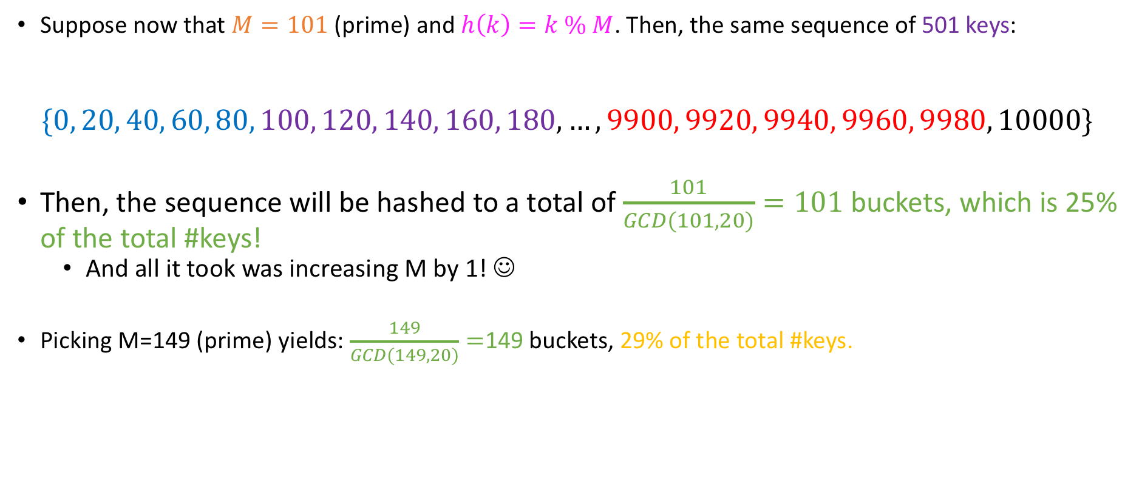
Evaluating the argument
Suppose now that $M=101$ (prime) and $h\left(k\right)=k \% M$. Then, the same sequence of 501 keys:
$$\{0, 20, 40, 60, 80, 100, 120, 140, 160, 180, …, 9900, 9920, 9940, 9960, 9980, 10000\}$$
Then, the sequence will be hashed to a total of $\frac{101}{GCD(101, 20)}=101$buckets, which is 25% of the total #keys!
And all it took was increasing M by 1! ☺
Picking M=149 (prime) yields: $\frac{149}{GCD(149, 20)}=$149 buckets, 29% of the total #keys.

Slide 15
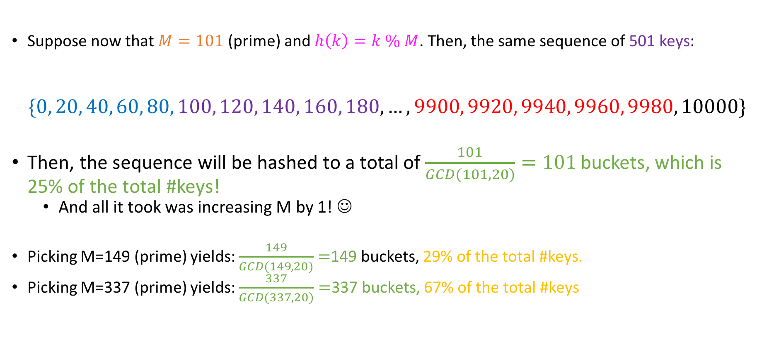
Evaluating the argument
Suppose now that $M=101$ (prime) and $h\left(k\right)=k \% M$. Then, the same sequence of 501 keys:
$$\{0, 20, 40, 60, 80, 100, 120, 140, 160, 180, …, 9900, 9920, 9940, 9960, 9980, 10000\}$$
Then, the sequence will be hashed to a total of $\frac{101}{GCD(101, 20)}=101$buckets, which is 25% of the total #keys!
And all it took was increasing M by 1! ☺
Picking M=149 (prime) yields: $\frac{149}{GCD(149, 20)}=$149 buckets, 29% of the total #keys.
Picking M=337 (prime) yields: $\frac{337}{GCD(337, 20)}=$337 buckets, 67% of the total #keys

Slide 16
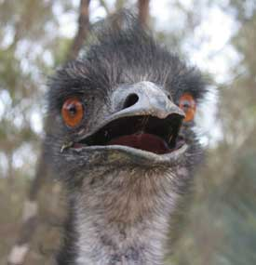
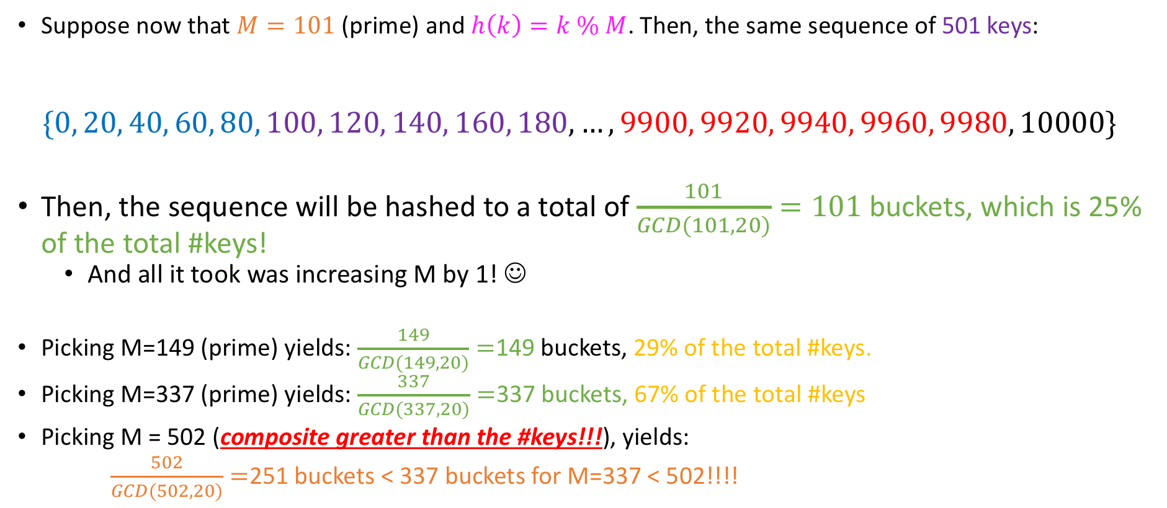
Evaluating the argument
Suppose now that $M=101$ (prime) and $h\left(k\right)=k \% M$. Then, the same sequence of 501 keys:
$$\{0, 20, 40, 60, 80, 100, 120, 140, 160, 180, …, 9900, 9920, 9940, 9960, 9980, 10000\}$$
Then, the sequence will be hashed to a total of $\frac{101}{GCD(101, 20)}=101$buckets, which is 25% of the total #keys!
And all it took was increasing M by 1! ☺
Picking M=149 (prime) yields: $\frac{149}{GCD(149, 20)}=$149 buckets, 29% of the total #keys.
Picking M=337 (prime) yields: $\frac{337}{GCD(337, 20)}=$337 buckets, 67% of the total #keys
Picking M = 502 (composite greater than the #keys!!!), yields:
$\frac{502}{GCD(502, 20)}=$251 buckets < 337 buckets for M=337 < 502!!!!

Slide 17
Hash functions: Keys are Integers
When your keys are ints, a simple modular hash function will do.
This is the approach that we will follow in class.

Slide 18

Hash functions for characters
A data structure known as a trie (“try”) indexes by character!
Note that this is not a modular hash function!
a | b | … | … | y | z
* | * | … | … | * | *
$h(k) = (int)k – 97$, (where $k∈\{^{′}a^{′},^{′}b^{′},…,^{′}z′\})$

Slide 19
Hash functions for characters
A data structure known as a trie (“try”) indexes by character!
Note that this is not a modular hash function!
a | b | … | … | y | z
* | * | … | … | * | *
A subtrahend of 97 allows ASCII ‘a’ (lowercase ‘A’) to be hashed to 0! ☺
$h(k) = (int)k – 97$, (where $k∈\{^{′}a^{′},^{′}b^{′},…,^{′}z′\})$

Slide 20
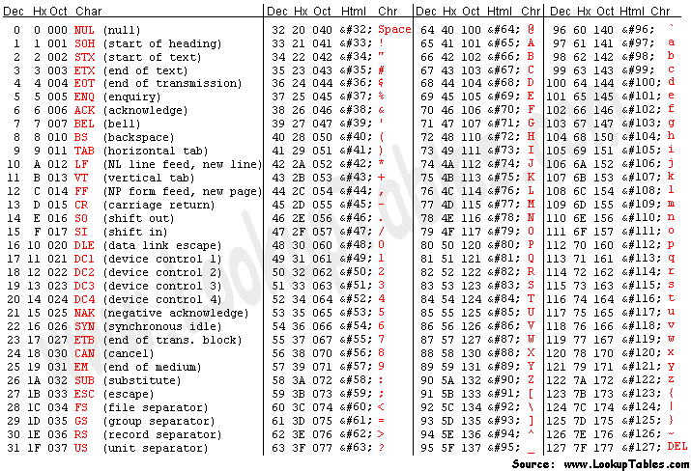
Hash functions for characters
A data structure known as a trie (“try”) indexes by character!
Note that this is not a modular hash function!
a | b | … | … | y | z
* | * | … | … | * | *
A subtrahend of 97 allows ASCII ‘a’ (lowercase ‘A’) to be hashed to 0! ☺
$h(k) = (int)k – 97$, (where $k∈\{^{′}a^{′},^{′}b^{′},…,^{′}z′\})$

Slide 21
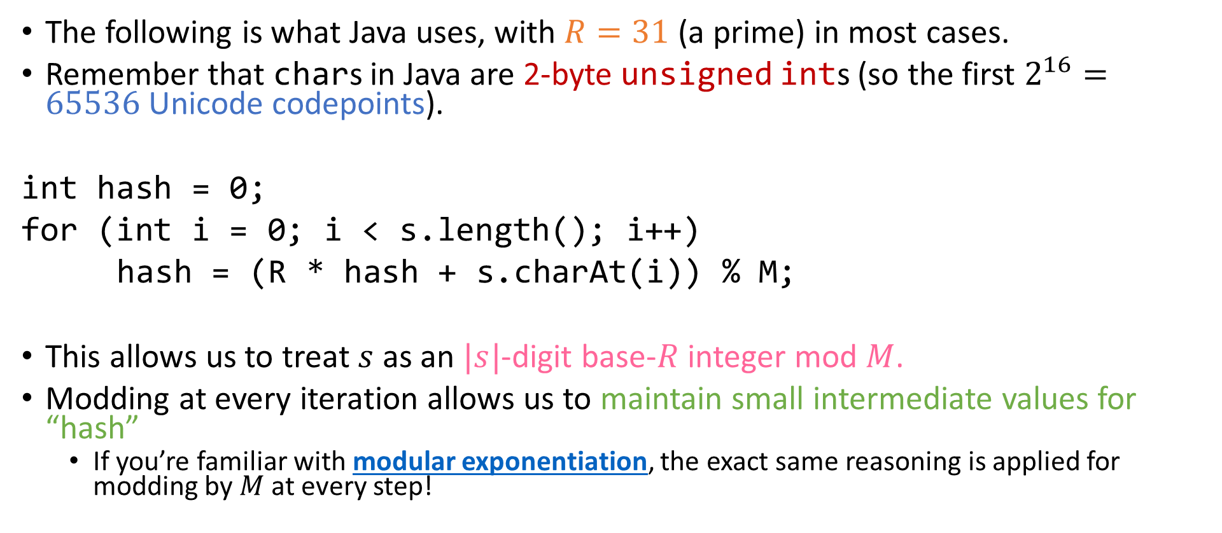
Hash functions for strings
The following is what Java uses, with $R=31$ (a prime) in most cases.
Remember that chars in Java are 2-byte unsigned ints (so the first $2^{16}=65536$ Unicode codepoints).
int hash = 0;
for (int i = 0; i < s.length(); i++)
hash = (R * hash + s.charAt(i)) % M;
This allows us to treat $s$ as an $|s|$-digit base-$R$ integer mod $M$.
Modding at every iteration allows us to maintain small intermediate values for “hash”
If you’re familiar with modular exponentiation, the exact same reasoning is applied for modding by$M$at every step!

Slide 22

Hash functions for floating-point keys
Humans typically write floating-point numbers in base 10. Example:
$$π_{(10)}≈3.14159…_{\left(10\right)}=3×{10}^{0}+\frac{1}{10}+\frac{4}{{10}^{2}}+\frac{1}{{10}^{3}}+\frac{5}{{10}^{4}}+\frac{9}{{10}^{5}}+…$$

Slide 23
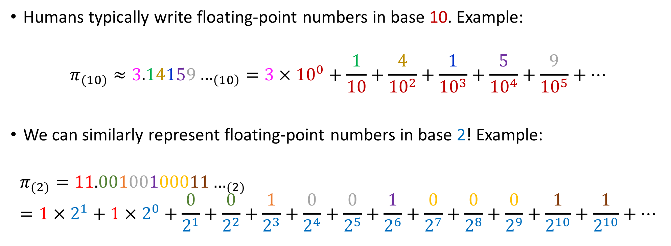
Hash functions for floating-point keys
Humans typically write floating-point numbers in base 10. Example:
$$π_{(10)}≈3.14159…_{\left(10\right)}=3×{10}^{0}+\frac{1}{10}+\frac{4}{{10}^{2}}+\frac{1}{{10}^{3}}+\frac{5}{{10}^{4}}+\frac{9}{{10}^{5}}+…$$
We can similarly represent floating-point numbers in base 2! Example:
$$π_{(2)}=11.00100100011…_{(2)}=1×2^{1}+1×2^{0}+\frac{0}{2^{1}}+\frac{0}{2^{2}}+\frac{1}{2^{3}}+\frac{0}{2^{4}}+\frac{0}{2^{5}}+\frac{1}{2^{6}}+\frac{0}{2^{7}}+\frac{0}{2^{8}}+\frac{0}{2^{9}}+\frac{1}{2^{10}}+\frac{1}{2^{10}}+…$$

Slide 24

Hash functions for floating-point keys
Exercise!
$${2.75}_{(10)}=?_{(2)} \\ {3.25}_{(10)}=?_{(2)}$$

Slide 25

Hash functions for floating-point keys
Exercise!
$${2.75}_{(10)}={10.11}_{(2)} \\ {3.25}_{(10)}={11.01}_{(2)}$$

Slide 26
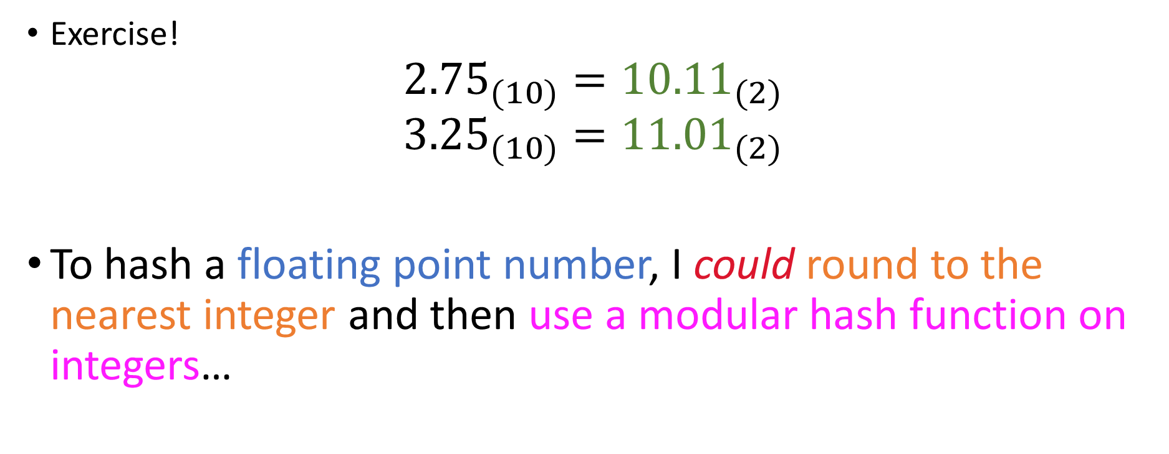
Hash functions for floating-point keys
Exercise!
$${2.75}_{(10)}={10.11}_{(2)} \\ {3.25}_{(10)}={11.01}_{(2)}$$
To hash a floating point number, I could round to the nearest integer and then use a modular hash function on integers…

Slide 27

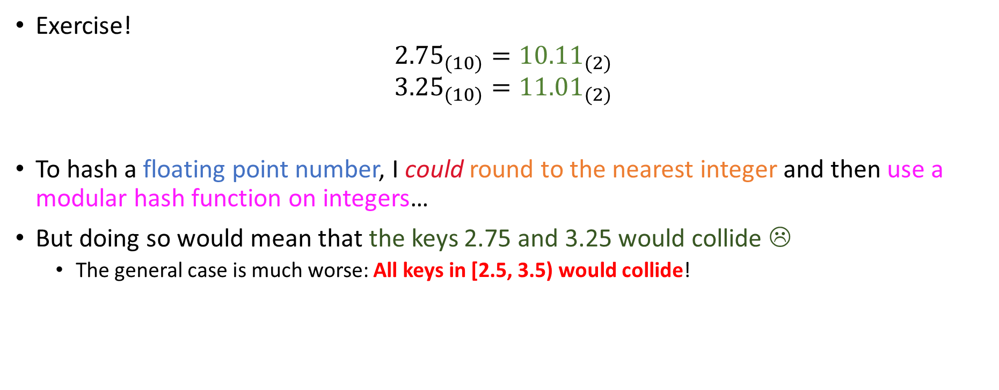
Hash functions for floating-point keys
Exercise!
$${2.75}_{(10)}={10.11}_{(2)} \\ {3.25}_{(10)}={11.01}_{(2)}$$
To hash a floating point number, I could round to the nearest integer and then use a modular hash function on integers…
But doing so would mean that the keys 2.75 and 3.25 would collide ☹
The general case is much worse: All keys in [2.5, 3.5) would collide!

Slide 28

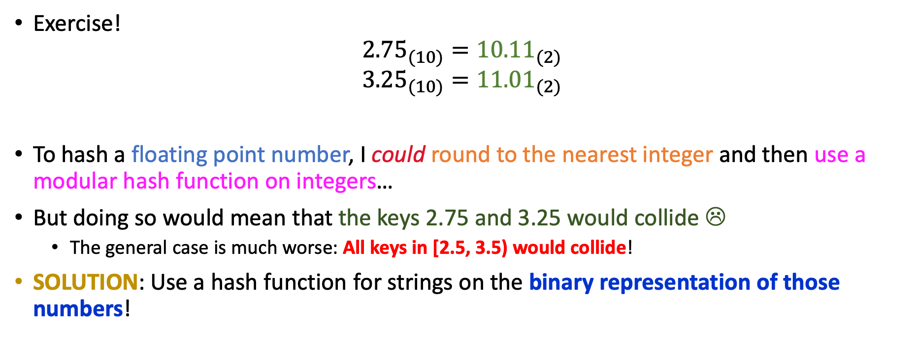
Hash functions for floating-point keys
Exercise!
$${2.75}_{(10)}={10.11}_{(2)} \\ {3.25}_{(10)}={11.01}_{(2)}$$
To hash a floating point number, I could round to the nearest integer and then use a modular hash function on integers…
But doing so would mean that the keys 2.75 and 3.25 would collide ☹
The general case is much worse: All keys in [2.5, 3.5) would collide!
SOLUTION: Use a hash function for strings on the binary representation of those numbers!

Slide 29
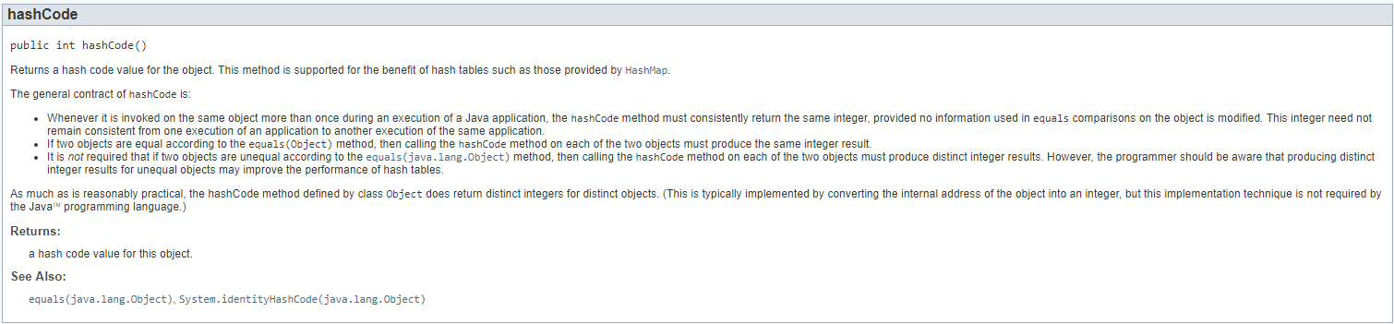
Using Java’s hashCode()

Slide 30
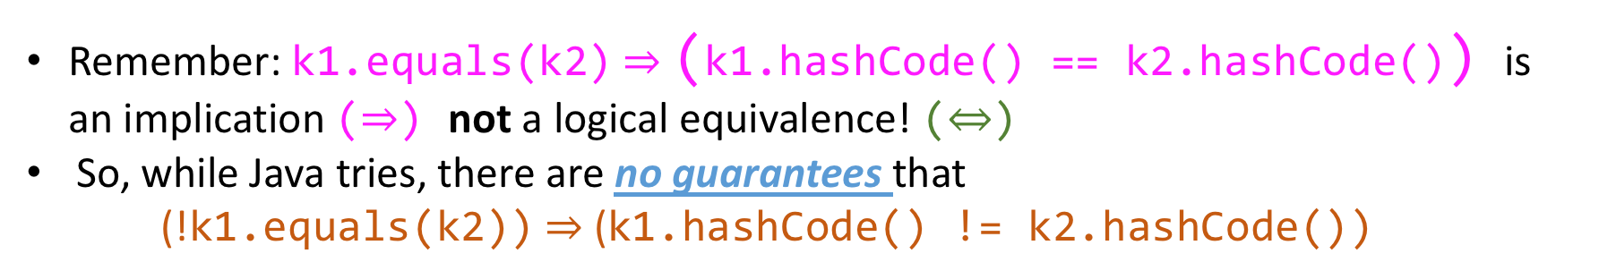
Using Java’s hashCode()
Remember: k1.equals(k2) $⇒$ (k1.hashCode() == k2.hashCode()) is an implication ($⇒$) not a logical equivalence! ($⇔$)
So, while Java tries, there are no guarantees that (!k1.equals(k2)) $⇒$ (k1.hashCode() != k2.hashCode())

Slide 31

Using Java’s hashCode()
So what about negative hashCode()s?
Remember: k1.equals(k2) $⇒$ (k1.hashCode() == k2.hashCode()) is an implication ($⇒$) not a logical equivalence! ($⇔$)
So, while Java tries, there are no guarantees that (!k1.equals(k2)) $⇒$ (k1.hashCode() != k2.hashCode())

Slide 32
Using Java’s hashCode(): Negative hashes
To ensure that the values that hashCode() returns are useable as array indices (e.g in a modular hash function), we need to mask the top bit!

Slide 33

Using Java’s hashCode(): Negative hashes
To ensure that the values that hashCode() returns are useable as array indices (e.g in a modular hash function), we need to mask the top bit!
This means that Java hash tables can not grow beyond $2^{30}−1$ positions!

Slide 34
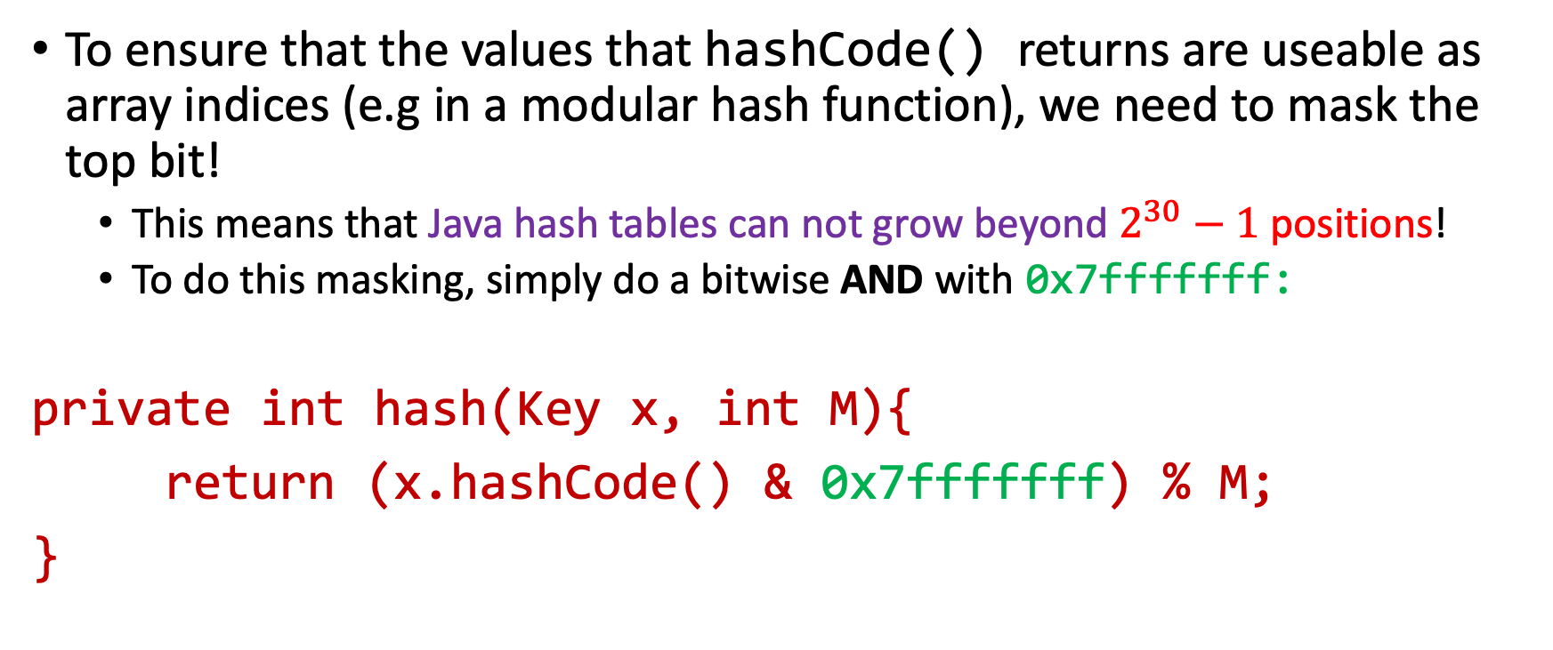
Using Java’s hashCode(): Negative hashes
To ensure that the values that hashCode() returns are useable as array indices (e.g in a modular hash function), we need to mask the top bit!
This means that Java hash tables can not grow beyond $2^{30}−1$positions!
To do this masking, simply do a bitwise AND with 0x7fffffff:
private int hash(Key x, int M){
return (x.hashCode() & 0x7fffffff) % M;
}

Slide 35

Using Java’s hashCode(): Custom data types
Recall: Default hashCode() based on object’s address in memory.
Also, let’s not forget our contract:
k1.equals(k2) $⇒$ (k1.hashCode() == k2.hashCode())

Slide 36

Using Java’s hashCode(): Custom data types
Recall: Default hashCode() based on object’s address in memory.
Also, let’s not forget our contract:
k1.equals(k2) $⇒$ (k1.hashCode() == k2.hashCode())
Demo time!

Slide 37
Take-home message from hashCode() and custom data types
Overriding the default hashCode()should have the same priority as :
Creating appropriate constructors
Overriding equals() in a type-safe manner
Overriding compareTo() (for Comparables).

Slide 38
Take-home message from hashCode() and custom data types
Overriding the default hashCode()should have the same priority as :
Creating appropriate constructors
Overriding equals() in a type-safe manner
Overriding compareTo() (for Comparables).
Jason considers this a design flaw of Java (and any other language that might replicate this behavior).
Many developers go through their entire careers without ever having had to understand the inner workings of Object.hashCode(), and that’s ok!
Yet, if client code uses their data types as keys, inconsistencies can arise because equality has not been extended to the hash code level…

Slide 39

Resizing our hash table
At some point, no matter how large of a prime number we have as $M$, or no matter how “uniform” $h$ is, our performance will hurt with our current $M$ ☹
So we have to enlarge our table (increase $M$somehow)

Slide 40
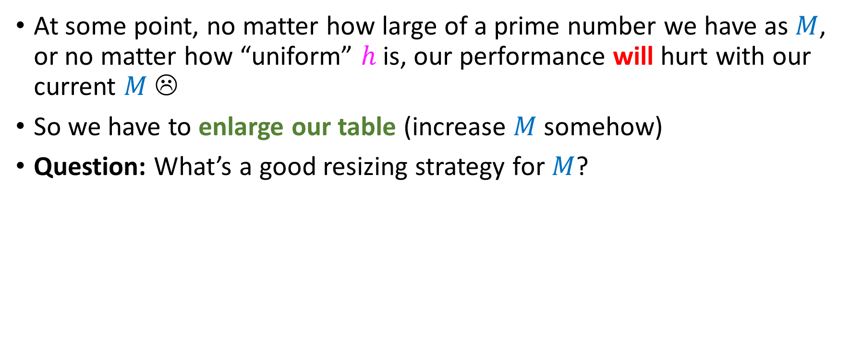
Resizing our hash table
At some point, no matter how large of a prime number we have as $M$, or no matter how “uniform” $h$ is, our performance will hurt with our current $M$ ☹
So we have to enlarge our table (increase $M$somehow)
Question: What’s a good resizing strategy for $M$?
M <- 2*M
M <- 3*M
M <- 4*M
M <- 17*M

Slide 41

Resizing our hash table
At some point, no matter how large of a prime number we have as $M$, or no matter how “uniform” $h$ is, our performance will hurt with our current $M$ ☹
So we have to enlarge our table (increase $M$somehow)
Question: What’s a good resizing strategy for $M$?
NONE OF THEM. ALL OF THEM make M composite!
M <- 2*M
M <- 3*M
M <- 4*M
M <- 17*M
Best option: Maintain a large look-up table of primes and increase the choice of M to the next prime each time!

Slide 42
When to resize?
It’s your choice.
Tradeoff: Resizing implies reinserting everything based on the new M.
So, if you resize at 40% capacity, you are paying for re-insertions much more often than resizing at an 80% capacity.
But! You end up with a very efficient hash table (few collisions)
In practice: some people online mention 70% as a good compromise
Jason found Cython source for a dict() implementation somewhere (based on double hashing) which resized at 60 or 66% (can’t remember exact percentage)

