Slide 1
Intro to Hashing
CMSC 420

Slide 2

Terminology
Looking at texts, you will see stuff such as
Maps (implemented in C++ STL)
Multi-Maps (also implemented in C++ STL)
Associative Arrays (PHP and others)
Dictionaries (Python’s dict())
HashMaps / HashTrees (Java)
Lookup tables (academic papers by people who haven’t programmed in a decade)

Slide 3
Terminology
Looking around, you will see stuff such as
Maps (implemented in C++ STL)
Multi-Maps (also implemented in C++ STL)
Associative Arrays (PHP and others)
Dictionaries (Python’s dict())
HashMaps / HashTrees (Java)
Lookup tables (academic papers by people who haven’t programmed in a decade)
Very few people can intelligently converse about the differences between those….
Today, we will try to move towards that direction, and then some!

Slide 4
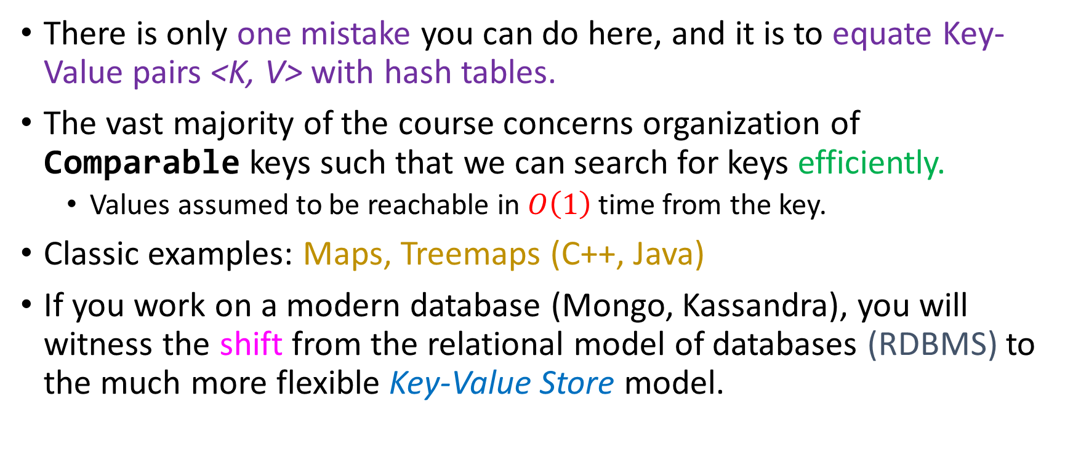
Key-Value pairs
There is only one mistake you can do here, and it is to equate Key-Value pairs <K, V> with hash tables.
The vast majority of the course concerns organization of Comparable keys such that we can search for keys efficiently.
Values assumed to be reachable in $O\left(1\right)$ time from the key.
Classic examples: Maps, Treemaps (C++, Java)
If you work on a modern database (Mongo, Kassandra), you will witness the shift from the relational model of databases (RDBMS) to the much more flexible Key-Value Store model.

Slide 5
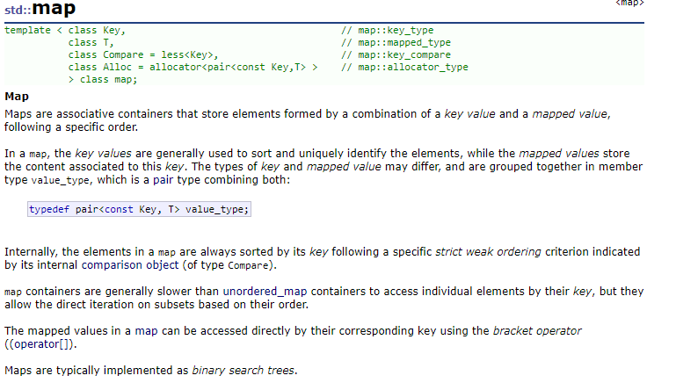
Speaking of Maps…
Maps are modern programming language’s ways of saying “Key-Value store” (a store of pairs <K, V>, where K has to be some Comparable type)
C++: std::map

Slide 6
Speaking of Maps…
Maps are modern programming language’s ways of saying “Key-Value store” (a store of pairs <K, V>, where K has to be some Comparable type)
C++: std::map
Ctrl + F “hash” on that page returns at most 0 results!

Slide 7
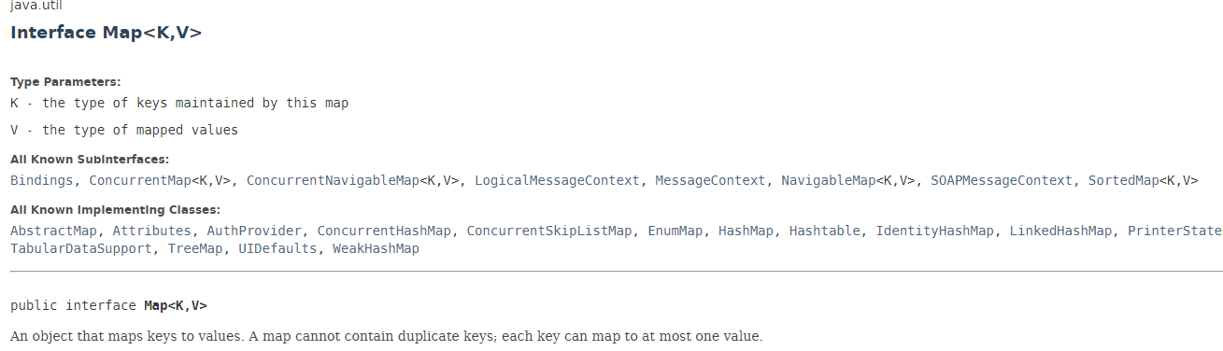
Speaking of Maps…
Java also has Maps!
Interface Map<K, V>

Slide 8
Speaking of Maps…
Java also has Maps!
Interface Map<K, V>
Almost entirely the same (HashTable is thread-safe)
R-B Tree based (we’ve already seen this…)
Interesting reads for you

Slide 9
Take-home message
A Map (or Key-Value store) is not a hash table!
A hash table is simply an implementation of a Map. Whether or not you should use a hash depends on the kinds of queries you want to speedup.
Range query, groupby, aggregations? R-B Trees / B-Trees.
Insertion, deletion, search of a single record? Hash Tables.
If you’re able to understand this distinction:
You will become better Computer Scientists
Jason will be happy

Slide 10

Python’s dict()s
In Python, you can do this:
d = dict([(1, “Jason”), (2, “Shandra”), (4, 5), (5, date.today()), (11, {“pi”:3.14, “e”: 0.58})]}
And then this:
print(d[2]) // Will print Shandra
d[2]=“Monica” // Updates the value pointed by key 2
print(d[2]) // Will print Monica

Slide 11
Python’s dict()s
In Python, you can do this:
d = dict([(1, “Jason”), (2, “Shandra”), (4, 5), (5, date.today()), (11, {“pi”:3.14, “e”: 0.58})]}
But you can’t do this!
print(d[2:6])
Traceback (most recent call last):
File "<pyshell#27>", line 1, in <module>
print(d[2:6])
TypeError: unhashable type: 'slice'

Slide 12
Python’s dict()s
In Python, you can do this:
d = dict([(1, “Jason”), (2, “Shandra”), (4, 5), (5, date.today()), (11, {“pi”:3.14, “e”: 0.58})]}
But you can’t do this!
print(d[2:6])
Traceback (most recent call last):
File "<pyshell#27>", line 1, in <module>
print(d[2:6])
TypeError: unhashable type: 'slice'
If you want to do range search, you’ll need to write code on top (sort, loop,…)
Implication: Python dict()s are hash tables!
(With flexible value types!)
They will find / update / delete d[key] very fast, but they’re not useful for other queries!
2:6 is a “slice” in Python

Slide 13
Associative arrays
In PHP, you can define an array ages like this
$ages = array(“Jason”->28, “Sravanthi”->29, “Varun”->27, “Keith”->30);
And you can do the same things you could do with a Python dict():
echo $ages[“Sravanthi”]; // prints 29
$ages[“Sravanthi”]=26; // Updates the value pointed to by “Sravanthi”
echo $ages[“Sravanthi”]; // prints 26

Slide 14
Associative arrays
But you still don’t have native support for a range search ☹

Slide 15
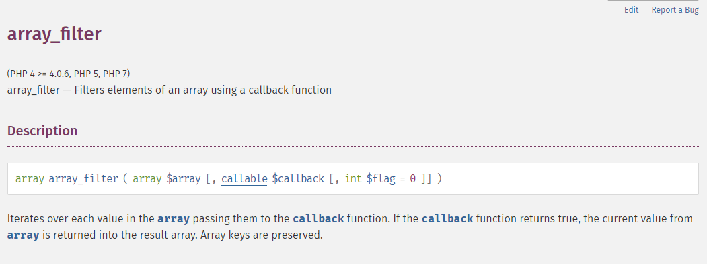
Associative arrays
But you still don’t have native support for a range search ☹
Even in methods where it looks like a range can be efficiently generated:

Slide 16
Associative arrays
But you still don’t have native support for a range search ☹
Even in methods where it looks like a range can be efficiently generated:

Slide 17
Associative arrays
But you still don’t have native support for a range search ☹
Even in methods where it looks like a range can be efficiently generated:
Implication: PHP associative arrays are hash tables from strings to some type of interest.

Slide 18

Associative arrays
But you still don’t have native support for a range search ☹
Even in methods where it looks like a range can be efficiently generated:
Implication: PHP associative arrays are hash tables from strings to some type of interest???

Slide 19

Strings are hashable
$ages
Internal Buffer
0
1
2
3
4
5
6
7
27
55
26
31
23
78
34
18
2
26
$$h$$
“Sravanthi”
echo $ages[“Sravanthi”];

Slide 20
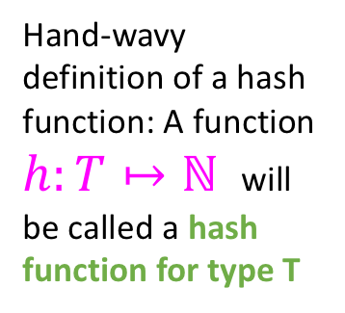
Strings are hashable
$ages
Internal Buffer
0
1
2
3
4
5
6
7
27
55
26
31
23
78
34
18
2
26
$$h$$
“Sravanthi”
Hand-wavy definition of a hash function: A function $h:T↦ℕ^{ }$ will be called a hash function for type T
echo $ages[“Sravanthi”];

Slide 21

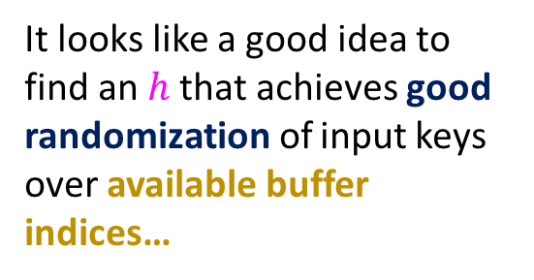
Strings are hashable
$ages
Internal Buffer
0
1
2
3
4
5
6
7
27
55
26
31
23
78
34
18
2
26
$$h$$
“Sravanthi”
Hand-wavy definition of a hash function: A function $h:T↦ℕ^{ }$ will be called a hash function for type T
It looks like a good idea to find an $h$ that achieves good randomization of input keys over available buffer indices…
echo $ages[“Sravanthi”];

Slide 22
Question
True or False: Only immutable data types can be hashable
True (why?)
False (example)

Slide 23
Question
True or False: Only immutable data types can be hashable
Allowing mutation of a key after you use it breaks search.
No guarantee of correctness = guarantee of non-usefulness
True (why?)
False (example)

Slide 24
If memory were infinite…
There would be no need for anything but huge arrays.
Constant access everywhere
But memory, as we all know, is not infinite
CPU Registers->Cache->RAM->Disk
SSDs have helped a lot to make that last part faster for seeking, reading and writing.

Slide 25
Storage smaller than the available data ☹
Caroline, Jordan, Damien, Phong, Muhammad, Chris, Dorothy, D’Angelo, Mark, Julie, Sabrina, Jacqueline, Connie, Melanie, Trisha, Fred, Fabio, Hans, Harry, …
0
1
2
3
4
5
6
7
8
9

Slide 26
Storage smaller than the available data ☹
Caroline, Jordan, Damien, Phong, Muhammad, Chris, Dorothy, D’Angelo, Mark, Julie, Sabrina, Jacqueline, Connie, Melanie, Trisha, Fred, Fabio, Hans, Harry, …
0
1
2
3
4
5
6
7
8
9
Only good news: you won’t need to store the entire data in memory.
Problem: By pigeonhole principle, sooner or later I am guaranteed a collision : An assignment of two different keys at the same index.

Slide 27
The two elements of hashing
Find a good hash function for your data type
“Good” means:
It minimizes collisions (so it uniformly distributes keys over the array)
It is easy to compute (since we’ll need at least one computation for every operation)
It is consistent: k1.equals(k2) implies k1.hashCode() == k2.hashCode()
Object.hashCode declares this requirement for all overridings!

Slide 28
The two elements of hashing
Find a good hash function for your data type
“Good” means:
It minimizes collisions (so it uniformly distributes keys over the array)
It is easy to compute (since we’ll need at least one computation for every operation)
It is consistent: k1.equals(k2) implies k1.hashCode() == k2.hashCode()
Object.hashCode declares this requirement for all overridings!
Example: Hashing Social Security Numbers

Slide 29
The two elements of hashing
Find a good hash function for your data type
“Good” means:
It minimizes collisions (so it uniformly distributes keys over the array)
It is easy to compute (since we’ll need at least one computation for every operation)
It is consistent: k1.equals(k2) implies k1.hashCode() == k2.hashCode()
Object.hashCode() declares this requirement for all overridings!
Resolve collisions in your hash table
Even with the best hash function, collisions will happen
Separate chaining
Open Addressing
Linear Probing
Quadratic / Exponential Probing
Double hashing
Hybrid methods

Slide 30
The true story
For most common data types, Java will give you a good hashCode() implementation.
As long as you define a dict() with a hashable type, Python will give you an excellent hashcode completely transparently.
In PHP, once you call $age[“Sravanthi”], again completely transparently, a hash function for strings will be used.

Slide 31
The true story
For most common immutable data types, Java will give you a good hashCode() implementation.
As long as you define a dict()with a hashable type, Python will give you an excellent hashcode completely transparently.
In PHP, once you call $age[“Sravanthi”], again completely transparently, a hash function for strings will be used.
Take-home message: some of the things we discuss about are solved in a modern language.
But! Defining your own types will require re-thinking the default hashCode()!
If you can be given any sort of control over which collision resolution strategy you should employ, data statistics (data type size, which bits typically change from one entry to another, etc) can be leveraged to help you choose!

