Slide 1
Huffman character encoding
CMSC 420

Slide 2
You bigoted UTF-8 you!
“Archimedes” will take 10 bytes to store…
“Αρχιμήδης” will take >> 10 bytes to store!

Slide 3
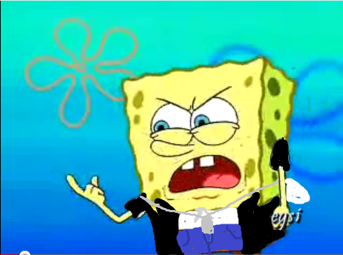
You bigoted UTF-8 you!
“Archimedes” will take 10 bytes to store…
“Αρχιμήδης” will take >> 10 bytes to store!
But with the vast majority of text being in English… people have adapted!
And the Earth keeps on turning.

Slide 4
You bigoted UTF-8 you!
“Archimedes” will take 10 bytes to store…
“Αρχιμήδης” will take >> 10 bytes to store!
But with the vast majority of text being in English… people have adapted!
And the Earth keeps on turning.
UTF8 is a variable-length encoding that has taken advantage of the frequency of English communications on the Web to present an overall very efficient way to store character data.

Slide 5
Quiz
Is ASCII a variable – length encoding?
Yes
No

Slide 6
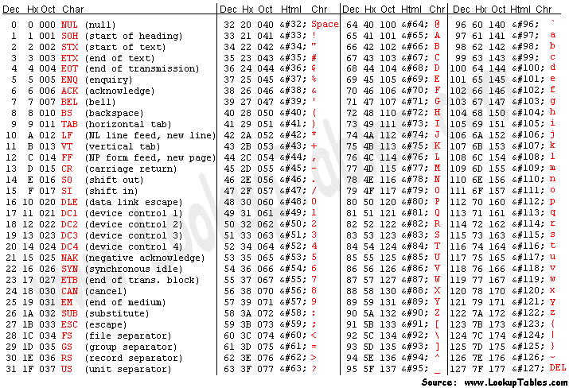
Quiz
Is ASCII a variable – length encoding?
Remember: 7 bits per character.
Can represent 128 characters, with about 30 of them non-printable.
But still, a remarkably useful subset, with 51.6% of the Web written in English, and lots of those characters including:
Punctuation (, , . ,!, …) almost universally used
MANY characters that other Romance languages, like Spanish and French, use (a, s, t, r, …)
ALL different kinds of whitespace (‘\0’, tabs, space, CRLF,…)!
Yes
No

Slide 7
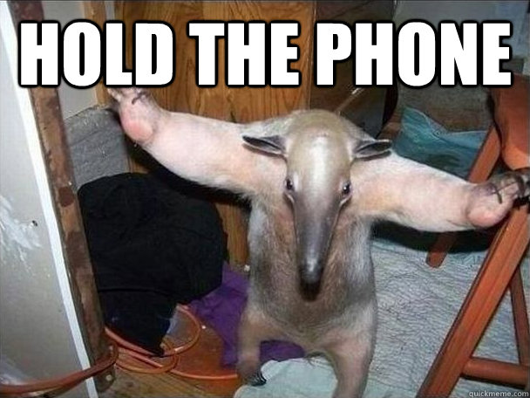
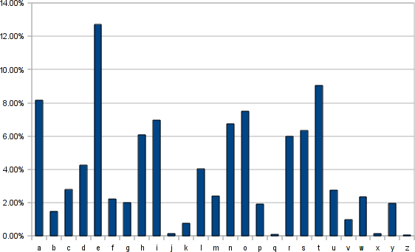
A different kind of redundancy…

Slide 8
A different kind of redundancy…
This doesn’t seem fair!
Encoding cost: 7 bits
Encoding cost: also 7 bits!

Slide 9

A different kind of redundancy…
This doesn’t seem fair!
We should do better.
Encoding cost: 7 bits
Encoding cost: also 7 bits!

Slide 10

Oh, by the way, bits matter now
When we move from memory storage to transmitting information through a network, every little bit counts!
The bit is the most basic unit information in Claude Shannon’s Information Theory.
We essentially forget any kind of packet padding that might exist at the packet – level representation of data, and count the transmitted bits from source to sink.

Slide 11
What we want
For unigrams (characters) with the largest frequencies in this histogram to receive economical storage, since we expect to use them a lot, given their frequency.
For those that we expect to rarely use, accept a long bit representation.

Slide 12
What we want
For unigrams (characters) with the largest frequencies in this histogram to receive economical storage, since we expect to use them a lot, given their frequency.
For those that we expect to rarely use, accept a long bit representation.
Frequent? Make them cheap.
Rare? I don’t care!

Slide 13

Careful!
A crucial detail: We want our encodings to not be confusible! For example, if our encoding for e is 01, that of a is 00 and that of h is 0100, what should the sink interpret if it sees 0100?
So any encoding algorithm we come up with has this constraint as well!
ae? h?

Slide 14
Careful!
A crucial detail: We want our encodings to not be confusible! For example, if our encoding for e is 01, that of a is 00 and that of h is 0100, what should the sink interpret if it sees 0100?
So any encoding algorithm we come up with has this constraint as well!
We call this property the prefix property.
ae? h?

Slide 15
Huffman Coding
We will describe a simple greedy algorithm that is guaranteed to maintain that property.
This algorithm is called Huffman Coding, pioneered by David A. Huffman
The algorithm will build a binary trie, bottom-up.

Slide 16
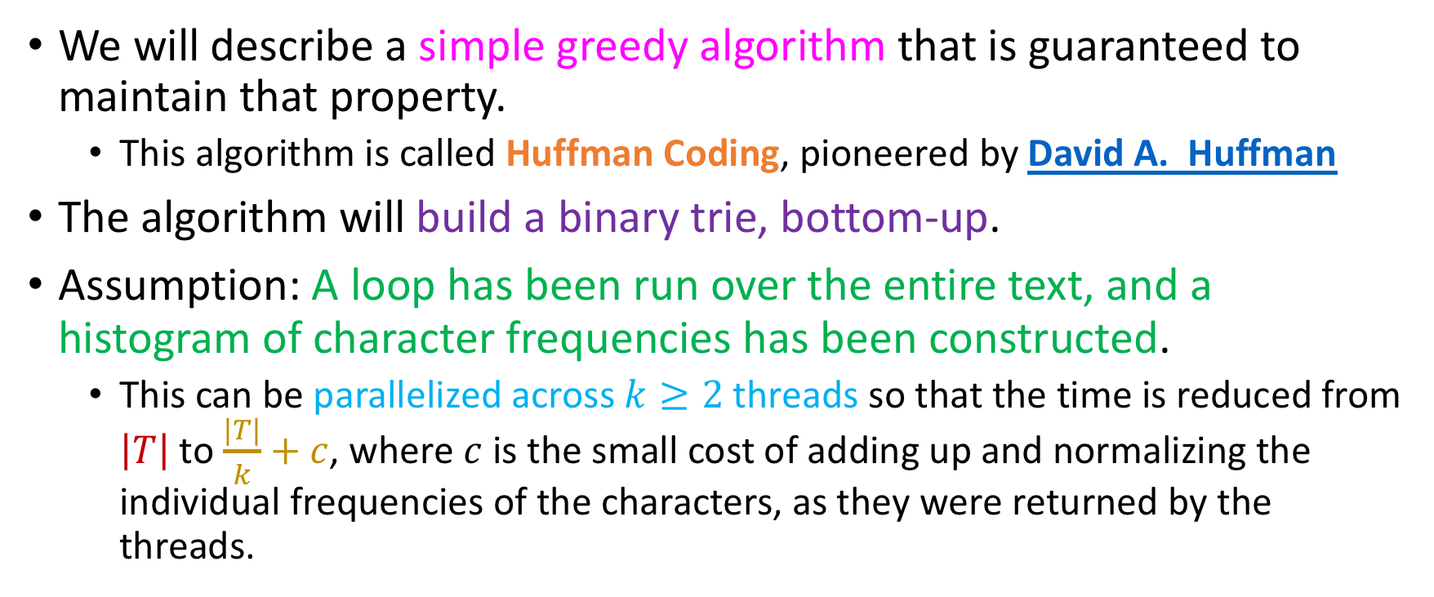
Huffman Coding
We will describe a simple greedy algorithm that is guaranteed to maintain that property.
This algorithm is called Huffman Coding, pioneered by David A. Huffman
The algorithm will build a binary trie, bottom-up.
Assumption: A loop has been run over the entire text, and a histogram of character frequencies has been constructed.
This can be parallelized across $k≥2$ threads so that the time is reduced from $\left|T\right|$ to $\frac{|T|}{k}+c$, where $c$ is the small cost of adding up and normalizing the individual frequencies of the characters, as they were returned by the threads.

Slide 17
Huffman Coding
We insert all the <character, frequency> pairs in a Priority Queue
Our goal will be, at every point in time, to have fast access to the two nodes with the smallest frequencies

Slide 18
Building the binary tree….
Running example string:
“Jason loves chocolate.”

Slide 19
Building the binary tree….
Running example string:
“Jason loves chocolate.”
Don’t forget spaces and punctuation!

Slide 20






Building the binary tree….
Running example string:
“Jason loves chocolate.”
Scan the text and build nodes containing <character, #occurrences> pairs
Don’t forget spaces and punctuation!
SPACE CHARACTER!
J, 1
a, 2
s, 2
o, 4
n, 1
$ℓ$, 2
$v$, 1
$e$, 2
$c$, 2
$h$, 1
$t$, 1
` ‘, 2
`.’, 1

Slide 21





Building the binary tree….
Put all of the nodes in a Priority Queue sorted on frequencies, in ascending order. Smaller is higher priority.
Ties will be broken lexicographically.
Again, smaller up front ☺
`.’, 1
J, 1
h, 1
n, 1
$t$, 1
$v$, 1
` ’, 2
a, 2
$c$, 2
$e$, 2
$ℓ$, 2
s, 2
o, 4

Slide 22
Building the binary tree….
Put all of the nodes in a Priority Queue sorted on frequencies, in ascending order. Smaller is higher priority.
Ties will be broken lexicographically.
Again, smaller up front ☺
Lexicographically, periods < characters and spaces < periods < characters
Don’t worry: In exams, you will be given an ASCII table to deduce lexicographic order on the fly.
`.’, 1
J, 1
h, 1
n, 1
$t$, 1
$v$, 1
` ’, 2
a, 2
$c$, 2
$e$, 2
$ℓ$, 2
s, 2
o, 4

Slide 23

Building the binary tree….
Put all of the nodes in a Priority Queue sorted on frequencies, in ascending order. Smaller is higher priority.
Ties will be broken lexicographically.
Again, smaller up front ☺
Lexicographically, periods < characters and spaces < periods < characters
Don’t worry: In exams, you will be given an ASCII table to deduce lexicographic order on the fly.
This is not an error; SPACE might be lexicographically least, but its frequency is 2 ☺ So its position is “least among those with frequency 2”
`.’, 1
J, 1
$h$, 1
n, 1
$t$, 1
$v$, 1
` ’, 2
a, 2
$c$, 2
$e$, 2
$ℓ$, 2
s, 2
o, 4

Slide 24





Building the binary tree….
As long as the queue has more than 1 elements in it
Apply getMin() twice to dequeue the 2 least elements in the queue.
For a MinHeap-based PQ, this is extremely fast: $2⋅\log_{2}{|A|}$ where $A$ is your alphabet. Even for the subset of printable Unicode $U$with $\left|U\right|=65535$we have $2⋅\log_{2}\left|A\right|=32$ compares in the worst case for a queue that will be pinned to cache because of temporal locality! Recall: heaps stored as arrays (consecutive cache storage)
`.’, 1
J, 1
$h$, 1
n, 1
$t$, 1
$v$, 1
` ’, 2
a, 2
$c$, 2
$e$, 2
$ℓ$, 2
s, 2
o, 4

Slide 25


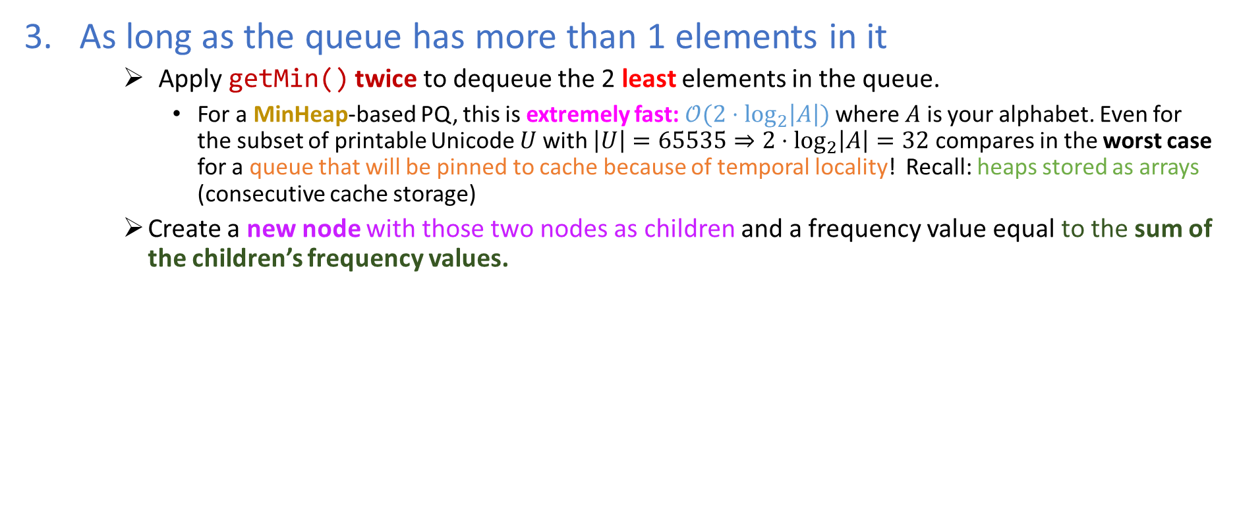



Building the binary tree….
As long as the queue has more than 1 elements in it
Apply getMin() twice to dequeue the 2 least elements in the queue.
For a MinHeap-based PQ, this is extremely fast: $𝒪(2⋅\log_{2}\left|A\right|)$ where $A$ is your alphabet. Even for the subset of printable Unicode $U$with $\left|U\right|=65535⇒2⋅\log_{2}\left|A\right|=32$ compares in the worst case for a queue that will be pinned to cache because of temporal locality! Recall: heaps stored as arrays (consecutive cache storage)
Create a new node with those two nodes as children and a frequency value equal to the sum of the children’s frequency values.
2
`.’, 1
J, 1
h, 1
n, 1
$t$, 1
$v$, 1
` ’, 2
a, 2
$c$, 2
$e$, 2
$ℓ$, 2
s, 2
o, 4

Slide 26
Building the binary tree….
As long as the queue has more than 1 elements in it
Apply getMin() twice to dequeue the 2 least elements in the queue.
For a MinHeap-based PQ, this is extremely fast: $𝒪(2⋅\log_{2}\left|A\right|)$ where $A$ is your alphabet. Even for the subset of printable Unicode $U$with $\left|U\right|=65535⇒2⋅\log_{2}\left|A\right|=32$ compares in the worst case for a queue that will be pinned to cache because of temporal locality! Recall: heaps stored as arrays (consecutive cache storage)
Create a new node with those two nodes as children and a frequency value equal to the sum of the children’s frequency values.
2
We follow the convention that the first child pulled from the queue is on the left, and the second on the right
`.’, 1
J, 1
h, 1
n, 1
$t$, 1
$v$, 1
` ’, 2
a, 2
$c$, 2
$e$, 2
$ℓ$, 2
s, 2
o, 4

Slide 27


Building the binary tree….
As long as the queue has more than 1 elements in it
Apply getMin() twice to dequeue the 2 least elements in the queue.
For a MinHeap-based PQ, this is extremely fast: $𝒪(2⋅\log_{2}\left|A\right|)$ where $A$ is your alphabet. Even for the subset of printable Unicode $U$with $\left|U\right|=65535⇒2⋅\log_{2}\left|A\right|=32$ compares in the worst case for a queue that will be pinned to cache because of temporal locality! Recall: heaps stored as arrays (consecutive cache storage)
Create a new node with those two nodes as children and a frequency value equal to the sum of the children’s frequency values.
2
Important implementation detail; These nodes are assumed to hold the NULL character (first in ASCII table!)
`.’, 1
J, 1
h, 1
n, 1
$t$, 1
$v$, 1
` ’, 2
a, 2
$c$, 2
$e$, 2
$ℓ$, 2
s, 2
o, 4

Slide 28





Building the binary tree….
As long as the queue has more than 1 elements in it
Apply getMin() twice to dequeue the 2 least elements in the queue.
For a MinHeap-based PQ, this is extremely fast: $𝒪(2⋅\log_{2}\left|A\right|)$ where $A$ is your alphabet. Even for the subset of printable Unicode $U$with $\left|U\right|=65535⇒2⋅\log_{2}\left|A\right|=32$ compares in the worst case for a queue that will be pinned to cache because of temporal locality! Recall: heaps stored as arrays (consecutive cache storage)
Create a new node with those two nodes as children and a frequency value equal to the sum of the children’s frequency values.
Insert that node into the trie!
2
Important implementation detail; These nodes are assumed to hold the NULL character (first in ASCII table!)
`.’, 1
J, 1
h, 1
n, 1
$t$, 1
$v$, 1
2
` ’, 2
a, 2
$c$, 2
$e$, 2
$ℓ$, 2
s, 2
o, 4

Slide 29
Building the binary tree….
As long as the queue has more than 1 elements in it
Apply getMin() twice to dequeue the 2 least elements in the queue.
For a MinHeap-based PQ, this is extremely fast: $𝒪(2⋅\log_{2}\left|A\right|)$ where $A$ is your alphabet. Even for the subset of printable Unicode $U$with $\left|U\right|=65535⇒2⋅\log_{2}\left|A\right|=32$ compares in the worst case for a queue that will be pinned to cache because of temporal locality! Recall: heaps stored as arrays (consecutive cache storage)
Create a new node with those two nodes as children and a frequency value equal to the sum of the children’s frequency values.
Insert that node into the trie!
2
Important implementation detail; These nodes are assumed to hold the NULL character (first in ASCII table!)
`.’, 1
J, 1
And that is why the node fits EXACTLY THERE!
h, 1
n, 1
$t$, 1
$v$, 1
2
` ’, 2
a, 2
$c$, 2
$e$, 2
$ℓ$, 2
s, 2
o, 4

Slide 30
Building the binary tree….
2
`.’, 1
J, 1
h, 1
n, 1
$t$, 1
$v$, 1
2
` ’, 2
a, 2
$c$, 2
$e$, 2
$ℓ$, 2
s, 2
o, 4

Slide 31
Building the binary tree….
2
2
`.’, 1
J, 1
`h’, 1
n, 1
$t$, 1
$v$, 1
2
` ’, 2
a, 2
$c$, 2
$e$, 2
$ℓ$, 2
s, 2
o, 4

Slide 32
Building the binary tree….
2
2
This is a full tie: PQ resolves in FIFO way!
`.’, 1
J, 1
h, 1
n, 1
$t$, 1
$v$, 1
2
` ’, 2
a, 2
$c$, 2
$e$, 2
$ℓ$, 2
s, 2
o, 4

Slide 33

Building the binary tree….
2
2
`.’, 1
J, 1
h, 1
n, 1
$t$, 1
$v$, 1
2
2
` ’, 2
a, 2
$c$, 2
$e$, 2
$ℓ$, 2
s, 2
o, 4

Slide 34

Building the binary tree….
2
2
2
`.’, 1
J, 1
h, 1
n, 1
$t$, 1
$v$, 1
2
2
2
` ’, 2
a, 2
$c$, 2
$e$, 2
$ℓ$, 2
s, 2
o, 4

Slide 35

Building the binary tree….
4
2
2
2
`.’, 1
J, 1
h, 1
n, 1
$t$, 1
$v$, 1
2
` ’, 2
a, 2
$c$, 2
$e$, 2
$ℓ$, 2
s, 2
4
o, 4

Slide 36

Building the binary tree….
4
4
2
2
2
`.’, 1
h, 1
n, 1
$t$, 1
$v$, 1
` ’, 2
J, 1
a, 2
$c$, 2
$e$, 2
$ℓ$, 2
s, 2
4
4
o, 4

Slide 37


Building the binary tree….
4
4
2
2
4
2
`.’, 1
h, 1
n, 1
$t$, 1
$v$, 1
` ’, 2
a, 2
$c$, 2
J, 1
$e$, 2
$ℓ$, 2
s, 2
4
4
4
o, 4

Slide 38
Building the binary tree….
4
4
2
2
4
4
2
h, 1
n, 1
$v$, 1
` ’, 2
a, 2
$c$, 2
$e$, 2
$ℓ$, 2
`.’, 1
J, 1
$t$, 1
s, 2
4
4
4
4
o, 4

Slide 39


Building the binary tree….
6
4
4
2
2
4
4
2
s, 2
h, 1
n, 1
$v$, 1
` ’, 2
a, 2
$c$, 2
$e$, 2
$ℓ$, 2
`.’, 1
J, 1
$t$, 1
4
4
4
o, 4
6

Slide 40
Building the binary tree….
6
8
4
4
2
2
4
2
4
s, 2
`.’, 1
J, 1
h, 1
n, 1
$v$, 1
` ’, 2
a, 2
$c$, 2
$e$, 2
$ℓ$, 2
$t$, 1
4
o, 4
6
8

Slide 41





Building the binary tree….
6
8
4
4
8
2
2
4
4
2
` ’, 2
a, 2
$c$, 2
$e$, 2
$ℓ$, 2
o, 4
s, 2
`.’, 1
J, 1
h, 1
n, 1
$t$, 1
$v$, 1
6
8
8

Slide 42





Building the binary tree….
6
8
4
4
8
2
2
4
4
2
h, 1
$v$, 1
` ’, 2
a, 2
$c$, 2
$e$, 2
$ℓ$, 2
o, 4
s, 2
`.’, 1
J, 1
n, 1
$t$, 1
6
8
8
Just made PQ slimmer and moved everything down a bit…

Slide 43
Building the binary tree….
14
6
8
4
4
8
2
2
4
4
2
$v$, 1
` ’, 2
a, 2
$c$, 2
$e$, 2
$ℓ$, 2
o, 4
s, 2
`.’, 1
J, 1
h, 1
n, 1
$t$, 1
8
14

Slide 44


Building the binary tree….
22
14
8
6
4
4
8
2
2
4
4
2
o, 4
h, 1
n, 1
$t$, 1
$v$, 1
` ’, 2
a, 2
$c$, 2
$e$, 2
$ℓ$, 2
s, 2
`.’, 1
J, 1
22
Queue now has single element; loop ends!

Slide 45



Building the binary tree….
Last node in PQ becomes root of tree
root
22
14
8
6
4
4
8
2
2
4
4
2
o, 4
h, 1
n, 1
$t$, 1
$v$, 1
` ’, 2
a, 2
$c$, 2
$e$, 2
$ℓ$, 2
s, 2
`.’, 1
J, 1

Slide 46
Building the binary tree….
Last node in PQ becomes root of tree
root
22
14
8
Sanity check: Is the frequency of the root the sum of the leaves’ frequencies?
6
4
4
8
2
2
4
4
2
o, 4
h, 1
n, 1
$t$, 1
$v$, 1
` ’, 2
a, 2
$c$, 2
$e$, 2
$ℓ$, 2
s, 2
`.’, 1
J, 1

Slide 47
AND NOW FOR THE KILLER….
root
22
14
8
6
4
4
8
2
2
4
4
2
o, 4
h, 1
n, 1
$t$, 1
$v$, 1
` ’, 2
a, 2
$c$, 2
$e$, 2
$ℓ$, 2
s, 2
`.’, 1
J, 1

Slide 48
Building the binary trie!
Associate left links with 0s and right links with 1s, turning the binary tree into a binary trie!
root
22
1
14
0
1
0
8
6
0
1
4
1
8
4
0
0
0
1
0
1
1
2
2
4
4
2
0
0
1
0
1
0
1
1
0
1
o, 4
h, 1
n, 1
$t$, 1
$v$, 1
` ’, 2
a, 2
$c$, 2
$e$, 2
$ℓ$, 2
s, 2
`.’, 1
J, 1

Slide 49
Building the binary trie!
Associate left links with 0s and right links with 1s, turning the binary tree into a binary trie!
root
22
1
14
0
1
0
8
Now every character has a binary string; the encoding of the path from the root to the key!
6
0
1
4
1
8
4
0
0
0
1
0
1
1
2
2
4
4
2
0
0
1
0
1
0
1
1
0
1
o, 4
h, 1
n, 1
$t$, 1
$v$, 1
` ’, 2
a, 2
$c$, 2
$e$, 2
$ℓ$, 2
s, 2
`.’, 1
J, 1

Slide 50


Building the binary trie!
Associate left links with 0s and right links with 1s, turning the binary tree into a binary trie!
root
22
1
14
0
1
0
Rare characters correspond to lengthier bitstrings than more frequent characters!
8
6
0
1
4
1
8
4
0
0
0
1
0
1
1
2
2
4
4
2
0
0
1
0
1
0
1
1
0
1
$v$, 1
` ’, 2
a, 2
$c$, 2
$t$, 1
$v$, 1
h, 1
$t$, 1
o, 4
h, 1
n, 1
$e$, 2
$ℓ$, 2
s, 2
`.’, 1
J, 1
n, 1

Slide 51
Final structure: lookup table
Perform a preorder traversal of the trie to build a two-way lookup table that associates characters with Huffman binary encodings and vice versa
Likeliest inner implementation of this lookup table: two hash tables.
In exams, you won’t have to do this, since you can immediately “see” the encoding without the use of a lookup table.

Slide 52
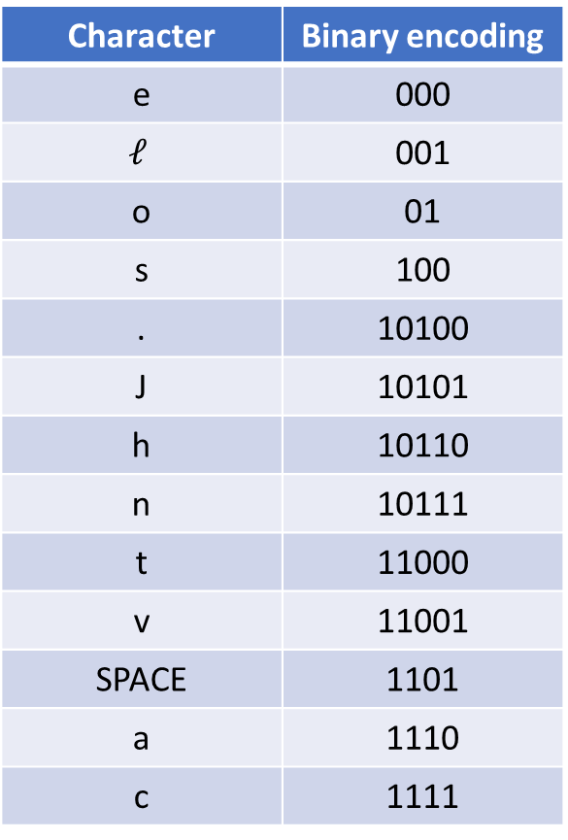
Final structure: lookup table
Character | Binary encoding
e | 000
$$ℓ$$ | 001
o | 01
s | 100
. | 10100
J | 10101
h | 10110
n | 10111
t | 11000
v | 11001
SPACE | 1101
a | 1110
c | 1111

Slide 53
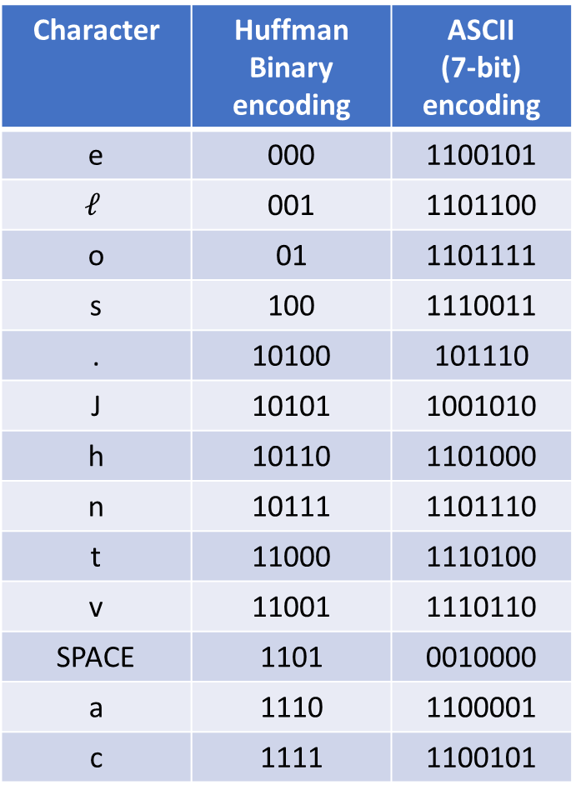
Encoding our message in two ways
Character | Huffman Binary encoding | ASCII (7-bit) encoding
e | 000 | 1100101
$$ℓ$$ | 001 | 1101100
o | 01 | 1101111
s | 100 | 1110011
. | 10100 | 101110
J | 10101 | 1001010
h | 10110 | 1101000
n | 10111 | 1101110
t | 11000 | 1110100
v | 11001 | 1110110
SPACE | 1101 | 0010000
a | 1110 | 1100001
c | 1111 | 1100101

Slide 54
Encoding our message in two ways
Character | Huffman Binary encoding | ASCII (7-bit) encoding
e | 000 | 1100101
$$ℓ$$ | 001 | 1101100
o | 01 | 1101111
s | 100 | 1110011
. | 10100 | 101110
J | 10101 | 1001010
h | 10110 | 1101000
n | 10111 | 1101110
t | 11000 | 1110100
v | 11001 | 1110110
SPACE | 1101 | 0010000
a | 1110 | 1100001
c | 1111 | 1100101
Note that the most expensive Huffman encodings in this table are still under 7 bits!

Slide 55

Encoding our message in two ways
Character | Huffman Binary encoding | ASCII (7-bit) encoding
e | 000 | 1100101
$$ℓ$$ | 001 | 1101100
o | 01 | 1101111
s | 100 | 1110011
. | 10100 | 101110
J | 10101 | 1001010
h | 10110 | 1101000
n | 10111 | 1101110
t | 11000 | 1110100
v | 11001 | 1110110
SPACE | 1101 | 0010000
a | 1110 | 1100001
c | 1111 | 1100101
Note that the most expensive Huffman encodings in this table are still under 7 bits!
What is this owed to?

Slide 56
Encoding our message in two ways
Character | Huffman Binary encoding | ASCII (7-bit) encoding
e | 000 | 1100101
$$ℓ$$ | 001 | 1101100
o | 01 | 1101111
s | 100 | 1110011
. | 10100 | 101110
J | 10101 | 1001010
h | 10110 | 1101000
n | 10111 | 1101110
t | 11000 | 1110100
v | 11001 | 1110110
SPACE | 1101 | 0010000
a | 1110 | 1100001
c | 1111 | 1100101
Note that the most expensive Huffman encodings in this table are still under 7 bits!
What is this owed to?
Our agreement that the inner nodes in the trie will hold the NULL character
The string that we chose to encode
The use of a minheap as a PQ in Huffman
Something else (what?)

Slide 57
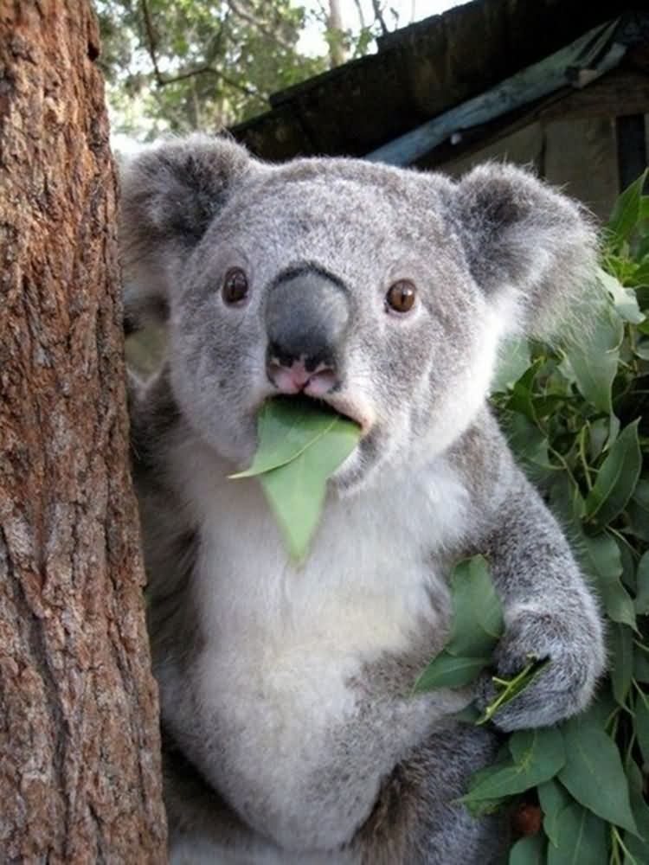
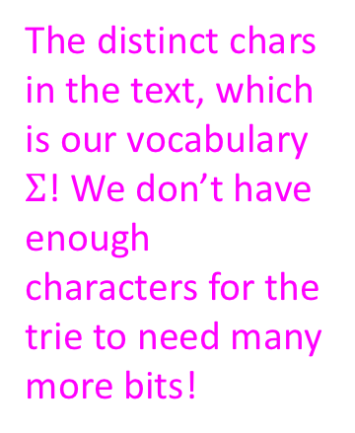
Encoding our message in two ways
Character | Huffman Binary encoding | ASCII (7-bit) encoding
e | 000 | 1100101
$$ℓ$$ | 001 | 1101100
o | 01 | 1101111
s | 100 | 1110011
. | 10100 | 101110
J | 10101 | 1001010
h | 10110 | 1101000
n | 10111 | 1101110
t | 11000 | 1110100
v | 11001 | 1110110
SPACE | 1101 | 0010000
a | 1110 | 1100001
c | 1111 | 1100101
Note that the most expensive Huffman encodings in this table are still under 7 bits!
What is this owed to?
Our agreement that the inner nodes in the trie will hold the NULL character
The string that we chose to encode
The distinct chars in the text, which is our vocabulary $Σ$! We don’t have enough characters for the trie to need many more bits!
The use of a minheap as a PQ in Huffman
Something else (what?)

Slide 58
Encoding our message in two ways
Character | Huffman Binary encoding | ASCII (7-bit) encoding
e | 000 | 1100101
$$ℓ$$ | 001 | 1101100
o | 01 | 1101111
s | 100 | 1110011
. | 10100 | 101110
J | 10101 | 1001010
h | 10110 | 1101000
n | 10111 | 1101110
t | 11000 | 1110100
v | 11001 | 1110110
SPACE | 1101 | 0010000
a | 1110 | 1100001
c | 1111 | 1100101
Let’s compare how the message
“Jason loves chocolate”
decodes through both ASCII and Huffman:

Slide 59
Encoding our message in two ways
Character | Huffman Binary encoding | ASCII (7-bit) encoding
e | 000 | 1100101
$$ℓ$$ | 001 | 1101100
o | 01 | 1101111
s | 100 | 1110011
. | 10100 | 101110
J | 10101 | 1001010
h | 10110 | 1101000
n | 10111 | 1101110
t | 11000 | 1110100
v | 11001 | 1110110
SPACE | 1101 | 0010000
a | 1110 | 1100001
c | 1111 | 1100101
Let’s compare how the message
“Jason loves chocolate”
decodes through both ASCII and Huffman:
ASCII: 1001010110000111100111101111 110111000100001101100110111111101101100101111001100100001100011 1101000 1101111 1100011 1101111 11011001101111 1100001 1110100 1100101, 147 bits total.

Slide 60
Encoding our message in two ways
Character | Huffman Binary encoding | ASCII (7-bit) encoding
e | 000 | 1100101
$$ℓ$$ | 001 | 1101100
o | 01 | 1101111
s | 100 | 1110011
. | 10100 | 101110
J | 10101 | 1001010
h | 10110 | 1101000
n | 10111 | 1101110
t | 11000 | 1110100
v | 11001 | 1110110
SPACE | 1101 | 0010000
a | 1110 | 1100001
c | 1111 | 1100101
Let’s compare how the message
“Jason loves chocolate”
decodes through both ASCII and Huffman:
ASCII: 1001010110000111100111101111 110111000100001101100110111111101101100101111001100100001100011 1101000 1101111 1100011 1101111 11011001101111 1100001 1110100 1100101, 147 bits total.
Huffman: 101011110100011011111010010111001000100110111111011001111101001111011000000, 75 bits total

Slide 61
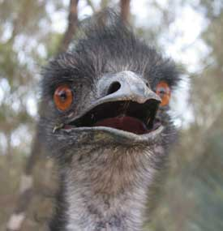
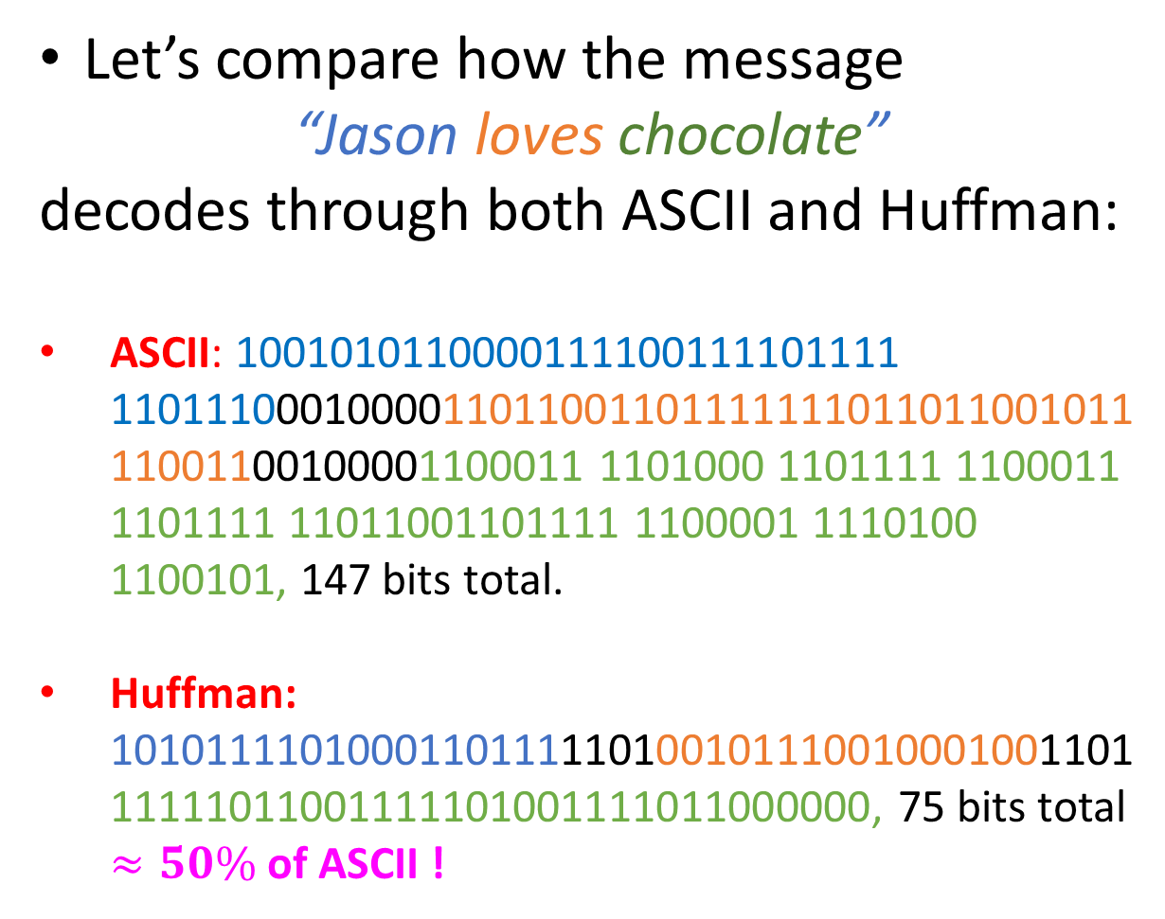
Encoding our message in two ways
Character | Huffman Binary encoding | ASCII (7-bit) encoding
e | 000 | 1100101
$$ℓ$$ | 001 | 1101100
o | 01 | 1101111
s | 100 | 1110011
. | 10100 | 101110
J | 10101 | 1001010
h | 10110 | 1101000
n | 10111 | 1101110
t | 11000 | 1110100
v | 11001 | 1110110
SPACE | 1101 | 0010000
a | 1110 | 1100001
c | 1111 | 1100101
Let’s compare how the message
“Jason loves chocolate”
decodes through both ASCII and Huffman:
ASCII: 1001010110000111100111101111 110111000100001101100110111111101101100101111001100100001100011 1101000 1101111 1100011 1101111 11011001101111 1100001 1110100 1100101, 147 bits total.
Huffman: 101011110100011011111010010111001000100110111111011001111101001111011000000, 75 bits total $≈50\%$ of ASCII !

Slide 62
Encoding our message in two ways
Character | Huffman Binary encoding | ASCII (7-bit) encoding
e | 000 | 1100101
$$ℓ$$ | 001 | 1101100
o | 01 | 1101111
s | 100 | 1110011
. | 10100 | 101110
J | 10101 | 1001010
h | 10110 | 1101000
n | 10111 | 1101110
t | 11000 | 1110100
v | 11001 | 1110110
SPACE | 1101 | 0010000
a | 1110 | 1100001
c | 1111 | 1100101
Can I encode other strings using this table (remember, we created it using the string “Jason loves chocolate”)?
Yes
No

Slide 63
Encoding our message in two ways
Character | Huffman Binary encoding | ASCII (7-bit) encoding
e | 000 | 1100101
$$ℓ$$ | 001 | 1101100
o | 01 | 1101111
s | 100 | 1110011
. | 10100 | 101110
J | 10101 | 1001010
h | 10110 | 1101000
n | 10111 | 1101110
t | 11000 | 1110100
v | 11001 | 1110110
SPACE | 1101 | 0010000
a | 1110 | 1100001
c | 1111 | 1100101
Can I encode other strings using this table (remember, we created it using the string “Jason loves chocolate”)?
As long as the table covers the subset of the alphabet they need!
As an example, let’s encode the string “Jonas loves nachos” in both ASCII and Huffman, using this table ☺
Yes
No

Slide 64
Encoding our message in two ways
Don’t worry, Jason has made sure that the alphabet is the same! :)
Character | Huffman Binary encoding | ASCII (7-bit) encoding
e | 000 | 1100101
$$ℓ$$ | 001 | 1101100
o | 01 | 1101111
s | 100 | 1110011
. | 10100 | 101110
J | 10101 | 1001010
h | 10110 | 1101000
n | 10111 | 1101110
t | 11000 | 1110100
v | 11001 | 1110110
SPACE | 1101 | 0010000
a | 1110 | 1100001
c | 1111 | 1100101
“Jonas loves nachos”
ASCII:100101011011111101110110000111100110010000110110011011111110110110010111100110010000110111011000011100011110100011011111110011 = 126 bits

Slide 65
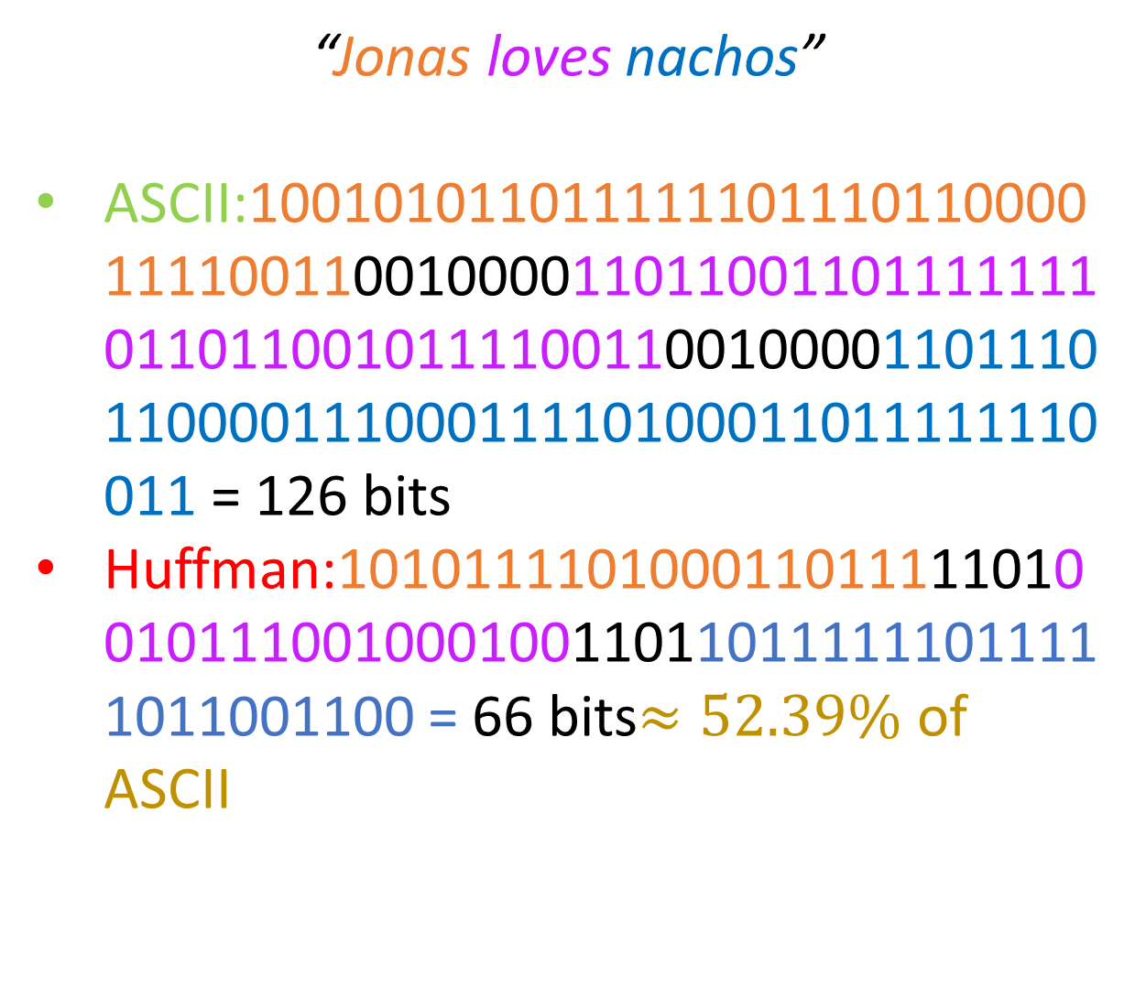

Encoding our message in two ways
Alphabet is the same!
$Σ=${a, c,e,h, j, l, n, o, s, v}
Character | Huffman Binary encoding | ASCII (7-bit) encoding
e | 000 | 1100101
$$ℓ$$ | 001 | 1101100
o | 01 | 1101111
s | 100 | 1110011
. | 10100 | 101110
J | 10101 | 1001010
h | 10110 | 1101000
n | 10111 | 1101110
t | 11000 | 1110100
v | 11001 | 1110110
SPACE | 1101 | 0010000
a | 1110 | 1100001
c | 1111 | 1100101
“Jonas loves nachos”
ASCII:100101011011111101110110000111100110010000110110011011111110110110010111100110010000110111011000011100011110100011011111110011 = 126 bits
Huffman:101011110100011011111010010111001000100110110111111011111011001100 = 66 bits$≈52.39\%$ of ASCII

Slide 66
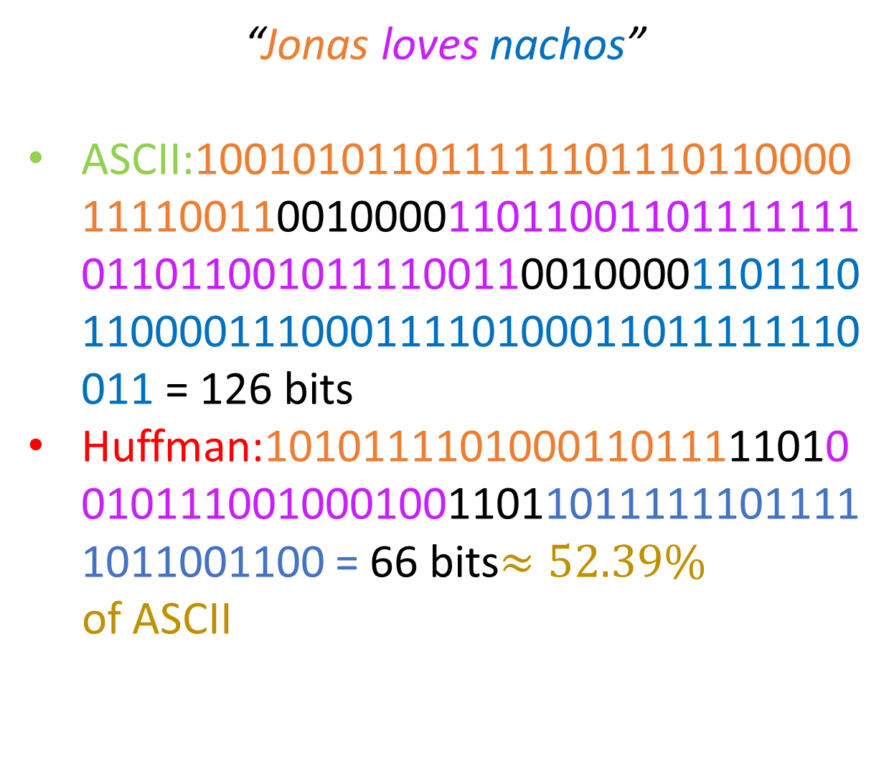
Encoding our message in two ways
Alphabet is the same!
$Σ=${a, c,e,h, j, l, n, o, s, v}
Character | Huffman Binary encoding | ASCII (7-bit) encoding
e | 000 | 1100101
$$ℓ$$ | 001 | 1101100
o | 01 | 1101111
s | 100 | 1110011
. | 10100 | 101110
J | 10101 | 1001010
h | 10110 | 1101000
n | 10111 | 1101110
t | 11000 | 1110100
v | 11001 | 1110110
SPACE | 1101 | 0010000
a | 1110 | 1100001
c | 1111 | 1100101
“Jonas loves nachos”
ASCII:100101011011111101110110000111100110010000110110011011111110110110010111100110010000110111011000011100011110100011011111110011 = 126 bits
Huffman:101011110100011011111010010111001000100110110111111011111011001100 = 66 bits$≈52.39\%$
of ASCII
Slightly worse than before!
Why?.

Slide 67
Your turn!
Jason: Give students an ASCII table on a different projector….
Build the Huffman trie for the string
“Data structures”

Slide 68
Solution
SPC: 1
‘a’: 2
‘c’: 1
‘D’: 1
‘e’: 1
‘r’: 2
‘s’: 2
‘t’: 3
‘u’: 2
“Data structures”

Slide 69
Solution
SPC: 1
‘a’: 2
‘c’: 1
‘d’: 1
‘e’: 1
‘r’: 2
‘s’: 2
‘t’: 3
‘u’: 2
In this text, there are more ‘t’s and ‘u’s than ‘e’s. This is unrealistic in the full spectrum of English.
As our text grows, your histogram will look more and more like the one we’ve seen:
“Data structures”

Slide 70
Solution
SPC: 1
‘a’: 2
‘c’: 1
‘d’: 1
‘e’: 1
‘r’: 2
‘s’: 2
‘t’: 3
‘u’: 2
“Data structures”
SPC, 1
D, 1
c, 1
e, 1
a, 2
r, 2
s, 2
u, 2
t, 3

Slide 71
Solution
SPC: 1
‘a’: 2
‘c’: 1
‘D’: 1
‘e’: 1
‘r’: 2
‘s’: 2
‘t’: 3
‘u’: 2
“Data structures”
Note: In ASCII, Space precedes caps, which precede lowercase!
SPC, 1
D, 1
c, 1
e, 1
a, 2
r, 2
s, 2
u, 2
t, 3

Slide 72
Solution
NULL, 2
SPC, 1
D, 1
c, 1
e, 1
NULL, 2
a, 2
r, 2
s, 2
u, 2
t, 3

Slide 73
Solution
NULL, 2
NULL, 2
SPC, 1
D, 1
c, 1
e, 1
NULL, 2
NULL, 2
a, 2
r, 2
s, 2
u, 2
t, 3

Slide 74
Solution
NULL, 4
NULL, 2
NULL, 2
SPC, 1
D, 1
c, 1
e, 1
a, 2
r, 2
s, 2
u, 2
t, 3
NULL, 4

Slide 75
Solution
NULL, 4
NULL, 2
NULL, 2
NULL, 4
SPC, 1
D, 1
c, 1
e, 1
a, 2
r, 2
s, 2
u, 2
t, 3
NULL, 4
NULL, 4

Slide 76
Solution
NULL, 4
NULL, 4
NULL, 4
NULL, 2
NULL, 2
SPC, 1
D, 1
c, 1
e, 1
a, 2
r, 2
s, 2
u, 2
t, 3
NULL, 4
NULL, 4
NULL, 4

Slide 77
Solution
NULL, 7
NULL, 4
NULL, 4
NULL, 4
NULL, 2
NULL, 2
t, 3
SPC, 1
D, 1
c, 1
e, 1
a, 2
r, 2
s, 2
u, 2
NULL, 4
NULL, 4
NULL, 7

Slide 78
Solution
NULL, 7
NULL, 8
NULL, 4
NULL, 4
NULL, 4
NULL, 2
NULL, 2
t, 3
SPC, 1
D, 1
c, 1
e, 1
a, 2
r, 2
s, 2
u, 2
NULL, 7
NULL, 8

Slide 79
Solution
NULL, 15
NULL, 7
NULL, 8
NULL, 4
NULL, 4
NULL, 4
NULL, 2
NULL, 2
t, 3
SPC, 1
D, 1
c, 1
e, 1
a, 2
r, 2
s, 2
u, 2
NULL, 15

Slide 80
Solution
root
NULL, 15
NULL, 7
NULL, 8
NULL, 4
NULL, 4
NULL, 4
NULL, 2
NULL, 2
t, 3
SPC, 1
D, 1
c, 1
e, 1
a, 2
r, 2
s, 2
u, 2

Slide 81
Solution
root
NULL, 15
0
1
NULL, 7
1
NULL, 8
NULL, 4
1
0
0
0
1
NULL, 4
NULL, 4
NULL, 2
NULL, 2
0
1
0
1
0
1
0
1
t, 3
SPC, 1
D, 1
c, 1
e, 1
a, 2
r, 2
s, 2
u, 2

Slide 82
Solution
Character | Huffman Encoding
t | 00
SPC | 0100
D | 0101
c | 0110
e | 0111
a | 100
r | 101
s | 110
u | 111
root
NULL, 15
0
1
NULL, 7
1
NULL, 8
NULL, 4
1
0
0
0
1
NULL, 4
NULL, 4
NULL, 2
NULL, 2
0
1
0
1
0
1
0
1
t, 3
SPC, 1
D, 1
c, 1
e, 1
a, 2
r, 2
s, 2
u, 2

Slide 83
Solution
Character | Huffman Encoding
t | 00
SPC | 0100
D | 0101
c | 0110
e | 0111
a | 100
r | 101
s | 110
u | 111
Remember: This step is necessary to encode the string, but you won’t have to do it in an exam (feel free to if it helps you out, though)
root
NULL, 15
0
1
NULL, 7
1
NULL, 8
NULL, 4
1
0
0
0
1
NULL, 4
NULL, 4
NULL, 2
NULL, 2
0
1
0
1
0
1
0
1
t, 3
SPC, 1
D, 1
c, 1
e, 1
a, 2
r, 2
s, 2
u, 2

Slide 84
Solution
Character | Huffman Encoding
t | 00
SPC | 0100
D | 0101
c | 0110
e | 0111
a | 100
r | 101
s | 110
u | 111
Transmission:
“Data structures” =
0101100001000100110001011110110001111010111110
root
NULL, 15
0
1
NULL, 7
1
NULL, 8
NULL, 4
1
0
0
0
1
NULL, 4
NULL, 4
NULL, 2
NULL, 2
0
1
0
1
0
1
0
1
t, 3
SPC, 1
D, 1
c, 1
e, 1
a, 2
r, 2
s, 2
u, 2

Slide 85
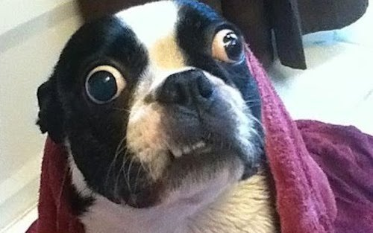
Solution
Character | Huffman Encoding
t | 00
SPC | 0100
D | 0101
c | 0110
e | 0111
a | 100
r | 101
s | 110
u | 111
Transmission:
“Data structures” =
0101100001000100110001011110110001111010111110
46 bits. Compare with 15 * 7 = 105 for ASCII… (43.8%)
root
NULL, 15
0
1
NULL, 7
1
NULL, 8
NULL, 4
1
0
0
0
1
NULL, 4
NULL, 4
NULL, 2
NULL, 2
0
1
0
1
0
1
0
1
t, 3
SPC, 1
D, 1
c, 1
e, 1
a, 2
r, 2
s, 2
u, 2

Slide 86

Encoding phase
Formally, what we did is known as the encoding phase of Huffman.
We encoded characters from some alphabet $Σ$ based on their frequencies in a (hopefully representative!) text.

Slide 87

Encoding phase
Formally, what we did is known as the encoding phase of Huffman.
We encoded characters from some alphabet $Σ$ based on their frequencies in a (hopefully representative!) text.
But what if some characters from $Σ$ never appear in the text?

Slide 88
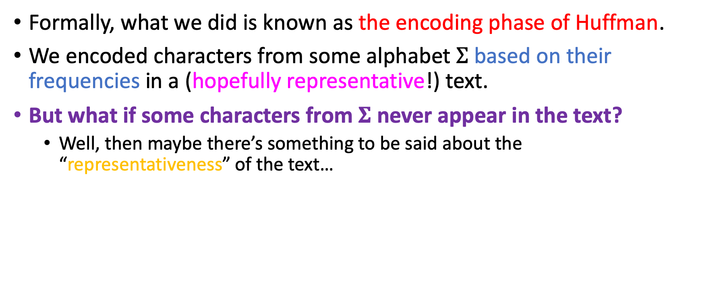
Encoding phase
Formally, what we did is known as the encoding phase of Huffman.
We encoded characters from some alphabet $Σ$ based on their frequencies in a (hopefully representative!) text.
But what if some characters from $Σ$ never appear in the text?
Well, then maybe there’s something to be said about the “representativeness” of the text…

Slide 89
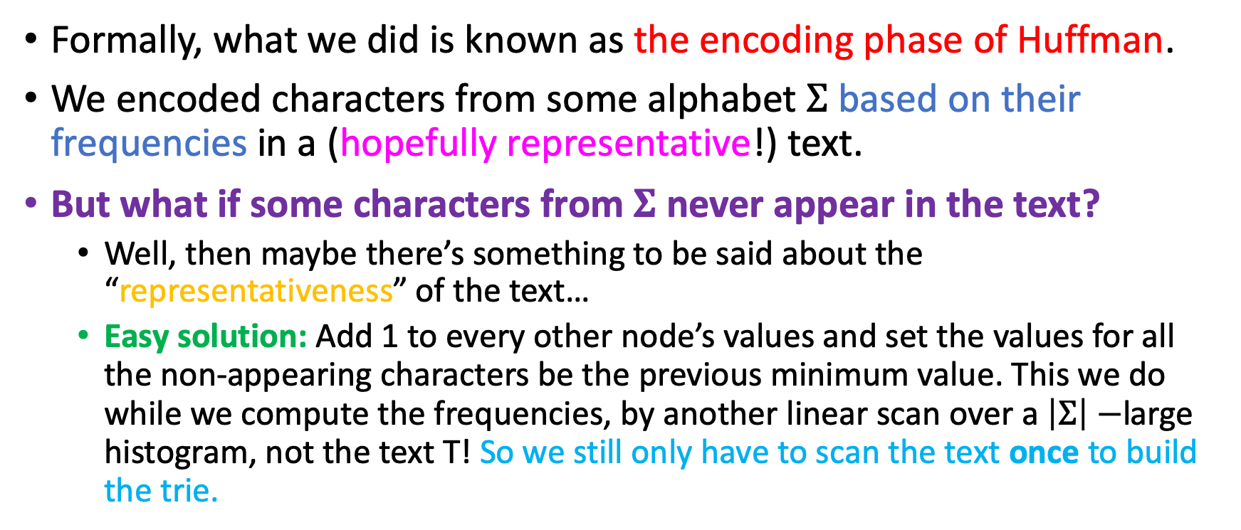
Encoding phase
Formally, what we did is known as the encoding phase of Huffman.
We encoded characters from some alphabet $Σ$ based on their frequencies in a (hopefully representative!) text.
But what if some characters from $Σ$ never appear in the text?
Well, then maybe there’s something to be said about the “representativeness” of the text…
Easy solution: Add 1 to every other node’s values and set the values for all the non-appearing characters be the previous minimum value. This we do while we compute the frequencies, by another linear scan over a $\left|Σ\right|−$large histogram, not the text T! So we still only have to scan the text once to build the trie.

Slide 90
Encoding phase
Invariant satisfaction: Recall; one of our goals was for no code to be the prefix of another.

Slide 91

Encoding phase
Invariant satisfaction: Recall; one of our goals was that no code to be the prefix of another.
This is trivially satisfied by Huffman Encoding, since all codes are generated by following paths from the root to the leaves!
And there’s nothing “below” the leaves!

Slide 92
Criticism of Huffman’s encoding phase
Huffman has to traverse the string twice, once for frequency computation and once for encoding. ☹
This is one of the main criticisms of Huffman encoding.

Slide 93
Criticism of Huffman’s encoding phase
Huffman has to traverse the string twice, once for frequency computation and once for encoding. ☹
This is one of the main criticisms of Huffman encoding.
Huffman encoding can be seen as a method for string compression, since we save memory space per character.

Slide 94
Criticism of Huffman’s encoding phase
Huffman has to traverse the string twice, once for frequency computation and once for encoding. ☹
This is one of the main criticisms of Huffman encoding.
Huffman encoding can be seen as a method for string compression, since we save memory space per character.
However, the LZW compression algorithm does better ☺

