Slide 1
LZW String encoding (and decoding)
CMSC420
This material is not covered during the Fall of 2019, but we include it so that you can learn some things about LZW compression.

Slide 2
String compression
So far we’ve dealt with efficient character encoding
An allocation of bit length to characters that, over the long run, will save us space (and processing time at the destination!)
Technically, this is still string compression
But, it turns out we can do better!

Slide 3
Compression: Lossy vs Lossless
A different kind of debate when compared to character encoding strategies.
Lossy: describes a compression process during which some data loss is incurred.
Lossless: not lossy!
Different applications have different needs.
Audio: highly compressible. Lossy compression (mp3/mp4) with variable bitrate (128, 160, … , 320 kb/s)
Images: JPEG and JPEG2000 algorithms both lossy, but can compress an image 10 to 1 with virtually no perceived quality loss.
Text: Here, we can’t risk mistakes. Lossless compression is the only way
Patent documents
Courtroom proceedings
University admission decisions
….

Slide 4

Concatenating Huffman encodings
We could concatenate the Huffman encodings of the individual characters…
But this doesn’t take into consideration that, in language, groups of consecutive characters ($n$-grams), are very often used repeatedly!

Slide 5

Concatenating Huffman encodings
We could concatenate the Huffman encodings of the individual characters…
But this doesn’t take into consideration that, in language, groups of consecutive characters ($n$-grams), are very often used repeatedly!
For example: “th” is used in “the, that, than, there, these, those, thor”.

Slide 6
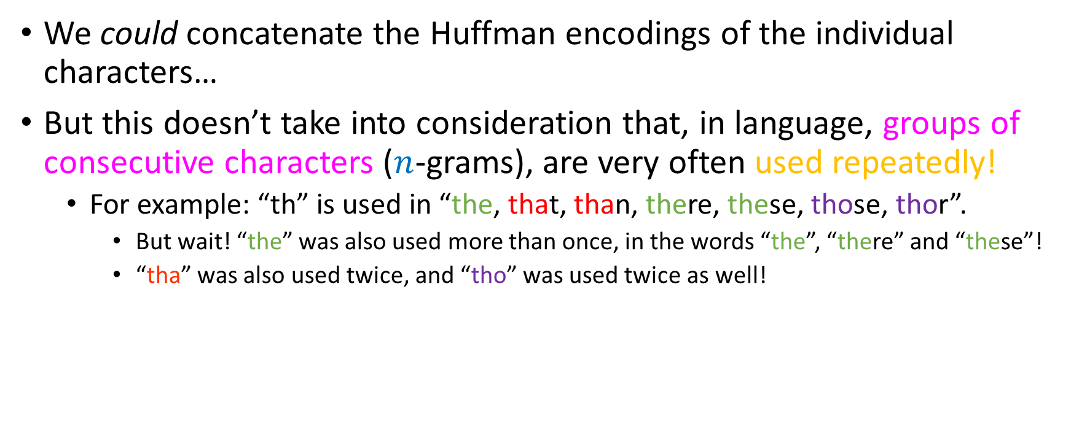
Concatenating Huffman encodings
We could concatenate the Huffman encodings of the individual characters…
But this doesn’t take into consideration that, in language, groups of consecutive characters ($n$-grams), are very often used repeatedly!
For example: “th” is used in “the, that, than, there, these, those, thor”.
But wait! “the” was also used more than once, in the words “the”, “there” and “these”!
“tha” was also used twice, and “tho” was used twice as well!

Slide 7

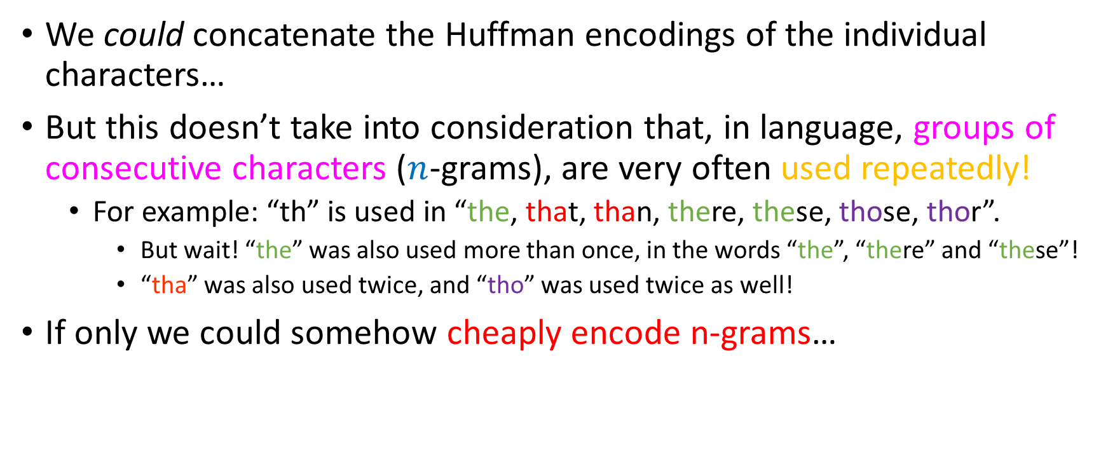
Concatenating Huffman encodings
We could concatenate the Huffman encodings of the individual characters…
But this doesn’t take into consideration that, in language, groups of consecutive characters ($n$-grams), are very often used repeatedly!
For example: “th” is used in “the, that, than, there, these, those, thor”.
But wait! “the” was also used more than once, in the words “the”, “there” and “these”!
“tha” was also used twice, and “tho” was used twice as well!
If only we could somehow cheaply encode n-grams…

Slide 8
Recall the pipeline…

Slide 9
Recall the pipeline…
UNICODE

Slide 10

Recall the pipeline…
No storage standard
UNICODE

Slide 11
Recall the pipeline…
No storage standard
UNICODE
UCS-2

Slide 12

Recall the pipeline…
No storage standard
UNICODE
UCS-2
Rare symbols should pay more than frequent ones!

Slide 13
Recall the pipeline…
No storage standard
UTF-8
UNICODE
UCS-2
UTF-16
Rare symbols should pay more than frequent ones!

Slide 14

Recall the pipeline…
No storage standard
Unigram frequencies should be leveraged for better data compression
UTF-8
UNICODE
UCS-2
UTF-16
Rare symbols should pay more than frequent ones!

Slide 15
Recall the pipeline…
No storage standard
Unigram frequencies should be leveraged for better data compression
UTF-8
UNICODE
UCS-2
Huffman
UTF-16
Rare symbols should pay more than frequent ones!

Slide 16

Recall the pipeline…
No storage standard
Unigram frequencies should be leveraged for better data compression
UTF-8
UNICODE
UCS-2
Huffman
UTF-16
Rare symbols should pay more than frequent ones!
Bi-Tri/… N-gram frequencies should be leveraged for better data compression!

Slide 17

Recall the pipeline…
No storage standard
Unigram frequencies should be leveraged for better data compression
UTF-8
UNICODE
UCS-2
Huffman
UTF-16
Rare symbols should pay more than frequent ones!
Lempel-Ziw-Welch (LZW) String Compression Algorithm
Bi-Tri/… N-gram frequencies should be leveraged for better data compression!

Slide 18
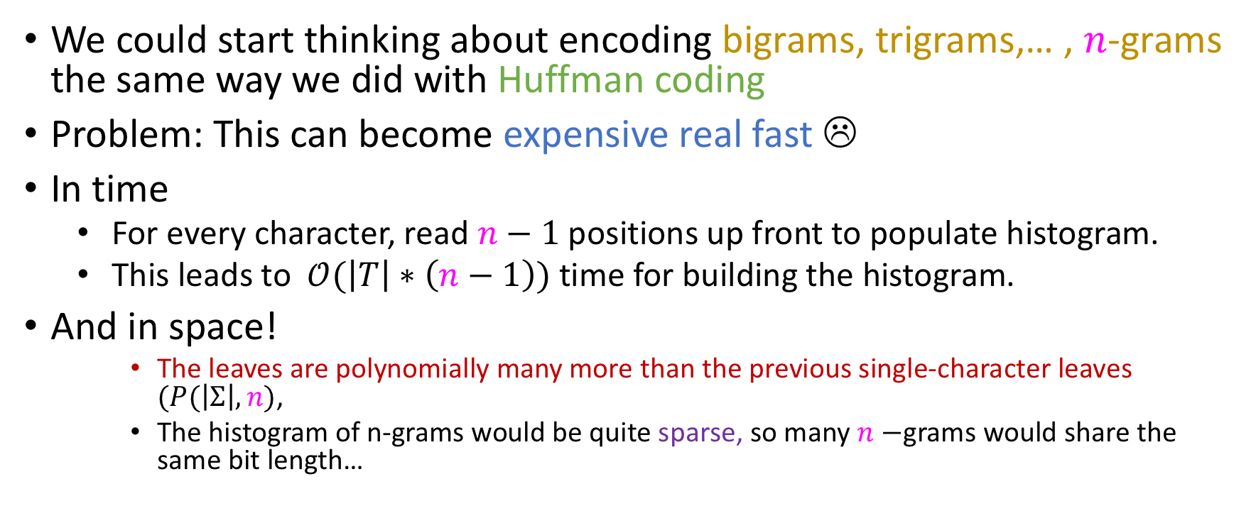
Naïve approach won’t work
We could start thinking about encoding bigrams, trigrams,… , $n$-grams the same way we did with Huffman coding
Problem: This can become expensive real fast ☹
In time
For every character, read $n−1$ positions up front to populate histogram.
This leads to $𝒪(\left|T\right|∗\left(n−1\right))$ time for building the histogram.
And in space!
The leaves are polynomially many more than the previous single-character leaves $(P(\left|Σ\right|, n)$,
The histogram of n-grams would be quite sparse, so many $n−$grams would share the same bit length…

Slide 19
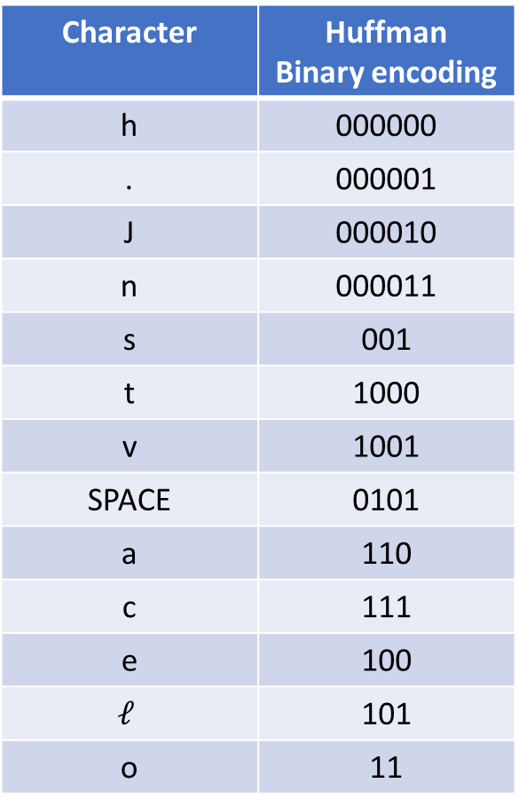
Lookup tables and “source” tries
Character | Huffman Binary encoding
h | 000000
. | 000001
J | 000010
n | 000011
s | 001
t | 1000
v | 1001
SPACE | 0101
a | 110
c | 111
e | 100
$$ℓ$$ | 101
o | 11
Huffman ended with a 2-way lookup table like this:
As mentioned, a two-way lookup table can be implemented via a pair of hash tables: One on characters, one on binary strings
The encoder will take the one on binary strings and transform it into a trie-like structure known as a source trie

Slide 20
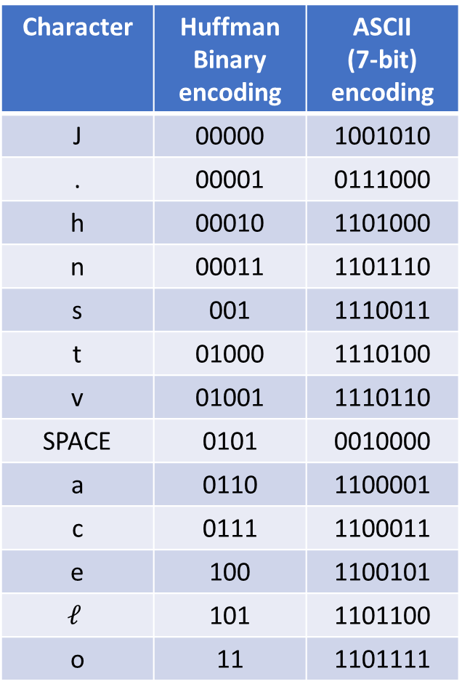

Source trie corresponding to Huffman encoding
Character | Huffman Binary encoding | ASCII (7-bit) encoding
J | 00000 | 1001010
. | 00001 | 0111000
h | 00010 | 1101000
n | 00011 | 1101110
s | 001 | 1110011
t | 01000 | 1110100
v | 01001 | 1110110
SPACE | 0101 | 0010000
a | 0110 | 1100001
c | 0111 | 1100011
e | 100 | 1100101
$$ℓ$$ | 101 | 1101100
o | 11 | 1101111
J
o
11
.
$$ℓ$$
000000
e
101
h
c
100
000001
n
s
t
v
a
SPACE
000010
0111
000011
0110
001
01000
01001
0101

Slide 21
Source trie corresponding to ASCII encoding!
Character | Huffman Binary encoding | ASCII (7-bit) encoding
J | 00000 | 1001010
. | 00001 | 0111000
h | 00010 | 1101000
n | 00011 | 1101110
s | 001 | 1110011
t | 01000 | 1110100
v | 01001 | 1110110
SPACE | 0101 | 0010000
a | 0110 | 1100001
c | 0111 | 1100011
e | 100 | 1100101
$$ℓ$$ | 101 | 1101100
o | 11 | 1101111
J
o
1101111
.
$$ℓ$$
1001010
e
1101100
h
c
1100101
0111000
n
s
t
v
a
SPACE
1101000
1100011
1101110
1100001
1110100
1110011
1110110
0010000
Any character encoding can be fed to LZW (we show ASCII here)!
We will always be explicit about which one we assume in exams.

Slide 22
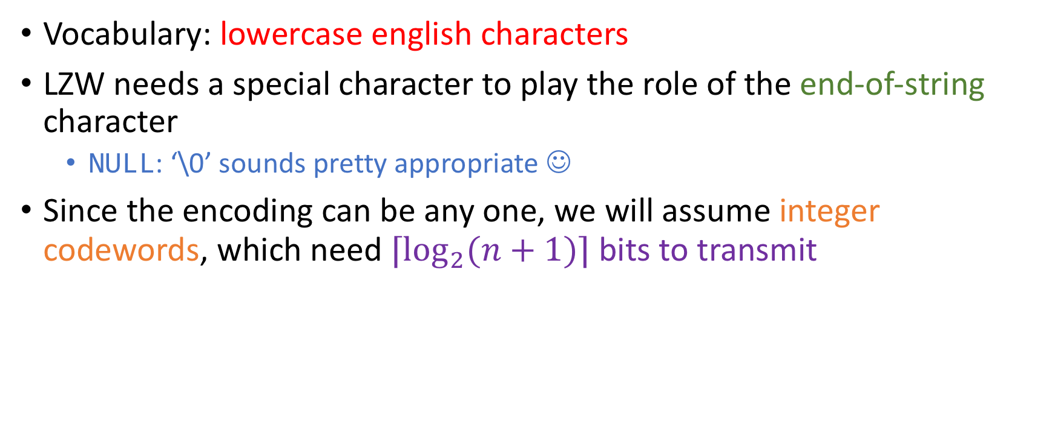
An easier example
Vocabulary: lowercase english characters
LZW needs a special character to play the role of the end-of-string character
NULL: ‘\0’ sounds pretty appropriate ☺
Since the encoding can be any one, we will assume integer codewords, which need $⌈\log_{2}{(n+1)⌉}$ bits to transmit
a
e
b
c
d
1
5
2
3
4

Slide 23
Encoding example
Suppose that we want to encode the string
ededadedeedeeeee\0.
This is how LZW would do it:
a
e
b
c
d
MAX CODE = 5
1
5
2
3
4
Numbers transmitted:

Slide 24
Encoding example
If I transmit character-by-character character codes, I get
5454145455455555
Suppose that we want to encode the string
ededadedeedeeeee\0.
This is how LZW would do it:
a
e
b
c
d
MAX CODE = 5
1
5
2
3
4
Numbers transmitted:

Slide 25
Encoding example
Suppose that we want to encode the string
ededadedeedeeeee\0.
This is how LZW would do it:
a
e
b
c
d
MAX CODE = 5
1
5
2
3
4
Numbers transmitted: 5

Slide 26
Encoding example
Suppose that we want to encode the string
ededadedeedeeeee\0.
This is how LZW would do it:
a
e
Key step of LZW: we will peek ahead, look at the next character, make a new path that encodes this bigram and append MAX CODE + 1 to it.
b
c
d
MAX CODE = 5
1
5
2
3
4
d
6
Numbers transmitted: 5

Slide 27
Encoding example
Suppose that we want to encode the string
ededadedeedeeeee\0.
This is how LZW would do it:
a
e
Key step of LZW: we will peek ahead, look at the next character, make a new path that encodes this bigram and append MAX CODE + 1 to it.
b
c
d
MAX CODE =6
1
5
2
3
4
d
Let’s not forget to increase MAX CODE…
6
Numbers transmitted: 5

Slide 28
Encoding example
Suppose that we want to encode the string
ededadedeedeeeee\0.
This is how LZW would do it:
a
e
Key step of LZW: we will peek ahead, look at the next character, make a new path that encodes this bigram and append MAX CODE + 1 to it.
b
c
d
MAX CODE =6
1
5
2
3
4
d
Let’s not forget to increase MAX CODE…
6
Some people call these longer sequences tokens.
Numbers transmitted: 5

Slide 29
Encoding example
Suppose that we want to encode the string
ededadedeedeeeee\0.
This is how LZW would do it:
a
e
b
c
d
MAX CODE =6
1
5
2
3
4
d
6
Numbers transmitted: 5

Slide 30
Encoding example
Suppose that we want to encode the string
ededadedeedeeeee\0.
This is how LZW would do it:
a
e
b
c
d
MAX CODE =6
1
5
2
3
4
d
6
Numbers transmitted: 5 4

Slide 31
Encoding example
Suppose that we want to encode the string
ededadedeedeeeee\0.
This is how LZW would do it:
a
e
Peek ahead and give me a cheap encoding for token “de”!
b
c
d
MAX CODE =7
1
5
2
3
4
d
e
7
6
Numbers transmitted: 5 4

Slide 32
Encoding example
Suppose that we want to encode the string
ededadedeedeeeee\0.
This is how LZW would do it:
a
e
b
c
d
MAX CODE =7
1
5
2
3
4
d
e
7
6
Numbers transmitted: 5 4

Slide 33
Encoding example
Suppose that we want to encode the string
ededadedeedeeeee\0.
This is how LZW would do it:
a
e
b
c
d
Now we can take advantage of the cheap encoding for token “ed” which has already been inserted into source trie ☺
MAX CODE =7
1
5
2
3
4
d
e
7
6
Numbers transmitted: 5 4 6

Slide 34
Encoding example
Suppose that we want to encode the string
ededadedeedeeeee\0.
This is how LZW would do it:
a
e
b
c
d
Now we can take advantage of the cheap encoding for token “ed” which has already been inserted into source trie ☺
MAX CODE =8
1
5
2
3
4
d
e
7
6
But we should not forget to peek ahead, and add a larger token to our trie!
a
8
Numbers transmitted: 5 4 6

Slide 35
Encoding example
Suppose that we want to encode the string
ededadedeedeeeee\0.
This is how LZW would do it:
a
e
b
c
d
MAX CODE =8
1
5
2
3
4
d
e
7
6
a
8
Numbers transmitted: 5 4 6 1

Slide 36
Encoding example
Suppose that we want to encode the string
ededadedeedeeeee\0.
This is how LZW would do it:
a
e
b
c
d
MAX CODE =9
1
5
2
3
4
d
d
e
9
7
6
a
8
Numbers transmitted: 5 4 6 1

Slide 37
Encoding example
Suppose that we want to encode the string
ededadedeedeeeee\0.
This is how LZW would do it:
a
e
b
d
de already in the trie ☺
Transmit its codeword, 7
c
MAX CODE =9
1
5
2
3
4
d
d
e
9
7
6
a
8
Numbers transmitted: 5 4 6 1 7

Slide 38
Encoding example
Suppose that we want to encode the string
ededadedeedeeeee\0.
This is how LZW would do it:
a
e
b
d
de already in the trie ☺
Transmit its codeword, 7
Peeking ahead gives us a new token with its codeword=max code + 1
c
MAX CODE =10
1
5
2
3
4
d
d
e
9
7
6
d
a
8
10
Numbers transmitted: 5 4 6 1 7

Slide 39
Encoding example
Suppose that we want to encode the string
ededadedeedeeeee\0.
This is how LZW would do it:
a
e
b
d
de already in the trie ☺
Transmit its codeword, 7
Peeking ahead gives us a new token with its codeword=max code + 1
We also update MAX_CODE ☺
c
MAX CODE =10
1
5
2
3
4
d
d
e
9
7
6
d
a
8
10
Numbers transmitted: 5 4 6 1 7

Slide 40
Encoding example
Suppose that we want to encode the string
ededadedeedeeeee\0.
This is how LZW would do it:
a
e
b
d
de already in the trie (again!) ☺
Transmit its codeword, 7
c
MAX CODE =10
1
5
2
3
4
d
d
e
9
7
6
d
a
8
10
Numbers transmitted: 5 4 6 1 7 7

Slide 41
Encoding example
Suppose that we want to encode the string
ededadedeedeeeee\0.
This is how LZW would do it:
a
e
b
d
de already in the trie (again!) ☺
Transmit its codeword, 7
Peek ahead, notice e and insert token dee in the trie, with code MAX_CODE + 1
c
MAX CODE =10
1
5
2
3
4
d
d
e
9
7
6
d
e
a
8
10
11
Numbers transmitted: 5 4 6 1 7 7

Slide 42
Encoding example
Suppose that we want to encode the string
ededadedeedeeeee\0.
This is how LZW would do it:
a
e
b
d
de already in the trie (again!) ☺
Transmit its codeword, 7
Peek ahead, notice e and insert token dee in the trie, with code MAX_CODE + 1
Update MAX CODE appropriately.
c
MAX CODE =11
1
5
2
3
4
d
d
Update MAX CODE appropriately.
e
9
7
6
d
e
a
8
10
11
Numbers transmitted: 5 4 6 1 7 7

Slide 43
Encoding example
Suppose that we want to encode the string
ededadedeedeeeee\0.
This is how LZW would do it:
a
e
b
d
ed in the trie
Transmit its codeword, 6
ede is added as a trie token with codeword MAX CODE + 1
MAX CODE is updated
c
MAX CODE =12
1
5
2
3
4
d
d
e
9
7
6
e
d
e
a
8
12
10
11
Numbers transmitted: 5 4 6 1 7 7 6

Slide 44
Encoding example
Suppose that we want to encode the string
ededadedeedeeeee\0.
This is how LZW would do it:
a
e
b
c
d
e in the trie
Transmit its codeword, 5
ee is added as a trie token with codeword MAX CODE + 1
MAX CODE is updated
e
MAX CODE =13
1
5
2
3
4
d
d
13
e
9
7
6
e
d
e
a
8
12
10
11
Numbers transmitted: 5 4 6 1 7 7 6 5

Slide 45
Encoding example
Suppose that we want to encode the string
ededadedeedeeeee\0.
This is how LZW would do it:
ee in the trie
Transmit its codeword, 13
eee is added as a trie token with codeword MAX CODE + 1
MAX CODE is updated
a
e
b
c
d
e
MAX CODE =14
1
5
2
3
4
d
d
13
e
e
9
14
7
6
e
d
e
a
8
12
10
11
Numbers transmitted: 5 4 6 1 7 7 6 5 13

Slide 46
Encoding example
Suppose that we want to encode the string
ededadedeedeeeee\0.
This is how LZW would do it:
ee in the trie
Transmit its codeword, 13
If we look ahead, we see the end-of-string-character, so nothing more to add; we can stop.
a
e
b
c
d
e
MAX CODE =14
1
5
2
3
4
d
d
13
e
e
9
14
7
6
e
d
e
a
8
12
10
11
Numbers transmitted: 5 4 6 1 7 7 6 5 13 13

Slide 47
Encoding example
Suppose that we want to encode the string
ededadedeedeeeee\0.
This is how LZW would do it:
ee in the trie
Transmit its codeword, 13
If we look ahead, we see the end-of-string-character, so nothing more to add; we can stop.
a
e
b
c
d
e
MAX CODE =14
1
5
2
3
4
d
d
13
e
Compare to the character-by-character sending from before: 5454145455455555
e
9
14
7
6
e
d
e
a
101100110111111111010111011101 = 30 bits
1011001011001100101100101101100101101101101101101 = 49 bits
8
12
10
11
Numbers transmitted: 5 4 6 1 7 7 6 5 13 13

Slide 48
Characteristics of LZW encoding process
During encoding, we greedily enlarged the trie after every transmission, since it looked like a good idea at the time!
It turns out that it is a good idea, even if some tokens are never actually used (e.g the token “ad” was stored in the trie, but never used later on).

Slide 49
Characteristics of LZW encoding process
During the encoding of the string you might have noticed that we partitioned the string into code-emitting tokens:
ededadedeedeeeee\0
5 4 6 1 7 7 6 5 13 13
This process is known as tokenization: Before transmitted, the string will have to be tokenized into tokens which have a 1-1 correspondence with a code.

Slide 50
Characteristics of LZW encoding process
During the encoding of the string you might have noticed that we partitioned the string into code-emitting tokens:
e|d|ed|a|de|de|ed|e|ee|ee
5| 4| 6| 1| 7| 7 |6 |5| 13| 13
This process is known as tokenization: Before transmitted, the string will have to be tokenized into tokens which have a 1-1 correspondence with a code.
Advice: Since you don’t (necessarily) have access to multiple colored pens in exams, delineate the tokens with vertical bars!

Slide 51
Let’s work on this!
Run LZW encoding, using the following source trie to encode acacdgqgqqgqqqq\0
a
q
c
d
g
1
16
4
6
3

Slide 52

LZW decoding
The big question now is: Given a stream of integers, can we flawlessly (losslessly) recover the original character sequence?
This is particularly important given that integer codewords don’t satisfy the prefix property like Huffman tries do!
E.g, $1_{(2)}=1, 3_{(2)}=11$, and the codeword for 1 is a prefix of that of 3 ☹

Slide 53
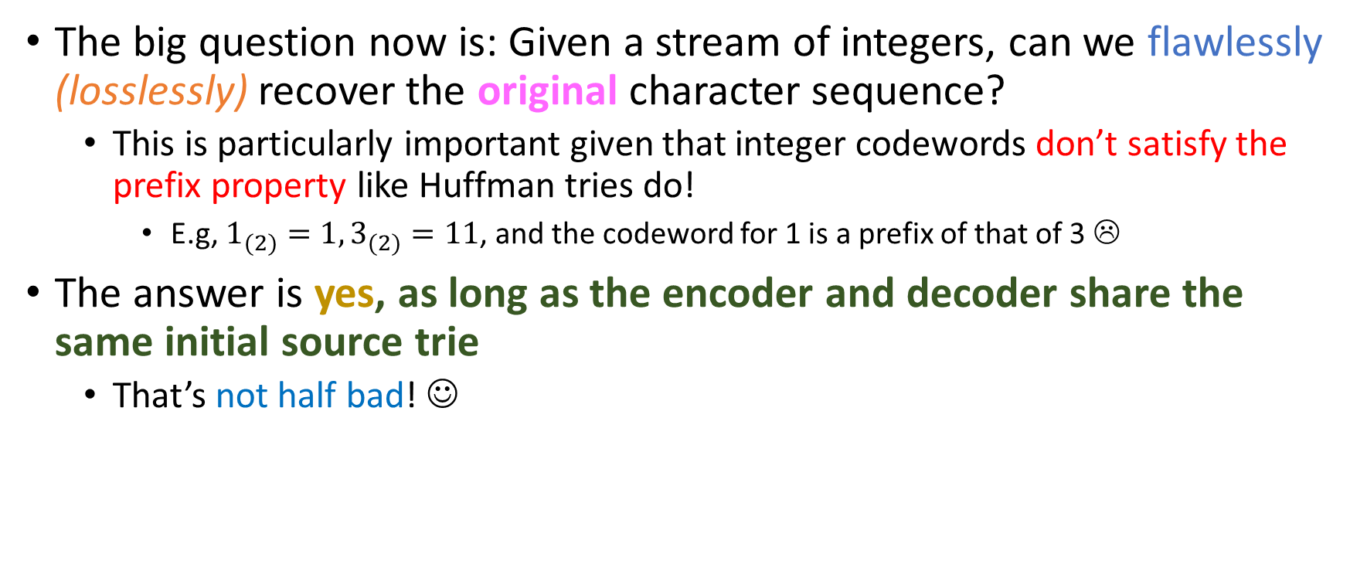
LZW decoding
The big question now is: Given a stream of integers, can we flawlessly (losslessly) recover the original character sequence?
This is particularly important given that integer codewords don’t satisfy the prefix property like Huffman tries do!
E.g, $1_{(2)}=1, 3_{(2)}=11$, and the codeword for 1 is a prefix of that of 3 ☹
The answer is yes, as long as the encoder and decoder share the same initial source trie
That’s not half bad! ☺

Slide 54
Decoding Example
Assume I have the following source trie:
And I receive 5| 4| 6| 1| 7| 7 |6 |5| 13| 13
Our quest is to decode this tokenized sequence of integers into the precise original character sequence.
Remember: lossless compression!
a
e
b
c
d
1
5
2
3
4

Slide 55
Decoding Example
a
e
b
c
d
1
5
2
3
4
Decoder input: 5| 4| 6| 1| 7| 7 |6 |5| 13| 13
Decoder output:

Slide 56
Decoding Example
Tokenized codeword ‘5’ corresponds to character ‘e’.
‘e’ is in the source trie!
Clearly, this means that ‘e’ is exactly the character sent first.
Put ‘e’ in output buffer!
a
e
b
c
d
1
5
2
3
4
Decoder input: 5| 4| 6| 1| 7| 7 |6 |5| 13| 13
Decoder output: e |

Slide 57
Decoding Example
Tokenized codeword ‘4’ corresponds to character ‘d’.
So I can output ‘d’ immediately
a
e
b
c
d
1
5
2
3
4
Decoder input: 5| 4| 6| 1| 7| 7 |6 |5| 13| 13
Decoder output: e | d

Slide 58

Decoding Example
Tokenized codeword ‘4’ corresponds to character ‘d’.
So I can output ‘d’ immediately
Key step: After writing ‘d’ to the output buffer, I will add ‘ed’ to my copy of the trie, since I know that this is LZW, and there’s no other way the encoder would operate!
a
e
b
c
d
1
5
2
3
4
d
6
Decoder input: 5| 4| 6| 1| 7| 7 |6 |5| 13| 13
Decoder output: e | d

Slide 59
Decoding Example
Codeword ‘6’ corresponds to token ‘ed’ which I just added to my trie!
Output it.
Add “de” to the trie (last token transmitted + first character of current token)
a
e
b
c
d
1
5
2
3
4
e
d
7
6
Decoder input: 5| 4| 6| 1| 7| 7 |6 |5| 13| 13
Decoder output: e | d | ed |

Slide 60
Decoding Example
Codeword ‘1’ corresponds to stored token ‘a’
Output it.
Add “eda” to the trie (last token transmitted + first character of current token)
a
e
b
c
d
1
5
2
3
4
e
d
7
6
a
8
Decoder input: 5| 4| 6| 1| 7| 7 |6 |5| 13| 13
Decoder output: e | d | ed | a |

Slide 61
Decoding Example
Codeword ‘7’ corresponds to (recently!) stored token “de”
Output it.
Add “ad” to the trie (last token transmitted + first character of current token)
a
e
b
c
d
1
5
2
3
4
d
e
d
9
7
6
a
8
Decoder input: 5| 4| 6| 1| 7| 7 |6 |5| 13| 13
Decoder output: e | d | ed | a | de |

Slide 62
Decoding Example
Codeword ‘7’ corresponds to (recently!) stored token “de” again!
Output it.
Add “ded” to the trie (last token transmitted + first character of current token)
a
e
b
c
d
1
5
2
3
4
d
e
d
9
7
6
a
d
8
10
Decoder input: 5| 4| 6| 1| 7| 7 |6 |5| 13| 13
Decoder output: e | d | ed | a | de | de

Slide 63
Decoding Example
Codeword ‘6’ corresponds to (recently!) stored token “ed”
Output it.
Add “dee” to the trie (last token transmitted + first character of current token)
a
e
b
c
d
1
5
2
3
4
d
e
d
9
7
6
e
a
d
8
10
11
Decoder input: 5| 4| 6| 1| 7| 7 |6 |5| 13| 13
Decoder output: e | d | ed | a | de | de | ed

Slide 64
Decoding Example
Codeword ‘5’ corresponds to stored token “e”
Output it.
Add “ede” to the trie (last token transmitted + first character of current token)
a
e
b
c
d
1
5
2
3
4
d
e
d
9
7
6
e
e
a
d
12
10
11
8
Decoder input: 5| 4| 6| 1| 7| 7 |6 | 5 | 13| 13
Decoder output: e | d | ed | a | de | de | ed | e

Slide 65
Decoding Example
Codeword ‘13’ corresponds to… wait, what?
a
e
b
c
d
1
5
2
3
4
d
e
d
9
7
6
e
e
a
d
12
11
8
10
Decoder input: 5| 4| 6| 1| 7| 7 |6 | 5 | 13| 13
Decoder output: e | d | ed | a | de | de | ed | e

Slide 66

Decoding Example
Codeword ‘13’ corresponds to… wait, what?
‘13’ is not in the trie!
a
e
b
c
d
1
5
2
3
4
d
e
d
9
7
6
e
e
a
d
12
11
8
10
Decoder input: 5| 4| 6| 1| 7| 7 |6 | 5 | 13| 13
Decoder output: e | d | ed | a | de | de | ed | e

Slide 67
Decoding Example
Codeword ‘13’ corresponds to… wait, what?
‘13’ is not in the trie!
a
e
b
c
d
1
5
2
3
4
d
e
d
Which token do you guys think should 13 be decoded to?
9
7
6
e
e
a
ede
ee
d
12
11
8
10
deee
Something Else (what?)
Decoder input: 5| 4| 6| 1| 7| 7 |6 | 5 | 13| 13
Decoder output: e | d | ed | a | de | de | ed | e

Slide 68

Decoding Example
Codeword ‘13’ corresponds to… wait, what?
‘13’ is not in the trie!
a
e
b
c
d
1
5
2
3
4
d
e
d
Which token do you guys think should 13 be decoded to?
9
7
6
e
e
LET’S SEE WHY!
a
ede
ee
d
12
11
8
10
deee
Something Else (what?)
Decoder input: 5| 4| 6| 1| 7| 7 |6 | 5 | 13| 13
Decoder output: e | d | ed | a | de | de | ed | e

Slide 69
Decoding Example
CRUCIAL STEP: Since codeword 13 is not in the trie, we know that the encoder, before transmitting it, had just created it.
e
a
b
c
d
1
5
2
3
4
d
e
d
9
7
6
e
e
a
d
12
11
8
10
Decoder input: 5| 4| 6| 1| 7| 7 |6 | 5 | 13| 13
Decoder output: e | d | ed | a | de | de | ed | e

Slide 70
Decoding Example
CRUCIAL STEP: Since codeword 13 is not in the trie, we know that the encoder, before transmitting it, had just created it.
What should the minimum length of the corresponding token be?
e
a
b
c
d
1
5
2
3
4
d
e
d
9
7
6
e
e
Something Else (what?)
d
a
1
2
12
10
11
8
Decoder input: 5| 4| 6| 1| 7| 7 |6 | 5 | 13| 13
Decoder output: e | d | ed | a | de | de | ed | e

Slide 71
Decoding Example
These are my minimal length positions where 13 might exist….
CRUCIAL STEP: Since codeword 13 is not in the trie, we know that the encoder, before transmitting it, had just created it.
What should the minimum length of the corresponding token be?
e
a
b
c
d
1
5
?
2
3
4
d
13
?
e
?
d
?
?
13
9
13
13
7
6
e
e
a
1
2
Something Else (what?)
13
d
12
10
11
8
Decoder input: 5| 4| 6| 1| 7| 7 |6 | 5 | 13| 13
Decoder output: e | d | ed | a | de | de | ed | e

Slide 72
Decoding Example
I don’t understand why it needs to be ee
a
e
b
c
d
1
5
e
2
3
4
d
13
?
e
?
d
?
?
13
9
13
13
7
6
e
e
a
13
d
12
10
11
8
Decoder input: 5| 4| 6| 1| 7| 7 |6 | 5 | 13| 13
Decoder output: e | d | ed | a | de | de | ed | e

Slide 73

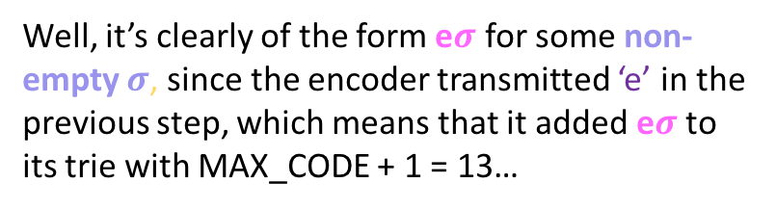
Decoding Example
a
e
b
c
d
1
5
e
2
3
4
d
13
?
e
?
d
?
?
13
9
13
13
7
6
e
e
a
13
d
12
10
11
8
Well, it’s clearly of the form e$σ$ for some non-empty $σ$, since the encoder transmitted ‘e’ in the previous step, which means that it added e$σ$ to its trie with MAX_CODE + 1 = 13…
Decoder input: 5| 4| 6| 1| 7| 7 |6 | 5 | 13| 13
Decoder output: e | d | ed | a | de | de | ed | e | e$σ$

Slide 74
Decoding Example
a
e
b
c
d
1
5
?
2
3
4
d
13
So all of the other hypotheses can now safely go
?
e
?
d
?
?
13
9
13
13
7
6
e
e
a
13
d
12
10
11
8
Well, it’s clearly of the form e$σ$ for some non-empty $σ$, since the encoder transmitted ‘e’ in the previous step, which means that it added e$σ$ to its trie with MAX_CODE + 1 = 13…
Decoder input: 5| 4| 6| 1| 7| 7 |6 | 5 | 13| 13
Decoder output: e | d | ed | a | de | de | ed | e | e$σ$

Slide 75
Decoding Example
a
e
b
c
d
1
5
?
2
3
4
d
13
e
d
9
7
6
e
e
a
d
12
11
8
10
Well, it’s clearly of the form e$σ$ for some non-empty $σ$, since the encoder transmitted ‘e’ in the previous step, which means that it added e$σ$ to its trie with MAX_CODE + 1 = 13…
Decoder input: 5| 4| 6| 1| 7| 7 |6 | 5 | 13| 13
Decoder output: e | d | ed | a | de | de | ed | e | e$σ$

Slide 76
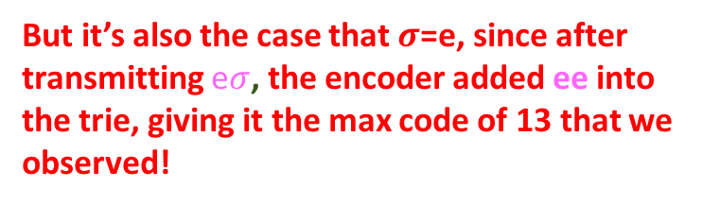
Decoding Example
a
e
b
c
d
1
5
e
2
3
4
d
13
e
d
9
7
6
e
e
But it’s also the case that $σ$=e, since after transmitting e$σ$, the encoder added ee into the trie, giving it the max code of 13 that we observed!
a
d
12
10
11
8
Well, it’s clearly of the form e$σ$ for some non-empty $σ$, since the encoder transmitted ‘e’ in the previous step, which means that it added e$σ$ to its trie with MAX_CODE + 1 = 13…
Decoder input: 5| 4| 6| 1| 7| 7 |6 | 5 | 13| 13
Decoder output: e | d | ed | a | de | de | ed | e | ee

Slide 77
Decoding Example
a
e
b
c
d
1
5
e
2
3
4
d
13
e
e
d
9
14
7
6
Receive 13, which is now in the trie
Output 13 again
Expand trie with token “eee”
e
e
a
d
12
11
8
10
Decoder input: 5| 4| 6| 1| 7| 7 |6 | 5 | 13| 13
Decoder output: e | d | ed | a | de | de | ed | e | ee | ee

Slide 78

Decoding Example
a
e
b
c
d
1
5
e
2
3
4
d
13
e
e
d
9
14
7
6
Receive 13, which is now in the trie
Output 13 again
Expand trie with token “eee”
e
e
a
d
12
10
11
8
Done!
Decoder input: 5| 4| 6| 1| 7| 7 |6 | 5 | 13| 13
Decoder output: e | d | ed | a | de | de | ed | e | ee | ee

Slide 79
Your turn!
Assuming this source trie…
Decode 1 | 4 | 17 |6 |3 |16 |21| 22 | 16 | 25 | 16.
q
a
c
g
16
d
1
4
6
3

Slide 80
Criticisms of LZW
Have to transmit initial source trie.
This can be slow for large alphabets with variable length encodings (not easy to take chunks of data without “breaking into” the invidual encodings)
Encoding and decoding is slow, since the “string encoding” produced by LZW is variable-length: two strings of the same length are not guaranteed an encoding of the same length.
…? ideas ?

