Slide 1
LZW String encoding
CMSC420

Slide 2
String compression
So far we’ve dealt with efficient character encoding
An allocation of bit length to characters that, over the long run, will save us space (and processing time at the destination!)
Technically, this is still string compression
But, it turns out we can do better!

Slide 3
Compression: Lossy vs Lossless
A different kind of debate when compared to character encoding strategies.
Lossy: describes a compression process during which some data loss is incurred.
Lossless: not lossy!
Different applications have different needs.
Audio: highly compressible. Lossy compression (mp3/mp4) with variable bitrate (128, 160, … , 320 kb/s)
Images: JPEG and JPEG2000 algorithms both lossy, but can compress an image 10 to 1 with virtually no perceived quality loss.
Text: Here, we can’t risk mistakes. Lossless compression is the only way
Patent documents
Courtroom proceedings
University admission decisions
….

Slide 4
Concatenating Huffman encodings
We could concatenate the Huffman encodings of the individual characters…
BUT…

Slide 5
Recall the pipeline…

Slide 6
Recall the pipeline…
UNICODE

Slide 7

Recall the pipeline…
No storage standard
UNICODE

Slide 8
Recall the pipeline…
No storage standard
UNICODE
UCS-2

Slide 9

Recall the pipeline…
No storage standard
UNICODE
UCS-2
Rare symbols should pay more than frequent ones!

Slide 10
Recall the pipeline…
No storage standard
UTF-8
UNICODE
UCS-2
UTF-16
Rare symbols should pay more than frequent ones!

Slide 11

Recall the pipeline…
No storage standard
Unigram frequencies should be leveraged for better data compression
UTF-8
UNICODE
UCS-2
UTF-16
Rare symbols should pay more than frequent ones!

Slide 12
Recall the pipeline…
No storage standard
Unigram frequencies should be leveraged for better data compression
UTF-8
UNICODE
UCS-2
Huffman
UTF-16
Rare symbols should pay more than frequent ones!

Slide 13

Recall the pipeline…
No storage standard
Unigram frequencies should be leveraged for better data compression
UTF-8
UNICODE
UCS-2
Huffman
UTF-16
Rare symbols should pay more than frequent ones!
Bi-Tri/… N-gram frequencies should be leveraged for better data compression!

Slide 14

Recall the pipeline…
No storage standard
Unigram frequencies should be leveraged for better data compression
UTF-8
UNICODE
UCS-2
Huffman
UTF-16
Rare symbols should pay more than frequent ones!
Lempel-Ziw-Welch (LZW) String Compression Algorithm
Bi-Tri/… N-gram frequencies should be leveraged for better data compression!

Slide 15
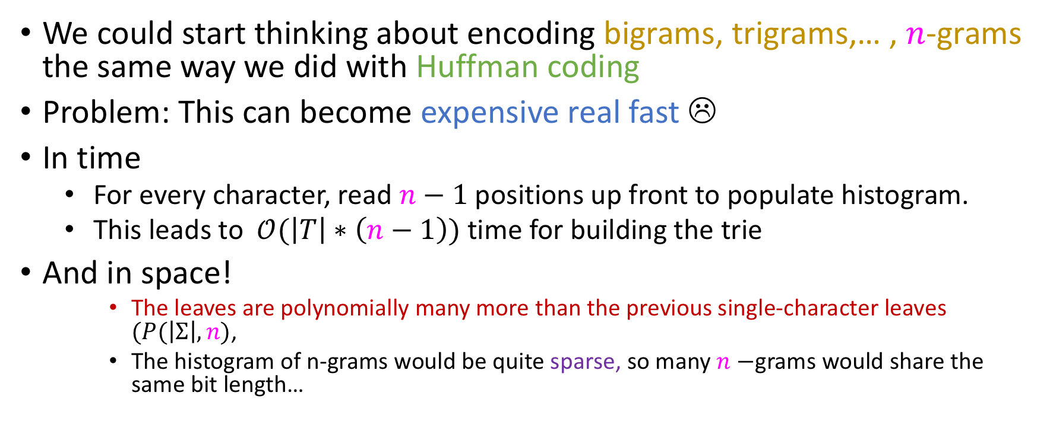
Naïve approach won’t work
We could start thinking about encoding bigrams, trigrams,… , $n$-grams the same way we did with Huffman coding
Problem: This can become expensive real fast ☹
In time
For every character, read $n−1$ positions up front to populate histogram.
This leads to $𝒪(\left|T\right|∗\left(n−1\right))$ time for building the trie
And in space!
The leaves are polynomially many more than the previous single-character leaves $(P(\left|Σ\right|, n)$,
The histogram of n-grams would be quite sparse, so many $n−$grams would share the same bit length…

Slide 16
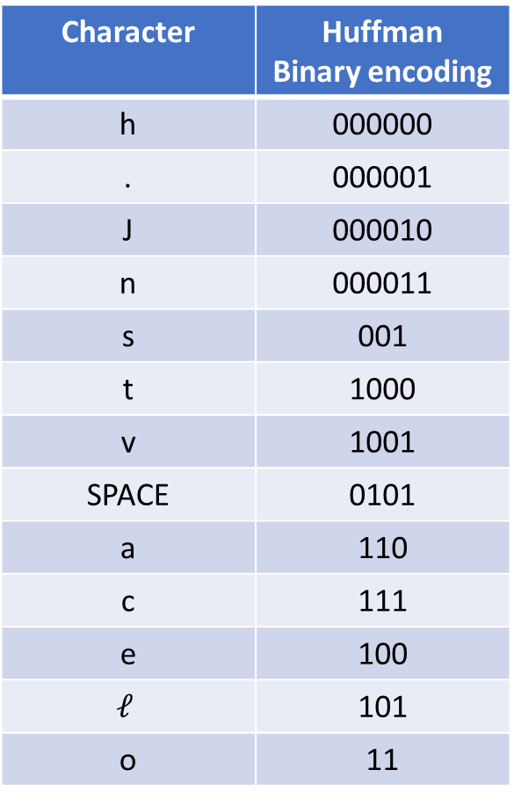
Lookup tables and “source” tries
Character | Huffman Binary encoding
h | 000000
. | 000001
J | 000010
n | 000011
s | 001
t | 1000
v | 1001
SPACE | 0101
a | 110
c | 111
e | 100
$$ℓ$$ | 101
o | 11
Huffman ended with a 2-way lookup table like this:
As mentioned, a two-way lookup table c n be implemented via a pair of hash tables: One on characters, one on binary strings
The encoder will take the one on binary strings and transform it into a trie-like structure known as a source trie

Slide 17

Source trie for our example
Character | Huffman Binary encoding
h | 000000
. | 000001
J | 000010
n | 000011
s | 001
t | 1000
v | 1001
SPACE | 0101
a | 110
c | 111
e | 100
$$ℓ$$ | 101
o | 11
o
.
$$ℓ$$
h
11
e
000000
J
c
101
n
s
t
v
SPACE
a
000001
100
000010
111
000011
001
1000
1001
0101
110

Slide 18

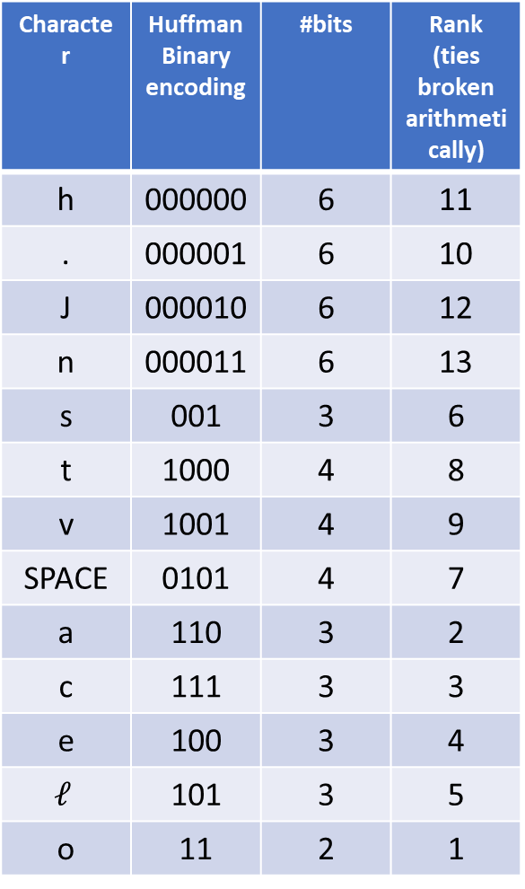
Source trie for our example
Character | Huffman Binary encoding | #bits | Rank (ties broken arithmetically)
h | 000000 | 6 | 11
. | 000001 | 6 | 10
J | 000010 | 6 | 12
n | 000011 | 6 | 13
s | 001 | 3 | 6
t | 1000 | 4 | 8
v | 1001 | 4 | 9
SPACE | 0101 | 4 | 7
a | 110 | 3 | 2
c | 111 | 3 | 3
e | 100 | 3 | 4
$$ℓ$$ | 101 | 3 | 5
o | 11 | 2 | 1
o
.
$$ℓ$$
h
11
e
000000
J
c
101
n
s
t
v
SPACE
a
000001
100
000010
111
000011
001
1000
1001
0101
110
We now rank the bitstrings based on length of their Huffman representation!

Slide 19
Source trie for our example
Character | Huffman Binary encoding | #bits | Rank (ties broken arithmetically)
h | 000000 | 6 | 11
. | 000001 | 6 | 10
J | 000010 | 6 | 12
n | 000011 | 6 | 13
s | 001 | 3 | 6
t | 1000 | 4 | 8
v | 1001 | 4 | 9
SPACE | 0101 | 4 | 7
a | 110 | 3 | 2
c | 111 | 3 | 3
e | 100 | 3 | 4
$$ℓ$$ | 101 | 3 | 5
o | 11 | 2 | 1
o
.
$$ℓ$$
h
11
e
000000
J
c
101
Uppercase letters < lowercase letters in ASCII ;)
n
s
t
v
SPACE
a
000001
100
000010
111
000011
001
1000
1001
0101
110
We now rank the bitstrings based on length of their Huffman representation!

Slide 20
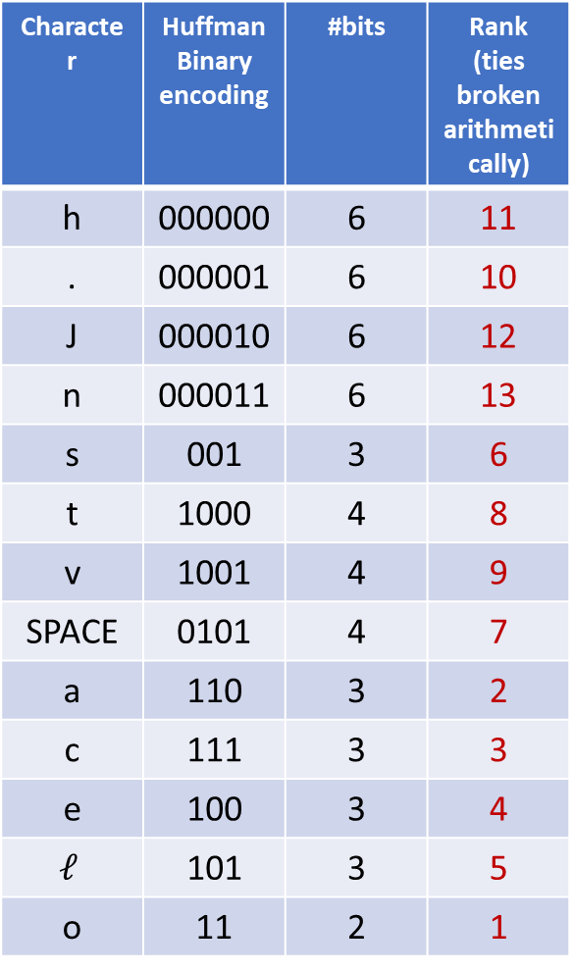
Source trie for our example
Character | Huffman Binary encoding | #bits | Rank (ties broken arithmetically)
h | 000000 | 6 | 11
. | 000001 | 6 | 10
J | 000010 | 6 | 12
n | 000011 | 6 | 13
s | 001 | 3 | 6
t | 1000 | 4 | 8
v | 1001 | 4 | 9
SPACE | 0101 | 4 | 7
a | 110 | 3 | 2
c | 111 | 3 | 3
e | 100 | 3 | 4
$$ℓ$$ | 101 | 3 | 5
o | 11 | 2 | 1
o
.
$$ℓ$$
h
1
e
11
J
c
5
n
s
t
v
SPACE
a
10
4
12
3
13
6
8
9
7
2
We now rank the bitstrings based on length of their Huffman representation!
Expensive characters have high ranks, which need more bits to represent ;)

Slide 21
Source trie for our example
Character | Huffman Binary encoding | #bits | Rank (ties broken arithmetically)
h | 000000 | 6 | 11
. | 000001 | 6 | 10
J | 000010 | 6 | 12
n | 000011 | 6 | 13
s | 001 | 3 | 6
t | 1000 | 4 | 8
v | 1001 | 4 | 9
SPACE | 0101 | 4 | 7
a | 110 | 3 | 2
c | 111 | 3 | 3
e | 100 | 3 | 4
$$ℓ$$ | 101 | 3 | 5
o | 11 | 2 | 1
o
.
$$ℓ$$
1
1011
h
1
e
11
J
c
5
101
n
s
t
v
SPACE
a
1010
10
4
100
12
3
1100
13
6
8
9
7
2
11
1101
110
1000
1001
111
10
We now rank the bitstrings based on length of their Huffman representation!
Expensive characters have high ranks, which need more bits to represent ;)

Slide 22
Source trie for our example
Character | Huffman Binary encoding | #bits | Rank (ties broken arithmetically)
h | 000000 | 6 | 11
. | 000001 | 6 | 10
J | 000010 | 6 | 12
n | 000011 | 6 | 13
s | 001 | 3 | 6
t | 1000 | 4 | 8
v | 1001 | 4 | 9
SPACE | 0101 | 4 | 7
a | 110 | 3 | 2
c | 111 | 3 | 3
e | 100 | 3 | 4
$$ℓ$$ | 101 | 3 | 5
o | 11 | 2 | 1
MAX_VAL = 13
o
.
$$ℓ$$
1
1011
h
1
e
11
J
c
5
101
n
s
t
v
SPACE
a
1010
10
4
100
12
3
1100
13
6
8
9
7
2
11
1101
110
1000
1001
111
10
We now rank the bitstrings based on length of their Huffman representation!
Expensive characters have high ranks, which need more bits to represent ;)

Slide 23

Source trie for our example
Character | Huffman Binary encoding | #bits | Rank (ties broken arithmetically)
h | 000000 | 6 | 11
. | 000001 | 6 | 10
J | 000010 | 6 | 12
n | 000011 | 6 | 13
s | 001 | 3 | 6
t | 1000 | 4 | 8
v | 1001 | 4 | 9
SPACE | 0101 | 4 | 7
a | 110 | 3 | 2
c | 111 | 3 | 3
e | 100 | 3 | 4
$$ℓ$$ | 101 | 3 | 5
o | 11 | 2 | 1
MAX_VAL = 13
o
.
$$ℓ$$
1
1011
h
1
e
11
J
c
5
101
n
s
t
v
SPACE
a
1010
10
4
100
12
3
1100
13
6
8
9
7
2
11
1101
110
1000
1001
111
10
CORE IDEA: If the encoder encounters the string “va”….

Slide 24
Source trie for our example
Character | Huffman Binary encoding | #bits | Rank (ties broken arithmetically)
h | 000000 | 6 | 11
. | 000001 | 6 | 10
J | 000010 | 6 | 12
n | 000011 | 6 | 13
s | 001 | 3 | 6
t | 1000 | 4 | 8
v | 1001 | 4 | 9
SPACE | 0101 | 4 | 7
a | 110 | 3 | 2
c | 111 | 3 | 3
e | 100 | 3 | 4
$$ℓ$$ | 101 | 3 | 5
o | 11 | 2 | 1
MAX_VAL = 13
o
.
$$ℓ$$
1
1011
h
1
e
11
J
c
5
101
n
s
t
v
SPACE
a
1010
10
4
100
12
3
1100
13
6
8
9
7
2
11
1101
110
1000
1001
111
10
CORE IDEA: If the encoder encounters the string “va”….
It should transmit the code for ‘v’, 9…

Slide 25

Source trie for our example
Character | Huffman Binary encoding | #bits | Rank (ties broken arithmetically)
h | 000000 | 6 | 11
. | 000001 | 6 | 10
J | 000010 | 6 | 12
n | 000011 | 6 | 13
s | 001 | 3 | 6
t | 1000 | 4 | 8
v | 1001 | 4 | 9
SPACE | 0101 | 4 | 7
a | 110 | 3 | 2
c | 111 | 3 | 3
e | 100 | 3 | 4
$$ℓ$$ | 101 | 3 | 5
o | 11 | 2 | 1
MAX_VAL = 14
o
.
$$ℓ$$
1
1011
h
1
e
11
J
c
5
101
n
s
t
v
SPACE
a
1010
10
4
100
12
3
1100
13
6
8
9
7
2
11
1101
110
1000
1001
111
10
a
14
1110
CORE IDEA: If the encoder encounters the string “va”….
It should transmit the code for ‘v’, 9…
But it will additionally place “va” in the source trie, with rank MAX_VAL + 1!

Slide 26
Source trie for our example
Character | Huffman Binary encoding | #bits | Rank (ties broken arithmetically)
h | 000000 | 6 | 11
. | 000001 | 6 | 10
J | 000010 | 6 | 12
n | 000011 | 6 | 13
s | 001 | 3 | 6
t | 1000 | 4 | 8
v | 1001 | 4 | 9
SPACE | 0101 | 4 | 7
a | 110 | 3 | 2
c | 111 | 3 | 3
e | 100 | 3 | 4
$$ℓ$$ | 101 | 3 | 5
o | 11 | 2 | 1
MAX_VAL = 14
o
.
$$ℓ$$
1
1011
h
1
e
11
J
c
5
101
n
s
t
v
SPACE
a
1010
10
4
100
12
3
1100
13
6
8
9
7
2
11
1101
110
1000
1001
111
10
a
Makes sense to set to a just encountered token the most expensive cost so far!
14
1110
CORE IDEA: If the encoder encounters the string “va”….
It should transmit the code for ‘v’, 9…
But it will additionally place “va” in the source trie, with rank MAX_VAL + 1!

Slide 27
An easier example
Vocabulary: lowercase english characters
LZW needs a special character to play the role of the end-of-string character
NULL: ‘\0’ sounds pretty appropriate ☺
Suppose we’ve run Huffman Coding, ranked the characters based on Huff. encoding’s bit length, etc and we came up with this source trie:
a
e
b
c
d
1
5
2
4
3

Slide 28
An easier example
Task: encode
a
e
b
c
d
1
5
2
4
3

Slide 29
Criticisms of LZW
Have to transmit initial dept-1 source trie before encoding-decoding.
This requires that the sender uses Hoffman encoding!
It also takes some (perhaps negligible) time.
Remember: If we don’t want to spend time building a new Huffman source trie, can use an existing one (but I can’t expect optimal length codes for the given text).
Tradeoffs, tradeoffs, tradeoffs

