Slide 1
Tries (“try”-s)
CMSC 420

Slide 2
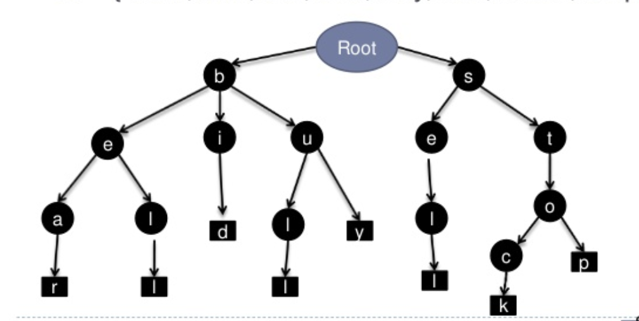
Tries

Slide 3
Tries
Pronounced exactly like the verb!

Slide 4
Tries
Pronounced exactly like the verb!
E.g “José tries to catch the ball”
This can be sometimes perplexing, since they are essentially trees… don’t let this confuse you.

Slide 5
Tries
Pronounced exactly like the verb!
E.g “José tries to catch the ball”
This can be sometimes perplexing, since they are essentially trees… don’t let this confuse you.
A trie is a tree-like data structure where paths store strings, and branches are taken based on the relevant character of the string that is searched for (or inserted / deleted).
An additional bit field tells us if we have reached an actual string that was stored in the trie.

Slide 6
Tries
Pronounced exactly like the verb!
E.g “José tries to catch the ball”
This can be sometimes perplexing, since they are essentially trees… don’t let this confuse you.
A trie is a tree-like data structure where paths store strings, and branches are taken based on the relevant character of the string that is searched for (or inserted / deleted).
An additional bit field tells us if we have reached an actual string that was stored in the trie.
Invented in late 1950s by René de la Briandais, esteemed French person.

Slide 7

Structure of a trie node
We must always specify the alphabet $Σ$ that we sample characters from!
Common choices: ASCII, UNICODE.

Slide 8

Structure of a trie node
We must always specify the alphabet $Σ$ that we sample characters from!
Common choices: ASCII, UNICODE.
In this course, we will be using ASCII or small subsets thereof.

Slide 9

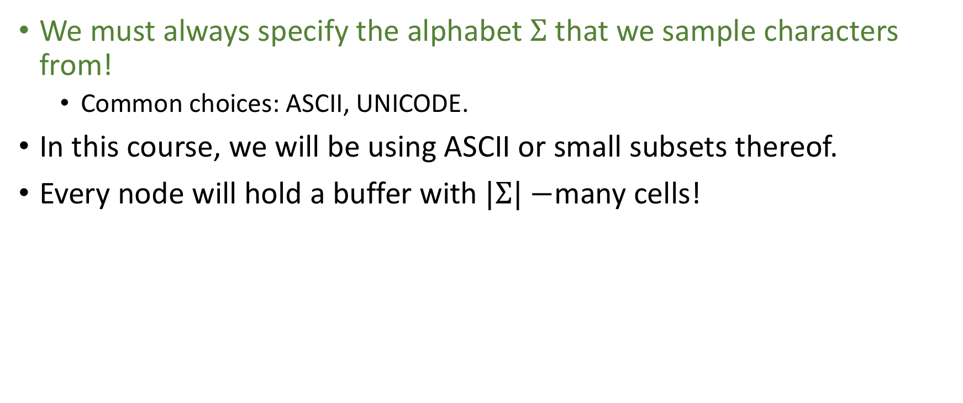
Structure of a trie node
We must always specify the alphabet $Σ$ that we sample characters from!
Common choices: ASCII, UNICODE.
In this course, we will be using ASCII or small subsets thereof.
Every node will hold a buffer with $|Σ|−$many cells!

Slide 10
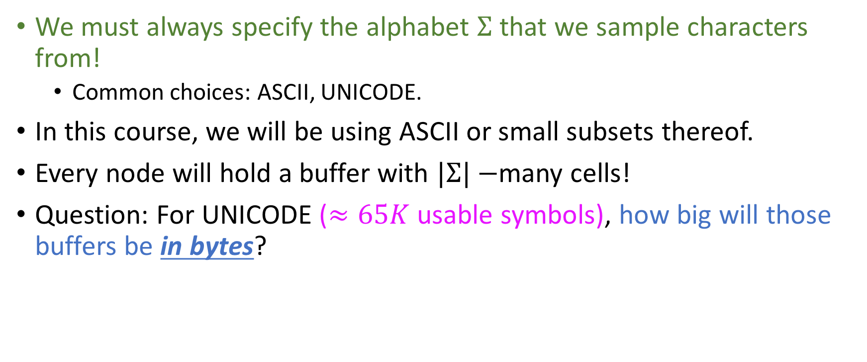
Structure of a trie node
We must always specify the alphabet $Σ$ that we sample characters from!
Common choices: ASCII, UNICODE.
In this course, we will be using ASCII or small subsets thereof.
Every node will hold a buffer with $|Σ|−$many cells!
Question: For UNICODE ($≈65K$ usable symbols), how big will those buffers be in bytes?
128
65K
>65K
<65K

Slide 11
Structure of a trie node
We must always specify the alphabet $Σ$ that we sample characters from!
Common choices: ASCII, UNICODE.
In this course, we will be using ASCII or small subsets thereof.
Every node will hold a buffer with $|Σ|−$many cells!
Question: For UNICODE ($≈65K$ usable symbols), how big will those buffers be in bytes?
Only the first 128 characters are stored in a single byte each!
128
65K
>65K
<65K

Slide 12

Structure of a trie node
This is an example of what a trie node would look like if alphabet is ASCII:
To make the art (?) tractable, we will be shortening the nodes to only have outgoing links that correspond to actual characters that are dynamically used in the trie
NUL | SOH | … | TAB | … | A | B | … | a | b | … | DEL
Non-printable characters, like system bell, paper feed, carriage return….
$$n$$
a
z
b
…

Slide 13
Structure of a trie node
It turns out that in a trie node, we also need some information that tells us
Does the path from the root of the trie correspond to an actual string stored in it?

Slide 14

Structure of a trie node
It turns out that in a trie node, we also need some information that tells us
Does the path from the root of the trie correspond to an actual string stored in it?
This corresponds to a single bit! “Art” convention: Red for set, blue for unset
NUL | SOH | … | TAB | … | A | B | … | a | b | … | DEL
a
$$n$$
z
b
…

Slide 15

Structure of a trie node
It turns out that in a trie node, we also need some information that tells us
Does the path from the root of the trie correspond to an actual string stored in it?
This corresponds to a single bit! “Art” convention: Red for set, blue for unset
NUL | SOH | … | TAB | … | A | B | … | a | b | … | DEL
a
$$n$$
z
b
…

Slide 16

Not so fast!
Don’t I need 2 buffers, to store both characters and pointers?
NUL | SOH | … | TAB | … | A | B | … | a | b | … | DEL
$$n$$
a
z
b
…

Slide 17
Not so fast!
Don’t I need 2 buffers, to store both characters and pointers?
Yes
No
NUL | SOH | … | TAB | … | A | B | … | a | b | … | DEL
$$n$$
a
z
b
…

Slide 18
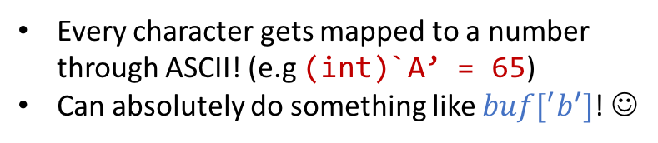
Not so fast!
Don’t I need 2 buffers, to store both characters and pointers?
Yes
No
Every character gets mapped to a number through ASCII! (e.g (int)`A’ = 65)
Can absolutely do something like $buf[^{′}b^{′}]$! ☺
NUL | SOH | … | TAB | … | A | B | … | a | b | … | DEL
$$n$$
a
z
b
…

Slide 19
Example
Assume alphabet to be ASCII: 128 characters.
The following trie stores the strings “abba”, “aba”, “car”, “cars”:
root
a
c
b
a
a
b
r
s
a

Slide 20
Example
Assume alphabet to be ASCII: 128 characters.
The following trie stores the strings “abba”, “aba”, “car”, “cars”:
root
a
c
Do we perhaps see the utility of the “end-of-stored string” bit now? ☺
b
a
a
b
r
s
a

Slide 21

Example
Assume alphabet to be ASCII: 128 characters.
The following trie stores the strings “abba”, “aba”, “car”, “cars”:
root
a
c
Do we perhaps see the utility of the “end-of-stored string” bit now? ☺
b
a
a
b
r
Note that encountering a set bit while traversing the tree is not a sufficient reason to stop your search for more keys along that path!
s
a

Slide 22
Inserting a key
Quiz: Inserting a new key into a trie always involves the allocation of new nodes.
Yes (why?)
No (give me an example)

Slide 23
Inserting a key
Quiz: Inserting a new key into a trie always involves the allocation of new nodes.
In our familiar trie, suppose that “car” was not already
stored.
Yes (why?)
No (give me an example)
root
a
c
b
a
a
b
r
s
a

Slide 24
Inserting a key
Quiz: Inserting a new key into a trie always involves the allocation of new nodes.
In our familiar trie, suppose that “car” was not already
stored.
Then, we traverse the trie following the links for ‘c’,
‘a’ and ‘r’ and we set the relevant bit!
Yes (why?)
No (give me an example)
root
a
c
b
a
a
b
r
s
a

Slide 25
Inserting a key
Quiz: Inserting a new key into a trie always involves the allocation of new nodes.
In our familiar trie, suppose that “car” was not already
stored.
Then, we traverse the trie following the links for ‘c’,
‘a’ and ‘r’ and we set the relevant bit!
Generally: inserting a key that is a prefix of an existing key
never leads to a heap visit!
Yes (why?)
No (give me an example)
root
a
c
b
a
a
b
r
s
a

Slide 26
Inserting a key
Quiz: Inserting a new key into a trie always involves the allocation of new nodes.
In our familiar trie, suppose that “car” was not already
stored.
Then, we traverse the trie following the links for ‘c’,
‘a’ and ‘r’ and we set the relevant bit!
Generally: inserting a key that is a prefix of an existing key
never leads to a heap visit!
With ASCII and Unicode-sized buffers, that’s not too bad of an idea….
Yes (why?)
No (give me an example)
root
a
c
b
a
a
b
r
s
a

Slide 27
Trie insertion: exercise
root
a
c
public class AsciiTrie { // No need to make it a generic ; tries store strings!
private class Node {
private Node[] next = new Node[128];
byte eosFlag; // Wish I could manipulate a single bit…
}
private Node root;
public void insert(String key){ // More general solution: CharSequences instead of Strings
root = insert(root, key, 0); // Could also make it a method of Node
}
private Node insert(Node root, String key, int currStringIndex){
/* YOU fill this in NOW!
* Hints:
*
* (1) Strings have a method with signature charAt(int index) that returns the char at position index of the string * (index is 0-based).
* (2) Think: When do I complete my insertion?
* (3) What if I need to allocate a new node?
* (4) What if I don’t?
*/
}
}
b
a
a
b
r
s
a

Slide 28

Trie insertion: exercise
root
a
c
public class AsciiTrie {// No need to make it a generic ; tries store strings!
private class Node {
private Node[] next = new Node[128];
byte eosFlag;
}
private Node root;
public void insert(String key){ // More general solution: CharSequences instead of Strings
root = insert(root, key, 0); // Could also make it a method of Node
}
private Node insert(Node node, String key, int currStringIndex){
assert key != null && key.size() > 0, “Key can’t be null or empty.”;
if(node == null) // key is not a prefix of any already stored key…
node = new Node(); // Node class defn allocates memory immediately, no need for explicit constructor defn.
if(currStringIndex == key.size())
node.eosFlag = (byte)1;
else
node.next[key.charAt(currStringIndex)] = insert(node.next[key.charAt(currStringIndex)], key, currStringIndex + 1);
return node;
}
}
b
a
a
b
r
s
a
This could work! ☺

Slide 29

Trie insertion: exercise
root
public class AsciiTrie {// No need to make it a generic ; tries store strings!
private class Node {
private Node[] next = new Node[128];
byte eosFlag;
}
private Node root;
public void insert(String key){ // More general solution: CharSequences instead of Strings
root = insert(root, key, 0); // Could also make it a method of Node
}
private Node insert(Node node, String key, int currStringIndex){
assert key != null && key.size() > 0, “Key can’t be null or empty.”;
if(node == null)
node = new Node();
if(currStringIndex == key.size())
node.eosFlag = (byte)1;
else
node.next[key.charAt(currStringIndex)] = insert(node.next[key.charAt(currStringIndex)], key, currStringIndex + 1);
return node;
}
}
a
c
b
a
a
b
r
s
a
key is not really stored anywhere…
Can we perhaps get rid of it?
Yes (how?)
No (why?)

Slide 30

Trie insertion: exercise
root
a
c
public class AsciiTrie {// No need to make it a generic ; tries store strings!
private class Node {
private Node[] next = new Node[128];
byte eosFlag;
}
private Node root;
public void insert(String key){ // More general solution: CharSequences instead of Strings
root = insert(root, key, 0); // Could also make it a method of Node
}
private Node insert(Node node, String key, int currStringIndex){
assert key != null && key.size() > 0, “Key can’t be null or empty.”;
if(node == null){ // key is not a prefix of any already stored key…
node = new Node();
if(currStringIndex == key.size())
node.eosFlag = (byte)1;
else
node.next[key.charAt(currStringIndex)] = insert(node.next[key.charAt(currStringIndex)], key, currStringIndex + 1);
return node;
}
}
b
a
a
b
r
s
a
Yes (how?)
No (why?)
Just because the reference isn’t stored doesn’t mean that:
It isn’t useful for the insertion algorithm
There is no implicit storage for the string in the trie (links and node bits!)

Slide 31
Iterative insertion!
root
a
c
b
a
public class AsciiTrie {// No need to make it a generic ; tries store strings!
private class Node {
private Node[] next = new Node[128];
byte eosFlag;
}
private Node root;
public void insert(String key){
/* Fill this in with an iterative implementation
* of trie insertion!
*/
}
}
a
b
r
s
a

Slide 32

Iterative insertion!
root
a
c
b
a
public class AsciiTrie {// No need to make it a generic ; tries store strings!
private class Node {
private Node[] next = new Node[128];
byte eosFlag;
}
private Node root;
public void insert(String key){
assert key != null && key.size() > 0, “Key can’t be empty.”;
int currIndex = 0;
Node curr = root, prev = null;
while(currIndex < key.size()){
char charToFollow = key.charAt(currIndex);
if(curr == null)
curr = new Node();
if(prev != null)
prev.next[charToFollow] = curr;
currIndex++;
prev = curr;
curr = curr.next[charToFollow];
}
curr.eosFlag = (byte)1;
}
}
a
b
r
s
a

Slide 33
Deleting a key
Quite simple: traverse the trie and, if you find the key, set the bit to blue.
Nothing to do if the bit is already blue (key not actually in DB)

Slide 34
Deleting a key
Quite simple: traverse the trie and, if you find the key, set the bit to blue.
Nothing to do if the bit is already blue (key not actually in DB)
If you encounter a null pointer before you exhaust the key’s characters, then you also know that the key is not in DB!

Slide 35
Deleting a key
Quite simple: traverse the trie and, if you find the key, set the bit to blue.
Nothing to do if the bit is already blue (key not actually in DB)
If you encounter a null pointer before you exhaust the key’s characters, then you also know that the key is not in DB!
In those two cases, make a choice between returning null or throwing an Exception.
No matter what you do, commit to it in your interface!
If you throw an Exception, it must be checked and documented (@throws)
This is an example of “soft” deletion.

Slide 36
Deleting a key
Quite simple: traverse the trie and, if you find the key, set the bit to blue.
Nothing to do if the bit is already blue (key not actually in DB)
If you encounter a null pointer before you exhaust the key’s characters, then you also know that the key is not in DB!
In those two cases, make a choice between returning null or throwing an Exception.
No matter what you do, commit to it in your interface!
If you throw an Exception, it must be checked and documented (@throws)
This is an example of “soft” deletion.

Slide 37
“Soft” vs “hard” deletion in a trie: what would you do?
Suppose that you want to delete ``beers” from the following trie.
root
c
a
b
a
t
i
r
e
r
c
e
r
r
s

Slide 38
“Soft” vs “hard” deletion in a trie: what would you do?
Suppose that you want to delete ``beers” from the following trie.
root
c
a
b
a
t
i
r
e
r
Since “beers” is the only stored string in this long path from the root (35.7% of total nodes), we could throw away this entire path, e.g by setting root[‘b’] = null
c
e
r
r
s

Slide 39
“Soft” vs “hard” deletion in a trie: what would you do?
Suppose that you want to delete ``beers” from the following trie.
root
Would you do this? (No right or wrong answer here!)
c
a
b
a
t
i
r
e
r
Since “beers” is the only stored string in this long path from the root (35.7% of total nodes), we could throw away this entire path, e.g by setting root[‘b’] = null
Yes (why?)
No (why?)
c
e
r
r
s

Slide 40

“Soft” vs “hard” deletion in a trie: what would you do?
Suppose that you want to delete ``beers” from the following trie.
root
Would you do this? (No right or wrong answer here!)
c
E.g consider a future insertion of “beer”, “bee”, or “bear!”
Caveat: If for some reason you know that in the future you won’t insert any strings that start with a ‘b’, can delete subtree safely ☺
a
b
a
t
i
r
e
r
Yes (why?)
No (why?)
c
e
r
r
Jason wouldn’t: strings in a trie, particularly long ones, allow for many prefixes to be stored with either no heap visits or few heap visits!
s

Slide 41
Complexity of searching for a key in a trie
Given insertion and deletion, search(String k) should be easy for you to implement.

Slide 42




Complexity of searching for a key in a trie
Given insertion and deletion, search(String k) should be easy for you to implement.
Most important question in tries: What is the worst-case complexity of searching for a key in a trie with $n$ keys?
$$≈log_{2}{n}$$
$$≈log_{k}{n},$$ $k>2$
$$≈𝒪(n)$$
Something else (what?)

Slide 43

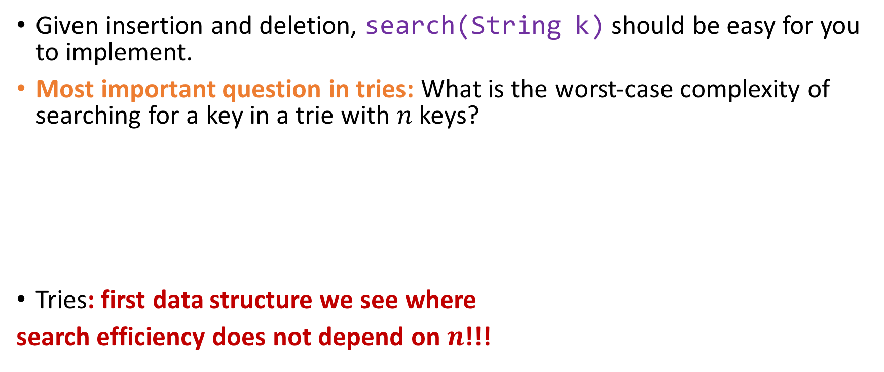
Complexity of searching for a key in a trie
Given insertion and deletion, search(String k) should be easy for you to implement.
Most important question in tries: What is the worst-case complexity of searching for a key in a trie with $n$ keys?
Tries: first data structure we see where
search efficiency does not depend on $n$!!!
$$≈log_{2}{n}$$
$$≈log_{k}{n},$$ $k>2$
$$≈𝒪(n)$$
Something else (what?)
LENGTH OF THE LONGEST EXISTING KEY IN THE TRIE!

Slide 44
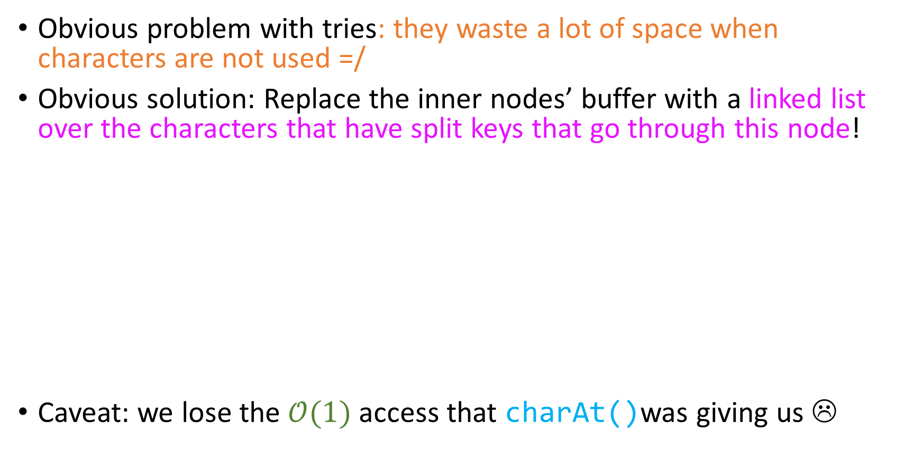
De la Briandais Tries
Obvious problem with tries: they waste a lot of space when characters are not used =/
Obvious solution: Replace the inner nodes’ buffer with a linked list over the characters that have split keys that go through this node!
Caveat: we lose the $𝒪(1)$ access that charAt()was giving us ☹
NUL | SOH | … | TAB | … | A | B | … | a | b | … | DEL
SOH
…
A
a
…
…
…

Slide 45
Cool things we can do with tries
Quiz: Can we use a trie as a dictionary, the way that we’ve used AVL Trees, Red-Black Trees, etc?

Slide 46
Cool things we can do with tries
Quiz: Can we use a trie as a dictionary, the way that we’ve used AVL Trees, Red-Black Trees, etc?
Yes
No
Not sure

Slide 47
Cool things we can do with tries
Quiz: Can we use a trie as a dictionary, the way that we’ve used AVL Trees, Red-Black Trees, etc?
Absolutely!
They offer excellent search efficiency no matter how many strings they hold.
Insertion on par with search
Deletion more efficient than B-Trees (at least for small strings)
Plus, as in with BSTs, all dictionary operations can be implemented iteratively! ☺
Yes
No
Not sure

Slide 48
Trie-specific stuff
Much like with balanced trees, where we could ask for index-specific stuff such as inorder traversal and height, we can also use tries for non-dictionary related things! ☺
Practice: In the next slide, fill-in the code of the instance method longestPrefixOf(String key), which returns the longest prefix of key key in the trie.

Slide 49
Longest Prefix!
root
a
c
public class AsciiTrie {
private class Node {
Node[] next = new Node[128];
byte eosFlag;
}
private Node root;
public String longestPrefixOf(String couldBeAKeyOrNot){
/* Fill this in!
* Hints:
* (1) Recall that only nodes with a red bit can be candidates for
* encoding the longest prefix of couldBeAKeyOrNot!
* (2) couldBeAKeyOrNot.substr(int startIndex, int length) will return a substring * of couldBeAKeyOrNot that starts from startIndex and has a length of * “length”. It might be useful.
*/
}
}
b
a
a
b
r
s
a

Slide 50
Longest Prefix!
root
public class AsciiTrie {
private class Node {
private Node[] next = new Node[128];
byte eosFlag;
}
private Node root;
public String longestPrefixOf(String key){
int longestPrefixLength = getMaxPrefixLength(root, key, 0, 0);
return key.substr(0, longestPrefixLength);
}
private int getMaxPrefixLength(Node curr, String key, int currInd, int maxLenRec){
if(curr == null || currInd == key.length()) return maxLenRec;
if(curr.eosFlag == (byte)1) maxLenRec = currInd;
return getMaxPrefixLength(curr.next[key.charAt(currInd)], key, currInd + 1, maxLenRec);
}
}
a
c
b
a
a
b
r
s
a
This works!

Slide 51
Longest Prefix!
root
public class AsciiTrie {
private class Node {
private Node[] next = new Node[128];
byte eosFlag;
}
private Node root;
public String longestPrefixOf(String key){
int longestPrefixLength = getMaxPrefixLength(root, key, 0, 0);
return key.substr(0, longestPrefixLength);
}
private int getMaxPrefixLength(Node curr, String key, int currInd, int maxLenRec){
if(curr == null || currInd == key.length()) return maxLenRec;
if(curr.eosFlag == (byte)1) maxLenRec = currInd;
return getMaxPrefixLength(curr.next[key.charAt(currInd)], key, currInd + 1, maxLenRec);
}
}
a
c
b
a
a
b
r
s
a
This works… and is also tail recursive!

Slide 52
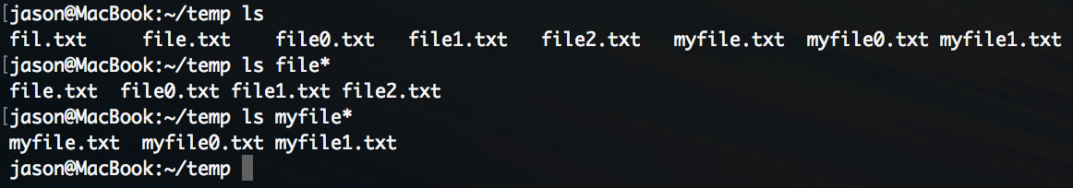
Metacharacter (glob) search!

Slide 53

Metacharacter (glob) search!
The metacharacter ‘*’ will match every string that begins with “AVL”, and will print them in lexicographic order!
The BASH shell stores all file names under the current directory in a trie!
So let’s try to implement metacharacter parsing in a trie ☺

Slide 54
Metacharacter parsing
root
a
c
public class AsciiTrie {
private class Node {
private Node[] next = new Node[128];
byte eosFlag;
}
private Node root;
public Collection<String> keysWithPrefix(String prefix){
/* Fill the code for this method! *
* Hints:
*
* (1) In the trie to the top right, calling keysWithPrefix(“ca”) would have the same * effect as ls ca*. Same thing with ls c*.
*
* (2) In Java, a Collection is an interface implemented by all kinds of linear
* containers (LinkedList, ArrayList, Queue, Stack, etc)
*
* (3) Remember: We want lexicographic ordering!
*/
}
}
b
a
a
b
r
s
a

Slide 55
Metacharacter parsing
root
public class AsciiTrie {
private class Node {
private Node[] next = new Node[128];
byte eosFlag;
}
private Node root;
public Collection<String> keysWithPrefix(String prefix){
Node prefixNode = fetchNode(root, prefix, 0);
ArrayList<String> keys = new ArrayList<String>();
populate(prefixNode, prefix, keys);
return keys;
}
private void populate(Node curr, String prefix, ArrayList<String> keys){
if(curr == null) return;
if(curr.eosFlag == (byte)1) keys.add(prefix);
for(int i = 0; i < curr.next.length; i++)
populate(curr.next[i], prefix + (char)i, keys);
}
private Node fetchNode(Node curr, String prefix, int currIndex){
if(curr == null) return null;
if(currIndex == prefix.length()) return curr;
return fetchNode(curr.next[prefix.charAt(currIndex)], prefix, currIndex + 1);
}
}
a
c
b
a
a
b
r
s
a
Tail recursion!

Slide 56
Trie redundancy
root
a
c
a
Not everything is perfect in the trie universe!
b
a
b
r
s
a

Slide 57
Trie redundancy
root
a
c
a
Not everything is perfect in the trie universe!
Do you agree with me that all the nodes that I circled
on the right are effectively useless overhead?
b
a
b
r
s
a

Slide 58
Trie redundancy
Not everything is perfect in the trie universe!
Do you agree with me that all the nodes that I circled
on the right are effectively useless overhead?
It would be much better if we could have something like this!
root
ab
car
a
ba
s

Slide 59
Trie redundancy
root
ab
car
Not everything is perfect in the trie universe!
Do you agree with me that all the nodes that I circled
on the right are effectively useless overhead?
It would be much better if we could have something like this!
This we will accomplish with Patricia Tries, a compressed form of trie!
a
ba
s

Slide 60

Trie redundancy
root
ab
car
Not everything is perfect in the trie universe!
Do you agree with me that all the nodes that I circled
on the right are effectively useless overhead?
It would be much better if we could have something like this!
This we will accomplish with Patricia Tries, a compressed form of trie!
a
ba
s

