Slide 1
How the Snake Lost Its Legs
Condensed version:
Snakes once had legs, and some still do. Superstitious people made up stories about how the snakes lost their legs.
If have suggestions, e-mail me at:
jason@snakelegs.com

Slide 2
Genesis 3 (ASV-1901)
Now the serpent was more subtle than any beast of the field which Jehovah God had made. And he said unto the woman, Yea, hath God said, Ye shall not eat of any tree of the garden? And the woman said unto the serpent, Of the fruit of the trees of the garden we may eat: but of the fruit of the tree which is in the midst of the garden, God hath said, Ye shall not eat of it, neither shall ye touch it, lest ye die. And the serpent said unto the woman, Ye shall not surely die: for God doth know that in the day ye eat thereof, then your eyes shall be opened, and ye shall be as God, knowing good and evil. And when the woman saw that the tree was good for food, and that it was a delight to the eyes, and that the tree was to be desired to make one wise, she took of the fruit thereof, and did eat; and she gave also unto her husband with her, and he did eat. And the eyes of them both were opened, and they knew that they were naked; and they sewed fig-leaves together, and made themselves aprons. And they heard the voice of Jehovah God walking in the garden in the cool of the day: and the man and his wife hid themselves from the presence of Jehovah God amongst the trees of the garden. And Jehovah God called unto the man, and said unto him, Where art thou? And he said, I heard thy voice in the garden, and I was afraid, because I was naked; and I hid myself. And he said, Who told thee that thou wast naked? Hast thou eaten of the tree, whereof I commanded thee that thou shouldest not eat? And the man said, The woman whom thou gavest to be with me, she gave me of the tree, and I did eat. And Jehovah God said unto the woman, What is this thou hast done? And the woman said, The serpent beguiled me, and I did eat. And Jehovah God said unto the serpent, Because thou hast done this, cursed art thou above all cattle, and above every beast of the field; upon thy belly shalt thou go, and dust shalt thou eat all the days of thy life: and I will put enmity between thee and the woman, and between thy seed and her seed: he shall bruise thy head, and thou shalt bruise his heel. Unto the woman he said, I will greatly multiply thy pain and thy conception; in pain thou shalt bring forth children; and thy desire shall be to thy husband, and he shall rule over thee. And unto Adam he said, Because thou hast hearkened unto the voice of thy wife, and hast eaten of the tree, of which I commanded thee, saying, Thou shalt not eat of it: cursed is the ground for thy sake; in toil shalt thou eat of it all the days of thy life; thorns also and thistles shall it bring forth to thee; and thou shalt eat the herb of the field; in the sweat of thy face shalt thou eat bread, till thou return unto the ground; for out of it wast thou taken: for dust thou art, and unto dust shalt thou return. And the man called his wife's name Eve; because she was the mother of all living. And Jehovah God made for Adam and for his wife coats of skins, and clothed them. And Jehovah God said, Behold, the man is become as one of us, to know good and evil; and now, lest he put forth his hand, and take also of the tree of life, and eat, and live for ever- therefore Jehovah God sent him forth from the garden of Eden, to till the ground from whence he was taken. So he drove out the man; and he placed at the east of the garden of Eden the Cherubim, and the flame of a sword which turned every way, to keep the way of the tree of life.

Slide 3
Genesis 3 (KJV-1611)
Now the serpent was more subtil than any beast of the field which the Lord God had made. And he said unto the woman, Yea, hath God said, Ye shall not eat of every tree of the garden? And the woman said unto the serpent, We may eat of the fruit of the trees of the garden: But of the fruit of the tree which is in the midst of the garden, God hath said, Ye shall not eat of it, neither shall ye touch it, lest ye die. And the serpent said unto the woman, Ye shall not surely die: For God doth know that in the day ye eat thereof, then your eyes shall be opened, and ye shall be as gods, knowing good and evil. And when the woman saw that the tree was good for food, and that it was pleasant to the eyes, and a tree to be desired to make one wise, she took of the fruit thereof, and did eat, and gave also unto her husband with her; and he did eat. And the eyes of them both were opened, and they knew that they were naked; and they sewed fig leaves together, and made themselves aprons. And they heard the voice of the Lord God walking in the garden in the cool of the day: and Adam and his wife hid themselves from the presence of the Lord God amongst the trees of the garden. And the Lord God called unto Adam, and said unto him, Where art thou? And he said, I heard thy voice in the garden, and I was afraid, because I was naked; and I hid myself. And he said, Who told thee that thou wast naked? Hast thou eaten of the tree, whereof I commanded thee that thou shouldest not eat? And the man said, The woman whom thou gavest to be with me, she gave me of the tree, and I did eat. And the Lord God said unto the woman, What is this that thou hast done? And the woman said, The serpent beguiled me, and I did eat. And the Lord God said unto the serpent, Because thou hast done this, thou art cursed above all cattle, and above every beast of the field; upon thy belly shalt thou go, and dust shalt thou eat all the days of thy life: And I will put enmity between thee and the woman, and between thy seed and her seed; it shall bruise thy head, and thou shalt bruise his heel. Unto the woman he said, I will greatly multiply thy sorrow and thy conception; in sorrow thou shalt bring forth children; and thy desire shall be to thy husband, and he shall rule over thee. And unto Adam he said, Because thou hast hearkened unto the voice of thy wife, and hast eaten of the tree, of which I commanded thee, saying, Thou shalt not eat of it: cursed is the ground for thy sake; in sorrow shalt thou eat of it all the days of thy life; Thorns also and thistles shall it bring forth to thee; and thou shalt eat the herb of the field; In the sweat of thy face shalt thou eat bread, till thou return unto the ground; for out of it wast thou taken: for dust thou art, and unto dust shalt thou return. And Adam called his wife's name Eve; because she was the mother of all living. Unto Adam also and to his wife did the Lord God make coats of skins, and clothed them. And the Lord God said, Behold, the man is become as one of us, to know good and evil: and now, lest he put forth his hand, and take also of the tree of life, and eat, and live for ever: Therefore the Lord God sent him forth from the garden of Eden, to till the ground from whence he was taken. So he drove out the man; and he placed at the east of the garden of Eden Cherubims, and a flaming sword which turned every way, to keep the way of the tree of life.

Slide 4
Genesis 3 (Vulgate)
sed et serpens erat callidior cunctis animantibus terrae quae fecerat Dominus Deus qui dixit ad mulierem cur praecepit vobis Deus ut non comederetis de omni ligno paradisi cui respondit mulier de fructu lignorum quae sunt in paradiso vescemur de fructu vero ligni quod est in medio paradisi praecepit nobis Deus ne comederemus et ne tangeremus illud ne forte moriamur dixit autem serpens ad mulierem nequaquam morte moriemini scit enim Deus quod in quocumque die comederitis ex eo aperientur oculi vestri et eritis sicut dii scientes bonum et malum vidit igitur mulier quod bonum esset lignum ad vescendum et pulchrum oculis aspectuque delectabile et tulit de fructu illius et comedit deditque viro suo qui comedit et aperti sunt oculi amborum cumque cognovissent esse se nudos consuerunt folia ficus et fecerunt sibi perizomata et cum audissent vocem Domini Dei deambulantis in paradiso ad auram post meridiem abscondit se Adam et uxor eius a facie Domini Dei in medio ligni paradisi vocavitque Dominus Deus Adam et dixit ei ubi es qui ait vocem tuam audivi in paradiso et timui eo quod nudus essem et abscondi me cui dixit quis enim indicavit tibi quod nudus esses nisi quod ex ligno de quo tibi praeceperam ne comederes comedisti dixitque Adam mulier quam dedisti sociam mihi dedit mihi de ligno et comedi et dixit Dominus Deus ad mulierem quare hoc fecisti quae respondit serpens decepit me et comedi et ait Dominus Deus ad serpentem quia fecisti hoc maledictus es inter omnia animantia et bestias terrae super pectus tuum gradieris et terram comedes cunctis diebus vitae tuae inimicitias ponam inter te et mulierem et semen tuum et semen illius ipsa conteret caput tuum et tu insidiaberis calcaneo eius mulieri quoque dixit multiplicabo aerumnas tuas et conceptus tuos in dolore paries filios et sub viri potestate eris et ipse dominabitur tui ad Adam vero dixit quia audisti vocem uxoris tuae et comedisti de ligno ex quo praeceperam tibi ne comederes maledicta terra in opere tuo in laboribus comedes eam cunctis diebus vitae tuae spinas et tribulos germinabit tibi et comedes herbas terrae in sudore vultus tui vesceris pane donec revertaris in terram de qua sumptus es quia pulvis es et in pulverem reverteris et vocavit Adam nomen uxoris suae Hava eo quod mater esset cunctorum viventium fecit quoque Dominus Deus Adam et uxori eius tunicas pellicias et induit eos et ait ecce Adam factus est quasi unus ex nobis sciens bonum et malum nunc ergo ne forte mittat manum suam et sumat etiam de ligno vitae et comedat et vivat in aeternum emisit eum Dominus Deus de paradiso voluptatis ut operaretur terram de qua sumptus est eiecitque Adam et conlocavit ante paradisum voluptatis cherubin et flammeum gladium atque versatilem ad custodiendam viam ligni vitae

Slide 5
Genesis 3 (Young’s Literal Translation)
And the serpent hath been subtile above every beast of the field which Jehovah God hath made, and he saith unto the woman, `Is it true that God hath said, Ye do not eat of every tree of the garden?' And the woman saith unto the serpent, `Of the fruit of the trees of the garden we do eat, and of the fruit of the tree which [is] in the midst of the garden God hath said, Ye do not eat of it, nor touch it, lest ye die.' And the serpent saith unto the woman, `Dying, ye do not die, for God doth know that in the day of your eating of it -- your eyes have been opened, and ye have been as God, knowing good and evil.' And the woman seeth that the tree [is] good for food, and that it [is] pleasant to the eyes, and the tree is desirable to make [one] wise, and she taketh of its fruit and eateth, and giveth also to her husband with her, and he doth eat; and the eyes of them both are opened, and they know that they [are] naked, and they sew fig-leaves, and make to themselves girdles. And they hear the sound of Jehovah God walking up and down in the garden at the breeze of the day, and the man and his wife hide themselves from the face of Jehovah God in the midst of the trees of the garden. And Jehovah God calleth unto the man, and saith to him, `Where [art] thou?' and he saith, `Thy sound I have heard in the garden, and I am afraid, for I am naked, and I hide myself.' And He saith, `Who hath declared to thee that thou [art] naked? of the tree of which I have commanded thee not to eat, hast thou eaten?' and the man saith, `The woman whom Thou didst place with me -- she hath given to me of the tree -- and I do eat.' And Jehovah God saith to the woman, `What [is] this thou hast done?' and the woman saith, `The serpent hath caused me to forget -- and I do eat.' And Jehovah God saith unto the serpent, `Because thou hast done this, cursed [art] thou above all the cattle, and above every beast of the field: on thy belly dost thou go, and dust thou dost eat, all days of thy life; and enmity I put between thee and the woman, and between thy seed and her seed; he doth bruise thee -- the head, and thou dost bruise him -- the heel.' Unto the woman He said, `Multiplying I multiply thy sorrow and thy conception, in sorrow dost thou bear children, and toward thy husband [is] thy desire, and he doth rule over thee.' And to the man He said, `Because thou hast hearkened to the voice of thy wife, and dost eat of the tree concerning which I have charged thee, saying, Thou dost not eat of it, cursed [is] the ground on thine account; in sorrow thou dost eat of it all days of thy life, and thorn and bramble it doth bring forth to thee, and thou hast eaten the herb of the field; by the sweat of thy face thou dost eat bread till thy return unto the ground, for out of it hast thou been taken, for dust thou [art], and unto dust thou turnest back.' And the man calleth his wife's name Eve: for she hath been mother of all living. And Jehovah God doth make to the man and to his wife coats of skin, and doth clothe them. And Jehovah God saith, `Lo, the man was as one of Us, as to the knowledge of good and evil; and now, lest he send forth his hand, and have taken also of the tree of life, and eaten, and lived to the age,' -- Jehovah God sendeth him forth from the garden of Eden to serve the ground from which he hath been taken; yea, he casteth out the man, and causeth to dwell at the east of the garden of Eden the cherubs and the flame of the sword which is turning itself round to guard the way of the tree of life.

Slide 6
Gospel of St. Barnabus
[Medieval text - gotta find a copy.]

Slide 7
Targum Pseudo-Jonathan
“Then the Lord God brought the three of them to judgment, and he said to the serpent, "Because you have done this, cursed are you above all cattle, and above all beasts of the field. Upon your belly you shall go about, and your feet shall be cut off, and you will cast off your skin once every seven years, and the poison of death will be in your mouth, and you shall eat dust all the days of your life.”
http://jefferson.village.virginia.edu/anderson/bible/gen1-3/genv3.14.html

Slide 8
Josephus
God therefore commanded that Adam and his wife should eat of all the rest of the plants, but to abstain from the tree of knowledge; and foretold to them, that if they touched it, it would prove their destruction. But while all the living creatures had one language, (5) at that time the serpent, which then lived together with Adam and his wife, shewed an envious disposition, at his supposal of their living happily, and in obedience to the commands of God; and imagining, that when they disobeyed them, they would fall into calamities, he persuaded the woman, out of a malicious intention, to taste of the tree of knowledge, telling them, that in that tree was the knowledge of good and evil; which knowledge, when they should obtain, they would lead a happy life; nay, a life not inferior to that of a god: by which means he overcame the woman, and persuaded her to despise the command of God. Now when she had tasted of that tree, and was pleased with its fruit, she persuaded Adam to make use of it also. Upon this they perceived that they were become naked to one another; and being ashamed thus to appear abroad, they invented somewhat to cover them; for the tree sharpened their understanding; and they covered themselves with fig-leaves; and tying these before them, out of modesty, they thought they were happier than they were before, as they had discovered what they were in want of. But when God came into the garden, Adam, who was wont before to come and converse with him, being conscious of his wicked behavior, went out of the way. This behavior surprised God; and he asked what was the cause of this his procedure; and why he, that before delighted in that conversation, did now fly from it, and avoid it. When he made no reply, as conscious to himself that he had transgressed the command of God, God said, "I had before determined about you both, how you might lead a happy life, without any affliction, and care, and vexation of soul; and that all things which might contribute to your enjoyment and pleasure should grow up by my providence, of their own accord, without your own labor and pains-taking; which state of labor and pains-taking would soon bring on old age, and death would not be at any remote distance: but now thou hast abused this my good-will, and hast disobeyed my commands; for thy silence is not the sign of thy virtue, but of thy evil conscience." However, Adam excused his sin, and entreated God not to be angry at him, and laid the blame of what was done upon his wife; and said that he was deceived by her, and thence became an offender; while she again accused the serpent. But God allotted him punishment, because he weakly submitted to the counsel of his wife; and said the ground should not henceforth yield its fruits of its own accord, but that when it should be harassed by their labor, it should bring forth some of its fruits, and refuse to bring forth others. He also made Eve liable to the inconveniency of breeding, and the sharp pains of bringing forth children; and this because she persuaded Adam with the same arguments wherewith the serpent had persuaded her, and had thereby brought him into a calamitous condition. He also deprived the serpent of speech, out of indignation at his malicious disposition towards Adam. Besides this, he inserted poison under his tongue, and made him an enemy to men; and suggested to them, that they should direct their strokes against his head, that being the place wherein lay his mischievous designs towards men, and it being easiest to take vengeance on him, that way. And when he had deprived him of the use of his feet, he made him to go rolling all along, and dragging himself upon the ground. And when God had appointed these penalties for them, he removed Adam and Eve out of the garden into another place.
Antiquities of the Jews, I.1.50.

Slide 9
Gen. Rab. 20:5

Slide 10
Gen. R. 20; T.S. 3, 89.
When the Holy One, blessed be He, said to him, Upon thy belly shalt thou go, ministering angels descended and cut off his hands and feet, and his cries resounded from one end of the world to the other. Thus the serpent comes to throw light upon the downfall of Egypt, and is itself illumined thereby, viz., The cry thereof shall go like the serpent’s [Jer. 46:22]. Rab Judah and R. Huna commented: The Almighty said to the serpent: “Thou hast caused people to follow their dead prostrate with grief, therefore thou too, upon they belly shalt thou go.” R. Eliezer observed: Even in God’s curse there is a blessing: had He not sentened him, upon thy belly shalt thou go, how could he have fled to a hole in a wall and escape his pursuers?
[Quoted in “Encyclopedia of Biblical Interpretation,” pg. 129.]

Slide 11
Targum Jerushalmi; T.S. 3, 95.
[Concerning ‘Upon thy belly shalt thou go’]:
That means, upon thine intestines thou shalt scrape along.
[Quoted in “Encyclopedia of Biblical Interpretation,” pg. 129.]

Slide 12
Tikkune Zohar 22:60; T.S. 3, 96.
The current proverb, “A lie has no feet to stand on,” is based on the serpent’s mendacity against God, for which he was punished by losing his feet, when he was sentenced, Upon thy belly shalt thou go.
[Quoted in “Encyclopedia of Biblical Interpretation,” pg. 129.]

Slide 13
Ginzberg Legends, p. 40; Gen. R. 19:1.
The serpent, too, is other than it was at first. Before the fall of man it was the cleverest of all animals created, and in form it resembled man closely. It stood upright, and was of extraordinary size. Afterward, it lost the mental advantages it had possessed as compared with other animals, and it degenerated physically, too; it was deprived of its feet, so that it could not pursue other animals and kill them.
[Quoted in “Encyclopedia of Biblical Interpretation,” pg. 129.]

Slide 14
Alphabet of Rabbi Akiba; T.S. 3, 91.
Then the Holy One, blessed be He, summoned the serpent and said to him, “Because thou hast done this … upon thy belly shalt thou go.” Upon hearing his doom the serpent answered: ”Sovereign of the universe! If so be Thy will, then let me be like the fish in the sea which have no feeet.” Now, when He added, and dust shalt thou eat, the serpent rejoined: “Sovereign of the Universe! If the fish eat dust, then must I too eat dust.” Thereupon God seized him and slithered his tongue in two and addressed him thus: “Miserable wretch! The first to display an evil tongue; therefore I make it known to all that it was thine own tongue which brought this evil upon thee.”
[Quoted in “Encyclopedia of Biblical Interpretation,” pg. 129, 130.]

Slide 15
The Epic of Gilgamesh
When Gilgamesh heard this he opened the sluices so that a sweet-water current might carry him out to the deepest channel; he tied heavy stones to his feet and they dragged him down to the water-bed. There he saw the plant growing; although it pricked him he took it in his hands; then he cut the heavy stones from his feet, and the sea carried him and threw him on to the shore. Gilgamesh said to Urshanabi the ferryman, “Come here, and see this marvellous plant. By its virtue a man may win back all his former strength. I will take it to Uruk of the strong walls; there I will give it to the old men to eat. Its name shall be “The Old Men Are Young Again”; and at last I shall eat it myself and have back all my lost youth.’ So Gilgamesh returned by the gate through which he had come, Gilgamesh and Urshanabi went together. They travelled their twenty leagues and then they broke their fast; after thirty leagues they stopped for the night.
Gilgamesh saw a well of cool water and he went down and bathed; but deep in the pool there was lying a serpent, and the serpent sensed the sweetness of the flower. It rose out of the water and snatched it away, and immediately it sloughed its skin and returned to the well. Then Gilgameshh sat down and wept, the tears ran down his face, and he took the hand of Urshanabi; ‘O Urshanabi, was it for this that I toiled with my hands, is it for this I have wrung out my hear’s blood For myself I have gained nothing; no I, but the beast of the earth has joy of it now. Already the stream has carried it twenty leagues back to the channels where I found it. I found a sign and now I have lost it. Let us leave the boat on the bank and go.’
N.K. Sandars, Penguin Classics, New York, 1972, pg. 116, 117

Slide 16
Sir James Frazer
“After comparing many stories in which the snake by chance or design obtains man’s immortality, Sir James Frazer came to the conclusion that the story of the Fall in the third chapter of Genesis is incomplete and perhaps originally ran as follows. The serpent was sent as a messenger to the Garden of Eden, where there grew two wondrous trees, to warn Adam and Eve that the fruit of one of these trees would bring death to the eater while the fruit of the other would ensure eternal life. The wily serpent decided that he would like to live for ever so he perverted God’s message, persuading Eve to eat the fatal fruit from the tree of death. The wily serpent meanwhile ate from the tree of life and so became immortal”
Ramona and Desmond Morris, “Men and Snakes,” McGraw-Hill: 19xx, pg. 56.

Slide 17
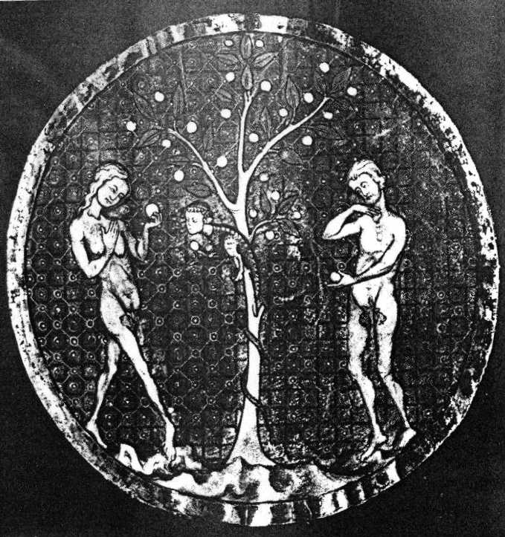
Manuscript Miscellany
From a late 13th-century Hebrew manuscript miscellany from North France. British Library, London.
Graphic from “Jewish Legends,” pg. 41.

Slide 18
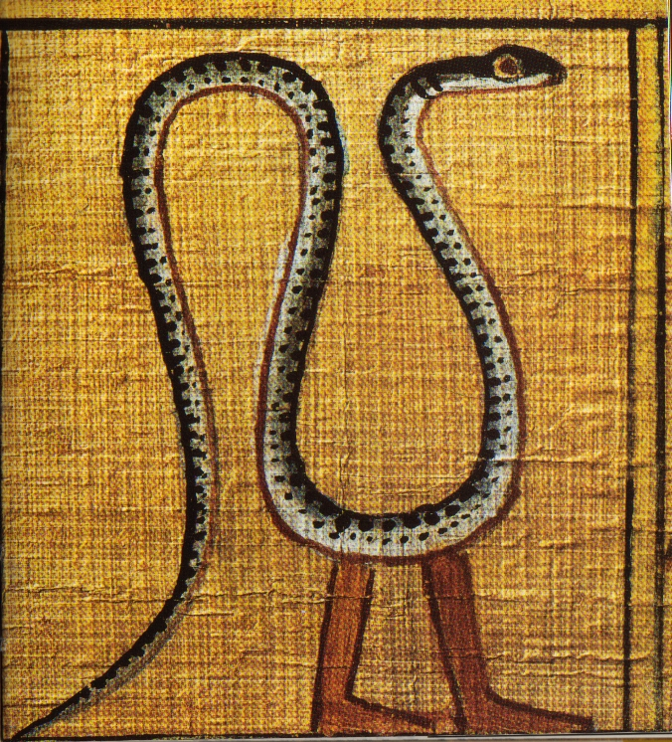
Egyptian Book of the Dead
"Sacred Symbols: Ancient Egypt," pg 51, Thames and Hudson Ltd. London, 1995. ISBN 0-500-06013-4
From the Papyrus of Ani.

Slide 19
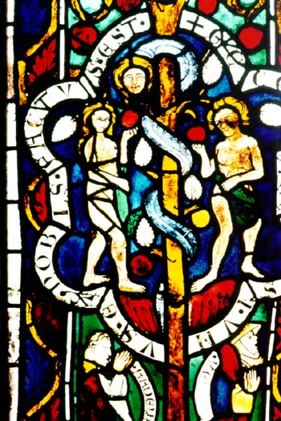
Anonymous German stained-glass window.

Slide 20
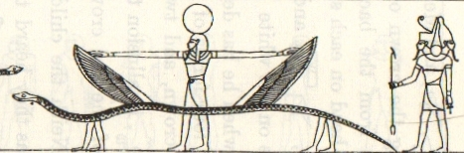
Book of the Underworld 1
"The Gods of the Egyptians, or Studies in Egyptian Mythology," by E. A. Wallis Budge, vol 1, pg 251, Dover Publications Inc., New York, 1969. ISBN 0-486-22055-9.

Slide 21

Book of the Underworld 2
"The Gods of the Egyptians, or Studies in Egyptian Mythology," by E. A. Wallis Budge, vol 1, pg 217, Dover Publications Inc., New York, 1969. ISBN 0-486-22055-9

Slide 22
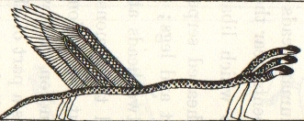
Book of the Underworld 3
"The Gods of the Egyptians, or Studies in Egyptian Mythology," by E. A. Wallis Budge, vol 1, pg 219, Dover Publications Inc., New York, 1969. ISBN 0-486-22055-9.

Slide 23
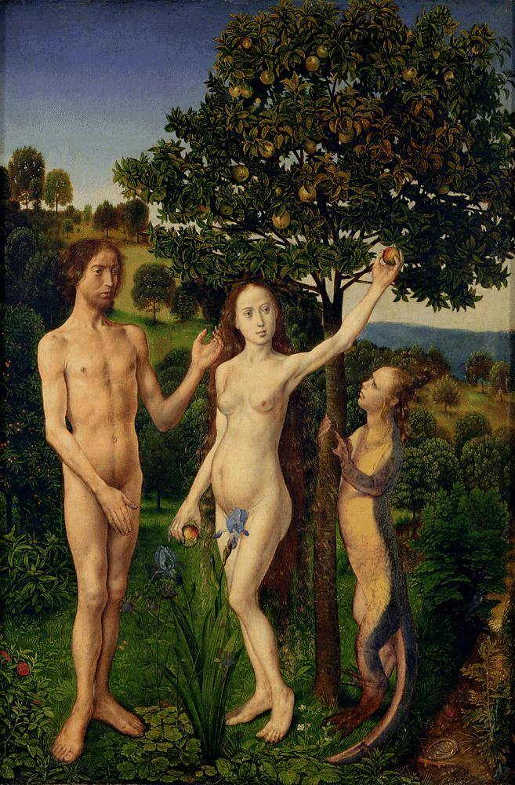
Van der Goes Fall of Man

Slide 24
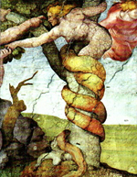
Michelangelo’s Temptation
Sistine Chapel

Slide 25
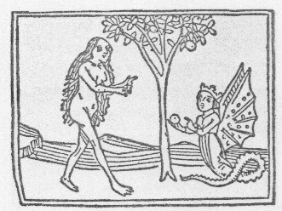
Augsburg, 1470.
The Tempting of Eve (Augsburg, 1470). Graphic from “Men and Snakes,” pg. 57.

Slide 26
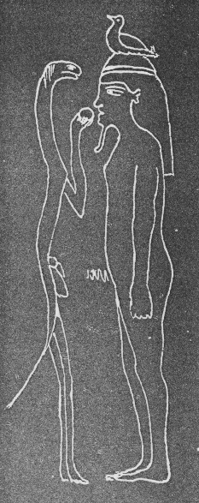
Sarcophagus Engraving #1
Reproduction of engraving on Egyptian sarcophagus. Graphic from “Men and Snakes,” pg. 57.

Slide 27
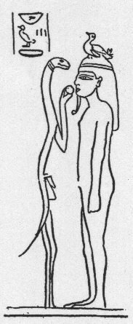
Sarcophagus Engraving #2
Reproduction of engraving on Egyptian sarcophagus. Graphic from “The Accuracy of the Bible,” pg. 184.

Slide 28
Favorite Links to Visit
Http://www.snakelegs.com

