Slide 1

Code Craft Kick-Start

Slide 2
Modules
Day 1
  Classic Test-Driven Development
  Refactoring
  Design Principles
Day 2
  Test Doubles
  Specification By Example
  Outside-In TDD
Day 3
  The Testing Pyramid
  Continuous Integration & Continuous Delivery
  Legacy Code
  Beyond TDD
© Codemanship Ltd 2020

Slide 3
Schedule (GMT)
09:00 Morning Session
10:30 Break
10:45 ‘Morning’ Session (cont.)
12:00 ‘Lunch’
13:00 ‘Afternoon’ Session
14:30 Break
14:45 ‘Afternoon’ Session (cont.)
16:00 Finish
© Codemanship Ltd 2020

Slide 4
What To Expect?
Each Module:
  20-30 mins trainer demonstration
  60-90 mins practical exercises
Pair Programming (except for one exercise)
  Pairs will be assigned to breakout rooms randomly for each exercise
© Codemanship Ltd 2020

Slide 5
Good To Know…
Zoom meetings can be exhausting – if you need a comfort break during the exercises, feel free
Demonstrations will be recorded for you to review after this course, or should you have to miss any of them for any reason
Trainer’s code will be shared on GitHub for you to review at any time
All demonstrations will be in Python
  IDE = JetBrains PyCharm
  Unit testing = unittest
  Mocking = unittest.mock
  Version Control = Git (GitHub)
THESE ARE THE ONLY SLIDES!
© Codemanship Ltd 2020

Slide 6

The Course Book
http://codemanship.com/codecraft.html
© Codemanship Ltd 2020

Slide 7
About Codemanship
Training and coaching in code craft
Established 2009
Clients include the BBC, UBS, John Lewis, Fujitsu, ESA, Asos, EA, Samsung, Ordnance Survey, Springer Nature, Salesforce, Sky
© Codemanship Ltd 2020

Slide 8
NOTES & FIGURES
© Codemanship Ltd 2020

Slide 9
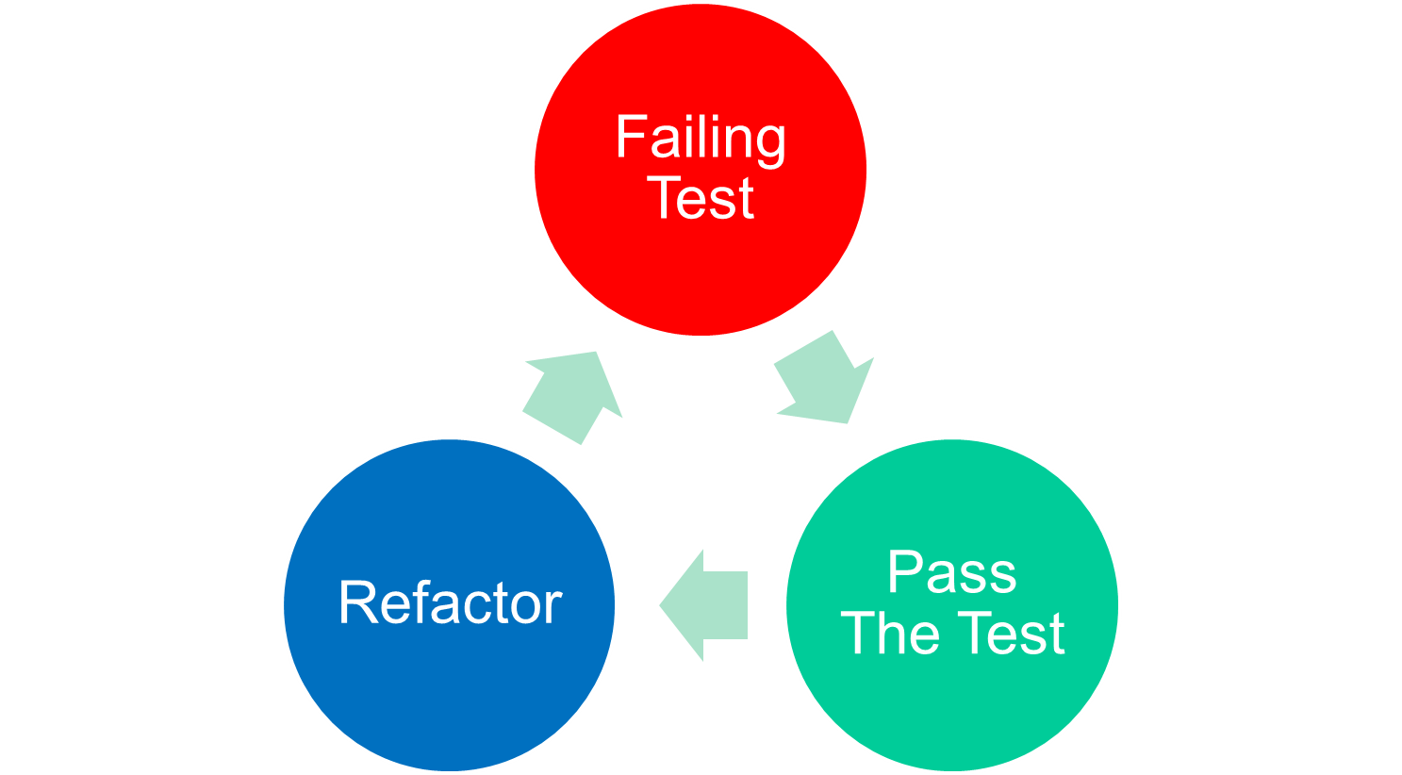
TDD Cycle
Assert First
See the test fail
One reason to fail
Baby steps
Continuous testing
Frequent commits
Regular pushes
Simplest thing
© Codemanship Ltd 2020

Slide 10
Version Control
© Codemanship Ltd 2020

Slide 11

Simple Design
It Works!
Communicates Intent
Free of Duplication
  D.R.Y. – Don’t Repeat Yourself
As SIMPLE As Possible
  Y.A.G.N.I. – You Ain’t Gonna Need It
© Codemanship Ltd 2020

Slide 12
Modular Design
One Job
Hide Internal Workings (“Tell, Don’t Ask”)
Swappable Dependencies
Client-Specific Interfaces
© Codemanship Ltd 2020

Slide 13
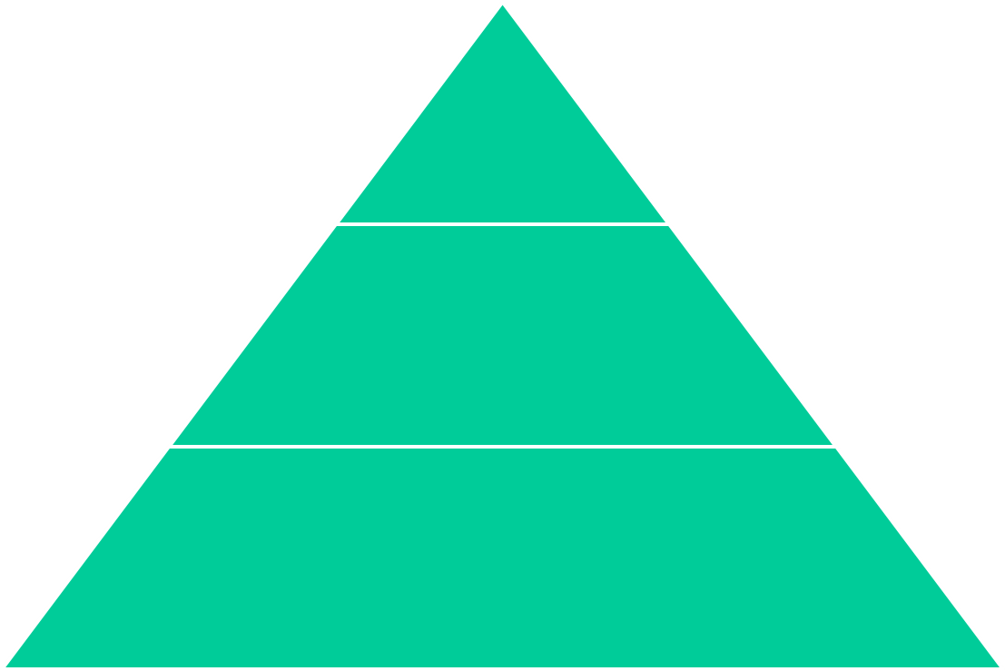
Execution time
System
Configuration
10s
Integration
Contracts
100s
Unit
Logic
1000s
© Codemanship Ltd 2020

Slide 14
jason.gorman@codemanship.com
@jasongorman @codemanship
© Codemanship Ltd 2020

