Slide 1

Test-Driven Development

Slide 2
Modules
Day 1
  The 3 Steps of the TDD cycle
  Good TDD habits
  What should we test?
Day 2
  Duplication & The Rule of 3
  Approaches to TDD
  Scaling TDD with Test Doubles
© Codemanship Ltd 2020

Slide 3
Schedule (GMT)
09:00 ‘Morning’ Session
10:30 Break
10:45 ‘Morning’ Session (cont.)
12:00 ‘Lunch’
13:00 ‘Afternoon’ Session
14:30 Break
14:45 ‘Afternoon’ Session (cont.)
16:00 Finish
© Codemanship Ltd 2020

Slide 4
What To Expect?
Each Module:
  20-30 mins trainer demonstration
  60-90 mins practical exercises
Pair Programming
  Pairs will be assigned to breakout rooms randomly for each exercise
© Codemanship Ltd 2020

Slide 5
Good To Know…
Zoom meetings can be exhausting – if you need a comfort break during the exercises, feel free
Demonstrations will be recorded for you to review after this course, or should you have to miss any of them for any reason
Trainer’s code will be shared on GitHub for you to review at any time
All demonstrations will be in Python
  IDE = JetBrains PyCharm
THESE ARE THE ONLY SLIDES!
© Codemanship Ltd 2020

Slide 6

The Course Book
http://codemanship.com/codecraft.html
© Codemanship Ltd 2020

Slide 7
About Codemanship
Training and coaching in code craft
Established 2009
Clients include Ford, BBC, UBS, John Lewis, Fujitsu, ESA, Asos, EA, Samsung, Ordnance Survey, Springer Nature, Salesforce, Sky
© Codemanship Ltd 2020

Slide 8
NOTES & FIGURES
© Codemanship Ltd 2020

Slide 9
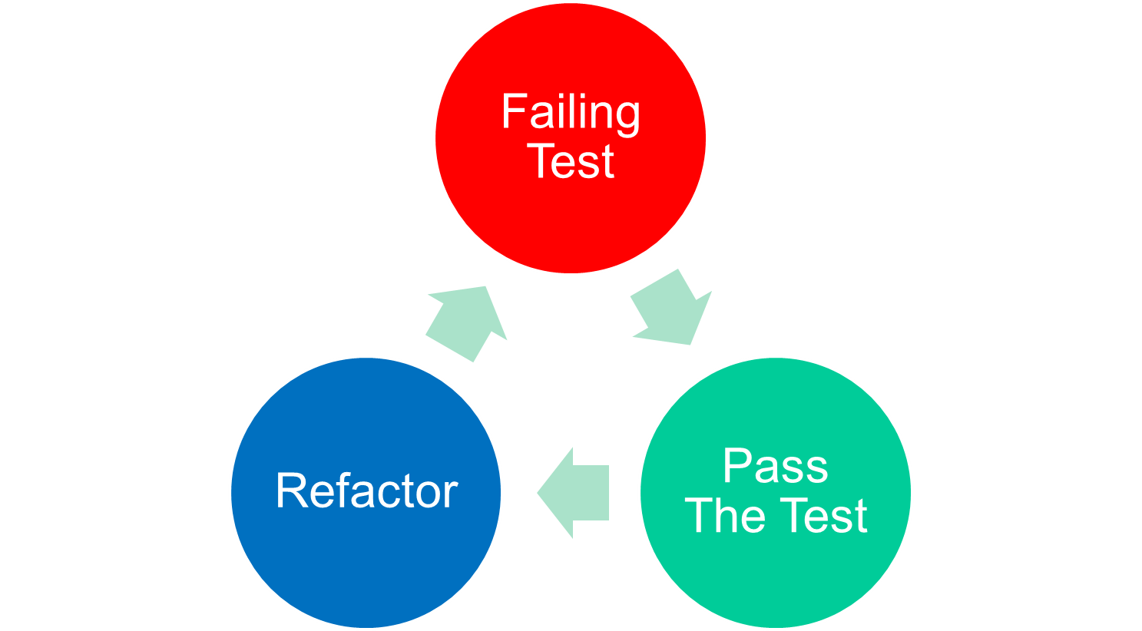
TDD Cycle
Assert First
See the test fail
One reason to fail
Baby steps
Continuous testing
Frequent commits
Regular pushes
Simplest thing
© Codemanship Ltd 2020

Slide 10


Execution time
System
Configuration
10s
Integration
Contracts
100s
Unit
Logic
1000s
© Codemanship Ltd 2020

Slide 11
jason.gorman@codemanship.com
@jasongorman @codemanship
© Codemanship Ltd 2020

