Slide 1
Introduction to C++
Data Abstraction w/ Classes
Topic #3
CS162 Topic #3

Slide 2
Topic #3
Abstract Data Types
  Introduction to...Object Models
  Introduction to...Data Abstraction
  Using Data Abstraction in C++ ...an introduction to the class
Members of a Class
  The class interface, using the class, the class interface versus implementation
  Classes versus Structures
  Constructors, Destructors
  Dynamic Memory and Linked Lists
CS162 Topic #3

Slide 3
Programming Paradigms
The most important aspect of C++ is its ability to support many different programming paradigms
  procedural abstraction
  modular abstraction
  data abstraction
  object oriented programming (this is discussed later, in CS202)
Procedural Abstraction
  What we have been doing!
  This is where you build a “fence” around program segments, preventing some parts of the program from “seeing” how tasks are being accomplished.
  Any use of globals causes side effects that may not be predictable, reducing the viability of procedural abstraction
CS162 Topic #3

Slide 4
Modular Abstraction
With modular abstraction, we build a “screen” surrounding the internal structure of our program prohibiting programmers from accessing the data except through specified functions.
Many times data structures (e.g., structures) common to a module are placed in a header files along with prototypes (allows external references)
The corresponding functions that manipulate the data are then placed in an implementation file.
Modules (files) can be compiled separately, allowing users access only to the object (.o) files
We progress one small step toward OOP by thinking about the actions that need to take place on data...
CS162 Topic #3

Slide 5
Modular Abstraction
We implement modular abstraction by separating out various functions/structures/classes into multiple .cpp and .h files.
.cpp files contain the implementation of our functions
.h files contain the prototypes, class and structure definitions.
We then include the .h files in modules that need access to the prototypes, structures, or class declarations:
  #include “myfile.h”
  (Notice the double quotes!)
We then compile programs (on UNIX) by:
  g++ main.cpp myfile.cpp
  (Notice no .h file is listed on the above line)
  Or, you can compile as g++ *.cpp ← This works find if all of the functions are
  in the same directory and are part of
  the same project. If there are other
  .cpp files in this directory, the wildcard
  will not be appropriate!
CS162 Topic #3

Slide 6
Working with Multiple Files
Header files (.h files):
Used for declarations
#include(s)
Constant(s)
Struct(s)
Prototype(s)
Class Interface(s)
Do NOT implement the “body” of a function in a .h file
Do NOT #include any .cpp file
Implementation files (.cpp files):
Used for function definitions
#include “header_file.h”
  Goes to your current working directory, unless a path is specified
Function implementations
  The body of a function
There needs to be a main function in one of the .cpp files
  But, there can be only one main!
CS162 Topic #3

Slide 7
Data Abstraction
Data Abstraction is one of the most powerful programming paradigms
It allows us to create our own user defined data types (using the class construct) and
  then define variables (i.e., objects) of those new data types.
With data abstraction we think about what operations can be performed on a particular type of data and not how it does it
  Here we are one step closer to object oriented programming
CS162 Topic #3

Slide 8
Data Abstraction
Data abstraction is used as a tool to increase the modularity of a program
It is used to build walls between a program and its data structures
  what is a data structure?
  talk about some examples of data structures
We use it to build new abstract data types
An abstract data type (ADT) is a data type that we create
  consists of data and operations that can be performed on that data
Think about a char type
  it consists of 1 byte of memory and operations such as assignment, input, output, arithmetic operations can be performed on the data
CS162 Topic #3

Slide 9
Data Abstraction
Once we have determine what data and operations make sense for a new data type, we can define them using the class construct in C++
Once defined, we can create lists without worrying about how the data is stored
  We “hide” the data structure used for the data within the data type -- so it is transparent to the program using the data type
  We call the program using this new data type: the client program (or client)
Once you have defined a class, you can create as many instances of that class as you want
  Each “instance” of the class is considered to be an “object” (variable)
  And, just as we can have zero or more variables of any data type...we can have zero or more objects of a class!
  Then, we can perform operations on an object in the same way that we can access members of a struct...
Think of a class as similar to a data type and an object as a variable
CS162 Topic #3

Slide 10
What is a Class?
Remember, we used a structure to group different types of data together under a common name
With a class, we can go the next step an actually define a new data type
In reality, structures and classes are 100% the same except for the default conditions
  everything you can do with a class you can do with a structure!
CS162 Topic #3

Slide 11
“class” Terminology
Class
  think data type
Object
  instance of a class, e.g., variable
Members
  like structures, the data and functions declared in a class
  called “data members” and “member functions”
CS162 Topic #3

Slide 12
Creating a “Class Interface”
Once we have decided on how the new type of data should behave, we are ready to define a class.
This should be done in a .h file
  class data_type_name
  {
  public:
  //place member functions here
  private:
  //place data members here
  }; ← Notice the semicolon
CS162 Topic #3

Slide 13
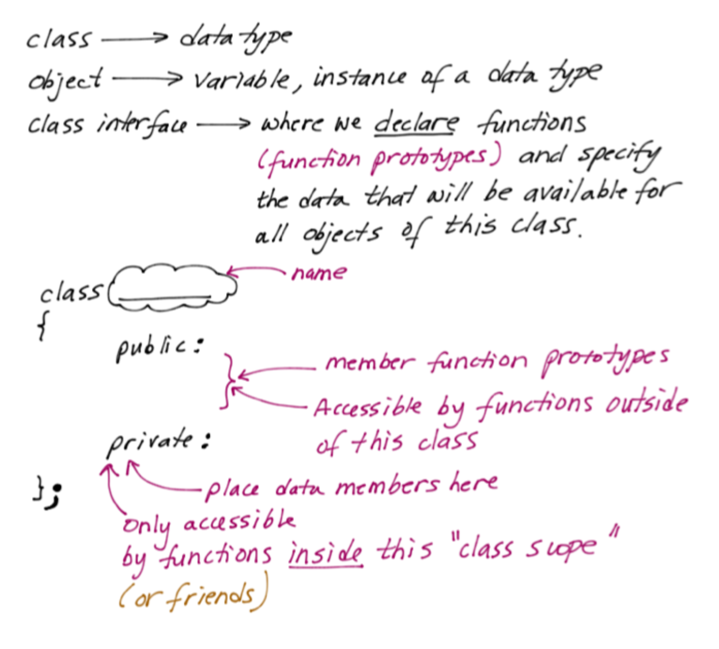
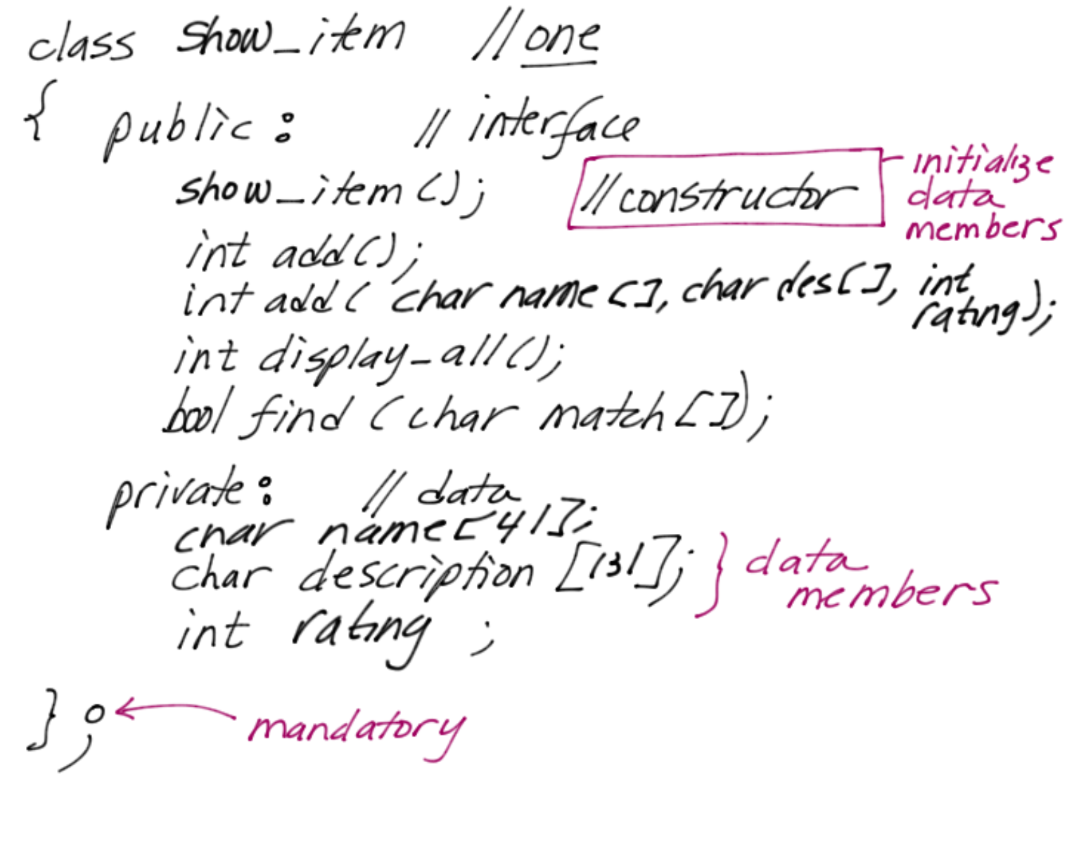
Creating a Class Interface
Incrementally Implement
The Class Construct
CS162 Topic #3

Slide 14
Class Interface (.h)
Class Interface: list.h
  class list {
  public:
  int display_all()
  •••
  private:
  video my_list[CONST_SIZE];
  int num_of_videos;
  };
list.h can contain:
      prototype statements
      structure declarations and definitions
      class interfaces and class declarations
      include other files
CS162 Topic #3

Slide 15
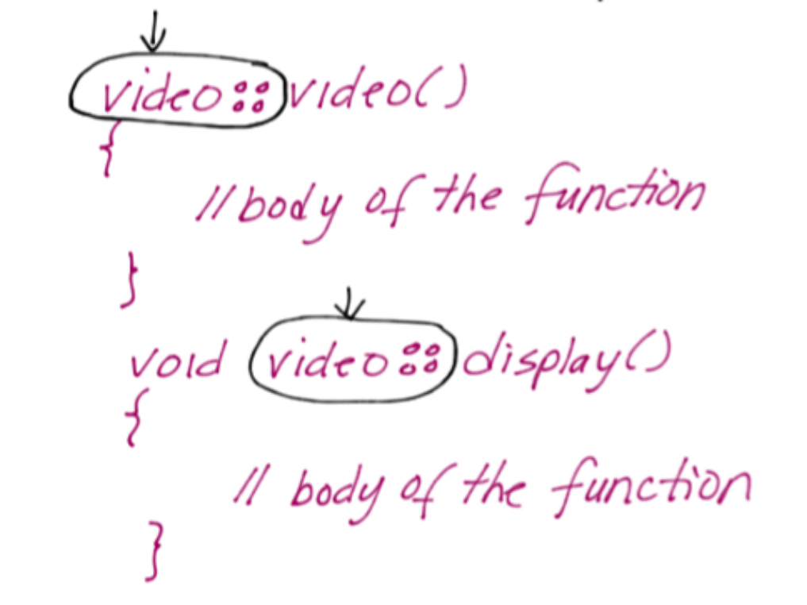
Implementing the class
In the .cpp file ALL prototypes listed in the class interface (in the .h file) MUST be implemented
Preceed the function name with the class name and the scope resolution operator (::)
CS162 Topic #3

Slide 16
Class Implementation
Class Implementation list.c
  #include “list.h” notice the double quotes
  int list::display_all() {
  for (int i=0; i<num_of_videos; ++i)
  cout <<my_list[i].title <<‘\t’
  <<my_list[i].category
  <<‘\t’ <<my_list[i].quantity <<endl;
  }
  Notice, the code is the same
  But, the function is prefaced with the class name and the scope resolution operator!
  This places the function in class scope even though it is implemented in another file
  Including the list.h file is a “must”
CS162 Topic #3

Slide 17
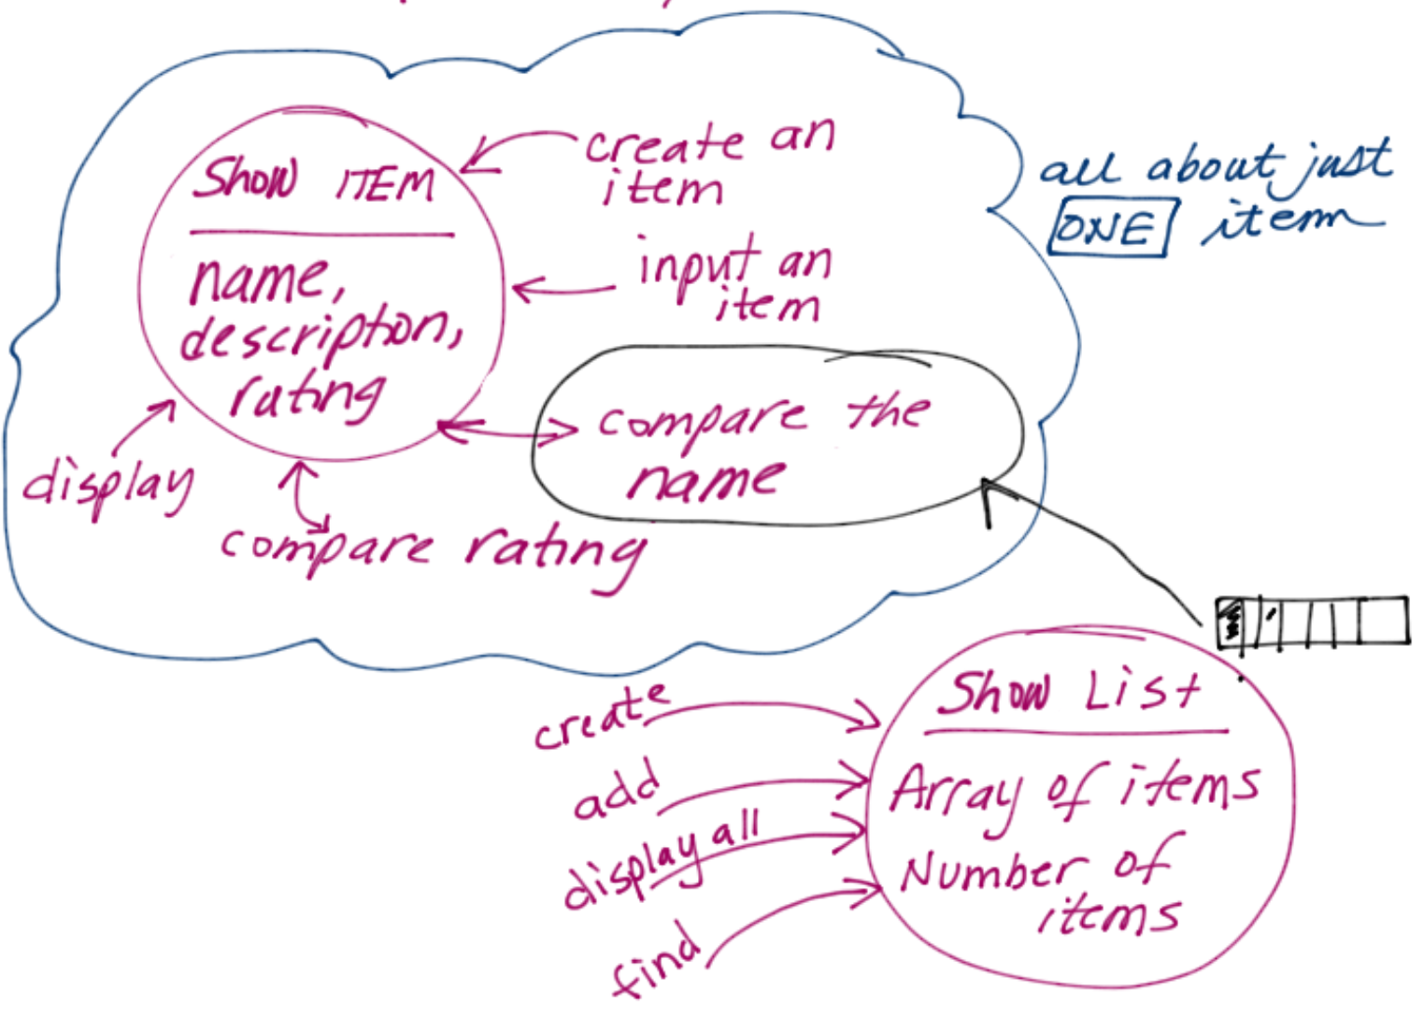
Now, using classes with our Movie example
Design the solution by thinking about the DATA and then thinking about what operations make sense working on that data
Make classes that have clear levels of responsibility
Then group it together!
CS162 Topic #3

Slide 18
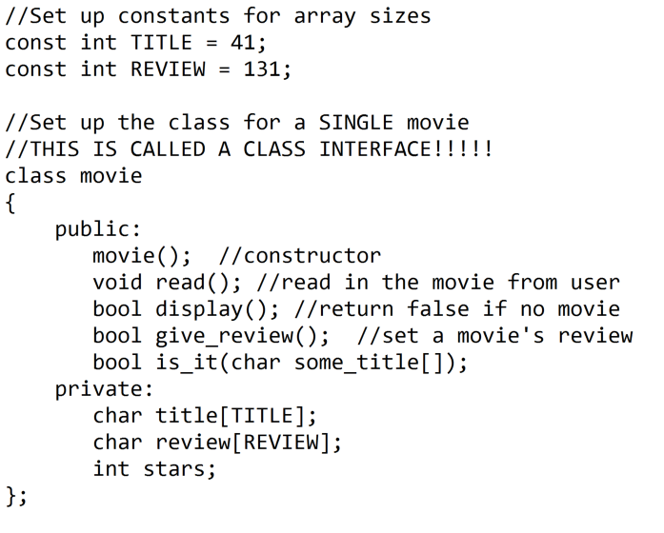
For Example, here is a Class Interface
CS162 Topic #3

Slide 19
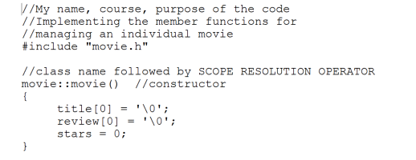
Then, the Class Implementation
Let’s start with the constructor
The purpose of the constructor is to initialize data members
BE CAREFUL to NOT re-create local variables of the same name as your data members. It is a common “typo”!
CS162 Topic #3

Slide 20
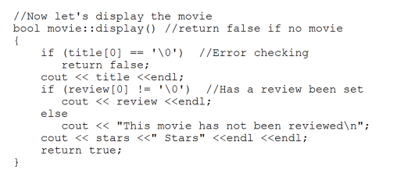
Then, the Class Implementation
For each member function, precede the function name with the class name and scope resolution operator
For non-void returning functions, remember to return the appropriate value!
Notice how the function has direct access to all of the data within the class. The scope resolution operator places us within the scope of that class!
CS162 Topic #3

Slide 21
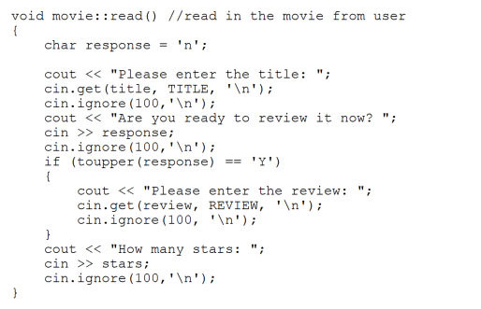
More of the Class Implementation
CS162 Topic #3

Slide 22
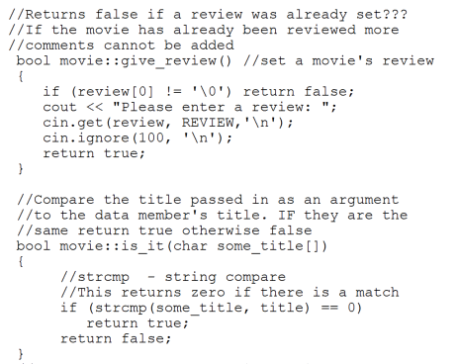
More of the Class Implementation
CS162 Topic #3

Slide 23
Using the class from main…
CS162 Topic #3

Slide 24
Defining Objects of this Class
To use the class, we must create an “object” of a class
  Notice how similar defining objects of class is to defining variables of any data type
Defining an object causes the “constructor” to be invoked; a constructor is the same named function as the class (string) and is used to initialize the memory set aside for this object
Think about how much memory is set aside?
What initial values should it take on?
CS162 Topic #3

Slide 25
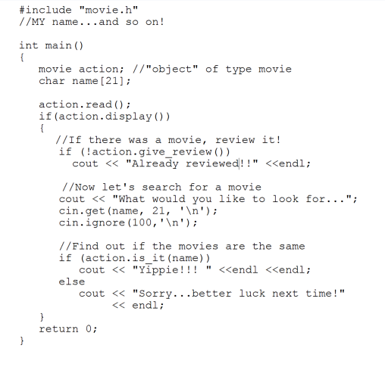
Using the class: main.cpp
To use the class, we must create an “object” of a class
  Notice how similar defining objects of class is to defining variables of any data type
Defining an object causes the “constructor” to be invoked; a constructor is the same named function as the class (string) and is used to initialize the memory set aside for this object
Think about how much memory is set aside?
What initial values should it take on?
CS162 Topic #3

Slide 26
Using Objects of this Class
Think about how you can use those objects
We are limited to using only those operations that are defined within the public section of the class interface
The only “built-in” operation that can be used with objects of a class is the assignment operation, which does a memberwise copy (as we learned with structures)
  Avoid this operator as it will not perform correctly once we get into Topic #4!
CS162 Topic #3

Slide 27
Using Objects of this Class
Notice how similar the use of these operations is to the cin.get function.....
cin.get(ch);
This should be a clue. cin therefore is an object of the istream class.
The dot is the member access operator; it allows us to access a particular public member function defined within the istream class.
The function get is therefore defined within the public section of the istream class
CS162 Topic #3

Slide 28
Remember “class” Terminology
Now we can have a collection of movies!
  class list { <--- the data type!!!
  public:
  list(); <--- the constructor
  int add (const movie &); 3 member functions
  int remove (char title[]);
  int display_all();
  private:
  movie my_list[CONST_SIZE]; data members
  int num_of_videos;
  }; <--- notice like structures we need a semicolon
CS162 Topic #3

Slide 29
List Example – from main
For a client to create a list object:
  int main()
  {
  list home_videos; //has an array of 100 movies
  list kids_shows; //another 100 movies here...
  •••
  movie action;
  cin.get(action.title,100,’\n’);
  cin.ignore(100,’\n’);
  •••
  home_videos.add(action); //Call a member function!
CS162 Topic #3

Slide 30
Using Classes vs Structs
If we examine the previous class,
  notice that classes are really very similar to structures
  a class is simply a generalized structure
  in fact, even though we may not have used structures in this way...
  Structures and Classes are 100% identical except for their default conditions...
      by default, all members in a structure are available for use by clients (e.g., main programs); they are public
This limited use of a structure was appropriate, because
  it served the purpose of grouping different types of data together as a single unit
  so, anytime we want to access a particular video -- we get all of the information pertaining to the video all at once
CS162 Topic #3

Slide 31
Using Classes vs Structs
To accomplish data hiding and encapsulation
  we usually turn towards classes
What is data hiding?
  It is the ability to protect data from unauthorized use
  Notice, with the video structure, any code that has an object of the structure can access or modify the title or other members
With data hiding
  accessing the data is restricted to authorized functions
  “clients” (e.g., main program) can’t muck with the data directly
  this is done by placing the data members in the private section
  and, placing member functions to access & modify that data in the public section
CS162 Topic #3

Slide 32
Data Hiding
So, the public section
  includes the data and operations that are visible, accessible, and useable by all of the clients that have objects of this class
  this means that the information in the public section is “transparent”; therefore, all of the data and operations are accessible outside the scope of this class
  by default, nothing in a class is public!
The private section
  includes the data and operations that are not visible to any other class or client
  this means that the information in the private section is “opaque” and therefore is inaccessible outside the scope of this class
  the client has no direct access to the data and must use the public member functions
  this is where you should place all data to ensure the memory’s integrity
CS162 Topic #3

Slide 33
Data Hiding
The good news is that
  member functions defined in the public section can use, return, or modify the contents of any of the data members, directly
  it is best to assume that member functions are the only way to work with private data
    (there are “friends” but don’t use them this term)
  Think of the member functions and private data as working together as a team
CS162 Topic #3

Slide 34
Constructors
Remember that when you define a local variable in C++, the memory is not automatically initialized for you
This could be a problem with classes and objects
If we define an object of our list class, we really need the “num_of_videos” data member to have the value zero
Uninitialized just wouldn’t work!
CS162 Topic #3

Slide 35
Constructors
Luckily, with a constructor we can write a function to initialize our data members
  and have it implicitly be invoked whenever a client creates an object of the class
The constructor is a strange function, as it has the same name as the class, and no return type (at all...not even void).
CS162 Topic #3

Slide 36
Constructor
The list constructor was: (list.h)
  class list {
  public:
  list(); <--- the constructor
  •••
  };
The implementation is: (list.cpp)
  list::list(){
  num_of_videos = 0;
  }
CS162 Topic #3

Slide 37
Constructor
The constructor is implicitly invoked when an object of the class is formed:
  int main() {
  list fun_videos; implicitly calls the constructor
  list all_videos[10]; implicitly calls the
  constructor 10 times for
  each of the 10 objects!!
CS162 Topic #3

Slide 38
Another Constructor
Remember function overloading? We can have the same named function occur (in the same scope) if the argument lists are unique.
So, we can have another constructor take in a value as an argument of the number of videos
  and go ahead and allocate the memory, so that subsequent functions can use the array
CS162 Topic #3

Slide 39
Clients creating objects
The client can cause this 2nd constructor to be invoked by defining objects with initial values
    list fun_videos(20); //size is 20
  If a size isn’t supplied, then no memory is allocated and nothing can be stored in the array....
CS162 Topic #3

Slide 40
Default Arguments
To fix this problem, we can merge the two constructors and replace them with a single constructor:
    list::list(int size=100) {
    my_list = new video [size];
    video_list_size = size;
    num_of_videos = 0;
    }
    (Remember, to change the prototype for the constructor in the class interface)
CS162 Topic #3

Slide 41
Review of Classes
What is the difference between a class and a struct
What is a data member?
Where should a data member be placed in a class? (what section)
What is a member function?
Where should member functions be placed, if clients should use them?
CS162 Topic #3

Slide 42
Review of Classes
What is the difference between a member function and a regular-old C++ function?
What is the purpose of the constructor?
Why is it important to implement a constructor?
What is the difference between a class and an object?
CS162 Topic #3

Slide 43
Review of Classes
Show an example of how a client program defines an object of a list class
How then would the client program call the constructor? (trick question!)
How then would the client program call the display_all function?
Why are parens needed?
CS162 Topic #3

Slide 44
Review of Classes
Write a simple class interface (called number) that has the following members:
  an integer private data member (containing a value)
  a constructor
  a set member function, that takes an integer as an argument and returns nothing
  a display member function
CS162 Topic #3

Slide 45
Review of Classes
Now, let’s try our hand at implementing these functions
  a constructor
  a set member function, that takes an integer as an argument and returns nothing
  a display member function
CS162 Topic #3

Slide 46
Review of Classes
What happens if we forgot to put the keyword public in the previous class interface?
Why is it necessary to place the class name, followed by the scope resolution operator (::) when we implement a member function outside of a class?
CS162 Topic #3

