Slide 1
Power And Data Movement GitHub: https://github.com/jasongraalum/CS533_Spring2018_Group2_Project
- Alex Kelly
-Ajinkya Shinde
-Jason Graalum
-Shikha Shah

Slide 2
Goals:
Write benchmark codes that target specific configurations expected to be power efficient or power inefficient.
Conduct a study using the benchmarks to actually measure the power consumption.

Slide 3
Hypothesis & Decision
Assumed that power consumption increases with the increase in data movement and makes code less efficient with degradation in performance.
Well, How to measure?

Slide 4
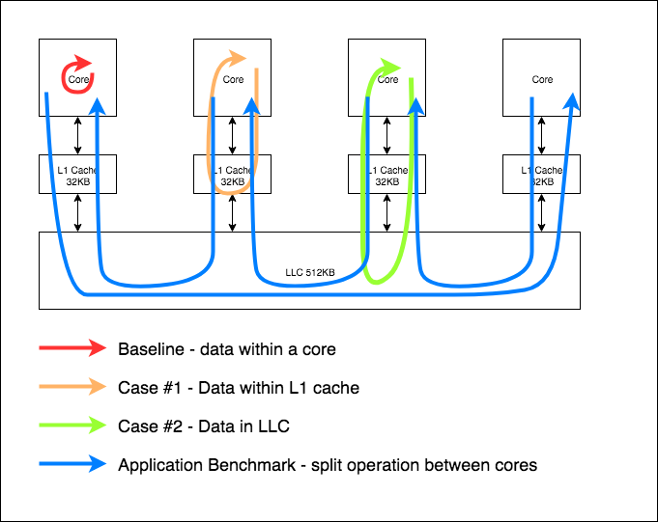
Methodology
Three Cases
Baseline(red line)
Load data into core and operate
L1 Cache Loads(orange line)
On each operation, load data from L1 to core
LLC Cache Loads(green line)
On each operation, load data from LLC to L1 to core

Slide 5
Data Movement
Initialization
For all cases, we need a consistent configuration cost
Memory allocation and initialization
Array size == 2X L1 Cache Size
Baseline
Simple operation(addition) on value in core registers
L1 Cache
Alternate between two L1 cache lines
LLC
Load from a new cache line on each access
Twice as many cache lines in the array as in L1
Guarantees that every load causes a L1 cache miss

Slide 6
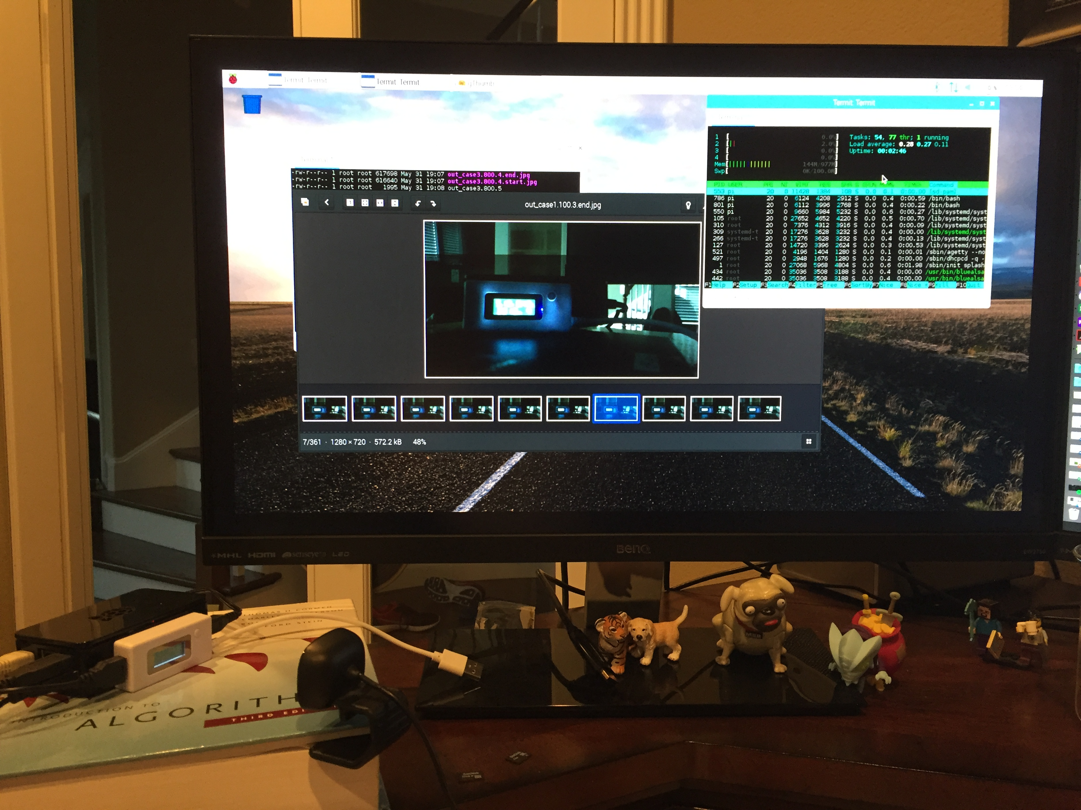
Experimental Setup
Used bash script to run multiple cases
Took photo of power meter in between each run
Found good use for my old Algorithms Textbook

Slide 7
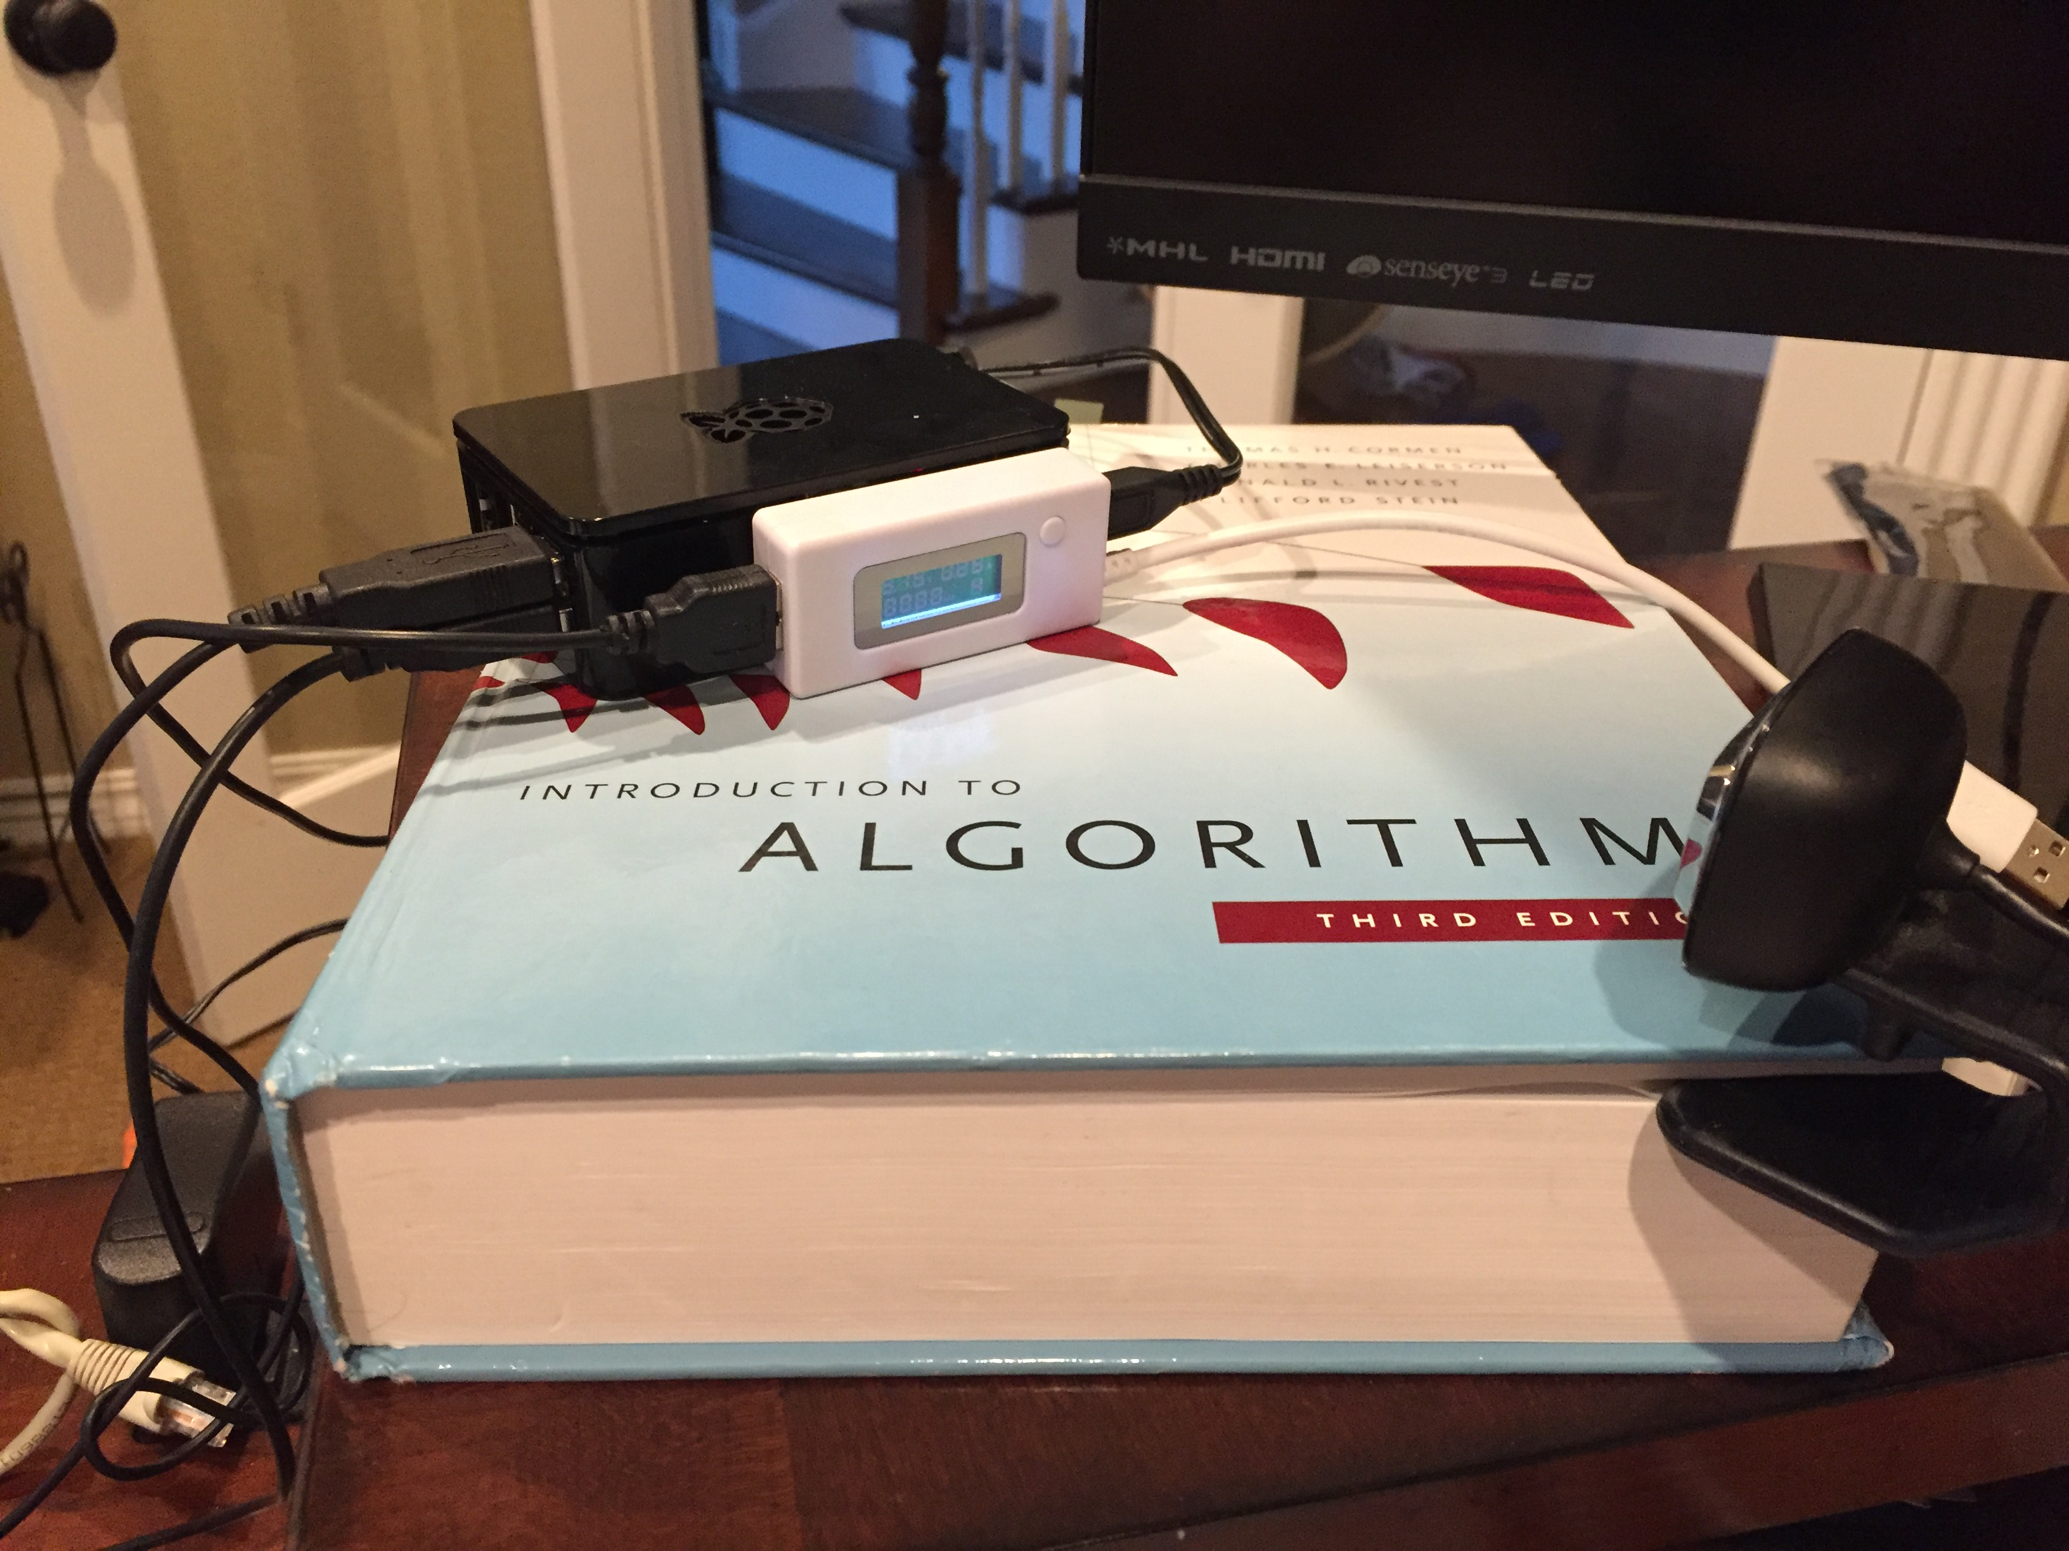
Experimental Setup
Used bash script to run multiple cases
Took photo of power meter in between each run
Found good use for my old Algorithms Textbook

Slide 8
Real-World(ish) Data-Flow Cases:
What kind of data-intensive applications are common in the wild?
Databases
Analytics / Machine Learning
Network traffic
How do different data-flow patterns in these cases affect power/performance?
How can we test something like this?

Slide 9
Big Data: Map, Filter, Reduce
Simple high-level algorithms for dealing with massive data asynchronously
One of the most popular cases of functional programming used in practice
Google and Amazon like these a lot
Used everywhere all the time

Slide 10
NLP: Markov-chain N-Gram
Very simple but powerful probabilistic natural language model
Build a probability model of all possible next words given a sequence of N words
Underpins a lot of machine translation, text synthesis, and sentiment analysis
Lots of data to crunch: Needs huge corpuses to be even remotely useful

Slide 11
Markov Ouroboros: “Realistic” test
Process a big corpus of data (Tweets)
Filter and Map to generate n-grams, then stack them with a reduce step
Build a simplistic markov-chain bigram model with all the data
Sample new text from the model and feed it right back through the first step

Slide 12
Markov Ouroboros: Why?
Moves a whole bunch of data around
Different kinds of data processing
Aggregation
Filtering
Comparisons
Highly entropic data, so likely to cause cause cache misses

Slide 13
Markov Ouroboros: Cases
Baseline: Do it on one core
How much power does just spinning up the python runtime take?
Parallel: Split the data, put it on 4 cores
With full processor utilization, how much more power do we use?
Cascading: Move the data between cores
Does moving the data around increase power consumption?

Slide 14
Markov Ouroboros: Details
Does the size/amount of data matter?
Cache vs Memory
What about complexity?
Will the power usage go down if the models regulaize the data?
Controlling for the disk read
What kind of processing do you cascade?
Different steps?
“Juggling” data?

Slide 15
Markov Ouroboros: “Results”
Working test case, but...
Power monitor stopped working
Only subjective results
Spoilers: Different processes are a hard test case to get right
But working test code which we will make available if anyone’s curious

Slide 16
Results
To perform the actual analysis , we use the perf tool
Collect statistics - vary loop iterations i. e 100, 400, 800 etc.
Identified key metrics for the analysis and plotted as :
1. Power consumed per instruct. in all of the cases.
2. Power consumed while data movement Main mem -> L1
3. Power consumed while storing data back to L1( on cache miss) .
4. Power consumed while data movement Mem -> LLC -> L1
5. Power consumed while storing data back to LLC (on cache miss)

Slide 17
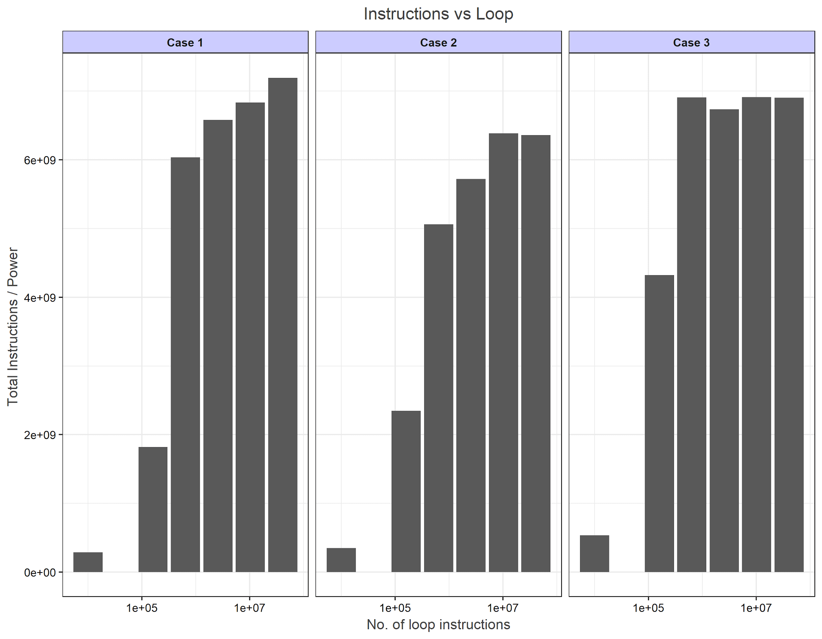
Results - Analysis
Analysis - 1 : Power consumed per instructions after incr. in loop iteration
Should increase exponentially. Same are the results as shown below

Slide 18
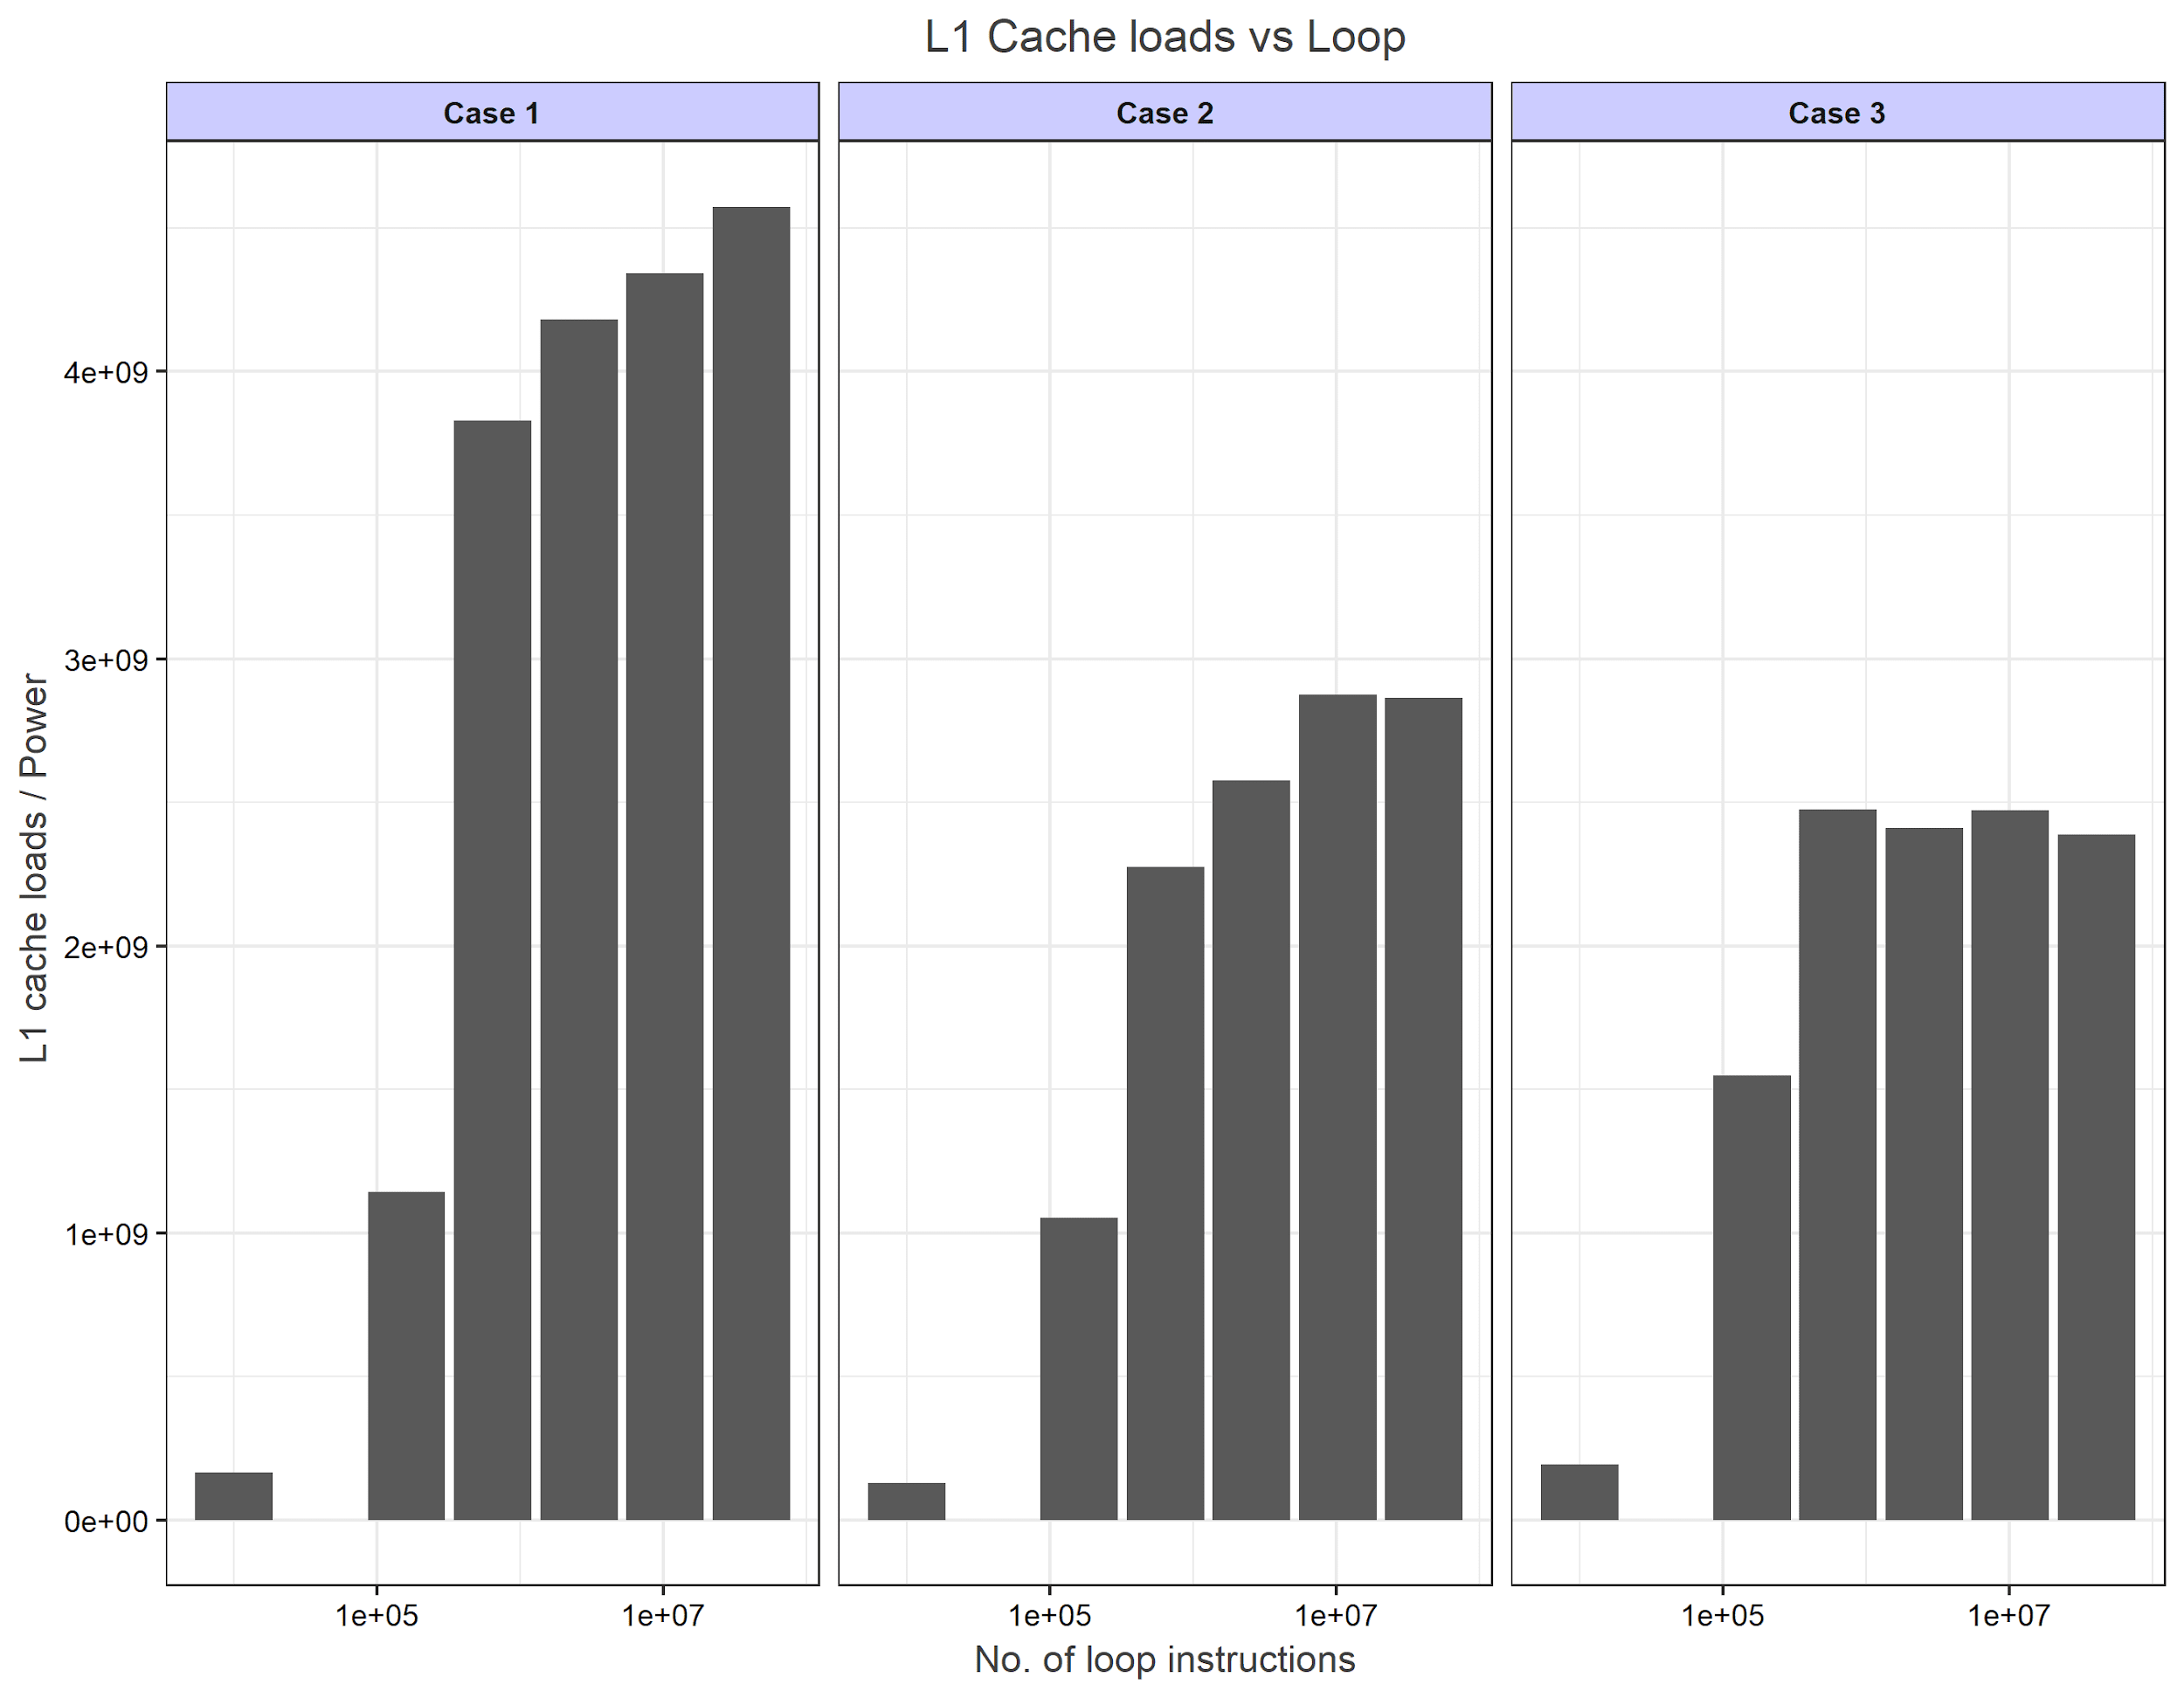
Results - Analysis
Analysis - 2 : Power consumed while moving data from main mem -> L1
For case 1 , there shouldn't be any change. With exp. incr. for case 2 & 3 .
However, the results are : -

Slide 19
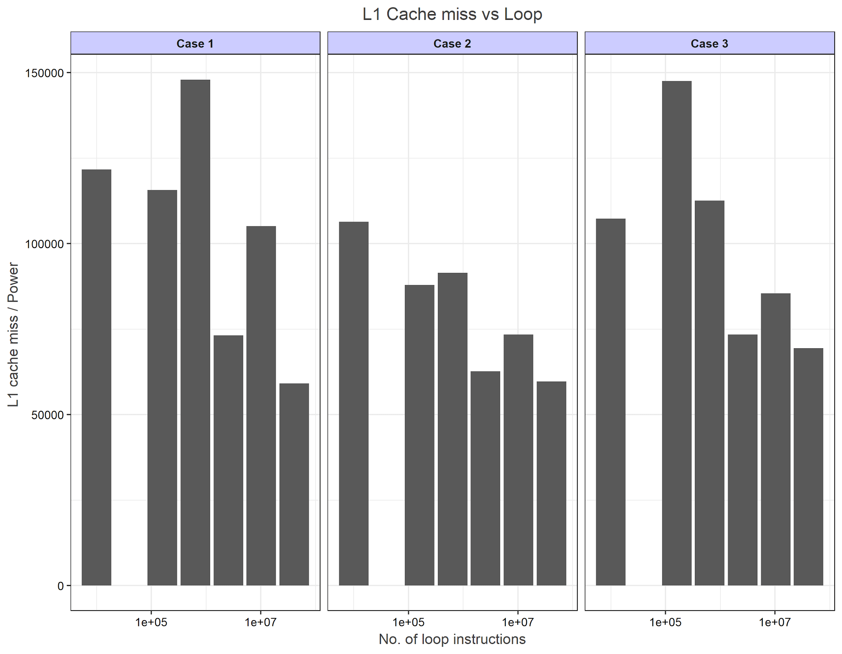
Results - Analysis
Analysis - 3 : Power consumed while storing data back to L1
Here, on cache miss , there shouldn't be any change in case 1 , with exp. incr for other cases.
However, the results are : -

Slide 20
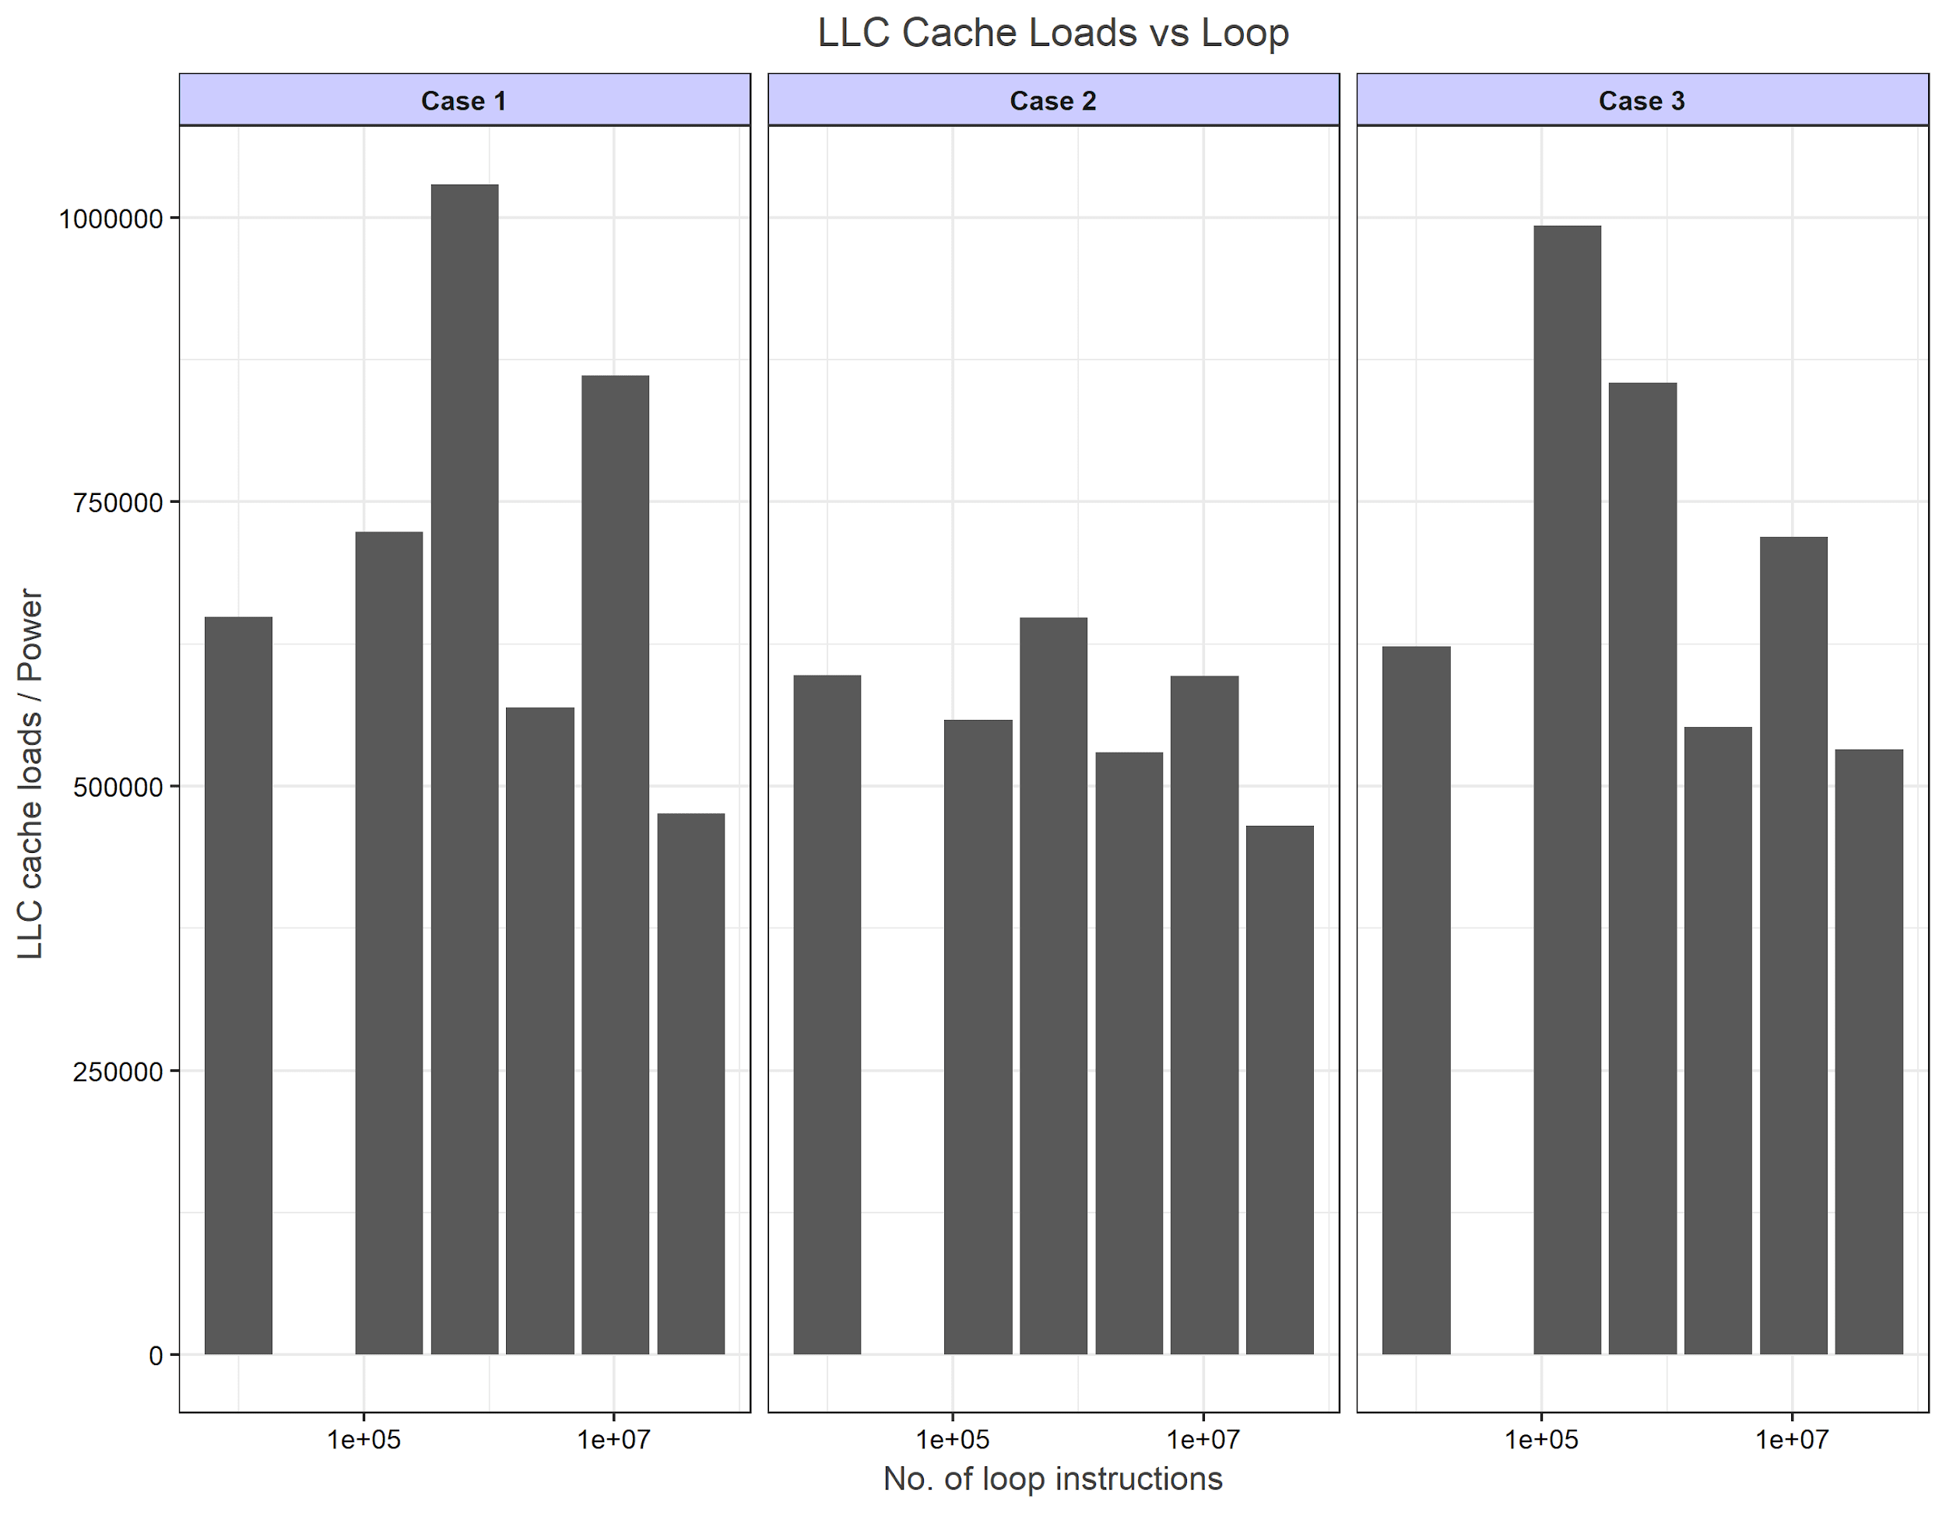
Results - Analysis
Analysis - 4 : Power consumed while data movement from Mem->LLC->L1
For case 1, 2 there shouldn’t be any relative change , with exp. incr. in case 3
However, the results are : -

Slide 21
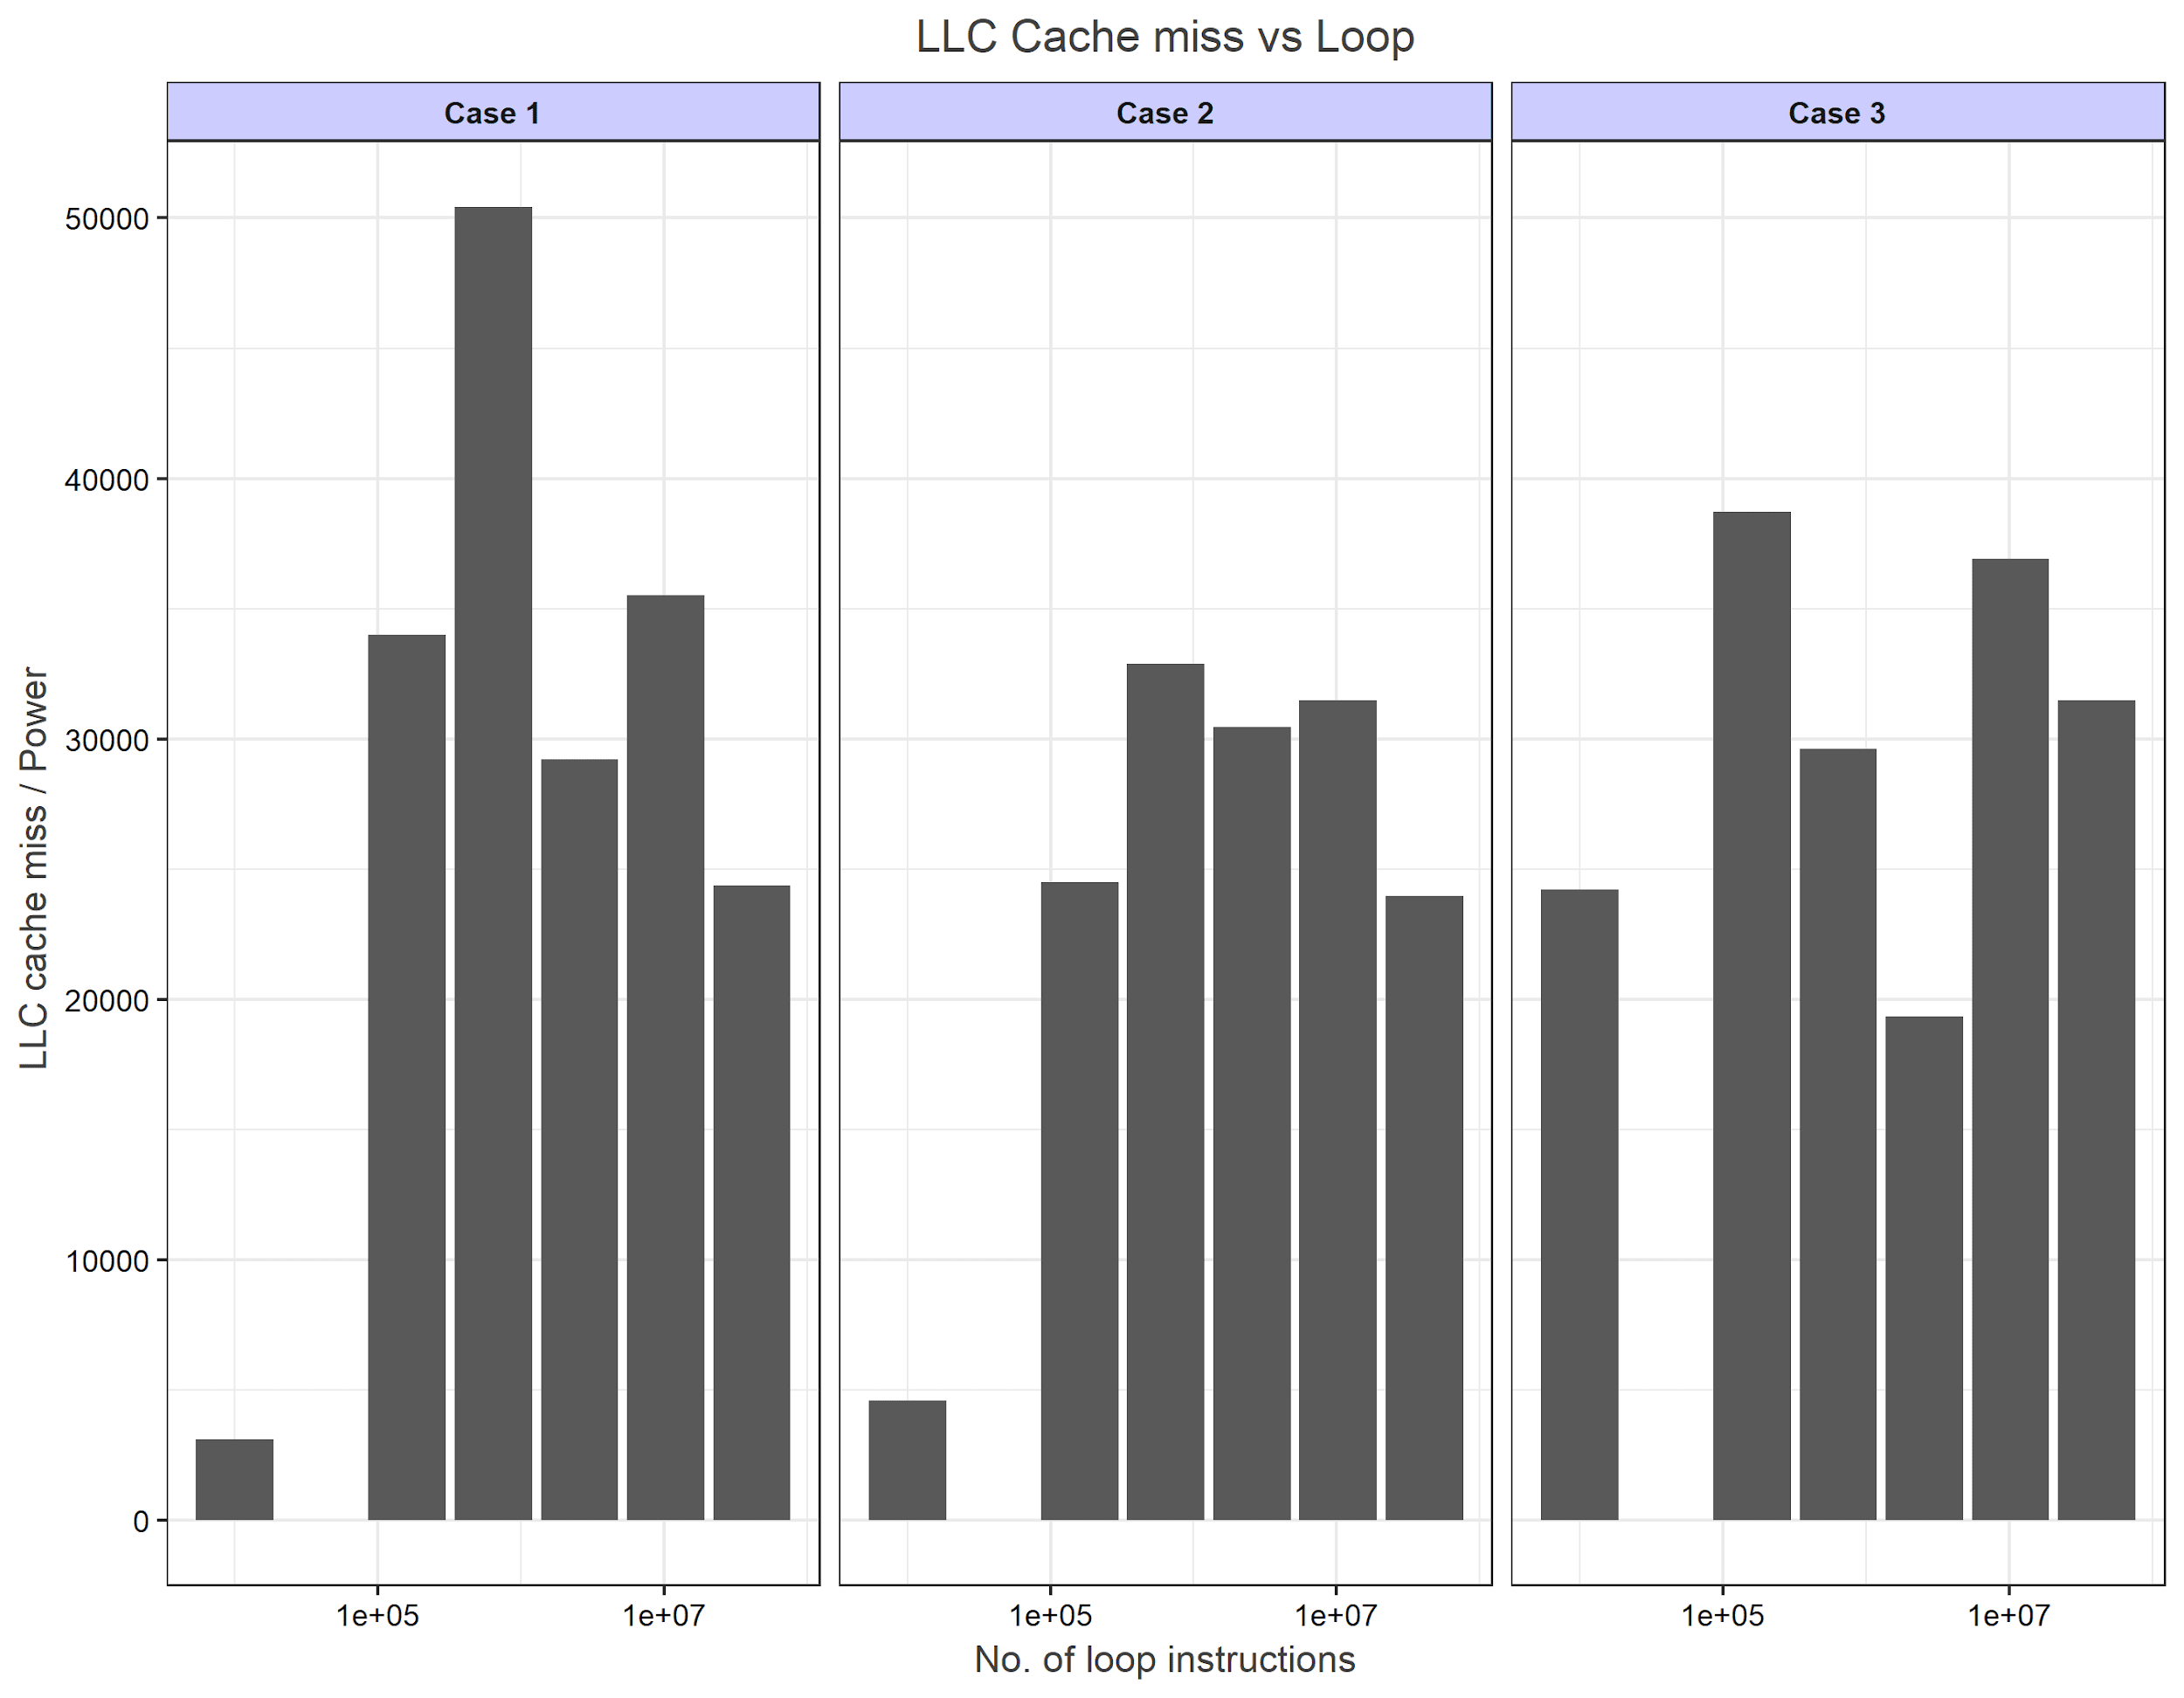
Results - Analysis
Analysis - 5 : Power consumed while getting data back at LLC ->Main Mem.
Similar to analysis -4, for case 1, 2 there shouldn’t be any relative change , with exp. incr. in case 3
However, the results are : -

Slide 22
Conclusion
Measuring power is easy. Measuring power accurately is hard!
To measure the power of internal data movements, large amounts of data movement is needed.
Overall, the benchmarks did what they were designed to do – move data between the core, L1 cache and LLC.
But, the OS gets in the way – time outs and context switches – which adds noise to the data
Future work would include modifications to the kernel to limit time-outs and context switches as well as move to a system which allowed more access to power data

Slide 23
Back up slides

Slide 24
Raspberry Pi 3
Why did we use a Raspberry Pi 3?
Ease of use
Easy Access
Easy Configuration
Power measurement through USB power supply
Was it a good decision?

Slide 25
Power per L1 Cache Load

Slide 26
Power per LLC Cache Load

