Slide 1
Introduction to C++
Recursion
Topic #5
CS162 Topic #5

Slide 2
CS162 - Topic #5
Lecture: Recursion
  The Nature of Recursion
  Tracing a Recursive Function
  Work through Examples of Recursion
  Problem solving with recursion
CS162 Topic #5

Slide 3
CS162 - Recursion
Recursion is repetition (by self-reference)
  it is caused when a function calls/invokes itself.
  Such a process will repeat forever unless terminated by some control structure.
So far, we have learned about control structures that allow C++ to iterate a set of statements a number of times.
In addition to iteration, C++ can repeat an action by having a function call itself.
  This is called recursion. In some cases it is more suitable than iteration.
While recursion is very powerful
  and will allow us to at times simply solve complex problems
  it should not be used if iteration can be used to solve the problem in a maintainable way (i.e., if it isn’t too difficult to solve using iteration)
  so, think about the problem. Can loops do the trick instead of recursion?
CS162 Topic #5

Slide 4
CS162 - Recursion
  Why select iteration versus recursion?
    Efficiency!
    Every time we call a function a stack frame is pushed onto the program stack and a jump is made to the corresponding function
    This is done in addition to evaluating a control structure (such as the conditional expression for an if statement) to determine when to stop the recursive calls.
    With iteration all we need is to check the control structure (such as the conditional expression for the while, do-while, or for)
CS162 Topic #5

Slide 5
CS162 - Recursion
Let's look at a very simple example;
  in this case we can see that by using recursion we can make some difficult problems very trivial...
  many of these problems would be very difficult to solve if you only were able to use iteration.
  trace through the following problem in class...showing how the stack frame works
CS162 Topic #5

Slide 6
CS162 - Recursion
What is the purpose of the following?
      void strange(void);
      int main(){
      cout <<"Please enter a string" <<endl;
      strange();
      cout <<endl;
      return 0;
      }
      void strange(void) {
      char ch;
      cin.get(ch);
      if (!cin.eof() && ch != '\n'){
      strange();
      cout <<ch;
      }
      }
CS162 Topic #5

Slide 7
CS162 - Recursion
This program writes the reverse of what was entered at the keyboard, no matter how many characters were entered!
    Try to write an equally simple program just using the iterative statements we know about; it would be difficult to make it behave the same without limiting the number of characters that can be entered or using up a lot of memory with a huge array of characters!
    Notice, with recursion, we didn't have to even use an array!!
CS162 Topic #5

Slide 8
CS162 - Recursion
When a recursive call is encountered, execution of the current function is temporarily stopped.
This is because the result of the recursive call must be known before it can proceed.
So, it saves all of the information it needs in order to continue executing that function later (i.e., all current values of all local variables and the location where it stopped).
Then, when the recursive call is completed, the computer returns and completes execution of the function.
CS162 Topic #5

Slide 9
CS162 - Recursion
In order for your recursive calls to be useful, they must be designed so that your program will ultimately terminate.
As with iteration or looping, there is danger of creating a recursive function that is an infinite loop!
We need to be careful to prevent infinite repetition.
Therefore, when designing a recursive function
  one of the first steps should be to determine what the stopping condition should be
CS162 Topic #5

Slide 10
CS162 - Recursion
The best way to do this is to use
  an if statement to determine if a recursive call should be made -- depending on the value of some conditional expression.
Eventually, every recursive set of calls should reach a point that does not require recursion (i.e., this will stop recursion).
Recursion should not be used if it makes your algorithm harder to understand or if it results in excessive demands on storage or execution time.
CS162 Topic #5

Slide 11
CS162 - Recursion
Therefore, there are three requirements when using recursion:
Every recursive function must contain a control structure that prevents further recursion when a certain state is reached.
That state must be able to be reached each time you run the program.
When that state is reached, the function must have completed its computation and (if the function returns a value) return the appropriate value for each recursive call. don’t forget to have the function “use” the returned value...if there is one!
CS162 Topic #5

Slide 12
CS162 - Recursion
If you request nesting or recursion that goes beyond what your system can handle...you will get an error when you try to execute your program...such as "stack overflow".
This simply means that you've tried to make too many function calls - recursively.
If you get this error, one clue would be to look to see if you have infinite recursion.
  This situation will cause you to exceed the size of your stack -- no matter how large your stack is!
CS162 Topic #5

Slide 13
CS162 - Examples of Recursion
Two meaningful examples of recursion are the
  towers of hanoi problem
  binary search
Let’s discuss each of these in class and examine:
  the process they go thru
  see how recursion helps solve the problem
  look at the implementation details (of the binary search)
  discuss the benefits and drawbacks of recursion for these algorithms
CS162 Topic #5

Slide 14
CS162 - Using Recursion and practicing LLL
Today we will walk through examples solving problems with recursion
To get used to this process
  we will select simple problems that in reality should be solved using iteration and not recursion
  but, it should give you an understanding of how to design using recursion
  which we will need to understand for CS163
CS162 Topic #5

Slide 15
CS162 - Example #1
First, let’s display the contents of a linear linked list, recursively
  obviously this is should be done iteratively!
  but, as an exercise determine what the stopping condition should be first:
    when the head pointer is NULL
  what should be done when this condition is reached? return
  what should be done otherwise? display and call the function recursively
CS162 Topic #5

Slide 16
CS162 - Example #1
If we were to do this iteratively:
  void display(node * head) {
  while (head) {
  cout <<head->data->title <<endl;
  head = head->next;
  }
  }
Why is it ok in this case to change head?
Look at the stopping condition
  with recursion we will replace the while with an if....and replace the traversal with a function call
CS162 Topic #5

Slide 17
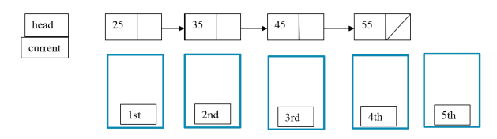
CS162 - Example #1
If we were to do this recursively:
  void display(node * head) {
  if (head) {
  cout <<head->data->title <<endl;
  display(head->next);
  }
  }
CS162 Topic #5

Slide 18
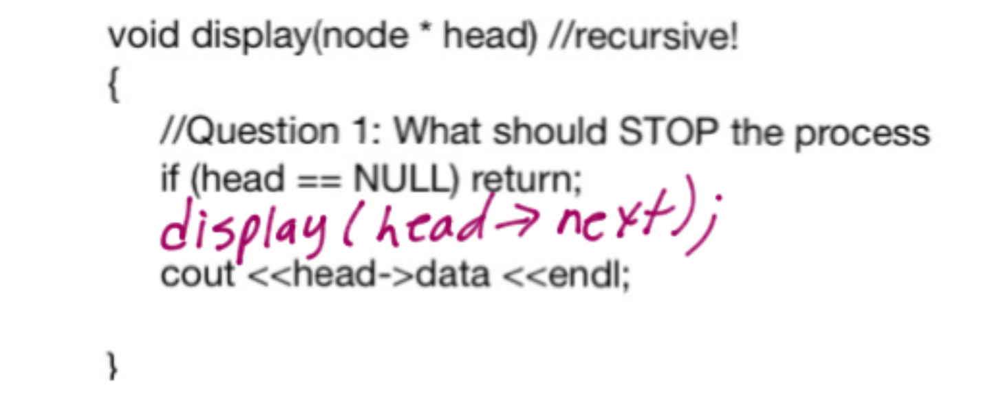
CS162 – Alter the order of the recursive call
CS162 Topic #5

Slide 19
CS162 - Example #2
Next, let’s insert at the end of a linear linked list, recursively
  again this is should be done iteratively!
  but, as an exercise determine what the stopping condition should be first:
    when the head pointer is NULL
  what should be done when this condition is reached? allocate memory and save the data
  what should be done otherwise? call the function recursively with the next ptr
CS162 Topic #5

Slide 20
CS162 - Example #2
If we were to do this iteratively:
  void append(node * & head, const video & d) {
  if (!head) {
  head = new node;
  head->data = ••• //save the data
  head->next = NULL;
  } else {
  node * current = head;
  while (current->next) {
  current = current->next;
  }
  current->next = new node;
  current = current->next;
  current->data = ••• //save the data
  current->next = NULL;
  }
  }
CS162 Topic #5

Slide 21
CS162 - Example #2 - Recursive
  void append(node * & head, const video & d) {
  if (!head) {
  head = new node;
  head->data = ••• //save the data
  head->next = NULL;
  } else
  append(head->next,d);
  }
Notice this is much shorter (but less efficient)
Notice the stopping condition (!head)
Examine how the pass by reference can be used to implicitly connect up the nodes
CS162 Topic #5

Slide 22
CS162 - Example #2
This can also be done recursively by using the returned value (rather than call by reference):
  node * append(node * head, const video & d) {
  if (!head) {
  head = new node;
  head->data = ••• //save the data
  head->next = NULL;
  } else
  head ->next = append(head->next,d);
  return head;
  }
Notice the function call must use the returned value
Here, we are explicitly connecting up the nodes
Walk thru an example of invoking this function
CS162 Topic #5

Slide 23
CS162 - Example #3
Next, let’s remove an item from a linear linked list, recursively
  again this is should be done iteratively!
  but, as an exercise determine what the stopping condition should be first:
    when the head pointer is NULL
    when a match (the item to be removed) is found
  what should be done when this condition is reached? deallocate memory
  what should be done otherwise? call the function recursively with the next ptr
CS162 Topic #5

Slide 24
CS162 - Example #3
If we were to do this recursively:
  int remove(node * & head, const video & d) {
  if (!head) return 0; //match not found!
  if (strcmp(head->data->title, d->title)==0) {
  delete [] head->data->title;
  delete head->data;
  delete head;
  head = NULL;
  return 1;
  } return remove(head->next,d);
  }
Does this reconnect the nodes?
How does it handle the special cases of a) empty list, b) deleting the first item, c) deleting elsewhere
CS162 Topic #5

Slide 25
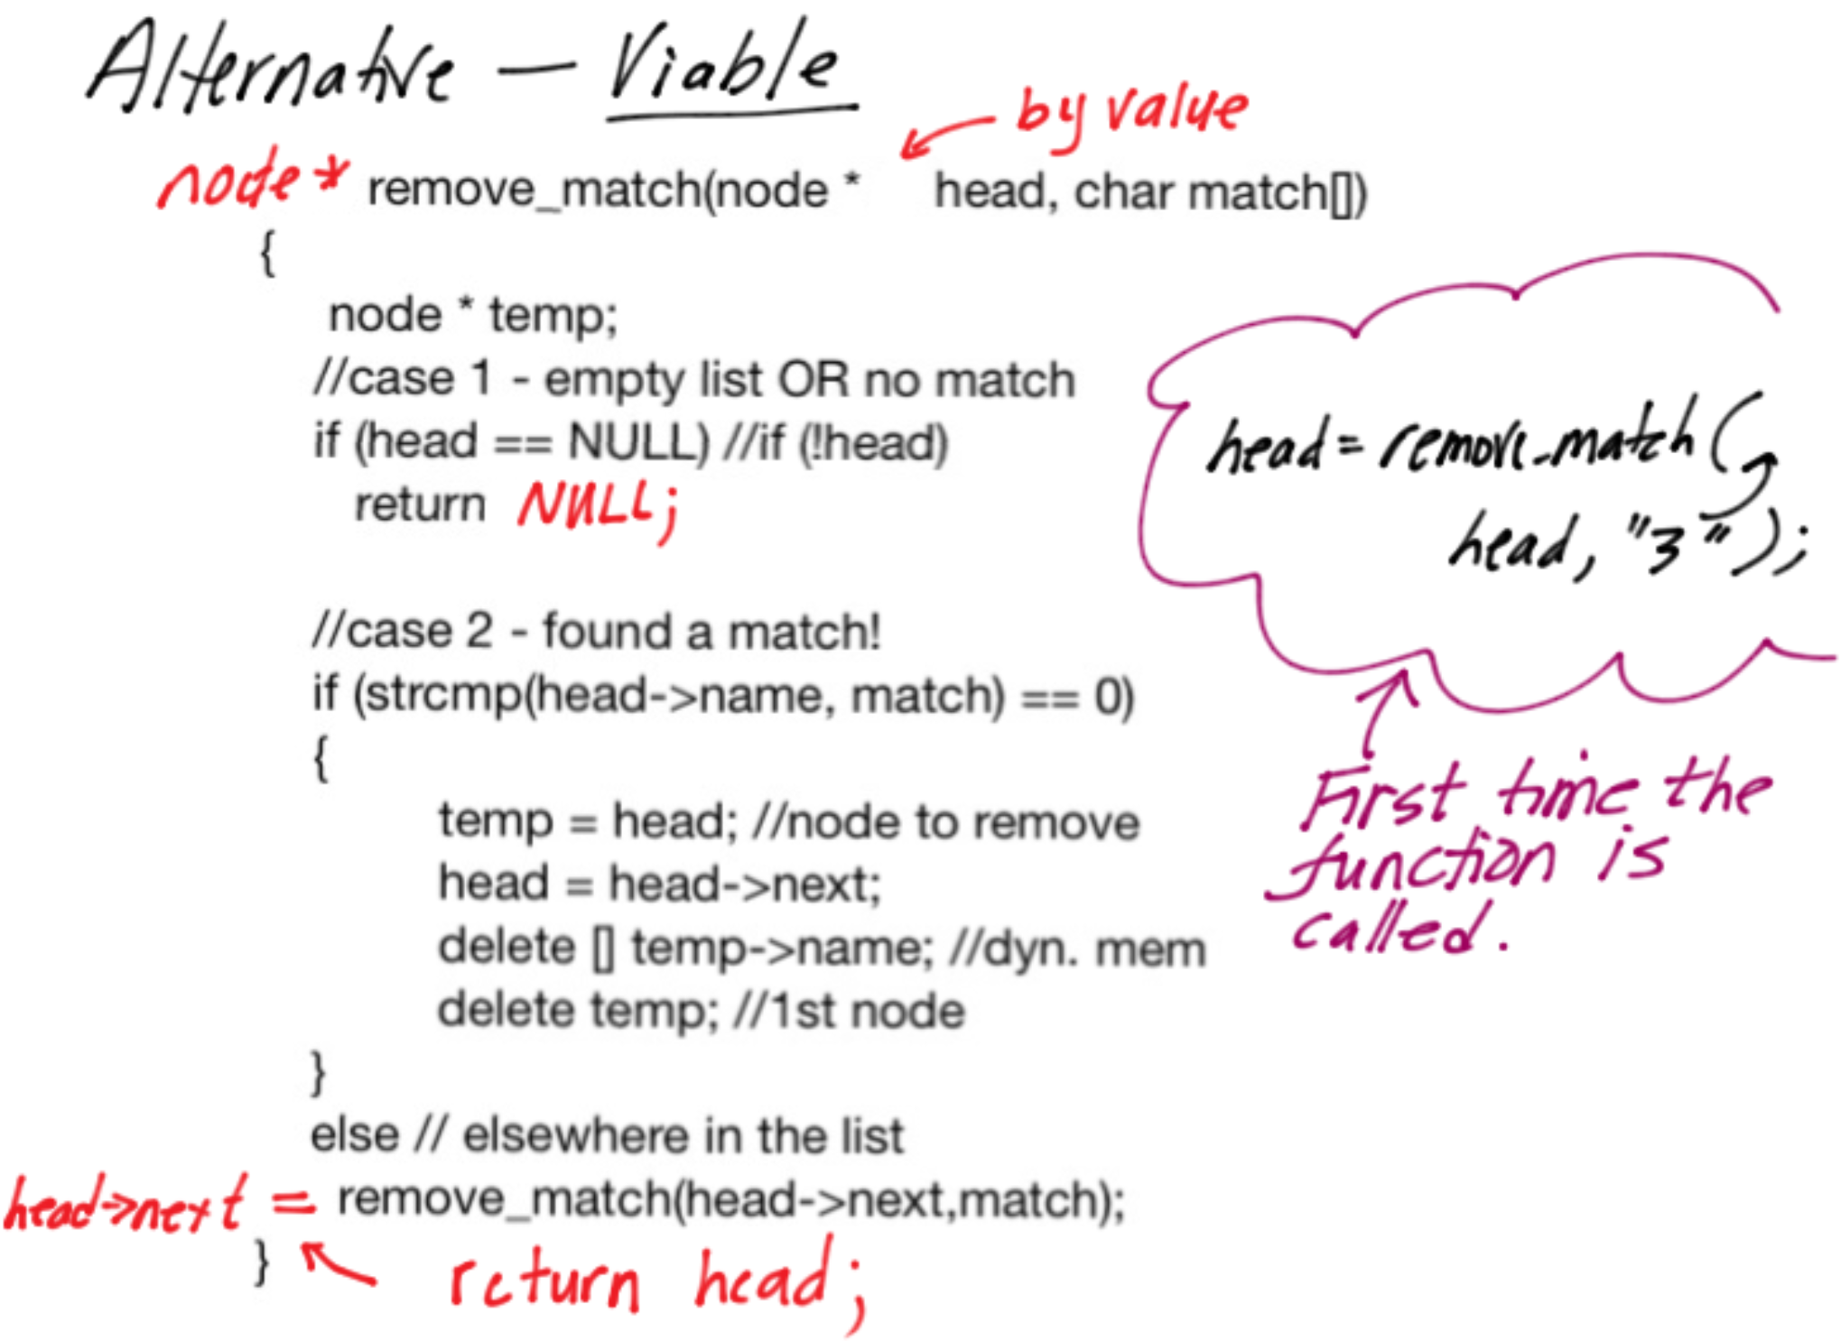
CS162 - Example #3 – Returning a node ptr
CS162 Topic #5

Slide 26
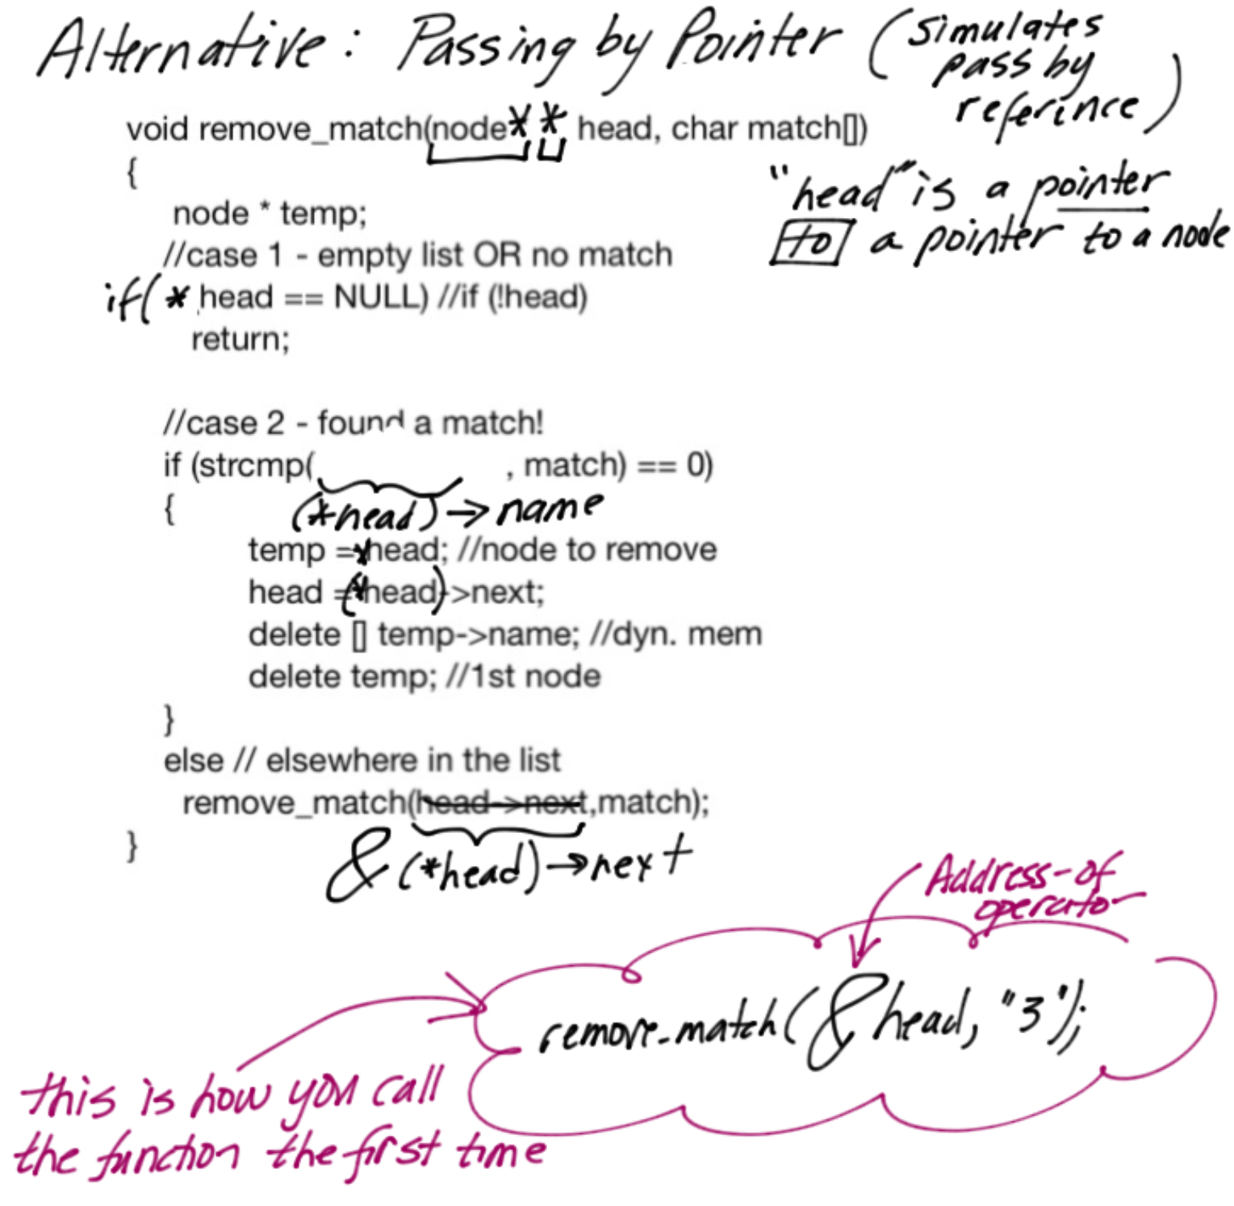
CS162 - Example #3 – Returning a node ptr
CS162 Topic #5

Slide 27
CS162 – Practice LLL and Recursion
Now in class, let’s design and implement the following recursively
  count the number of items in a linear linked list
    Return the count (with an integer return type)
    Should head be passed by value or by reference?____________
  Retrieve a matching item from a linear linked list
    Return true if the item exists in the list (with a bool return type)
    Should head be passed by value or by reference?____________
  Removing the last two nodes from a linear linked list
    Return true if the item exists in the list (with a bool return type)
    Should head be passed by value or by reference?____________
CS162 Topic #5

Slide 28
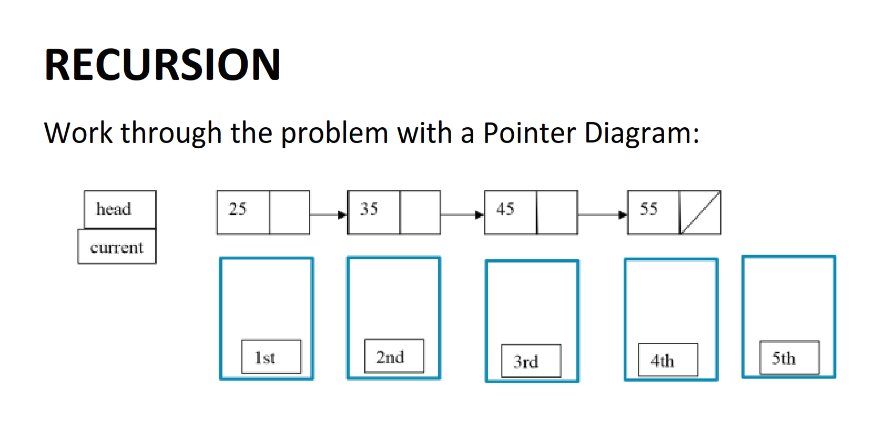
CS162 Topic #5

Slide 29
CS162 Topic #5

Slide 30
CS162 Topic #5

